Slide 1
Maintain an Organized Portfolio
Align portfolio management practices with COBIT (APO05: Manage Portfolio).

Slide 2
ANALYST PERSPECTIVE
Integrate your portfolio management practices into the broader realm of IT governance.
Businesses put a lot of rigor into spending controls, down to lunch expenses and that new $30 mouse for your notebook.
If we all put that level of rigor into our project portfolio, we would have the right number of projects and the right amount of time. We wouldn’t have to cancel many projects mid-stream and we wouldn’t commit to dates and deliverables that are unrealistic. Mostly, the leadership would feel like they are in control, guiding and steering as needed with a responsive organization pulling in the same direction.
Integrate your portfolio management practice into the broader realm of IT governance. Make it practical so that you can be certain that it will always be followed, helping to drive project throughput, and never viewed as an inhibitor.
Do this and your organization will be able to focus on delivery instead of the process itself.
Barry Cousins,
Senior Director, PMO Research Info-Tech Research Group

Slide 3
Our understanding of the problem
Portfolio Managers and PMO Directors who need to establish more disciplined and mature portfolio management practices.
PMO Leaders and CIOs who want to standardize IT’s portfolio management practices and metrics in order to better maintain the project portfolio throughout its lifecycle.
Better understand the current state of your project portfolio.
Establish a target mix of projects and programs for your portfolio.
Align your portfolio management processes with broader IT frameworks (i.e. COBIT 5).
CIOs looking for ways to improve the value of the IT project portfolio.
IT Steering Committee members looking for more rigorous portfolio governance standards.
Better understand how the project portfolio can be aligned to strategic goals and financial and resource capacity.
Govern the portfolio by ensuring that those charged with managing it have a clear understanding of the criteria that should guide portfolio management decisions.

Slide 4
Executive summary
As portfolio manager, you’re responsible for maintaining a portfolio of projects and programs that represent the organization’s strategic and operational goals.
You need processes and criteria to ensure the portfolio remains aligned with these goals and bound by financial and resourcing constraints.
Portfolio management is primarily about portfolios, not processes. In project portfolio management (PPM), it is common to get too fixated on processes and lose sight of the importance of the actual content of the portfolio.
While processes are important, what is actually in the portfolio directly impacts the level of value creation achieved through it.
A portfolio structured around well-defined value criteria, and driven by strong project selection practices, is the best way to keep the organization’s project activity aligned with its strategic goals.
At present, the shape of the portfolio is largely determined by squeaky wheels. It’s more like an unorganized heap of stakeholder demand rather than an organized collection of strategically valuable work.
You lack a way forward for organizing the portfolio. The business has no agreed-upon standard for determining portfolio value and for judging those projects that are most worthy of inclusion.
Establish clear and consistent criteria for portfolio success. An organized portfolio depends upon a consistent set of criteria that can be used as a guiding star for portfolio value when it comes to project selection. Use this blueprint to help define the appropriate criteria for your portfolio and to help establish a process for managing the portfolio by this criteria.
Equip yourself with the right portfolio organizers. Use the tools associated with this blueprint to help analyze the current state of your portfolio and identify how the organization more optimally spend its financial and human resource budgets to better align with and drive the organization’s strategic goals.
Grow within a portfolio management framework, not into one. While industry frameworks like COBIT outline the necessary processes, they are often perceived as unrealistic or unattainable for organizations with low PPM maturity. This blueprint helps distill industry best practices into an actionable portfolio management program that can be scaled for use by organizations at any stage of PPM maturity.

Slide 5
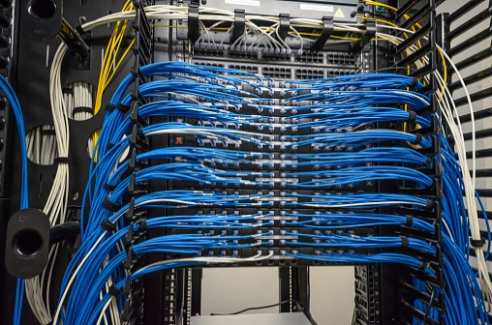
Use clear standardized portfolio criteria and processes to organize your portfolio and improve portfolio management
This image is absolutely terrifying for anyone in IT.
BUT, this is exactly what a portfolio of programs and projects turns into if it is not carefully and continually organized and maintained.
If this is not acceptable for $10 wires, why is it acceptable for projects and programs that can be worth hundreds of thousands (if not millions) of dollars?
Just as the wiring in this image is possible with clear plans and rules, so too is an organized portfolio possible if a clear portfolio target mix is established and effective portfolio processes are in place.
Portfolio management can be transformed from a random and overwhelming guessing game to an organized and manageable collection of projects that are contained within the organization’s actual capacity and aligned to the organization’s goals.

Slide 6
Choose between doing nothing to better maintain an organized portfolio or accepting significant project losses
Monetary Losses
Opportunities Lost
Stop the leaks.
Don’t miss the boat.
Organizations LOSE an average of $109 MILLION for every $1 billion spent on projects.
– PMI, High Cost of Low Performance, 2014
 | Higher Strategic Alignment | Lower Strategic Alignment | Agility Sacrificed w/o PPM
% identifying as “highly agile”* | 23% | 5% | -18
 | Higher agility* | Lower agility* | Success Sacrificed w/o PPM
% reporting successful strategic initiatives | 69% | 45% | -24
Earning a net positive ROI on projects is difficult enough.
Don’t find yourself fighting against rising losses that can be mitigated through improved portfolio management.
Despite this, only 15 percent report high levels of organizational agility*, suggesting that organizations are not prepared to adapt to shifts in today’s complex market environment and shifts in consumer demands and expectations.
– PMI, High Cost of Low Performance, 2014
*Note: In these quotes “agile” and “agility” refer to the ability “to respond successfully to change” and not the project management methodology.

Slide 7
Investing in improved portfolio organization and management can yield net benefits
Organizations identified as “portfolio management leaders” in a PMI survey are far more likely to report positively in the following areas:
Senior Management Satisfaction Reported | “Portfolio Management Leaders” | “Others” | Net Benefit for Portfolio Leaders
ROI from strategic initiatives | 30% | 7% | +23%
Quality of decision making | 32% | 7% | +25%
Speed of implementation | 35% | 8% | +27%
Strategic agility | 26% | 6% | +20%
Strategic adaptability | 38% | 6% | +32%
Out of those organizations that tracked the benefits of maturing their PPM processes:
63%
reported an ROI of 10% or more
50%
ROI was reported by 10%
Source: PM Solutions, “The State of Project Portfolio Management (PPM): 2013.”
(PMI, Implementing Project Portfolio, 2015, p. 10)

Slide 8
Sustain organization throughout the portfolio lifecycle
Represent Current Portfolio Mix
All too often, discussions of portfolio management focus on processes, but PPM is ultimately about the portfolio.
Processes are necessary to maintain the portfolio, but they are ultimately a means to an end.
Effective portfolio managers keep constantly focused on the portfolio itself and not merely adherence to workflows.
Having clearly defined criteria and constraints ensures that the right kind of projects enter and leave the portfolio at the right time.
Reprioritize Projects/ Programs
Assess Alignment and Viability of Current Portfolio Mix
Portfolio Criteria
And
Constraints
Accept New Projects/ Programs
Close and Terminate Projects/ Programs
Assess Project/Program Benefits Achieved

Slide 9
Organize your portfolio with clearly defined goals and constraints
Goals: Mission, Strategic, and Operational
These tell you:
What the outputs of the portfolio should be.
How much of the portfolio should be going to each division of the organization.
Constraints: Financial, Human Resourcing, Technology, Risk
These tell you:
What you have to work with.
How large the portfolio can be.
Budget
Marketing
Sales
Sales
Sales
IT
Production
Marketing
Sales
Technology
Risk
Production
Production
IT
Production
IT
Human Resources
Strategic Goal 1
Strategic Goal 2
Strategic Goal 3

Slide 10
Don’t grow into a framework, grow within one
All too often organizations perpetually delay implementing processes that are aligned with frameworks like COBIT or PMBOK.
Putting off alignment, however, only makes alignment more difficult later on. As your organization matures, more processes will be put into place. This means that there will be more processes to potentially align later on.
By starting early you can ensure that as the processes you have mature, they grow in a way that is aligned from the start rather than having to shift directions later on.

Slide 11
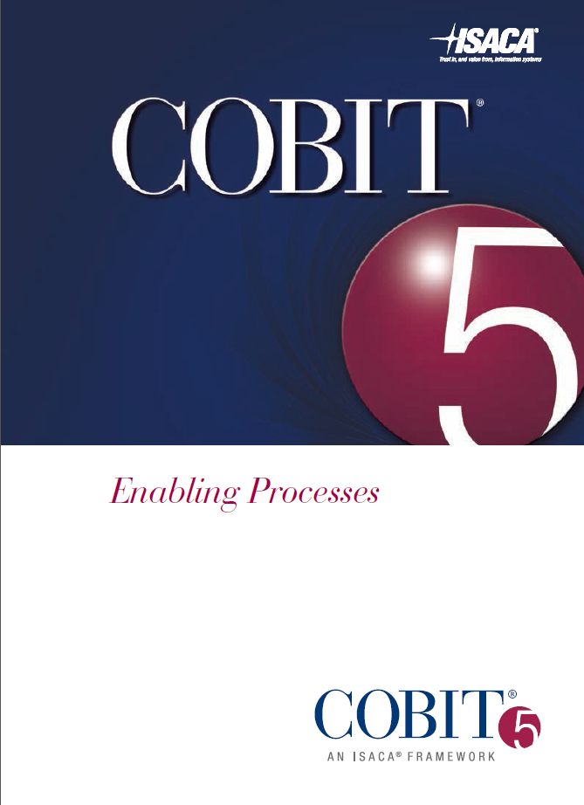
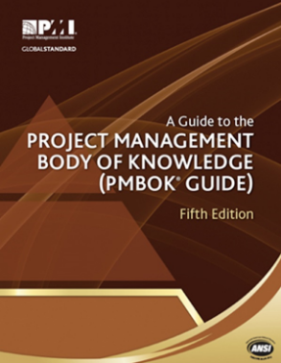
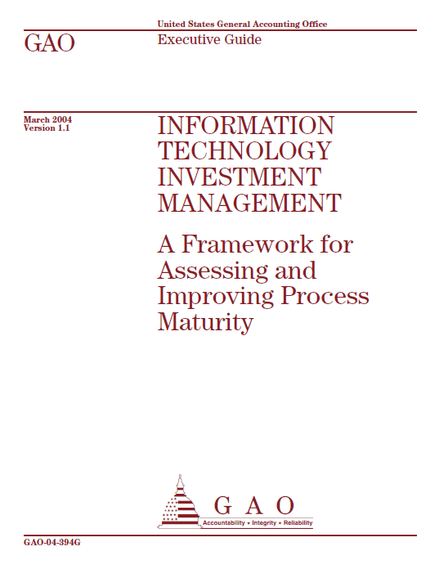
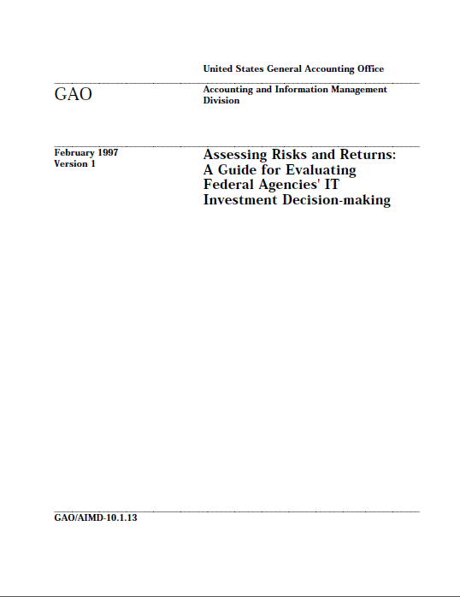
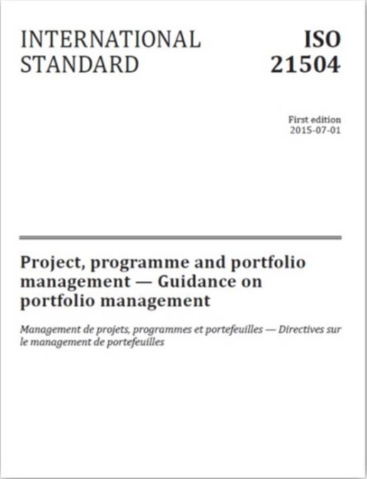
Align your PPM processes with industry standards
This blueprint has been informed by COBIT 5 (APO05), the PMI’s PMBOK (5th Edition), and the U.S. Government’s ITIM framework. Other relevant frameworks and guides are also listed below.
Information Systems Audit and Control Association (ISACA)
COBIT 5
Enterprise Value: Governance of IT Investments: VAL IT Framework
Project Management Institute (PMI):
Project Management Body of Knowledge – 5th Edition. (PMBOK)
Standard for Portfolio Management – Third Ed. (PMI)
Government of the United States of America
Information Technology Investment Management (ITIM)
Free Online: Designed for federal public sector, but applicable beyond this.
Assessing Risks and Returns: A Guide for Evaluating Federal Agencies' IT Investment Decision-making (GAO 1997)
International Organization for Standardization (ISO)
ISO 21504:2015 Project, Programme and Portfolio Management – Guidance on Portfolio Management

Slide 12
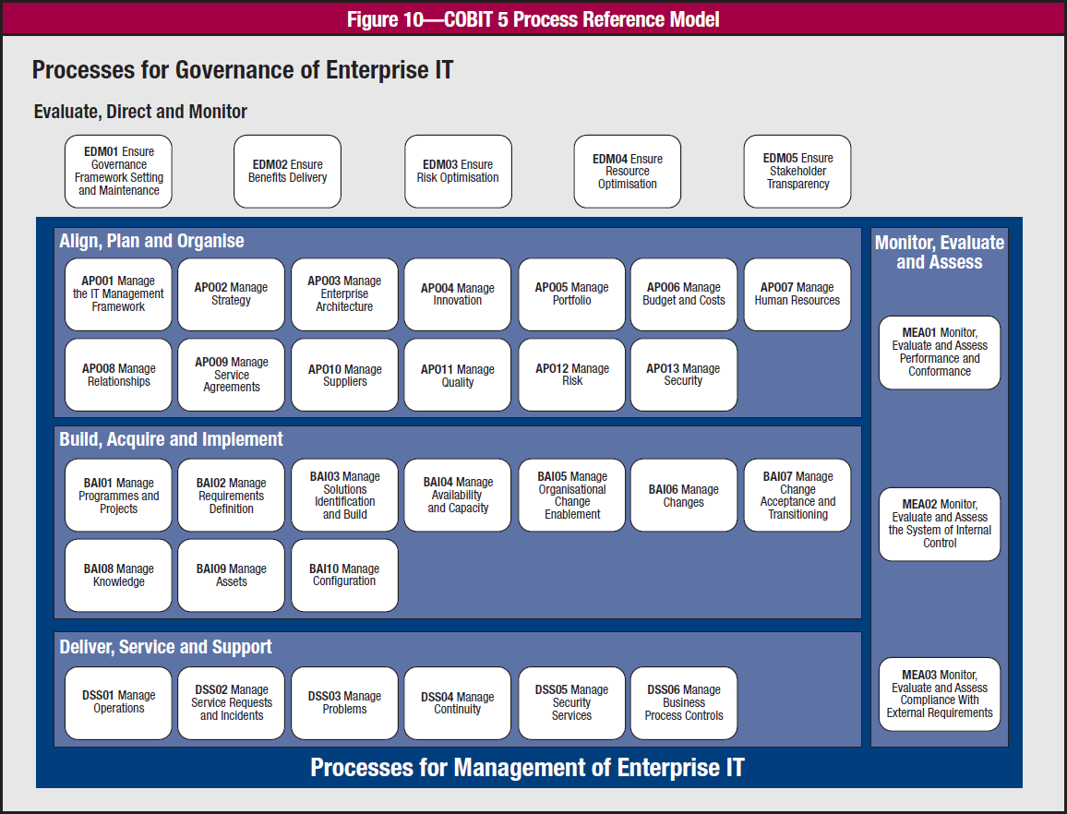
Info-Tech uses COBIT to help situate portfolio management within a large IT governance framework
Why COBIT?
Info-Tech is committed to producing projects and advice that are COBIT aligned. This helps ensure that our own research uses consistent terms and concepts across the different research areas.
COBIT’s PPM framework is both comprehensive yet also compact. It breaks down the various aspects of PPM into six core areas of focus.
COBIT covers all areas of IT governance and management. For organizations that have aligned other areas of IT to COBIT, it will be easier to integrate the PPM roles, accountabilities, responsibilities, processes, and activities into the broader IT governance and management structures.
Low maturity organizations can implement basic processes yet still be aligned to COBIT (at least in terms of the spirit and direction of COBIT).
(COBIT 5, 24)

Slide 13
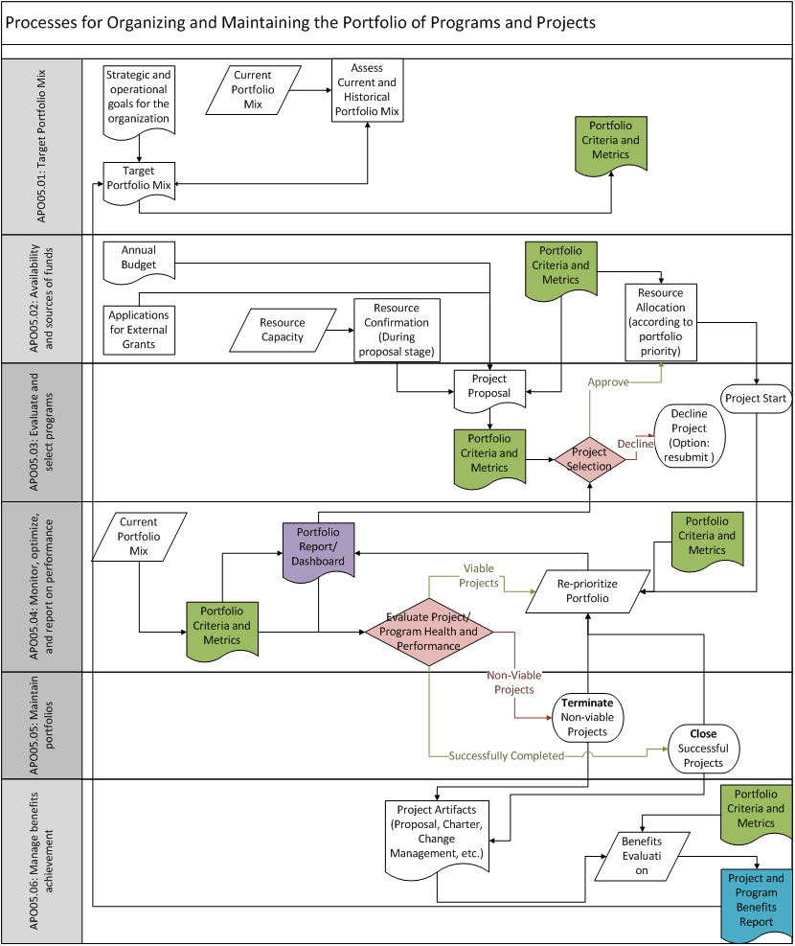
Take an actionable approach to COBIT APO05
This blueprint provides a tactical approach to APO05, helping organizations of all sizes incorporate COBIT best practices into their portfolio management practices.
Within COBIT, portfolio management is broken down into six distinct yet interrelated sub-processes.
The portfolio criteria and metrics established in the first sub-process are used in each following sub-process.
This blueprint will help you define these criteria and metrics for your portfolio. It will then help to build a set of processes around your criteria to ensure they guide portfolio decisions and help the organize realize value from its project activity.
External Inputs | Source of Input
Strategic and operational goals | Executive
Annual budget | CFO
Resource capacity | HR
External Outputs
Portfolio reports and/or dashboard
Project and program benefits report

Slide 14
Improved portfolio management through current-state analysis, framework adoption, and organizational change management
CASE STUDY
Industry
Source
Healthcare
PMI. PMI Case Study: AmeriHealth Mercy, 2014.
Challenge
A new director was hired to take over a three-year-old PMO. During those three years the PMO had implemented standard project management processes and artifacts; however, based on previous experience the new director believed that also improving portfolio management could help improve the strategic alignment of the portfolio and the overall success of the organization.
Solution
The new director started by carrying out a thorough current-state assessment of project and portfolio management at the organization. The diagnostic and analysis confirmed that there were gaps in portfolio management processes and highlighted project prioritization as a particular area in need of improvement.
Results
Based on the current-state analysis, the new director was able to create a prioritized high-level (quarter by quarter) roadmap of portfolio management improvements. They started by identifying clear prioritization criteria and implementing a prioritization process. They also clarified portfolio management roles and responsibilities. Implementation challenges arose, but adopting organizational change management practices allowed them to adapt and learn from them. Ultimately, they were able to achieve greater strategic alignment of the portfolio and showed this to the organization.
EXPERIENCE:
Assess the effectiveness of rules and criteria in practical experience.
Record revised rules, roles, relationships and criteria.
Record revised rules, roles, relationships, and criteria.
FRAMEWORK:
Use a framework to organize and harmonize rules and criteria.

Slide 15
Follow Info-Tech’s blueprint to maintain an organized portfolio of projects and programs
Assess the current state of the portfolio
and PPM processes
Enhance portfolio organization
through improved PPM criteria and processes
Implement improved portfolio management practices
1. Assess the current state of the portfolio mix
1. Establish the target investment mix (APO05.01)
2. Determine the availability and sources of funds (APO05.02)
1. Plan organizational changes necessary to improve portfolio management practices
Portfolio Mix Assessment
Change Impact Analysis
3. Evaluate and select projects or programs to fund (APO05.03)
4. Monitor portfolio performance (APO05.04)
2. Assess the current state of PPM processes
Portfolio Management Process Assessment
5. Maintain the portfolio (APO05.05)
6. Manage benefits achievement (APO05.06)
Portfolio Management SOP

Slide 16
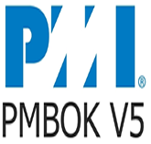
Info-Tech’s approach to portfolio management is informed by industry best practices and rooted in practical research
Relative to project management research and frameworks, the literature available on portfolio management is in its early stages of development; however, industry best practices can still provide insight – so long as they’re consumed with a view of the day-to-day reality of IT departments in the present.
Info-Tech consulted PMI and COBIT 5 frameworks where appropriate. Our understanding of the role of project portfolio management is generally aligned with these frameworks. The process outlined for implementing portfolio management processes is directly based upon the COBIT framework, especially APO05. In fact, Phase 2 provides advice and activities to help organizations implement the six sub-processes for APO05 and uses the title of each sub-process for the steps in that phase.
PMBOK is the leading project management industry framework, providing project management best practices and process guidelines.
COBIT 5 is the leading framework for the governance and management of enterprise IT.
In addition to industry-leading frameworks, our best-practice approach is enhanced by the insights and guidance from our analysts, industry experts, and clients.
Our peer network of over 33,000 happy clients proves the effectiveness of our research.
33,000+
Our team conducts primary and secondary research to ensure that our approach is enhanced by best practices.

Slide 17
Use these icons to help direct you as you navigate this research
Use these icons to help guide you through each step of the blueprint and direct you to content related to the recommended activities.
This icon denotes a slide where a supporting Info-Tech tool or template will help you perform the activity or step associated with the slide. Refer to the supporting tool or template to get the best results and proceed to the next step of the project.
This icon denotes a slide with an associated activity. The activity can be performed either as part of your project or with the support of Info-Tech team members, who will come onsite to facilitate a workshop for your organization.

Slide 18
Info-Tech offers various levels of support to best suit your needs
Guided Implementation
DIY Toolkit
Workshop
Consulting
“Our team has already made this critical project a priority, and we have the time and capability, but some guidance along the way would be helpful.”
“Our team knows that we need to fix a process, but we need assistance to determine where to focus. Some check-ins along the way would help keep us on track.”
“We need to hit the ground running and get this project kicked off immediately. Our team has the ability to take this over once we get a framework and strategy in place.”
“Our team does not have the time or the knowledge to take this project on. We need assistance through the entirety of this project.”
Diagnostics and consistent frameworks used throughout all four options

Slide 19
Maintain an Organized Portfolio – project overview
1. Assess
Current State
2. Enhance Portfolio Organization
3. Plan to Implement Changes
Best-Practice Toolkit | 1.1 Assess current portfolio mix 1.2 Assess current portfolio management practices | 2.1 Establish the target mix (APO05.01) 2.2 Determine sources of funding and resourcing (APO05.02) 2.3 Select projects and programs (APO05.03) 2.4 Monitor performance (APO05.04) 2.5 Maintain through closure, termination, and reprioritization (APO05.05) 2.6 Track benefits (APO05.06) | 3.1 Prepare the organization for portfolio management change
Guided Implementations | Assess portfolio mix. Assess portfolio management practices. | Integrating standard portfolio criteria across all portfolio management sub-processes. Review the SOP. | Create a stakeholder engagement plan. Initiate the projects and engagement.
Onsite Workshop | Module 1: Assess the current state of your portfolio and your portfolio management practices | Module 2: Enhance portfolio organization through improved portfolio criteria and improved workflows | Module 3: Ensure sustainable long-term adoption of proposed changes through stakeholder engagement
 | Phase 1 Outcome: Current-state assessment PPM improvement roadmap | Phase 2 Outcome: Improved PPM processes based upon clearly defined and standard criteria Portfolio Management SOP | Phase 3 Outcome: Change impact analysis Stakeholder engagement plan

Slide 20
Workshop overview
Contact your account representative or email Workshops@InfoTech.com for more information.
 | Workshop Day 1 | Workshop Day 2 | Workshop Day 3 | Workshop Day 4 | Workshop Day 5
Activities | Assess Portfolio Mix Current State 1.1 (Pre-work: Prepare a complete project list.) 1.2 Define existing portfolio categories, criteria, and targets. 1.3 Analyze the current portfolio mix. 1.4 Identify areas of concern with current portfolio mix. | Assess Portfolio Process Current State 2.1 Review the six COBIT sub-processes for portfolio management (APO05.01-06). 2.2 Assess the degree to which these sub-processes have been currently achieved at the organization. 2.3 Assess the degree to which portfolio supporting IT governance and management processes exist. 2.4 Perform a gap analysis. | Define Portfolio Target Mix, Criteria, and Roadmap 3.1 Identify determinants of the portfolio mix, criteria, and constraints. 3.2 Define the target mix, portfolio criteria, and portfolio metrics. 3.3 Identify sources of funding and resourcing. 3.4 Review and record the portfolio criteria based upon the goals and constraints. 3.5 Create a PPM improvement roadmap. | Design Improved Portfolio Sub-Processes 4.1 Ensure that the metrics used for each sub-process are based upon the standard portfolio criteria. 4.2 Establish the roles, accountabilities, and responsibilities for each sub-process needing improvement. 4.3 Outline the workflow for each sub-process needing improvement. | Change Impact Analysis and Stakeholder Engagement Plan 5.1 Conduct a change impact analysis. 5.2 Create a stakeholder engagement plan.
Deliverables | Analysis of the current portfolio mix | Assessment of COBIT alignment and gap analysis | Portfolio criteria Portfolio metrics for intake, monitoring, closure, termination, reprioritization, and benefits tracking Portfolio management improvement roadmap | A RACI chart for each sub-process A workflow for each sub-process | Portfolio management SOP (combining the outputs of days 3 and 4) Change impact analysis Stakeholder engagement plan

