Slide 1
Build an IT Strategy for Small Enterprises
Get in front of your workload with a right-sized and business-aligned IT strategy.
Info-Tech's products and services combine actionable insight and relevant advice with ready-to-use tools and templates that cover the full spectrum of IT concerns.© 1997-2020 Info-Tech Research Group

Slide 2
ANALYST PERSPECTIVE
Many smaller IT departments are consumed by their operational responsibilities and attempts to fulfill a barrage of requests for service.
An IT strategy aligned to business priorities helps gain the needed support to find the balance between the day-to-day and securing your role in the business’s future.
Without a strategy, IT’s capacity will remain challenged and their capabilities viewed as purely supportive or accessorial.
Ben Mackle
Research Manager, Small Enterprise Info-Tech Research Group
Info-Tech Research Group
SAMPLE

Slide 3
Is this research right for you?
Research Navigation
Formalizing an IT strategy is an essential step in satisfying and supporting the business. Each organization needs an IT strategy to ensure alignment between what the business wants and what IT does. Use the questions below to help guide you to the right Info-Tech resources that best align with the outcomes you want to achieve..
Question | If you answered no | If you answered yes
Does your IT department have less than 15 employees and is your organization’s revenue less than $25 million? | Review Info-Tech’s library of research for mid-sized and large enterprise clients. | Follow the guidance in this blueprint.
Does your organization require more than the essential IT capabilities outlined within our Small Enterprise Management & Governance Framework? | Follow the guidance in this blueprint. | Review Info-Tech’s library of research for mid-sized and large enterprise clients.
Info-Tech Research Group
SAMPLE

Slide 4
Our understanding of the problem
IT Directors/Managers or CIOs who need to develop, document, or improve their IT strategy.
IT leaders looking to become more effective.
IT leaders desiring to drive increased business value.
Create an IT strategy using an efficient and logical process.
Visualize IT’s target state and articulate how it will empower the organization’s success.
Develop the IT target state and IT initiatives designed to optimize business performance and enhance IT maturity.
Communicate the IT strategy to key stakeholders.
IT departmental leaders who need to participate in or lead sections of the development of an IT strategy.
Drive internal and external IT alignment through a common vision and a shared sense of purpose.
Create a collection of initiatives that streamline progression to the target IT state.
Establish a roadmap of initiatives to achieve the future of IT.
Info-Tech Research Group
SAMPLE

Slide 5
Executive summary
Info-Tech SE Insight
Small enterprise (SE) IT departments are so overburdened with managing the day-to-day that strategic thinking is an afterthought. 69% of SE IT departments surveyed say their IT strategies were less than adequate.
IT struggles to communicate its current or potential support of business goals. 41% of SE business leaders feel that their goals are unsupported by IT.
Don’t build a strategy to appease executives or view it as a request for permission. You’re making the case for the enhancements to the whole organization’s capabilities through the technology you deliver and operate.
Business stakeholders cannot translate how IT initiatives will help achieve their objectives or mitigate risk. Explain IT’s role in value creation and share the ownership of tech risk.
SEs invariably have less capacity, talent and tools to meet to meet a similar demand to MLEs. Prioritization is imperative to success, as is conveying how all gaps impact the business.
SE IT leaders don’t always get a seat at the table. Informal approaches to building and communicating IT’s strategic direction simply won’t cut it.
All IT departments are limited by their capacity, but SEs feel this constraint more than their medium and large enterprise (MLE) counterparts. Necessary strategic initiatives are neglected if their value and risk don’t translate to business terms.
Use Info-Tech’s IT Implications Checklist to discern IT implications from the business context.
Clearly communicate to business executives how IT will support the organization’s key objectives and initiatives using the Small Enterprise Executive Presentation Template.
Use Info-Tech’s Initiative Prioritization Tool to help make project decisions in a holistic manner that allows for the selection of the most valuable initiatives to become part of the IT strategic roadmap.
Demonstrate to business executives and the IT organization how the IT strategy was created using Info-Tech’s Small Enterprise IT Strategy Template.
Info-Tech Research Group
SAMPLE

Slide 6
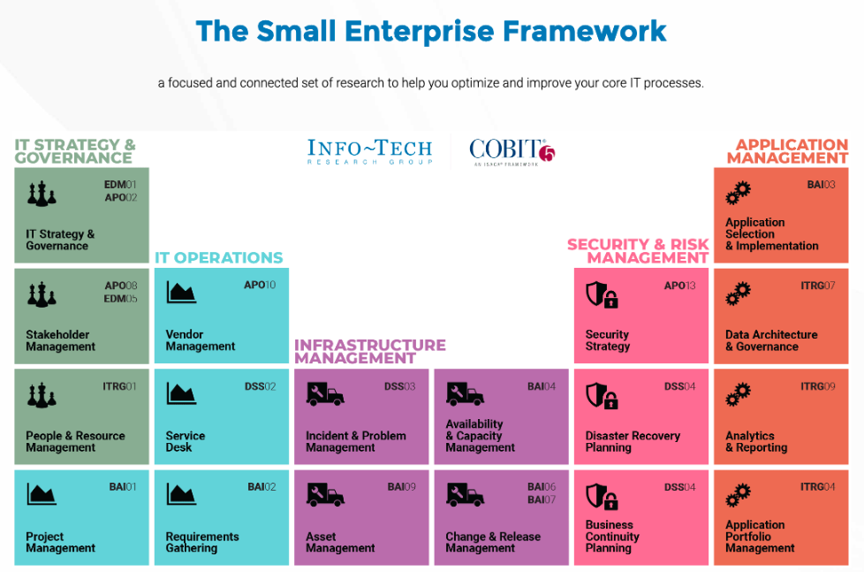
Your SE IT strategy defines the objectives and roadmap to develop the processes you need to deliver value
IT processes do not exist in a vacuum. They ensure the business has the technology it needs to operate effectively, and they must evolve to ensure the business achieves its future goals. Your IT strategy is the foundation for becoming a partner jointly committed to achieving those goals.
Info-Tech Research Group
SAMPLE

Slide 7
IT departments without IT strategies experience alignment, organization, prioritization, and ongoing resourcing issues
Missing alignment with business executives
When the organization views the IT department only in terms of IT functions, executive decision makers concern themselves accordingly. The business fails to see IT’s role in growth and enablement and believes that IT risk only has IT consequences.
Lack of organization
IT’s financial, technical, and human resources are chaotic and reactionary instead of being organized around a common understanding of goals and objectives.
Project prioritization issues
Projects and initiatives are not prioritized around business value. Synergies and dependencies are recognized too late. Projects often are late, are put on hold, or fail because of sudden changes to business requirements.
Limits to investment
!
Every IT organization has limited resources. In SEs, even more so. IT leaders must communicate the rationale for investment and resourcing necessary to fulfill the organization’s technology needs or they will suffer from cyclical capacity issues that force IT into firefighting and instability.
Info-Tech Research Group
SAMPLE

Slide 8
Limitations on SEs create an increased need to develop quality IT strategies compared to MLEs.
The same demand, but less capacity to delivery on it.
Small enterprise IT departments often live with resource constraints, while still experiencing a similar demand that any organization would face.
The business need for a diverse set of tools and services doesn’t really scale down with organization size alone. You need to build a strategy that prioritizes what's most important so it gets done.
The same risks, but fewer experts to mitigate them.
Small enterprise IT departments can’t always afford to build a team with high skillset diversity and security experts, yet they still need to keep the organization safe and secure.
The size of the organization doesn’t exempt it from external threats. You need to build a strategy that addresses your vulnerabilities regardless of whether you currently have the expertise.
The same need for adaptivity, but an imbalance of ops over innovation.
Any organization needs to be adaptive to changes in the marketplace, but when 100% of your time is spent keeping the organization’s current capabilities afloat, nothing is left over for exploring new opportunities.
Being small doesn’t mean you’re not subject to the volatility of a changing marketplace. In fact, it may mean you’re more vulnerable to trends or disruption.
The same need for technology leadership, but no seat at the table.
Decision making on technology needs to be informed by both those who know the business and those who know technology, but SE IT leaders often report through corporate service roles and have a diluted influence on key decisions.
You need to build a strategy that presents the alignment between technology and its impact on business goals to help make the best possible decisions for the organization.
Info-Tech Research Group
SAMPLE

Slide 9
CIOs who developed IT strategies are seen as more effective managers and stronger business partners
The percentage of business executives that rate CIOs as “effective” and/or “very effective” in the following areas changes significantly depending on whether the CIO has developed an IT strategy.
Without IT strategy:
With IT strategy:
18%
47%
Alignment with business
Alignment with business
29%
49%
Project prioritization
Project prioritization
Source: McKinsey & Company, 2015
Info-Tech Research Group
SAMPLE

Slide 10
IT organizations that have used Info-Tech’s methodology to build IT strategies experienced significant value
Measured value for Info-Tech’s IT Strategy Workshop with small enterprises
38,800
34.9
Average Dollar Impact*
Average Days Saved
*Only includes value experienced from Info-Tech’s workshops. Does not include additional monetary impact (e.g. budget increases, IT initiative approvals).
Info-Tech’s Measured Value Surveys
Info-Tech Research Group
SAMPLE

Slide 11
This blueprint is designed to create a roadmap that moves IT from the current state to target state
Reaching the target state is the ultimate goal of an organization, accomplished via the completion of initiatives. By uncovering the current state and the ideal target state, a roadmap can be created to chart initiatives and achieve the organization’s goals.
IT Current State
IT Target State
Roadmap
Start
Finish
Although it might be tempting to jump right into putting projects on a roadmap, a thorough understanding of both the target and current states are needed to build a successful IT strategy.
Info-Tech Research Group
SAMPLE

Slide 12
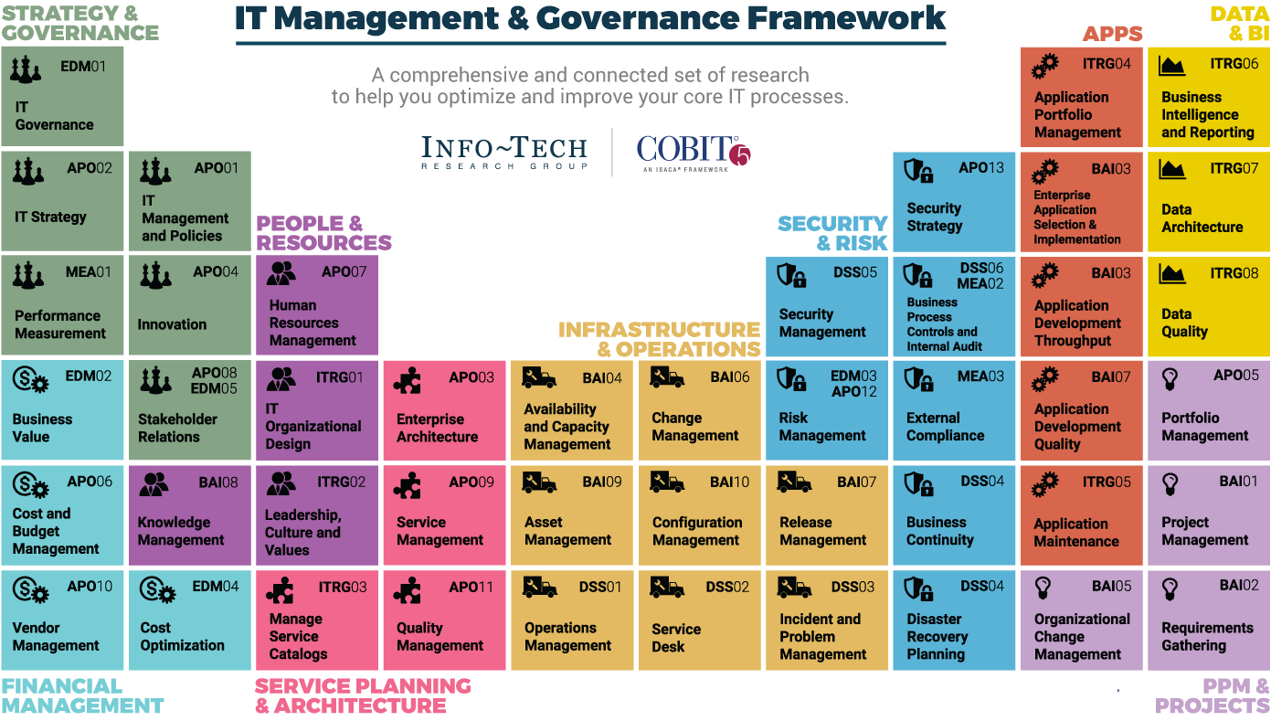
Dive Deeper Into Our Research
by Clicking One of the Elements Below
Find out how Info-Tech makes your job easier. Contact Us Today: Toll-Free (US & Canada): 1-888-670-8889
Info-Tech Research Group
SAMPLE
SAMPLE

