Slide 1
Develop and Conduct Threat and Risk Assessments
If you don’t assess risk, you’re accepting it.

Slide 2
ANALYST PERSPECTIVE
How are you assessing the risk related to new or existing projects?
Any new project or initiative is judged for the risk it may possess to the organization. First, there is the evaluation of whether the project carries too much risk to move forward and, second, whether your current security controls are sufficient to handle those risks.
However, this is often done very informally. It can start as the ‘bad feeling’ you have about project that can show up in a meeting. But how can you validate this bad feeling to know whether it is justified?
This blueprint will help you assess the risk of any IT project or initiative in a quantifiable model. By completing this assessment once, you can use the same model to regularly assess and compare risk and make informed treatment decisions.
Filipe De Souza
Research Manager – Security, Risk & Compliance Info-Tech Research Group

Slide 3
Our understanding of the problem
CISOs
Security Directors & Managers
IT Risk Managers
CIOs
Conduct a threat and risk assessment for any new or existing IT project or initiative.
Determine how a particular project compares in light of the organizational risk tolerance.
Leverage the results of a risk assessment into wider risk management best practices.
Any IT professional looking to understand the risk associated with their project.
Risk managers, from other departments, looking for new methodologies for assessing risk.
Assess the risk with any IT project.
Leverage a new model in which to understand the threats the organization faces.

Slide 4
Executive summary
IT departments are tasked with implementing new projects or initiatives, but are often unsure how to assess the associated risk.
Often, stakeholders will have an informal discussion regarding any risks and make a final decision based on that.
Standardize your risk assumptions. When evaluating risk, you need to assume what the frequency and impact will be for any potential threats. You need to establish clear definitions for these assumptions that can be used repeatedly in order to help validate the results of the report.
Risk assessments can extend to the entire IT department and beyond. The Info-Tech risk framework is adaptable to all projects and initiatives and can even extend to non-IT areas.
Informal, ad hoc discussions do not allow for informed risk assessments, which can affect how the organization as a whole manages risk.
Even for companies looking to adopt formal risk management, there are numerous frameworks and assessment techniques that offer best-practice advice, but no clear methodology on how to complete a threat and risk assessment.
Use Info-Tech’s risk assessment methodology to quantifiably evaluate the threat severity for any new or existing project and initiative.
Determine what the scope of the assessment is and build frequency and impact definitions in order to have a repeatable process.
Make informed risk treatment decisions based on the results – whether to accept, transfer, mitigate, or terminate the risk.
Connect your threat and risk assessment results to your wider risk management program. Doing this can inform the organization as to the aggregate level of risk that it faces.

Slide 5
The FARM acronym defines the risk management lifecycle
F
This blueprint addresses the ASSESS step of risk management – using your risk frame to identify and quantify risk.
Frame
A
Assess
R
Respond
M
Monitor
Determine the organizational risk tolerance
Develop and implement threat and risk assessments
Implement formal processes for risk approval or rejection
Continuously track and manage the organizational risk profile
Establish the context for risk-based business decisions.
How do we define risk?
What is the organizational culture towards risk acceptance or avoidance?
What types of business impact could we tolerate and how often?
What are our strategic business priorities?
Develop a formal process for assessing risk that is relevant for the business and will identify:
Threats and vulnerability exposure
The impact or harm that would occur if a threat were exploited
The likelihood that the impact will occur
Implement a consistent and formal process to respond to security risks and security assessment results.
Determine whether risks are tolerable or not
Determine the appropriate course of action
Implement the appropriate risk response (accept, reject, or additional mitigations)
Address how the organization plans to:
Verify that the planned risk responses have been implemented
Manage ongoing effectiveness of security controls in mitigating risk
Monitor and manage the overall risk profile of the organization

Slide 6
A critical aspect of risk management is the ability to assess risk on a per-project basis
As new projects, initiatives, or even vulnerabilities are identified within the organization, it will be necessary to assess the risk associated with these through threat and risk assessments (TRAs). By understanding the risk associated with a particular project or scenario, it is possible to know if existing security controls are sufficient to meet organizational requirements and expectations.
TRAs allow organizations to:
Conduct objective and repeatable assessments of existing risk.
Determine how this compares to the organizational risk tolerance level and the current state of security controls.
In addition, any risk information from any one individual project can be managed into a larger risk management program that evaluates organizations.
To conduct a TRA, the following process is used:
Overall risk is assessed based on the potential threats and their impact and frequency.
Existing controls are evaluated to view how the overall risk is being mitigated and how much residual risk is left over.
Risk actions will be determined – whether to accept, mitigate, transfer, or terminate the risk.
Final risk decisions will become part of the larger organizational risk management program.
Info-Tech has built a risk methodology and model that will allow you to validate all projects being assessed.

Slide 7
Many organizations struggle with risk analysis and management
Risk assessments are not easy:
Much of the analysis around risk is formed around assumptions – whether a threat is likely to occur, what the potential impact can be, how it can vary in the future, etc.
There is difficulty associated with quantifying these assumptions as they often are just qualitative “hunches” or “feelings” rather than an actual value.
63%
of CEOs indicate that they want IT to provide better risk metrics.
(CIO-CEO Alignment survey data, Info-Tech Research Group)
46%
of survey respondents were unsure whether organizations have a good understanding of the IT security risks they face.
(Kaspersky Lab)
According to the Allianz Risk Barometer, cyber risk is the most underestimated risk by businesses.
(Alliance Global Corporate & Speciality)
According to a report by ESI International, more than half of organizations surveyed are under the impression that they are somewhat or not very effective at risk assessments.
Source: ESI International

Slide 8
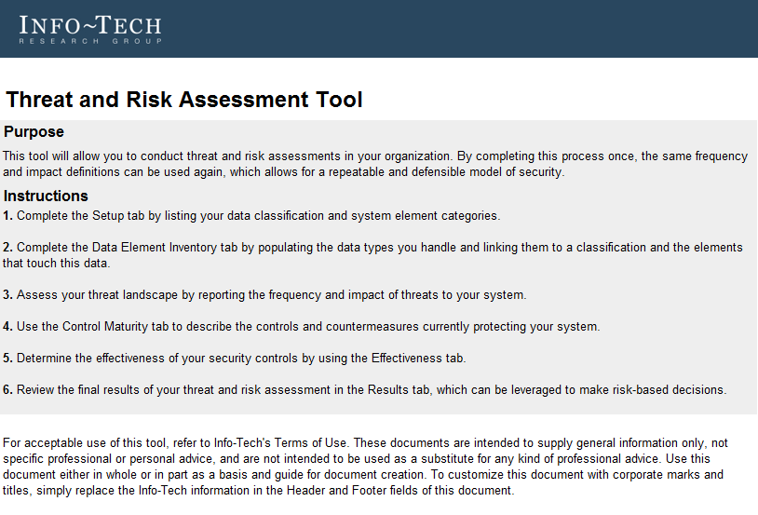
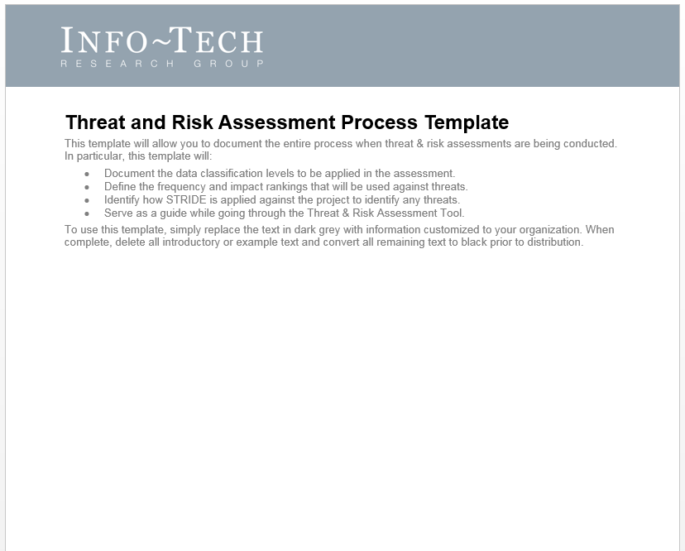
This blueprint will walk you through two key deliverables as you build your TRA
The first tool will help you establish a repeatable process, while the other will be used when conducting threat and risk assessments.
Threat and Risk Assessment Tool
This tool serves as the functional portion of your risk assessment. For any new project that needs to be evaluated, a copy of this tool can be used to analyze it.
Using Info-Tech’s risk model, you can examine threats associated with your project, existing security controls in place to address them, and the frequency and impact associated with those threats.
This tool will identify the threats with the highest risk associated with this project in a quantitative fashion. The results of this tool can then be used to explain the risk associated with the overall project.
Threat and Risk Assessment Process Template
This document will serve as the document that describes the exact process used when conducting a threat and risk assessment, which will help to standardize the risk assumptions.
Any reader of this document will understand the process that is completed, including the threat identification, frequency and impact definitions, and the effectiveness of the mitigating controls.
By completing this process once, you will have established your risk criteria. This means this same criteria can be used again for future TRAs as part of a repeatable and objective process.

Slide 9
Overall value of Guided Implementation
The value of a threat and risk assessment
Phase | Guided Implementation
Phase 1: Define the scope | Cost to define the scope of the project 40 FTE hours @ $80k per year = $1,600 Cost to perform data discovery 80 FTE hours @ $80k per year = $3,200
Phase 2: Conduct the risk assessment | Cost of conducting the risk assessment 160 FTE hours @ $80k per year = $6,400
Phase 3: Communicate and manage results | Cost to manage results and communicate to stakeholders 100 FTE hours @ $80k per year = $4,000
Potential financial savings from utilizing Info-Tech resources: | Phase 1 ($4,800) + Phase 2 ($6,400) + Phase 3 ($4,000) = $15,200 By using our Guided Implementation rather than a self-directed implementation, you can expect to save ~75% of the overall cost, which represents ~$11,400. Engage with Info-Tech from the outset for the best opportunity to maximize your benefits.
Completing a threat and risk assessment will help you identify the risk associated with any particular project. This can be useful for:
Upcoming initiatives where you are unsure of the risk. Turn “the feeling” that there is some risk into something more quantifiable.
Existing projects that need to be reviewed as to the threat they can pose to the organization.
By doing this process once with Info-Tech’s methodology, it can then be repeated, allowing all future risk assessments to run more smoothly.
In addition, this process relates to Info-Tech’s other research on risk management, mitigation effectiveness, and risk tolerance, meaning that this model follows through all these respective actions.

Slide 10
Threat and risk assessments fit as part of a highly mature risk management program

Slide 11
Use these icons to help direct you as you navigate this research
Use these icons to help guide you through each step of the blueprint and direct you to content related to the recommended activities.
This icon denotes a slide where a supporting Info-Tech tool or template will help you perform the activity or step associated with the slide. Refer to the supporting tool or template to get the best results and proceed to the next step of the project.
This icon denotes a slide with an associated activity. The activity can be performed either as part of your project or with the support of Info-Tech team members, who will come onsite to facilitate a workshop for your organization.

Slide 12
Info-Tech offers various levels of support to best suit your needs
Guided Implementation
DIY Toolkit
Workshop
Consulting
“Our team has already made this critical project a priority, and we have the time and capability, but some guidance along the way would be helpful.”
“Our team knows that we need to fix a process, but we need assistance to determine where to focus. Some check-ins along the way would help keep us on track.”
“We need to hit the ground running and get this project kicked off immediately. Our team has the ability to take this over once we get a framework and strategy in place.”
“Our team does not have the time or the knowledge to take this project on. We need assistance through the entirety of this project.”
Diagnostics and consistent frameworks used throughout all four options

Slide 13
Develop and Conduct Threat and Risk Assessments – project overview
1. Define the Scope
2. Conduct the Risk Assessment
3. Communicate and Manage Results
Best-Practice Toolkit | 1.1 Determine when to initiate a threat and risk assessment 1.2 Determine your data classification scheme 1.3 Identify the system elements and perform data discovery 1.4 Map data types to the elements 1.5 Define the organizational risk tolerance | 2.1-2.3 Define the frequency and impact, and determine weightings 2.4 Identify STRIDE threats and assign frequency and impact rankings 2.5 Determine risk actions being taken currently and indicate which countermeasures are in place 2.6 Calculate mitigated risk severity based on the countermeasures 2.7 Review the results of the risk assessment | 3.1 Proceed with the project, if below the risk tolerance 3.2 Mitigate against threats in order for your project to proceed below the risk tolerance level 3.3 Look for opportunities to transfer the risk 3.4 Terminate the project, if still above the risk tolerance, or proceed with caution 3.5 Enter the results into your risk register as part of risk management
Guided Implementations | Determine when to initiate a risk assessment. Define the scope of the assessment. Identify the organizational risk tolerance. | Define frequency and impact. Identify STRIDE threats. Assign countermeasures and review final results. | Discuss potential risk action options. Perform “what if” analysis with mitigations. Connect to the risk management program.
Onsite Workshop | Module 1: Define the Scope | Module 2: Conduct the Risk Assessment | Module 3: Communicate and Manage Results
 | Phase 1 Outcome: Defined scope of the risk assessment including data and assets. | Phase 2 Outcome: Final risk assessment results, including highest identified threats and comparison to risk tolerance. | Phase 3 Outcome: Understanding of how risk assessments connect to risk management best practices.

Slide 14
Workshop overview
Contact your account representative or email Workshops@InfoTech.com for more information.
 | Workshop Day 1 | Workshop Day 2 | Workshop Day 3 | Workshop Day 4
Activities | Define the scope 1.1 Determine when to initiate a risk assessment. 1.2 Review appropriate data classification scheme. 1.3 Identify system elements and perform data discovery. 1.4 Map data types to the elements. | Define the organizational risk tolerance 2.1 Define the security executive function RACI chart. 2.2 Assess your organizational risk culture. 2.3 Perform a cursory assessment of management risk culture. 2.4 Define frequency or impact thresholds outside of individual risk tolerance level. 2.5 Evaluate risk scenarios to determine your individual risk tolerance level. 2.6 Finalize the individual risk tolerance level. | Conduct the risk assessment 3.1 Define frequency and impact. 3.2 Identify STRIDE threats and assign rankings. 3.3 Determine risk actions taking place and assign countermeasures. 3.4 Calculate mitigated risk severity based on actions. 3.5 Review results of the risk assessment. | Manage results 4.1 Determine decision to make based on results. This includes: Proceed with the project. Mitigate against threats. Look for opportunities to transfer the risk. Terminate the project, if necessary. 4.2 Enter results into risk register.
Deliverables | Established criteria for conducting risk assessments. Clear scope of system elements and data within the assessment. Mapped data to the different element types. | Defined individual risk tolerance level for all IT projects and initiatives. | Clear frequency and impact definitions. Identification of STRIDE threats that apply and existing controls in place to mitigate against threats. Results of the threat and risk assessment. | Risk-based decision, based on the assessment. Entering results as part of the risk register.

