Slide 1


Select and Implement an Enterprise Content Management Solution
Understand the ECM vendor market, make an informed decision, and take a bottom-up, process-based approach for an agile solution implementation.
Info-Tech's products and services combine actionable insight and relevant advice with ready-to-use tools
and templates that cover the full spectrum of IT concerns.© 1997 - 2016 Info-Tech Research Group

Slide 2



ANALYST PERSPECTIVE
Understand the market, but don’t forget your organizational needs and culture.
Enterprise content management (ECM) platforms are a key component in the digital transformations taking hold in organizations everywhere. When deployed and managed properly, ECM provides a foundation on which to build out advanced information capabilities.
ECM projects often appear smaller than they turn out to be. The biggest mistake made during an ECM implementation is not designing and configuring to architectural and governance standards before rolling capabilities out to user communities. Without this planning, sins of the past are often repeated.
Following Info-Tech’s bottom-up, process-based approach to ECM avoids these costly pitfalls and ensures the right solution is adopted and configured in accordance with agreed upon standards, thus ensuring the quality of one of the most critical assets an organization has – its information.
Ryan Smith
Associate Director, Information Management Practice
Info-Tech Research Group

Slide 3
Stop! Are you ready for this project?
IT teams tasked with exploring the ECM vendor market and making recommendations.
Business units going into the selection or early implementation phases of an ECM technology project.
Organizations looking to review or change a specific component of their ECM platform.
Understand the ECM market of today, including functionality and vendor performance.
Follow best practices to gather requirements and assess your organizational needs through a use-case lens.
Structure the selection stage of your project, including vendor interactions.
Follow a bottom-up, process-based ECM implementation methodology.
ECM project team or working group tasked with managing an RFP process for vendor selection.
ECM project team or working group tasked with implementing the ECM solution in the organization.
ECM architects, developers, and administrators tasked with configuring ECM solutions in accordance with stakeholder needs.
Draft an RFP, manage the review process, and select a vendor.
Introduce ECM capabilities through an Agile methodology (i.e. minimum-viable solutions) with alignment to the organization’s greater ECM program vision.
Follow best practices when designing systems, sites, taxonomy, naming conventions, metadata, policies, etc.

Slide 4
Executive summary and problem definition
Organizations everywhere are transforming their information management practices, and look to introduce or update enterprise content management (ECM) solutions as a foundational piece.
The ECM market is confusing and there is a need to disambiguate the players, shortlist and evaluate solutions, and arrive at a vendor decision.
ECM is a key piece of digital transformation. Quality information provides a foundation for innovation.
Plan ahead or the sins of the past will be recreated. Without carefully planned architecture, governance, and management, users will resort to the way they’ve always done things.
ECM technology on its own is not enough. To truly realize the benefits of ECM on an on-going basis, a program is needed to manage it as a capability.
ECM technology is in a mature and saturated market, but not all solutions compare equally and understanding the nuances is a daunting task.
ECM ends up serving many different use cases across the organization; coordinating and satisfying all these needs requires a structured approach.
Organizations often underestimate the effort involved with content transformations and attempt to roll out to too many areas at once.
Understand where you want to go by setting an ECM program vision aligned to your organization’s greater enterprise information management (EIM) vision, and by structuring your ECM selection and implementation project accordingly.
Align your ECM solution selection to the organization’s broader ECM/EIM system architecture (including network drives, other content management products, data architectures, and enterprise or LOB applications).
Explore the ECM vendor market through a use-case lens and benchmark performance of key functions to make an informed decision about requirements and priorities.
Structure and conduct due diligence activities when evaluating solutions in order to validate vendors’ claims during the selection process and arrive at a confident vendor selection.
Implement the ECM program gradually and in a way that avoids common pitfalls, overcomes resistance to change, and minimizes the need for costly re-work by following Info-Tech’s bottom-up, process-based approach for ECM.

Slide 5






Understand how content management technology has evolved to continuously drive organizational efficiencies
Vendor consolidation and functional integration helps organizations transform work from ad hoc to managed, person to process, and paper to paperless.
 | The Age of Productivity Pockets |  | The Age of Enterprise Information Management
 | Content imaging, workflow, document management, and records management available as standalone products and deployed as point solution for individuals or teams. |  | End-to-end ECM solutions with process automation, integration capabilities, and cheaper scalability provide the technological foundation for enterprise-wide content management programs.
 | 1980s & 1990s |  | Today
 | 4 | 4 | 4 | 4
 |  | 2000s & 2010s |  | Tomorrow
 |  | Emergence of collaboration and process management functionality provides full information lifecycle management capabilities deployed at content domain, process, or departmental levels of organizations. |  | Enhanced options for integration and process management and automation will continue to see more processes digitized (made paperless) and managed within centralized ECM platforms across organizations.
 |  | The Age of Siloed Information Management |  | The Age of Digital Information Management

Slide 6
Today’s ECM technology market booms as organizations transform, unleashing the power of their information assets
ECM Technology Adoption (2016)
ECM Technology Market Growth
Of organizations with an ECM platform…
$66.27B
72%
use a general purpose, single-vendor solution, including 20% that rely on out-of-the-box functions, 29% that leverage supplemental add-ons, and 23% with additional customization.
$59.87B
$28.10B
13%
have an integrated set of ECM best-of-breed components.
$24.62B
13%
manage content through an in-house developed solution (10%) or a sector-specific supplier (3%).
Source: MarketsandMarkets (2016)
The ECM market will double by 2021.
The global ECM market has grown 14% in the past year and is forecasted to grow an additional 136% in the next five years at a compound annual growth rate (CAGR) of 18.7%.
Process functionality is top spending area.
AIIM identifies the top five ECM product spends as:
Getting beyond network drives…
At the same time, network drives remain a dominant piece of ECM system architectures for 53% of organizations in 2016 (down from 62% in 2015).
However, improving collaboration and mobile or remote access to information is a key focus area for 51% of organizations in 2016, and ECM platforms will be a major part of attaining these goals.
Workflow/BPM
Content Analytics/Big Data
Universal Search
Cloud Services
Email Management
Source: AIIM (2016)

Slide 7
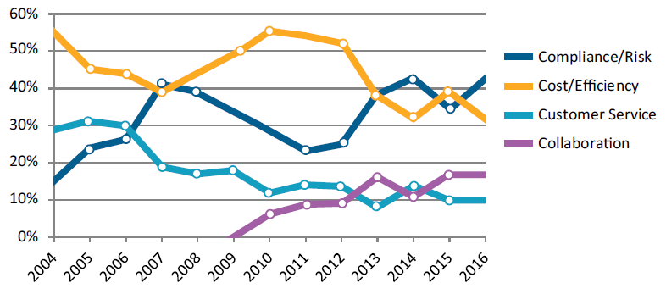
Organizations get the most out of their ECM technology investments by deploying them as part of a larger program
ECM Program Adoption (2016)
ECM Program Drivers
AIIM tracks the four primary drivers of ECM adoption to show how these change over time.
As of 2016…
Enterprise (5,000+ employees) and mid-size (500-5,000 employees) organizations have elevated compliance and risk to the number one ECM driver position.
Smaller organizations (<500 employees) keep cost and efficiency in the top two spot overall, with 40% stating it is the number one driver.
Improving ECM functionality is the number one project focus in 2016…
AIIM indicates the remaining top project focuses include:
85%
of organizations have either recently completed an enterprise-wide ECM capability or are actively engaged in ECM program development.
No capability, no plans
Looking to replace existing capability
Planning capability within next 18 months
Completed an enterprise-wide capability
Rolling out siloed capabilities
Rolling out enterprise-wide capability
Integrating capabilities across siloes
Putting the Enterprise in ECM…
79% of organizations claim that they still have room to grow when it comes to their ECM programs, either by enhancing existing capabilities or extending these capabilities to other areas of the organization.
Digitizing Paper Processes
Introducing or Enhancing Collaboration
Rolling Out to More Users
Integrating ILM Functionality
Source: AIIM (2016)

Slide 8

Organizations measure ECM project success across process efficiency, resource efficiency, and risk mitigation metrics
In its own right, ECM plays an important role in running an intelligent, efficient, and lean organization.
ECM Process Efficiency
ECM Resource Efficiency
ECM Risk Mitigation
73% of knowledge workers waste time looking for files. 47% of knowledge workers have worked on the wrong document. | 40% of organizations report lowering costs and improving IT efficiency as the number one driver for ECM. | 33% of organizations report compliance and risk as a critical driver for ECM.
Pains: Unable to find content; recreating content Manually indexing content Manually routing content through workflows Inaccurately stored content Print → Sign → Scan processes | Pains: IT time spent managing storage environments Redundant, outdated, and trivial content stored in repositories | Pains: Non-compliance fees Storing content beyond retention periods; litigation exposure Litigation discovery time and cost Off-brand content
Gains: Automated content indexing Faster content retrieval Digital workflows Just-in-time content delivery Faster collaboration and creation Improved employee experience | Gains: Reduced network demand Reduced storage consumption Optimal storage and archival media Resources reallocated to more innovative pursuits | Gains: Standard designs, naming conventions, and terminology Reduced litigation risk Automated and defensible content disposal eDiscovery
Harris Interactive, 2012
AIIM, 2015
AIIM, 2015
Leverage the benefits to sell information improvement initiatives to the organization. Whether you are embarking on ECM as a stand-alone initiative, as part of a broader transformational effort, or as some place in between, the positive impacts of ECM can be used to gain executive buy-in and organizational support. On its own, front-load digital transformation or knowledge management projects with ECM work to unlock quick wins.

Slide 9
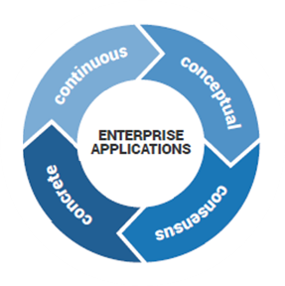
Follow Info-Tech’s methodology for selection and implementation
Prior to embarking on the vendor selection stage, ensure you have set the right building blocks and completed the necessary prerequisites.
Follow Info-Tech’s enterprise applications program that covers the application lifecycle from the strategy stage, through selection and implementation, and up to governance and optimization.
The implementation and execution stage entails the following steps:
Define the business case.
Gather and analyze requirements.
Build the RFP.
Conduct detailed vendor evaluations.
Finalize vendor selection.
Review implementation considerations.
1
2
3
4
5
6
A critical preceding task is developing a strategy that makes the case for the ECM procurement and creates alignment with corporate objectives. Use the ECM Readiness Assessment Checklist to ensure you have completed the necessary steps.

Slide 10
Use Info-Tech’s ECM technology framework to understand how ECM features apply across the information lifecycle
Table stakes represent the minimum standard all ECM platforms offer, while advanced features can vary widely by vendor in terms of availability, quality, and applicability to the information lifecycle.
Information Lifecycle Model for ECM Technology:
Table Stakes
Advanced Features
Generate
Capture
Deliver and Utilize
Manage and Retire
Metadata Mgmt.
Retention Mgmt.
Structured Collab.
Library Services
Basic Workflows
Document Imaging
Format Conversions
Version Controls
Version Controls
Access & Permissions
Format Conversions
Access & Permissions
OCR/ICR
Multimedia and Email Capture
Process & Workflow
Case Mgmt.
Defensible Disposal
Real-Time Collab.
eSignatures
Custom Views
eForms
Auto-Indexing
eDiscovery
Content Analytics
External Sharing
Advanced Search
Mobile Experience
Content Analytics
Mobile Experience
Content Analytics
Content Analytics
Please note: Different ECM features (such as document or records management and content capture) are displayed here in their component parts.

Slide 11
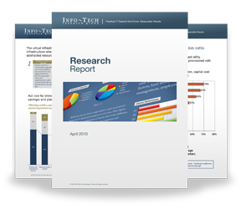

Info-Tech Research Group Helps IT Professionals To:
Quickly get up to speed
with new technologies
Make the right technology
purchasing decisions – fast
Deliver critical IT
projects, on time and
within budget
Manage business expectations
Justify IT spending and
prove the value of IT
Train IT staff and effectively
manage an IT department
Sign up for free trial membership to get practical
solutions for your IT challenges
“Info-Tech helps me to be proactive instead of reactive –
a cardinal rule in a stable and leading edge IT environment.
  - ARCS Commercial Mortgage Co., LP
Toll Free: 1-888-670-8889
www.infotech.com

