Slide 1
Improve Requirements Gathering
Back to basics: great products are built on great requirements.

Slide 2
Analyst Perspective
A strong process for business requirements gathering is essential for application project success. However, most organizations do not take a strategic approach to optimizing how they conduct business analysis and requirements definition.
“Robust business requirements are the basis of a successful project. Without requirements that correctly articulate the underlying needs of your business stakeholders, projects will fail to deliver value and involve significant rework. In fact, an Info-Tech study found that of projects that fail over two-thirds fail due to poorly defined business requirements.
Despite the importance of good business requirements to project success, many organizations struggle to define a consistent and repeatable process for requirements gathering. This results in wasted time and effort from both IT and the business, and generates requirements that are incomplete and of dubious value. Additionally, many business analysts lack the competencies and analytical techniques needed to properly execute the requirements gathering process.
This research will help you get requirements gathering right by developing a set of standard operating procedures across requirements elicitation, analysis, and validation. It will also help you identify and fine-tune the business analyst competencies necessary to make requirements gathering a success.”
Ben Dickie
Director, Enterprise Applications Info-Tech Research Group

Slide 3
Our understanding of the problem
This Research is Designed for:
This Research Will Also Assist:
This Research Will Help You:
This Research Will Help Them:
The IT applications director who has accountability for ensuring that requirements gathering procedures are both effective and efficient.
The designated business analyst or requirements gathering professional who needs a concrete understanding of how to execute upon requirements gathering SOPs.
The business partner/stakeholder who is interested in ways to work with IT to improve upon existing procedures for requirements gathering.
Systems analysts and developers who need to understand how business requirements are effectively gathered upstream.
Diagnose your current state and identify (and prioritize) gaps that exist between your target requirements gathering needs and your current capabilities and processes.
Build a requirements gathering SOP that prescribes a framework for requirements governance and technology usage, as well as techniques for elicitation, analysis, and validation.
Understand the significance and importance of business requirements gathering on overall project success and value alignment.
Create rules of engagement for assisting IT with the collection of requirements from the right stakeholders in a timely fashion.

Slide 4
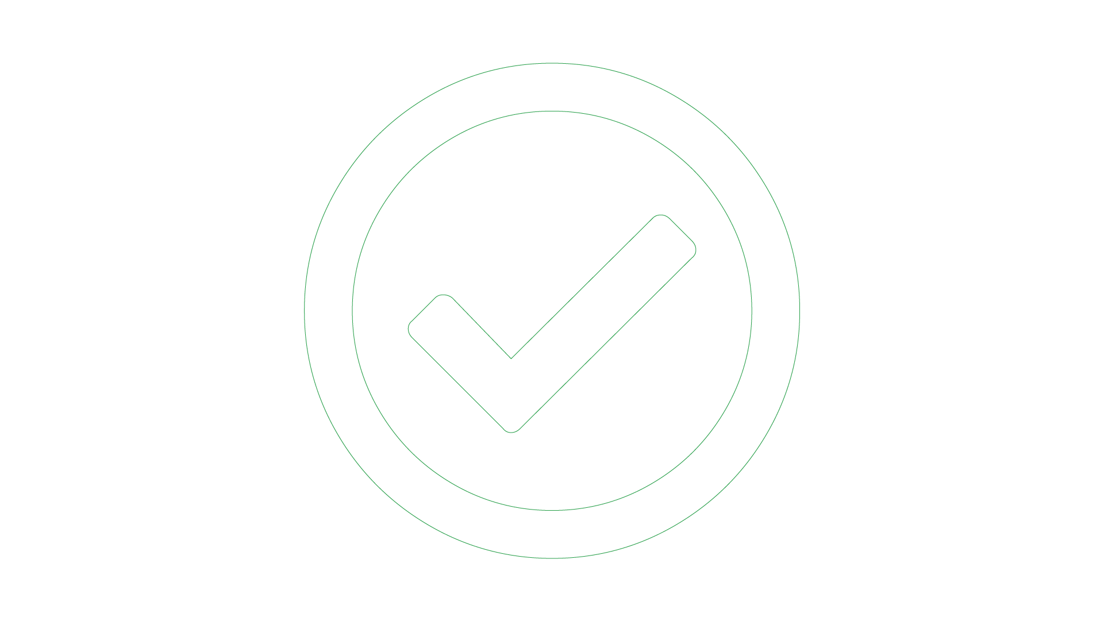
Executive Summary
Situation
Resolution
Info-Tech’s Approach
Strong business requirements are essential to project success – inadequate requirements are the number one reason that projects fail.
Organizations need a consistent, repeatable, and prescriptive set of standard operating procedures (SOPs) that dictate how business requirements gathering should be conducted.
To avoid delivering makeshift solutions (paving the cow path), organizations need to gather requirements with the desired future state in mind. Organizations need to keep an open mind when gathering requirements.
Creating a unified set of SOPs is essential for effectively gathering requirements; these procedures should cover not just elicitation, analysis, and validation, but also include process governance and documentation.
BAs who conduct requirements gathering must demonstrate proven competencies for stakeholder management, analytical techniques, and the ability to speak the language of both the business and IT.
An improvement in requirements analysis will strengthen the relationship between business and IT, as more and more applications satisfy stakeholder needs. More importantly, the applications delivered by IT will meet all of the must-have and at least some of the nice-to-have requirements, allowing end users to execute their day-to-day responsibilities.
Requirements gathering SOPs should be prescriptive based on project complexity. Complex projects will require more analytical rigor. Simpler projects can be served by more straightforward techniques like user story development.
Business analysts (BA) can make or break the execution of the requirements gathering process. A strong process still needs to be executed well by BAs with the right blend of skills and knowledge.
Complication
If proper due diligence for requirements gathering is not conducted, then the applications that IT is deploying won’t meet business objectives, and they will fail to deliver adequate business value.
Inaccurate requirements definition can lead to significant amounts of project rework and hurt the organization’s financial performance. It will also damage the relationship between IT and the business.

Slide 5
Understand what constitutes a strong business requirement
A business requirement is a statement that clearly outlines the functional capability that the business needs from a system or application. There are several attributes to look at in requirements:
Achievable
Possible to accomplish with budgetary and technological constraints.
Unitary
Addresses only one thing and cannot be decomposed into multiple requirements.
Verifiable
Stated in a way
that can be easily tested.
Complete
Contains all relevant information.
Unambiguous
Free of subjective terms and can only be interpreted in one way.
Consistent
Does not conflict with other requirements.
Traceable
Trackable from inception through to testing.
Agnostic
Does not presuppose a specific vendor or product
Not all requirements will meet all of the attributes.
In some situations, an insight will reveal new requirements. This requirement will not follow all of the attributes listed above and that’s okay. If a new insight changes the direction of the project, re-evaluate the scope of the project.
Attributes are context specific.
Depending on the scope of the project, certain attributes will carry more weight than others. Weigh the value of each attribute before elicitation and adjust as required. For example, verifiable will be a less-valued attribute when developing a client-facing website with no established measuring method/software.

Slide 6
Build a firm foundation: Requirements gathering is an essential step in any project, but many organizations struggle
Proper requirements gathering is critical for delivering business value from IT projects, but it remains an elusive and perplexing task for most organizations. You need to have a strategy for end-to-end requirements gathering, or your projects will consistently fail to meet business expectations.
What happens when requirements are no longer effective?
Poor requirements can have a very visible and negative impact on deployed apps.
IT receives the blame for any project shortcomings or failures.
IT loses its credibility and ability to champion future projects.
Late projects use IT resources longer than planned.
of IT professionals believe the business is “usually” or “always” out of sync with project requirements.
50%
of project rework is attributable to problems with requirements.
78%
Source: Info-Tech Research Group
Source: Blueprint Software Systems
Requirements gathering is truly an organization-spanning issue, and it falls directly on the IT directors who oversee projects to put prudent SOPs in place for managing the requirements gathering process. Despite its importance, the majority of organizations have challenges with requirements gathering.
of IT professionals admit to being “fuzzy” about the details of a project’s business objectives.
45%
of delivered features are utilized by end users.
45%
Source: The Standish Group
Source: Blueprint Software Systems

Slide 7
Requirements gathering is a core component of the overall project lifecycle that must be given its due diligence
PMBOK’s Five Phase Project Lifecycle
Requirements gathering is a critical stage of project planning.
Depending on whether you take an Agile or Waterfall project management approach, it can be extended into the initiate and execute phases of the project lifecycle.
Plan
Requirements Gathering Lives Here
Control
Initiate
Execute
Close
2nd
most common cause of project failure.
Inaccurate requirements is the

Slide 8
Strong stakeholder satisfaction with requirements gathering results in higher satisfaction in other areas
Organizations that had high satisfaction with requirements gathering were more likely to be highly satisfied with the other areas of IT. In fact, 72% of organizations that had high satisfaction with requirements gathering were also highly satisfied with the availability of IT capacity to complete projects.
90%
92%
72%
74%
8.4x Higher
5.0x Higher
21.3x Higher
13.2x Higher
19%
6%
11%
3%
*Note: High satisfaction was classified as organizations with a score greater or equal to 8. Not high satisfaction was every other organization that scored below 8 on the area questions.
N=395 organizations from Info-Tech’s CIO Business Vision diagnostic

Slide 9
Requirements gathering efforts are filled with challenges; review these pitfalls to avoid in your optimization efforts
The challenges that afflict requirements gathering are multifaceted and often systemic in nature. There isn’t a single cure that will fix all of your requirements gathering problems, but an awareness of frequently encountered challenges will give you a basis for where to consider establishing better SOPs. Commonly encountered challenges include:
70%
of projects fail due to poor requirements.
Source: Info-Tech Research Group
Process Challenges
Stakeholder Challenges
Requirements may be poorly documented, or not documented at all.
Elicitation methods may be inappropriate (e.g. using a survey when collaborative whiteboarding is needed).
Elicitation methods may be poorly executed.
IT and business units may not be communicating requirements in the same terms/language.
Requirements that conflict with one another may not be identified during analysis.
Requirements cannot be traced from origin to testing.
Stakeholders may be unaware of the requirements needed for the ideal solution.
Stakeholders may have difficulty properly articulating their desired requirements.
Stakeholders may have difficulty gaining consensus on the ideal solution.
Relevant stakeholders may not be consulted on requirements.
Sign-off may not be received from the proper stakeholders.

Slide 10
Address the root cause of poor requirements to increase project success
Info-Tech Insight
Requirements gathering is the number one failure point for most development or procurement projects that don’t deliver value. This has been and continues to be the case as most organizations still don't get requirements gathering right. Overcoming organizational cynicism can be a major obstacle when it is time to optimize the requirements gathering process.
Key Responsibilities
Root Causes of Poor Requirements Gathering:
Requirements gathering procedures don’t exist.
Requirements gathering procedures exist but aren’t followed.
There isn't enough time allocated to the requirements gathering phase.
There isn't enough involvement or investment secured from business partners.
There is no senior leadership involvement or mandate to fix requirements gathering.
There are inadequate efforts put towards obtaining and enforcing sign-off.
Outcomes of Poor Requirements Gathering:
Rework due to poor requirements leads to costly overruns.
Final deliverables are of poor quality.
Final deliverables are implemented late.
Predicted gains from deployed applications are not realized.
There are low feature utilization rates by end users.
There are high levels of end-user dissatisfaction.
There are high levels of project sponsor dissatisfaction.

Slide 11
Reduce wasted project work with clarity of business goals and analysis of requirements
You can reduce the amount of wasted work by making sure you have clear business goals. In
Likewise, you could see an improvement of as much as 43% by going from a low level of satisfaction with analysis of requirements (<2) to a high level of satisfaction (≥5).
fact, you could see an improvement of as much as 50% by going from a low level
Key Responsibilities
of satisfaction with clarity of
business goals (<2) to a high level of satisfaction (≥5).
Amount of Wasted Work
Amount of Wasted Work
Clarity of Business Goals Satisfaction
Analysis of Requirements Satisfaction
Note: Waste is measured by the amount of cancelled projects; suboptimal assignment of resources; analyzing, fixing, and re-deploying; inefficiency, and unassigned resources.
N=200 teams from the Project Portfolio Management diagnostic

Slide 12
Effective requirements gathering supports other critical elements of project management success
Good intentions and hard work aren’t enough to make a project successful. As you proceed with a project, step back and assess the critical success factors. Make sure that the important inputs and critical activities of requirements gathering are supporting, not inhibiting, project success.
1. Streamlined Project Intake
3. Defined Project Scope
5. Environmental Analysis
2. Strong Stakeholder Management
4. Effective Project Management

Slide 13
Don’t improvise: Have a structured, end-to-end approach for successfully gathering useful requirements
Creating a unified SOP guide for requirements elicitation, analysis, and validation is a critical step for requirements optimization; it gives your BAs a common frame of reference for conducting requirements gathering.
The key to requirements optimization is to establish a strong set of SOPs that provide direction on how your organization should be executing requirements gathering processes. This SOP guide should be a holistic document that walks your BAs through a requirements gathering project from beginning to end.
An SOP that is put aside is useless; it must be well communicated to BAs. It should be treated as the veritable manifesto of requirements management in your organization.
Info-Tech Insight
Having a standardized approach to requirements management is critical, and SOPs should be the responsibility of a group. The SOP guide should cover all of the major bases of requirements management. In addition to providing a walk-through of the process, an SOP also clarifies requirements governance.

Slide 14
Leverage Info-Tech’s proven requirements gathering framework as the basis for building requirements processes
Info-Tech’s Requirements Gathering Framework is a comprehensive approach to requirements management that can be scaled to any size of project or organization. This framework has been extensively road-tested with our clients to ensure that it balances the needs of IT and business stakeholders to give a holistic, end-to-end approach for requirements gathering. It covers the foundational issues (elicitation, analysis, and validation) and prescribes techniques for planning, monitoring, communicating, and managing the requirements gathering process.
PLAN
MONITOR
APPLICATIONS THAT DELIVER BUSINESS VALUE
ELICIT
ANALYZE
VALIDATE
Prepare
Conduct
Confirm
Organize
Prioritize
Verify
Translate
Allocate
Approve
MANAGE
COMMUNICATE

Slide 15
Don’t forget resourcing: the best requirements gathering process will still fail if you don’t develop BA competencies
When creating the process for requirements gathering, think about how it will be executed by your BAs, and what the composition of your BA team should look like. A strong BA needs to serve as an effective translator, being able to speak the language of both the business and IT.
What are some core competencies of a good BA?
Strong stakeholder management.
Proven track record in facilitating elicitation sessions.
Ability to bridge the gulf between IT and the business by speaking both languages.
Ability to ask relevant probing questions to uncover latent needs.
Experience with creating project operating models and business process diagrams.
Ability to set and manage expectations throughout the process.
1
2
3
To ensure alignment of your BAs to the requirements gathering process, undertake a formal skills assessment to identify areas where analysts are strong, and areas that should be targeted for training and skills development.
Training of BAs on the requirements gathering process and development of intimate familiarity with SOPs is essential; you need to get BAs on the same page to ensure consistency and repeatability of the requirements process.
Consider implementing a formal mentorship and/or job shadowing program between senior and junior BAs. Many of our members report that leveraging senior BAs to bootstrap the competencies of more junior team members is a proven approach to building skillsets for requirements gathering.
Throughout this blueprint, look for the “BA Insight” box to learn how steps in the requirements gathering process relate to the skills needed by BAs to facilitate the process effectively.

Slide 16
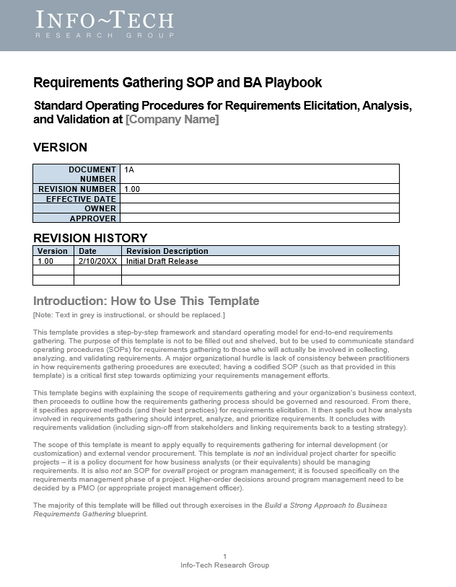
A mid-sized local government overhauls its requirements gathering approach and sees strong results
Case Study
Industry:
Source:
Government
Info-Tech Research Group Workshop
The Client
The Requirements Gathering Challenge
The Improvement
The organization was a local government responsible for providing services to approximately 600,000 citizens in the southern US. Its IT department is tasked with deploying applications and systems (such as HRIS) that support the various initiatives and mandate of the local government.
The IT department recognized that a strong requirements gathering process was essential to delivering value to its stakeholders. However, there was no codified process in place – each BA unilaterally decided how they would conduct requirements gathering at the start of each project. IT recognized that to enhance both the effectiveness and efficiency of requirements gathering, it needed to put in place a strong, prescriptive set of SOPs.
Working with a team from Info-Tech, the IT leadership and BA team conducted a workshop to develop a new set of SOPs that provided clear guidance for each stage of the requirements process: elicitation, analysis, and validation. As a result, business satisfaction and value alignment increased.
The Requirements Gathering SOP and BA Playbook offers a codified set of SOPs for requirements gathering gave BAs a clear playbook.

Slide 17
Use these icons to help direct you as you navigate this research
Use these icons to help guide you through each step of the blueprint and direct you to content related to the recommended activities.
This icon denotes a slide where a supporting Info-Tech tool or template will help you perform the activity or step associated with the slide. Refer to the supporting tool or template to get the best results and proceed to the next step of the project.
This icon denotes a slide with an associated activity. The activity can be performed either as part of your project or with the support of Info-Tech team members, who will come onsite to facilitate a workshop for your organization.

Slide 18
Info-Tech offers various levels of support to best suit your needs
Diagnostics and consistent frameworks used throughout all four options
DIY Toolkit
Guided Implementation
Workshop
Consulting
“Our team has already made this critical project a priority, and we have the time and capability, but some guidance along the way would be helpful.”
“Our team knows that we need to fix a process, but we need assistance to determine where to focus. Some check-ins along the way would help keep us on track.”
“We need to hit the ground running and get this project kicked off immediately. Our team has the ability to take this over once we get a framework and strategy in place.”
“Our team does not have the time or the knowledge to take this project on. We need assistance through the entirety of this project.”

Slide 19
Build a Strong Approach to Business Requirements Gathering – project overview
1
Build the Target State for Requirements Gathering
2
3
4
Define the Elicitation Process
Analyze and Validate Requirements
Create a Requirements Governance Action Plan
 | 1.1 Understand the Benefits of Requirements Optimization 1.2 Determine Your Target State for Requirements Gathering | 2.1 Determine Elicitation Techniques 2.2 Structure Elicitation Output | 3.1 Create Analysis Framework 3.2 Validate Business Requirements | 4.1 Create Control Processes for Requirements Changes 4.2 Build Requirements Governance and Communication Plan
 | Review Info-Tech’s requirements gathering methodology. Assess current state for requirements gathering – pains and challenges. Determine target state for business requirements gathering – areas of opportunity. | Assess elicitation techniques and determine best fit to projects and business environment. Review options for structuring the output of requirements elicitation (i.e. SIPOC). | Create policies for requirements categorization and prioritization. Establish best practices for validating the BRD with project stakeholders. | Discuss how to handle changes to requirements, and establish a formal change control process. Review options for ongoing governance of the requirements gathering process.
 | Module 1: Define the Current and Target State | Module 2: Define the Elicitation Process | Module 3: Analyze and Validate Requirements | Module 4: Governance and Continuous Improvement Process
 | Phase 1 Results: Clear understanding of target needs for the requirements process. | Phase 2 Results: Best practices for conducting and structuring elicitation. | Phase 3 Results: Standardized frameworks for analysis and validation of business requirements. | Phase 4 Results: Formalized change control and governance processes for requirements.
Best-Practices Toolkit
Guided Implementation
Onsite Workshop

Slide 20
Workshop Overview
 | Workshop Day 1 | Workshop Day 2 | Workshop Day 3 | Workshop Day 4 | Workshop Day 5
 | Define Current State and Target State for Requirements Gathering Understand current state and document existing requirement process steps. Identify stakeholder, process, outcome, and reigning challenges. Conduct target state analysis. Establish requirements gathering metrics. Identify project levels 1/2/3/4. Match control points to project levels 1/2/3/4. Conduct project scoping and identify stakeholders. | Define the Elicitation Process Understand elicitation techniques and which ones to use. Document and confirm elicitation techniques. Create a requirements gathering elicitation plan for your project. Practice using interviews with business stakeholders to build use case models. Practice using table-top testing with business stakeholders to build use case models. Build the operating model for your project. | Analyze and Validate Requirements Categorize gathered requirements for use. Consolidate similar requirements and eliminate redundancies. Practice prioritizing requirements. Rightsize the requirements documentation template. Present the business requirements document (BRD) to business stakeholders. Identify testing opportunities. | Establish Change Control Processes Review existing CR process. Review change control process best practices & optimization opportunities. Build guidelines for escalating changes. Confirm your requirements gathering process for project levels 1/2/3/4. | Establish Ongoing Governance for Requirements Gathering Define RACI for the requirements gathering process. Define the requirements gathering governance process. Define RACI for requirements gathering governance. Define the agenda and cadence for requirements gathering governance. Identify and analyze stakeholders for communication plan. Create communication management plan. Build the action plan.
 | Requirements gathering maturity assessment Project level selection tool Requirements gathering documentation tool | Project elicitation schedule Project operating model Project use cases | Requirements gathering documentation tool Requirements gathering testing checklist | Requirements traceability matrix Requirements gathering communication tracking template | Requirements gathering action plan
Activities
Deliverables
Contact your account representative or email Workshops@InfoTech.com for more information.

Slide 21
Use these icons to help direct you as you navigate this research
Use these icons to help guide you through each step of the blueprint and direct you to content related to the recommended activities.
This icon denotes a slide where a supporting Info-Tech tool or template will help you perform the activity or step associated with the slide. Refer to the supporting tool or template to get the best results and proceed to the next step of the project.
This icon denotes a slide with an associated activity. The activity can be performed either as part of your project or with the support of Info-Tech team members, who will come onsite to facilitate a workshop for your organization.

