Slide 1

Minimize the Damage of IT Cost Cuts
When IT cuts costs, everyone feels it.

Slide 2


ANALYST PERSPECTIVE
Cutting costs is easy. Cutting the right costs can mean the difference between success and failure.
A good CIO doesn’t wait for the economy to take a turn for the worse before looking at how they are spending money. In fact, the proactive CIO is always looking to get the best value for their IT dollar and being prudent with their expenditures.
But cutting costs unwisely can quickly lead to a race to the bottom. Before taking an axe to your budget, you need to clearly understand where you are spending your money, the value that those expenditures bring to the organization, where money can be saved with the least impact, and if necessary, how to engage with business stakeholders to get their buy-in before you affect their ability to do business.
This program will lead you through the process of understanding the right cost-cutting approach for you and how to optimally save money.
David Yackness,
Director, CIO Advisory
Info-Tech Research Group

Slide 3
Executive summary
The axe has fallen. Whether it is just IT, or the entire organization, when the axe falls, it is critical to be able to absorb the blow.
Beat the axe to the chopping block. Fiscally-conscious CIOs proactively foster a culture of perpetual cost optimization. Cutting costs and driving efficiencies before the mandate comes down, helps build a strong relationship with the CFO and increases the business’ confidence in IT.
Trade in the axe for a scalpel. Cost optimization gives you an opportunity to trim the fat and the flaws of the IT organization and increase efficiency and performance.
IT cost cuts are everyone’s cost cuts. When IT’s budget is slashed, everyone feels it. While fiscally prudent CIOs know that they need to do their part to save money, working collaboratively with the business to convey the full implications of IT cost cuts can help mitigate risk and preserve IT’s most fundamental capabilities.
Measure twice before making the first cut. Don’t try to cut everything all at once or your actions may have unintended consequences for the business. Understand the magnitude and urgency of your cost-cutting mandate before taking action.
Don’t prune dead trees – cut them down. Pursuing incremental gains in efficiency is a complete waste of time if you shouldn’t be delivering that service in the first place.
Average growth rates for Opex and Capex budgets are expected to continue to decline over the next fiscal year.
Common “quick-win” cost-cutting initiatives are not enough to satisfy the organization’s mandate.
Cost-cutting initiatives often take longer than expected, failing to yield sufficient cost savings before the organization’s deadline.
Cost optimization projects often have unanticipated consequences that offset potential cost savings, and result in business dissatisfaction.
Complete this blueprint to systematically identify and prioritize cost optimization initiatives to smartly cut IT expenses without undermining IT’s core capabilities.

Slide 4


Info-Tech’s cost-cutting insights
Central Insight:
IT cost cuts are everyone’s cost cuts. When IT’s budget is slashed, everyone feels it. While fiscally prudent CIOs know that they need to do their part, working collaboratively with the business to convey the full implications of IT cost cuts can help mitigate risk and preserve IT’s fundamental capabilities.
Info-Tech Insight
Info-Tech Insight
Phase 1
Measure twice before making the first cut. Don’t try to cut everything all at once or your actions may have unintended consequences for the business. Understanding the magnitude and urgency of your cost-cutting mandate is essential for identifying which initiatives fit within your timeframe and match your appetite for risk.
Info-Tech Insight
Phase 2
Don’t prune dead trees – cut them down. Pursuing incremental gains in service efficiency is a complete waste of time if you shouldn’t be delivering that service in the first place. Don’t weaken essential services that the business needs, but instead, target non-essential services that can be completely eliminated or where significant cuts can be found that don’t have a serious impact on business users.
Phase 3
Info-Tech Insight
Buy-in happens long before your plan ends up on the CFO’s desk. The sale happens long before the pitch. Communicate the links between IT’s proposed cost cuts and their impact on the business throughout the process to have broad buy-in before selling your plan to management.

Slide 5
CIOs are bracing for austerity once again
MoneyBeat: Estimates Fall in a Hurry
Wall Street’s earnings estimates for S&P 500 companies are falling at the fastest pace since the height of the financial crisis.
Since the start of 2016, Wall Street has gone from anticipating 0.3% growth in first-quarter earnings for S&P 500 companies to an 8% decline, according to FactSet. It is the biggest such shift since the start of 2009, when first-quarter earnings expectations then tumbled 24 percentage points. The reduction in first-quarter earnings forecasts comes as last year’s pressure points—namely oil’s price slump and a stronger dollar—persist.
(Wall Street Journal, Mar. 6, 2016)
Elusive global growth outlook requires urgent policy response
“Global growth prospects have practically flat-lined, recent data have disappointed and indicators point to slower growth in major economies, despite the boost from low oil prices and low interest rates,” said OECD Chief Economist Catherine L. Mann. “Given the significant downside risks posed by financial sector volatility and emerging market debt, a stronger collective policy approach is urgently needed, focusing on a greater use of fiscal and pro-growth structural policies, to strengthen growth and reduce financial risks.”
(OECD Global Interim Economic Outlook, Feb. 18, 2016)
CFOs Rein In Capex After
2015’s Tough Finish
The cautious approach suggests that executives remain wary as the strong dollar and weak growth in developing markets hurts their foreign sales, and the stock market’s slide and fears of a downbeat economy unsettle investors and consumers at home, despite improvements in housing and employment.
(Wall Street Journal, Feb. 8, 2016)

Slide 6
If you haven’t felt the pinch yet, you may be feeling it soon
CEOs in all industries are projecting a decline in revenue growth
Operational budgets are forecasted to continue to decline
For the first time since 2013, US CEOs’ outlook on year-over-year expected revenue growth has declined.
The amount that organizations are increasing spending in their operational budgets has been declining in recent months.
Change in Expected Revenue Growth
% Change in Operational Budget
from Previous Year
Change in Operational Budget Growth
2013 - 2014
2014 - 2015
2015 - 2016
Source: PwC, 2016 US CEO Survey, January 2016
Source: Info-Tech Research Group, MeasureIT Budgeting Survey, January 2016; N=70

Slide 7

CIOs are being asked to do more with less
Just because your budget is being cut, doesn’t mean that the organization’s expectations of IT are any lower.
52
%
of IT budgets are expected to remain the same or decrease in 2016.
Source: Spiceworks, The 2016 State of IT
This mandate and expectation from the business is an unfortunate reality for many of Info-Tech’s clients.
What does this mean?
CIOs are trying to do the SAME or MORE with LESS money.

Slide 8
Don’t make these common cost-cutting mistakes
How IT often tries to cut costs:
Shield the plan from the CFO and “the business” to ensure that IT’s priorities are protected.
While putting yourself on an island may buy you time and help you avoid personnel cuts, you risk making cuts
that negatively impact the business, and making the approval of your proposals an uphill battle.
Find many small efficiency-gains in IT’s existing services to avoid large cuts.
It may seem like a good idea to avoid large, highly visible cuts and instead make small, incremental gains in
efficiency. However, efficiency initiatives are almost never sufficient to achieve significant cuts in IT spending
and are rarely worth the time and effort.
Convince senior leadership that IT is already as lean as it can get without major drops in service levels.
Pushing back on a cost-cutting mandate has a low rate of success. When facing organization-wide cost cuts,
every business unit is expected to do its part and even if you are right, you won’t find a sympathetic ear.
Cut and paste cost-cutting “ideas” that other firms have tried.
A “quick fix” might help move the dial in the right direction, but it likely won’t be enough. Inevitably, IT
departments facing steep cuts will have to put its capabilities and operations under the microscope.
X
X
X
X

Slide 9
The Info-Tech cost-cutting methodology will help you achieve your mandate and realize tangible benefits
Benefits of the Info-Tech Cost-Cutting Program:
A
B
Reduce Costs
No one wants to cut costs. Yet, IT leaders are obligated to contribute to organization-wide cost-cutting efforts, and must continuously demonstrate fiscal responsibility.
Get Business Users in Your Corner
Your business users are your customers and they will feel the impacts of IT cost cuts most. Effectively communicating the implications of cost cuts to key business stakeholders can help turn them into your biggest boardroom advocates.
C
D
Protect IT’s Core Capabilities and the
Business User
Consulting business stakeholders at key intervals in the process will ensure that you understand how potential IT cost cuts will impact the organization as a whole.
Don’t Do More Than You Need To
Too often, IT leaders begin making cuts without truly understanding the internal and external drivers behind the mandate. Investing a little bit of time at the outset to understand the magnitude and urgency of the cuts will ensure that you don’t select initiatives that are misaligned with your mandate.

Slide 10
Follow these five steps to select the cost-cutting initiatives that get you the savings you need – without sinking the ship
PHASE 1
PHASE 2
1
3
Identify initiatives that will save your organization money
Know your mandate
Don’t start identifying potential cuts before truly understanding the external and internal drivers that are dictating the urgency and magnitude of the mandate.
Follow the activities in this step to unpack the organization’s mandate, and use it to whittle down your list of initiatives to only those that align properly.
While providing many examples of initiatives that have achieved considerable cost savings for Info-Tech clients, this blueprint will also walk you through our three-pronged approach to find cost cuts that make sense for your unique IT department
  Conduct a high-level brainstorming session, harnessing the collective knowledge of the IT leadership team.
  Conduct a detailed review of IT’s financials (budget, GL, invoices).
  Follow the activities in this blueprint to take a service portfolio perspective of IT expenditure and identify cuts in IT’s lowest value services.
2
Build momentum with “quick wins”
The best way to gain the trust of the CFO is to put IT cost savings where your mouth is. Low-risk, quick-to-implement initiatives can enhance your reputation as a fiscally prudent IT leader – even if initial savings are small.
Implement quick wins in days, not weeks by using Info-Tech’s list of common quick-win initiatives.

Slide 11
Follow these five steps to select the cost-cutting initiatives that get you the savings you need – without sinking the ship
PHASE 2
PHASE 3
4
Select initiatives that align with your mandate
5
Obtain approval for your cost-cutting proposal
Use the Cost-Cutting Planning Tool to analyze and sift through your list of cost-cutting initiatives and select only those that work within your timeframe and reflect your level of risk tolerance.
Prioritize and order your list of selected cost-cutting initiatives and build a roadmap of when each project will be executed and who is responsible for implementation.
Use the Cost Cutting Plan template to effectively make your recommendations to senior leadership, highlighting the expected cost savings and potential business impacts of each project.
Communicate the costs and benefits of each initiative, and ensure that the decision to lower service levels is shared between the CIO and the rest of the leadership team.
Prepare business users and IT staff for changes associated with the cost-cutting measures.

Slide 12

IT cost cuts are everyone’s cost cuts
Don’t hide your cost-cutting plans from the business.
When business stakeholders are consulted and brought into the cost-cutting process at strategic points, and on your terms, you will:
Prevent IT’s core capabilities from being eroded by rushed cost-cutting initiatives.
Obtain support from business units to avoid selecting IT cost cuts that negatively impact them. Have them advocate for you.
Receive less pushback when IT cost cuts negatively impact business users.
Build a better relationship with the CFO.
Info-Tech Insight
IT cost cuts are everyone’s cost cuts. When IT’s budget is slashed, everyone feels it. While fiscally prudent CIOs know that they need to do their part, working collaboratively with the business to convey the full implications of IT cost cuts can help mitigate risk and preserve IT’s fundamental capabilities.

Slide 13
Make sure your aim is true before pulling the trigger on IT cost cuts
Understand the organization’s cost-cutting mandate before you select your initiatives.
What type of cost cutter are you?
The answers to the questions “how much?” and “how soon?” will dictate:
Your tolerance for risk.
The level of investment/effort you’re willing to put forward.
The duration of initiatives.
The complexity of initiatives.
Magnitude ($)
High
Strategist
Survivalist
Low
Opportunist
Tactician
Low
High
Urgency (Timing)
Info-Tech Insight
Make sure your aim is true before pulling the trigger on IT cost cuts. Don’t try to cut everything all at once or your actions may have unintended consequences for the business. Understanding the magnitude and urgency of your cost-cutting mandate is essential for identifying which initiatives fit within your timeframe and match your appetite for risk.

Slide 14
Don’t prune dead trees – cut them down
Don’t undermine essential IT services by seeking incremental efficiency gains.
First, collaborate with business users to prioritize your IT services and then,
eliminate or take big cuts from low-value services.
Follow the activities in step 4 to:
Create a “level-zero” service catalog.
Elicit business stakeholder engagement to help evaluate and prioritize IT services.
Conduct level-zero service portfolio management.
Identify larger cost cuts by focusing on low-value and non-essential IT services.
Info-Tech Insight
Don’t prune dead trees – cut them down. Pursuing incremental gains in efficiency is a complete waste of time if you shouldn’t be delivering that service in the first place. Don’t weaken essential services that the business needs, but instead target non-essential services that can be eliminated or where significant cuts can be found that don’t have a serious impact on business users.

Slide 15
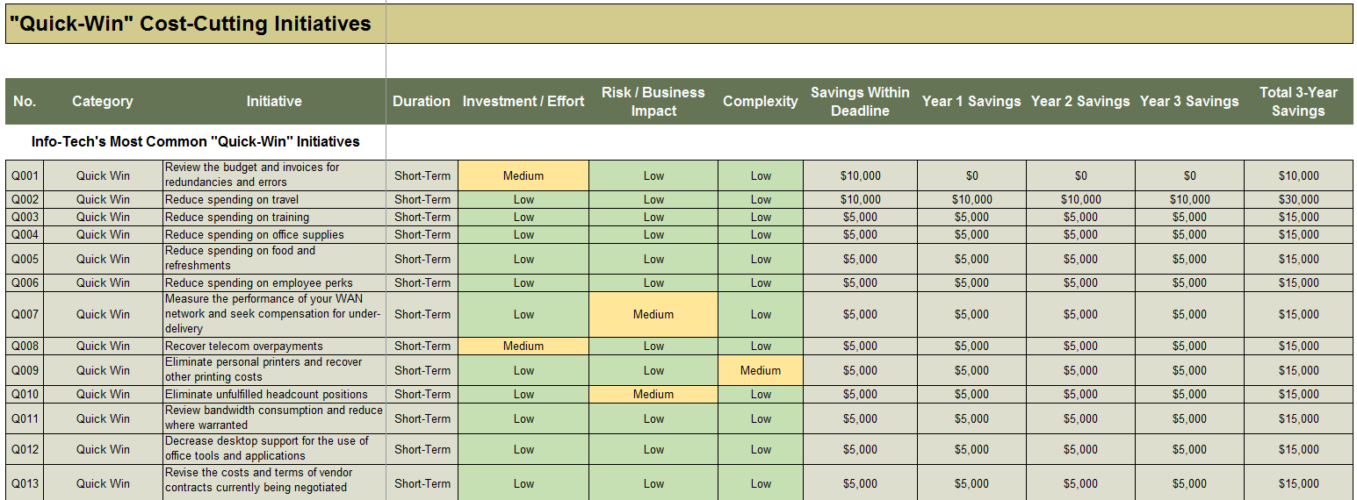
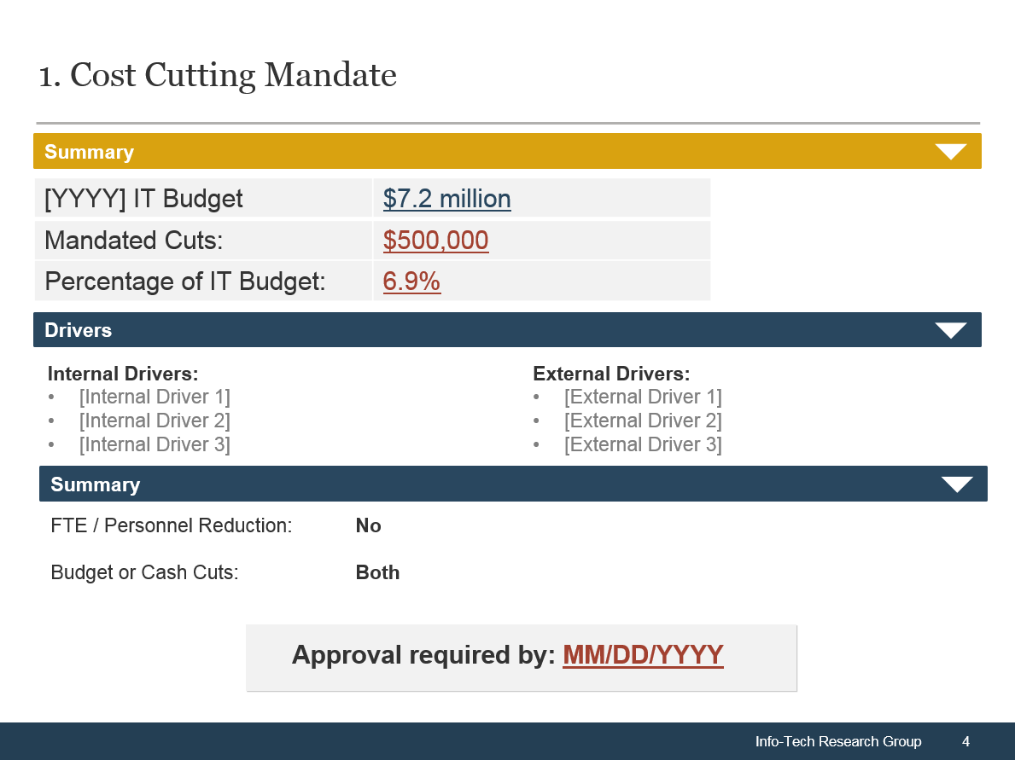
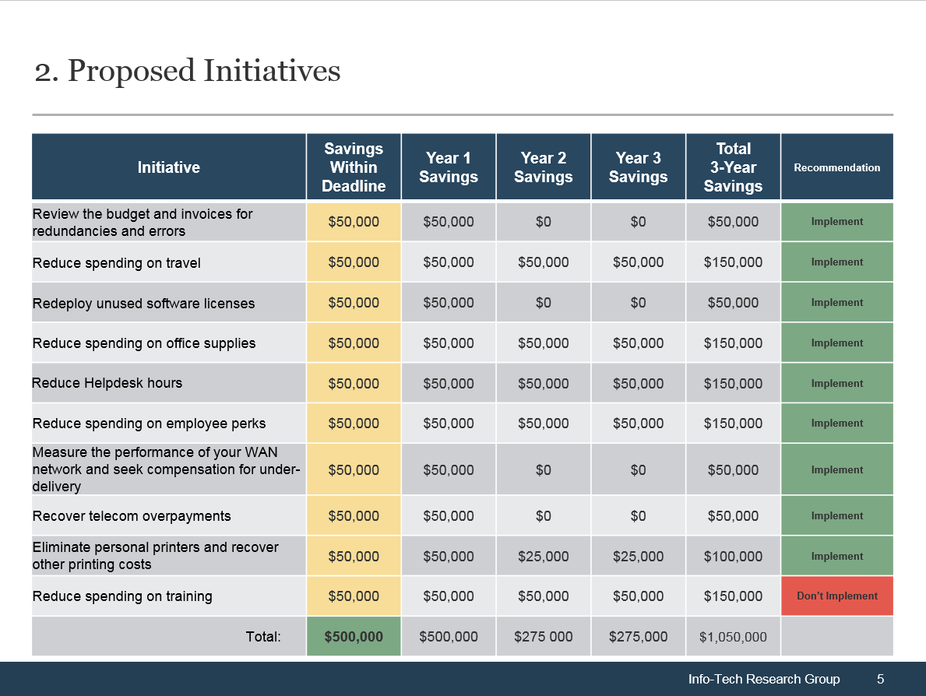
How we make this process easier
Two primary deliverables:
Develop and Monitor the Plan
Present and Execute the Plan
Cost-Cutting Planning Tool
Cost-Cutting Plan
Document and analyze cost-cutting initiatives.
Makes recommendations based on the magnitude and urgency of the your mandate.
Select initiatives to implement.
Outputs help create the cost-cutting plan and roadmap.
Present proposed cost cuts to Finance or senior leadership.
Easy to customize (15 minutes).
Summarizes the process taken to select and analyze initiatives.
Allows senior leadership to make informed decisions that minimize negative impact on the business.

Slide 16

Our methodology in action
A large energy company asks IT to cut $9 million over the next three years.
CASE STUDY
Industry
Energy
Dissecting the mandate with the CFO
A quick win
IT received a mandate to reduce its $50 million/year operating budget by an average of $3 million over each of the next three years.
Approved open headcount positions would need to be eliminated and personnel cuts may be necessary.
The CIO met with IT leaders and reviewed the upcoming budget for duplicates and items no longer required.
While tedious, this exercise resulted in $338,000 in savings that could be communicated to the Finance department as early progress towards the mandate.

Slide 17
Our methodology in action (continued)
A large energy company asks IT to cut $9 million over the next three years.
CASE STUDY
Industry
Energy
Assessing budget and invoices
Assessing services
An in-depth review of IT’s Opex budget and invoices resulted in the decision to change their primary mobility provider, resulting in annual savings of $100,000.
A further $140,000 was realized through renegotiations with a storage vendor.
An organization-wide printer consolidation project was expected to save the company $165,000 per year.
They identified Help Desk & Desktop Support and Change Management as the two services that could absorb budgetary cuts without severe repercussions to the business.
By reducing 2 FTE from Help Desk & Desktop Support and 1 FTE from Change Management, IT was able to save $180,000 per year.
An additional $1.1 million was saved by eliminating provisioning for vacant positions.

Slide 18




Info-Tech offers various levels of support to best suit your needs
Guided Implementation
DIY Toolkit
Workshop
Consulting
“Our team has already made this critical project a priority, and we have the time and capability, but some guidance along the way would be helpful.”
“Our team knows that we need to fix a process, but we need assistance to determine where to focus. Some check-ins along the way would help keep us on track.”
“We need to hit the ground running and get this project kicked off immediately. Our team has the ability to take this over once we get a framework and strategy in place.”
“Our team does not have the time or the knowledge to take this project on. We need assistance through the entirety of this project.”
Diagnostics and consistent frameworks used throughout all four options

Slide 19



Minimize the Damage of IT Cost Cuts – project overview
1. Understand the mandate and take immediate action
2. Select cost-cutting initiatives
3. Get approval for your cost-cutting plan and adopt change management best practices
Best-Practice Toolkit | 1.1 Determine your cost optimization stance and obtain support from the business. 1.2 Build momentum with quick wins. | 2.1 Identify cost-cutting initiatives. 2.2 Select initiatives and build a roadmap. | 3.1 Get approval for your cost-cutting plan and adopt change management best practices.
Guided Implementations | Start cost-cutting project and determine the cost-cutting stance. Decide on quick wins for the project and determine how to report progress to Finance. | Decide on how to determine initiatives for cost cutting. Review cost-cutting initiatives and select those to be put on a roadmap. | Transform roadmap into finalized plan with monitoring plan and engage stakeholders to achieve adoption.
Onsite Workshop | Day 1 (AM) – Day 2 (AM) See next slide. | Day 2 (AM) – Day 3 (AM) See next slide. | Day 3 (PM) – Day 4 See next slide.
 | Phase 1 Outcome: Cost-cutting goals and mandate A number of defined quick wins Approval from Finance for the cost-cutting project | Phase 2 Outcome: Comprehensive list of potential cost-cutting initiatives and their descriptions. A number of cost-cutting initiatives. A roadmap for the cost-cutting project. | Phase 3 Outcome: Finalized cost-cutting plan. Monitoring plan. Engaged stakeholders.

Slide 20
Workshop overview
Contact your account representative or email Workshops@InfoTech.com for more information.
 | Workshop Day 1 | Workshop Day 2 | Workshop Day 3 | Workshop Day 4
Activities | AM: Determine Your Cost Optimization Stance 1.1 Develop SMART project metrics. 1.2 Dissect the mandate. 1.3 Identify your cost-cutting stance. | AM: Identify Initiatives 3.1 Brainstorm cost-cutting initiatives. 3.2 Scrutinize financial statements for saving opportunities. 3.3 Assemble a level-zero service catalog. | AM: Select Initiatives 4.1 Define characteristics of cost-cutting initiatives. 4.2 Review risk tolerance and levels. 4.3 Select cost-cutting initiatives. | AM: Get Approval for Your Cost-Cutting Plan 5.1 Customize the cost-cutting plan. 5.2 Build a stakeholder communication management plan. 5.3 Create stakeholder engagement plans.
 | PM: Build Momentum with Quick Wins 2.1 Select and implement quick wins using the planning tool. 2.2 Plan to report progress to Finance. | PM: Evaluate Services 3.4 Evaluate the importance of IT services to users. 3.5 Prioritize IT services. 3.6 Identify cost-cutting initiatives. | PM: Build a Roadmap 4.4 Determine the order of initiatives. 4.5 Build a roadmap for initiative implementation. | PM: Adopt Change Management Best Practices 5.4 Transfer ownership of initiatives project managers. 5.5 Monitor cost savings.
Deliverables | Project metrics and mandate documentation List of quick-win initiatives | List of potential cost-cutting initiatives | High-level descriptions of cost-cutting initiatives Cost-cutting roadmap | Finalized cost-cutting plan Stakeholder engagement plan Cost monitoring plan

