Slide 1
Modernize Communications and Collaboration Infrastructure
Your legacy telephony infrastructure is dragging you down – modern communications and collaboration technology can dramatically improve productivity.
Info-Tech's products and services combine actionable insight and relevant advice with ready-to-use tools and templates that cover the full spectrum of IT concerns.© 1997 - 2016 Info-Tech Research Group

Slide 2
ANALYST PERSPECTIVE
Employees expect more flexibility in the workplace.
The ability to work anytime from anywhere on any device is now the norm, not the exception – unless you’re still relying on legacy telephony infrastructure.
In our personal lives, technology is seamless, and we expect it to be. If it’s not, we upgrade to the shiniest next best thing. Why doesn’t this happen in the workplace?
Plain and simple, the lack of modern communications in your environment is reducing the effectiveness of your people and business processes.
VoIP and UC are 15+ year old technologies. Both are mature. It’s no longer a topic for discussion. VoIP and UC are the proven way forward, and they’re just the first step. What’s stopping you from moving forward?
Brad Wells,
Research Director, Infrastructure Info-Tech Research Group

Slide 3
Our understanding of the problem
IT Managers
Network/Infrastructure Managers
Develop a clear snapshot of the current state of communications infrastructure
Understand your business and technical requirements
Define a desired target state that aligns with business needs, goals, and end-user needs
Build an RFP for a UC solution.
Develop a communications deck to pitch modernization to senior management
CIOs
IT Directors
Ensure their organization’s IT capabilities support the evolving business needs
Understand and articulate the need and benefit of implementing or refreshing communications-related infrastructure

Slide 4
Executive summary
Organizations are losing productivity from managing the limitations of yesterday’s technology. The business is changing and the current solution no longer adequately connects end users.
You need a solution that meets budgetary requirements and improves internal and external communication, productivity, and the ability to work together.
Project scope and assessment take more time than you think. Defining project scope and assessing the existing solution make up 60% of project time. Being thorough here will make the difference moving forward.
It’s not about the technology. Don’t focus solely on tech without considering the requirements of your people and process.
Business first. IT second. Ensure your IT team communicates with the business throughout the process and establishes business requirements.
Poorly-defined technical requirements can result in failure to meet the needs of the business.
A wide range of deployment options (on-premises to managed cloud services) makes it difficult to find the best solution.
Modernizing your communications infrastructure can be an expensive project and getting business buy-in may be tough.
Define a comprehensive set of requirements (across people, process, and technology) at the start of the project. Communication solutions are long-term commitments and mistakes in planning will be amplified during implementation.
Analyze the pros and cons of each deployment option and identify a communications solution that balances your budget and communications objectives and requirements.
Create an effective RFP by outlining your specific business and technical needs and goals.
Make the case for your communications infrastructure modernization project and be prepared to support it.

Slide 5
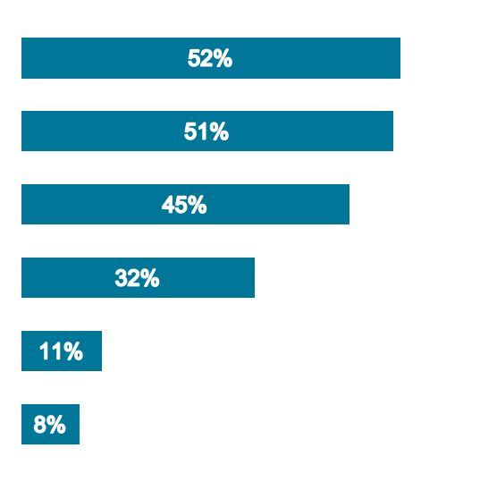
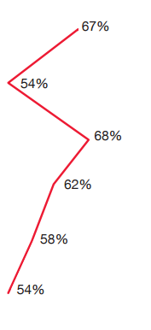
Failure to modernize wastes an opportunity for significant productivity and efficiency gains
Unified communications (UC), for example, is an increasingly mature technology that businesses are using to achieve real benefits. For every business driver of UC adoption, the actual benefits realized are greater than expected.
Most businesses make the decision to adopt UC based on business reasons (as they should), such as:
Productivity
Opex Savings
Efficiency gains
What most organizations don’t expect is that UC significantly benefits a business’ employee-base too. While collaboration, employee demand, and well-being were initially less highly prized, 62%, 57%, and 54%, respectively, of all UC buyers reported realization of these soft benefits post-deployment.
Drivers of UC Adoption
Expected Benefits
Realized Benefits
Productivity
Opex savings
Efficiency gains
Collaboration
5x more!
Employee demand
6.75x more!
Employee well-being
Source: PwC

Slide 6
First, redefine how you think about communications
Communications infrastructure is the foundation for your employees and business to function, interact, and produce quality content, ideas, and end results.
It isn’t simply about having a better phone.
Communications infrastructure is not just:
End-to-end tools
Call quality
Instant messaging
Presence
Video conferencing
Document management
It is about building a holistic network that brings business and people together.
Enable your team to work together anywhere, anytime, and in any way to benefit from:
Immediate access and availability to coworkers
Better and more fluid productivity
Accurate and real-time representation and relation of ideas

Slide 7
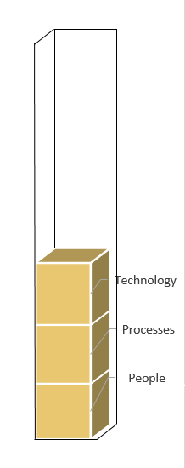
Mitigate technical debt to power business agility
Failure to address technical debt by continuing with legacy communications infrastructure constrains people and process.
Most think tech debt is just about dumping old technology and they forget the interconnected nature of people, process, and technology. Remember:
People are either limited or enabled by the right tools.
Effective technology enables the processes in place to better serve the business.
People, process, technology all performing strongly
Something isn’t working...
The top reasons businesses with legacy PBX solutions are now evaluating VoIP are:
52%
End-of-life system problems
26%
Lack of call routing functionality
Deep in technical debt
13%
Lack of scalability
If you are experiencing these problems or other reoccurring problems and limitations, you are probably deep in technical debt.
Source: Harris, Daniel. “VoIP Software Small Business Buyer Report - 2015.”

Slide 8
Prioritize investments in technology that earn your business the highest reward
For the enterprise, no other technology has better cost success and ROI success than UC. It’s tested, proven, and mature.
Low Risk
5
UC was rated the #1 technology investment choice in 2015!
1
7
3
2
8
9
6
4
11
Unified Communications
IaaS
Desktop Virtualization
PaaS
Mobile Apps
Software-Defined Storage
Human Capital Management
Social/Collaboration
SaaS
CRM
Tablets
Supply Chain Management
Data Warehouse
ERP
Cost Success (Risk)
10
13
14
12
ROI Success (Reward)
High Reward
Source: Computer Economics

Slide 9
Unified communications & collaboration go hand-in-hand: build a strategy that addresses both
Unified Communications
Unified Communications
Collaboration
Collaboration
Focus on enabling individual productivity.
Allows employees to efficiently communicate whenever/wherever/ however makes the most sense.
Business value derived from reduced impediments to communication.
Focus on enabling knowledge sharing and team-based productivity.
Allows employees to efficiently share ideas.
Business value derived from creation of high-performing knowledge workers and project teams.
Communication-Enabled Collaboration
Focus on optimizing employee-to-employee and team-based collaboration through enhanced use of real-time communication tools and presence.
Unified communications and enterprise collaboration strategies are complementary, not mutually exclusive. Implementation strategy for one impacts the other. For more about collaboration-centric implementation and optimization, see Info-Tech’s solution set, Implement a Collaboration Platform.

Slide 10
Leverage a hybrid solution model to invest in your communications infrastructure and avoid a “rip and replace”
Sixty-five percent of UC deployments are on-premises, but demand for cloud solutions will likely result in hybrid UC solutions emerging as the go-forward standard.
Source: Sonus
Deployment Models:
On-Premises: Internal IP PBX/Solution
Hosted: External IP PBX/Solution; Private cloud with dedicated infrastructure
Cloud: External IP PBX/Solution; Shared infrastructure with other clients accessible online
Hybrid: Combine any aspect of the above deployment models and movement can occur in any direction.
On- Premises
Cloud
Hosted
Hybrid
Hybrid
Hybrid
The deployment model that best fits your business is dependent on your current and future business needs.
Instead of having to rip and replace, an overlay may be far more effective for your business. Hold onto your PBX until its end of life and get the framework you need as a bridge to tie the systems together. Then this also gives you leverage to use more than one vendor and you’re not locked in.
– Brendan Ziolo, Head of Large Enterprise Strategy, Alcatel-Lucent

Slide 11
Follow Info-Tech’s methodology to modernize communications and collaboration infrastructure
Phase 1: Assess Infrastructure
Phase 2: Define the Target State
Phase 3: Advance the Project
Phases
Steps
1.1
Preliminary assessment
2.1
Align business needs and goals
3.1
Draft the RFP
1.2
Assess people, process, and technology
2.2
Evaluate the deployment options
3.2
Gain project approval
Build the roadmap and compare option costs
2.3
Communications Infrastructure Roadmap Tool – Tech Debt
Request for Proposal Template
Tools and Templates
Team Skills Inventory Tool
Stakeholder Engagement Workbook
Executive Presentation Deck
MACDs Workflows Template
Business Requirements Document Template
Platform Assessment
Short- and Long-Term Initiative Timelines
TCO Tool

Slide 12
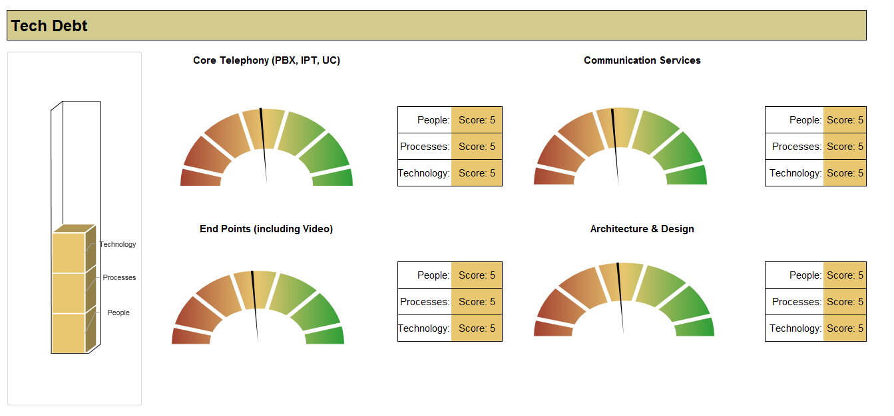
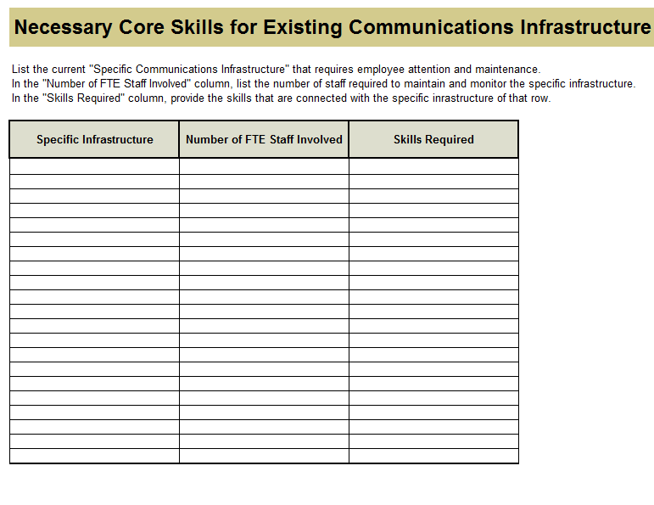
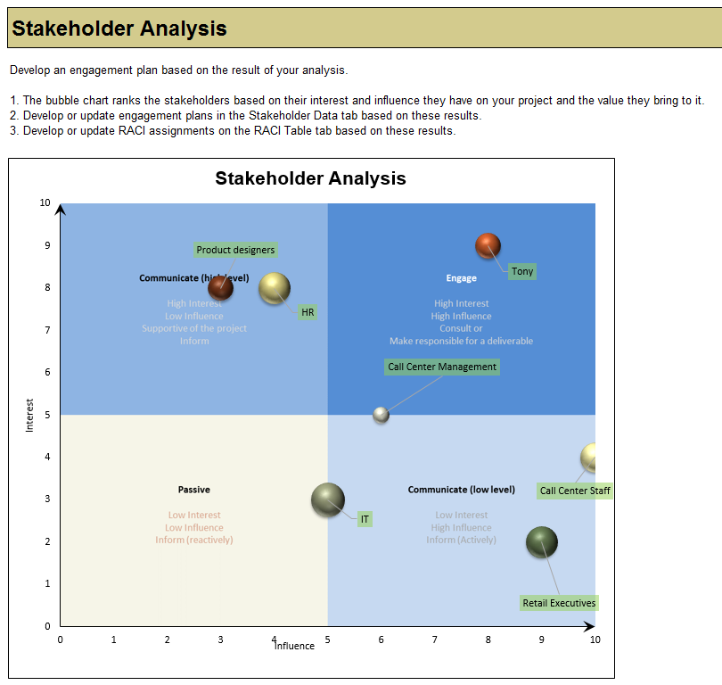
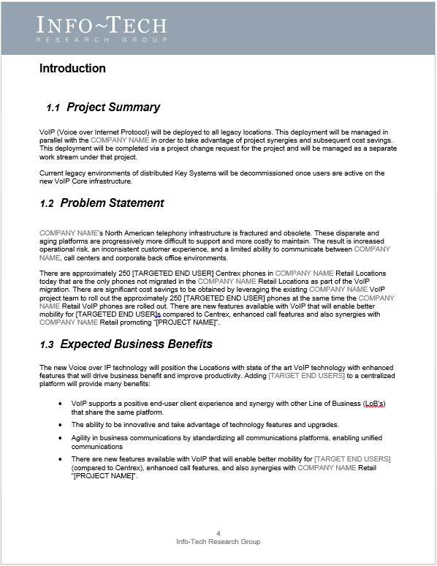
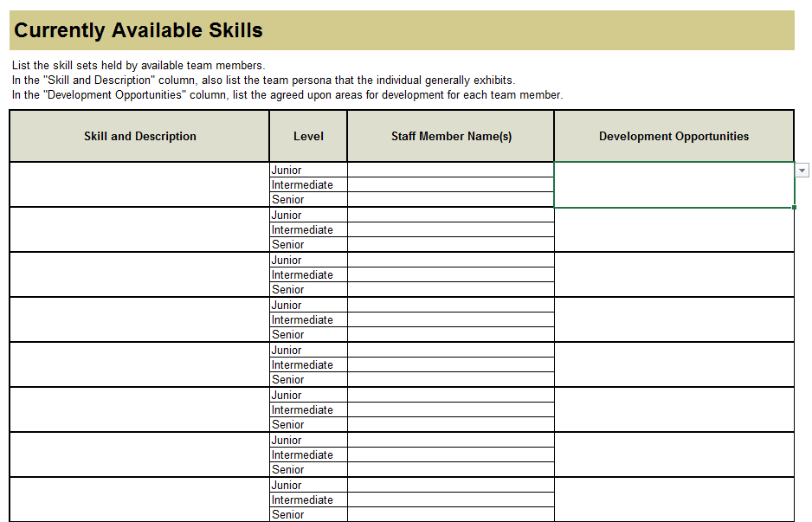
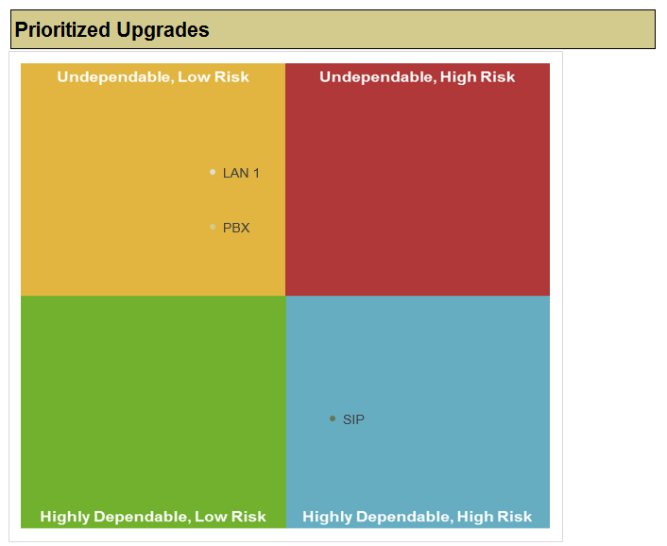
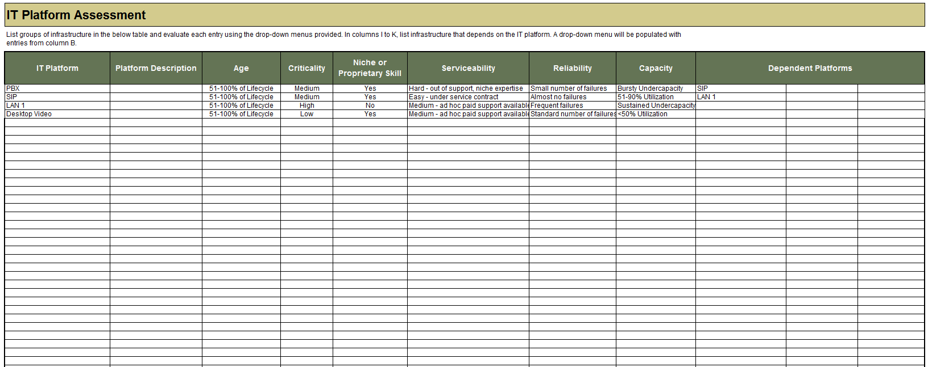
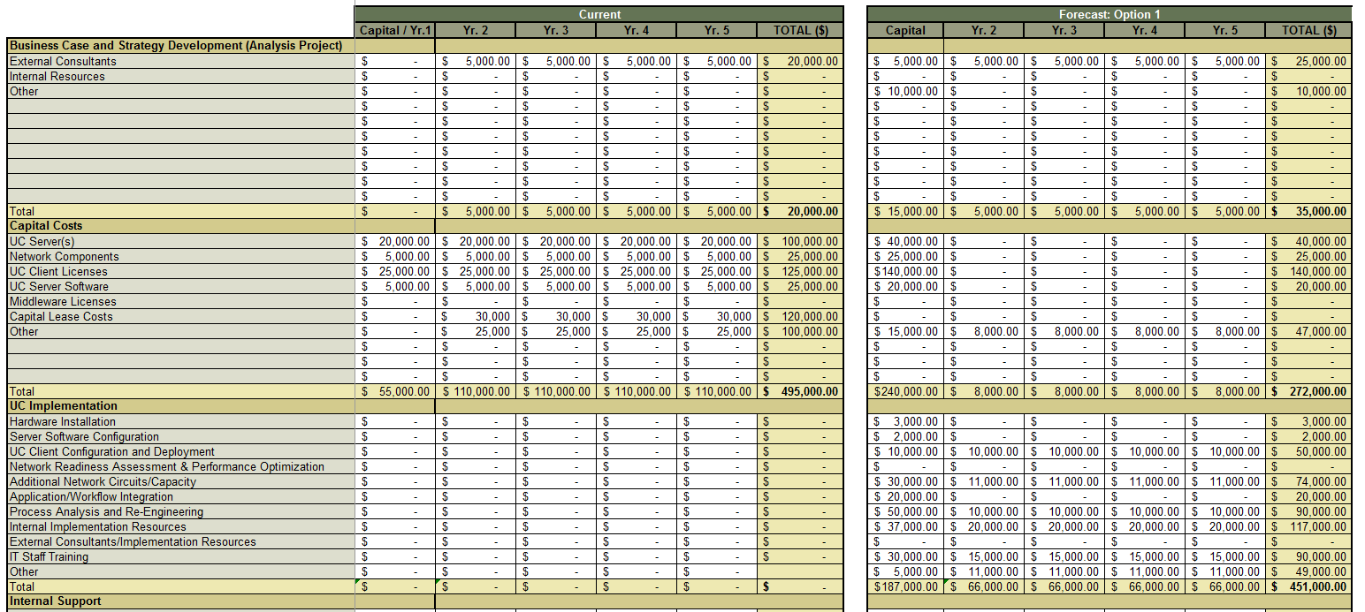
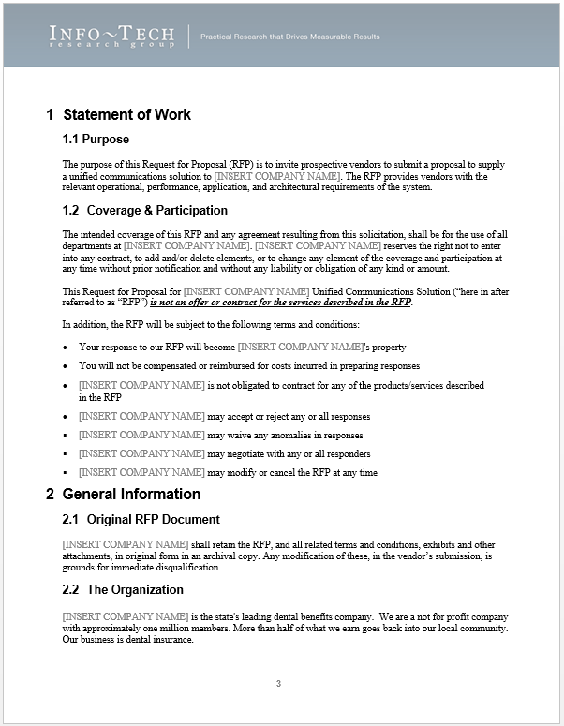
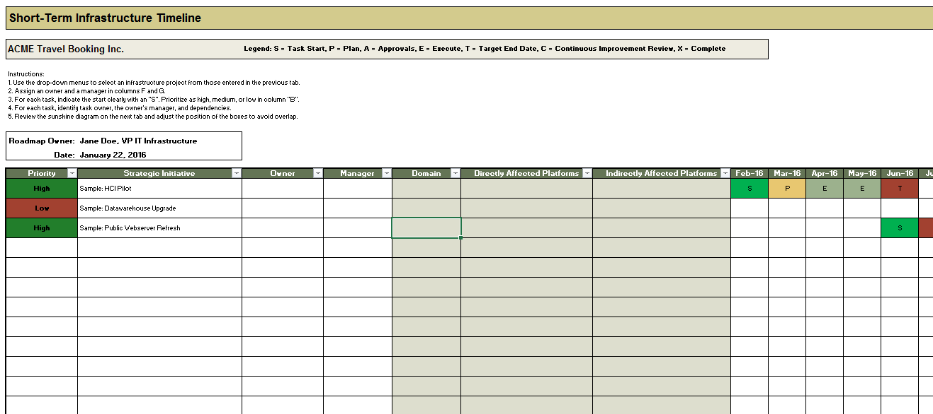
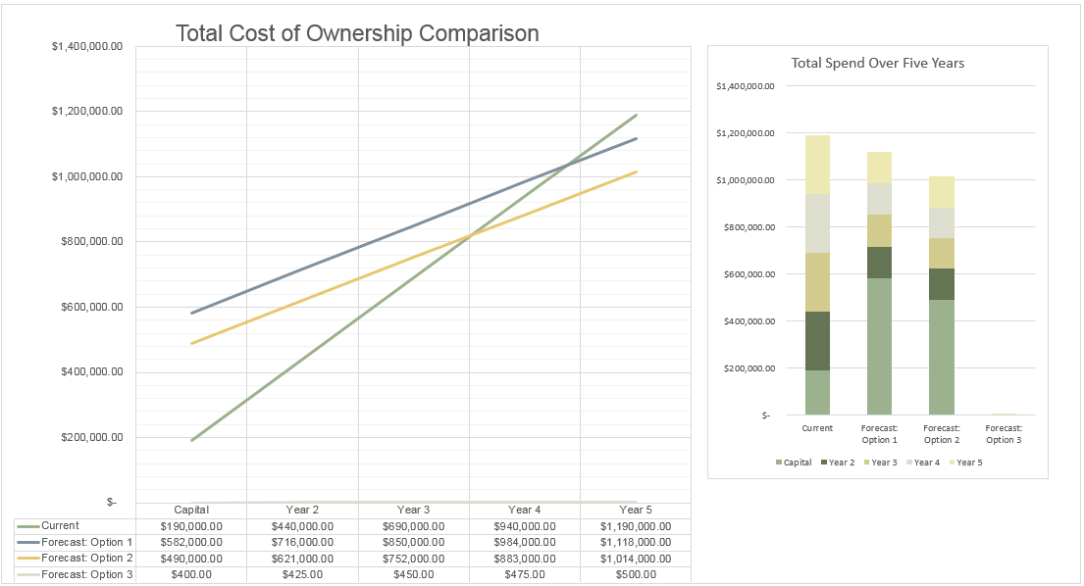
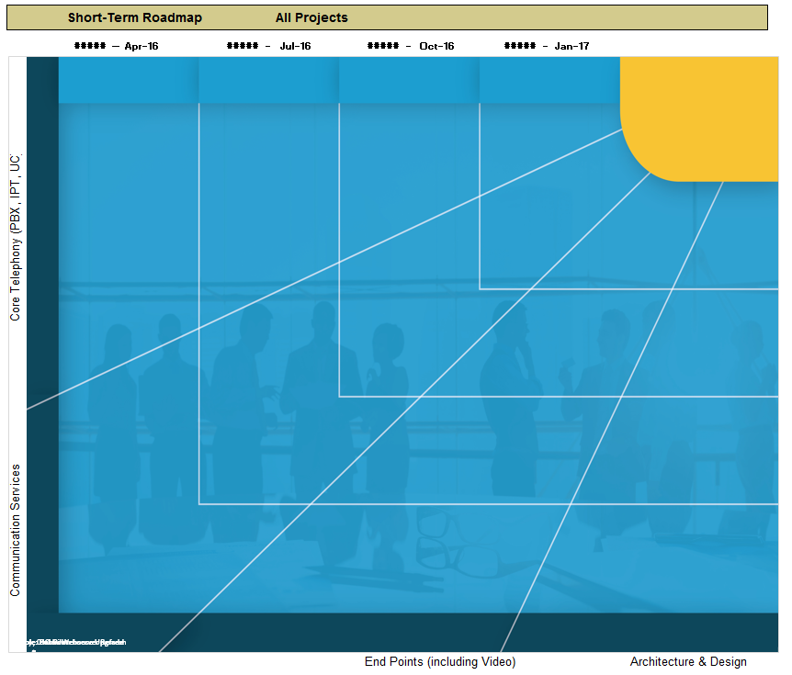
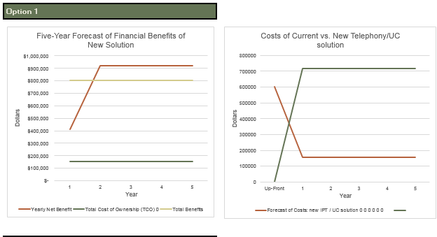
Info-Tech delivers: Use our tools and templates to accelerate your modernization project to completion
Tech Debt and Platform Assessment (Excel)
Team Skills Inventory
Tool (PowerPoint)
Stakeholder Engagement
Workbook (Excel)
Business Requirements
Document (Word)
Communication Infrastructure Roadmap Tool (Excel)
Communications TCO-ROI Comparison Calculator (Excel)
UC Solution RFP Template
(Word)
Modernize Communications Infrastructure Executive Presentation (PowerPoint)

Slide 13
Info-Tech offers various levels of support to best suit your needs
Guided Implementation
DIY Toolkit
Workshop
Consulting
“Our team has already made this critical project a priority, and we have the time and capability, but some guidance along the way would be helpful.”
“Our team knows that we need to fix a process, but we need assistance to determine where to focus. Some check-ins along the way would help keep us on track.”
“We need to hit the ground running and get this project kicked off immediately. Our team has the ability to take this over once we get a framework and strategy in place.”
“Our team does not have the time or the knowledge to take this project on. We need assistance through the entirety of this project.”
Diagnostics and consistent frameworks used throughout all four options

Slide 14
Measured value for Guided Implementations (GIs)
Engaging in GIs doesn’t just offer valuable project advice, it also results in significant cost savings.
GI | Measured Value
Phase 1: | Time, value, and resources saved by using Info-Tech’s methodology to inventory IT skills, build process flow diagrams, inventory and evaluate infrastructure, engage stakeholders, develop a project vision, and assess your current state. For example, 2 FTEs * 10 days * $80,000/year = $6,200
Phase 2: | Time, value, and resources saved by using Info-Tech’s tools and templates to engage stakeholders, conduct a focus group, build a business requirements document, and evaluate project cost and benefit. For example, 2 FTEs * 10 days * $80,000/year = $6,200
Phase 3: | Time, value, and resources saved by following Info-Tech’s tools and methodology to build an RFP, executive presentation, and project roadmap. For example, 1 FTEs * 10 days * $80,000/year = $3,000
Total savings | $15,400

Slide 15
Modernize Communications and Collaboration Infrastructure – project overview
1. Assess communications infrastructure
2. Define the target state
3. Advance the project
Best-Practice Toolkit | 1.1 Preliminary assessment Communications Infrastructure Roadmap 1.2 People, process, technology IT Team Skills Inventory Process Map High-Level System Map Readiness Assessment Checklist Inventory Evaluation | 2.1 Align business needs and goals Stakeholder Engagement Workbook Focus Group Sample Business Requirements Doc 2.2 Evaluate the options 2.3 Build the roadmap Communications Infrastructure Roadmap TCO-ROI Comparison | 3.1 Draft the RFP Sample RFP 3.2 Gain management approval Executive Presentation Deck
Guided Implementations | Gain a notional picture of your “tech debt.” Determine methodology and goals for a deeper assessment. Check in with analyst on progress. Brainstorm solutions to any current or upcoming obstacles. | Discuss and gain a clear picture of business needs and goals for documenting purposes. Gain a working knowledge of the deployment model options available and how they relate to your business. High-level gap analysis between current and future state; make plan to gather data for TCO/ROI. | Gain expert insight from Info-Tech analysts on how to approach and draft your RFP. Leverage Info-Tech as a sounding board and ensure your RFP misses nothing critical to obtain a successful response. Ready to take this project to upper management? Let our analysts give you experienced and objective insight on how to present the case for modernization.
Onsite Workshop | Module 1: Communications Infrastructure | Module 2: Evaluate the Options & Gap Analysis | Module 3: Build the Deliverables
 | Phase 1 Outcome: Completed assessment of existing communications infrastructure | Phase 2 Outcome: BRD, gap analysis, technical requirements, project roadmap, TCO/ROI | Phase 3 Outcome: RFP, executive presentation deck

Slide 16
Workshop overview
Contact your account representative or email Workshops@InfoTech.com for more information.
 | Workshop Day 1 | Workshop Day 2 | Workshop Day 3 | Workshop Day 4
Activities | Task – Assess the Communications Infrastructure 1.1 Identify pain points 1.2 Skills inventory 1.3 Define and rationalize template configuration needs 1.4 Define standard service requests – map workflow 1.5 Discuss/examine site type(s) and existing technology 1.6 Determine network state and readiness | Task – Learn & Evaluate Options to Define Future 2.1 Focus group meeting 2.2 Define business needs and goals 2.3 Define solution options 2.4 Evaluate options 2.5 Discuss business value and readiness for options | Task – Identify and Close the Gaps 3.1 Identify gaps 3.2 Examine and evaluate ways to remedy gaps 3.3 Introduce draft of BRD – determine specific business requirements | Task – Build the Roadmap 4.1 Introduce RFP template 4.2 Develop statement of work 4.3 Document technical requirements 4.4 Cost benefit analysis 4.5 Money, effort, disruption analysis
Deliverables | Documented IT skills Documented process maps Complete list of relevant communications and collaboration technologies Completed readiness checklist | Assessment of business needs and goals Understanding of potential future state solution options | Description of future state Identification of gaps Identification of key business requirements | First draft of RFP (including business requirements, technical/functional requirements, cost benefit analysis)

Slide 17
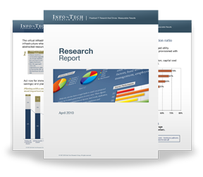
Info-Tech Research Group Helps IT Professionals To:
Quickly get up to speed with new technologies
Make the right technology purchasing decisions – fast
Deliver critical IT projects, on time and within budget
Manage business expectations
Justify IT spending and prove the value of IT
Train IT staff and effectively manage an IT department
Sign up for free trial membership to get practical
solutions for your IT challenges
“Info-Tech helps me to be proactive instead of reactive – a cardinal rule in a stable and leading edge IT environment.
- ARCS Commercial Mortgage Co., LP
Toll Free: 1-888-670-8889
www.infotech.com

