Slide 1

Build a Service Desk Consolidation Strategy
Manage the dark side of growth.

Slide 2


ANALYST PERSPECTIVE
A successful service desk consolidation begins and ends with people.
It’s tempting to focus strategic planning on the processes and technology that will underpin the consolidated service desk. Consistent processes and a reliable tool will cement the consolidation, but they are not what will hold you back.
The most common barrier to a successful consolidation is workforce resistance to change. Cultural difference, perceived risks, and organizational inertia can hinder data gathering, deter collaboration, and impede progress from the start.
Building a consolidated service desk is first and foremost an exercise in organizational change. Garner executive support for the project, enlist a team of volunteers to lead the change, and communicate with key stakeholders early and often. The key is to create a shared vision for the project and engage those who will be most affected.
Sandi Conrad
Senior Director, Infrastructure Practice
Info-Tech Research Group

Slide 3
Our understanding of the problem
CIOs who need to reduce support costs and improve customer service.
IT leaders tasked with the merger of two or more IT organizations.
Service managers implementing a shared service desk tool.
Organizations rationalizing IT service management (ITSM) processes.
Develop a shared vision for the consolidated service desk.
Assess key metrics and report on existing service desk architecture.
Design a target service desk architecture and assess how to meet the new requirements.
Deploy a strategic roadmap to build the consolidated service desk architecture.

Slide 4
Executive summary
Every organization must grow to survive. Good growth makes an organization more agile, responsive, and competitive, which leads to further growth.
The proliferation of service desks is a hallmark of good growth when it empowers the service of diverse end users, geographies, or technologies.
Every step should put people first. It’s tempting to focus the strategy on designing processes and technologies for the target architecture. However, the most common barrier to success is workforce resistance to change.
A consolidated service desk is an investment, not a cost-reduction program. Focus on efficiency, customer service, and end-user satisfaction. Cost savings, and there will be many, should be seen as an indirect consequence of the pursuit of efficiency and customer service.
Growth has its dark side. Bad growth within a business can hinder agility, responsiveness, and competitiveness, leading to stagnation.
Supporting a large number of service desks can be costly and inefficient, and produce poor or inconsistent customer service, especially when each service desk uses different ITSM processes and technologies.
Manage the dark side of growth. Consolidating service desks can help standardize ITSM processes, improve customer service, improve service desk efficiency, and reduce total support costs. A consolidation is a highly visible and mission critical project, and one that will change the public face of IT. Organizations need to get it right.
Building a consolidated service desk is an exercise in organizational change. The success of the project will hinge on how well the organization engages those who will be most affected by the change. Build a guiding coalition for the project, create a shared vision, enlist a team of volunteers to lead the change, and communicate with key stakeholders early and often.
Use a structured approach to facilitate the development of a shared strategic vision, design a detailed consolidated architecture, and anticipate resistance to change to ensure the organization reaps project benefits.

Slide 5
Focus the service desk consolidation project on improving customer service to overcome resistance to change
Emphasizing cost reduction as the most important motivation for the consolidation project is risky.
End users, IT leaders, and process owners recognize the importance of the service desk.
End-user satisfaction is a more reliable measure of a successful consolidation.
Too many variables affect the impact of the consolidation on the operating costs of the service desk to predict the outcome reliably.
Potential reductions in costs are unlikely to overcome organizational resistance to change.
Successful service desk consolidations can increase ticket volume as agents capture tickets more consistently and increase customer service.
The project will generate many cost savings, but they will take time to manifest, and are best seen as an indirect consequence of the pursuit of customer service.
On average, IT leaders and process owners rank the service desk 2nd in terms of importance out of 45 core IT processes.
Source: Info-Tech Research Group, Management and Governance Diagnostic (2015, n = 486)
2nd
out of 45
On average, end users who were satisfied with service desk effectiveness rated all other IT services 42.1% higher than dissatisfied end users.
Source: Info-Tech Research Group, End-User Satisfaction Survey (2015, n = 133)
42.1%
Info-Tech Insight
Business units facing a service desk consolidation are often concerned that the project will lead to a loss of access to IT resources. Focus on building a customer-focused consolidated service desk to assuage those fears and earn their support.
On average, end users who were satisfied with service desk timeliness rated all other IT services 38.0% higher than dissatisfied end users.
Source: Info-Tech Research Group, End-User Satisfaction Survey (2015, n = 133)
38.0%

Slide 6
Overcome the perceived barriers from differing service unit cultures to pursue a consolidated service desk (CSD)
Island cultures are the largest barrier to consolidation
In most organizations, the greatest hurdles that consolidation projects face are related to people rather than process or technology.
In a survey of 168 service delivery organizations without a consolidated service desk, the Service Desk Institute found that the largest internal barrier to putting in place a consolidated service desk was organizational resistance to change.
Specifically, more than 56% of respondents reported that the different cultures of each service
unit would hinder the level of collaboration such an initiative
would require.
Service Desk Institute (n = 168, 2007)
Info-Tech Insight
Use a phased approach to overcome resistance to change. Focus on quick-win implementations that bring two or three service desks together in a short time frame and add additional service desks over time.

Slide 7
Avoid the costly proliferation of service desks that can come with organizational growth
Good and bad growth
Challenges arising from service desk proliferation:
Every organization must grow to survive, and relies heavily on its IT infrastructure to do that. Good growth makes an organization more agile, responsive, and competitive, and leads to further growth.
However, growth has its dark side. Bad growth hobbles agility, responsiveness, and competitiveness, and leads to stagnation.
Challenge
Impact
Incompatible
Technologies
Inability to negotiate volume discounts.
Costly skill set maintenance.
Increased support costs.
Increased shadow IT.
As organizations grow organically and through mergers, their IT functions create multiple service desks across the enterprise to support:
  Large, diverse user constituencies.
  Rapidly increasing call volumes.
  Broader geographic coverage.
  A growing range of products and services.
A hallmark of bad growth is the proliferation of redundant and often incompatible ITSM services and processes.
Inconsistent Processes
Low efficiency.
High support costs.
Inconsistent support quality.
Less staffing flexibility.
Lack of Data Integration
Only partial view of IT.
Inefficient workflows.
Limited troubleshooting ability.
Project triggers:
  Organizational mergers
  ITSM tool purchase
  Service quality or cost-reduction initiatives
Low Customer Satisfaction
Fewer IT supporters.
Lack of organizational support.

Slide 8
Consolidate service desks to integrate the resources, processes, and technology of your support ecosystem
What project benefits can you anticipate?
A successful consolidation can significantly reduce cost per transaction, speed up service delivery, and improve the customer experience through:
  Single point of contact for end users.
  Integrated ITSM solution where it makes sense.
  Standardized processes.
  Staffing integration.
Consolidated Service Desk
End-user group #1
End-user group #2
End-user group #3
End-user group #4
Project Outcome | Expected Benefit
Integrated information | The capacity to produce quick, accurate, and segmented reports of service levels across the organization.
Integrated staffing | Flexible management of resources that better responds to organizational needs.
Integrated technology | Reduced tool procurement costs, improved data integration, and increased information security.
Standardized processes | Efficient and timely customer service and a more consistent customer experience.

Slide 9
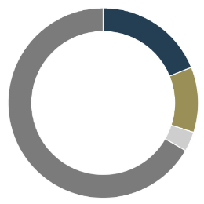
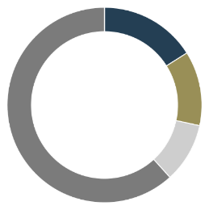
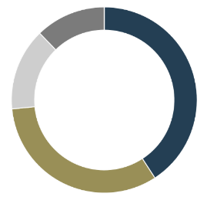
Standardized and consolidated service desks will optimize infrastructure, services, and resources benefits
To set up a functioning service desk, the organization will need to invest resources to build and integrate tier 1, tier 2, and tier 3 capabilities to manage incidents and requests.
The typical service desk (Figure 1) can address a certain number of tickets from all three tiers. If your tickets in a given tier are less than that number, you are paying for 100% of service costs but consuming only a portion of it.
The consolidated model (Figure 2) reduces the service cost by reducing unused capacity.
Benefits of consolidation include a single service desk solution, a single point of contact for the business, data integration, process standardization, and consolidated administration, reporting, and management.
Service Desk 1
Service Desk 2
Figure 1 – Service provisioning with
distinct service desks
Figure 2 – Service provisioning with
Consolidated service providers
Tier 1 capacity
Tier 2 capacity
Tier 3 capacity
Unused capacity

Slide 10

Info-Tech’s approach to service desk consolidation draws on key metrics to establish a baseline and a target state
Info-Tech Insight
The foundation of a successful service desk consolidation initiative is a robust current state assessment. Given the project’s complexity, however, determining the right level of detail to include in the evaluation of existing service desks can be challenging.
The Info-Tech approach to service desk consolidation includes:
Envisioning exercises to set project scope and garner executive support.
Surveys and interviews to identify the current state of people, processes, technologies, and service level agreements (SLAs) in each service desk, and to establish a baseline for the consolidated service desk.
Service desk comparison tools to gather the results of the current state assessment for analysis and identify current best practices for migration to the consolidated service desk.
Case studies to illustrate the full scope of the project and identify how different organizations deal with key challenges.
The two key hurdles that a successful service desk consolidation must overcome are organizational complexity and resistance to change.
Effective planning during the current state assessment can overcome these challenges.
Identify existing best practices for migration to the consolidated service desk to foster agent engagement and get the consolidated service desk up quickly.
The project blueprint walks through a method that helps identify which processes and technologies from each service desk work best, and it draws on them to build a target state for the consolidated service desk.
Inspiring your target state from internal tools and best practices is much more efficient than developing new tools and processes from scratch.

Slide 11
A consolidation project should include the following steps and may involve multiple transition phases to complete
Phase 1:
Develop a Shared Vision
Phase 2:
Design the Consolidation
Phase 3:
Plan the Transition
Identify stakeholders
Develop vision
Measure baseline
Design
target state
Evaluate
and prepare for next transition phase (if applicable)
Evaluate
and stabilize
CSI
Assess
gaps to
reach
target
Make the transition
Whether or not your project requires multiple transition waves to complete the consolidation depends on the complexity of the environment.
For a more detailed breakdown of this project’s steps and deliverables, see the next slide.
Assess logistics and cost
Communicate changes
Develop project plan and roadmap

Slide 12
Follow Info-Tech’s methodology to develop a service desk consolidation strategy
Phase 1: Develop a Shared Vision
Phase 2: Design the Consolidated Service Desk
Phase 3: Plan the Transition
Phases
Steps
1.1
Identify and engage key stakeholders
2.1
Design target consolidated service desk
3.1
Build the project roadmap
1.2
Develop a vision to give the project direction
2.2
Assess logistics and cost of consolidation
3.2
Communicate the change
Conduct a full assessment of each service desk
1.3
Consolidate Service Desk Scorecard Tool
Service Desk Consolidation Roadmap
Tools and Templates
Executive Presentation
Consolidated Service Desk SOP
Communications and Training Plan Template
Consolidate Service Desk Assessment Tool
Service Desk Efficiency Calculator
News Bulletin & FAQ Template
Service Desk Consolidation TCO Comparison Tool

Slide 13



Service desk consolidation is the first of several optimization projects focused on building essential best practices
Extend
Facilitate the extension of service management best practices to other business functions to improve productivity and position IT as a strategic partner.
Improve
Build a continual improvement plan for the service desk to review and evaluate key processes and services, and manage the progress of improvement initiatives.
Info-Tech’s
Service Desk
Methodology aligns with the ITIL framework
Standardize
Build essential incident, service request, and knowledge management processes to create a sustainable service desk that meets business needs.
Adopt Lean
Build essential incident, service request, and knowledge management processes to create a sustainable service desk that boosts business value.
Our Approach to the Service Desk
Service desk optimization goes beyond the blind adoption of best practices.
Info-Tech’s approach focuses on controlling support costs and making the most of IT’s service management expertise to improve productivity.
Complete the projects sequentially
or in any order.
Select and Implement
Review mid-market and enterprise service desk tools, select an ITSM solution, and build an implementation plan to ensure your investment meets your needs.
Consolidate
Build a strategic roadmap to consolidate service desks to reduce end-user support costs and sustain end-user satisfaction.

Slide 14
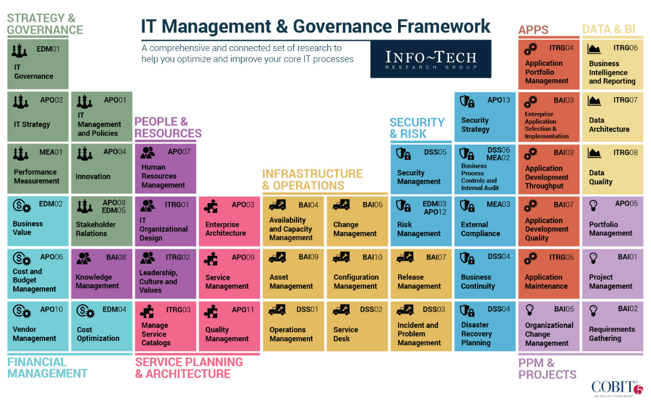
Info-Tech draws on the COBIT framework, which focuses on consistent delivery of IT services across the organization

Slide 15







Oxford University IT Service Desk successfully undertook a consolidation project to merge five help desks into one
Part 1/6
CASE STUDY
Industry
Source
Higher Education
Oxford University, IT Services
Background
Until 2011, three disparate information technology organizations offered IT services, while each college had local IT officers responsible for purchasing and IT management.
ITS Service Desk Consolidation Project
Oxford merged the administration of these three IT organizations into IT Services (ITS) in 2012, and began planning for the consolidation of five independent help desks into a single robust service desk.
Complication
The relative autonomy of the five service desks had led to the proliferation of different tools and processes, licensing headaches, and confusion from end users about where to acquire IT service.
Oxford University IT at a Glance
One of the world’s oldest and most prestigious universities.
36 colleges with 100+ departments.
Over 40,000 IT end users.
Roughly 350 ITS staff in 40 teams.
300 more distributed IT staff.
Offers more than 80 services.
Help Desks
Processes
Processes
Processes
Business Services & Projects
Computing Services
ICT Support Team
IT Services are aiming to provide a consolidated service which provides a unified and coherent experience for users. The aim is to deliver a ‘joined-up’ customer experience when users are asking for any form of help from IT Services. It will be easier for users to obtain support for their IT – whatever the need, service or system.
– Oxford University, IT Services

Slide 16




Info-Tech offers various levels of support to best suit your needs
Guided Implementation
DIY Toolkit
Workshop
Consulting
“Our team has already made this critical project a priority, and we have the time and capability, but some guidance along the way would be helpful.”
“Our team knows that we need to fix a process, but we need assistance to determine where to focus. Some check-ins along the way would help keep us on track.”
“We need to hit the ground running and get this project kicked off immediately. Our team has the ability to take this over once we get a framework and strategy in place.”
“Our team does not have the time or the knowledge to take this project on. We need assistance through the entirety of this project.”
Diagnostics and consistent frameworks used throughout all four options

Slide 17


Use these icons to help direct you as you navigate this research
Use these icons to help guide you through each step of the blueprint and direct you to content related to the recommended activities.
This icon denotes a slide where a supporting Info-Tech tool or template will help you perform the activity or step associated with the slide. Refer to the supporting tool or template to get the best results and proceed to the next step of the project.
This icon denotes a slide with an associated activity. The activity can be performed either as part of your project or with the support of Info-Tech team members, who will come onsite to facilitate a workshop for your organization.

Slide 18

Build a Service Desk Consolidation Strategy – project overview
1. Develop shared vision
2. Design consolidation
3. Plan transition
Best-Practice Toolkit | 1.1 Identify and engage key stakeholders 1.2 Develop a vision to give the project direction 1.3 Conduct a full assessment of each service desk | 2.1 Design target consolidated service desk 2.2 Assess logistics and cost of consolidation | 3.1 Build project roadmap 3.2 Communicate the change
Guided Implementations | Build the project team and define their roles and responsibilities, then identify key stakeholders and formulate an engagement plan Develop an executive visioning session plan to formulate and get buy-in for the goals and vision of the consolidation Use diagnostics results and the service desk assessment tool to evaluate the maturity and environment of each service desk | Define the target state of the consolidated service desk in detail Identify requirements for the consolidation, broken down by people, process, technology and by short- vs. long-term needs Plan the logistics of the consolidation for process, technology, and facilities, and evaluate the cost and cost savings of consolidation with a TCO tool | Identify specific initiatives for the consolidation project and evaluate the risks and dependencies for each, then plot initiatives on a detailed project roadmap Brainstorm potential objections and questions and develop a communications plan with targeted messaging for each stakeholder group
Onsite Workshop | Module 1: Engage stakeholders to develop a vision for the service desk Module 2: Conduct a full assessment of each service desk | Module 3: Design target consolidated service desk | Module 4: Plan for the transition
 | Phase 1 Outcomes: Stakeholder engagement and executive buy-in Vision for the consolidation Comprehensive assessment of each service desk’s performance | Phase 2 Outcomes: Defined requirements, logistics plan, and target state for the consolidated service desk TCO comparison | Phase 3 Outcomes: Detailed consolidation project roadmap Communications plan and FAQs

Slide 19
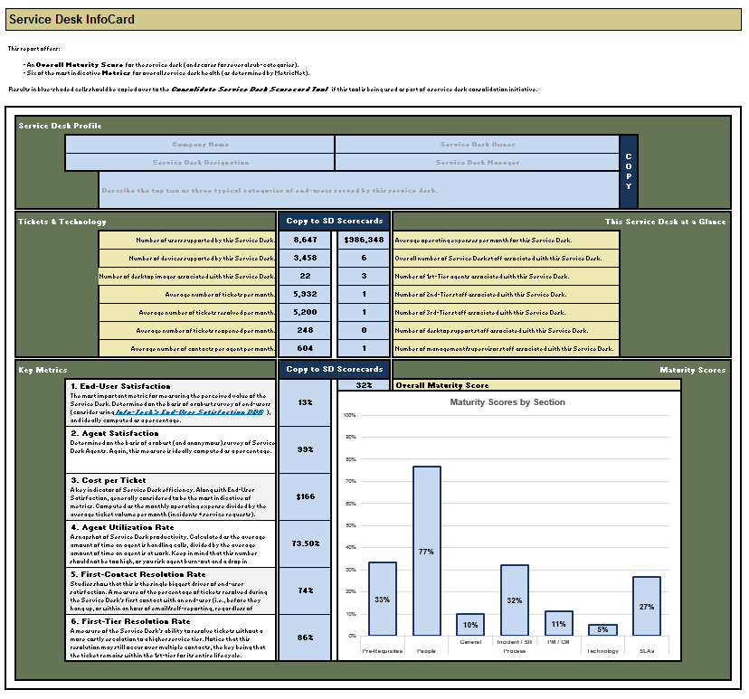
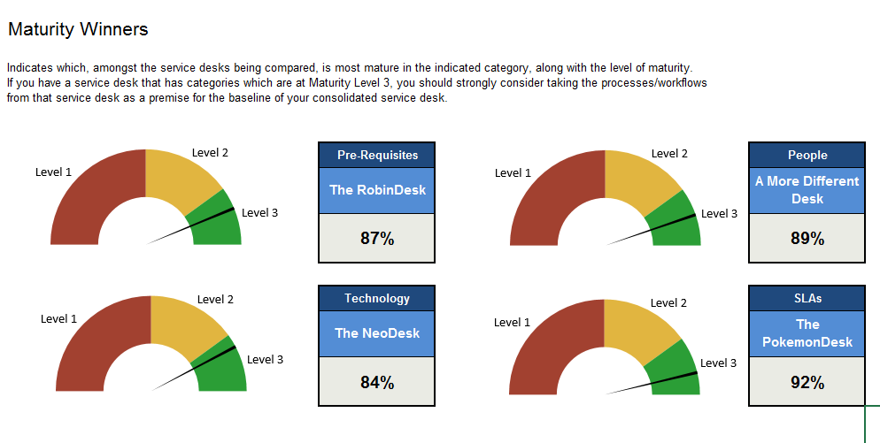
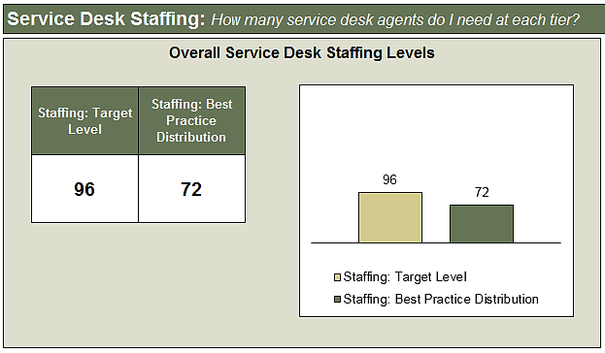
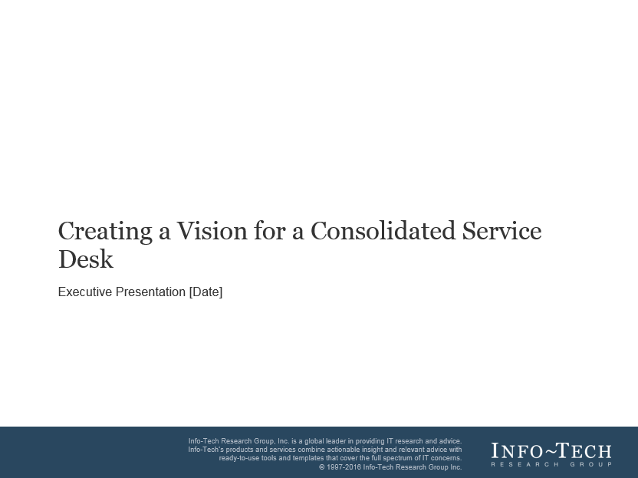
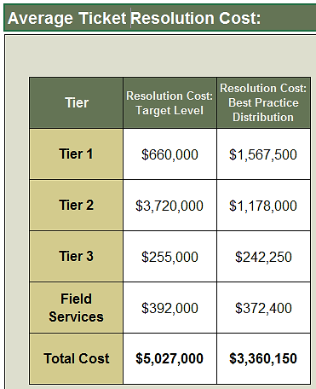
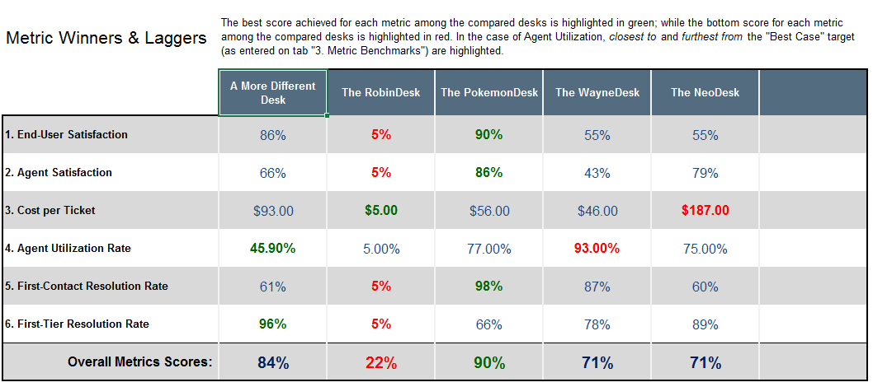
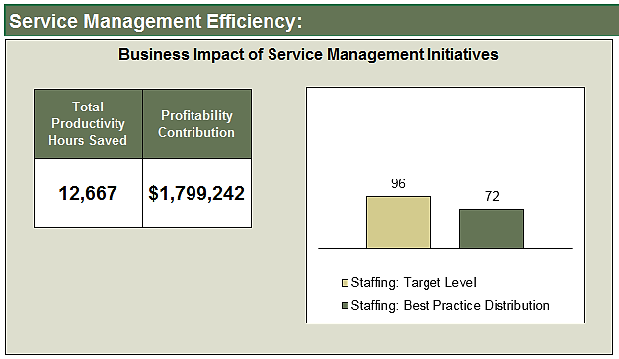
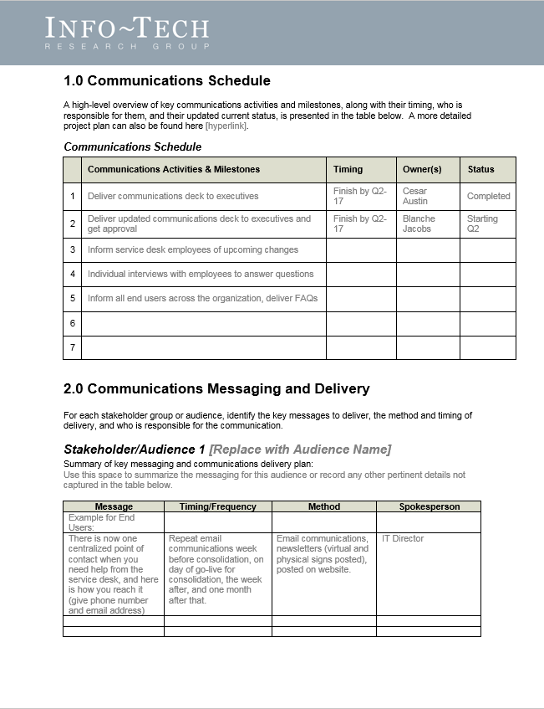
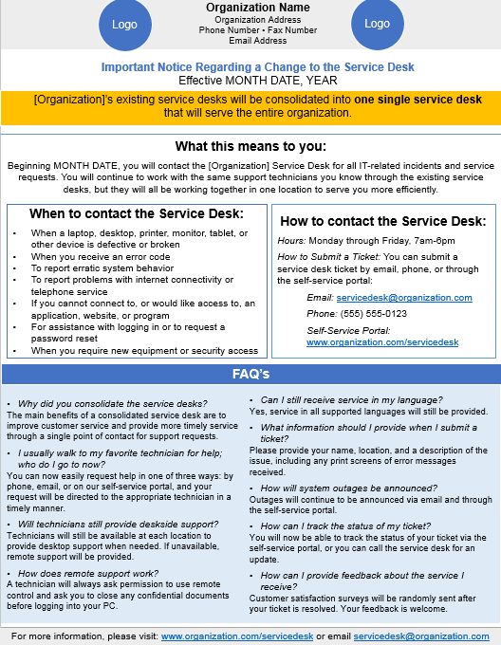
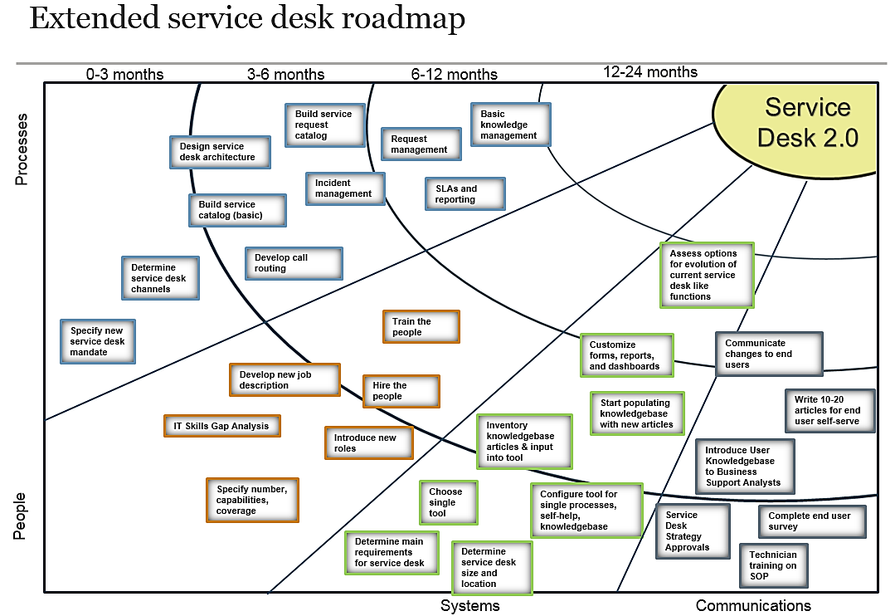
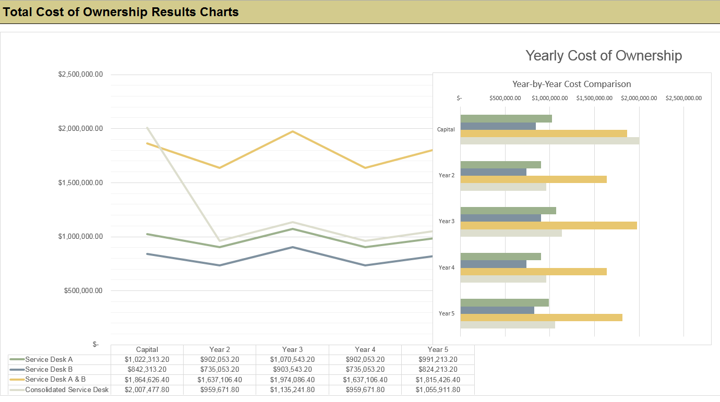
Info-Tech delivers: Use our tools and templates to accelerate your project to completion
Service Desk Assessment Tool (Excel)
Executive
Presentation (PowerPoint)
Service Desk Scorecard Comparison Tool (Excel)
Service Desk
Efficiency Calculator (Excel)
Service Desk
Consolidation Roadmap (Excel)
Service Desk Consolidation TCO Tool (Excel)
Communications and Training Plan (Word)
Consolidation News Bulletin & FAQ Template (PowerPoint)

Slide 20
Measured value for Guided Implementations (GIs)
Engaging in GIs doesn’t just offer valuable project advice, it also results in significant cost savings.
GI | Measured Value
Phase 1: | Time, value, and resources saved by using Info-Tech’s methodology to engage stakeholders, develop a project vision, and assess your current state. For example, 2 FTEs * 10 days * $80,000/year = $6,200
Phase 2: | Time, value, and resources saved by using Info-Tech’s tools and templates to design the consolidated service desk and evaluate cost and logistics. For example, 2 FTEs * 5 days * $80,000/year = $3,100
Phase 3: | Time, value, and resources saved by following Info-Tech’s tools and methodology to build a project roadmap and communications plan. For example, 1 FTE * 5 days * $80,000/year = $1,500
Total savings | $10,800

Slide 21
Workshop overview
Contact your account representative or email Workshops@InfoTech.com for more information.
 | Pre-Workshop | Workshop Day 1 | Workshop Day 2 | Workshop Day 3 | Workshop Day 4
Activities | Module 0: Gather relevant data 0.1 Conduct CIO Business Vision Survey 0.2 Conduct End-User Satisfaction Survey 0.3 Measure Agent Satisfaction | Module 1: Engage stakeholders to develop a vision for the service desk 1.1 Identify key stakeholders and develop an engagement plan 1.2 Brainstorm desired service desk attributes 1.3 Conduct an executive visioning session to craft a vision for the consolidated service desk 1.4 Define project goals, principles, and KPIs | Module 2: Conduct a full assessment of each service desk 2.1 Review the results of diagnostic programs 2.2 Map organizational structure and roles for each service desk 2.3 Assess overall maturity and environment of each service desk 2.4 Assess current information system environment | Module 3: Design target consolidated service desk 3.1 Identify requirements for target consolidated service desk 3.2 Build requirements document and shortlist for ITSM tool 3.3 Use the scorecard comparison tool to assess the gap between existing service desks and target state 3.4 Document standardized processes for new service desk | Module 4: Plan for the transition 4.1 Plan the logistics of the transition 4.2 Assess the cost and savings of consolidation to refine business case 4.3 Identify initiatives and develop a project roadmap 4.4 Plan communications for each stakeholder group
Deliverables | CIO Business Vision Survey Diagnostic Results End-User Satisfaction Survey Diagnostic Results | Stakeholder Engagement Workbook Executive Presentation | Consolidate Service Desk Assessment Tool | Consolidate Service Desk Scorecard Tool Consolidated Service Desk SOP | Consolidation TCO Tool Executive Presentation Consolidation Roadmap Communications Plan News Bulletin & FAQ Template

Slide 22
Insight breakdown
Phase 1 Insight
How we can help
Don’t get bogged down in the details. A detailed current state assessment is a necessary first step for a consolidation project, but determining the right level of detail to include in the evaluation can be challenging. Gather enough data to establish a baseline and make an informed decision about how to consolidate, but don’t waste time collecting and evaluating unnecessary information that will only distract and slow down the project, losing management interest and buy-in.
Leverage the Consolidate Service Desk Assessment Tool to gather the data you need to evaluate your existing service desks.
How we can help
Phase 2 Insight
Select the target state that is right for your organization. Don’t feel pressured to move to a complete consolidation with a single point of contact if it wouldn’t be compatible with your organization’s needs and abilities, or if it wouldn’t be adopted by your end users. Design an appropriate level of standardization and centralization for the service desk and reinforce and improve processes moving forward.
Leverage the Consolidate Service Desk Scorecard Tool to analyze the gap between your existing processes and your target state.
Phase 3 Insight
How we can help
Getting people on board is key to the success of the consolidation, and a communication plan is essential to do so. Develop targeted messaging for each stakeholder group, keeping in mind that your end users are just as critical to success as your staff. Know your audience, communicate to them often and openly, and ensure that every communication has a purpose.
Leverage the Communications Plan and Consolidation News Bulletin & FAQ Template to plan your communications.

