Slide 1

Craft a Cloud Strategy for the Enterprise Database
There’s no cloud. There’s just the database.

Slide 2


ANALYST PERSPECTIVE
There’s no cloud. There’s just the database.
You need to know if the database is ready for the cloud – not just if the cloud is ready for the database.
The cloud is inevitable, but not for all workloads, and not right away. Don’t do everything at once. Prioritize quick wins that can seed success for more complex projects in the future.
Then, take a deep dive to assess the risks that face workloads in the cloud. Too often, challenges are only apparent after the move. Do due diligence. Identify risks, draft mitigation strategies, and create a plan for deployment and beyond.
Andrew Sharp
Consulting Analyst, Infrastructure
Info-Tech Research Group

Slide 3
Our understanding of the problem
IT Infrastructure Managers
Data and Enterprise Architects
Chief Technology Officers
Integrate existing enterprise databases in the overarching cloud strategy.
Identify value opportunities to move.
Navigate stakeholder needs and expectations.
Communicate results to project sponsors.
Business stakeholders
Applications managers
Enterprise risk managers
Understand risks and rewards of deploying enterprise databases to the cloud.
Understand the terminology around cloud technologies.

Slide 4
Executive summary
Enterprise database licensing, deployment, and maintenance are among the most complex and expensive activities in IT.
Leadership wants to leverage cloud deployments to reduce management costs, convert capital expenditure (Capex) to operational expenditure (Opex), and enable scale on demand, all with only paying for resources when used.
There’s no cloud – there’s just the database.
It’s not enough to decide if the cloud is ready for the database – you must assess whether the database workload is ready for the cloud.
It’s not “no” – it’s “not now.”
Prioritize databases that are ready to move and present considerable opportunities to create business value. Wait on the rest.
Not all databases present a use case for a cloud deployment.
The effort required to re-platform enterprise systems for the cloud can erode perceived savings.
IT may not have the skills to deploy, integrate, and support enterprise systems in the cloud.
Identify database workloads to move to the cloud via a holistic cloud strategy; avoid an ad hoc approach that’s more expensive, time-consuming, and can leave you with blind spots.
Review your current environment and attitudes toward cloud technologies to ensure your stakeholders are on the same page.
Look before you leap; identify risks and mitigation strategies associated with moving the enterprise database to the cloud.
Vendors will be much more tightly integrated into your ability to deliver services. Review vendor best practices, and move from ad hoc vendor management to a defined process.

Slide 5



There are real opportunities to create value by moving the right database to the cloud…
37%
Putting the database in the cloud allowed us to efficiently and securely provide access to our vendors and clients.
– Lloyd Brathwaite, IT Infrastructure Manager
Duplicating on-premises infrastructure to a DR data center is prohibitively expensive… a cloud-based DR deployment is more attractive because [cloud providers] typically use a pay-as-you-use pricing model.
– David Rahbany,
Director of Enterprise IT Infrastructure
We’re seeing the pervasiveness of cloud disrupt industries across the board as companies look to maximize and implement cloud as a strategic and integral technology.
– Jim Moran, General Partner, North Bridge
of cloud users report decreased costs. ¹
57%
report greater scalability. ¹
62%
report improved access to infrastructure. ¹
Meanwhile,
81%
of sales and marketing activities
are in the cloud. ²
79%
of customer service activities are cloud based. ²
74%
of HR and payroll activities take place in the cloud. ²
1. RightScale, 2016.
2. North Bridge Partners, Wikibon. Future of Cloud Computing Survey, 2015.

Slide 6

…but migrating the wrong database can result in negative ROI
The challenges may not be where you think they are.
Select databases and data sets that could serve as a pilot project, and perform a review to ensure the expected reward justifies the risk.
Cloud Challenges
Migration complexity
Latency
Data residency
Vendor lock-in
Legacy infrastructure
Legacy platforms
Application integration
Resources and staff skills
Cost control
Regulation and compliance
Availability and reliability
Security and privacy
Cloud governance
Vendor management
26%
A quarter of respondents indicated cost control was a problem in 2016, up from 18% in 2013.¹
32%
Almost a third cited a lack of resources or expertise as a challenge. ¹
41%
Almost half of all IT decision makers thought “managing cloud vendors is confusing and challenging” ² – and the same number didn’t know what application data was stored in the cloud. ³
47%
Decision makers felt they had “less control over their information estate” as it moved into the cloud. ³
The cloud is not:
A silver bullet
A cheaper deployment option
A mysterious technology
Something to fear
1. RightScale, 2016.
2. KPMG, 2014.
3. NTT Communications, 2015.

Slide 7

Follow Info-Tech’s methodology to craft a strategy for the database in the cloud
Phase 1: Review the value opportunity
Phase 2: Document and mitigate cloud database risks
Phase 3: Complete the cloud database strategy
Review cloud definitions and assess your current state
Identify the risk to your deployment and develop a risk register
Review vendors and contractual best practices
Identify and prioritize use cases for cloud database deployment
Develop mitigation strategies
Measure performance and total cost
Assess value and readiness for cloud candidates
Evaluate mitigation strategies and develop a roadmap
Develop SOPs and document strategy
Cloud Database Workbook
Executive Presentation Template
Mitigation Strategy Roadmap
Project Charter
TCO Calculator

Slide 8

The cloud is inevitable, but not for all workloads, and not right away
1
PHASE
Databases are stateful. Migration without downtime requires significant planning and can be complex.
Where can moving the database to the cloud provide value?
Can on-demand scalability relieve bottlenecks or allow the development team to be more agile?
Could a cloud deployment allow IT to avoid major capital expenditures?
How ready is the database to move to the cloud?
Not all versions of database software are supported by cloud providers.
Not all cloud versions of database engines can deliver the same functionality.
Re-architecting and additional development of existing databases and applications can be prohibitively expensive.
Care is required to ensure that the move to a new platform doesn’t negatively impact the development team.
It’s crucial to identify the cost and difficulty of repatriating data if the cloud option doesn’t work out. The high cost of extracting data could effectively lock the business into a single cloud provider.
Good to Go
This database is ready for the cloud
Readiness
Caution!
Some work required ahead of migration
No-Go Right Now
Lots of work to be done and/or more maturity required
Value

Slide 9
Take the time to identify and rightsize risks to avoid headaches later
2
PHASE
Cloud migrations for the database are often complex. Compare the value opportunities and cloud readiness of each database from the perspective of people, processes, and technology.
1
List the risks of a move to cloud for each database workload that is a candidate for deployment to Infrastructure as a Service (IaaS) or Platform as a Service (PaaS). Don’t debate the severity of the risks at this stage – just focus on getting them all documented.
Review the risks. While some risks can prevent you from migrating to a cloud solution, many can be accepted as is or mitigated. Decide whether to mitigate or accept each of the risks identified.
Develop mitigation strategies that can bring risk to a level that’s acceptable to the business.
Review the mitigation strategies you’ve identified, and estimate the time, effort, and cost required to implement them. The numbers don’t need to be perfect; it’s a sanity check, not an approval exercise. The cost of the mitigation may mean that you choose to accept the risk.
Info-Tech’s Five Areas of Cloud Risk
Security and Compliance
Availability and Reliability
2
Cloud
Strategy
Enabling Technologies
Data and App Integration
3
4
IT Skills and Resources
Most enterprises want to move directly to the cloud as quickly as possible. They’ve made commitments to their leadership, they have lease contracts coming up, they're working against deadlines, and a lot of this stuff gets tossed out the window. And that's normally when mistakes occur.
– David Linthicum, SVP, Cloud Technology Partners

Slide 10
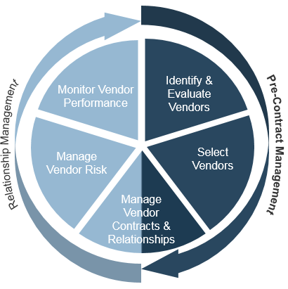
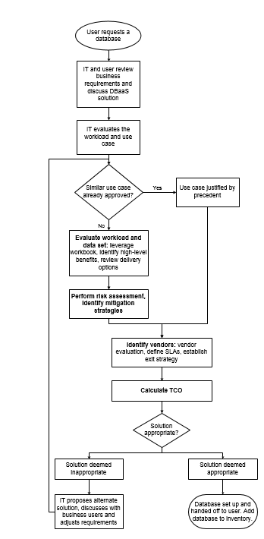
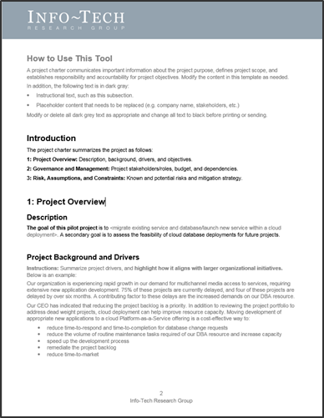
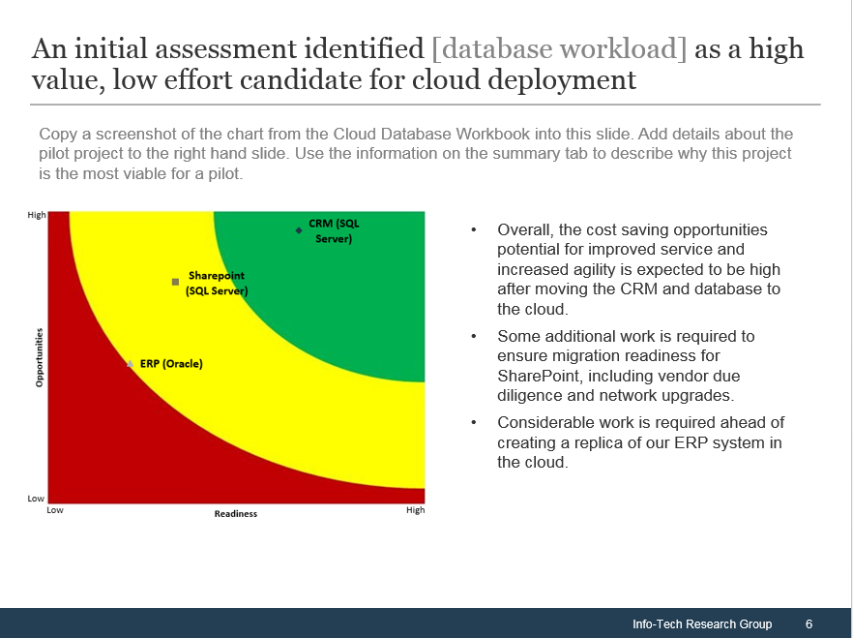
Look beyond the migration
3
PHASE
Moving to the cloud will significantly change how you provide value to the business.
Evaluate IT’s longer term role and create processes to make cloud database provisioning repeatable.
You need to assign experienced staff to requirements gathering and vendor management – which will become a more important role.
Review major public cloud vendors and vendor offerings.
Develop SOPs for cloud database provisioning and management. Streamline the process. Make the documentation usable and the process repeatable.
Summarize your cloud strategy for stakeholders. Let them know why you’re moving to cloud, how you’re managing the risks, and what you need from them.
Create a project charter and get sign-off.

Slide 11
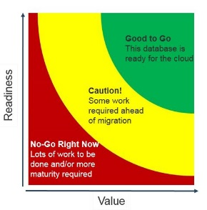
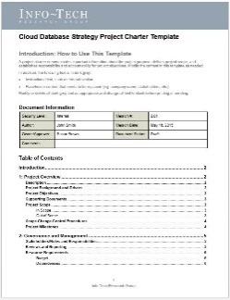
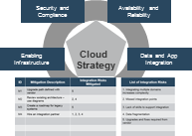
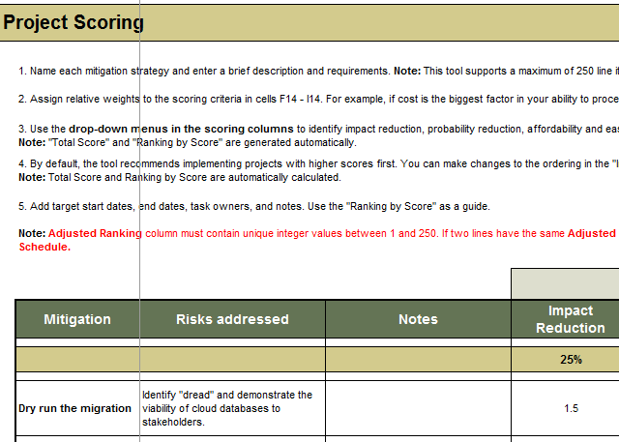
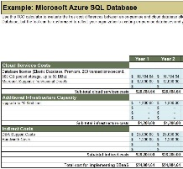
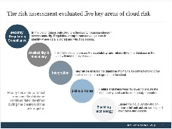
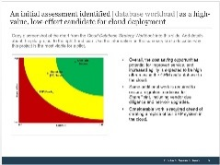
Info-Tech delivers: Use our tools and templates to accelerate your project to completion
1
5
6
2
3
4
7
Risk Register
Identify cloud risks and mitigation strategies.
TCO Tool
Calculate 6-year TCO for a pilot deployment.
Charter
Get sign-off for the pilot deployment.
Decision Matrix
Evaluate which workloads will require the least effort for the highest payoff.
Mitigation Roadmap
Prioritize mitigation strategies. Develop a project workflow and timelines.
SOP Template
Leverage Info-Tech’s example to create SOPs for cloud DB provisioning and upkeep.
Exec Presentation
Communicate high-level project goals and needs.

Slide 12


Thomas Publishing discovers options to deliver value with cloud databases by carefully evaluating its existing environment
CASE STUDY
Industry
Source
Industry Research
Amazon Customer Story
Situation
Thomas Publishing connects buyers to suppliers across a range of industrial sectors. In recent years, it has transformed its renowned industry registry into a digital service. As it moved to a digital-first offering, the technology team urgently needed to develop the capacity to host and manage rapidly growing volumes of data in order to deliver results faster.
Complication
According to Hans Wald, Thomas Publishing CTO, the company was “confronted with unattractive options requiring significant upfront investment in both infrastructure and Oracle license expense.” Yet at first glance, the cloud was not an option either. It was assumed significant effort was required to modify the company’s legacy PL/SQL code base.
Action
After a careful evaluation, the team discovered that most of the migration could be automated using Amazon’s migration services, enabling them to move more databases to cloud and leverage the scalable, on-demand capabilities of cloud services.
Faced with constraints on internal infrastructure, Thomas Publishing was able to identify the cloud as a viable option.
Rapidly growing volumes of data
Need to deliver results on shorter timelines
Additional licensing spend required
Additional infrastructure Capex required
Analysis identifies cloud as a viable option

Slide 13
Measured Value for Guided Implementations
Engaging in GIs doesn’t just offer valuable project advice, it also results in significant cost savings.
GI | Measured Value
Phase 1: Review the value opportunity | Time and resources saved using Info-Tech’s assessment and Decision Matrix to systematically identify database workloads that are ready to move to cloud and will provide the most value from a deployment. For example: 2 FTEs * 5 days * $80,000/year = $3,200
Phase 2: Document and mitigate cloud database risks | Time and resources saved using our best-practice guidance to develop a risk register and mitigation strategies. For example: 4 FTEs * 5 days * $80,000/year = $6,400
Phase 3: Complete the cloud database strategy | Time and resources saved using tools and templates to present stakeholders with project expectations, risks, needs, and next steps. For example: 2 FTEs * 2 days * $80,000/year = $1,280
Total Savings | $10,880

Slide 14


Use these icons to help direct you as you navigate this research
Use these icons to help guide you through each step of the blueprint and direct you to content related to the recommended activities.
This icon denotes a slide where a supporting Info-Tech tool or template will help you perform the activity or step associated with the slide. Refer to the supporting tool or template to get the best results and proceed to the next step of the project.
This icon denotes a slide with an associated activity. The activity can be performed either as part of your project or with the support of Info-Tech team members, who will come onsite to facilitate a workshop for your organization.
1.1
1.2
1.3
Look for these icons at the top right of the slide to help you navigate through the three phases of the blueprint.

Slide 15




Info-Tech offers various levels of support to best suit your needs
Guided Implementation
DIY Toolkit
Workshop
Consulting
“Our team has already made this critical project a priority, and we have the time and capability, but some guidance along the way would be helpful.”
“Our team knows that we need to fix a process, but we need assistance to determine where to focus. Some check-ins along the way would help keep us on track.”
“We need to hit the ground running and get this project kicked off immediately. Our team has the ability to take this over once we get a framework and strategy in place.”
“Our team does not have the time or the knowledge to take this project on. We need assistance through the entirety of this project.”
Diagnostics and consistent frameworks used throughout all four options

Slide 16

Craft a cloud strategy for the enterprise database – project overview
1. Review the value opportunity
2. Document and mitigate cloud database risks
3. Complete the cloud database strategy
Best-Practice Toolkit | 1.1 Review cloud definitions and assess your current state 1.2 Identify and prioritize use cases for cloud database deployment 1.3 Assess value and readiness for cloud candidates | 2.1 Identify the risk to your deployment and develop a risk register 2.2 Develop mitigation strategies 2.3 Evaluate mitigation strategies and develop a roadmap | 3.1 Review vendors and contractual best practices 3.2 Measure performance and total cost 3.3 Develop SOPs and document strategy
Guided Implementations | Review project drivers, existing deployments and initiatives, and current processes; discuss cloud deployment options. Review potential use cases for the database in the cloud. Complete the readiness-value exercise. | Review project risks and develop a risk register for all workloads. Assess risk impact. Look back over project risks. Identify mitigation strategies to rightsize project risks. Score mitigation strategies, run a tabletop exercise, and create a roadmap. | Review the structure of your requirements gathering process. Discuss potential vendors. Develop performance metrics based on vendor requirements, value opportunities, and risks. Review the charter and executive presentation.
Onsite Workshop | Module 1: Use the current state as a springboard to identify cloud deployment opportunities. | Module 2: Identify and rightsize risks. | Module 3: Establish vendor best practices, create repeatable processes, and document the strategy.
 | Phase 1 Outcome: Document the current state and select workloads for a deep dive in phase 2. | Phase 2 Outcome: Identify risks and mitigation strategies, and develop a mitigation roadmap. | Phase 3 Outcome: Create a plan for the future and communicate the cloud strategy.

Slide 17
Workshop overview
Contact your account representative or email Workshops@InfoTech.com for more information.
 | Workshop Prep | Workshop Day 1 | Workshop Day 2 | Workshop Day 3 | Workshop Day 4
Activities | Create a team and set the pilot project scope Create a cloud migration project team, and define roles and responsibilities. Establish parameters for the project. Identify workloads that can be considered for a pilot migration. | Assess cloud value opportunities 1.1 Review current state as a team. 1.2 Review cloud terminology – get everyone on the same page. 1.3 Identify and prioritize cloud database use cases. 1.4 Complete the value assessment. | Identify cloud migration risks 2.1 Complete readiness assessment. 2.2 Review and discuss decision matrix. 2.3 Assess risks for the specific database workload. | Rightsize risks with mitigation strategies 3.1 Identify mitigation strategies to address risks. 3.2 Score and prioritize mitigation strategies. 3.3 Conduct tabletop planning to build a roadmap. | Complete the cloud database strategy 4.1 Review vendor and contracting best practices. Discuss potential vendors. Assign requirements gathering tasks. 4.2 Develop metrics to track vendor performance and project success. 4.3 Develop repeatable provisioning SOPs. 4.4 Summarize workshop results.
Deliverables | Defined IT mandate | Cloud Database Workbook | Cloud Database Workbook Risk Register | Cloud Database Workbook Mitigation Roadmap | TCO Calculator Cloud Database Project Charter Executive Presentation

