Slide 1
Implement Risk-Based Vulnerability Management
Get off the patching merry-go-round and start mitigating risk!
EXECUTIVE BRIEF

Slide 2
Table of Contents
4 Analyst Perspective
5 Executive Summary
6 Common Obstacles
8 Risk-based approach to vulnerability management
16 Step 1.1: Vulnerability management defined
24 Step 1.2: Defining scope and roles
34 Step 1.3: Cloud considerations for vulnerability management
33 Step 1.4: Vulnerability detection
46 Step 2.1: Triage vulnerabilities
51 Step 2.2: Determine high-level business criticality
56 Step 2.3: Consider current security posture
61 Step 2.4: Risk assessment of vulnerabilities
71 Step 3.1: Assessing remediation options

Slide 3
Table of Contents
80 Step 3.2: Scheduling and executing remediation
85 Step 3.3: Continuous improvement
89 Step 4.1: Metrics, KPIs, and CSFs
94 Step 4.2: Vulnerability management policy
97 Step 4.3: Select & implement a scanning tool
107 Step 4.4: Penetration testing
118 Summary of accomplishment
119 Additional Support
120 Bibliography

Slide 4
Analyst Perspective
In this age of discovery, technology changes at such a rapid pace. New things are discovered, both in new technology and in old. The pace of change can often be very confusing as to where to start and what to do.
The ever-changing nature of technology means that vulnerabilities will always be present. Taking measures to address these completely will consume all your department’s time and resources. That, and your efforts will quickly become stale as new vulnerabilities are uncovered. Besides, what about the systems that simply can’t be patched? The key is to understand the vulnerabilities and the levels of risk they pose to your organization, to prioritize effectively and to look beyond patching.
A risk-based approach to vulnerability management will ensure you are prioritizing appropriately and protecting the business. Reduce the risk surface!
Vulnerability management is more than just systems and application patching. It is a full process that includes patching, compensating controls, segmentation, segregation, and heightened diligence in security monitoring.
Vulnerabilities will always be present. Know the unknowns!
Jimmy Tom Research Advisor – Security, Privacy, Risk, and Compliance Info-Tech Research Group

Slide 5
Executive Summary
Your Challenge
Common Obstacles
Info-Tech’s Approach
Vulnerability scanners, industry alerts, and penetration tests are revealing more and more vulnerabilities, and it is unclear how to manage them.
Organizations are struggling to prioritize the vulnerabilities for remediation, as there are many factors to consider, including the threat of the vulnerability and the potential remediation option.
Patches are often seen as the answer to vulnerabilities, but these are not always the most suitable solution.
Some systems deemed vulnerable simply cannot be patched or easily replaced.
Companies are unaware of the risk implications that come from leaving the vulnerability open and from the remediation option itself.
Design and implement a vulnerability management program that identifies, prioritizes, and remediates vulnerabilities.
Understand what needs to be considered when implementing remediation options, including patches, configuration changes, and defense-in-depth controls.
Build a process that is easy to understand and allows vulnerabilities to be remediated proactively, instead of in an ad hoc fashion.
Info-Tech Insight
Vulnerability management does not always equal patch management. There is more than one way to tackle the problem, particularly if a system cannot be easily patched or replaced. If a vulnerability cannot be completely remediated, steps to reduce the risk to a tolerable level must be taken.

Slide 6
Common obstacles
CVSS Score Distribution From the National Vulnerability Database:
These barriers make vulnerability management difficult to address for many organizations:
The value of vulnerability management is not well articulated in many organizations. As a result, investment in vulnerability scanning technology is often insufficient.
Many organizations feel that a “patch everything” approach is the most effective path.
Vulnerability management is commonly misunderstood as being a process that only supports patch management.
There is often misalignment between SecOps and ITOps in remediation action and priority, affecting the timeliness of remediation.
Source: NIST National Vulnerability Database Dashboard

Slide 7
Leverage risk to sort, triage, and prioritize vulnerabilities
Reduce your risk surface to avoid cost to your business; everything else is table stakes.
Reduce the critical and high vulnerabilities below the risk threshold and operationalize the remediation of medium/low vulnerabilities by following your effective vulnerability management program cycles.
Identify vulnerability sources
An inventory of your scanning tool and vulnerability threat intelligence data sources will help you determine a viable strategy for addressing vulnerabilities. Defining roles and responsibilities ahead of time will ensure you are not left scrambling when dealing with vulnerabilities.
Triage and prioritize
Bring the vulnerabilities into context by assessing vulnerabilities based on your security posture and mechanisms and not just what your data sources report. This will allow you to gauge the true urgency of the vulnerabilities based on risk and determine an effective mitigation plan.
Remediate vulnerabilities
Address the vulnerabilities based on their level of risk. Patching isn't the only risk mitigation action; some systems simply cannot be patched, but other options are available. Reduce the risk down to medium/low levels and engage your regular operational processes to deal with the latter.
Measure and formalize
Upon implementation of the program, measure with metrics to ensure that the program is successful. Improve the program with each iteration of vulnerability mitigation to ensure continuous improvement.
Tactical Insight 1
All actions to address vulnerabilities should be based on risk and the organization’s established risk tolerance.
Tactical Insight 2
Reduce the risk surface down below the risk threshold.

Slide 8
The industry has shifted to a risk-based approach
Traditional vulnerability management is no longer viable.
“For those of us in the vulnerability management space, ensuring that money, resources, and time are strategically spent is both imperative and difficult. Resources are dwindling fast, but the vulnerability problem sure isn’t. “
– Kenna Security
“Unlike legacy vulnerability management, risk-based vulnerability management goes beyond just discovering vulnerabilities. It helps you understand vulnerability risks with threat context and insight into potential business impact.”
– Tenable
“Using vulnerability scanners to identify unpatched software is no longer enough. Keeping devices, networks, and digital assets safe takes a much broader, risk-based vulnerability management strategy – one that includes vulnerability assessment and mitigation actions that touch the entire ecosystem.”
–Balbix
“A common mistake when prioritizing patching is equating a vulnerability’s Common Vulnerability Scoring System (CVSS) score with risk. Although CVSS scores can provide useful insight into the anatomy of a vulnerability and how it might behave if weaponized, they are standardized and thus don’t reflect either of the highly situational variables — namely, weaponization likelihood and potential impact — that factor into the risk the vulnerability poses to an organization.”
– SecurityWeek

Slide 9
Why a take risk-based approach?
Info-Tech Insight
Taking a risk-based approach will allow you to focus on mitigating risk, rather than “just patching” your environment.
Vulnerabilities, by the numbers
60%
74%
The average cost of a breach in 2020 is $3.86 million, and “…the price tag was much less for mature companies and industries and far higher for firms that had lackluster security automation and incident response processes.”
– Dark Reading
In 2019, 60% of breaches were due to unpatched vulnerabilities.
In the same survey, 74% of survey responses said they cannot take down critical applications and systems to patch them quickly.
Source: SecurityBoulevard, 2019

Slide 11
Info-Tech’s vulnerability management methodology
Focus on developing the most efficient processes.
Vulnerability management isn’t “old school.”
The vulnerability management market is relatively mature; however, vulnerability management remains a very relevant and challenging topic.
Security practitioners are inundated with the advice they need to prioritize their vulnerabilities. Every vulnerability scanning vendor will proclaim their ability to prioritize the identified vulnerabilities.
Third-party prioritization methodology can’t be effectively applied across all organizations. Each organization is too unique with different constraints. No tool or service can account for these variables.
When patching is not possible, other options exist: configuration changes (hardening), defense-in-depth, compensating controls, and even elevated security monitoring are possible options.
Info-Tech Insight
Vulnerability management is not only patch management. Patching is only one aspect.
CVSS Score
Risk Assessment
Vulnerability Urgency
Organization-Specific Remediation Options
Vulnerability Priority
Related Data Classification Level
Business Criticality of Affected System

Slide 12
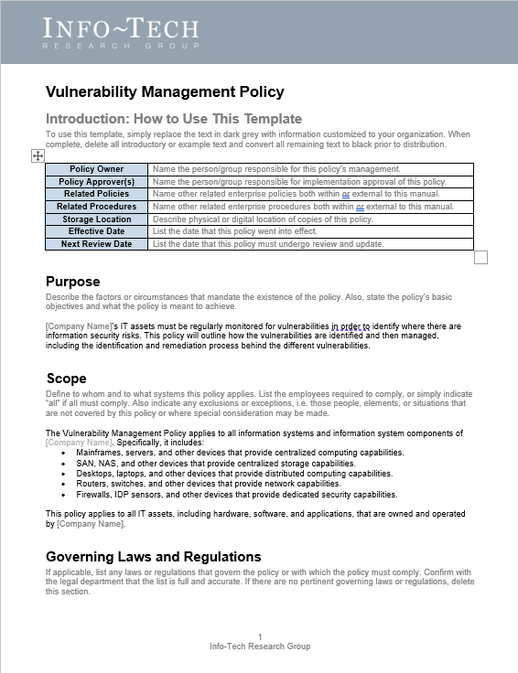
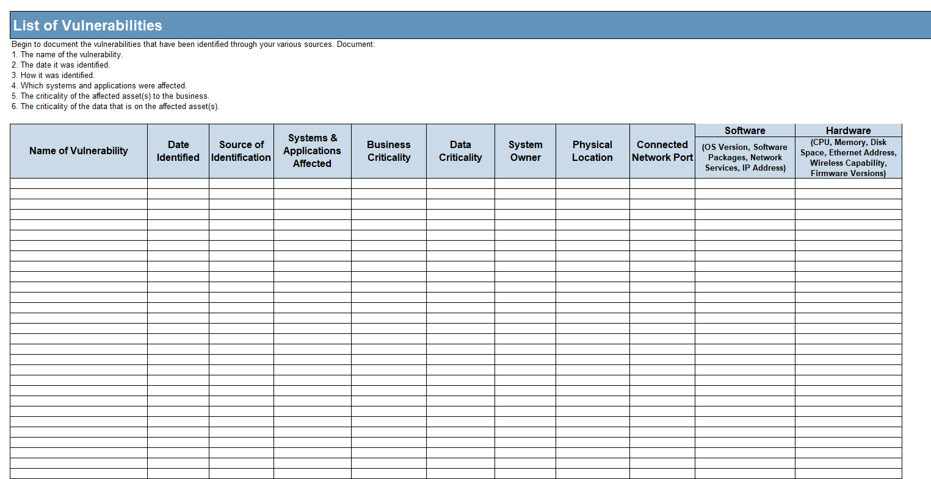
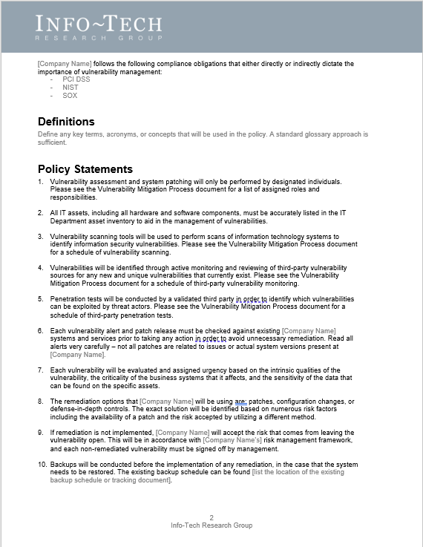
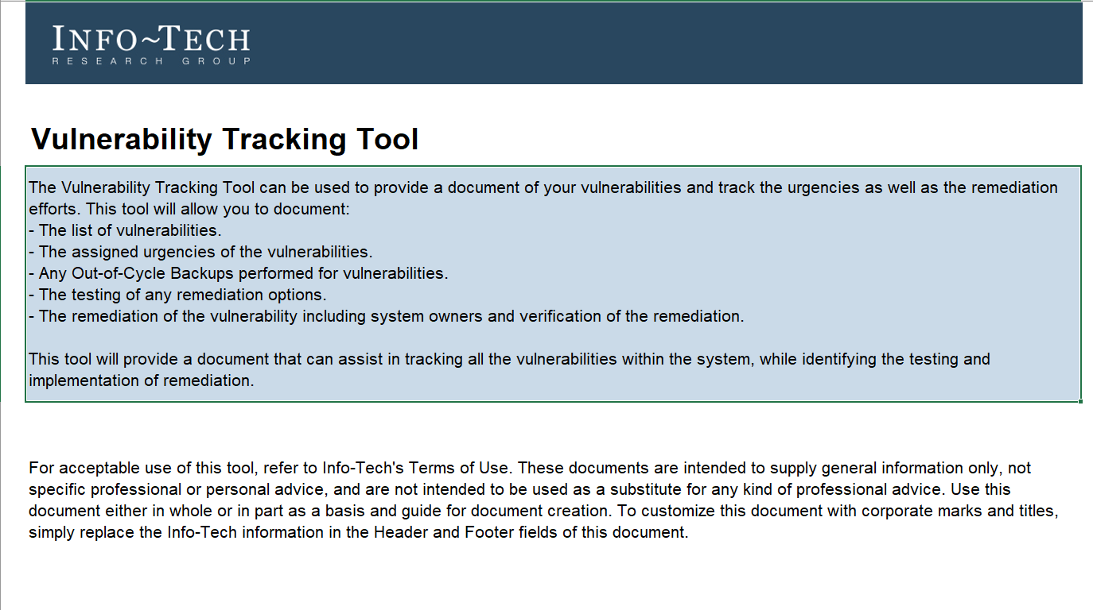
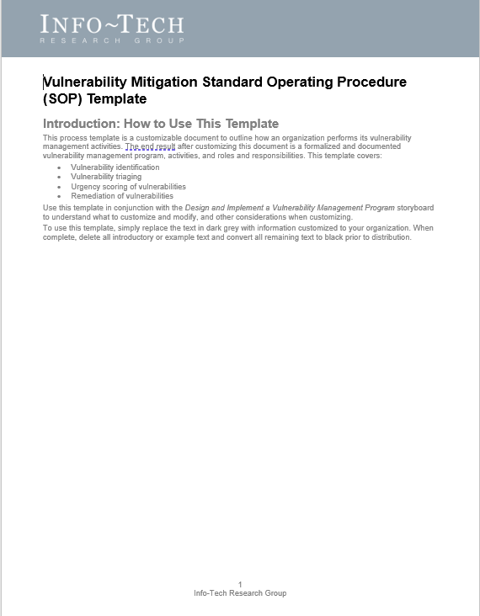
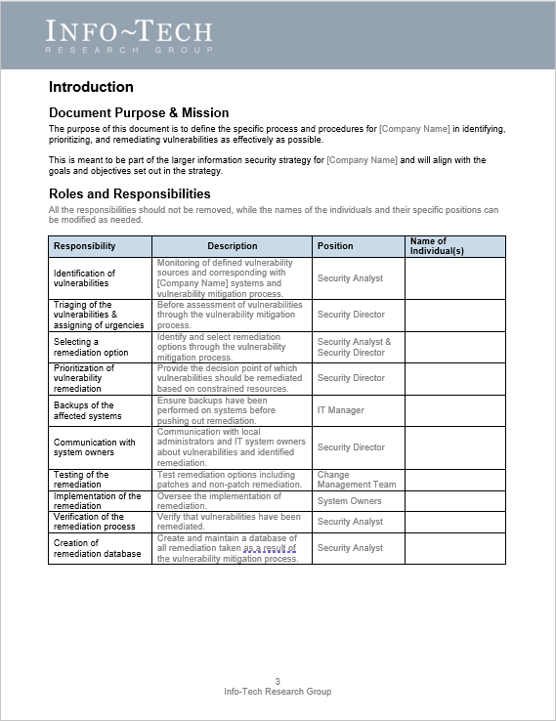
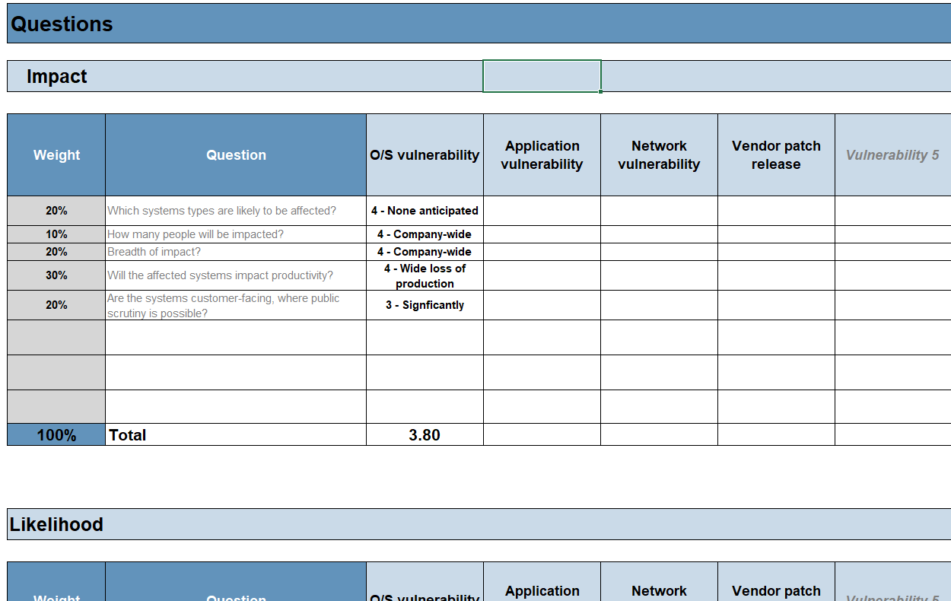
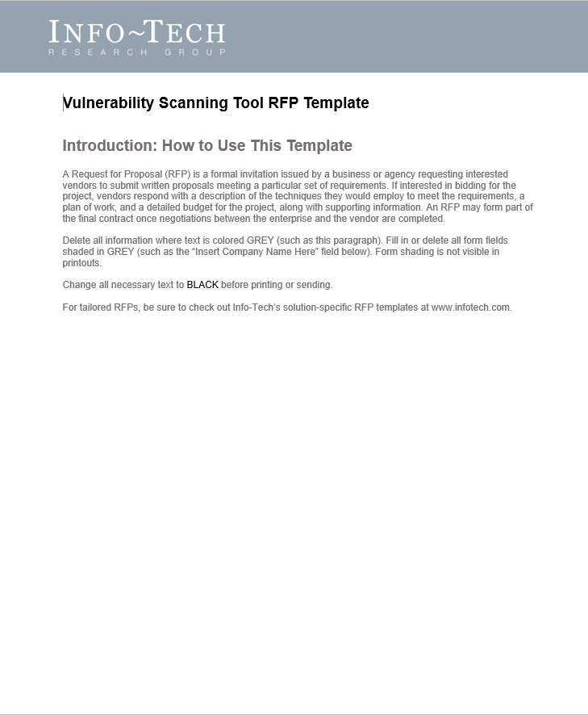
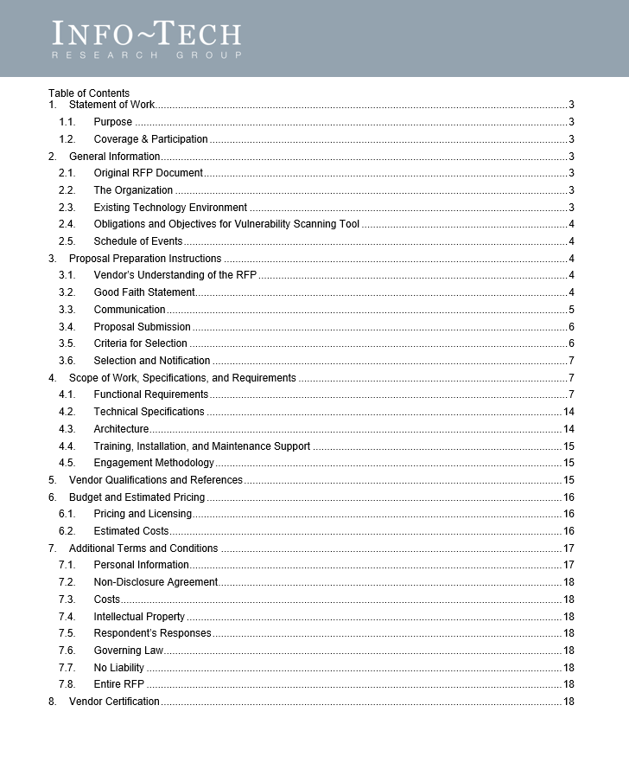
Blueprint deliverables
Key deliverable:
Each step of this blueprint is accompanied by supporting deliverables to help you accomplish your goals:
Vulnerability Management SOP
The Standard operating procedure (SOP) will comprise the end-to-end description of the program: roles & responsibilities, data flow, and expected outcomes of the program.
Vulnerability Management Policy
Vulnerability Tracking Tool
Template for your vulnerability management policy.
This tool offers a template to track vulnerabilities and how they are remedied.
Vulnerability Scanning RFP Template
Vulnerability Risk Assessment Tool
Request for proposal template for the selection of a vulnerability scanning tool.
Methodology to assess vulnerability risk by determining impact and likelihood.

Slide 13
Blueprint benefits
IT Benefits | Business Benefits
A standardized, consistent methodology to assess, prioritize, and remediate vulnerabilities. A risk-based approach that aligns with what’s important to the business. A way of dealing with the high volumes of vulnerabilities that your scanning tool is reporting. Identification of “where to start” in terms of vulnerability management. Ability to not lose yourself in the patch madness but rather take a sound approach to scheduling and prioritizing patches and updates. Knowledge of what to do when patching is simply not possible or feasible. | Alignment with IT in ensuring that business processes are only interrupted when absolutely necessary while maintaining a regular cadence of vulnerability remediation. A consistent program that the business can plan around and predict when interruptions will occur. IT’s new approach being integrated with existing IT operations processes, offering the most efficient yet expedient method of dealing with vulnerabilities.

Slide 14
Info-Tech’s process can save significant financial resources
Phase | Measured Value
Phase 1: Identify vulnerability sources | Define the process, scope, roles, vulnerability sources, and current state Consultant at $100 an hour for 16 hours = $1,600
Phase 2: Triage vulnerabilities and assign urgencies | Establish triaging and vulnerability evaluation process Consultant at $100 an hour for 16 hours = $1,600 Determine high-level business criticality and data classifications Consultant at $100 an hour for 40 hours = $4,000 Assign urgencies to vulnerabilities Consultant at $100 an hour for 8 hours = $800
Phase 3: Remediate vulnerabilities | Prepare documentation for the vulnerability process Consultant at $100 an hour for 8 hours = $800 Establish defense-in-depth modelling Consultant at $100 an hour for 24 hours = $2,400 Identify remediation options and establish criteria for use Consultant at $100 an hour for 40 hours = $4,000 Formalize backup and testing procedures, including exceptions Consultant at $100 an hour for 8 hours = $800 Remediate vulnerabilities and verify Consultant at $100 an hour for 24 hours = $2,400
Phase 4: Continually improve the vulnerability management process | Establish a metrics program for vulnerability management Consultant at $100 an hour for 16 hours = $1,600 Update vulnerability management policy Consultant at $100 an hour for 8 hours = $800 Develop a vulnerability scanning tool RFP Consultant at $100 an hour for 40 hours = $4,000 Develop a penetration test RFP Consultant at $100 an hour for 40 hours = $4,000
Potential financial savings from using Info-Tech resources | Phase 1 ($1,600) + Phase 2 ($6,400) + Phase 3 ($10,400) + Phase 4 ($10,400) = $28,800

Slide 15
Guided Implementation
A Guided Implementation (GI) is series of calls with an Info-Tech analyst to help implement our best practices in your organization.
A typical GI is between 8 to 12 calls over the course of 4 to 6 months.
What does a typical GI on this topic look like?
Phase 1
Phase 4
Phase 2
Phase 3
Call #1: Scope requirements, objectives, and your specific challenges.
Call #3: Identify triage methods and business criticality.
Call #5: Discuss remediation options and scheduling.
Call #7: Identify metrics, KPIs, and CSFs.
Call #2: Discuss current state and vulnerability sources.
Call #4: Review current defense-in-depth and discuss risk assessment.
Call #6: Review release and change management and continuous improvement.
Call #8: Review vulnerability management policy.
Info-Tech Research Group | 15

Slide 16
Workshop Overview
Contact your account representative for more information. workshops@infotech.com 1-888-670-8889
 | Day 1 | Day 2 | Day 3 | Day 4 | Day 5
Activities | Identify vulnerability sources | Triage and prioritize | Remediate vulnerabilities | Measure and formalize | Next Steps and Wrap-Up (offsite)
 | 1.1 What is vulnerability management? 1.2 Define scope and roles 1.3 Cloud considerations for vulnerability management 1.4 Vulnerability detection | 2.1 Triage vulnerabilities 2.2 Determine high-level business criticality 2.3 Consider current security posture 2.4 Risk assessment of vulnerabilities | 3.1 Assess remediation options 3.2 Schedule and execute remediation 3.3 Drive continuous improvement | 4.1 Metrics, KPIs & CSFs 4.2 Vulnerability Management Policy 4.3 Select & implement a scanning tool 4.4 Penetration testing | 5.1 Complete in-progress deliverables from previous four days 5.2 Set up review time for workshop deliverables and to discuss next steps
Deliverables | Scope and boundary definition of vulnerability management program Responsibility assignment for vulnerability identification and remediation Monitoring and review process of third-party vulnerability sources Incident management and vulnerability convergence | Methodology for evaluating identified vulnerabilities Identification of high-level business criticality Defined high-level data classifications Documented defense-in-depth controls Risk assessment criteria for impact and likelihood | Documented risk assessment methodology and remediation options | Defined metrics, key performance indicators (KPIs), and critical success factors (CSFs) Initial draft of vulnerability management policy Scanning tool selection criteria Introduction to penetration testing | Completed vulnerability management standard operating procedure Defined vulnerability management risk assessment criteria Vulnerability management policy draft

