Slide 1

Move from Firefighter to Reliable Operator
Transform from reactive to proactive.

Slide 2
Our understanding of the problem
CIOs of IT organizations who want to move beyond firefighting mode.
Senior management who want to stabilize IT and focus on service delivery.
Discover and prioritize tactics for moving from a chaotic IT environment to a stable one.
Identify gaps in service management processes.
Determine what steps are necessary to reach the target state.
IT managers who face daily management challenges due to a lack of process and/or hero culture.
Identify gaps and improve maturity in the following processes:
  Service Desk & Incident Management
  Change & Deployment Management
  Event & Problem Management
  Capacity & Performance Management

Slide 3
Executive Summary
IT departments in a firefighting state can’t gain control of their operations, deliver acceptable levels of service to the business, or sustain stability for infrastructure, applications, or staff.
Get the fire under control before you put it out.
Adopt our sure-fire quick-win solutions and you’ll be able to douse the flames enough to begin your transformation.
You must establish a stable environment before becoming proactive.
Repeatable processes for service desk, incidents, and changes must be established before tackling problem and capacity management.
A chronic IT firefighter suffers through loss of productivity, high turnover, low engagement, and the perception that IT adds very little strategic value to the business.
Often, IT departments don’t have the ability to improve their service management simply because they have got their hands full handling incidents.
Info-Tech’s blueprint will direct and guide CIOs in transitioning out of a reactive state into a reliable and proactive state. The project will:
  Take you through an assessment of current processes.
  Provide guidance on tackling quick wins to handle the most immediate and pressing issues.
  Walk you through implementing best practices to turn your IT department into a stable and controlled environment.

Slide 4

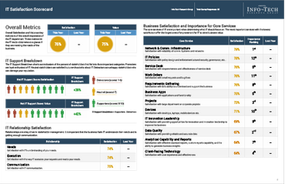
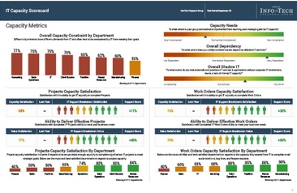
You may have arrived here for different reasons:
1
You recently completed a CIO Business Vision survey and the results indicated that you need to improve your service management processes.
You came across this blueprint on our website.
You are experiencing challenges delivering IT services and wish to get out of firefighting mode.
2
3
CIO Business Vision
Since 2013, Info-Tech has surveyed over 20,000 business stakeholders as part of our CIO Business Vision program.
If you haven’t taken the CIO Business Vision diagnostic, we strongly recommend you conduct this low effort, high impact program that will give you detailed report cards on the organization's satisfaction with IT’s core services.
Learn more about the CIO Business Vision program.

Slide 5
Firefighters often experience the following pain points
This research is designed to help organizations successfully transition to a stable IT environment. Assess your fit for this blueprint by determining whether the below statements sound familiar:
As a CIO, my IT organization is experiencing the following:
Continuous crisis management with every problem self-declaring as high priority.
Constantly resolving urgent and recurring technology issues to achieve short-term gains.
Running around from one emergency to the next, with no time to plan or think ahead.
Poor service delivery to business units with little momentum toward strategic innovation or competitive advantage.
Recurring incidents as a result of ineffective resolution of root causes.
Deteriorating morale and low engagement among all IT staff members, resulting in attrition of key employees.
Pushback on standardized processes and implemented changes.
Everything done from scratch with an over-reliance on key personnel.
Inability to follow budget or resource plans; misallocation of time and effort, leading to higher costs.
High response/resolution times.
Poor management and lack of confidence in leadership causing reduced productivity and inefficiencies.

Slide 6


Being a firefighter is costly to your budget and your reputation
The lack of service management process creates an ineffective service delivery model that does not provide value to the organization and reflects poorly on IT. Often, IT finishes putting out a fire only to be notified of another incident.
Failure is expensive.
75% of unplanned downtime is caused by human error.
For major corporations, the average hourly cost of an infrastructure failure is $100,000 per hour.
ComputerWeekly.com
DevOps.com
For the Fortune 1000, the average cost of a critical application failure per hour is $500,000 to $1 million.
Average firm spends 75 percent of IT budgets on “keeping the lights on” types of activities.
DevOps.com
WIRED
It’s tough to be strategic when your pants are on fire.
- Ron Kifer,
Hewlett-Packards’s VP of Global IT

Slide 7
Info-Tech’s methodology will significantly elevate your service management maturity
Outcomes
You will experience improved maturity in the following processes:
  Service Desk & Incident Management
  Change & Deployment Management
  Event & Problem Management
  Capacity & Performance Management
Benefits
Drastically reduce the number of fires and incidents within the IT department.
Reduce effort and time spent on managing repeatable incidents and problems.
Decrease costs associated with operating, maintaining, and implementing services.
Establish repeatable processes for key aspects of service management.
Improve the quality of service delivered to the business.
Improve IT’s image within the organization.
Increase morale and reduce attrition among IT employees.
Lessen resolution time for incidents and problems; achieve higher satisfaction with result.

Slide 8
Transform to a reliable and proactive organization in four steps
Proactive
4
  Implement selected service management processes to begin your transformation to a proactive organization.
Become more proactive
  Implement selected service management processes to stabilize your environment and move out of reactive mode.
3
Firefighter
Complete firefighting
2
  Employ Info-Tech’s quick wins to gain some breathing room.
Firefighter
Begin quenching the fire
1
  Assess the current state to determine if this project is right for you.

Slide 9
Insight breakdown
Insight 2
You must establish a stable environment before becoming proactive.
Work on activities that will move you out of a reactive state before you tackle the proactive processes.
Proactive
4
Become more proactive
3
Insight 1
Firefighter
Complete firefighting
Get the fire under control before you put it out.
Follow our sure-fire methodology and you’ll be able to douse the flames enough to get you on your way.
2
Firefighter
Begin quenching the fire
1

Slide 10
In order to move from reactive to proactive mode, you must establish the following processes
This project follows a four-step process and helps organizations address the most fundamental aspects of service management.
By leveraging the content in this blueprint, your organization can increase the quality of services that IT provides, reduce the cost of service management, and enable IT’s transformation into a trusted operator.
Steps | Processes | Reasons
1. Assess current state | Multiple service management processes | Determine if this blueprint is right for you by assessing the maturity of your service management processes.
2. Quick wins | Multiple service management processes | Use Info-Tech’s proven quick-win methodologies to alleviate immediate fire and gain some breathing room.
3. Move out of firefighting | Service Desk & Incident Management | You must establish repeatable processes in these two pairings in order to maintain a stable environment.
 | Change & Deployment Management
4. Become proactive | Event & Problem Management | These two pairings will help your IT department to become more proactive.
 | Capacity & Performance Management

Slide 11
Our tools and templates will help you accelerate the project
Proactive
4
Become proactive roadmap
Related Info-Tech blueprints and tools
Become more proactive
3
Move out of firefighting roadmap
Related Info-Tech blueprints and tools
Firefighter - Complete firefighting
2
Info-Tech quick win recommendations
Service management quick wins roadmap
Firefighter - Begin quenching the fire
Firefighter to Reliable Operator Assessment Tool
Reliable Operator Project Kick-Off Presentation
1

Slide 12


Improve your service management maturity by following our process ladder
Strategic Partner
Service Provider
Service Portfolio Management
Demand Management
Proactive
Service Level Management
Service Metrics
Service Catalog
Future
Business Relationship Management
Target State
Capacity & Performance Management
Stabilize
Event Management + Monitoring & Alerting
Problem Management
Change Management
Deployment Management
Incident Management
Service Desk
Current
Current State

Slide 13
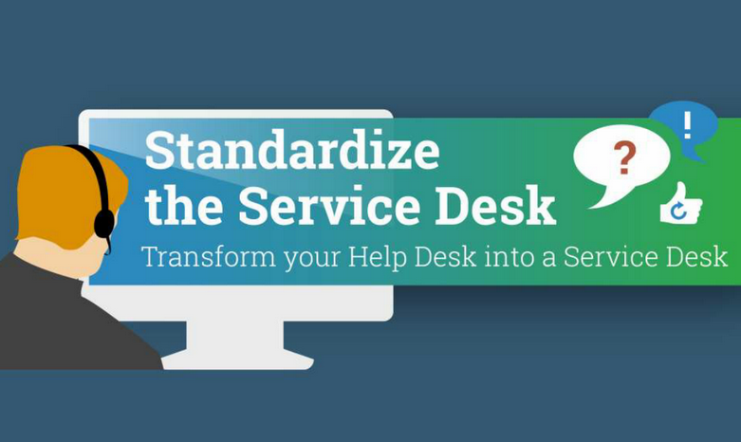
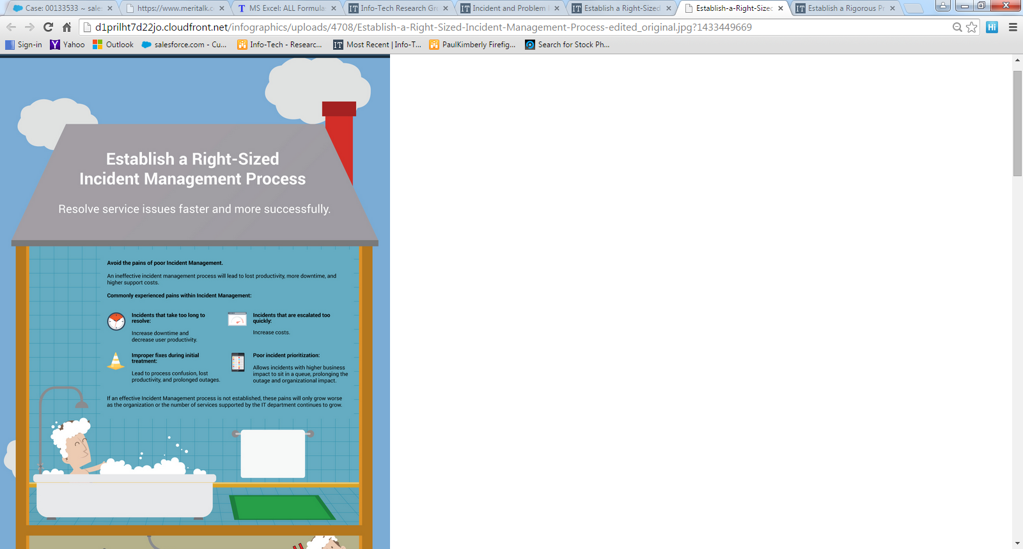



Use these Info-Tech blueprints as your guide to complete the service management journey
Standardize the Service Desk
Transform your Help Desk into a Service Desk.
Establish a Right-Sized Incident Management Process
Resolve service issues faster and more successfully.
Optimize the Change Management Process
Establish change intake, assessment, approval, testing, and deployment processes.
Stop Just Managing Capacity by Moving to a Capacity-as-a-Service Strategy
Plan and manage your capacity as a service.
Establish a Rigorous Problem Management Process
Monitor, analyze, and prevent problems.

Slide 14
At the end of your journey, you will have the following deliverables completed
Service Desk & Incident Management
Change & Deployment Management
Event & Problem Management
Capacity & Performance Management
Service Desk Ticket Classification and Dashboard
Change Management Project Charter
Problem Management Standard Operating Procedure
IT Service Design Survey and Descriptor Library
Service Management Standard Operating Procedure
Change Management Standard Operating Procedure
Problem Management Casual Root Cause Analysis Methodology
Capacity Analysis Tool
Service Desk Triage Workflow
Request for Change Form
Diagnostic RCA Methodology
Capacity Planning Project Plan
Knowledgebase Article
Change Advisory Board Charter
Proactive RCA Methodology
Service Desk Software and RFP Evaluation Tool
Change Management Metrics Tool
Problem Management Stakeholder Buy-in
Service Desk Support Call Worksheet
Incident Management Standard Operating Procedure
Incident Management Metrics Tool

Slide 15
CIOs must demonstrate support for this transition project and find the right person to lead the change
Senior management support is essential and it needs to start with the CIO. This project will only succeed if CIO endorsement is clearly communicated to all departments across IT.
Without visible support from the CIO, you will not be able to deliver on your improvements as buy-in is critical for execution and uniting your stakeholders around a common vision.
The Ideal Project Lead has:
A highly visible presence within the IT organization.
Strong influence to ensure staff commitment to the project.
Extensive technical experience and knowledge.
Effective facilitation skills and can lead short yet productive work sessions.
THE IDEAL PROJECT LEAD HAS:
As a CIO, you should initiate and sponsor this project, but you’ll need to delegate the project work to a key individual who will see it through to completion. Enabling effective leadership for this initiative will create accountability at the source and ensure the right skills are in place to manage people, delegate, plan, and organize.
IDEAL ROLES:
VP of Operations
VP of Infrastructure
Service Delivery Manager
Project Manager

Slide 16

CIO at Mohegan Sun improves service management maturity
CASE STUDY
Industry
Source
Gaming
CIO Business Vision
Challenge
Solution
Results
The incoming CIO at Mohegan Sun was faced with big tasks to improve IT’s service delivery.
Many existing processes did not make sense and the high rate of incidents had became a running joke with the business.
Additionally, the organizational structure was very splintered. This allowed leaders to make all the decisions on their own and managers were underused.
The CIO implemented a rigorous process to identify the key bottlenecks and to improve process effectiveness and efficiencies. This effort took 4-5 months to complete.
The CIO clearly identified areas of improvement. For example, he discovered that the abandonment rate for service desk was extremely high because the person answering the phone was also responsible for resolving the ticket. By identifying the cause, he can take action to resolve the issue.
As a result of the transformation, IT significantly improved its ability to deliver reliable and stable IT services. This resulted in a significant reduction in incidents and an increase in the number of solved service desk tickets.
At the end of this project, IT is no longer under constant pressure to put out fires and IT staff are more engaged with higher morale. The business’ perception of IT also dramatically improved across the organization.

Slide 17


Use these icons to help direct you as you navigate this research
Use these icons to help guide you through each step of the blueprint and direct you to content related to the recommended activities.
This icon denotes a slide where a supporting Info-Tech tool or template will help you perform the activity or step associated with the slide. Refer to the supporting tool or template to get the best results and proceed to the next step of the project.
This icon denotes a slide with an associated activity. The activity can be performed either as part of your project or with the support of Info-Tech team members, who will come onsite to facilitate a workshop for your organization.
This icon denotes an Info-Tech insight. Use these insights to gain a deeper understanding into the unique aspects of the program implementation.

Slide 18




Info-Tech offers various levels of support to best suit your needs
Guided Implementation
DIY Toolkit
Workshop
Consulting
“Our team has already made this critical project a priority, and we have the time and capability, but some guidance along the way would be helpful.”
“Our team knows that we need to fix a process, but we need assistance to determine where to focus. Some check-ins along the way would help keep us on track.”
“We need to hit the ground running and get this project kicked off immediately. Our team has the ability to take this over once we get a framework and strategy in place.”
“Our team does not have the time or the knowledge to take this project on. We need assistance through the entirety of this project.”
Diagnostics and consistent frameworks used throughout all four options

Slide 19



Move from Firefighter to Reliable Operator – project overview
1. Assess the current state
2. Tackle the quick wins
3. Move out of firefighting
4. Become proactive
Best-Practice Toolkit | 1.1 Understand the profile of a firefighting and a reliable organization 1.2 Determine if your organization is in firefighting mode 1.3 Assess the results of the diagnostic tool 1.4 Identify gaps in service management processes | 2.1 Establish objectives and benefits of quick wins 2.2 Identify sure-fire quick wins 2.3 Implement the quick wins and measure the results 2.4 Communicate results to the team and the business | 3.1 Identify and implement process activities for: Service Desk & Incident Management Change & Deployment Management 3.2 Extinguish the firefighting culture 3.3 Create roadmap | 4.1 Identify and implement process activities for: Event & Problem Management Capacity & Performance Management 4.2 Build your capabilities 4.3 Create roadmap
Guided Implementations | Assess the current state of reactive service management processes Assess the current state of proactive service management processes. Identify maturity level. | Identify quick wins. Create a task force and implement the quick wins. | Identify process activities for service desk & incident management. Remove the hero culture. Identify process activities for change & deployment management. Communicate result to the business. | Identify process activities for event & problem management. Build your capacities. Identify process activities for capacity & performance management. Communicate result to the business.
Onsite Workshop | Phase 1 Results: Comprehensive understanding of maturity level in each process | Phase 2 Results: Identify quick wins that will help you douse the fire | Phase 3 Results: Implementation of reactive service management processes | Phase 4 Results: Implementation of proactive service management processes

Slide 20

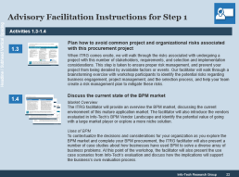
Workshop overview
Contact your account representative or email Workshops@InfoTech.com for more information.
This workshop can be deployed as either a four or five day engagement depending on the level of preparation completed by the client prior to the facilitator arriving onsite.
Day 1 | Day 2 | Day 3 | Day 4 | Day 5
Preparation | Workshop Day | Workshop Day | Workshop Day | Working Session
Workshop Preparation Facilitator meets with the project manager and reviews workshop agenda. Identify key stakeholders for the workshop. Ensure representatives from each operational area are present at the workshop. | Morning Itinerary Introduce workshop objectives and agenda. Assess the maturity level of service management processes using assessment tool. Determine current state and target state for each process. Afternoon Itinerary Identify which quick win would help the organization douse the fire. Appoint a project/task leader. | Morning Itinerary Introduce process activities for the service desk. Introduce process activities for incident management. Afternoon Itinerary Introduce process activities for change management. Introduce process activities for deployment management. | Morning Itinerary Introduce process activities for event management. Introduce process activities for problem management. Afternoon Itinerary Introduce process activities for capacity management. Introduce process activities for performance management. | Workshop Debrief Create an action plan with task owner for next step. Next Steps Appoint a project/task leader. Create a repository to document all project plans and progress.
The light blue slides at the end of each section highlight the key activities and exercises that will be completed during the engagement with our analyst team.

