Slide 1
Modernize Data Architecture for Measurable Business Results
Modernize your data architecture capabilities to enable agile, fit-for-purpose delivery of quality data services in the small and big data space.
Info-Tech's products and services combine actionable insight and relevant advice with ready-to-use tools and templates that cover the full spectrum of IT concerns.© 1997 - 2015 Info-Tech Research Group

Slide 2
Analyst perspective
The future is here! Is your data architecture practice ready?
At the heart of tomorrow’s insights-driven enterprises is a modern data environment anchored in fit-for-purpose data architectures.
Disruptive data forces such as big data and Hadoop are stimulating new ways of thinking and empowering organizations to dismantle silos and collaborate within a democratic and rapidly changing data ecosystem.
The role of traditional data architecture is transcending beyond organizational boundaries and its focus is shifting from “keeping the lights on” (i.e. operational data and BI), to providing game changing insights gleaned from untapped “big data.”
This calls to action the need for an agile and fit-for-purpose approach to architecting and delivering data.
Nurith Rochon,
Senior Director, Information Management Practice Info-Tech Research Group

Slide 3
Engage the right roles to oversee and implement the Modernize Data Architecture project
Primary Audience
CIOs, Heads of IT, Data Architects, and Data Professionals (Modelers, Scientists, Specialists and Administrators) tasked with creating data architectures that are strategically aligned to business priorities.
Secondary Audience
Data governance professionals who govern the data architecture practice.
Enterprise architects concerned with the cohesion of the enterprise architecture practice.
Data management professionals playing a role in data architecture management.
The creation of a data architecture practice.
Identification of the capability gaps around an organization’s data architecture.
A roadmap that includes improvement initiatives that will support the organization in managing data as a corporate asset.
The objective of this blueprint is to create a roadmap to guide organizations in modernizing their data architecture capabilities to better align with business priorities.
The data architecture roadmap will enable you to:
Build a fit-for purpose data architecture practice.
Create a data delivery architecture that harmonizes traditional and modern architectural opportunities.

Slide 4
Executive summary
For data to be valuable and available to an organization on a scalable and long term level, it must be supported by a proper data architecture practice.
Organizations are using data in new and exciting ways. With this increase in usage and the complexity of the use cases and data behind this consumption, there is a growing need to improve the architecting and blueprinting of the organization’s data.
At the heart of tomorrow’s insights-driven enterprises is a modern data environment anchored in fit-for-purpose data architectures.
As an organization evolves its data requirements and use cases, adopting new practices such as in big data analytics, its underpinning data architecture must also evolve and modernize.
All your architectures underpin an authoritative data delivery model.
Data architecture is often an underinvested area of an organization. Due to its diffused benefits, it can be difficult to explicitly show the business benefits. But, as organizations seek to leverage new technologies in big data and analytics, more mature and modernized data architecture practices will become a necessity.
Fit-for-Purpose: Build a data architecture practice that fits your architecture needs today and positions your organization to capitalize on opportunities in the information management space as they arise.
Incremental Improvement: Building a mature and optimized practice won’t occur overnight – it will take time and effort. Use the diagnostic assessment within this blueprint to support you in assessing current capabilities, identifying target capability goals, and designing initiatives that allow you to close the gaps between them.
Maintain Business Alignment: As you build your practice, consider the business’s strategic vision and priorities. A central struggle of traditional data architecture practices is that the initiatives within them often fail, or fail to provide clear business value. Keeping your initiative plans aligned with business requirements and considerations will help to garner buy-in and prove the value of data architecture and the larger more strategic initiatives on its roadmap.

Slide 5
Business executives see data management as one of IT’s core services
Since 2013, Info-Tech has surveyed over 20,000 business stakeholders as part of our CIO Business Vision program.
We asked them to rank the importance of the following 12 core IT services…
Top IT Services for Business Stakeholders
Top Upcoming Technology Innovations for CEOs
1
Network Infrastructure
Service Desk
Business Applications
Data Quality
Devices
Analytical Capability
Client-Facing Technology
Work Orders
Innovation Leadership
Projects
IT Policies
Requirements Gathering
1
Mobile for Employees
Big Data - Analytics
Internal Collaboration Tools
Mobile for Customers
Social Media for Engagement
Big Data - Collection
Cloud for Application Functionality
Cloud for Agile Infrastructure
Social Media for Acquisition
Internet of Things for Product Innovation
Internet of Things for Product Tracking
2
2
3
3
4
4
5
5
6
6
7
7
8
Learn more about the CIO Business Vision program.
8
9
10
9
11
10
12
11
n = 21,367
n = 215

Slide 6
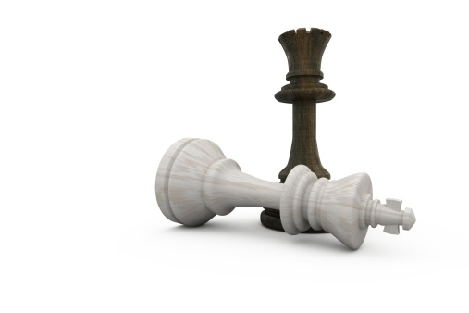
To differentiate and remain competitive in today’s marketplace, organizations are becoming more data-driven
Analytic Competitor
Leveraging data as a competitive advantage makes data a central enabler to an organization’s operations and strategy.
Analytical Companies
Analytical Aspirations
Localized Analytics
Analytically Impaired
Source: Davenport and Harris,
Competing on Analytics, 2007
Data and the use of data analytics has become a centerpiece to effective modern business. Top-performing organizations across a variety of industries have been cited to use analytics five times more than lower performers.
Source: MIT Sloan Management Review

Slide 7
What is data architecture?
A description of the structure and interaction of the enterprise’s major types and sources of data, logical data assets, physical data assets, and data management resources (TOGAF 9).
The subject area of data management that defines the data needs of the enterprise and designs the master blueprints to meet those needs (DAMA DMBOK, 2009).
Although definitions vary slightly across major architecture and management frameworks, there is agreement on the fact that data architecture provides organizations with alignment, planning, road-mapping, design, and change management functions that guide their information management program.
Govern, Direct | Data Governance
Align, Plan | Information Strategy
 | Data Architecture
Build, Acquire | Database Operations
Deliver, Service, Support | Data Warehousing | Big Data | BI & Analytics | Reference and Master Data | Document and Content Mgmt. | Metadata Mgmt.
 | Data Security / Data Privacy
Monitor, Evaluate, Improve | Data Quality
 | IM Practice Evolution
Info-Tech’s Information Management Framework

Slide 8
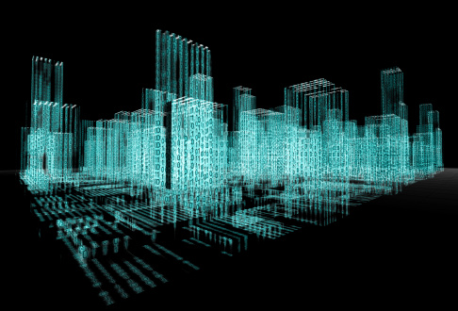
What is the value of data architecture?
Data Architecture
Defines and clearly communicates a single, consistent, and authoritative view of an organization’s data (as-is, to-be, and transitional views) through an integrated set of models/blueprints.
Formulates a roadmap for incremental and agile delivery of data improvements.
Crafts a well positioned and authoritative data delivery environment.
Business Value
Well architected data meets evolving business needs and supports operational, tactical, and strategic data requirements.
Well architected data is trusted, relevant, available, secure, and compliant.
Well architected data significantly reduces the total cost of data ownership and provides an incremental roadmap for continuous improvement.
Build data blueprints that empower the business
A successful data architecture practice creates business-aligned data blueprints that support business agility, operational efficacy, and customer intimacy. These blueprints play a critical role in developing effective IT systems and services.

Slide 9
Changes in data scope, usage, and complexity require a shift in how data architecture is approached and performed
Big Data
Unstructured Data
Regulatory Changes
The capacity of traditional data storage and processing systems is limiting companies’ ability to leverage data effectively.
The percentage of organizational data that is expected to be used for analysis will grow significantly.
^{(IDC, 2014)}
Today 2020
Historical methods for structuring, organizing, storing and accessing data were designed for structured data.
Rapidly changing regulatory environment calls to action the need for business agility.
On average, 70 to 80 percent of an organization’s data is unstructured.
(Baseline Magazine, 2015)
Regulations around data privacy, access, usage, and storage are increasing. The potential fines and legal ramifications associated with data breaches and inappropriate use represent a high business risk.
22%
37%
Bottom Line
Bottom Line
Bottom Line
The volume, velocity, and variety of data that organizations must now manage require a re-evaluation of the underlying data architectures.
The growing number of types and formats of source data necessitates modernization of data architectures and their underlying data standards.
Meeting the needs of changing regulatory / legal environments require an agile and responsive data architecture.

Slide 10
What are the fundamental building blocks of data architecture?
Data Architecture
Information Value Chains provide transparency on how data flows through an organization..
Data Delivery Architecture outlines the steps and components required to support the lifecycle of enterprise data from creation, through transformation, organization, integration, consumption, and finally archive/disposition.
Information Value Chains
Data Delivery Architecture
Enterprise Data Model
An Enterprise Data Model is a cohesive blueprint that provides a single snapshot of the data required by the enterprise to meet its current and strategic needs.
Related Data Architectures
Related Architectures identify the architectural capabilities and components that support:
Business Intelligence
Data Warehousing
Data Integration
Database Operations
Master Data Management
Metadata Management

Slide 11
Modernize the data architecture to position your organization to use data as an enabler for strategic growth
CENTRAL PRINCIPLES FOR A SUCCESSFUL MODERN DATA ARCHITECTURE
Emerging Data Types
Semi-structured & unstructured data
(e.g. sensor, sentiment, geo, social, text, clickstream, etc.)
Interoperability Data is integrated and accessible on inter and intra- enterprise basis.
Data Integrity Data assets are complete, up-to-date, and error-free.
Time to Data Data is accessible/delivered in accordance with SLAs.
Insightful and Automated Reporting Reporting is visual, valuable, and fast. Insights are game changing and inform sound decision making.
Traditional Data Types
Structured data generated by enterprise applications (e.g. CRM, ERP, SCM, LOB, etc.)
Modernizing your architecture requires:
An architecture environment positioned to house high volumes of data (structured, semi-structured, and unstructured).
Transparency and responsiveness to changes.
Ability to support highly automated and intelligent analytical functions.
Strong data lineage and metadata capabilities.
Modernizing your architecture will pave the way for more intelligent and efficient analytical and operational uses of data. Incorporating new technologies, such as Hadoop, will be a foundational platform for building a reliable and modern data delivery environment.

Slide 12
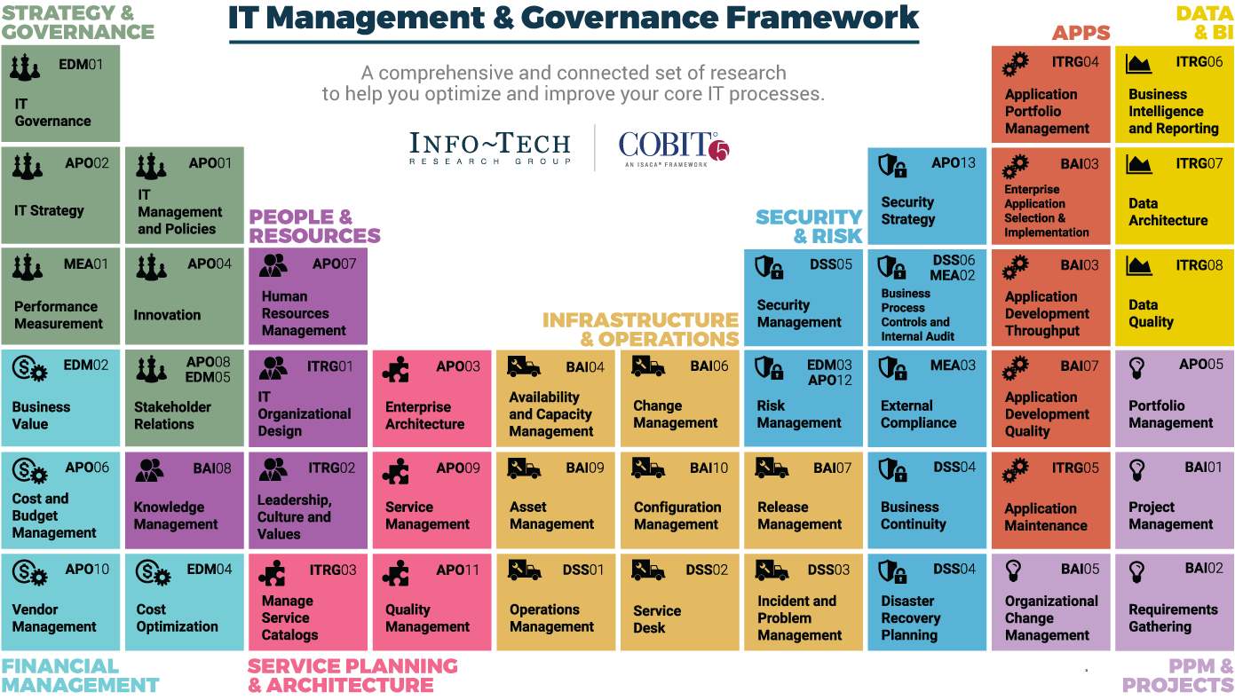
Dive Deeper Into Our Research
by Clicking One of the Elements Below
Find out how Info-Tech makes your job easier. Contact Us Today: Toll-Free (US & Canada): 1-888-670-8889

