Slide 1
Modernize Data Architecture for Measurable Business Results
Modernize your data architecture capabilities to enable agile, fit-for-purpose delivery of quality data services in the small and big data space.

Slide 2
ANALYST PERSPECTIVE
The future is here! Is your data architecture practice ready?
At the heart of tomorrow’s insights-driven enterprises is a modern data environment anchored in fit-for-purpose data architectures.
Disruptive data forces such as big data and Hadoop are stimulating new ways of thinking and empowering organizations to dismantle silos and collaborate within a democratic and rapidly changing data ecosystem.
The role of traditional data architecture is transcending beyond organizational boundaries and its focus is shifting from “keeping the lights on” (i.e. operational data and BI), to providing game changing insights gleaned from untapped “big data.”
This calls to action the need for an agile and fit-for-purpose approach to architecting and delivering data.
Nurith Rochon,
Senior Director, Information Management Practice Info-Tech Research Group

Slide 3
Engage the right roles to oversee and implement the Modernize Data Architecture project
Primary Audience
CIOs, Heads of IT, Data Architects, and Data Professionals (Modelers, Scientists, Specialists and Administrators) tasked with creating data architectures that are strategically aligned to business priorities.
Secondary Audience
Data governance professionals who govern the data architecture practice.
Enterprise architects concerned with the cohesion of the enterprise architecture practice.
Data management professionals playing a role in data architecture management.
The creation of a data architecture practice.
Identification of the capability gaps around an organization’s data architecture.
A roadmap that includes improvement initiatives that will support the organization in managing data as a corporate asset.
The objective of this blueprint is to create a roadmap to guide organizations in modernizing their data architecture capabilities to better align with business priorities.
The data architecture roadmap will enable you to:
Build a fit-for purpose data architecture practice.
Create a data delivery architecture that harmonizes traditional and modern architectural opportunities.

Slide 4
Executive summary
For data to be valuable and available to an organization on a scalable and long term level, it must be supported by a proper data architecture practice.
Organizations are using data in new and exciting ways. With this increase in usage and the complexity of the use cases and data behind this consumption, there is a growing need to improve the architecting and blueprinting of the organization’s data.
At the heart of tomorrow’s insights-driven enterprises is a modern data environment anchored in fit-for-purpose data architectures.
As an organization evolves its data requirements and use cases, adopting new practices such as in big data analytics, its underpinning data architecture must also evolve and modernize.
All your architectures underpin an authoritative data delivery model.
Data architecture is often an underinvested area of an organization. Due to its diffused benefits, it can be difficult to explicitly show the business benefits. But, as organizations seek to leverage new technologies in big data and analytics, more mature and modernized data architecture practices will become a necessity.
Fit-for-Purpose: Build a data architecture practice that fits your architecture needs today and positions your organization to capitalize on opportunities in the information management space as they arise.
Incremental Improvement: Building a mature and optimized practice won’t occur overnight – it will take time and effort. Use the diagnostic assessment within this blueprint to support you in assessing current capabilities, identifying target capability goals, and designing initiatives that allow you to close the gaps between them.
Maintain Business Alignment: As you build your practice, consider the business’s strategic vision and priorities. A central struggle of traditional data architecture practices is that the initiatives within them often fail, or fail to provide clear business value. Keeping your initiative plans aligned with business requirements and considerations will help to garner buy-in and prove the value of data architecture and the larger more strategic initiatives on its roadmap.

Slide 5
Business executives see data management as one of IT’s core services
Since 2013, Info-Tech has surveyed over 20,000 business stakeholders as part of our CIO Business Vision program.
We asked them to rank the importance of the following 12 core IT services…
Top IT Services for Business Stakeholders
Top Upcoming Technology Innovations for CEOs
1
Network Infrastructure
Service Desk
Business Applications
Data Quality
Devices
Analytical Capability
Client-Facing Technology
Work Orders
Innovation Leadership
Projects
IT Policies
Requirements Gathering
1
Mobile for Employees
Big Data - Analytics
Internal Collaboration Tools
Mobile for Customers
Social Media for Engagement
Big Data - Collection
Cloud for Application Functionality
Cloud for Agile Infrastructure
Social Media for Acquisition
Internet of Things for Product Innovation
Internet of Things for Product Tracking
2
2
3
3
4
4
5
5
6
6
7
7
8
Learn more about the CIO Business Vision program.
8
9
10
9
11
10
12
11
n = 21,367
n = 215

Slide 6
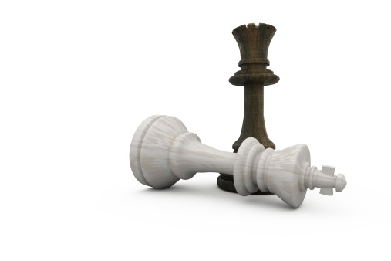
To differentiate and remain competitive in today’s marketplace, organizations are becoming more data-driven
Analytic Competitor
Leveraging data as a competitive advantage makes data a central enabler to an organization’s operations and strategy.
Analytical Companies
Analytical Aspirations
Localized Analytics
Analytically Impaired
Source: Davenport and Harris,
Competing on Analytics, 2007
Data and the use of data analytics has become a centerpiece to effective modern business. Top-performing organizations across a variety of industries have been cited to use analytics five times more than lower performers.
Source: MIT Sloan Management Review

Slide 7
What is data architecture?
A description of the structure and interaction of the enterprise’s major types and sources of data, logical data assets, physical data assets, and data management resources (TOGAF 9).
The subject area of data management that defines the data needs of the enterprise and designs the master blueprints to meet those needs (DAMA DMBOK, 2009).
Although definitions vary slightly across major architecture and management frameworks, there is agreement on the fact that data architecture provides organizations with alignment, planning, road-mapping, design, and change management functions that guide their information management program.
Govern, Direct | Data Governance
Align, Plan | Information Strategy
 | Data Architecture
Build, Acquire | Database Operations
Deliver, Service, Support | Data Warehousing | Big Data | BI & Analytics | Reference and Master Data | Document and Content Mgmt. | Metadata Mgmt.
 | Data Security / Data Privacy
Monitor, Evaluate, Improve | Data Quality
 | IM Practice Evolution
Info-Tech’s Information Management Framework

Slide 8
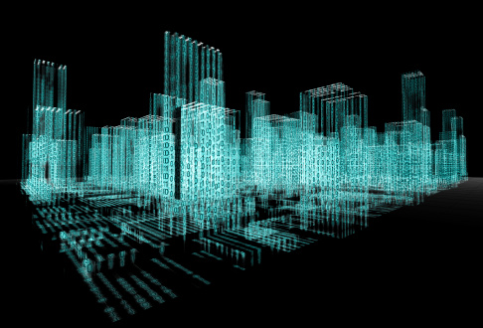
What is the value of data architecture?
Data Architecture
Defines and clearly communicates a single, consistent, and authoritative view of an organization’s data (as-is, to-be, and transitional views) through an integrated set of models/blueprints.
Formulates a roadmap for incremental and agile delivery of data improvements.
Crafts a well-positioned and authoritative data delivery environment.
Business Value
Well architected data meets evolving business needs and supports operational, tactical, and strategic data requirements.
Well architected data is trusted, relevant, available, secure, and compliant.
Well architected data significantly reduces the total cost of data ownership and provides an incremental roadmap for continuous improvement.
Build data blueprints that empower the business
A successful data architecture practice creates business-aligned data blueprints that support business agility, operational efficacy, and customer intimacy. These blueprints play a critical role in developing effective IT systems and services.

Slide 9
Changes in data scope, usage, and complexity require a shift in how data architecture is approached and performed
Big Data
Unstructured Data
Regulatory Changes
The capacity of traditional data storage and processing systems is limiting companies’ ability to leverage data effectively.
The percentage of organizational data that is expected to be used for analysis will grow significantly.
^{(IDC, 2014)}
Today 2020
Historical methods for structuring, organizing, storing and accessing data were designed for structured data.
Rapidly changing regulatory environment calls to action the need for business agility.
On average, 70 to 80 percent of an organization’s data is unstructured.
(Baseline Magazine, 2015)
Regulations around data privacy, access, usage, and storage are increasing. The potential fines and legal ramifications associated with data breaches and inappropriate use represent a high business risk.
22%
37%
Bottom Line
Bottom Line
Bottom Line
The volume, velocity, and variety of data that organizations must now manage require a re-evaluation of the underlying data architectures.
The growing number of types and formats of source data necessitates modernization of data architectures and their underlying data standards.
Meeting the needs of changing regulatory / legal environments require an agile and responsive data architecture.

Slide 10
What are the fundamental building blocks of data architecture?
Data Architecture
Information Value Chains provide transparency on how data flows through an organization..
Data Delivery Architecture outlines the steps and components required to support the lifecycle of enterprise data from creation, through transformation, organization, integration, consumption, and finally archive/disposition.
Information Value Chains
Data Delivery Architecture
Enterprise Data Model
An Enterprise Data Model is a cohesive blueprint that provides a single snapshot of the data required by the enterprise to meet its current and strategic needs.
Related Data Architectures
Related Architectures identify the architectural capabilities and components that support:
Business Intelligence
Data Warehousing
Data Integration
Database Operations
Master Data Management
Metadata Management

Slide 11
Modernize the data architecture to position your organization to use data as an enabler for strategic growth
CENTRAL PRINCIPLES FOR A SUCCESSFUL MODERN DATA ARCHITECTURE
Emerging Data Types
Semi-structured & unstructured data
(e.g. sensor, sentiment, geo, social, text, clickstream, etc.)
Interoperability Data is integrated and accessible on inter and intra- enterprise basis.
Data Integrity Data assets are complete, up-to-date, and error-free.
Time to Data Data is accessible/delivered in accordance with SLAs.
Insightful and Automated Reporting Reporting is visual, valuable, and fast. Insights are game changing and inform sound decision making.
Traditional Data Types
Structured data generated by enterprise applications (e.g. CRM, ERP, SCM, LOB, etc.)
Modernizing your architecture requires:
An architecture environment positioned to house high volumes of data (structured, semi-structured, and unstructured).
Transparency and responsiveness to changes.
Ability to support highly automated and intelligent analytical functions.
Strong data lineage and metadata capabilities.
Modernizing your architecture will pave the way for more intelligent and efficient analytical and operational uses of data. Incorporating new technologies, such as Hadoop, will be a foundational platform for building a reliable and modern data delivery environment.

Slide 12
Strike a balance between the traditional and modern elements of your organization’s fit-for-purpose data architecture
Traditional Data Architecture
Modern Data Architecture
Contains the blueprints, processes, and technology to manage data from traditional data sources.
Architecture designs are centered around supporting structured data types.
Modern data architecture creates blueprints, processes, and technology support for managing data coming from emerging sources (IoT, sensory data, social data, clickstream, etc.)
Strongly supports structured, unstructured, and semi-structured data.
Strong focus on supporting the capture, storage, and analytical use of big data.
Supports increasingly intelligent and complex analytical capabilities.
A hybrid architecture includes both traditional and modern architecture components. Even as organizations begin to rely heavily on new data sources and more modern data architecture, they will require the support and foundation of traditional data architecture.

Slide 13
The Mayo Clinic modernized its data architecture as it built its information management practice
CASE STUDY
Industry
Source
Healthcare
Journal of American Medical Informatics Association
Mayo Clinic
The Mayo Clinic in Rochester, Minnesota is a world renowned research and academic hospital that stands out as a leader, not only in research and medical services, but also in hospital operations and technological innovation.
Enterprise Information Management Initiative
The Mayo Clinic launched an Enterprise Information Management initiative with the objective of improving the collection and management of the organization’s data in order to improve business intelligence and ad hoc data delivery. For this initiative, the Mayo Clinic created five key components to improve the structuring of data, retrieval capabilities, and governance of data assets. Data architecture played a significant role in this initiative, specifically as they built an enterprise data warehouse, improved their data modeling, and refined their integrations, all while being considerate of their security and privacy requirements.
Results
Paired with the governance component of the EIM initiative, the architecture components were able to support the Mayo Clinic in working toward their ultimate aim of making more trustworthy data available to their 50,000 employees and their healthcare and research partners.
The Enterprise Information Management initiative included the following components
Enterprise Data Trust (EDT)
Data Governance
Enterprise Data Modeling
Enterprise Vocabulary
Enterprise Managed Metadata Management
Legend
Component falls into the scope of data architecture

Slide 14
Support your business in building a modern or hybrid data architecture by developing a strong data architecture practice
The presence of a practice will create the structure and control activities to ensure Data Architecture has the necessary capabilities to adequately support the business’s data requirements and ensure proper management, support, and use of architecture artifacts.
Key Building Blocks for a Successful Practice
Practice Capabilities
In order to support the business’s growing data requirements, an understanding of current capabilities and identification of target capabilities is necessary. Create a capability improvement roadmap and consistently measure and report on capability performance.
People
The data architecture team has the competencies to create and support data architecture artifacts and activities.
The data architecture team has the capacity to complete the domain’s workload.
Processes and Procedures
Target
The necessary policies and processes are in place to ensure proper creation, maintenance, and application of the organization’s enterprise data model, related architectures, and data delivery architecture.
Baseline
The value of data architecture sits with its use, not its existence. Leverage your practice to ensure capabilities and artifacts are applied to downstream operations and are used to support business requirements.
Technology
The appropriate technology to support data modeling, architectural mapping, and data delivery is present and meets the practice’s planning requirements and downstream operational needs.

Slide 15
Consider how your data architecture practice will fit within your organization’s enterprise architecture
Enterprise Architecture
Architecture domains are closely intertwined
Data architecture is a key component of enterprise architecture and is driven by the organization’s business architecture.
Data architecture collaborates with application architecture in the delivery of effective information systems that support required business capabilities and enterprise-level goals and objectives.
Data architecture informs technology architecture on data related infrastructure requirements/considerations.
Business Architecture
Data Architecture
Application Architecture
Technology Architecture
Adapted from TOGAF
Refer to Phase C of TOGAF and Bizbok for references to the components of Business Architecture that are used in Data Architecture.

Slide 16
Modernize Data Architecture for Measurable Business Results blueprint
Follow this blueprint to create a strategic roadmap that improves the capabilities of your data architecture practice.
Plan Project
Create an Architectural Vision
Assess Capabilities
Assess Gaps & Formulate Strategies
Develop a Roadmap
Create a Project Plan Including:
Scope and objectives
Resourcing
Sponsorship
Oversight body and reporting process
Outputs
Assess “as is” Data Architecture Capabilities
Assess the following:
Practice capabilities
Data architecture capabilities
Data lineage capabilities
Data delivery capabilities
Outputs
Identify the Business’s Data Requirements
Outputs
Assess Gaps and Formulate Strategies
Outputs
Develop Initiatives for Data Architecture
Outputs
Data Requirements
Prioritized Gap Analysis
Strategies
Documented Initiatives
Defined Terms of Reference
Documentation of Baseline Capabilities
Assess Initiative Feasibility
Create a Data Architecture Vision
Outputs
Determine Target Capabilities
Outputs
Create a Roadmap for Data Architecture Modernization
Outcome
Data Architecture Vision
Target Capabilities (Specs)
Data
Architecture Roadmap

Slide 17
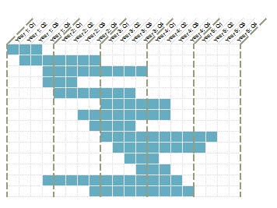
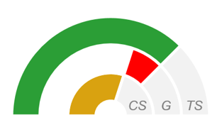
Build a fit-for-purpose data architecture practice using the deliverables created from this blueprint
Use the step-by-step advice within this blueprint to create a data architecture vision and build a roadmap that sequences and coordinates the improvement initiatives for your organization’s data architecture practice.
At the center of this project is a diagnostic assessment that analyzes your organization’s current and desired data architecture capabilities. Completing the assessment and using its findings will enable your organization to build a data architecture practice that provides the greatest business value.
Following the improvement initiatives documented in your roadmap will enable your organization to:
Build a fit-for purpose data architecture practice
Create a data delivery architecture that harmonizes traditional and modern architectural opportunities
Data Architecture Roadmap Presentation Template
Use the assessment within the blueprint to analyze your Practice, Enterprise Data Model, and Related Architectures.
Screenshot of tab 5. Scorecard and Roadmap from the Data Architecture Assessment and Roadmap Tool
BLUEPRINT TOOLS AND TEMPLATES
Data Architecture Assessment and Roadmap Tool
Data Architecture Roadmap Presentation Template
*This blueprint contains additional resources that support the creation of interim deliverables and the execution of project steps.

Slide 18
Launch the project by engaging the necessary participants and defining project expectations
Recommended Project Manager
Recommended Oversight
Head of the organization’s data architecture practice (Senior Data Architect)
If there is no formal head of Data Architecture, we recommend you identify a senior data management professional with the skills that best align with the project’s objectives.
Architecture Review Board (ARB)
If there is no ARB, we recommend you have this project report to the Data Governance Steering Committee or a senior official within the IT department.
Estimated Time for this Project
Project Scope
Three to six months
Assessment of the following components of data architecture:
Practice Capabilities
Enterprise Data Model
Related Architecture
Dynamic Data Architecture Models (i.e. Data Delivery Model)
Blueprint Outcome
Following this blueprint end to end will guide an organization in developing a strategic vision for its data architecture practice and a roadmap populated with improvement initiatives.

Slide 19
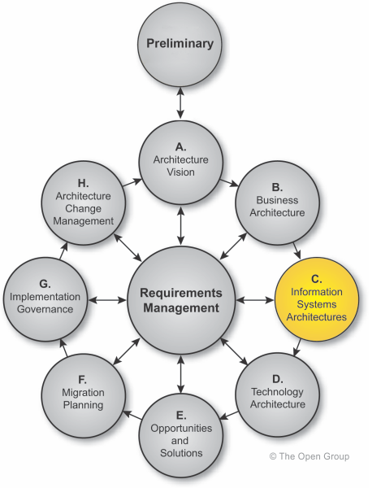
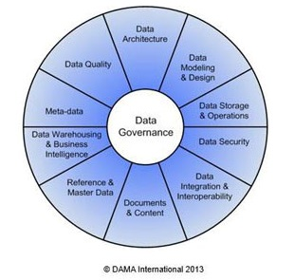
Central to our approach to data architecture (DA) are industry-leading frameworks
As part of our research process, we leveraged the frameworks of COBIT5, TOGAF, and DAMA DMBOK2. Contextualizing data architecture within these frameworks clarifies its importance and role and ensured that our assessment tool is focused on key priority areas.
The DMBOK2 Data Management framework by the Data Asset Management Association (DAMA) provided context for Data Architecture.
TOGAF’s analysis of Data Architecture and its position in Phase C as a component of Enterprise Architecture was reviewed and used as a foundation in assessing the business requirements and use of Data Architecture.
The COBIT 5 framework and its business enablers were used as a starting point for assessing the performance capabilities of the different components of Data Architecture.

Slide 20
Navigate the 3 phases of the blueprint using this table of contents
Phase 1: Create a Data Architecture Vision | Phase 2: Assess Data Architecture Capabilities | Phase 3: Create a Data Architecture Roadmap
Step 1.1: Plan your data architecture modernization project | Tool: Data Architecture Assessment and Roadmap Tool | Step 3.1: Develop a data architecture roadmap
Template: Modernize Data Architecture Project Charter | Step 2.1: Assess the capabilities of the data architecture practice | Template: Data Architecture Roadmap Presentation Template
Step 1.2: Translate the business’s drivers and strategies into a data architecture strategy | Step 2.2: Assess your enterprise data model (EDM)
Template: Data Architecture Strategic Planning Workbook | Step 2.3: Assess and plan the capabilities of each related architecture
 | Step 2.4: Assess your organization’s dynamic data architecture models
 | Step 2.5: Assess performance gaps Template: Initiative Definition Tool

Slide 21
Use these icons to help direct you as you navigate this research
Use these icons to help guide you through each step of the blueprint and direct you to content related to the recommended activities.
This icon indicates a slide where a supporting Info-Tech tool or template will help you perform the activity or step associated with the slide. Refer to the supporting tool or template to get the best results and proceed to the next step of the project.
This icon denotes a slide with an associated activity. The activity can be performed either as part of your project or with the support of Info-Tech team members, who will come onsite to facilitate a workshop for your organization.

Slide 22
Info-Tech offers various levels of support to best suit your needs
Consulting
Onsite Workshop
Guided Implementation
“Our team does not have the time or the knowledge to take this project on. We need assistance through the entirety of this project.”
DIY Toolkit
Info-Tech Involvement
“We need to hit the ground running and get this project kicked off immediately. Our team has the ability to take this over once we get a framework and strategy in place.”
“Our team knows that we need to fix a process, but we need assistance to determine where to focus. Some check-ins along the way would help keep us on track.”
“Our team has already made this critical project a priority, and we have the time and capability, but some guidance along the way would be helpful.”
Degree of Customization
Diagnostics and consistent methodologies throughout all four options

Slide 23
Modernize your data architecture blueprint overview
1. Develop a Data Architecture Vision
2. Assess Data Architecture Capabilities
3. Develop a Data Architecture Roadmap
Best-Practice Toolkit | 1.1: Structure your data architecture modernization project 1.2: Translate the business’s vision, drivers, and pain points into a data architecture strategy | Step 2.1: Assess the capabilities of the data architecture practice Step 2.2: Assess your enterprise data model (EDM) Step 2.3: Assess and plan the capabilities of each related architecture Step 2.4: Assess your organization’s dynamic data architecture models Step 2.5: Assess performance gaps | 3.1: Develop a data architecture roadmap
Guided Implementations | Plan your modernize data architecture project Create your data architecture vision | Due to the scope of the assessment, each evaluation step includes its own 2-call GI series focused on the diagnostic assessment and a review of results. | Review planned initiatives Discuss roadmap findings and next steps
Onsite Workshop | Module 1: Develop a Data Architecture Vision | Module 2: Assess Data Architecture Capabilities | Module 3: Develop a Data Architecture Roadmap
 | Phase 1 Outcome: Data Architecture Vision | Phase 2 Outcome: Diagnostic Assessment for Data Architecture | Phase 3 Outcome: Strategic Roadmap

Slide 24
Time constrained? Consider an onsite engagement to expedite your project and get to results faster
Offsite
Onsite
Contact your account representative or email Workshops@InfoTech.com for more information.
Info-Tech’s Data Architecture Diagnostic Workshop
Day 1 | Day 2 | Day 3 | Day 4 | Day 5
Workshop Day | Workshop Day | Workshop Day | Workshop Day | Working Day
Develop Data Architecture (DA) Vision 1.1 Explain approach and value proposition 1.2 Discuss business vision and key drivers 1.3 Discover business pain points and needs 1.4 Determine data strategies 1.5 Assess DA practice capabilities | Assess DA Core Capabilities (Part 1) 2.1 Present an overarching DA capability model (Part 1) 2.2 Assess current and target EDM capabilities 2.3 Assess current/target data warehouse, BI/analytics and big data architectures 2.4 Identify gaps and high level strategies | Assess DA Core Capabilities (Part 2) 3.1 Present an overarching DA capability model (Part 2) 3.2 Assess current/target MDM, metadata, data integration, and content architectures 3.3 Assess data lineage and data delivery model 3.4 Identify gaps and high level strategies | Analyze Gaps and Formulate Strategies 4.1 Map performance gaps to business vision, pain points, and needs 4.2 Identify additional gaps 4.3 Consolidate/rationalize/ prioritize gaps 4.4 Formulate strategies and actions to address gaps | Develop a DA Modernization Roadmap 5.1 Transform strategies into a plan of action 5.2 Plot actions onto a prioritized roadmap 5.3 Identify and discuss next milestone plan 5.4 Compile an executive report
Deliverables | Deliverables | Deliverables | Deliverables | Deliverables
Data strategies Data architecture vision Current/target capabilities for the modernized data architecture practice | Target capabilities for: EDM Data Warehouse Architecture BI Architecture Big Data Architecture | Target capabilities for: MDM Architecture Metadata Architecture Data Integration Arch. Document & Content Arch. Data Lineage / Delivery | Prioritized gaps Data architecture modernization strategies | Data architecture modernization roadmap Data architecture assessment and roadmap report (from analyst team)

