Slide 1
Select a Marketing Management Suite
A best-fit solution balances needs, cost, and capability.
Info-Tech's products and services combine actionable insight and relevant advice with ready-to-use tools and templates that cover the full spectrum of IT concerns.© 1997-2018 Info-Tech Research Group

Slide 2
ANALYST PERSPECTIVE
Navigate the complexity of a vast ecosystem by taking a structured approach to marketing management suite (MMS) selection.
Marketing applications are in high demand, but it is difficult to select a suite that is right for your organization. Market offerings have grown from 50 vendors to over 800 in the past five years. Much of the process of identifying an appropriate vendor is not about the vendor at all, but rather about having a comprehensive understanding of internal needs. There are instances where a smaller-point solution is necessary to satisfy requirements and a full marketing management suite is an overinvestment.
Likewise, a partner with differentiating features such as AI-driven workflows and a mobile software development kit can act as a powerful extension of an overall customer experience management strategy. It is crucial to make the right decision; missing the mark on an MMS selection will have a direct impact on the business’ bottom line.
Ben Dickie
Research Director, Enterprise Applications Info-Tech Research Group
SAMPLE

Slide 3
Phase milestones
Launch the MMS Project and Collect Requirements
Phase 1
Understand the MMS market space.
Assess organizational and project readiness for MMS selection.
Structure your MMS selection and implementation project by refining your MMS roadmap.
Align organizational use-case fit with market use cases.
Collect, prioritize, and document MMS requirements.
Shortlist MMS Tool
Phase 2
Review MMS market leaders and players within your aligned use case.
Review MMS vendor profiles and capabilities.
Shortlist MMS vendors based on organizational fit.
Submit request for proposal (RFP) to shortlisted vendors.
Evaluate vendor responses and develop vendor demonstration scripts.
Score vendor demonstrations and select the final product.
Select an MMS Phase 3
SAMPLE

Slide 4
Stop! Are you ready for this project?
IT applications directors and business analysts supporting their marketing teams in selecting and implementing a robust marketing solution.
Any organization looking to procure an MMS tool that will allow it to automate its marketing processes or learn more about the MMS vendor landscape.
Understand today’s MMS market, specific to marketing automation, marketing intelligence, and social marketing use-case scenarios.
Understand MMS functionality as well as marketing terminology.
Follow best practices to prepare for and execute on selection, including requirements gathering and vendor evaluation.
Marketing managers, brand managers, and any marketing professional looking to build a cohesive marketing platform.
MMS project teams or working groups tasked with managing an RFP process for vendor selection.
Assess organizational and project readiness for embarking on MMS selection.
Draft an RFP, manage the vendor and product review process, and select a vendor.
SAMPLE

Slide 5
Executive summary
The MMS market is a landscape of vendors offering campaign management, multichannel support, analytics, and publishing tools. Many vendors specialize in some of these areas but not all. Sometimes multiple products are necessary – but determining which feature sets the organization truly needs can be a challenging task. The right technology stack is critical in order to bring automation to marketing initiatives.
The new MMS market. Selecting a marketing management solution has become increasingly difficult, with the number of players in the marketplace ballooning to meet buyer demand.
Direct translation to revenue. Picking the wrong marketing solution has a direct impact on the bottom line. However, the right MMS can lead to a 7.3x greater year-over-year increase in annual revenue.
Don’t buy best-of-breed; buy best-for-you. Base your vendor selection on your requirements and use case, not on the vendor’s overall performance.
The first challenge is deciding whether to implement a full marketing suite or a point solution.
The number of marketing suites and point solutions has increased from 50 to more than 800 just in the past five years.
IT is receiving a growing number of marketing analytics requests and must be prepared to speak intelligently about marketing management vendor selection.
Leverage Info-Tech’s comprehensive three-phase approach to MMS selection projects: assess your organization’s preparedness to go into the selection stage, move through technology selection, and present decisions to stakeholders.
Conduct an MMS project preparedness assessment to ensure you maximize the value of your time, effort, and spend.
Determine whether your organization’s needs will best be met by a marketing management suite or a point solution.
Determine which use case your organization fits into and review the relevant vendor landscape, common capability, and areas of product differentiation. Consult Info-Tech’s market analysis to shortlist vendors for your RFP process.
Take advantage of traceable and auditable selection tools to run an effective evaluation and selection process. Be prepared to answer the retroactive question “Why this MMS?” with documentation of your selection process and outputs.
SAMPLE

Slide 6
MMS is a key piece of the CRM puzzle
In order to optimize cross-sell opportunities and marketing effectiveness, there needs to be a master customer database, which belongs in the customer relationship management (CRM) suite.
When it comes to marketing automation capabilities, using CRM is like building a car from a kit. All the parts are there, but you need the time and skill to put it all together. Using marketing automation is like buying the car you want or need, with all the features you want already installed and some gas in the tank, ready to drive. In either case, you still need to know how to drive and where you want to go.
– Mac McIntosh, Marketo Inc.
MMS
A master database – the central place where all up-to-the-minute data on a customer profile is stored – is essential for MMS success. This is particularly true for real-time capability effectiveness and to minimize customer fatigue.
Agencies
E-commerce
CRM
Data Mart
POS
Point Solutions
SAMPLE
Notes:
file:///C:/Users/sleese/Downloads/Definitive-Guide-to-Marketing-Automation-Marketo%20(1).pdf

Slide 7
Understand what an MMS can do for you
Take time to learn the capabilities of modern marketing applications. Understanding the “art of the possible” will help you to get the most out of your MMS.
MMS helps marketers in two primary ways:
It allows them to efficiently execute and manage campaigns across dozens of channels and products.
It allows them to analyze the outcomes of campaigns.
A marketing automation solution delivers essentially all the benefits of an email marketing solution along with integrated capabilities that would otherwise need to be cobbled together using various standalone technologies.
– Marketo Inc.
Marketing suites accomplish these tasks by:
Leveraging workflow automation to reduce the amount of time spent creating marketing campaigns
Using internal or third-party data to increase conversion effectiveness from customer databases across the organization
A strong MMS provides marketers with the data they need for actionable insights about their customers.
SAMPLE
Notes:
file:///C:/Users/sleese/Downloads/Marketing_Automation_and_Your_CRM_The_Dynamic_Duo_ebook.pdf

Slide 8
Review Info-Tech’s vendor profiles of the MMS market to identify vendors that meet your requirements
SAMPLE

Slide 9
Use Info-Tech’s MMS implementation methodology as a starting point for your organization’s MMS selection
Info-Tech’s implementation methodology is not a step-by-step approach to vendor selection, but rather it highlights the pertinent considerations for MMS selection at each of the five steps outlined below.
1
2
3
4
5
Establish Resources
Gather Requirements
Write and Assemble RFP
Exercise Due Diligence
Evaluate Candidate Solutions
Determine work initiative dependencies and project milestones. Establish the project timeline. Designate project resources. Prioritize rollout of functionality. | Link business goals with the MMS selection project. Determine user roles and profiles. Conduct stakeholder interviews. Build communication and change management plan. | Draft an RFP. Make a plan for soliciting feedback and publishing the RFP. | Customize a vendor demo script and scorecard. Conduct vendor demos. Speak with vendor references. Evaluate nonfunctional requirements. Understand upgrade schedules. | Define a vendor evaluation framework. Prepare the final evaluation. Prepare a presentation for management.
Contact your account representative or email Workshops@InfoTech.com for more information.
SAMPLE

Slide 10
Professional services provider engages Info-Tech to guide it through its MMS selection journey
CASE STUDY
Industry
Source
Professional Services
Info-Tech Consulting
Challenge
Solution
Results
A large professional services firm specializing in knowledge development was looking to modernize an outdated marketing services stack.
Previous investments in marketing tools ranging from email automation to marketing analytics led to system fragmentation. As a result, there was no 360-degree overview of marketing operations and no way to run campaigns at scale.
To satisfy the organization’s aspirations, a comprehensive marketing management suite had to be selected that met needs for the foreseeable future.
The Info-Tech consulting team was brought in to assist in the MMS selection process.
After meeting with several stakeholders, MMS requirements were developed and weighted. An RFP was then created from these requirements.
Following a market scan, four vendors were selected to complete the organization’s RFP. Demonstration scripts were then developed as the RFPs were completed by vendors.
Shortlisted vendors progressed to the demonstration phase.
Vendor scorecards were utilized during the two-day demonstrations with the core project team to score each vendor.
During the scoring process the team also identified the need to replace the organization’s core customer repository (a legacy CRM).
The decision was made to select a CRM before finalizing the MMS selection. Doing so ensured uniform system architecture and strong interoperability between the firm’s MMS and its CRM.
SAMPLE

Slide 11
Info-Tech offers various levels of support to best suit your needs
Guided Implementation
DIY Toolkit
Workshop
Consulting
“Our team has already made this critical project a priority, and we have the time and capability, but some guidance along the way would be helpful.”
“Our team knows that we need to fix a process, but we need assistance to determine where to focus. Some check-ins along the way would help keep us on track.”
“We need to hit the ground running and get this project kicked off immediately. Our team has the ability to take this over once we get a framework and strategy in place.”
“Our team does not have the time or the knowledge to take this project on. We need assistance through the entirety of this project.”
Diagnostics and consistent frameworks used throughout all four options
SAMPLE

Slide 12
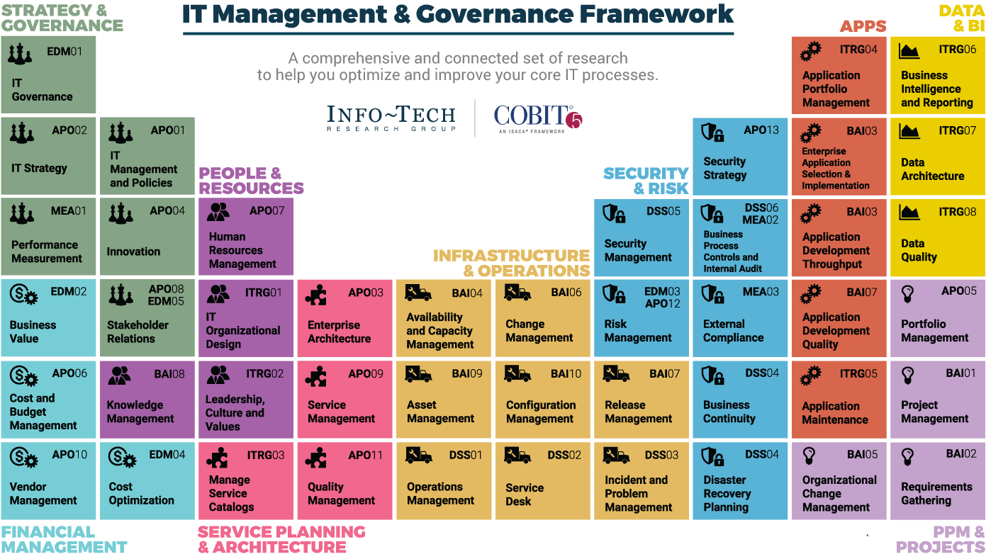
Dive Deeper Into Our Research
by Clicking One of the Elements Below
Find out how Info-Tech makes your job easier. Contact Us Today: Toll-Free (US & Canada): 1-888-670-8889
Info-Tech Research Group
SAMPLE

