Slide 1
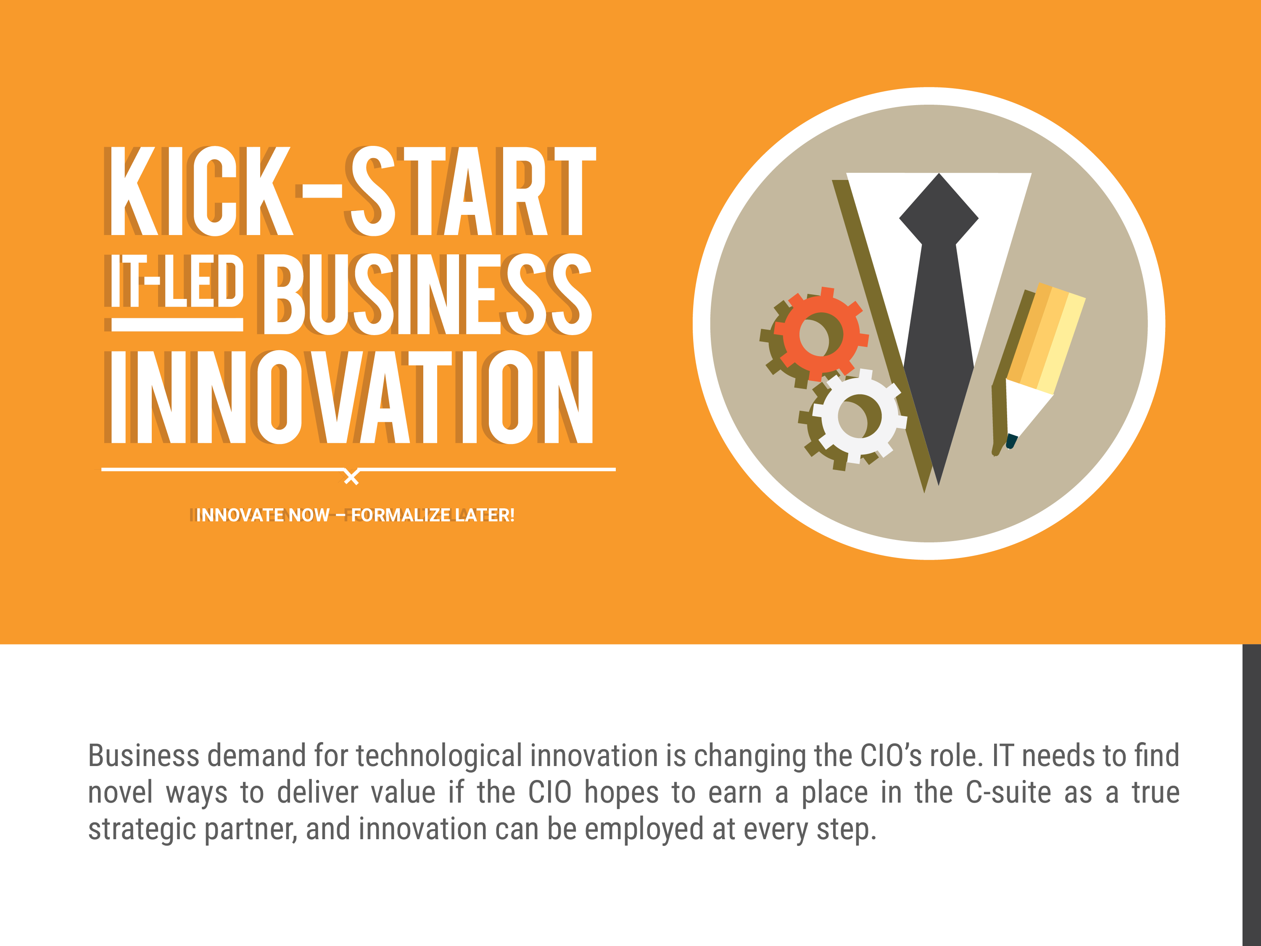

Slide 2
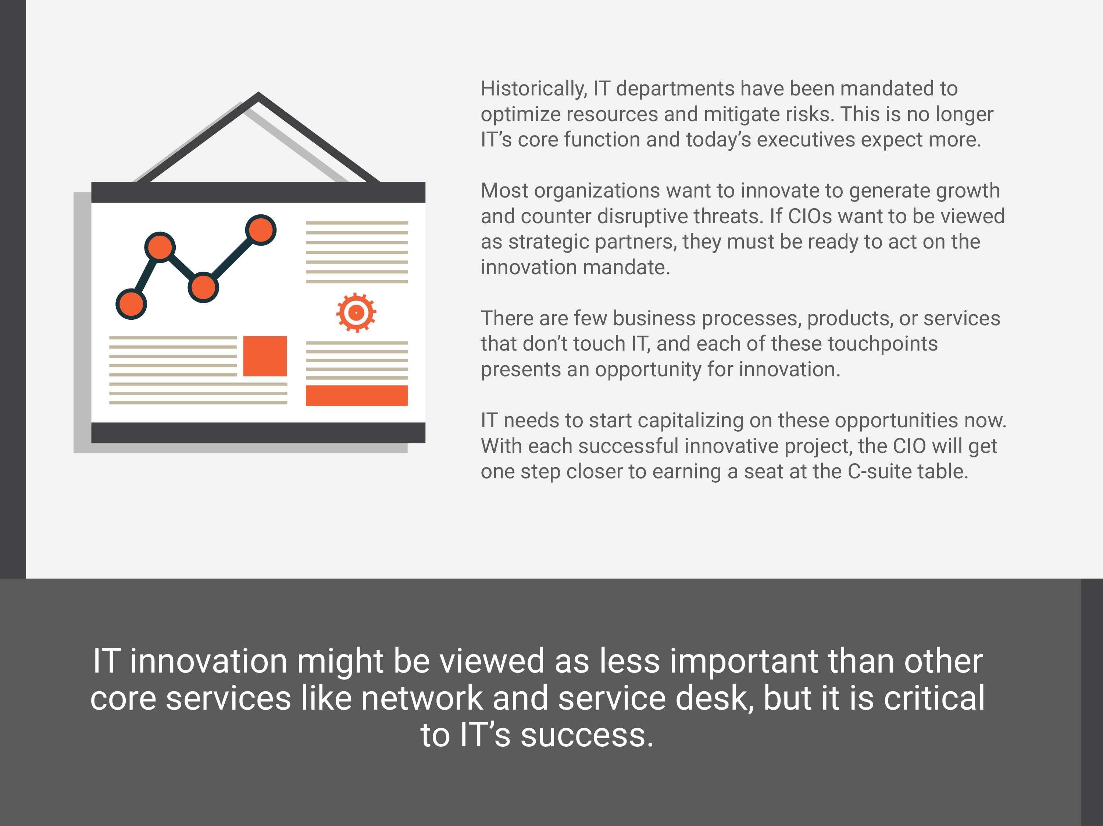

Slide 3
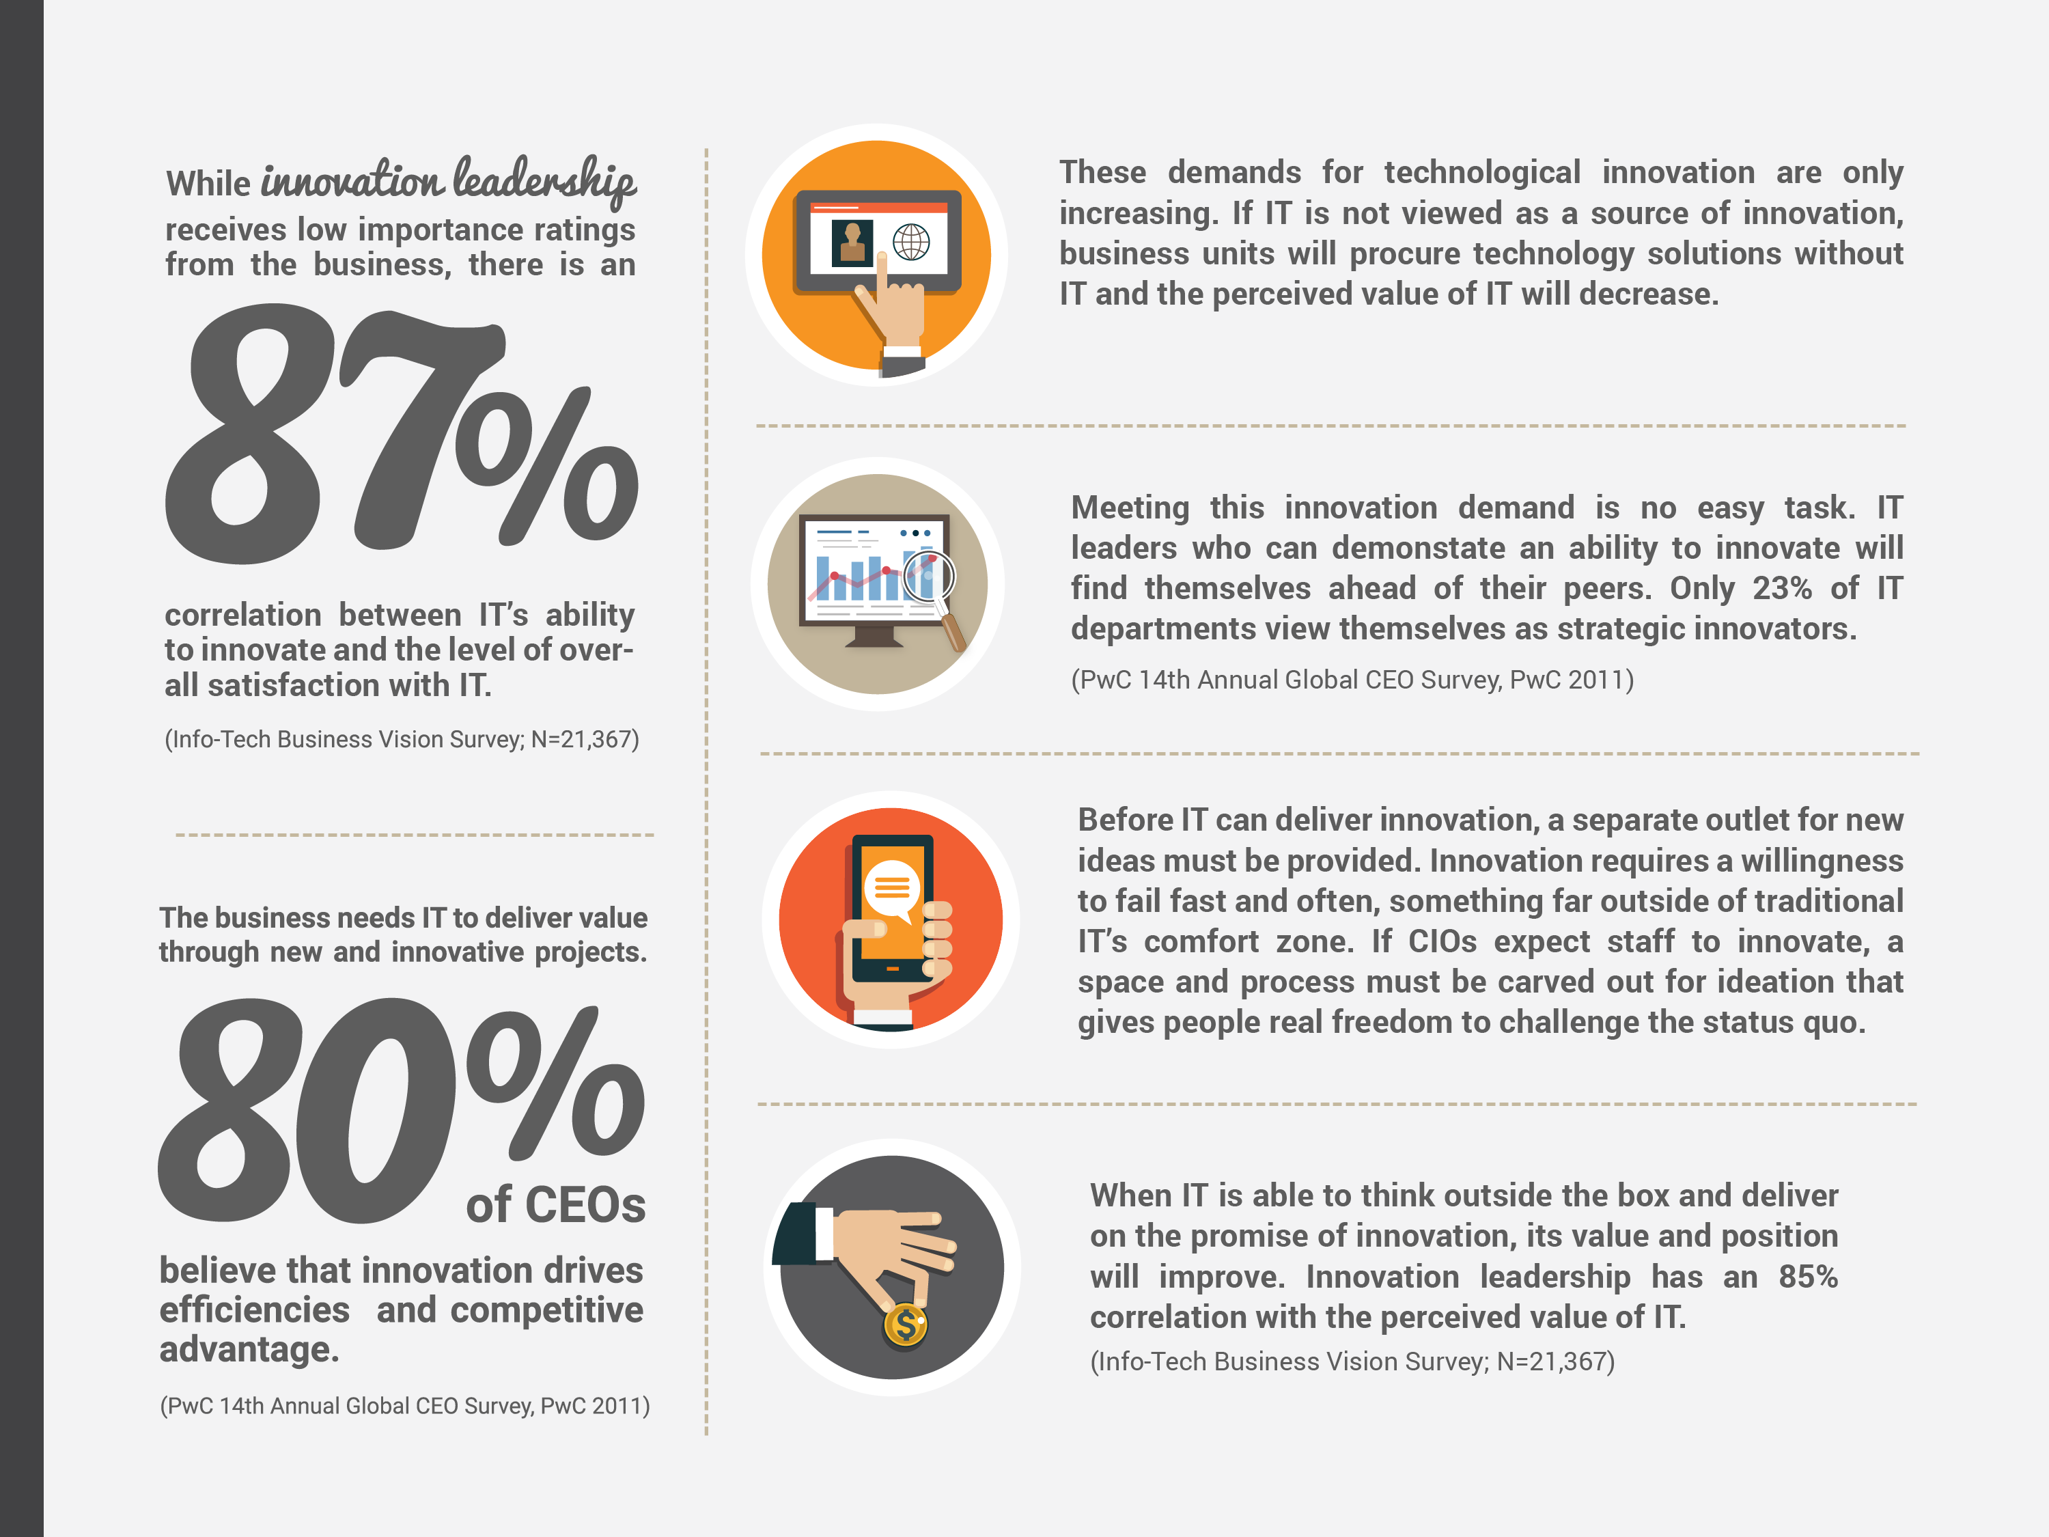

Slide 4
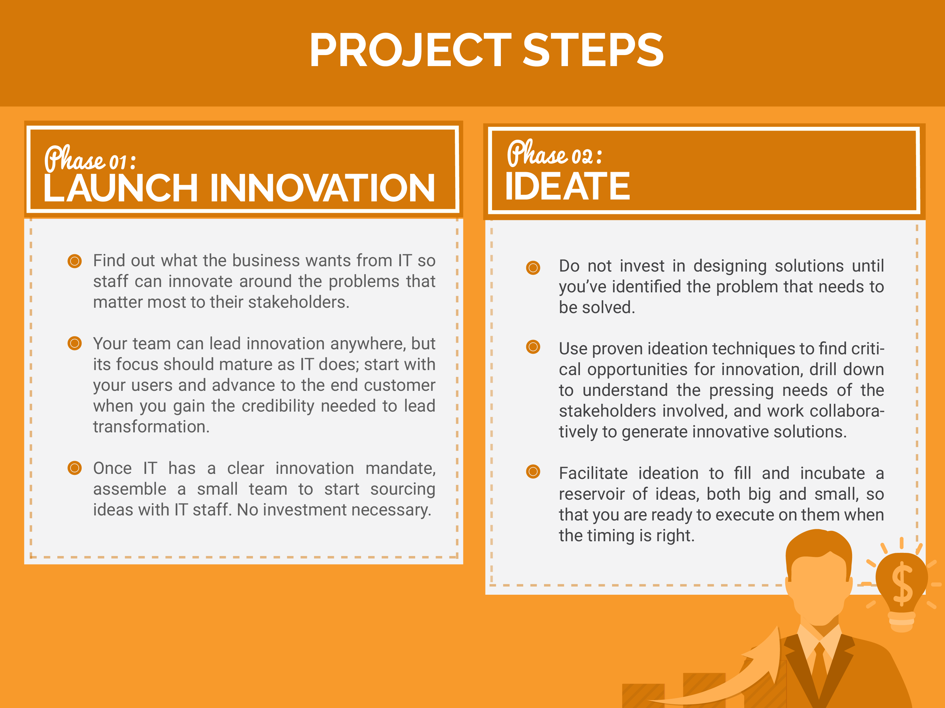

Slide 5
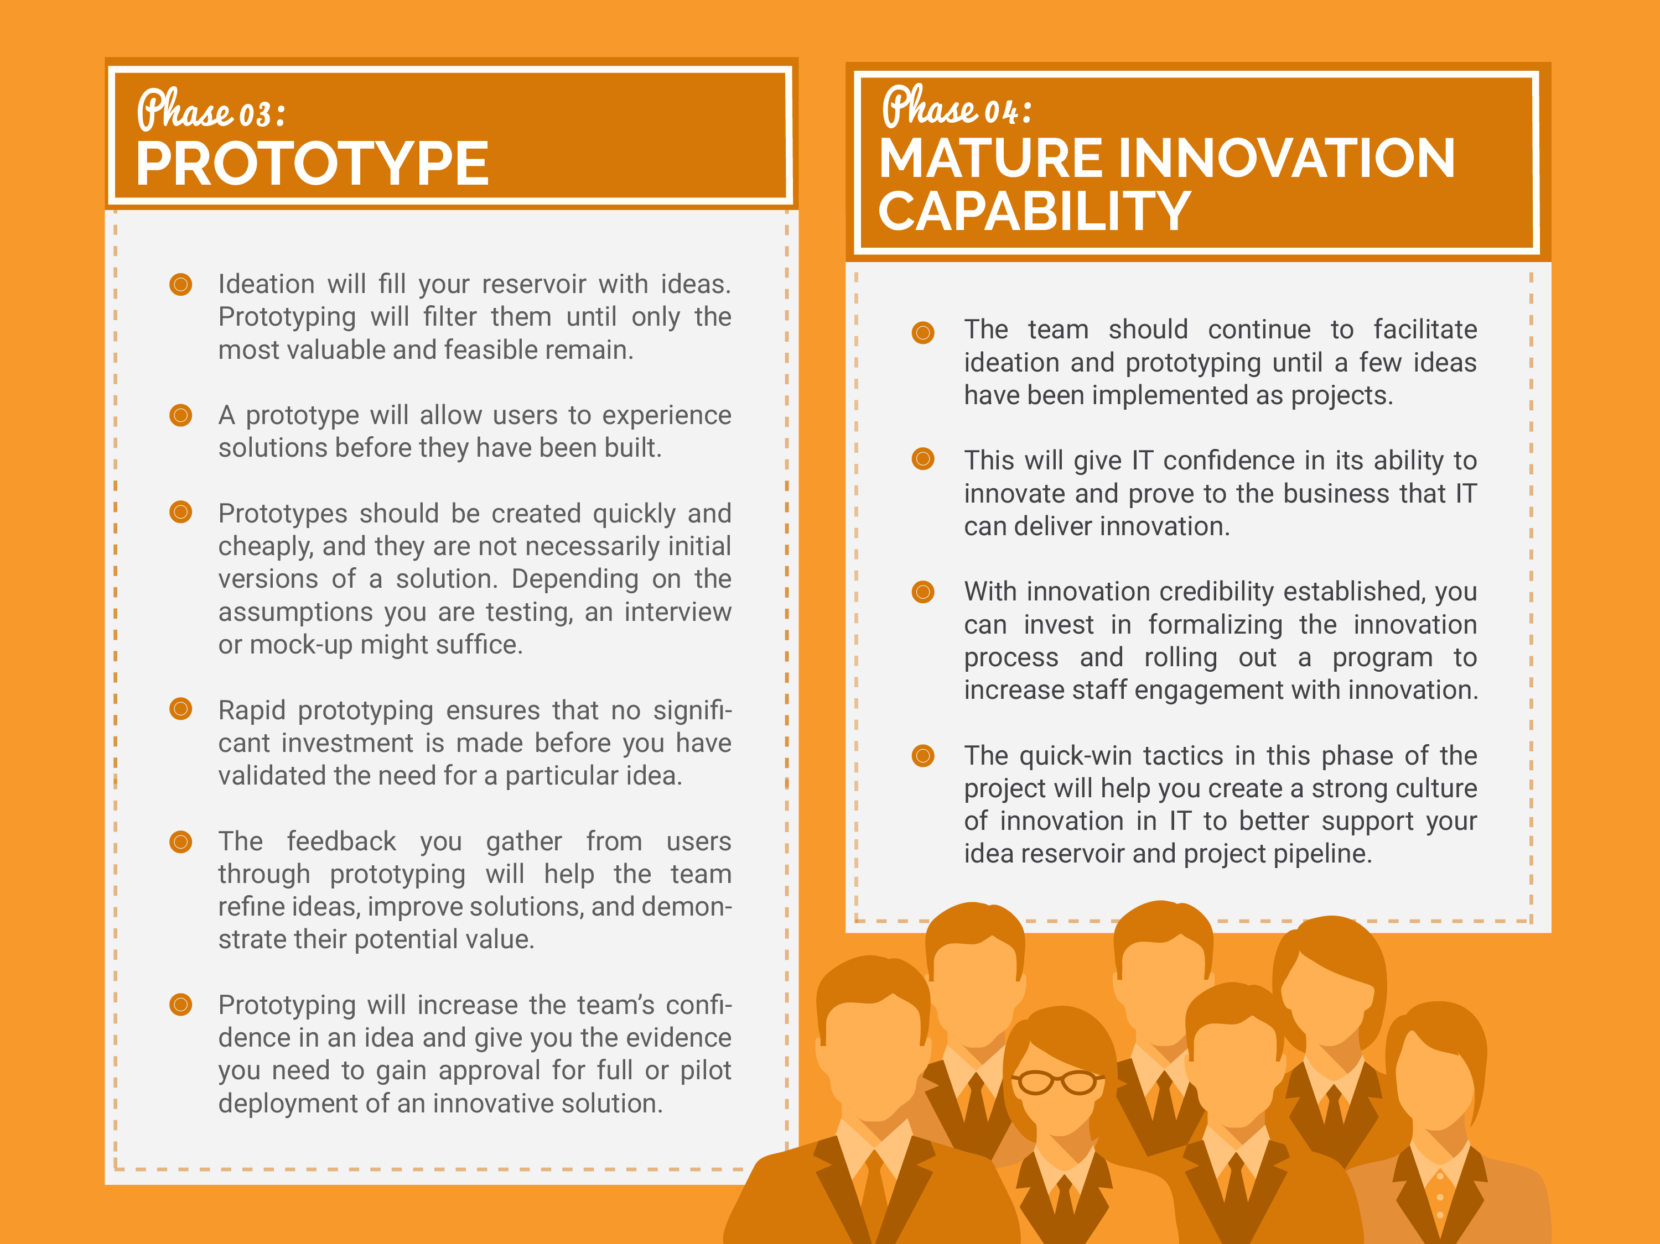

Slide 6
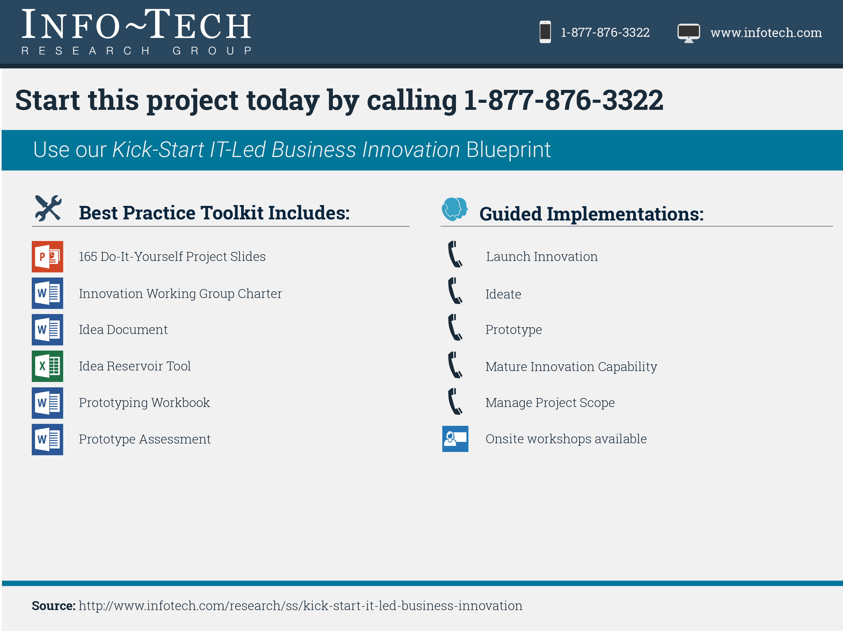

Slide 7

Kick Start IT-Led Business Innovation
Innovate now – formalize later!

Slide 8


How to navigate this Blueprint:
You are here
Executive Brief
Phase 1: Launch Innovation
Phase 2: Ideate
Phase 3: Prototype
Phase 4: Mature Capability
You are here to…. Learn about Info-Tech’s innovation methodology and approach. Decide if this project is right for your team. | Go here to… Define a sponsored mandate for innovation. Assemble a team to start facilitating ideation. | Go here to… Identify opportunities for innovation. Generate ideas. Prioritize ideas. | Go here to… Design prototypes. Socialize prototypes with users. Get prototypes approved. | Go here to… Design and implement improvements to your innovation process. Increase innovation engagement. Leverage our quick-win tactics.
Viewing Executive Brief | View Phase 1 | View Phase 2 | View Phase 3 | View Phase 4
View the entire Blueprint

Slide 9
Our understanding of the problem
CIOs
IT Directors
Senior IT Managers
Establish an innovation mandate for your IT organization.
Identify and capitalize on opportunities for IT-led innovation.
Prioritize ideas and prototype solutions that will fuel organizational success.
Establish and formalize an effective IT-led innovation process.
IT Managers
IT Staff
Business Stakeholders
Identify good opportunities for IT-led innovation.
Ideate around these opportunities.
Prototype effectively.
Gain business case approval for innovative solutions.

Slide 10
Executive Summary
The CIO is not considered a strategic partner. The business may be satisfied with IT services, but no one is looking to IT to solve business problems or drive the enterprise forward.
Even if IT staff do generate ideas that will improve operational efficiency or enable the business, few are ever assessed or executed upon.
Aim to develop innovators, not innovations. You need IT staff who intimately understand their users and are willing to fail often and fast to solve the problems that matter most.
Start innovating now, and refine the process later. Do not wait to begin creating a reservoir of ideas. All you need are business pains and people willing to ideate around them.
Business demand for new technology is creating added pressure to innovate. If IT is not viewed as a source of innovation, its perceived value will decrease and the threat of shadow IT will grow.
Executive stakeholders expect more from IT. IT needs to find novel ways to provide value if the CIO hopes to earn a place in the C-Suite.
Once you have defined your organization’s innovation mandate, assemble a small group to begin facilitating innovation. Waiting for someone to propose the next big idea does not work. Innovation requires purposeful and collaborative process.
This group will help your department identify the problems that present the best opportunities for IT-led innovation. Depending on your current maturity, you can address weaknesses in internal IT processes or look for ways to change business process and impact your customer directly.
Your innovation group will facilitate effective ideation and begin incubating a reservoir of ideas, both big and small, so that you are ready to execute on innovative projects when the timing is right.
Once you have a healthy reservoir of ideas, you can re-assess your innovation capability and further invest in building a permanent innovation program and process in IT.

Slide 11






















This blueprint was developed with input from seasoned innovators and IT leaders

Slide 12
Innovation leadership is highly correlated with overall IT satisfaction
Through CIO Business Vision, Info-Tech has asked over 21,300 business stakeholders to rate their satisfaction with twelve core IT services.
On average, innovation leadership receives low importance ratings from the business
However, innovation leadership is highly correlated to overall IT satisfaction*
Network Infrastructure
Service Desk
Business Applications
Data Quality
Devices
Analytical Capability
Client-Facing Technology
Work Orders
Innovation Leadership
Projects
IT Policies
Requirements Gathering
1
IT’s ability to innovate has an 87% correlation with the level of overall satisfaction with IT.
1
Projects
Work Orders
Innovation Leadership
Business Applications
Requirements Gathering
Service Desk
Client-Facing Technology
Network Infrastructure
Analytical Capability
Data Quality
IT Policies
Devices
2
2
3
3
4
4
5
5
6
6
7
7
8
8
9
Innovation leadership also has an 85% correlation with the perceived value of IT.
9
10
10
11
11
* As determined by strength of correlation between Core Service scores and Overall Satisfaction.
12
Info-Tech Business Vision Survey;
N = 21,367
12

Slide 13



The CIO wants into the C-Suite, and innovation can be employed at every step
Begin by treating innovation as problem solving, evolved. Use it to attack weaknesses in both user and customer-facing processes, and build the credibility IT needs to secure a seat in the boardroom.
The innovation gap
Transform products or services
Optimize business processes
Optimize IT processes
At some point in your innovation journey, the problems will become less obvious and the solutions even less so. To achieve true transformation, you will need to think more abstractly about the way the business interacts with its customers. Succeed and you may be able to position IT as the source of enterprise innovation.

Slide 14

As IT matures, the goal of innovation can shift from incremental improvement to business transformation
Innovation will help you get out of firefighting mode, but don’t stop there. In order to become a true strategic partner, you will need to innovate for the business.
Transformative Innovator – Transforms
Reliable Technology Innovation
Evolutionary Innovator – Expands
Effective Execution on Business Projects, Strategic Use of Analytics and Customer Technology
Trusted Operator – Optimizes
Effective Fulfillment of Work Orders, Functional Business Applications, and Reliable Service Management
Reliable Operator – Supports
Reliable Infrastructure and IT Service Desk
Firefighter – Struggles
Inability to Provide Reliable Business Services

Slide 15
Making the final leap from operator to innovator is no easy task; succeed and you’ll find yourself ahead of the pack
Only 23% of IT departments view themselves as strategic innovators.
Leverage technology to enable business expansion and define new industry frontiers.
Innovator
52% of IT departments view themselves as proactive operators.
Optimize business process, support business functions, and operational efficiencies.
Operator
25% of IT departments still view themselves as reactive fire fighters.
  Get the fundamentals right and keep the business happy.
Firefighter
Source: Info-Tech CIO Outlook, 2014

Slide 16


Do not be intimidated by the word; innovation is just a purposeful approach to problem solving
You don’t need to invent a new product, process, or service to be innovative. Innovation is simply a means of generating ideas and solutions that positively impact the business. This blueprint will help you develop innovators that are up to the task.
Identify an overlooked business pain.
Ideate and design an IT-enabled solution.
Implement the solution to solve the challenge. Deliver benefits to the business and bolster IT’s reputation.
Select a critical and well understood business pain.
An idea is only as good as the challenge it addresses. IT’s innovation process must assist with this critical problem identification step.

Slide 17

Innovation can be used to solve well-known business problems or the problems no one is talking about
Innovation begins when you define a problem. Once you start digging for pains, the opportunities are endless.
Innovate around a documented business pain.
Innovate around an overlooked business pain.
A shipping company was having difficultly measuring safety metrics on their vessels.
A craft brewery was having difficulty managing supply and ensuring customers had sufficient inventory.
The CIO was looking for opportunities to innovate and identified the safety reporting process as a source of pain.
Ships were not equipped with computers. Safety records were kept at sea and input manually when the vessel returned.
The CIO’s team ideated around this challenge and made the case for implementing tablets on ships.
Tablets, although not disruptive, allowed captains to record safety metrics in real-time and facilitated data-driven decision making. This was novel for the organization.
The IT director interviewed business stakeholders to identify challenges they faced in supply chain and inventory management.
The IT director observed that the business had limited information on real-time customer inventory. They did not know who needed what product and where it was needed.
The IT director consulted his IT sourcing team and prototyped an analytics application to track inventory at every establishment that sold their product.
IT was able to implement a solution for a problem before the problem had even been identified by the business unit.
Source: Info-Tech Research Interview; John Tavares, Network Administrator at Moran Towing Corporation
This is a sample case study for illustrative purposes only.

Slide 18




IT is perfectly suited to facilitate innovation, but is often unable to deliver
There are few business processes that don’t touch IT, and each of these touchpoints presents an opportunity for innovation. Why isn’t IT taking advantage?
  Low user engagement: User empathy is critical to successful innovation, whether the aim is to optimize an internal process or transform a product. Most IT staff are isolated from their users and even further removed from the organization’s customers.
  Fear of failure: Innovation requires a willingness to fail fast and often. The first 20 ideas may be killed, but the feedback gathered from these initial concepts will help teams develop the right solution quicker. For startups, this is a way of life, but in most other organizations, failure is still a bad word. If you expect your staff to innovate, you will need to carve out a distinct process and space for ideation that gives people the freedom to challenge the status quo.
It is not that innovation is the wild west, it’s that innovation is the other side of everything that made you successful.
– Anonymous, Chief Innovation Officer, Technology Services

Slide 19


You need to create an environment in which its safe to pursue out of the box ideas
The things that make IT an effective service provider – adherence to standards, risk management, and compliance – will also discourage innovation. Ideas might be generated, but fear and doubt will prevent anyone from acting on them.
Failure is expensive.
Management will not approve this idea.
If this idea fails, my job might be in jeopardy.
We cannot afford to take risks.
This will not comply with our standards.
Do not ask staff to innovate without providing a separate outlet for new ideas. Set aside time for facilitated ideation, encourage risk taking, set up a pipeline and reservoir for innovative ideas, and approve prototypes based on the potential benefit of implementing the solution and not the risk or cost.

Slide 20
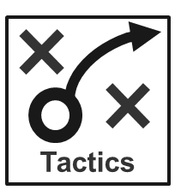




Info-Tech’s approach can get you innovating right away
Implement our quick-win tactics at any point to increase the level of innovation in IT.
Formalize the Innovation Process
Decide if you need to improve the innovation process or invest in a more permanent innovation program to increase the impact of your efforts.
Innovation Success
Get at least one prototype approved for pilot or full deployment. Gain credibility and generate wider interest in innovation.
Pilot Innovation Process
For 3-6 months, facilitate ideation and prototyping by running mini-workshops. Fill the idea reservoir.
IT’s Innovation Reputation
Kick-Start Innovation
Assemble a team to start sourcing ideas with IT staff. No investment necessary.
Resources Invested in Innovation

Slide 21

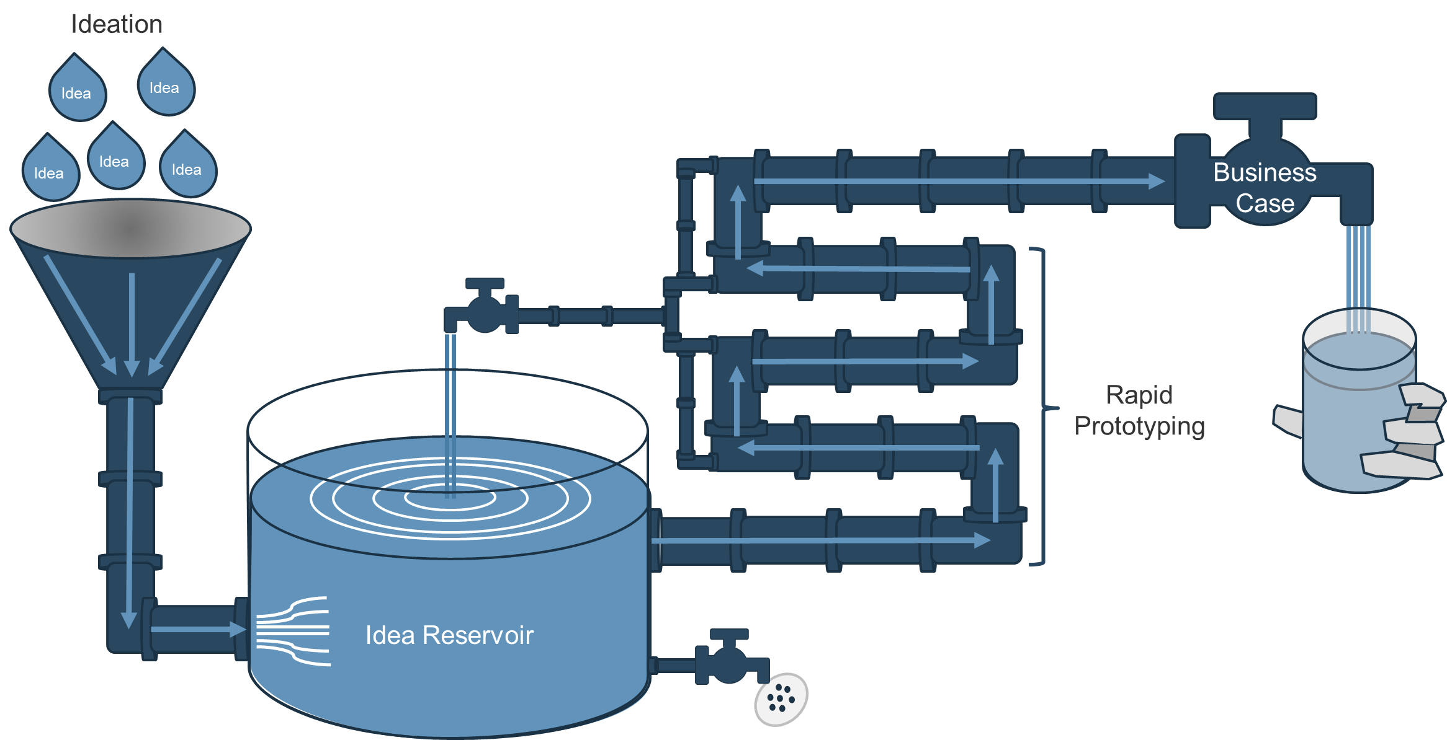
Our process will get you from idea to business case in 4 steps
1. Collaboration breeds innovation. We recommend that IT facilitate small group sessions to define and ideate around the problems that matter most and start feeding the idea reservoir.
4. Once an idea has been sufficiently prototyped to prove its value and feasibility, create a business case and seek project approval. It’s time to invest in a pilot or full deployment of the solution.
2. Avoid premature filtration. As the reservoir grows, you can integrate like-ideas to develop even better solutions.
3. Prototype cheaply and quickly to increase confidence in potential solutions. Good ideas that cannot be acted upon now will go back to the reservoir until the timing is right.

Slide 22
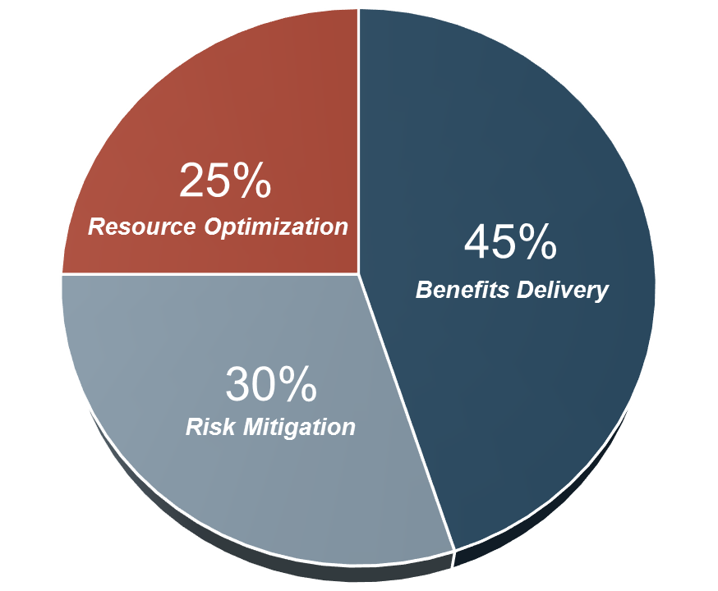
Our approach will help you deliver solutions that impact the top line
Historically, IT departments have been mandated to optimize resources and mitigate risks. This is no longer the core function of IT, and executives want more. We asked CEOs which business objectives IT should be able to support the best, and benefits delivery came first.
When IT delivers value through new projects, the business takes notice. Innovation will help you identify and act on these opportunities.
Source: Info-Tech CEO-CIO Alignment Program; N=60

Slide 23


With each successful innovative project, you’ll get one step closer to the boardroom
The Modern CEO Expects Innovation
The board never looks to the IT department to be the strategic planner. They have to earn the right to contribute to the broader organization.
– Former Chairman, nsight2day
80%
of CEOs believe that innovation drives efficiencies and competitive advantage.
PwC 14th Annual Global CEO Survey, PwC, 2011
73%
of highly innovative companies make primary IT investments into growth initiatives and leveraging emerging trends.
Raising your digital IQ,
PwC’s 4th annual digital IQ survey, 2012
Innovate Iteratively to Bolster IT’s Credibility
A
IT’s contribution to business strategy should be enormous. However, IT needs to earn the right to contribute first. Use Info-Tech’s approach to build innovation credibility and demonstrate the art of the possible.
Use Info-Tech’s methodology to identify unique opportunities and ideate ground-breaking solutions for the business. Prioritize opportunities and solutions appropriately so that IT does not over-extend itself and promise innovative solutions that it cannot deliver.
Arm your IT department with the skills to innovate. Leverage our tactics to build a culture of innovation in IT; as your practice matures, the business will take notice. IT will be viewed as both a source of innovation and a credible innovation facilitator.
B
C

Slide 24
Ready to apply our methodology? Select the right leader first
You can start asking your department to submit new ideas now, but you will be far more likely to succeed if you task a skilled and committed facilitator to own this as an initiative. For the next 3-6 months, this individual will:
Work with you to define a sponsored mandate for IT-led innovation.
Assemble and chair an innovation working group.
Guide the working group as it sources opportunities for innovation, assesses and prioritizes ideas, and facilitates ideation and prototyping.
Maintain the idea reservoir and feed the project pipeline.
The Ideal Project Lead has:
A vocal interest in innovation: entrepreneurial or design experience will be a plus.
Extensive facilitation experience: the best ideas are nurtured through collaborative sessions, and these benefit significantly from impartial and skilled facilitation. This experience might be gained through project work, consulting work, or formal training.
Strong relationships with most or all lines of business.
Program and project management experience.
Info-Tech Insight
Ideal Roles:
The architecture function is innovative by necessity, tasked with understanding the future state of the organization. If you have a strong staff member in this practice, he or she may be your best candidate.
Chief Architect/Enterprise Architect
Director/VP of Applications
Strategy or Planning Manager
Program Manager
Senior BA

Slide 25
Blueprint Timeline: It won’t take long to get started; set your team on the right path and watch innovation take flight
Your participation will be required to launch this initiative. Help your team define the innovation mandate to ensure that the projects generated by this process align with your objectives for IT.
2.1 Frame the Problem
1.1 Define the Innovation Mandate
4.1 Implement Process Improvements
1.2 Structure and Kick-Start
the Innovation Initiative
3.2 Approve Prototype
2.2 Ideate
4.2 Increase Innovation
Engagement
Start Innovating!
Week 1
Week 2-4
Months 2-6
Month 6
Month 7 and Beyond
3.2 Socialize Prototype
2.3 Prioritize Ideas
CIO involvement suggested
3.1 Design Prototype

Slide 26




Info-Tech offers various levels of project support to best suit your needs
Consulting
Workshop
Guided Implementation
“Our team does not have the time or the knowledge to take this project on. We need assistance through the entirety of this project.”
DIY Toolkit
Info-Tech Involvement
“We need to hit the ground running and get this project kicked off immediately. Our team has the ability to take this over once we get a framework and strategy in place.”
“Our team knows that we need to fix a process, but we need assistance to determine where to focus. Some check-ins along the way would help keep us on track.”
“Our team has already made this critical project a priority, and we have the time and capability, but some guidance along the way would be helpful.”
Degree of Customization
Diagnostics and consistent frameworks used throughout four options

Slide 27


Ready to innovate?
Start this project today by calling 1-877-876-3322
Launch Innovation
Ideate
Prototype
Mature Innovation Capability
Best-Practice Toolkit | 1.1 Define the Innovation Mandate 1.2 Structure and Kick-Start the Innovation Initiative | 2.1 Frame the Problem 2.2 Ideate 2.3 Prioritize Ideas | 3.1 Design Prototype 3.2 Socialize Prototype 3.2 Approve Prototype | 4.1 Implement Process Improvements 4.2 Increase Innovation Engagement 4.2 Leverage Quick-Win Tactics
Guided Implementations | Introduce innovation and set objectives. Select a team to begin facilitating innovation. Prepare to roll out the innovation process. | Identify opportunities for IT-led innovation and review any finalized problem statements. Discuss ideation techniques and review any completed idea documents. Establish an idea prioritization approach and help select top ideas. | Discuss prototyping techniques and review any completed prototype design work. Overcome prototyping challenges and review any user feedback. Prepare to submit business cases for completed prototypes. | Document the target innovation process. Create an action plan to operationalize the process. Identify innovation program components. Create an action plan to implement the innovation program. Assess innovation progress and address challenges.
 | Phase 1 Results: An innovation working group is created. | Phase 2 Results: New ideas are developed and prioritized. | Phase 3 Results: Prototypes are designed, socialized, and approved. | Phase 4 Results: A permanent innovation process and program is implemented.

Slide 28

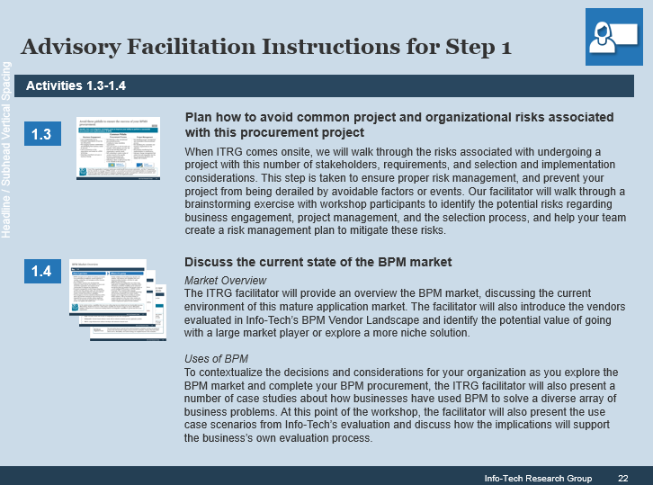
Or, accelerate your initiative with a workshop:
Contact your account representative or email Workshops@InfoTech.com for more information.
This workshop can be deployed as either a four or five day engagement depending on the level of preparation completed by the client prior to the facilitator arriving onsite.
Day 1 | Day 2 | Day 3 | Day 4 | Day 5
Preparation | Workshop Day | Workshop Day | Workshop Day | Workshop Day
Workshop Preparation Complete the CIO Business Vision Survey to assess overall IT maturity. Discuss the selection of workshop participants (based on the types of process pains you would like to ideate around). | Morning Itinerary Introduce innovation. Assess IT maturity. Define the innovation mandate. | Morning Itinerary Identify processes that present opportunities for IT-led innovation. Map selected processes. Finalize problem statements. | Morning Itinerary Select an urgent opportunity for IT-led innovation. Map the associated process. Finalize the problem statement. | Morning Itinerary Document a process for ideation. Assign roles and responsibilities. Document an action plan to roll out the process.
 | Afternoon Itinerary Introduce ideation. Practice ideation. | Afternoon Itinerary Establish ground rules for ideation. Generate ideas. Assess ideas. Pitch and prioritize ideas. | Afternoon Itinerary Generate ideas. Assess ideas. Pitch and prioritize ideas. Introduce prototyping. Map the user journey for top ideas. | Afternoon Itinerary Develop an innovation program. Document an action plan to roll out the innovation program. Summarize findings and gather feedback.
The light blue slides at the end of each section highlight the key activities and exercises that will be completed during the engagement with our analyst team.

