Slide 1


Implement Desktop Virtualization and Transition to Everything as a Service
Reports of desktop virtualization’s death have been greatly exaggerated; it is more powerful than ever, and part of a future-proof end-user computing strategy.
Info-Tech's products and services combine actionable insight and relevant advice with ready-to-use tools
and templates that cover the full spectrum of IT concerns.© 1997 - 2015 Info-Tech Research Group

Slide 2

Executive summary
Info-Tech Insight
Desktop virtualization is maturing. As we move into a post-PC world, businesses are looking at easier ways to manage the desktop. There are more virtualization options then ever, and many of the technologies, such as VDI, have made significant advancements in the last few years.
The push for businesses to be mobile is driving desktop virtualization adoption. As legacy PCs are reaching end of life, many businesses are looking for a solution that will support a mobile workforce.
Desktop virtualization technology has caught up to the dream. The last few hurdles are being overcome, and the value is higher than ever in a mobile, cloud-based world.
Focus on user experience. If the new user experience is not equal to or better than traditional desktops, the project will fail at the pilot stage.
The virtual desktop is only part of the device-agnostic workspace. A workspace that enables users from any device can involve desktop virtualization, but it’s only a piece of the puzzle.
There isn’t necessarily one desktop virtualization deployment method for all; unique evaluation of each user-group for fit with each deployment method is required in order to deploy a solution that is right for your organization.
Desktop virtualization options abound. VDI, DaaS, app virtualization? Each has strengths, drawbacks, and costs that should be considered.
Establish and align your IT goals with the solution requirements. Successful desktop virtualization involves implementing a solution that fits with the organization’s vision, but equally important is implementing it at a reasonable total cost, which can only be accomplished by establishing and aligning the goals and solution requirements.
Follow Info-Tech’s process for implementing the right desktop virtualization solution to create a project plan that will help ensure that you not only choose the right solution but also implement it effectively.
Balance user experience, infrastructure complexity, and total cost per desktop carefully as you evaluate the different desktop virtualization deployment methods, develop your strategy, run the pilot, and implement the solution.

Slide 3
Our understanding of the problem
Enterprises exploring desktop virtualization methods, such as virtual desktop infrastructure (VDI) and desktop as a service (DaaS), to replace or supplement traditional PCs and laptops.
Any size organization looking to enable multi-device access to ubiquitous virtual workspaces for professional workers.
Identify the key challenges and benefits associated with successful desktop virtualization implementation.
Review strategic priorities to ensure the right solution reaches the right users.
Plan and execute a full pilot, roll out the chosen technology, measure success, and enable future optimization.
Understand what’s new in the desktop virtualization market.
Determine which solutions are most appropriate for particular user-groups and scenarios.
Create a list of solution requirements, develop an RFP, and score the responses to select which solution—or set of solutions—is the best fit for the use cases.
Plan the pilot for the chosen solution(s) with the appropriate user-group to gauge project success.
Develop an implementation plan to roll out the desktop virtualization solution to the organization.

Slide 4

Introduction:
Desktop Virtualization for the Cloudy, Post-PC, Everything-as-a-Service World

Slide 5

There are at least three good reasons to pursue desktop virtualization
What is desktop virtualization?
Desktop virtualization (DV) separates the management and operation of desktop applications and operating system (OS) from physical machines through the various layers of virtual abstraction. These virtual desktops (or workspaces) are remotely accessed from a user access device (i.e. desktop, laptop, thin client, or mobile device). Access is managed through a connection broker. The broker connects the user with a specific set of virtualized desktop resources.
Why should we pursue desktop virtualization?
The time is right: software / hardware solutions are maturing.
DV products are evolving to deliver broader “workspaces” that include access to Windows applications and desktops, but also mobile and cloud-based applications and services. Infrastructure ranging from solid state storage to hyper-converged appliances is enabling performance at a lower cost per user.
Contribute to the IT transformation to everything-as-a-service.
The future of IT is less asset management and more brokering of services. This includes less PC management and more Desktop as a Service (DaaS).
Enable the transition to post-PC end-user computing.
Mobility and cloud are transforming the end-user experience from the Windows desktop on a fixed asset PC to software and services consumed from a range of devices.
Desktop virtualization enables IT to:
  Reduce deskside support costs by up to 40% through centralized desktop/app deployment and management, and improved desktop reliability.
  Boost productivity and flexibility by providing users with anywhere and any device access to their work.
  Bolster security of user data, and simplify disaster recovery by separating desktop processing and storage from hardware.
  Lower operational expenses by extending the life of desktop hardware (avoid the dreaded “big bang” refresh).

Slide 6
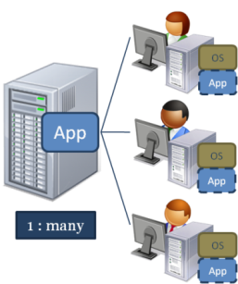
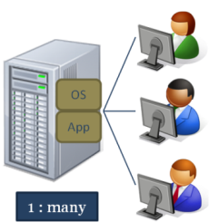
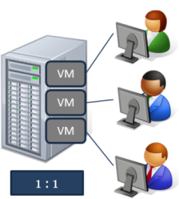

Desktop virtualization: the story so far…
Traditionally, the “desktop” in desktop virtualization has been the Microsoft Windows PC desktop and applications delivered as a service.
Desktop virtualization has been about the abstraction of Microsoft Windows client applications, as well as the Windows OS, away from the desktop PC and managing those end-user computing resources as delivered services.
The traditional methods of accomplishing desktop virtualization have been to:
  Host and share applications on a server (shared session hosting). Examples: Citrix XenApp, Microsoft Terminal Services.
  Stream virtualized applications to the desktop where they run within a virtual bubble. Example: Microsoft App-V.
  Host the entire desktop stack, OS, and applications on server-hosted virtual machines (virtual desktop infrastructure, or VDI). Examples: VMware View, Citrix XenDesktop.
These methods are not mutually exclusive. For example, a VDI desktop may itself access server session hosted applications. Organizations have had success with desktop virtualization leveraging multiple delivery methods to meet the needs of different types of workers.
Cloud Desktop-as-a-Service (DaaS) is next:
The above are typically hosted in on-premise data centers. The new thing is hosting desktop services in the external cloud. Example: VMware vCloud Air Desktop.
Session Virtualization
Application Virtualization
Virtual Desktop Infrastructure
Desktop-as-a-Service

Slide 7
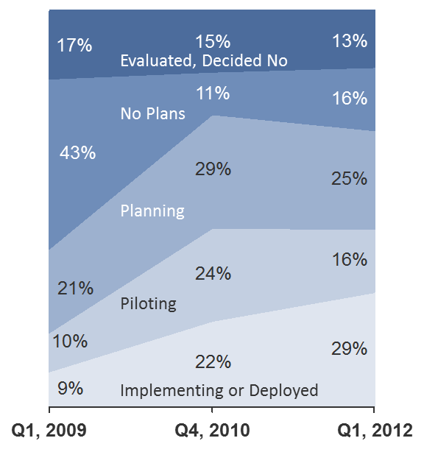
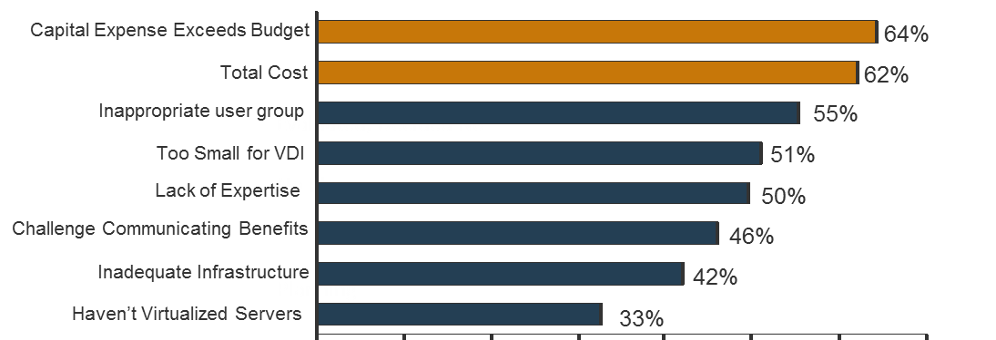
Virtual desktop infrastructure (VDI) has been through several challenges
Though session sharing of applications has been around since the 1990s (think Citrix Metaframe and Microsoft Terminal Services), desktop virtualization had a renewed boost beginning in 2008 with the rise of VDI options concurrent with increased use of server virtualization in the data center (VMware VDI and Citrix XenDesktop). After an initial flood of interest, and a significant amount of proof of concept piloting, adoption of VDI leveled off in about 2012.
Main reasons for this stalling of VDI development included:
Storage performance bottlenecks. Early adopters found that VDI tested well but did not scale well. The problem was particularly acute in storage, where traditional network storage arrays could not keep up with aggregate IO spikes, particularly elevated write to disk traffic.
Cost and complexity of solutions. Throwing more storage at the problem meant that in a migration from PC to VDI, the most inexpensive storage media available (consumer SATA drives in PCs) was being replaced with the most expensive media (enterprise grade solid state storage). Managing the VDI solutions also proved complex at scale.
Lack of necessity. A full VDI desktop is not necessary in every case. Traditional application delivery was not replaced by VDI but rather augmented and extended to new use cases by VDI. Focusing on VDI as the only solution for all use cases led to overspending and overprovisioning.
After initial enthusiasm, planning and piloting VDI leveled off in 2012. VDI implementation continues to advance but it is not taking the world by storm
Source: Info-Tech Research Group, N=102
Those who chose not to implement a VDI solution cited capital expense and total cost as the biggest barriers, followed by VDI not being the right DV solution for their user group.

Slide 8
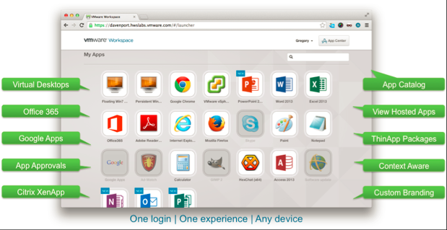


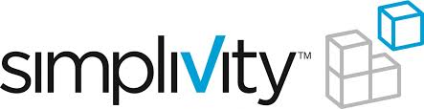
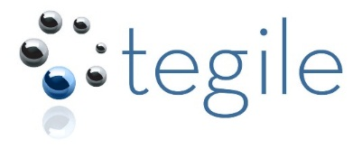

Overcome past challenges by improving hardware and software options
Software and hardware solutions are evolving to mitigate performance and cost challenges. DV products are evolving to deliver broader “workspaces.”
Key vendors in desktop virtualization software (Citrix, VMware) have evolved their products to deliver broader “workspaces” that include access to Windows applications and desktops, but also mobile and cloud-based applications and services. Microsoft is also making its core products more amenable to as-a-service delivery with their own cloud-first, mobile-first strategy.
Developments in storage technology—including falling cost of solid state storage and emerging hybrid solutions as well as hyperconverged storage/server appliances—are mitigating a number of performance and cost challenges of desktop virtualization (especially VDI).
Some vendors of hyperconverged appliances for VDI:
Some vendors of innovative hybrid solid state/disk storage arrays:
Example of VMware Horizon workspace. Citrix also has a Workspace product.

Slide 9
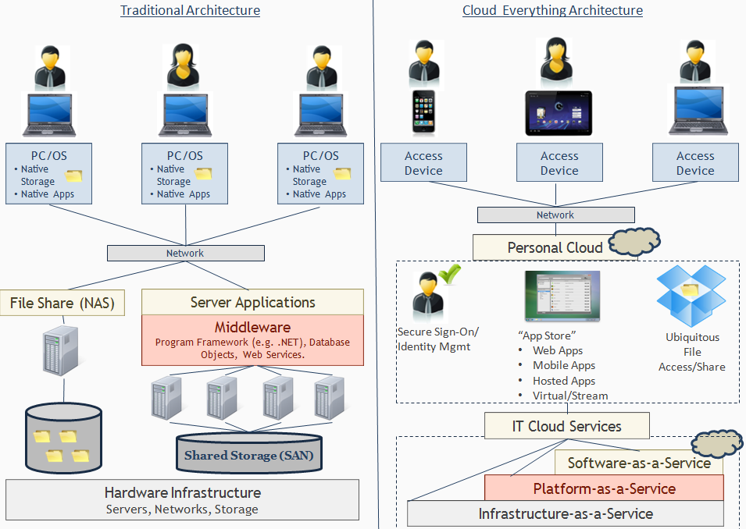
Begin the IT transformation into everything-as-a-service
In response to trends in convergence, virtualization, and cloud computing, IT departments are looking to transform from cost center technical asset managers to business enabling service brokers. Distributed desktop PCs are exemplars of the old asset management approach.
Also referred to as mobile cloud and cloud workspaces
Can be hosted on premise (private cloud), off premise, or a combination of both (hybrid cloud)

Slide 10

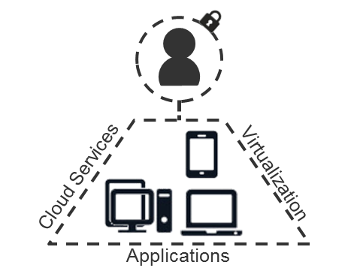
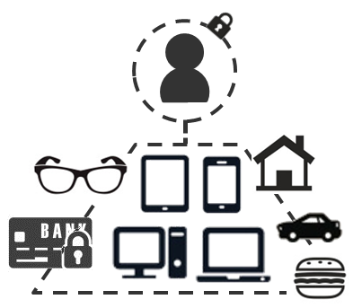
Enable the transition to the post-PC, multi-device world
Concurrent with the everything-as-a-service trend related to cloud computing, another major disruptive force in end-user computing has been the growth of mobile devices – smartphones, tablets, and the general mobility of users.
End-user computing is becoming an affair of multiple device types and multiple device ownership models, with bring-your-own options becoming commonplace.
A crucial first step in moving from the past of distributed PCs to the future of post PC is to break the bond tying Windows apps and desktop environments to those fixed asset distributed PCs.
10 Years Ago
Today
10 Years Later
Users were assigned to specific workstations to complete daily tasks using applications on the computers. Device variety and BYOD were not major issues.
Users have multiple endpoint devices, but maintain their unique profile across them. Access anywhere, anytime is technologically possible—and expected to be enabled by IT.
End-user computing will infuse itself into aspects of life currently unrelated to computing, further increasing the need to support a variety of devices, applications, and ownership models.

Slide 11
Best practice advice: plan your DV implementation with realistic goals and conduct a meaningful real-world pilot
Set realistic goals and cost estimates
Bad strategy will invariably lead to bad outcomes. Desktop virtualization is not for everybody. Make sure the use case is appropriate and that total costs are based on a realistic assessment of what it will take to deliver the solution at full scale.
Info-Tech clients ranked the importance of eight implementation activities
Ensure adequate capacity before implementation
1
Gain executive buy-in and support
2
Pilot to test implementation, not desktop virtualization itself
Successful proof of concept pilots have not been predictors of implementation success. As the market has gained experience in desktop virtualization challenges, pilots were rated as less important. A meaningful pilot tests assumptions for full implementation and uncovers potential pitfalls and pain points. Use a smaller proof of concept if desktop virtualization is still being evaluated.
Pilot with users
3
Conduct ROI or cost benefit analysis
4
Test more than one DV solution
5
Train IT staff
6
Create comm. strategy for users
7
Explore alternatives that will lower TCO
Desktop virtualization is not often a capital savings quick win, but neither is it a cost driver. Look for opportunities to lower TCO and continually revise your TCO calculations as you assess each stage of the project.
Use consultants/3rd party help
8
Source: Info-Tech Research Group, N=55
Desktop virtualization implementations that succeed focus on goal setting, piloting implementation, and minimizing TCO.

Slide 12
Organizations have improved desktop virtualization success with Info-Tech’s three-phase approach to implementation
Critical points where go / no-go decisions have to be made.
1
Strategy
3
Implement
2
Pilot
1. Strategy
  Why are you doing desktop virtualization?
  Who is going to use it?
  How will it be provisioned?
  What is the total cost?
  Go / no-go decision. If go, pilot.
2. Pilot
  Infrastructure and user requirements
  Desktop configuration
  What worked?
  What didn’t work / how to fix it?
  How will it scale (infrastructure)?
  How much will it cost to scale (TCO)?
  Go / no-go decision. If go, implement.
3. Implement
  Infrastructure plan
  Training / support
  Success measures
  Review / checkpoint

Slide 13
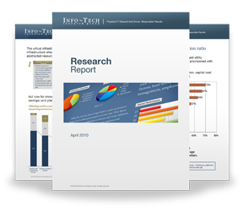

Info-Tech Research Group Helps IT Professionals To:
Quickly get up to speed
with new technologies
Make the right technology
purchasing decisions – fast
Deliver critical IT
projects, on time and
within budget
Manage business expectations
Justify IT spending and
prove the value of IT
Train IT staff and effectively
manage an IT department
Sign up for free trial membership to get practical
solutions for your IT challenges
“Info-Tech helps me to be proactive instead of reactive –
a cardinal rule in a stable and leading edge IT environment.
  - ARCS Commercial Mortgage Co., LP
Toll Free: 1-888-670-8889
www.infotech.com

