Slide 1
Build an Extensible Data Warehouse Foundation
Establish a well-architected core model with just enough oversight and governance.

Slide 2
ANALYST PERSPECTIVE
Don’t just build a data warehouse, build it smartly.
Data warehouse projects are some of the most challenging projects for IT because of their complexity. That being said, the data warehouse is still a technology that can help you gain a significant competitive advantage.
Start by architecting a data warehouse correctly and build it one subject area at a time.
Similar to building a house, the key to success is creating manageable pieces and integrating those pieces based on a well-architected plan and foundation with just enough oversight and governance. With this approach, you are able to develop a program around the data warehouse that will be able to empower your business over time.
Daniel Ko,
Manager, Information Management
Info-Tech Research Group

Slide 3
Our understanding of the problem
CIOs who want to build a data warehouse (DW) that helps business users make informed decisions.
Business executives who want to work with IT to leverage a data warehouse to improve business processes and access to correct data.
Establish an overall vision and identify key business processes for data warehousing.
Create the minimal level of data warehouse governance to maintain your data warehouse.
Understand business needs to pick the most suitable technological option for the data warehouse.
Project managers and business analysts in accelerating a data warehousing project by following a best-practice data warehousing approach that leverages emerging data modeling patterns and data technologies.
Architects who want to make the most logical data warehouse decisions.
Identify which architectural components suit your needs.
Populate source data into the data warehouse using the Rosetta Stone approach.
Detail the essential data elements that will feed tables in the core of the data warehouse.

Slide 4
Executive summary
Organizations are fully aware that data is a critical asset and an indispensable element in successful decision making.
The data and information landscapes have drastically expanded and diversified; combined with the increase in the speed of business, decision makers are in need of a system that provides the right information at the right time.
A data warehouse is a project; but successful data warehousing is a program. An effective data warehouse requires planning beyond the initial technology implementation.
Governance, not technology needs to be the core support system for enabling a data warehouse program.
Understand business processes at the operational, tactical, and ad hoc levels to ensure a fit-for-purpose data warehouse is built.
Data warehouse implementation is a costly and complex undertaking, and can end up not serving the business needs appropriately.
Too heavy a focus on technology creates a data warehouse that isn’t sustainable and ends up with poor adoption.
Emerging data sources and technologies add complexity to how the appropriate data is made available to business users.
Leverage an approach that focuses on constructing a data warehouse foundation that is able to address a combination of operational, tactical, and ad hoc business needs.
Invest time and effort to put together pre-project governance to inform and provide guidance to your data warehouse implementation with minimal ongoing operations requirements to keep the data warehouse healthy.
Develop the “Rosetta Stone” views of your data assets to facilitate data modeling and the order of building your data warehouse environment.
Select the most suitable architecture pattern to ensure the data warehouse is “built right” at the very beginning.

Slide 5
The speed of business is showing no signs of slowing down
Globalization of commerce and the shift towards creating customer experiences are significant drivers in the quickening of business users’ information needs.
57%
Of business users are unsatisfied with the speed of information delivery
and
yet
55%
Don’t feel they have access to data relevant to decision making
Sixty-six percent of business users reported a “shortening of their decision-making window”
Source: Aberdeen Group, 2014
Source: Aberdeen Group, 2014

Slide 6
Enterprise-wide views of data drive more holistic insights
Application-level reporting is ideal for short-term, operational decision making, and time-based reporting for in-application data. However, this same data becomes difficult to access and costly to leverage when trying to combine with other datasets to make enterprise strategic decisions if there is no data warehouse that has already defined the true sources of data for just such purposes.
Source: Deloitte, 2013
By creating a data warehouse environment layer that focuses on integrating real-time and historical data from multiple data sources and can be dedicated to reporting, your organization is in a better position for information sharing and enterprise-wide collaborative decision making that is efficient, effective, and timely.
Source: Deloitte, 2013

Slide 7
What is a data warehouse and why do you need it?
An integrated, centralized decision-support database and the related software programs used to collect, cleanse, transform, and store data from a variety of operational sources to support business intelligence. A data warehouse may also include dependent data marts (DAMA-DMBOK Guide, 2009).
Data Value Chain
Business intelligence is becoming a table stakes activity; all organizations need hard evidence to support decision making.
Shared Insight
Knowledge
Information
Data
Data warehouses (and associated architecture) bridge the gap between mass accumulation of data in source systems and comprehensive views of information, en route to creating shared insight and institutional knowledge at the top of the data value chain.

Slide 8
Industry Spotlight: Enterprise data warehouses are driving new value in the US healthcare sector
As healthcare organizations today are motivated more than ever to provide better patient outcomes per dollar spent, the use of business intelligence tools to facilitate data-driven decision making is imperative. Data comes from multiple sources, such as electronic health records (EHRs), financial systems, patient satisfaction surveys, and external laboratory testing databases – all may be used to improve services delivered.
At Texas Children’s Hospital, reports sourced from
the enterprise data warehouse cost 70% less to build than reports created directly from EHRs; one well-planned and flexible data visualization was able to replace ten static reports.
Key Benefits of the Healthcare Data Warehouse:
Enabling a More Efficient, Scalable Reporting Process
Using the enterprise data warehouse as a single source of truth, North Memorial Healthcare was able to coordinate multiple groups of healthcare professionals to reduce the number of pre-39 week deliveries by 75%.
Ensuring Consistent Data That Everyone Can Trust
Enabling Meaningful, Targeted Quality Improvement
Source: Health Catalyst, 2014

Slide 9
Industry Spotlight: Streamlining data availability to improve reporting in government finance
Tanzanian Revenue Authority (TRA) is responsible for several financial functions of the government, including the collection of tax revenues and conducting research to advise changes to tax policies. The Research, Policy and Planning department of the TRA ran into significant challenges with reporting and analysis as a result of having no centralized point of access for data residing in multiple siloes.
Source: TechnoBrain, 2015
TRA established an enterprise data warehouse that served as a hub to link internal and external data sources across departments. In addition to the storage infrastructure, the enterprise DW was designed for easy linkage to business intelligence tools and incorporated strict data validation and security procedures.
DW Adoption
Benefits:
1
Automated Data Integration
3
Third-Party System Integration
2
Automation of Business Process
4
Centralized Database Management System

Slide 10
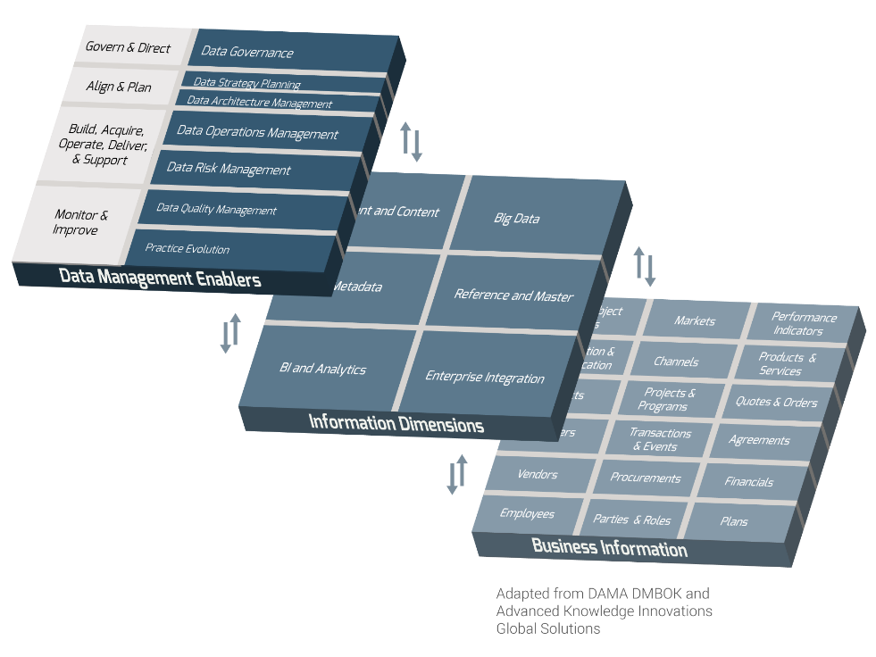
Data warehousing solutions are viewed as essential, but major challenges remain
A data warehouse is a powerful enabler in converting data to a usable asset, but can quickly turn into a nightmare when issues beyond the technology arise.
Successful data warehousing is reliant on several data management enablers in Info-Tech’s data management framework, namely data governance and data quality management.
Dealing with data quality and consistency issues
Integrating data from disparate sources
Getting funding/executive support for new projects
Managing multiple data warehouses or data marts
Integrating DWs with “big data” systems/
unstructured data stores
Managing growing volumes of data in data warehouse
Evaluating and selecting data warehouse technology
Maintaining system performance and availability
Implementing additional data warehouses
Scaling systems to support more users/queries
Source: Tech Target, 2013

Slide 11
Big data technology might be revolutionizing data warehousing, but the core isn’t going anywhere
With the excitement around big data and associated technologies that allow for ingestion and processing of larger volumes and varieties of data, some have been quick to say that the current state of data warehousing will be a thing of the past.
However,
What technologies does your organization plan to use to support its big data environment?
Mainstream relational databases/data warehouses
Analytics databases (columnar, MPP, etc.)
Data warehouse appliances
Hadoop/MapReduce
Data virtualization software
Complex event processing/real-time data integration tools
NoSQL databases
Other
and…
96%
of organizations do not see big data taking the place of the existing data warehouse infrastructure.
Source: Dimensional Research, 2015
Hadoop, NoSQL, and similar platforms are attractive for providing new capabilities for combining and storing data sets, but they do not replace a data warehouse; they COMPLEMENT a data warehouse.

Slide 12
Info-Tech emphasizes that a successful data warehouse should be framed as a program, not a project
Due to the high implementation costs and intensive architectural planning up-front, there is a tendency to assume that the data warehouse will simply run itself once the “project” is completed.
Data warehousing is a long-term commitment to creating an environment that facilitates data delivery and information consolidation for business users.
The biggest issue is that data warehouses are funded as a one-time project; they’re a living organism and need to have dedicated resources.
– Chris Debo
Senior Manager, Schneider Downs & Co., Inc.
Investing in defined processes and governance up-front is arguably just as integral to data warehouse sustainability as architecture or the technology platform.

Slide 13
Embed extensibility within the foundation of your data warehouse program
Industry-specific innovation will continue to change the standard for how products and services are delivered to consumers, forcing organizations to find new ways to accommodate these demands.
Rapid advances in technology are creating new opportunities for data-driven insight, primarily through the harnessing of big data.
And still…
55%
of organizations are currently unimpressed with the data warehouse’s ability to handle unstructured data (The Information Difference, 2015).
Pre-empt user dissatisfaction by building a core that can support a wider variety of business needs.

Slide 14
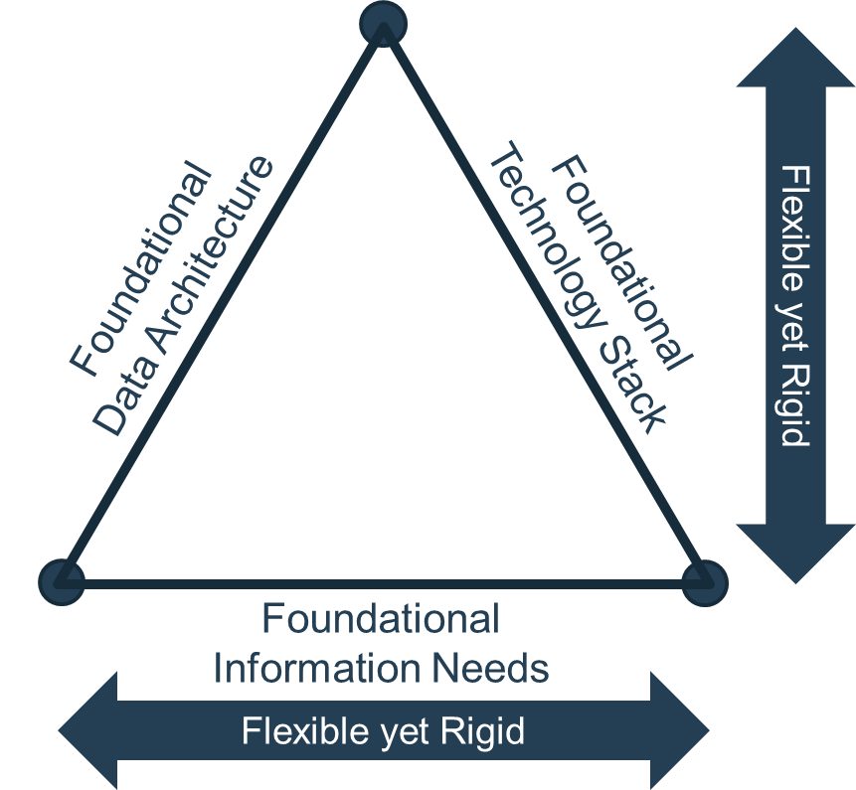
Use a three-piece framework to support your foundation
Inspired by architecture, a strong data warehouse foundation can be constructed using a triangular structure that is made of 1) foundational information needs, 2) foundational data architecture, and 3) foundational technology stack.
Future iterations will be built on top of this triangular structure. Foundational understanding of information needs has to be established to provide context for the data warehouse. High-level data modeling has to be completed to handle the common business entities of your organization. The right technologies have to be selected so that the stack is flexible yet solid for future development.

Slide 15
Follow Info-Tech’s approach to creating a robust data warehouse foundation
Business needs are going to constantly be evolving, with data and information needs of users following suit. Without creating a base from which you can adapt to these changes, IT runs the risk of alienating business users and hindering your company’s growth.
Info-Tech’s methodology will take you through the following challenges:
1
Identification of business processes
2
Standardizing data modeling guidelines
A data warehouse is destined for failure if its functions are not directly tied to facilitating business processes and activities. In-depth brainstorming sessions to get to the root of business opportunities and frustrations will provide greater insight into how IT can construct the right environment.
Solution: Our blueprint uses in-depth brainstorming sessions as a starting point to get to the root of business opportunities and frustrations to provide greater insight into how IT can construct the right environment.
Neglecting to devote appropriate time and resources to ensuring the relationships between data assets are sound will compromise reaching the end goal of an enterprise-wide view.
Solution: Info-Tech will provide your organization with a set of comprehensive templates containing important considerations that need to inform how data is characterized and linked within your data warehouse.
3
Right-sizing the architecture
4
Creating sustainable governance
Data warehouses can be a central part of a data architecture or data delivery model, but it needs to be supported by other components to provide some flexibility.
Solution: By having a thorough understanding of the business objectives, selecting the right pieces to your data warehousing puzzle is much more straightforward. Thorough descriptions of the different architectural pieces will help your data warehouse project team pick the best technologies for your business environment.
Without a robust governance plan for how the data warehouse will be continually used and expanded upon, even the most sophisticated platform will become a data management nightmare.
Solution: By discussing a wide variety of processes to consider before jumping into the technology, your project team will have a set of flexible guidelines to ensure the integrity of the data warehouse as the program grows.

Slide 16
Keep track of your data warehouse success as your program develops
Data Hoarder
Data Organizer
Data Facilitator
Data Source 1
Report
Build an Extensible Data Warehouse Foundation
Analytics
Data Warehouse Program
Data Source 2
Report
Self-Service BI
Iteration 2
Data Source 3
Iteration 1
Query
Data Mining
Data Source 4
Your current environment is too heavily reliant on point-to-point sourcing of data that produces inconsistent reporting. Without a proper understanding of what your users want and what the underlying data model should be, business intelligence capabilities are impaired and business satisfaction decreases.
This blueprint focuses on building a foundation that allows for later iterations to be layered on top by detailing business processes that will inform data model and architecture design. Combined with creating governance bodies and policies, this is the beginning of your data warehouse program.
By establishing a program that places emphasis on governance as well as technology, your organization’s data warehouse environment becomes more sustainable, extensible, and capable of providing critical value to your business users.

Slide 17
Blueprint overview – Build an Extensible Data Warehouse Foundation
Prepare for the Data Warehouse Foundation Project
Establish the Business Drivers and Data Warehouse Strategy
Plan for Data Warehouse Governance
Structure the Data Warehouse Project
Inputs:
Current state and business context
Outputs:
Understanding of relevant roles and responsibilities
Detailed project risks
Identify Essential Business Processes to Support
Inputs:
Detailed business objectives and processes
Outputs:
Prioritized list of processes to guide data warehouse design
Explore Technology Options
Inputs:
Architecture model
Outputs
Understanding of current vendor offerings for data warehouse solutions
Plan for the Data Warehouse Centre of Excellence
Inputs:
Data warehouse foundation scope
Outputs:
Plan for establishing a data warehouse center of excellence
Roadmap for data warehouse foundation activities
Data Warehouse Foundation Project Plan
Technology Capability Map
Position Descriptions
Data Warehouse Foundation Work Breakdown Structure
Create the Core Data Model
Inputs:
Identified data elements that support business processes
Outputs:
Core “Rosetta Stone” documents that will inform core data warehouse tables
Data Warehouse Steering Committee Charter
Define Operating Procedures
Inputs:
Data warehouse foundation scope
Outputs:
Documented procedures for data handling/manipulation
Service-level agreements
Create an Architectural Strategy
Inputs:
Key processes
Outputs:
High-level data warehouse architecture model
Data Warehouse Program Charter
Review Data Management Impacts
Inputs:
Current state of data management practices
Outputs:
Identified data management initiatives that will support data warehouse success
Business Data Glossary
Data Warehouse Architecture Planning Tool
Data Warehouse SOP Workbook
Data Classification Inventory Tool
Data Warehouse SLA
Master Data Mapping Tool

Slide 18
Use these icons to help direct you as you navigate this research
Use these icons to help guide you through each step of the blueprint and direct you to content related to the recommended activities.
This icon denotes a slide where a supporting Info-Tech tool or template will help you perform the activity or step associated with the slide. Refer to the supporting tool or template to get the best results and proceed to the next step of the project.
This icon denotes a slide with an associated activity. The activity can be performed either as part of your project or with the support of Info-Tech team members, who will come onsite to facilitate a workshop for your organization.

Slide 19
Info-Tech offers various levels of support to best suit your needs
Guided Implementation
DIY Toolkit
Workshop
Consulting
“Our team has already made this critical project a priority, and we have the time and capability, but some guidance along the way would be helpful.”
“Our team knows that we need to fix a process, but we need assistance to determine where to focus. Some check-ins along the way would help keep us on track.”
“We need to hit the ground running and get this project kicked off immediately. Our team has the ability to take this over once we get a framework and strategy in place.”
“Our team does not have the time or the knowledge to take this project on. We need assistance through the entirety of this project.”
Diagnostics and consistent frameworks used throughout all four options

Slide 20
Build an Extensible Data Warehouse Foundation – project overview
Prepare for the Data Warehouse Foundation Project
Establish the Business Drivers and Data Warehouse Strategy
Plan for Data Warehouse Governance
Best-Practice Toolkit | 1.1 Structure the data warehouse project 1.2 Review data management impacts | 2.1 Identify essential business processes to support 2.2 Create the core data model 2.3 Create an architectural strategy 2.4 Explore technology options | 3.1 Plan for the data warehouse centre of excellence 3.2 Refine operating procedures
Guided Implementations | Discuss structuring your project team, defining success metrics and risks, and organizing a steering committee. Discuss the impacts of other data management practices on your data warehouse foundation project. | Walk through how to characterize operational, tactical, and ad hoc business processes that will guide the data warehouse. Discuss the four “Rosetta Stones” for data modeling. Develop an architecture strategy based on business and data needs, and review the data warehouse vendor landscape. | Plan for the formation of a data warehouse center of excellence. Discuss defining standard operating procedures and service-level agreements for the data warehouse.
Onsite Workshop | Module 1: Prepare for the Data Warehouse Foundation Project | Module 2: Establish the Business Drivers and Data Warehouse Strategy | Module 3: Plan for Data Warehouse Operations

Slide 21
Workshop overview
Contact your account representative or email Workshops@InfoTech.com for more information.
 | Preparation | Workshop Day 1 | Workshop Day 2 | Workshop Day 3 | Workshop Day 4
Activities | Pre-Workshop Finalize workshop itinerary and scope. Identify workshop participants. Gather strategic documentation. Engage necessary stakeholders. | Structure the Foundation Project 1.1 Identify foundation project team and create a RACI chart. 1.2 Develop timelines for foundation project completion. 1.3 Define critical success factors, key performance metrics, and project risks. 1.4 Define the current and future states for key data management practices. | Identify the Business Processes 2.1 Understand the most fundamental needs of the business. 2.2 Define the data warehouse vision, mission, purpose, and goals. 2.3 Detail the most important operational, tactical, and ad hoc activities the data warehouse should support. 2.4 Link the processes that will be central to the data warehouse foundation. | Develop the Data and Architecture Models 3.1 Walk through the four-column model and business entity modeling as a starting point for data modeling. 3.2 Create data models using the business data glossary and data classification. 3.3 Identify master data elements to define dimensions. 3.4 Design lookup tables based on reference data. 3.5 Create a fit-for-purpose data warehousing model. | Review Technology and Plan for Governance 4.1 Develop a technology capability map to visualize your desired state. 4.2 Establish a data warehouse center of excellence. 4.3 Create a data warehouse foundation roadmap. 4.4 Define data warehouse service-level agreements. 4.5 Create standard operating procedures.
Deliverables | Workshop Itinerary Workshop Participant List | Job Descriptions and RACI Data Warehouse Foundation Project Plan Work Breakdown Structure Data Warehouse Steering Committee Charter | Data Warehouse Vision and Mission Documentation of Business Processes Data Warehouse Program Charter | Business Entity Map Business Data Glossary Data Classification Scheme Data Warehouse Architecture Model | Technology Capability Map Project Roadmap Service-Level Agreement Data Warehouse Standard Operating Procedure Workbook

