Slide 1
Develop and Implement a Security Risk Management Program
With great risk management comes a great security program.
Info-Tech's products and services combine actionable insight and relevant advice with ready-to-use tools and templates that cover the full spectrum of IT concerns.© 1997-2018 Info-Tech Research Group

Slide 2
ANALYST PERSPECTIVE
Elevate your security program with a formal understanding of risk.
While organizations continue to build security programs these days, there is often something missing. Controls are put into place based on best-practice frameworks and are often prioritized based on assumptions around where there is the most benefit. Many businesses are still relying on “hunches” about risk, often with qualitative rankings such as “high, medium, or low.”
To really bring a security program to the next level, security risk management is needed. There needs to be a unique quantitative risk model based upon the organization’s tolerance of risk, which can allow for better security initiative planning, prioritization, and budgeting. Only with a regular dynamic view into risk can a company confidently say that it is providing the necessary level of security needed.
Take advantage of Info-Tech’s approach to a security risk program to evolve your security program into one that is right-sized for your organization.
Filipe De Souza,
Research Manager – Security, Risk & Compliance Info-Tech Research Group

Slide 3
Our understanding of the problem
CISOs
Security Directors and Managers
Build an information security risk management program.
Develop a risk register to act as a repository of the organizational risks and threats.
Tie together your threat and risk assessments, risk tolerance, and mitigation effectiveness into a larger, enterprise-wide program.
CIOs
CxOs
Audit and Compliance Individuals
Gain an understanding of information security risk management.
Make informed decisions about spending on security controls or managing security risks.
Support the direction of the security program.

Slide 4
Executive summary
To build an information security program, there needs to be a strong understanding of the risks the organization faces to help prioritize the controls or initiatives that need to be completed.
Security risk is often very difficult for business leaders to understand as it falls out of the realm of their typical expertise.
The best security programs are built upon defensible risk management. With an appropriate risk management program in place, you can ensure that security decisions are made strategically instead of based on frameworks and gut feelings. This will optimize any security planning and budgeting.
All risks can be quantified. Security, compliance, legal, or other risks can be quantified using Info-Tech’s methodology.
There is no one universal framework or methodology that can be used when it comes to risk management.
Much of assessing and managing risk comes from making assumptions around certain threats, which are weakly informed at best.
Develop a security risk management program to properly assess and manage the risk that information systems face.
Tie together all aspects of your risk management program, including your information security risk tolerance level, threat and risk assessments, and mitigation effectiveness models.
Move away from framework-driven security programs and build one that is based on the organization’s unique risk profile.
Use Info-Tech’s Security Risk Register Tool to track all the different threats the organization faces and understand what is above or below the acceptable level of risk the organization is willing to accept.

Slide 5
The FARM acronym defines the risk management lifecycle
This blueprint addresses the RESPOND and MONITOR steps of risk management – where assessments are used to guide action and insight.
F
Frame
A
Assess
R
Respond
M
Monitor
Determine the organizational risk tolerance.
Develop and implement threat and risk assessments.
Implement formal processes for risk approval or rejection.
Continuously monitor and manage the organizational risk profile.
Establish the context for risk-based business decisions.
How do we define risk?
What is the organizational culture towards risk acceptance or avoidance?
What types of business impact could we tolerate and how often?
What are our strategic business priorities?
Develop a formal process for assessing risk that is relevant for the business and will identify:
Threats and vulnerability exposure.
The impact that would occur if a threat were exploited.
The likelihood that the impact will occur.
Implement a consistent and formal process to respond to security risks and security assessment results.
Determine whether risks are tolerable or not.
Determine the appropriate course of action.
Implement the appropriate risk response (accept, reject, or additional mitigations).
Address how the organization plans to:
Verify that the planned risk responses have been implemented.
Manage ongoing effectiveness of security controls in mitigating risk.
Monitor and manage the overall risk profile of the organization.

Slide 6
You’re not the only one struggling with security risk management
Most IT organizations struggle with security risk management. There is a lack of understanding of how to evaluate risk, how to communicate this to the business, and what actions need to be taken. Further, even organizations that do perform some level of risk management are often doing so in a very qualitative manner instead of a repeatable, quantifiable method.
While this is better than no program at all, organizations are not well equipped to become dynamic – where changes to the risk model can be viewed and worked upon.
Fifty-one percent of all businesses have taken some form of action to identify cybersecurity risks (NopSec, 2016).
Sixty percent of respondents to a NopSec survey indicated that company executives are only “somewhat” to “not at all” informed about the risk posed to their business from today’s security threats (NopSec, 2016).
Ninety-seven percent of companies surveyed clearly recognize the importance of collaboration between their risk management and IT departments on issues related to cybersecurity (Advisen, 2016).
Some of the core components of a security risk management program include:
Defining the information security risk tolerance level.
Developing a process for assessing risks of projects or initiatives.
Building a risk register for all organizational risks and processes.
Evaluating the effectiveness of the security controls against the risk model.
Grow the maturity of the security risk management program by determining what needs to be developed. See the next few slides to review what is needed to develop a risk management program.

Slide 7
Information Security Risk Management: Tactical/Low Maturity View
In a lower maturity risk management program, we commonly see:
Key elements are missing or highly informal.
Processes, where they exist, are extremely loosely coupled.
Typically using intuitive assessments or guesswork.
Decision-supported information is essentially absent.
Actions are typically undertaken reactively.
Security spend can be misguided as it is not effectively used for the largest organizational risks.
Scenario
Leaders: Are we secure?
CISO: Yes?

Slide 8
Information Security Risk Management: Qualitative/Moderate Maturity View
In a qualitative/moderate maturity risk management program, we commonly see:
All three bolded components are more consistently completed but are very unquantified and intuitive.
Processes are loosely coupled.
Typically using broad high, medium, and low rankings.
Decision-support information is available, but limited.
More formalization and documentation exists, but continues to remain largely qualitative.
Scenario
Leaders: Are we secure enough?
You: Yes?
Leaders: How do you (we) know?
You: Let’s review the Risk Register Dashboard…

Slide 9
Information Security Risk Management: Quantitative/High Maturity View
In a quantitative/high maturity risk management program, we commonly see:
All four bolded elements are established and formalized.
In addition, all elements should be built upon the same model, allowing for a defensible risk management approach.
Three are generally well-understood concepts:
Risk Tolerance
Threat & Risk Assessment
Risk Management
Note that quantifying these processes is an important change in mindset – but without requiring actuaries.
Scenario
Leaders: Are we going to be secure enough? And are we optimally using our InfoSec investments?
You: Let’s look at the Threat Modeling/Mitigation Effectiveness Analysis Dashboard!

Slide 10
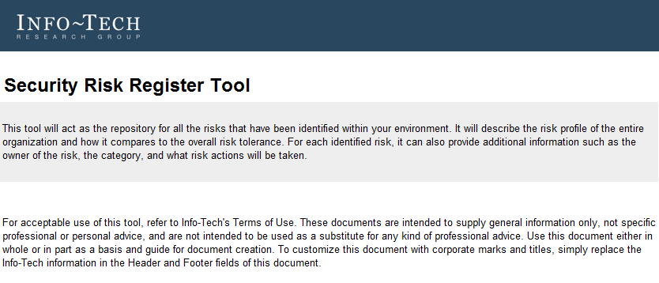
To build a highly mature risk management program, you must complete the following steps
Determine the overall level of risk facing the organization by completing the Security Risk Register Tool. This will allow you to collect and aggregate all the IT security risks, and it helps make risk-based security decisions to ensure that spend and resources are allocated accordingly. Info-Tech’s risk model allows risk to be defensible in a quantified and meaningful way.
Info-Tech has an entire suite of security risk management projects that should also be completed, including:
Define the Information Security Risk Tolerance Level
Determine what the organization is willing to accept in terms of risk to understand when you’ve gone past that point. Do this step first, before the other risk management projects.
Develop and Conduct Threat and Risk Assessments
Assess the risk associated with a particular IT project or initiative with this blueprint.
Optimize Security Mitigation Effectiveness Using STRIDE
Review the organizational threat model and determine how the current mitigations and security controls are faring against those threats.

Slide 11
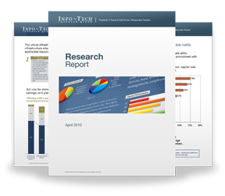
Info-Tech Research Group Helps IT Professionals To:
Quickly get up to speed with new technologies
Make the right technology purchasing decisions – fast
Deliver critical IT projects, on time and within budget
Manage business expectations
Justify IT spending and prove the value of IT
Train IT staff and effectively manage an IT department
Sign up for free trial membership to get practical
solutions for your IT challenges
“Info-Tech helps me to be proactive instead of reactive – a cardinal rule in a stable and leading edge IT environment.
- ARCS Commercial Mortgage Co., LP
Toll Free: 1-888-670-8889
www.infotech.com

