Slide 1

Vendor Landscape: Online Casino Content
Don’t treat choosing your games like a game.
Info-Tech's products and services combine actionable insight and relevant advice with ready-to-use tools
and templates that cover the full spectrum of IT concerns.© 1997 - 2013 Info-Tech Research Group

Slide 2
Introduction
As online gaming platforms become table stakes for casino operators, the selection of the right game content will be a very visible differentiator.
This Research Is Designed For:
This Research Will Help You:
Enterprises seeking to select Online Casino Content for their online casinos
Their Online Casino Content use case may include:
  Promoting an existing brick and mortar casino brand.
  Creating a new online brand and casino.
Understand what’s new in the Online Casino Content market.
Evaluate Online Casino Content vendors and products for your enterprise needs.
Determine which products are most appropriate for particular use cases and scenarios.

Slide 3

Market Overview
How it got here
Where it’s going
Online casinos first began appearing in the early 1990s. By the end of the decade, hundreds of online sites all over the world were accepting real-money wagers across digital versions of just about every casino game.
Evolutions in the presentation of game content have followed as enabling technologies improve. High-resolution video streaming has allowed for live-dealer games to be played across the internet, and 3D graphics engines have been deployed by game developers to provide eye-popping graphics for online slot machines.
The state of international regulation for online gambling (or lack thereof in the United States) has created two distinct market segments: European game providers who have continued to operate over the past decade, and US companies, who pulled out after the UIGEA, preparing to re-enter the space.
The demand on game performance is ever-increasing, and patrons will expect games to keep pace. Expect technologies such as retinal monitoring and gesture-based controls to be incorporated into games in the near future.
The next step in live-dealer play will be true virtual presence. Currently the technology is cost-prohibitive, but there is a real opportunity to deliver a truly immersive experience through this type of system, especially in the high roller player-vs.-player games such as poker.
Vendor partnerships have always been a tangled web online and don’t expect that to stop. There is, however, some market consolidation going on involving the bigger brands with brick and mortar presence buying up online content providers. This trend will continue and provide clients with more full-featured and turnkey solutions.
As the market evolves, capabilities that were once cutting edge become default and new functionality becomes differentiating. Integration with third-party platforms has become a Table Stakes capability and should no longer be used to differentiate solutions. Instead focus on mobile capability and multi-player games to get the best fit for your requirements.

Slide 4
















Defining online gaming
Online gaming, or iGaming, comes in many shapes and forms. You won’t necessarily need all of the pieces right now, or ever, but understanding the difference is a good place to start.
While many vendors offer turnkey solutions (featuring both platform and content), some vendors specialize in certain aspects of iGaming, and some don’t target casinos whatsoever.
Understand the different categories of vendors to leverage each vendor for its strengths.
This Vendor Landscape focuses on those that provide casino content for the online space. Some vendors offer this as part of their turnkey solution, whereas others rely on the client having an existing platform. Online casino content includes slots, table games, bingo, lottery, and poker; however, a future Vendor Landscape will address poker offerings in more detail.
Platform | Turnkey
Social/Other | Content
Platform
Content

Slide 5
Online Casino Content Vendor selection / knock-out criteria: market share, mind share, and platform coverage
The industry is at a high point of tension as the world, and especially the United States, waits to see how regulations will fall. Given this uncertainty and the unfamiliar nature of online casinos to most operators, Info-Tech has chosen experienced vendors who have already proven themselves in regulated, legal markets.
For this Vendor Landscape, Info-Tech focused on those vendors that offer broad capabilities across multiple platforms and that have a strong market presence and/or reputational presence among mid to large-sized enterprises.
Included in this Vendor Landscape:
Aristocrat. This Australian-based company is one of the largest gaming machine manufacturers in the world. Aristocrat’s online gaming offering has grown significantly, including a partnership with OnGame to provide online poker.
Bally. Bally is one of the most trusted names in land-based gaming with more than 80 years of experience in casino machine manufacturing. Bally’s online casino content is a combination of iconic Bally games and third-party content.
Blueprint. Blueprint Gaming is a part of the large German Gauselmann Group. It is largely European-focused with many land-based machines as well as online offerings.
Gamesys. A relatively new player compared to the rest of the vendors being considered, but it has rapidly earned a name for itself through its popular and addictive social games. It has recently branched into social casino gaming. While it doesn’t commonly offer a full solution to operators, it has partnered with operators in the past, such as Caesars.
GTECH. Part of the newly re-branded GTECH S.p.A. group (formerly Lottomatica Group), GTECH combines SPIELO game technology with the GTECH online experience to offer a variety of online gaming products including casino, sports betting, content, bingo, and lottery.
IGT Interactive. International Gaming Technology (IGT) is a leader in the gaming industry. IGT is known for its impressive land-based games and casino solutions, but has also developed a strong online offering, aided by its acquisition of Double Down Interactive.

Slide 6
Online Casino Content Vendor selection / knock-out criteria: market share, mind share, and platform coverage
Included in this Vendor Landscape, Continued:
OpenBet. OpenBet is an UK-based company, focused exclusively on online gaming. It has online casino, poker, and sports-betting modules with a single centralized account.
Playtech. Playtech has always been committed to the persistent improvement and expansion of its gaming offerings. It offers cross-platform solutions, providing a single account for online, mobile, and server-based games.
Williams Interactive. Williams Interactive was formed by WMS Industries in July 2012 to focus solely on online casinos, creating an end-to-end solution for online operators. Scientific Games recently announced that it is acquiring WMS Industries to further expand its online offering.

Slide 7
Online Casino Content criteria & weighting factors
Product Evaluation Criteria
Criteria Weighting:
Features
The solution provides basic and advanced feature/functionality.
Features
Usability
Usability
The end-user and administrative interfaces are intuitive and offer streamlined workflow.
Integration
Extensive integrations with both online content and core casino systems.
Architecture
Integration
Architecture
Multiple deployment options and extensive scalability capabilities are available.
Product
Vendor Evaluation Criteria
Viability
Vendor is profitable, knowledgeable, and will be around for the long-term.
Strategy
Vendor is committed to the space and has a future product and portfolio roadmap.
Vendor
Viability
Strategy
Reach
Vendor offers global coverage and is able to sell and provide post-sales support.
Partners
Vendor has established effective strategic partnerships to enhance its offering to the client.
Partners
Reach

Slide 8
Table Stakes represent the minimum standard; without these, a product doesn’t even get reviewed
The Table Stakes
What Does This Mean?
Feature
What it is:
The products assessed in this Vendor LandscapeTM meet, at the very least, the requirements outlined as Table Stakes.
Many of the vendors go above and beyond the outlined Table Stakes, some even do so in multiple categories. This section aims to highlight the products’ capabilities in excess of the criteria listed here.
Casino Content
Must feature casino-like content including slots or table games.
Compatibility with Platforms
Games must be able to be played on an online casino platform.
Wager-based Gaming
Whether through play money or real money, the games must support some sort of wagers.
If Table Stakes are all you need from your online casino content solution, the only true differentiator for the organization is price. Otherwise, dig deeper to find the best price to value for your needs.

Slide 9
Advanced Features are the capabilities that allow for granular market differentiation
Scoring Methodology
Advanced Features
Info-Tech scored each vendor’s features offering as a summation of their individual scores across the listed advanced features. Vendors were given one point for each feature the product inherently provided. Some categories were scored on a more granular scale with vendors receiving half points.
Feature
What we looked for:
Bingo
Vendor offers bingo content.
Branding
Partnerships with third-party brands, games on recent events, etc.
Game Legacy
Features well known games from brick and mortar casinos.
Lottery
Vendor offers lottery games including scratch cards.
Multi-Lingual
Games are available in multiple languages including double byte.
Multi-Player
Users can play against other live players rather than just against computer-generated players.
Poker
Vendor offers poker content, including a variety of types and video poker.
Slot Game Variety
Vendor offers a variety of slot games under a variety of themes.
Social Media
Can be integrated with social channels for additional customer data, promotions, etc.
Table Game Variety
Vendor offers a variety of table games under a variety of themes.
For an explanation of how Advanced Features are determined, see Information Presentation – Feature Ranks (Stop Lights) in the Appendix.

Slide 10
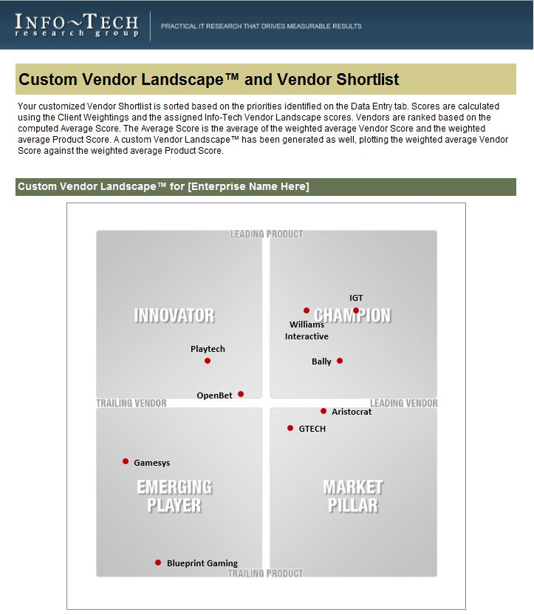
Identify leading candidates with the Online Casino Content Vendor Shortlist Tool
The Info-Tech Online Casino Content Vendor Shortlist Tool is designed to generate a customized shortlist of vendors based on your key priorities.
This tool offers the ability to modify:
Overall Vendor vs. Product Weightings
Individual product criteria weightings:
Features
Usability
Integration
Architecture
Individual vendor criteria weightings:
Viability
Strategy
Reach
Channel

Slide 11
Appendix
Vendor Landscape Methodology: Overview
Vendor Landscape Methodology: Product Selection & Information Gathering
Vendor Landscape Methodology: Scoring
Vendor Landscape Methodology: Information Presentation
Vendor Landscape Methodology: Fact Check & Publication

Slide 12


Info-Tech Research Group Helps IT Professionals To:
Quickly get up to speed
with new technologies
Make the right technology
purchasing decisions – fast
Deliver critical IT
projects, on time and
within budget
Manage business expectations
Justify IT spending and
prove the value of IT
Train IT staff and effectively
manage an IT department
Sign up for free trial membership to get practical
solutions for your IT challenges
“Info-Tech helps me to be proactive instead of reactive –
a cardinal rule in a stable and leading edge IT environment.
  - ARCS Commercial Mortgage Co., LP
Toll Free: 1-888-670-8889
www.infotech.com

