Slide 1




Covertly Establish a Business-Centric, Value-Driven EA Capability
Deploy an EA practice undercover. Focus it on the business and market its value contribution to earn business buy-in and executive support. Sell the sizzle, not the steak.
Burn after reading!
Info-Tech's products and services combine actionable insight and relevant advice with ready-to-use tools
and templates that cover the full spectrum of IT concerns.© 1997 - 2013 Info-Tech Research Group

Slide 2
Introduction
Secure business buy-in and executive support by bypassing prejudice and resistance to Enterprise Architecture (EA) and communicating EA contribution to business value.
This Research Is Designed For:
This Research Will Help You:
CIOs who want to establish or revive an EA capability.
Enterprise Architects who want to stay employed.
Organizations that are unable to demonstrate EA value to the business.
IT departments that experience push back on their EA initiatives.
Organizations that don’t want to do EA, but want to reap the benefits of EA, i.e. improved business alignment, effectiveness, efficiency, and agility.
Avoid prejudice and resistance towards EA.
Demonstrate EA’s value contribution.
Design a covert, business-centric EA operating model.
Achieve ongoing business buy-in and executive support for EA.

Slide 3

Executive Summary
Situation
Establishing an EA practice can help organizations enable their strategic business intent and improve effectiveness, efficiency, and agility.
Complication
The business typically doesn’t see the value of EA. ROI metrics don’t work well for EA.
Within IT, EA is frequently perceived as a roadblock, as an unneeded layer of bureaucracy that impedes project execution and kills innovation.
Having been frequently perceived as non-contributing to business value and unsuccessful, EA initiatives have earned their inglorious distinction. Even mentioning EA may evoke prejudice and resistance.
As a result, corporate IT is unable to secure ongoing business buy-in and executive support for EA initiatives.
Covert EA operation plan of action
Determine what matters to the business. Identify business imperatives, high-priority business capabilities and initiatives, and understand what value measures are relevant to them. Choose up to a dozen value measures that interest the business the most and can be improved by EA.
Define a covert, business-centric EA operating model. Rebrand EA to match the high-priority business goals or initiatives. Choose EA processes that will contribute the most to the selected business value measures. Establish EA roles and define responsibilities with a RACI chart. Stay away from traditional EA nomenclature and common EA mistakes.
Promote EA’s value contribution to secure business buy-in and ongoing executive support. Craft plausible value statements linking factual business benefits to outcomes of EA with causal clauses. Collect convincing value proof points to support value statements. Build an EA marketing plan and pitch EA value contributions at different levels of the enterprise, to both business and IT, through various media at every appropriate opportunity, both formally and informally. Create a charter document to obtain official sign-off and secure funding.

Slide 4



How to use this blueprint
There are multiple ways you can use this Info-Tech Best Practice Blueprint in your organization. Choose the option that best fits your needs:
Best Practice Blueprint
Free Guided
Implementation
Onsite
Workshops
Do-It-Yourself Implementation
Use this Best Practice Blueprint to help you complete your project. The slides in this Blueprint will walk you step-by-step through every phase of your project with supporting tools and templates ready for you to use.
Project Accelerator Workshop
You can also use this Best Practice Blueprint to facilitate your own project accelerator workshop within your organization using the workshop slides and facilitation instructions provided in the Appendix.
We recommend that you supplement the Best Practices Blueprint with a Guided Implementation.
For most Info-Tech members, these Guided Implementations are included in your membership plan.* Our expert analysts will provide telephone assistance to you and your team at key project milestones to review your materials, answer your questions, and explain our methodology.
Info-Tech Research Group’s expert analysts will come onsite to help you work through our project methodology in a 2-5 day project accelerator workshop. We take you through every phase of the project and ensure that you have a road map in place to complete your project successfully. In some cases, we can even complete the project while we are onsite.
Book your workshop
now by emailing: WorkshopBooking@InfoTech.com
*Gold and Silver level subscribers only
Or calling:
1-888-670-8889 Ext. 3001

Slide 5
Book a free guided implementation today!
Info-Tech is just a phone call away and can assist you with your project. Our expert Analysts can guide you to successful project completion. For most members, this service is available at no additional cost.*
Here’s how it works:
Enroll in a Guided Implementation for your project
Send an email to GuidedImplementations@InfoTech.com Or call 1-888-670-8889 and ask for the Guided Implementation Coordinator
Book your analyst meetings
Once you are enrolled in a Guided Implementation, our analysts will reach out to book a series of milestone-related telephone meetings with you and your team.
Get advice from a subject matter expert
At each Guided Implementation point, our Consulting Analyst will review your completed deliverables with you, answer any of your questions, and work with you to plan out your next phase.
This symbol signifies when you’ve reached a Guided Implementation point in your project.
*Gold and Silver level subscribers only

Slide 6
Book a workshop today!
An Info-Tech project accelerator workshop will help you to engage your stakeholders, gather important data, make key decisions, and generate a customized project road map.
Here’s how it works:
Enroll in a 2-5 day workshop for your project
Send an email to WorkshopBooking@InfoTech.com or call 1-888-670-8889 Ext. 3001. Your account manager will contact you and quote you the cost of a workshop.
Book your workshop
A Workshop Coordinator will contact you to book a workshop planning call with one of our Facilitators and arrange dates for your workshop. We can hold the workshop in Info-Tech’s world-class facility in Toronto or at your location.
Plan your workshop
A Workshop Facilitator will contact you to go over the workshop outline and choose the contents that are appropriate to your situation.
Participate in your workshop
Our experienced Workshop Facilitators will take your project team through your tailored slides and exercises and will summarize all the workshop outputs into a final report.
Free Beta Workshops
When we introduce new Blueprints, we offer workshops to our members at no charge for a short beta testing period. Please check the Workshop section of our website for a list of free beta workshops.

Slide 7
Guided Implementation Points in the Establish an EA Capability project
Book a Guided Implementation Today: Info-Tech is just a phone call away and can assist you with your initiative. Our expert Analysts can guide you to successful initiative completion.
Here are the suggested Guided Implementation points in the Establish an EA Capability project:
Section 2: Identify and Prioritize Value Measures
Review identified stakeholders, your business capability map, and transformational initiatives. Discuss prioritization of the list of identified value measures, including establishing metrics that haven’t been implemented.
Section 3: Define EA Operating Model and Roll-Out Plan
Discuss your rebranding of EA and defining the EA operating model including processes, activities, roles, and responsibilities. Develop a RACI chart that maps processes to roles. Create an EA capability plan.
Section 4: Refine EA Value Statements and Proof Points
Review value statements and value proof points; refine if necessary.
Section 4: Get the Most from the Marketing Plan
Review first draft of marketing plan and get recommendations for improvements. After presenting marketing plan to stakeholders, discuss and address their concerns to improve the plan.
Section 4: Get Sign-Off for Your EA Charter
Review first draft of charter and get recommendations for improvements. After distributing the charter to stakeholders, if sign-off is not obtained, discuss and address their feedback to improve the charter.
This symbol signifies when you’ve reached a Guided Implementation point in your initiative.
To enroll, send an email to GuidedImplementations@InfoTech.com or call 1-888-670-8889 and ask for the Guided Implementation Coordinator.

Slide 8

Lay the foundation for successful EA
What’s in this section:
Sections:
Focus on EA capability instead of EA blueprints.
Secure ongoing business buy-in and executive support to increase the likelihood of EA success.
Avoid the standard EA lingo, as it causes prejudice and resistance.
Steer away from the typical EA mistakes.
Lay the foundation for successful EA
Determine value measures that resonate with the business
Define a covert, business-centric EA operating model
Promote EA’s contribution to business value

Slide 9

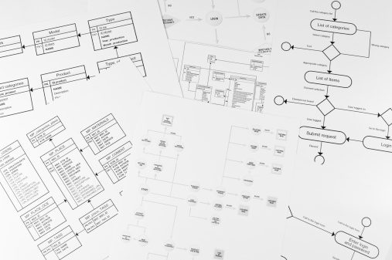
Focus on establishing an EA capability before you begin creating EA blueprints
This solution set focuses on establishing an EA capability, i.e. defining and implementing EA governance, processes, roles, and responsibilities.
EA capability |  | EA blueprints
An organizational capability (practice) that is focused on: Establishing principles that guide enterprise design and evolution. Studying as-is state and defining target enterprise state. Analyzing gaps and identifying project opportunities. Standardizing technology use. Creating reusable building blocks. |  | A holistic description of an enterprise that encompasses its business capabilities and processes, supporting information flows and services, tangible and intangible technology assets, and their inter-relationships. A product of an EA capability.

Slide 10

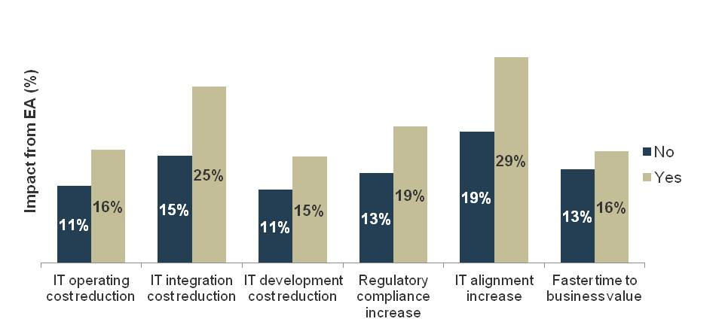
Secure ongoing business buy-in and executive support to increase the likelihood of EA success
EA is an enterprise-wide initiative that spans the business and IT. In order for EA to be successful, the business must be engaged and supportive.
EA success is rooted within the business’s cooperation with IT, for example:
Gathering business stakeholders’ definitions of business value.
Discovering business scenarios.
Creating a business capability map.
Involving the business in EA governance.
Recent Info-Tech research found that organizations who have ongoing executive support for EA realize greater benefits from their EA initiatives. To see how impact from EA was derived, please refer to Appendix E.
For enterprise architecture to really fulfill its true potential, business engagement is an imperative, it’s an absolute essential success factor. There could be some success without it, but much more muted than it could have been.
- Pallab Saha, National University of Singapore
Source: Info-Tech Research Group, N = 97

Slide 11
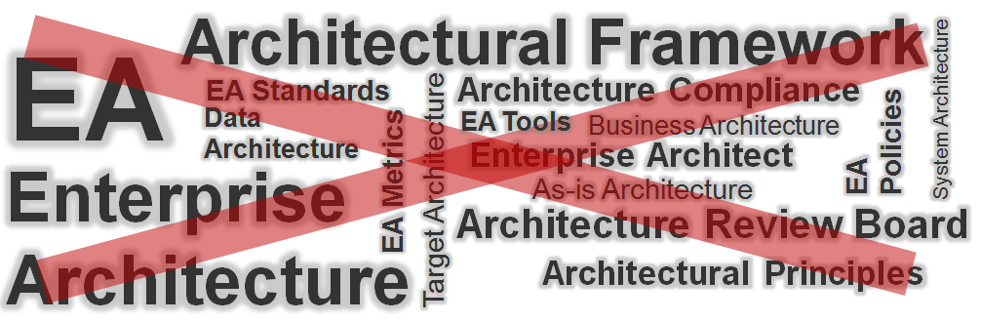
Ditch the standard EA lingo, as it causes prejudice and resistance
Over time, EA terms have earned a negative connotation due to repeated failures of EA. This terminology makes the business instinctively push back.
Covert EA operation plan of action
It is not essential to use the term EA. As long as you are doing what it is you are supposed to do, you will see value. Don’t intimidate your key stakeholders with the terminology. Doing EA without calling it EA has worked. Resistance to EA is a consequence of failure, not the cause for it.
- Pallab Saha, National University of Singapore
Operate your EA practice undercover and don’t use any of the above terms. In the PowerPoint version of this storyboard, EA is crossed out to emphasize the importance of being covert. Think of “EA” as a placeholder for your rebranded EA initiative name.

Slide 12
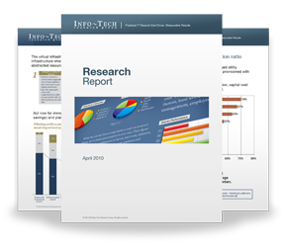

Info-Tech Research Group Helps IT Professionals To:
Quickly get up to speed
with new technologies
Make the right technology
purchasing decisions – fast
Deliver critical IT
projects, on time and
within budget
Manage business expectations
Justify IT spending and
prove the value of IT
Train IT staff and effectively
manage an IT department
Sign up for free trial membership to get practical
solutions for your IT challenges
“Info-Tech helps me to be proactive instead of reactive –
a cardinal rule in a stable and leading edge IT environment.
  - ARCS Commercial Mortgage Co., LP
Toll Free: 1-888-670-8889
www.infotech.com

