Slide 1
Evaluate the Application Lifecycle Management Landscape
Manage the complexity of today’s frequent deployment cycles and assure alignment and traceability with business objectives.
Info-Tech's products and services combine actionable insight and relevant advice with ready-to-use tools and templates that cover the full spectrum of IT concerns.© 1997-2018 Info-Tech Research Group

Slide 2
ANALYST PERSPECTIVE
Are you ready for data-driven application lifecycle management?
Is regulatory compliance mission critical for you? Do you have team members in every corner of the globe? Are complex applications and portfolios a fact of life?
Microsoft Word has been the de-facto standard for application lifecycle management for decades. The document-centric ALM is also a source of rework, inefficiency, and frustration for people who answer yes to these questions.
Application and development managers and their teams need to shift to a data-driven application lifecycle to manage these challenges. ALM solutions are a key to making the change, especially when combined with adoption programs that develop people and enhance practices.
Cole Cioran
Senior Director – Research, Application Development and Portfolio Management Info-Tech Research Group

Slide 3
Introduction
Application lifecycle management (ALM) solutions provide the transparency and automation capabilities needed to justify development and product decisions, monitor ALM tasks, and enable Agile and continuous delivery.
This Research is Designed For:
This Research Is Designed For:
This Research Will Help You:
This Research Will Help You:
IT leaders who seek insights into the efficiency and effectiveness of their application portfolio, development, and maintenance practices.
Application managers who must ensure their portfolio of applications drives business value and satisfaction.
Development managers and their teams who must deliver timely solutions and valuable software.
Operations managers and their teams who need insights into the systems they support in order to resolve work orders and service requests quickly and effectively.
Review vendor strengths and limitations compared to your current and projected ALM needs.
Determine which suite of ALM solutions is best suited given your scenarios.
Understand available functionality of current ALM solutions.
Shortlist the vendors that the best fit your organization.

Slide 4
Executive summary
Info-Tech reviewed 13 competitors in the ALM market and recognized the following trends:
Changes in the Vendor Landscape:
The 2017 merger of Micro Focus and HPE has given overlapping ALM solutions HP Octane, Serena, and Calibre a single owner.
Perforce’s acquisition of Hansoft and Seapine extends its development and requirements suite with testing and Agile work management solutions.
CA and Blueprint have partnered to deliver a seamless experience between CA Agile Central (formerly Rally) and Storyteller for requirements analysis and work management for Agile and DevOps.
Innovative Features:
Visure’s automated approach to requirements visualization and validation is overdue given how common requirements have poor quality and are unclear.
Visonera’s stakeholder-centric views of products help ensure teams are satisfying service agreements and communicating with stakeholders using the right information.
Blueprint’s visual models envision customer journeys and business processes through graphical process flows.
ServiceNow’s Workbench ensures organizations prioritize the right work based on value, risk, and size.
Tools are critical for the shift from document to data-driven ALM. ALM data is currently hidden in documents and network drives. ALM solutions provide the insight needed for governance and continuous improvement of every practice.
Organizations implement ALM solutions to manage products and projects. Application teams continuously strive to increase throughput and reduce contention, rework, and frustration when they develop and support their application portfolio. ALM solutions ensure that people have the information they need to manage the whole product, not just a single project or work order.
Teams want an open and integrated ALM environment. Teams are empowered to adopt the tools they need to address complexities and frequent changes while assuring end-to-end artifact traceability. ALM vendors are positioning their products as open solutions with out-of-the-box integrations and marketplaces to allow teams to create a tightly integrated and flexible tool environment.

Slide 5
Info-Tech offers various levels of support to best suit your needs
Guided Implementation
DIY Toolkit
Workshop
Consulting
“Our team has already made this critical project a priority, and we have the time and capability, but some guidance along the way would be helpful.”
“Our team knows that we need to fix a process, but we need assistance to determine where to focus. Some check-ins along the way would help keep us on track.”
“We need to hit the ground running and get this project kicked off immediately. Our team has the ability to take this over once we get a framework and strategy in place.”
“Our team does not have the time or the knowledge to take this project on. We need assistance through the entirety of this project.”
Diagnostics and consistent frameworks used throughout all four options

Slide 6
Book a guided implementation today!
Complete these steps on your own, or call us to complete a guided implementation. A guided implementation is a series of 2-3 advisory calls that help you execute each phase of a project. They are included in most advisory memberships.
Step 1: Shortlist Assistance and Requirements
Get off to a productive start: Discuss the market space and how vendors position themselves. Decide which implementation approach suits you best and narrow down the options based on customized requirements. Prepare your team to engage the vendors in your shortlist.
Step 2: RFP Review
Interpret and act on RFP results: Review your findings from your vendor RFPs and ensure the solution will meet your needs.
Step 3: Contract Review and Implementation Plan
Plan for implementation: Review contracts and discuss best practices in negotiation tactics to get the most out of your solution. Define the roadmap of your implementation plan.
Call 1-888-670-8889 or email GuidedImplementations@InfoTech.com for more information.

Slide 7
Obtain a comprehensive understanding of the ALM landscape with Info-Tech’s Software Reviews
Software Reviews provides the most in-depth and comprehensive understanding of the user experience to give you an unprecedented view into the product and vendor before you buy.
What Software Reviews Offers
Fact-based reviews of business software from IT professionals.
Product and category reports with state of the art data visualization.
Top-tier data quality backed by a rigorous quality assurance process.
User experience insight that reveals the intangibles of working with a vendor.

Slide 8
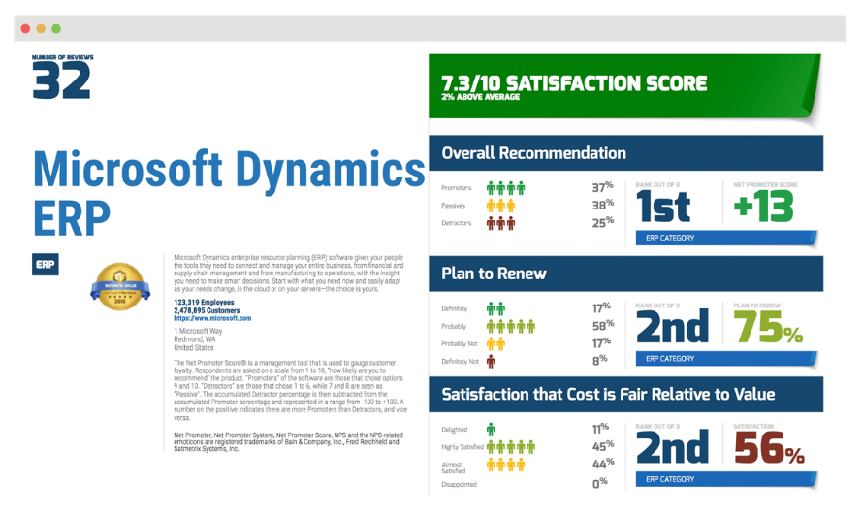
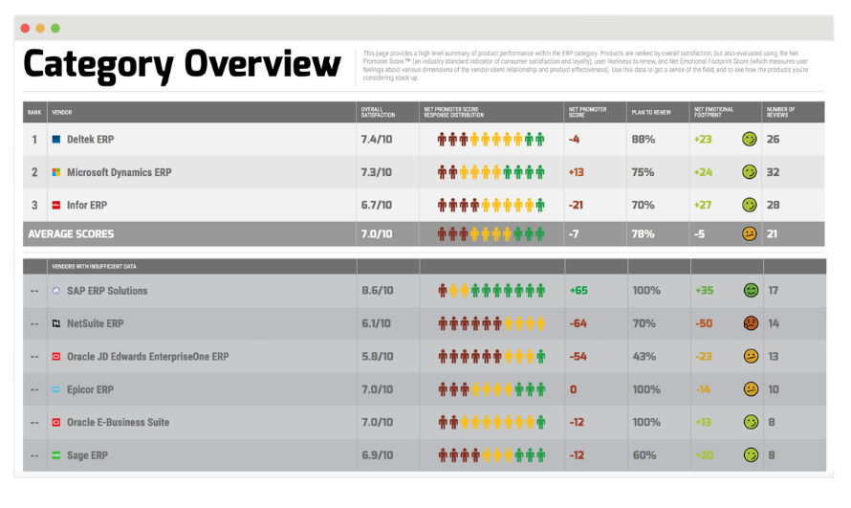
Leverage Software Reviews product scorecards and category reports in your vendor selection
Product Scorecard
A comprehensive report on an individual software, aggregating feedback from real IT professionals and business leaders.
Net Promoter Score & Planned Renewal Rates
Feature & Vendor Capability Breakdown
Version & Module Satisfaction Levels
Comparisons by Organization Size, Usage & Role
Individual Comments & Recommendations from Users
Category Report
A thorough evaluation and ranking of all software in an individual category to compare software across every dimension.
User Satisfaction Rankings
Business Value Scores
Vendor Capability Comparisons
Individual Feature Evaluations
Emotional Connection to Products

Slide 9
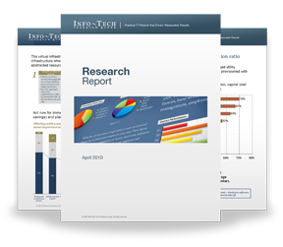
Info-Tech Research Group Helps IT Professionals To:
Quickly get up to speed with new technologies
Make the right technology purchasing decisions – fast
Deliver critical IT projects, on time and within budget
Manage business expectations
Justify IT spending and prove the value of IT
Train IT staff and effectively manage an IT department
Sign up for free trial membership to get practical
solutions for your IT challenges
“Info-Tech helps me to be proactive instead of reactive – a cardinal rule in a stable and leading edge IT environment.
- ARCS Commercial Mortgage Co., LP
Toll Free: 1-888-670-8889
www.infotech.com

