Slide 1

Develop a Web Content Management Strategy
Balance the needs of marketing and IT. Just don’t overbuy.
Info-Tech's products and services combine actionable insight and relevant advice with ready-to-use tools
and templates that cover the full spectrum of IT concerns.© 1997 - 2012 Info-Tech Research Group

Slide 2
Introduction
WCM isn’t dead yet. In fact, it’s thriving by meeting the increasingly diverse needs of the marketing department. Balance the requirements of IT and marketing… just don’t overbuy.
This Research Is Designed For:
This Research Will Help You:
IT managers involved in evaluating, selecting, and deploying a WCM platform.
Business and IT managers who are responsible for carrying out the initial evaluation and selection of a WCM platform.
Organizations that want to use their website as a platform for improving sales or customer service.
Business managers who want to improve web user engagement in order to drive prospect conversion.
Determine a strategy to use a WCM platform to facilitate website maintenance and to give marketing the tools it requires.
Distinguish WCM platforms from marketing automation and email marketing services.
Understand key market trends including what's new and the feature sets offered by WCM vendors.
Follow best practices for implementing the selected platform.

Slide 3
Executive Summary
Situation
Info-Tech Insight
Web Content Management (WCM) solutions remove the burden of web maintenance from IT while giving marketing new capabilities.
Web Experience Management (WEM) solutions have emerged as advanced WCM tools with specific tools to personalize content and deliver it to a wide variety of devices. They also provide marketing insight into web user behaviour.
WCM can save time and increase revenue.
  The biggest benefits of WCM are to IT. They remove IT from the common task of creating and shepherding content. WCM also provides benefits by giving web visitors a better experience. Marketing can then monitor their behaviour and use this information to warm leads.
Don’t overbuy.
  WCM vendors are increasingly selling to the marketing department. The products are incredibly appealing, but be realistic. Ask: can the enterprise actually deploy and use this kind of technology?
Review functional overlaps.
  The functionality of WCM solutions is converging with that of other tools like social media management and market automation. Review the entire portfolio.
Complication
WCM and WEM solutions have tremendous capability. It’s very easy to overbuy an expensive solution that is inappropriate for both IT and marketing.
Furthermore, WCM solutions must exist alongside of other content management tools and sales and marketing solutions.
Resolution
Every enterprise with a website needs a WCM solution. Most enterprises will never need to exploit all of the available features.
Make the case for WCM and determine how it interacts with other solutions for marketing automation, lead management, and email marketing. Don’t overbuy.

Slide 4
Follow Info-Tech’s web marketing roadmap
Info-Tech offers a variety of resources. This set will address how and why to develop a web content management strategy.
VL+: Lead Management Automation Platforms
Sales/Mktg.
CRM
Reintroduce the Information Lifecycle to the Content Management Strategy
A
You are here:
Develop a WCM Strategy
Content Mgmt.
VL: Web Content Management
VL: Web Experience Management
VL+: CRM Suites for Large Enterprises
VL+: E-Mail Marketing Services
VL+: CRM Suites for Small Enterprises
VL+: Marketing Automation Suites
VL+: Customer Service Mgmt. Platforms

Slide 5
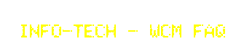
Use the pathfinder below if you need answers to specific WCM questions
Web Content Management
WCM, lead management, or marketing automation? | Slide 14
How does WCM help IT and marketing? | 11,17
What do my peers think? Why are they doing WCM? | 30
How much will WCM cost me? | 32
Should I implement a WCM solution? | 35
Who owns WCM: marketing or IT? | 40
What does the selection process look like? | 41
Where can I find an RFP, demo scripts, etc.? | 42-44
What are the key success factors for WCM projects? | 48
What metrics are important for WCM operation? | 51
How should we train administrators and users? | 53
What should I know about website redesign? | 57
How we overcome scaling and sizing issues? | 63
What's the future of WCM (video, mobile, social, Cloud, etc.)? | 69

Slide 6
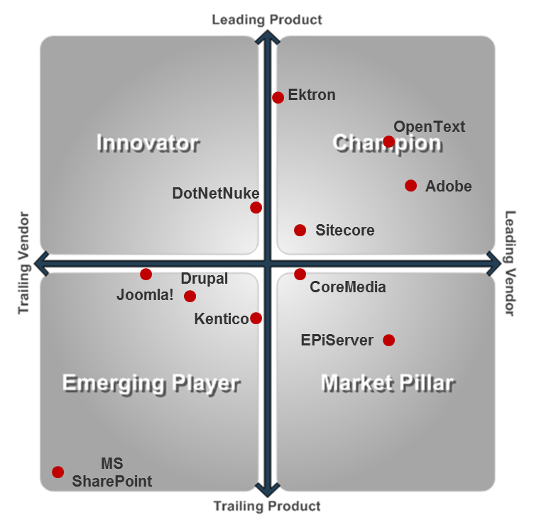
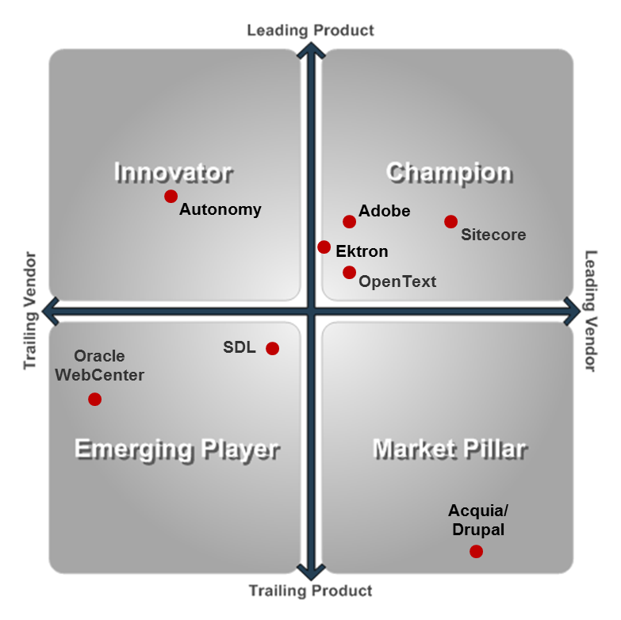
Consult Info-Tech’s Vendor Landscapes for vendor information
Info-Tech offers two tools to help make the vendor decision.
Web Content Management
Web Experience Management
VL: Web Content Management
VL: Web Experience Management

Slide 7

WCM: Why you should care
Market Overview
WCM: A tool for Marketing and IT
WCM in the Sales and Marketing technology portfolio
The difference between WCM and WEM
WCM: Why you should care
Make the case for WCM
Build a strategy for WCM selection
Implement a WCM platform
Anticipate the future

Slide 8

Market Overview
How it got here
Where it’s going
WCM grew out of the need for enterprises to manage branding issues that arise with multiple related websites.
WCM quickly became a tool to free IT from constantly recoding changing websites.
The acquisitions of Day by Adobe, and Fatwire by Oracle, caused traditional WCM vendors to quickly add strong marketing tools to compete with these large application providers.
The ever-evolving consumer device market has forced vendors to add a level of flexibility into their WCM software for both website templates and the content delivery.
The WCM market and Web Experience Management (WEM) market are quickly converging. WCM will soon be a module of the WEM market. For additional WEM insights look to Info-Tech’s VL: Web Experience Management.
The convergence of marketing and content management features at all spend levels is changing the basic definition of WCM. The increased similarity between WEM and WCM vendors will change the decision from a feature-based choice to a cost one.
Vendors differentiate themselves based on use case (e.g. e-commerce, marketing). This focus is key to ensure appropriate professional services and vendor references.
IT’s role is changing from owner to custodian. IT must ensure that the chosen WCM solution can be integrated into the other marketing (MA, CRM, LMA) and enterprise tools (ERP, ECM).
WCM is only one tool in a wide variety of marketing and content management solutions. See Info-Tech coverage of Sales, Marketing, and Customer Service Applications and research on Content and Document Management.

Slide 9




WCM: A solution for both marketing and IT
MARKETING
Your IT Efficiency is in my Marketing Solution!
INFORMATION TECH
Your Marketing Solution is in my IT Efficiency!
Web Content Management (WCM) is a solution that does two things. It makes life easier for IT and it provides advanced functionality to Marketing departments.

Slide 10



Life can be painful without a WCM solution
Don’t wait for multiple stakeholders to be disappointed.
IT is scrambling for resources to support organization’s web presence.
Is your IT department spending only 10 hours a week on website management? That’s 40 hours over a month and over 3 months of full-time employee’s work over a year.
Your customers are slowly becoming disenchanted with your brand and your product.
Your website visitors are not getting the best web experience, and their engagement levels are going down. Meanwhile, your competitors are offering them prime video, social, and mobile experience.
Marketing doesn’t have enough insight into the product of their strategy.
Your Marketing team is providing less warm leads to Sales, feeling as if they are looking for the impossible.
Allow for IT to deliver more value, and use their resources more efficiently.
Delight your customers before the spell is over.
Empower Marketing before it’s too late.

Slide 11
Web Content Management platforms provide multiple benefits for both IT and business processes
WCM solutions can integrate business strategies, marketing processes, and content management solutions across all stages of the sales lead lifecycle. This enables marketers to track leads from initial inquiry to sale, providing a closed loop reporting mechanism for marketing activities, and enabling campaign ROI measurement.
 | Time Savings | Additional Revenue Generation | Integration efficiencies | Better Reports and Analytics
Business Value | Decrease time to execute campaigns. Improve efficiency of lead acquisition activities. Increased resourcing options. | Higher campaign and response rates. Decrease lead acquisition costs. Broaden reach through social and video channels. | System integration gives sales a better view of prospect activity. Integrations with other content-generating systems can streamline content production. | Track, measure and prove the value of marketing activities.
IT Value | Reduce reliance on IT for routine tasks such as A/B testing, webpage coding, and data cleansing. Increase marketing autonomy. | Saved IT resources are now placed in sectors of the business where the ROI is of greatest value. | Improves the value delivered to the business. | Reduces need for constant customization on status reports on lead value and campaign success.

Slide 12


Info-Tech Research Group Helps IT Professionals To:
Quickly get up to speed
with new technologies
Make the right technology
purchasing decisions – fast
Deliver critical IT
projects, on time and
within budget
Manage business expectations
Justify IT spending and
prove the value of IT
Train IT staff and effectively
manage an IT department
Sign up for free trial membership to get practical
solutions for your IT challenges
“Info-Tech helps me to be proactive instead of reactive –
a cardinal rule in a stable and leading edge IT environment.
  - ARCS Commercial Mortgage Co., LP
Toll Free: 1-888-670-8889
www.infotech.com

