Slide 1

Formulate a Social Analytics Strategy
Decide when to do more than merely follow yourself on Twitter.

Slide 2
Introduction
Social media business objectives can be difficult to achieve if you don’t have measurement processes in place. Undertake a social analytics project to provide insight into social media and help the organization navigate its way to success.
This Research Is Designed For:
This Research Will Help You:
IT managers advising the business on improving the effectiveness and efficiency of social media campaigns.
IT professionals involved in evaluating, selecting, and deploying a social media management platform.
Sales, marketing, and customer service professionals interested in how social analytics can improve the outcomes of social media campaigns and interactions.
Understand the business benefits of using social analytics to guide social media initiatives, and how to help the organization to achieve objectives in areas such as sales, marketing, and customer service.
Grasp the current state of the social analytics solutions market and form a strategy for selecting a vendor that meets the organization’s requirements.
Implement and monitor the social analytics initiative.

Slide 3
Executive Summary
The value proposition of social analytics revolves around enhancing the benefits and directing the focus of any social media projects. Failing to couple social media projects with analytics makes it difficult to measure the value; you have no idea if your spent resources are having any effect, and if so, whether that effect is the one you are seeking.
IT must partner with other departments (e.g. marketing) to successfully plan and implement a social analytics initiative. Before beginning the initiative, the organization must have a solid idea of what objectives it wants the project to address.
Social analytics tools are relatively immature, with an increasing number of vendors swarming the market. Since this market is likely facing consolidation in the near term, organizations should aim to adopt solutions quickly and with little commitment, keeping the goals of the project short-term in nature.
Since social analytics as a business concept is a new idea, organizations need to recognize that the project will have limits. At this point in time, most organizations will be unable to draw valid trends from their social analytics due to their lack of social presence and/or historical data. As a result, organizations should focus on social listening and data retention until those deficiencies have been addressed.
Monetization is not the point of social analytics at this time. Focusing your initiative on customer service goals provides a much more highly correlated relationship with success than initiatives focused on revenue generation (64% vs. 37%).
Implement a social analytics project by choosing business objectives, assessing resources, performing a cost-benefit analysis, selecting tools and/or partners, training end users, and launching the solution.

Slide 4


The Info-Tech Sales, Marketing, and Customer Service Applications Roadmap
Social analytics will play a role in your organization’s BI strategy as well as your social media strategy. Info-Tech’s extensive research places it nicely in both areas.
Design a Customer Service Strategy that Serves the Social Customer
Customer service organizations are unsure how to integrate social media into their customer service strategy..
Social media channels must be part of a cohesive multi-channel customer interaction strategy across sales, marketing, and service.
Formulate a Social Analytics Strategy
Social analytics can help companies measure and influence their efforts to strengthen their brand, drive sales, and improve service.
This set will help you understand the importance of social media and how to form a strategy to manage your efforts.
Social Media Planning
Vendor Landscape Plus: Social Media Management Platforms
SMMPs empower managers with a variety of tools for effective (and efficient) use of enterprise social media.
Selecting an SMMP involves defining functional requirements, creating a shortlist, evaluating offerings, and choosing the platform.
Leverage Social Media for Enhanced Customer Interaction
Build a comprehensive strategy for social media that adds social to the existing channel mix. Select the social media services that best complement your existing channel interaction strategies in marketing, sales, and customer service.
Social Media Implementation

Slide 5



The Info-Tech Business Intelligence & Analytics Roadmap
Build a Data Warehouse on a Solid Foundation
Data warehousing is a business discipline, not an IT infrastructure project. Its true value consists in providing decision makers with timely and accurate views of the business.
Successful warehousing strategies start with business-focused requirements, the right team, and a sound project plan.
Customer Service Strategy
Develop a BI Strategy
Business Intelligence (BI) solutions have the potential to help organizations of all sizes glean valuable insights from otherwise nebulous data sets. However, without proper consideration of data integrity and quality, the value diminishes almost instantly.
Formulate a Social Analytics Strategy
Social analytics can help companies measure and influence their efforts to strengthen their brand, drive sales, and improve service.
This set will help you understand the importance of social media and how to form a strategy to manage your efforts.
BI Strategy
Optimize the BI Program for a Better ROI
BI programs are meant to provide better information to more users at a reduced cost-to-serve.
This set will help you reduce the costs of BI fragmentation, build a business intelligence competency center, and standardize the BI solution.
Upcoming Research: Execute the BI Implementation while Avoiding
Common Pitfalls
This set will help IT managers take a proactive approach to BI implementation management, and prevent project failure before it happens.
BI Optimization

Slide 6

Decide whether your organization needs to monitor social analytics by examining end-customer social media use
Social analytics is still at an early stage. Companies will struggle to predict its Return on Investment, or even to measure it accurately. Social analytics is about understanding and improving customer service. It is one more channel though which you can reach out to and understand your customer, a channel which is growing in strength and importance daily. This is something all organizations need to consider, but the level of action you should then take is a more complicated decision to address.
Start a social analytics project if:
Bypass a social analytics project if:
Your organization already has a large social footprint; you manage multiple feeds/pages on three or more social media services.
Your organization’s primary activity is B2C marketing; your target consumers are social media savvy.
The volume of marketing, sales, and service inquiries received over social channels has seen a sharp increase in the last 12 months.
Your firm or industry is the topic of widespread discussion in the social cloud.
Regulatory compliance prohibits the use of social media in your organization.
Your organization is focused on a small number of institutional clients with well-defined organizational buying behaviors.
Your target market is ambivalent towards monitoring social channels to interact with your organization.
Your organization is in a market space where only a bare-bones social media presence is seen as a necessity (for example, only a basic informational Facebook page is maintained). B2C organizations may need a more developed social presence than B2B.
Social analytics will be of tremendous use for those organizations with multiple brands and product portfolios (e.g. consumer packaged goods). Small organizations with limited social media goals can afford to postpone a social analytics project until their social presence is more developed.

Slide 7

Understanding the Social Media Landscape
Overview of the growing role of social media in business.
How social analytics can be used to extract insights that can be applied to customer service, marketing, sales, and public relations.
How the immaturity of social analytics as a business concept should constrain your organization’s goals.
Understanding the Social Media Landscape
Establishing a Process for Social Analytics

Slide 8
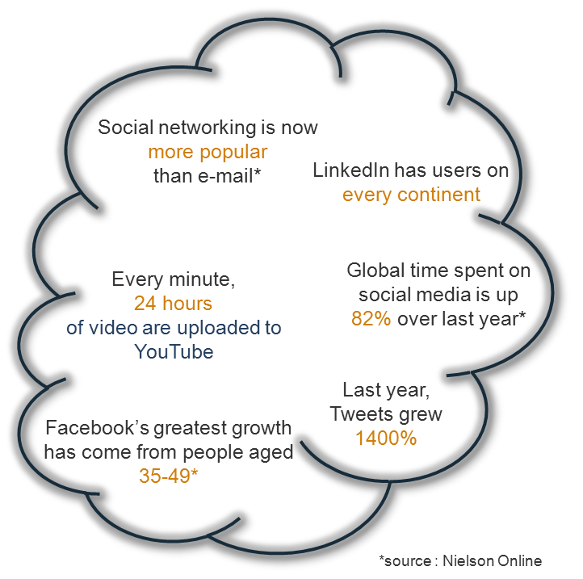
Fish where the fish are: Consumers are embracing social media services as their communication medium of choice
There’s an awful lot of benefit [to using social channels] for very little cost. - Carol Voss, Marketing Director
Businesses need to understand that social media is an integral part of their customers’ lives. Without a social presence, you risk falling behind competitors, and without analytics, you risk the opportunity to get ahead of them.
Social media services facilitate the creation and dissemination of user-generated content, from which social analytics can then elicit insights.
Adoption of social media began with younger consumers, but it has now taken off with all demographics.
Social media is displacing traditional e-channels, such as email, as consumers’ preferred method of interacting with one another.
Organizations must add social channels to the marketing, sales, and service mix or risk losing business to savvy competitors. Social channels are essential for B2C organizations: fish where the fish are!
For more information, refer to Info-Tech’s Leverage Social Media for Enhanced Customer Interaction.

Slide 9
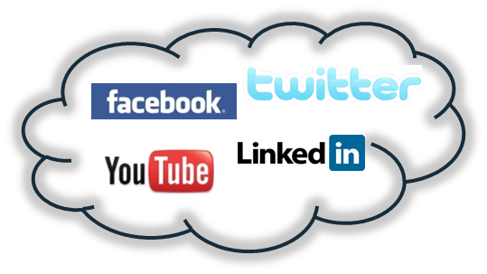
Do not leave value on the table; include social analytics in your social media initiative if you want it to reach its full potential
Social Media Management Platforms (SMMPs) are solutions (typically cloud-based) that offer a host of features for effectively monitoring and managing your organization’s presence in the social cloud. SMMPs give businesses the tools they need to run social campaigns in a timely and cost-effective manner. SMMP functionality falls broadly into three categories: account & campaign management, in-band response, and social monitoring/analytics.
In the social analytics aspect of social media management, organizations identify trends expressed through social media. When undertaken successfully, businesses can use this information to make better strategic decisions in terms of PR, marketing, customer service, and product development.
End Users
(e.g. marketing managers)
Account & Campaign Management
SMMP
In-Band Response
On the surface, a social analytics project can look very much like a business concern with minimal IT involvement. This is obviously untrue. There are three points IT will be central in:
The tools used to collect the data.
The data management disciplines (retention, organization, retrieval, consistency, appropriate use).
The integration of social media analytics and management platforms into other reporting, analytics, and transaction processing systems already established within the company.
Social Monitoring/Analytics
SMMPs mediate interactions between
end users and the social cloud.

Slide 10

Don’t treat social analytics like traditional BI; the immaturity of the market demands a different set of priorities
As it stands, the social analytics market is swamped with different vendors and products. There is a lack of agreement around what a common feature set entails. The next step for these immature markets has traditionally been consolidation. This means:
Some vendors will be acquired, some will stall, some will thrive, and some will die.
Don’t treat this like a typical BI project!
Since BI has mature vendor offerings, projects tend to be long, costly, and complex. However, the immaturity of social analytics is driving companies to avoid high risk projects. Opt for quick results and small commitments!
All long-term relationships are uncertain, so organizations should aim for quick results. Have goals planned for the short and medium-term.

Slide 11
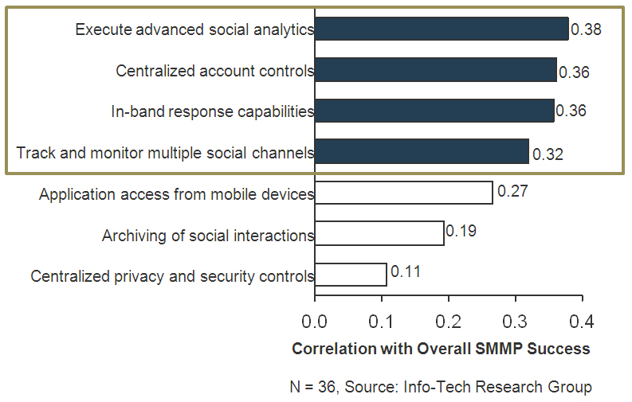
Social Analytics is still an emerging practice, but adoption and use are on the rise for the future
Forty-one percent of organizations are currently monitoring social analytics, with 24% planning to in the next 18 months.
If you are diving into social media, a social analytics initiative should follow close behind.
Source: Info-Tech Research Group; N = 90
Social analytics isn’t just the logical next step to a social media project; it is key to its success.
It was found that when organizations adopt an SMMP, placing a greater emphasis on the platform’s social analytics features has the strongest bearing on the success of the project.
*Each bar represents a statistical estimate of the impact each factor has on the overall SMMP success.
Refer to Vendor Landscape Plus: Social Media Management Platforms for information on how the success score
was calculated.

Slide 12
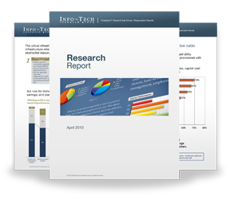

Info-Tech Research Group Helps IT Professionals To:
Quickly get up to speed
with new technologies
Make the right technology
purchasing decisions – fast
Deliver critical IT
projects, on time and
within budget
Manage business expectations
Justify IT spending and
prove the value of IT
Train IT staff and effectively
manage an IT department
Sign up for free trial membership to get practical
solutions for your IT challenges
“Info-Tech helps me to be proactive instead of reactive –
a cardinal rule in a stable and leading edge IT environment.
  - ARCS Commercial Mortgage Co., LP
Toll Free: 1-888-670-8889
www.infotech.com

