Slide 1
Discover and Classify Your Data
Provide your data the protection it deserves.

Slide 2

Analyst
Perspective
Keep data classification simple.
Organizations are overwhelmed with data, from quick emails to top-secret crown jewels. How can we ensure that important data is protected without wasting resources protecting everything?
Keep data classification simple for both the users and the data custodians:
  Don’t try to classify everything immediately.
  Work with data owners to focus on the most business-critical, high-sensitivity assets and systems, and then move forward.
  Avoid analysis paralysis by integrating the classification process into the daily routines of users as new documents are created.
Securing high volumes of data is a growing challenge, but incremental steps are key to an organized and classified corporate data model. Understand where critical data is being stored and how it’s being protected to justify security investments and to consolidate storage when possible.
Logan Rohde
Senior Research Analyst
Security, Privacy, Risk & Compliance
Info-Tech Research Group

Slide 3



Executive Summary
Your Challenge
Common Obstacles
Info-Tech’s Approach
You have compliance requirements to identify, classify, and you need to protect high-risk data.
Existing data handling procedures don’t properly address the sensitivity of your data.
Your data classification program is ad hoc or dated, and you don’t apply the scheme consistently.
You need to purchase software to support your data classification program.
You have a large data backlog and don’t know where to start the classification project.
You have a limited budget. You need to understand where the most protection against data breaches is required so you can save on storage costs.
End users are the weakest link in the data security chain. They need significant awareness and training to accurately classify sensitive information.
Formalize the data classification initiative with policies, standards, and a structured steering committee to ensure accountability and consistency.
Identify where your data lives and implement controls to protect it. Ensure the protection is proportional to its sensitivity and criticality.
Understand what tools are available to implement an efficient data classification program.
Info-Tech Insight
Avoid analysis paralysis. Classifying all your data at once may not be feasible. Start small, quantify and report your results, then tackle another data set. Focus your initial efforts on classifying new data in a few departments as they create it. Target smaller departments who deal with sensitive data, like finance, legal, or human resources. They are more likely to understand the importance of data classification and protection. Once you establish a suitable process, move on to classifying legacy data in other departments.

Slide 4
Your Challenge
This research is designed to help organizations design a process to discover and classify their data
Data classification is the process of organizing data into relevant categories. Classification helps improve information security and privacy by enabling the assignment of access permissions and the implementation of protection measures for different kinds of data.
Without a consistent process to discover and classify sensitive or critical data, you won’t be able to identify what data is at high-risk of being leaked or stolen, how to prioritize risk mitigation initiatives to prevent a data breach, or how to scale investment in data loss prevention tools.
Source: IBM, 2021 Cost of a Data Breach (n=537)
Data discovery and classification is the first step in protecting high-risk data from malicious actors.
Average data breach costs rose from $3.86 million to $4.24 million, the highest average total cost in the history of this report. Costs were significantly lower for organizations with a more mature security posture.

Slide 5
Common obstacles
Third-Party Data Breaches
Data discovery can be daunting. Avoid analysis paralysis.
Large data backlogs can make it difficult to figure out where to start. Classifying all your data at once may not be feasible.
You have a limited budget. You need to understand where you need the most protection against data breaches so you can save on storage costs.
The dynamic nature of data complicates matters. The criticality of a piece of data shifts over time. Your data classification program will need to incorporate reassessments to prevent overprotecting the data.
  74%
Source: Ponemon Institute (2021)
According to a report by Ponemon Institute, 74% of organizations who experienced a data breach in the previous 12 months attributed the breach to giving third parties too much access to sensitive information.
You can’t secure high-risk data that you haven’t identified. Focus the program to classify what matters. The classification program should be measurable, auditable, and manageable.

Slide 6
Info-Tech’s Approach
This blueprint will help you:
Formalize the data classification program with the proper policies, handling standards, and a structured steering committee to ensure accountability and consistency.
Understand where your data lives and what controls are implemented to protect it. Make sure the protection is proportional to the sensitivity and criticality of the assets.
Understand what tools are available to implement an efficient data classification program – whether provided by a third party or done in-house. Know how and when to revisit classifications to keep them up to date.
Data classification is a program, not a project
Formalize Program
Data Steering Committee
Data Classification Policy
Classify Data
Classify Data
Maintain and Optimize Program
.
Discover Data
Plan Data Discovery
Implement Discovery Plan

Slide 7
Insight summary
Overarching insight
Classifying all your data at once may not be feasible. Start small, quantify your results, report them to management, and then go back and tackle a larger portion.
Phase 1 insights
Keep it simple. Leave as little ambiguity as possible for an easy-to-follow classification program. Clearly define the roles and responsibilities of everyone involved, from data custodians to data users.
Provide your data the protection it deserves.
Phase 2 insight
Data, by its nature, does not stay static. A piece of data’s criticality will peak, but strategic reassessment will eliminate under/overprotection of data. Data classification must be a program, not a one-time project. Successful risk mitigation is dependent on knowing where your data lives and its criticality. While data discovery can be overwhelming, strategic interviews with data owners, in addition to the use of technology, are starting steps to mapping data. This information leads to more accurate threat modeling and security controls investments.
Phase 3 Insights
Focus the program on data whose classification is measurable, auditable, and manageable. Perform data location analysis and security analysis to inform your overall security initiatives. Understand which departments own the most sensitive data and provide training to improve awareness. Use the classification distribution visuals to make strategic decisions such as which security controls and processes your organization should expand and which repositories it should consolidate.

Slide 8


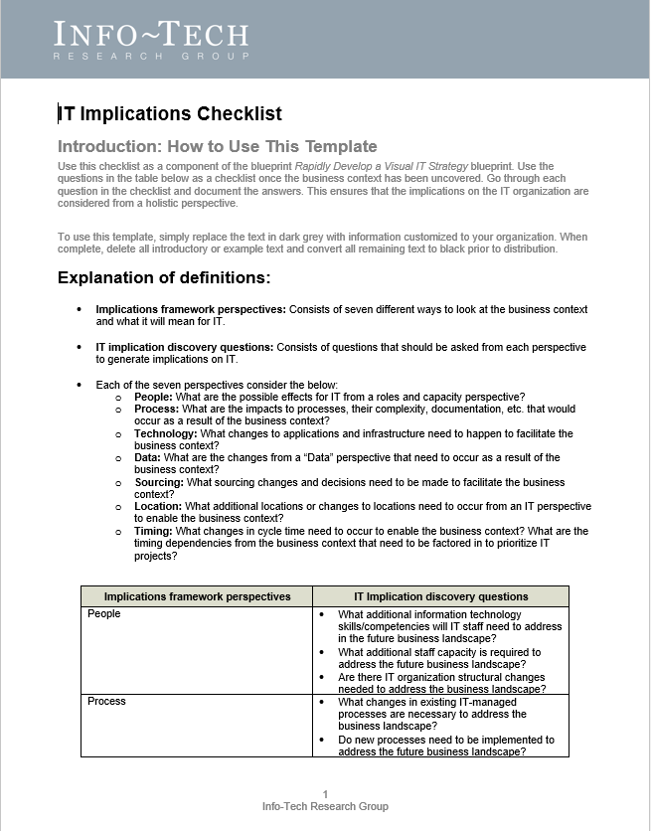
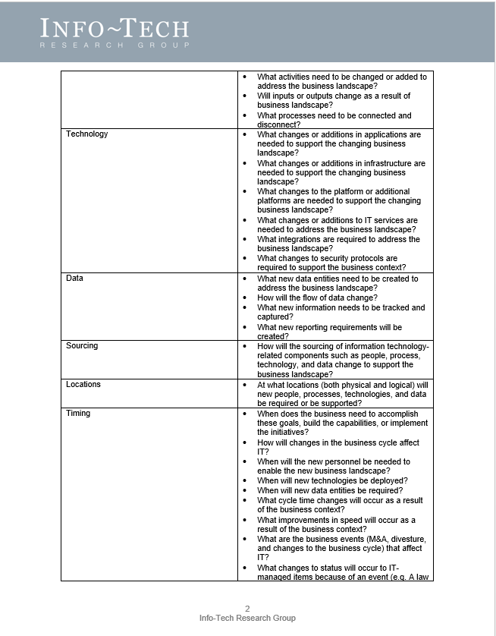
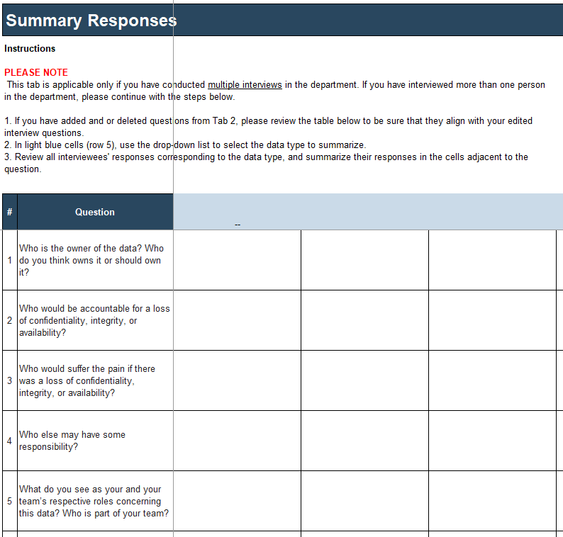
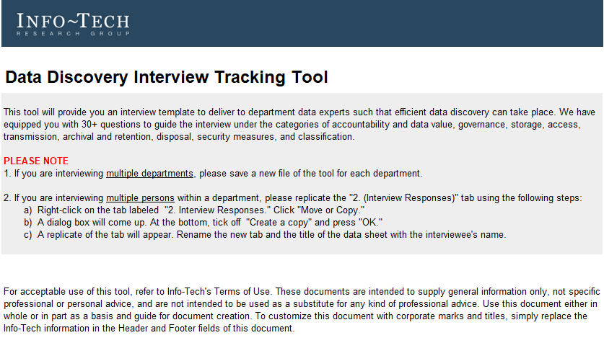
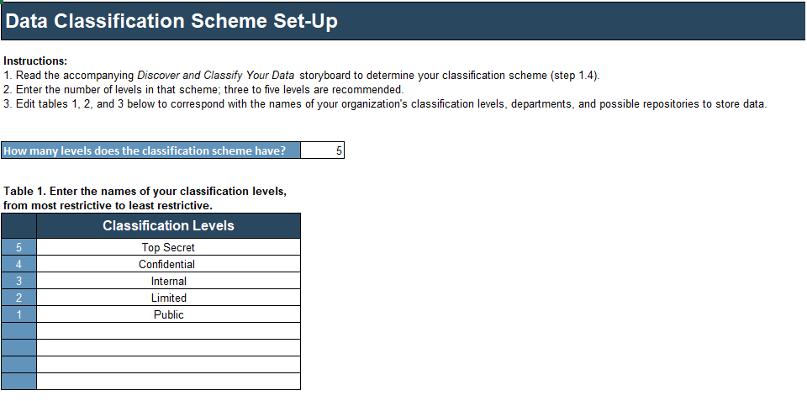
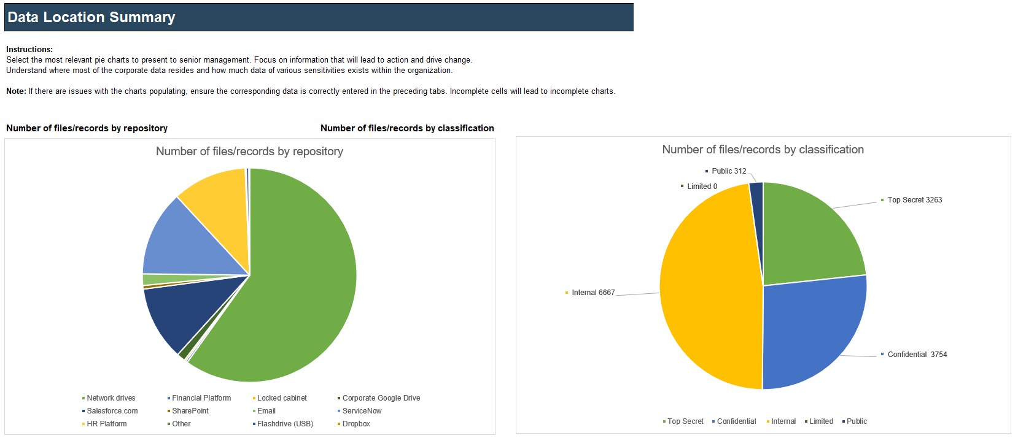
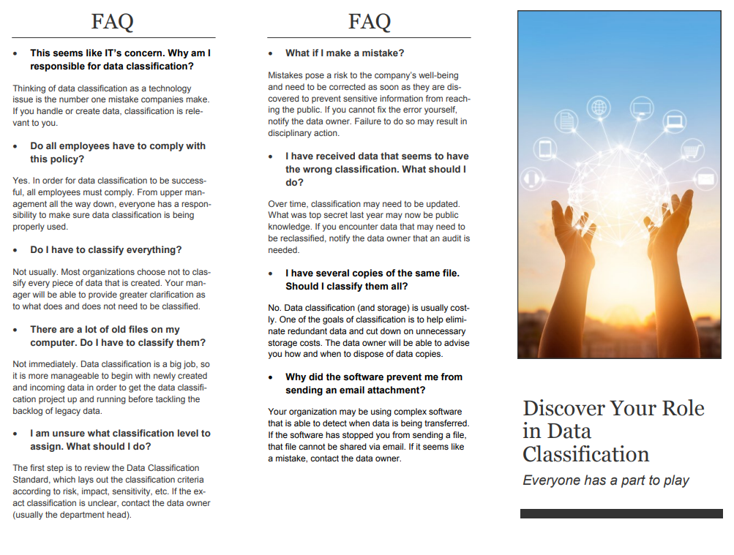
Blueprint deliverables
Key deliverable:
Each step of this blueprint is accompanied by supporting deliverables to help you accomplish your goals:
  Data Classification Inventory Tool
  Steering Committee Charter
  Classification Policy
  Classification Standard
  Data Classification RACI
  User Data Handling Requirements
  Data Discovery Interview Tracking
Use this tool to define your classification scheme, track and consolidate the classification of corporate assets, and gain visibility into the location and security of your organization’s most sensitive data.
Incorporate human and technology-based tools to simplify discovery
Develop a Classification Program
  Inventory Tool
  Verification Tool
  Metrics Tracking Tool
  Awareness Pamphlet
  Awareness Poster
Implement the classification program to ensure appropriate levels of protection

Slide 10

Guided Implementation
A Guided Implementation (GI) is a series
of calls with an Info-Tech analyst to help implement the project.
A typical GI for this project is four to six calls over the course of four to six months.
What does a typical GI on this topic look like?
Phase 1
Phase 2
Phase 3
Call #1:
Establish a data classification steering committee
Call #3:
Plan data discovery
Call #5:
Classify the data
Call #2:
Formalize data classification documentation
Call #4:
Implement data discovery
Call #6:
Maintain and optimize the program
Info-Tech Research Group | 10

Slide 11
Workshop Overview
Contact your account representative for more information.
workshops@infotech.com 1-888-670-8889
 | Day 1 | Day 2 | Day 3 | Day 4 | Day 5
Activities | Formalize the Classification Program | Discover the Data | Classify the Data | Plan to Implement the Program | Next Steps and Wrap-Up (offsite)
 | 1.1 Understand the benefits of data classification 1.2 Discuss legal, contractual, and regulatory obligations 1.3 Develop a data classification steering committee 1.4 Determine the data classification scheme 1.5 Develop the data classification policy 1.6 Develop the data classification standard 1.7 Define the data classification RACI | 2.1 Discuss benefits and challenges of data discovery 2.2 Discuss technology options for discovery and classification 2.3 Discuss the human-based approach to data discovery 2.4 Define discovery interview questions 2.5 Conduct data discovery interviews (approximately two interviews) | 3.1 Continue conducting interviews (approximately two interviews) and aggregate preliminary results 3.2 Classify preliminary findings uncovered from interviews 3.3 Understand the results of the Data Classification Inventory Tool 3.4 Discuss next steps for optimizing the process | 4.1 Identify data metrics to track and report 4.2 Develop awareness and training material 4.3 Discuss next steps for continuing the data classification initiative 4.4 Debrief | 5.1 Complete in-progress deliverables from previous four days. 5.2 Set up time to review workshop deliverables and discuss next steps.
Deliverables | Data Classification Steering Committee Charter Data Classification Policy User Data Handling Requirements Tool Data Classification Standard Data Classification RACI Tool | Data Discovery Interview Tracking Tool Approximately two completed interviews | Approximately two completed interviews Data Classification Inventory Tool Data Classification Verification Tool | Data Classification Metrics Tracking Tool Data classification awareness and training material

Slide 12
Measure the value of this blueprint
After each Info-Tech experience, we ask our members to quantify the real-time savings, monetary impact, and project improvements our research helped them achieve.
Phase | Purpose | Measured Value
Define Requirements | Understand classification requirements and formalize documentation. | Time, value, and resources saved with guidance and templates: 3 FTEs*3 days*$80,000/year = $2,880
Discover Your Data | Perform data discovery. | Expect to save 10% to 30% from discovery efforts with guidance.
 | Size of Organization | Small | Mid-sized | Large
 | Phase Duration | 45 days | 7 days | 180 days discovery
 | Savings | $1,440 - $4,320 | $2,400 - $7,200 | $5,700-$17,280
Implement Classification | Perform data classification and analysis. | Expect to save 10% to 30% from classification efforts with guidance.
 | Size of Organization | Small | Mid-sized | Large
 | Phase Duration | 180 days | 180 days | 360 days
 | Savings | $5,760 - $17,280 | $5,760 - $17,280 | $11,520 - $34,560
Average $ Saved
Overall Impact
Overall Impact
9.2 /10
Overall Average $ Saved
$25,015
Overall Average Days Saved
35

