Slide 1
Improve IT Operations With AI and ML
Deliver your IT services efficiently, go above and beyond, and exceed manual repetitive tasks.
EXECUTIVE BRIEF

Slide 2
Analyst Perspective
Ready your IT operations to transition to automation
AI and IT automation are becoming a necessity for managing complex organizations, enabling speed and agility of response. These deployments, however, need a comprehensive understanding of IT and business requirements. Vendors promise to tackle IT issues and improve operations. Nonetheless, tools alone cannot improve IT operations when processes are poor and inconsistent.
On the other hand, replacing AI-based solutions will not solve the issue if processes are broken.
IT operations practices and procedures need to be at a level that can support prerequisites for adopting AI capabilities. This research is designed to help you identify the pain points in your IT operations, develop an improvement plan, and transition seamlessly into AIOps by providing a guide.
Mahmoud Ramin Research Analyst, Infrastructure and Operations Info-Tech Research Group

Slide 3
Executive Summary
Your Challenge
Common Obstacles
Info-Tech’s Approach
You have difficulty meeting the business’ expectations for service delivery on a regular basis.
Despite a lot of investment in improving various areas of IT operations, IT staff at your organization still feel like they’re constantly firefighting.
To tackle these issues, your business is tempted to heavily invest in purchasing multiple solutions. This will not only complicate IT operations, but also potentially deteriorate its functions.
IT covers a broad spectrum of services and functions. As a result, pinpointing specific pain points and their root causes can be a difficult task.
Prioritizing areas to improve can also be difficult. All your initiatives seem to be demanding attention, but your resources are limited.
Your organization’s IT operations are not mature enough to leverage AI capabilities.
AI technology has become a major initiative for organizations, and vendors provide solutions with a multitude of features. This can make it challenging to prioritize deployment and set a realistic timeline for improvement.
Perform a current state assessment to identify which areas within your operations management are least mature and are causing the most grief. Then identify which functional areas within operations management need to be prioritized for improvement.
Make a shortlist of use cases that will get the most benefit from AI-based technology.
Prepare a plan to deploy AI capabilities to improve your IT operations.
Info-Tech Insight
To leverage AI capabilities, you need to assess the current state of your IT operations and know what your priorities are. Contemplate use cases that will get the most benefit from automation and start with processes that you are relatively comfortable handling. To ensure easy wins, analyze the initial plan and expand your AIOps.

Slide 4
Effective operations management practices will improve service delivery capabilities and lower IT costs
Effective operations management will help you do the following:
Since IT leaders are expected to predict disruptions to IT, automating IT operations would help them focus on technology strategy, innovation opportunities, and running IT – all at the same time. AIOps capabilities enable businesses to run their operations more intelligently.
1. Improve IT efficiency:
Effective operations management practices develop and use structured processes to automate activities and increase process consistency across the IT organization, ultimately improving IT’s efficiency.
2. Improve visibility and information sharing within IT:
Good operations management practices can provide more visibility into current IT performance and activities. They can expose weaknesses, help you anticipate potential future problems, and assist IT in better preparing to move from a firefighting role to an innovator role. Good IT operations management practices will also promote information sharing across different IT functions to enable good decision making.
3. Create and clarify accountability and responsibility:
Operations management practices will set a clear level of accountability throughout the IT organization and ensure role responsibility for all tasks and processes involved in IT service delivery.
4. Control IT costs:
IT operations management is concerned with delivering promised services in the most efficient way possible. Good IT operations management practices will provide insight into current costs across the IT organization and present opportunities for cost savings.
5. Identify opportunities for continuous improvement:
Effective operations management will offer you increased visibility into your current performance levels and the ability to accurately identify opportunities for continuous improvement.

Slide 5
What is AIOps?
AIOps is a combination of using artificial intelligence (AI) and machine learning (ML) to monitor and analyze IT operation systems. AIOps helps IT operations to improve their processes, tasks, and decisions by using a high volume of data.
AI enables the machine's ability to simulate human behavior. It enables machines to learn through a series of algorithms.
To get better quality simulations, you need to be provided with high-quality data. ML analyzes the data and presents findings to predict and alert your operations to possible issues.
According to a New Vantage Partners survey, 98.8% of executives are interested in applying AI and big data to their business operations.
Source: New Vantage Partners, 2020

Slide 6
AI and ML help managers cope with noisy and complex environments
According to a 2019 BigPanda survey, almost half of IT leaders believe that data has become noisier and more complex. That said, IT automation will have a big role in handling IT and business operations. This will give CXOs the capabilities to deal with their common challenges.
The Importance of Automation
What Do Enterprises Want?
89%
81%
Autonomous Noise Reduction
Ease of Adoption
Data Scientist Independent
Autonomous Resolution
77%
This graph depicts the percentage of respondents who felt automation was critical in these three areas. Source: BigPanda, 2019
Time to Value
Source: BigPanda, 2019

Slide 7
Despite its huge benefits, organizations hesitate to adopt AIOps
BigPanda’s 2019 survey asked respondents if AI tools facilitate automation:
Businesses face two major problems when trying to implement AI in IT operations:
Low confidence in whether AI and ML will be helpful and truly reflect innovation. This doubt will disappear as more businesses invest in AIOps and prove the true value of AI and ML.
A lack of knowledge of how to implement AIOps to help collect high-value data. Extensive research in this field and proactive planning for adopting AI and ML are pivotal to improve the confidence of executives and train them for successful AIOps implementation.
New Vantage Partners’ 2020 survey asked about business adoption of big data:
Only 37.8% of respondents reported that they have created a data-driven organization. More than 90% of respondents reported that the main challenge in adopting AIOps is more about people, process, and cultural readiness, than technology capabilities.
Sources: BigPanda, 2019 and New Vantage Partners, 2020

Slide 8
Info-Tech’s approach: Tackle your AIOps initiatives with a promising plan
1. Analyze IT operations’
maturity
5. Develop an adoption plan
and maintenance roadmap
If a practice requires improvement, leverage a relevant Info-Tech blueprint to improve maturity level. If the maturity level is medium or high, proceed.
Make a short-term and long-term plan to improve your IT operations with AI and ML. As you observe the success of these initiatives, redo the procedure for other practice areas.
5
1
2. Define AIOps
opportunities
4
2
Align AIOps use cases with your goals to decide which processes/practices will get the most benefit from AI technology.
4. Design a shortlist
3
You won’t be able to use all AI and ML capabilities. Make a list of primary initiatives that will give you the most benefits. Pick the low-hanging fruits, then expand your AIOps later.
3. Assess gaps
Identify your process and skills gaps and decide what you should take in-house and what should be outsourced.

Slide 9
Case Study
Operations management is crucial to IT service delivery.
INDUSTRY
SOURCE
Transportation
McMurdo Transport
Current Situation
Challenges
Solution
McMurdo Transport is an amalgamation of several independent, local, and regional government-owned transportation companies.
As a result of its creation, McMurdo Transport has been expected to uphold the service promises made to its customers by the local and regional governments based on political platforms.
After the amalgamation, the company’s focus switched from being centered around maintaining day-to-day functionality to meeting these promised service levels at all costs.
McMurdo is finding itself unable to support these promised service levels without causing major disruption in the company’s day-to-day operations.
Currently, McMurdo Transport finds itself in a “catch 22” scenario: the company is experiencing a significant lag in its ability to meet daily service delivery levels.
The company seeks to refocus on the operational aspects of IT, with initiatives including:
Knowledge standardization.
Automation of change and asset management processes.
Increased efforts to ensure the quality of information and its visibility across the organization.

Slide 10
Info-Tech’s methodology for improving IT operations with AI and ML
 | 1. Assess the Current State of Operations Management | 2. Identify Initiatives That Align With Operations Requirements | 3. Develop the AI Roadmap
Phase Steps | Analyze operations maturity Identify the SLA you need | Determine your business requirements Assess your shortlist | Create a process action plan Communicate your AI and ML initiatives to get stakeholder support
Phase Outcomes | Identify key IT pain points Assess your IT operations maturity before implementing AI Review the big picture and develop a high-level plan for improvement Define your business needs and the SLAs that will be satisfied with AIOps | Recognize the benefits of AI and ML for your business Determine skillsets for AIOps initiatives Create a list of roles and responsibilities for your initiatives Specify the shortlist of AI applications | Identify AIOps metrics Analyze the AIOps ROI Create an implementation roadmap Build a communications plan

Slide 11
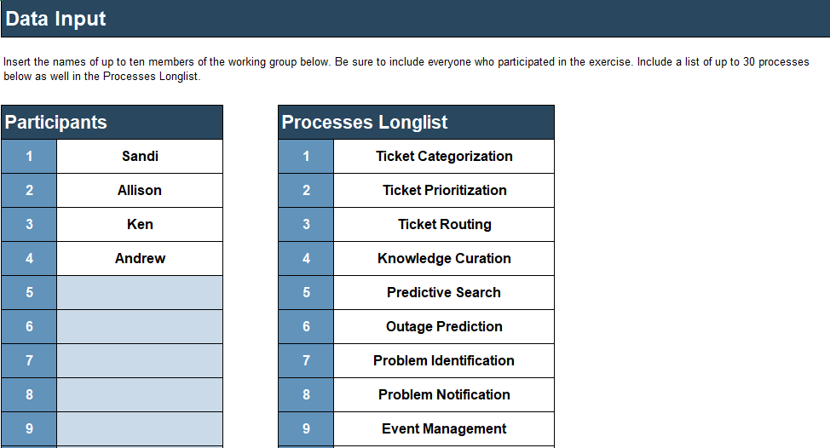
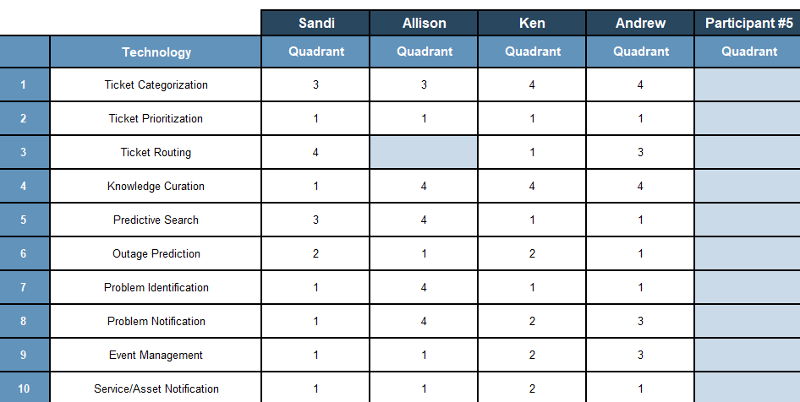
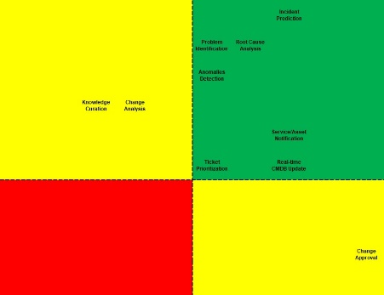
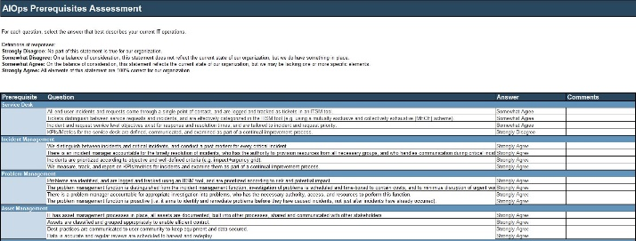
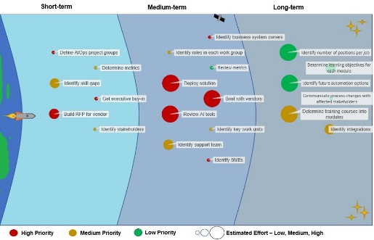
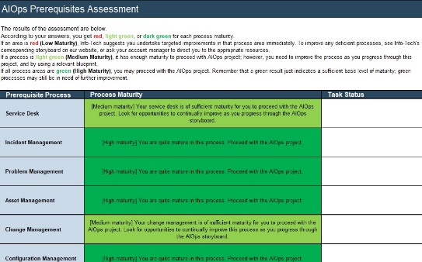
Blueprint deliverables
Key deliverable:
Each step of this blueprint is accompanied by supporting deliverables to help you accomplish your goals:
AIOps Prerequisites Assessment Tool
Identify the maturity level of your IT operations before you implement AI capabilities.
AIOps Shortlisting Tool
Leverage this tool to produce a shortlist of AIOps processes that will help you the most in reaching your goals.
AIOps Roadmap
Tool
Create an actionable plan for your AIOps project.

Slide 12
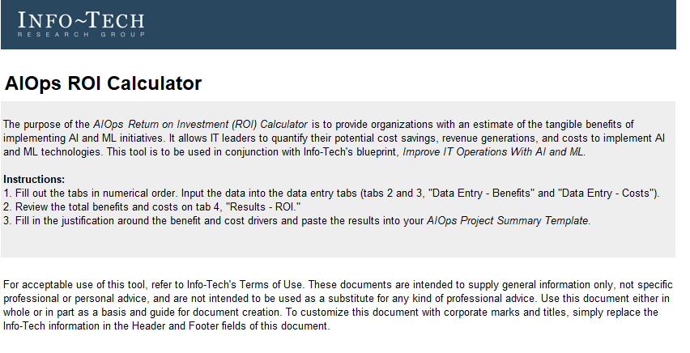
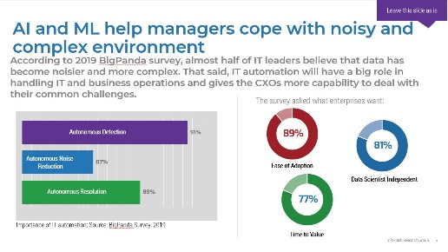
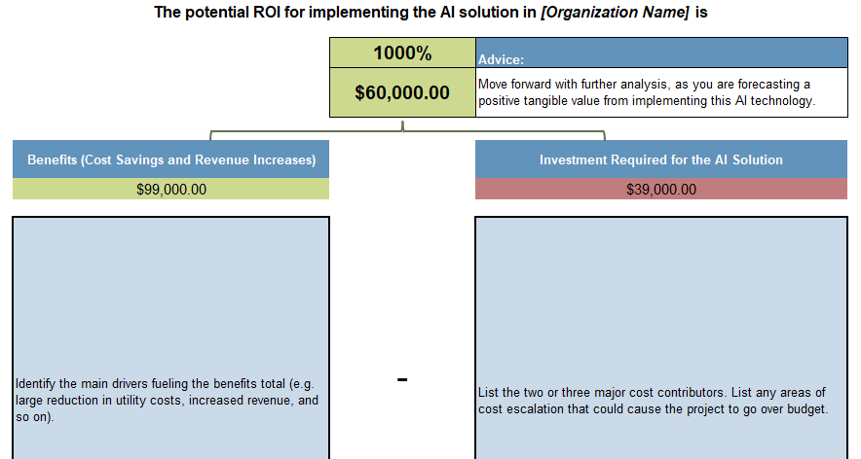
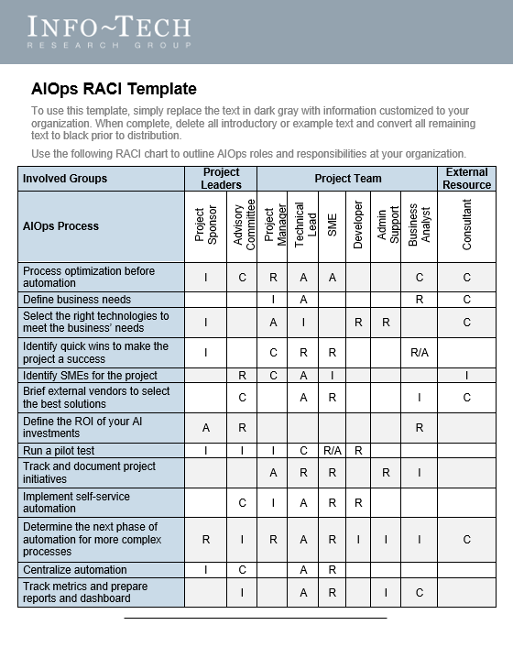
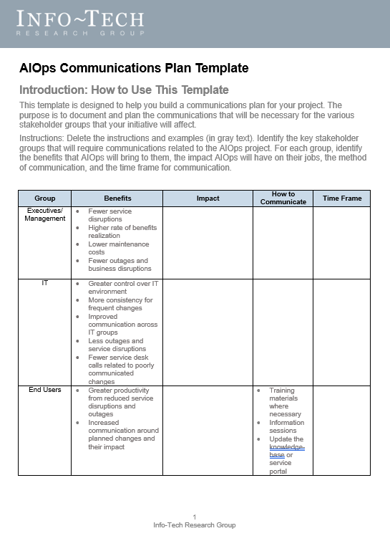
Additional Deliverables
AIOps Project Summary Template
AIOps ROI
Calculator
Use this template to build your business case and get everyone on board with your AIOps initiative.
Estimate the return on investment to determine if the benefits will be worth the cost and effort.
AIOps RACI Template
AIOps Communications Plan Template
Define roles and responsibilities with this guide.
Communicate your initiatives to affected stakeholders to get their support.

Slide 13
Insight summary
Improve processes, then automate
To leverage AI capabilities, you need to assess your current state of IT operations and know what your priorities are. Contemplate use cases that will get the most benefit from automation. Start with processes that you are relatively comfortable handling to get easy wins, analyze the initial plan, and then expand your AIOps.
Assess your process maturity to determine the right path
Before implementing any AI solution, assess your operation’s maturity level. Software may not improve IT processes when those processes have a low maturity level. Identify low maturity practice areas, augment the processes, and then leverage the right tool.
Think big, start small
Look at your IT operations holistically when building your strategy, but don’t automate all processes. Start with use cases to show the real benefits of AI to the affected stakeholders, then expand AI throughout IT.
Take constant action
Many organizations implement AIOps, then sit back and await their benefits. AI initiatives require continuous maintenance, accurate tracking, and effective communication with stakeholders to succeed.
Work persistently
Operations management isn’t a one-time project – it’s an ongoing effort. Assess the efficiency of your IT operations annually, compare it with the previous year, and enhance the processes that will provide the most benefits to IT and the business.
Get stakeholder buy-in
For your AIOps, start with low-hanging fruit. Automate processes that are fairly mature, that are easy to automate, and that automation will provide the most advantage for. Following the success of these initiatives, stakeholders will see the benefits of AI and ML and will continue using more capabilities.

Slide 14
Blueprint benefits
IT Benefits | Business Benefits
To implement AI-based solutions, IT needs to be at a certain maturity level. This blueprint will help you determine which IT practices need more focus before spending time and money to implement a solution. Once an applicable AI solution is selected, IT automation will reduce the time spent on repetitive and low-value tasks, freeing up more time for IT staff to work on more sophisticated activities. Following the guidelines, IT will define process requirements that fit IT and business goals. | Improving IT operations will provide high-quality and efficient service management practices that will benefit the whole organization. IT automation makes staff more productive, reduces cost, provides better allocation of resources, aligns them with business requirements, and improves business productivity. This blueprint help you will build a comprehensive list of business requirements that can be fulfilled with AIOps.

Slide 16
Guided implementation
A guided implementation (GI) is series of calls with an Info-Tech analyst to help implement our best practices in your organization.
A typical GI is six to seven calls over the course of three to four months.
What does a typical GI on this topic look like?
Phase 1
Phase 2
Phase 3
Call #1: Scope requirements, objectives, pain points, and process maturity of IT operations.
Call #3: Determine the benefits and costs of AI, as well as any skill gaps for undertaking the initiatives.
Call #5: Define project metrics.
Call #6: Analyze the return on investment.
Call #2: Determine the goals, benefits, and risks of an SLA for AIOps.
Call #4: Plan a shortlist of IT operations processes for your AIOps project.
Call #7: Build an implementation roadmap and a communications plan.
Info-Tech Research Group | 16

