Slide 1
Standardize the Service Desk
Improve customer service by driving consistency in your support approach and meeting SLAs.

Slide 2
Table of contents
1. Introduction
2. Project Rationale
3. Execute the Project/DIY Guide
Phase 1: Conduct Gap Analysis Phase 2: Design Incident Management Processes Phase 3: Design Request Fulfilment Processes Phase 4: Plan Service Desk Implementation
4. Summary/Conclusion
5. Next Steps

Slide 3


ANALYST PERSPECTIVE
Customer service issues are rarely based on personality but are almost always a symptom of poor and inconsistent process. When service desk managers are looking to hire to resolve customer service issues and executives are pushing back, it’s time to look at improving process and the support strategy to make the best use of technicians’ time, tools, and knowledge sharing. Once improvements have been made, it’s easier to make the case to add people or introduce automation.
Replacing service desk solutions will also highlight issues around poor process. Without fixing the baseline services, the new solution will simply wrap your issues in a prettier package.
Ultimately, the service desk needs to be the entry point for users to get help and the rest of IT needs to provide the appropriate support to ensure the first line of interaction has the knowledge and tools they need to resolve quickly and preferably on first contact. If your plans include optimization to self-serve or automation, you’ll have a hard time getting there without standardizing first.
Sandi Conrad,
Principal Research Director, Infrastructure & Operations Practice
Info-Tech Research Group

Slide 4
A method for getting your service desk out of firefighter mode
The CIO and senior IT management who need to increase service desk effectiveness and timeliness and improve end-user satisfaction.
The service desk manager who wants to lead the team from firefighting mode to providing consistent and proactive support.
Create a consistent customer service experience for service desk patrons.
Increase efficiency, first-call resolution, and end-user satisfaction with the Service Desk.
Decrease time and cost to resolve service desk tickets.
Understand and address reporting needs to address root causes and measure success.
Build a solid foundation for future IT service improvements.
Service desk teams who want to increase their own effectiveness and move from a help desk to a service desk.
Infrastructure and applications managers who want to decrease reactive support activities and increase strategic project productivity by shifting repetitive and low-value work left.

Slide 5
Executive summary
Most service desk managers are worried about tools and staffing. They never feel they have the right technology or enough people to provide the level of service the business needs.
If only the phone could stop ringing, the Service Desk could become proactive, address service levels, and improve end-user IT satisfaction.
Service desk improvement is an exercise in organizational change. Engage specialists across the IT organization in building the solution. Establish a single service-support team across the IT group and enforce it with a cooperative, customer-focused culture.
Don’t be fooled by a tool that’s new.
A new service desk tool alone won’t solve the problem. Service desk maturity improvements depend on putting in place the right people and processes to support the technology.
Not everyone embraces their role in service support. Specialists would rather work on projects than provide service support.
The Service Desk lacks processes and workflows to provide consistent service. Service desk managers struggle to set and meet service-level expectations, which further compromises end-user satisfaction.
Go beyond the blind adoption of best-practice frameworks. No simple formula exists for improving service desk maturity. Use diagnostic tools to assess the current state of the Service Desk. Identify service support challenges and draw on best-practice frameworks intelligently to build a structured response to those challenges.
An effective service desk must be built on the right foundations. Understand how:
  Service desk structure affects cost and ticket volume capacity.
  Incident management workflows can improve ticket handling, prioritization, and escalation.
  Request fulfillment processes create opportunities for streamlining and automating services.
  Knowledge sharing supports the processes and workflows essential to effective service support.

Slide 6
Directors and executives understand the importance of the service desk and believe IT can do better
Service Desk
Importance Scores
No Importance: 1.0-6.9
Limited Importance: 7.0-7.9
Significant Importance: 8.0-8.9
Critical Importance: 9.0-10.0
Service Desk
Effectiveness Scores
Not in Place: N/A
Not Effective: 0.0-4.9
Somewhat Ineffective: 5.0-5.9
Somewhat Effective: 6.0-6.9
Very Effective: 7.0-10.0
Source: Info-Tech, 2019 Responses (N=189 organizations)
Info-Tech Research Group’s IT Management and Governance Diagnostic (MGD) program assesses the importance and effectiveness of core IT processes. Since its inception, the MGD has consistently identified the service desk as an area to leverage.

Slide 7
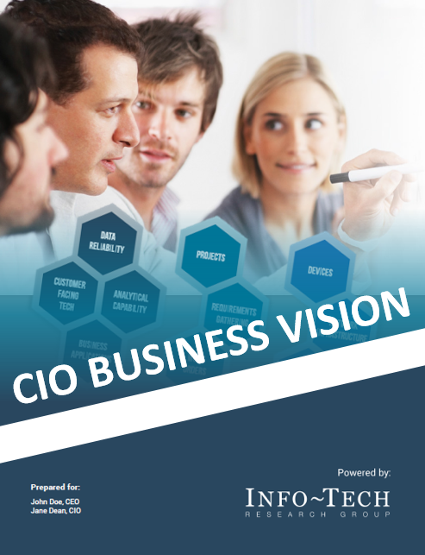
Business stakeholders consistently rank the service desk as one of the top five most important services that IT provides
Top IT Services for Business Stakeholders
Since 2013, Info-Tech has surveyed over 40,000 business stakeholders as part of our CIO Business Vision program.
Business stakeholders ranked the following 12 core IT services in terms of importance:
1
Network Infrastructure
IT Security*
Data Quality
Service Desk
Business Applications
Devices
Client-Facing Technology
Analytical Capability
IT Innovation Leadership
Projects
Work Orders
IT Policies
Requirements Gathering
2
3
4
5
6
7
8
9
10
Learn more about the CIO Business Vision program.
11
12
13
*Note: IT Security was added to CIO Business Vision 2.0 in 2019
Source: Info-Tech Research Group, 2019 (N=224 organizations)

Slide 8
Having an effective and timely service desk correlates with higher end-user satisfaction with all other IT services
46%
37%
On average, organizations that were satisfied with service desk effectiveness rated all other IT processes 46% higher than dissatisfied end users.
Organizations that were satisfied with service desk timeliness rated all other IT processes 37% higher than dissatisfied end users.
“Satisfied” organizations had average scores >=8.
“Dissatisfied" organizations had average scores <6.
Source: Info-Tech Research Group, 2019
(N=18,500+ respondents from 75 organizations)

Slide 9


Standardize the service desk the Info-Tech way to get measurable results
More than one hundred organizations engaged with Info-Tech, through advisory calls and workshops, for their service desk projects in 2016. Their goal was either to improve an existing service desk or build one from scratch.
Organizations that estimate the business impact of each project phase help us shed light on the average measured value of the engagements.
US$1,659,493.37
Sum of Measured Value Dollar Impact
US$19,755.87
Average Measured Value Dollar Impact
  The analysts are an amazing resource for this project. Their approach is very methodical, and they have the ability to fill in the big picture with detailed, actionable steps. There is a real opportunity for us to get off the treadmill and make real IT service management improvements.
– Rod Gula, IT Director
American Realty Advisors
27 Days
Average Measured Value Time Saved
Source: Info-Tech Research Group, 2016-2018 (N=141 records)

Slide 10
Info-Tech’s approach to service desk standardization focuses on building service management essentials
Phase 1:
Lay Service Desk Foundations
Phase 2:
Design Incident Management
Phase 3:
Design Request
Fulfilment
Phase 4:
Plan Implementation
1.1
Assess service desk challenges
2.1
Build incident management workflows
3.1
Build request workflows
4.1
Build communication plan
1.2
Review service support best practices
2.2
Design ticket categorization
3.2
Build a targeted knowledgebase
4.2
Build implementation roadmap
Identify metrics and reports
2.3
Design incident escalation and prioritization
1.3
2.3
3.3
Prepare for a self-service portal project
1.4
Review ticket handling procedures
Outputs
Current-state assessment
Incident and critical incident management workflows
Request workflows
Communication plan
Roles & responsibilities guide
Categorization scheme
KB article template
Project summary
Metrics and reports
Escalation guidelines
KB process and workflow
Implementation roadmap
Ticket handling procedures & guidelines
Prioritization matrix

Slide 11
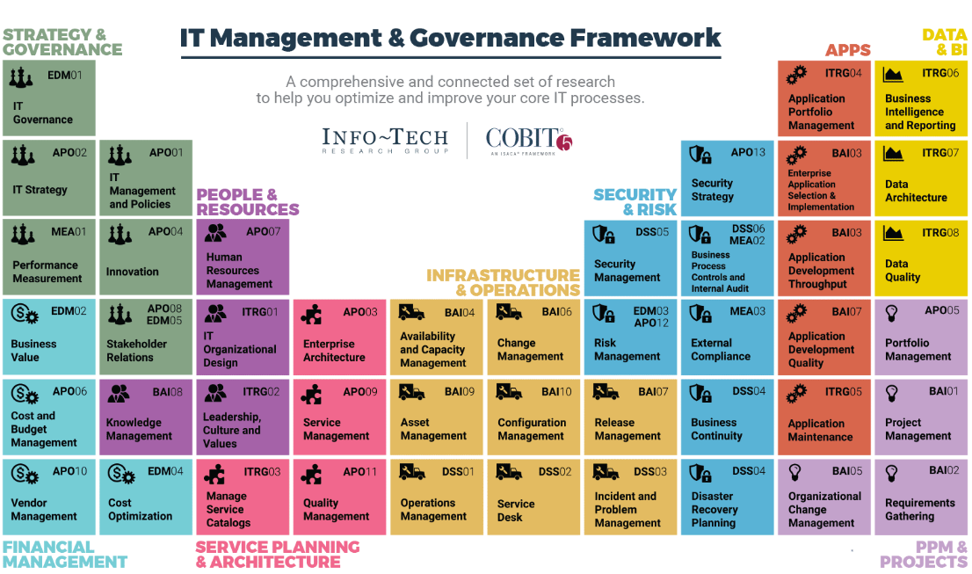
Info-Tech draws on the COBIT framework, which focuses on consistent delivery of IT services across the organization

Slide 12
The service desk is the foundation of all other service management processes
STRATEGIC PARTNER
Service Design
Service Portfolio
Management
Continual Improvement
Fully aligned with business
Drive innovation
Drive measurable value
Business Relationship Management
Service Metrics
Availability Management
SERVICE PROVIDER
Service Level
Management
Service Continuity Management
Understand business needs
Ensure services are available.
Measure service performance, based on business-oriented metrics
Event
Management
Capacity & Performance
Management
Release &
Deployment
Management
Asset Management
Service Catalog
Management
  PROACTIVE
  Improve quality of service (performance, availability, reliability)
  Avoid and prevent service disruptions and recurring incidents
Configuration
Management
Problem
Management
STABILIZE
Deliver stable, reliable IT services to the business
Respond to user requests quickly and efficiently
Resolve user issues in a timely manner
Deploy changes smoothly and successfully
Service Desk
Change Enablement
Knowledgebase
Intake
Request Management
Incident Management
Basic Catalog
Operational
Metrics
FOUNDATIONAL
Understand Value
Aligned Goals
Operating Model
Governance
Management Practices
Culture
OCM

Slide 13




Info-Tech offers various levels of support to best suit your needs
Guided Implementation
DIY Toolkit
Workshop
Consulting
“Our team has already made this critical project a priority, and we have the time and capability, but some guidance along the way would be helpful.”
“Our team knows that we need to fix a process, but we need assistance to determine where to focus. Some check-ins along the way would help keep us on track.”
“We need to hit the ground running and get this project kicked off immediately. Our team has the ability to take this over once we get a framework and strategy in place.”
“Our team does not have the time or the knowledge to take this project on. We need assistance through the entirety of this project.”
Diagnostics and consistent frameworks used throughout all four options

Slide 14


Use these icons to help direct you as you navigate this research
Use these icons to help guide you through each step of the blueprint and direct you to content related to the recommended activities.
This icon denotes a slide where a supporting Info-Tech tool or template will help you perform the activity or step associated with the slide. Refer to the supporting tool or template to get the best results and proceed to the next step of the project.
This icon denotes a slide with an associated activity. The activity can be performed either as part of your project or with the support of Info-Tech team members, who will come onsite to facilitate a workshop for your organization.

Slide 15

Standardize the Service Desk – project overview
Phase 1:
Lay Foundations
Phase 2:
Incident Management
Phase 3:
Request Fulfilment
Phase 4: Implementation
Best-Practice Toolkit | 1.1 Assess service desk current state 1.2 Review service support best practices 1.3 Identify metrics and reports 1.4 Review ticket handling procedures | 2.1 Build incident management workflows 2.2 Design ticket categorization 2.3 Design incident escalation and prioritization | 3.1 Build request workflows 3.2 Build a targeted knowledgebase 3.3 Prepare for a self-service portal project | 4.1 Build communication plan 4.2 Build an implementation roadmap
Guided Implementations | Conduct current-state assessment. Review shift-left service support strategy. Identify operations metrics, and reports. Review ticket handling procedures. | Map out incident management workflows. Design categorization and identify escalation points. Design prioritization guidelines and service-level objectives. | Differentiate between requests and projects, build request workflows, and make a self-service portal plan. Design processes and workflows to produce a targeted knowledgebase. | Build a communication plan and implementation roadmap.
Onsite Workshop | Module 1: Lay foundations | Module 2: Design incident management | Module 3: Design request fulfilment | Module 4: Plan implementation
 | Phase 1 Results: Current-state assessment and shift-left strategy Metrics and reports; ticket handling procedures | Phase 2 Results: Defined processes for logging, recording, and resolving incidents | Phase 3 Results: Defined processes for logging, scheduling, and fulfilling requests Knowledgebase processes | Phase 4 Results: Communication plan and implementation roadmap

Slide 16
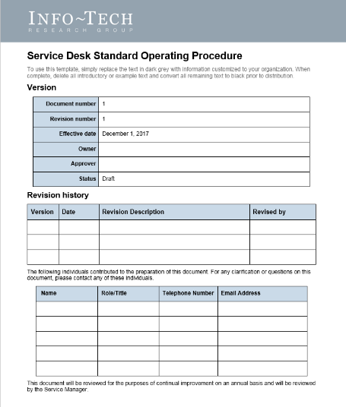
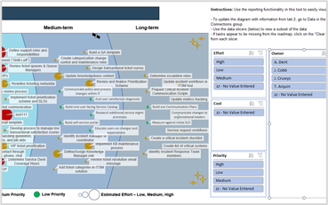
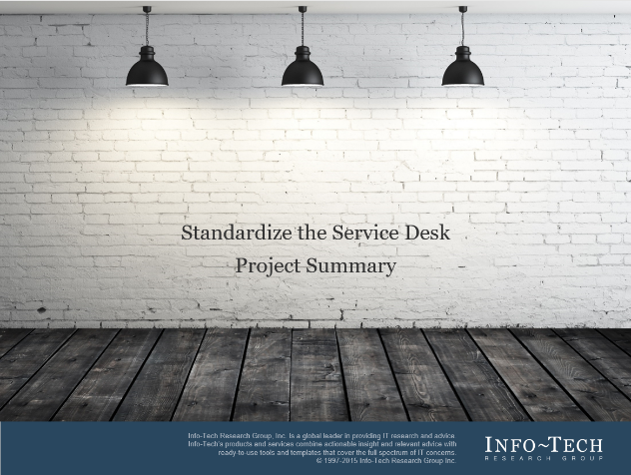
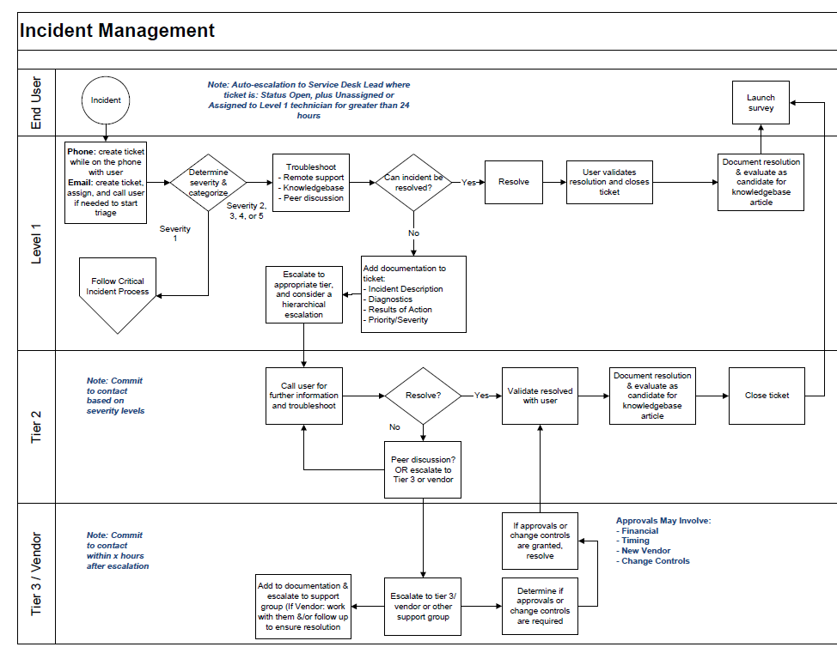
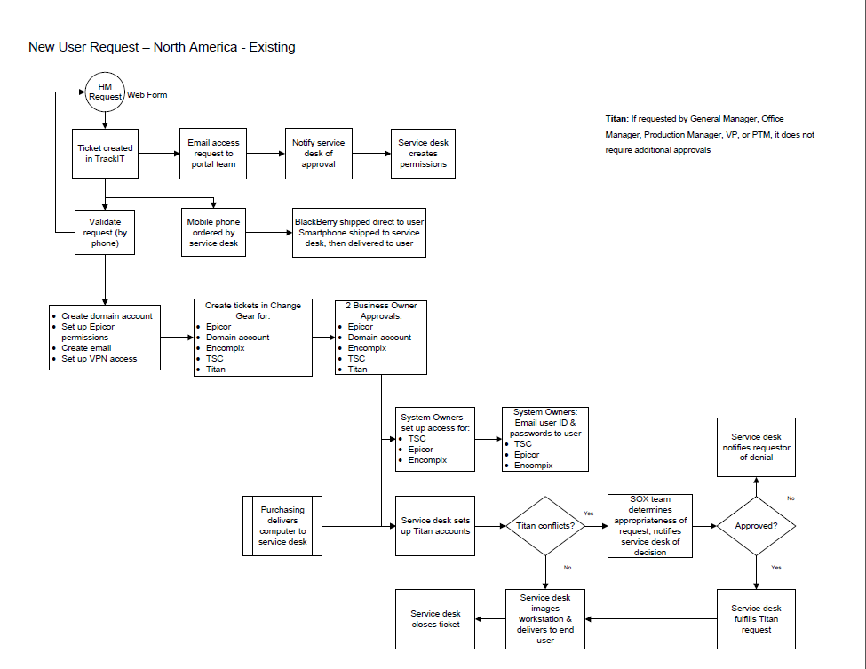
Info-Tech delivers: Use our tools and templates to accelerate your project to completion
Service Desk
Implementation Roadmap
Service Desk
Standard Operating Procedures
Project Summary
Incident, knowledge, and request management workflows
Service Desk
Maturity Assessment Tool

Slide 17
The project’s key deliverable is a service desk standard operating procedure
Benefits of documented SOPs | Impact of undocumented/undefined SOPs
Improved training and knowledge transfer: Routine tasks can be delegated to junior staff (freeing senior staff to work on higher priority tasks). | Tasks will be difficult to delegate, key staff become a bottleneck, knowledge transfer is inconsistent, and there is a longer onboarding process for new staff.
IT automation, process optimization, and consistent operations: Defining, documenting, and then optimizing processes enables IT automation to be built on sound processes, so consistent positive results can be achieved. | IT automation built on poorly defined, unoptimized processes leads to inconsistent results.
Compliance: Compliance audits are more manageable because the documentation is already in place. | Documenting SOPs to prepare for an audit becomes a major time-intensive project.
Transparency: Visually documented processes answer the common business question of “why does that take so long?” | Other areas of the organization may not understand how IT operates, which can lead to confusion and unrealistic expectations.
Cost savings: Work solved at first contact or with a minimal number of escalations will result in greater efficiency and more cost-effective support. This will also lead to better customer service. | Support costs are highest through inefficient processes, and proactive work becomes more difficult to schedule, making the organization vulnerable to costly disruptions.

Slide 18
Workshop overview
 | Workshop Day 1 | Workshop Day 2 | Workshop Day 3 | Workshop Day 4
Activities | Module 1: Lay service desk foundations. 1.1 Assess current state of the service desk. 1.2 Review service desk structure and shift-left strategy 1.3 Identify service desk metrics and reports. 1.4 Identify ticket handling procedures | Module 2: Design incident management. 2.1 Build incident and critical incident management workflows. 2.2 Design ticket categorization scheme and proper ticket handling guidelines. 2.3 Design incident escalation and prioritization guidelines. | Module 3: Design request fulfilment. 3.1 Build service request workflows. 3.2 Build a targeted knowledgebase. 3.3 Prepare for a self-serve portal project. | Module 4: Build project implementation plan. 4.1 Build implementation roadmap. 4.2 Build communication plan.
Outcomes | Current state assessment Shift-left strategy and implications Roles and responsibilities Service desk metrics and reports | Incident and critical incident management workflows Ticket categorization scheme Ticket escalation and prioritization guidelines | Distinguishing criteria for requests and projects Service request workflows and SLAs Knowledgebase article template, processes, and workflows | Project communication plan and workshop summary presentation Project implementation and task list
Deliverables | Standard Operating Procedures Workshop Summary |  | Workflow Library Implementation Task List
Contact your account representative or email Workshops@InfoTech.com for more information.

