Slide 1
Optimize IT Change Management
Right-size IT change management to protect the live environment.

Slide 2
Table of Contents
3 Executive Brief
4 Analyst Perspective
5 Executive Summary
26 Phase 1: Define ChangeManagement
27 Step 1.1: Assess Maturity
35 Step 1.2: Categorize Changes and Your Build Risk Assessment
50 Phase 2: Establish Roles and Workflows
51 Step 2.1: Determine Roles and Responsibilities
61 Step 2.2: Build Core Workflows
82 Phase 3: Define the RFC and Post-Implementation Activities
83 Step 3.1: Design the RFC
93 Step 3.2: Establish Post- Implementation Activities
103 Phase 4: Measure, Manage, and Maintain
104 Step 4.1: Identify Metrics and Build the Change Calendar
117 Step 4.2: Implement the Project
126 Summary of Accomplishment
127 Additional Support
129 Select Bibliography
130 Appendix I: Expedited Changes
131 Appendix II: Optimize IT Change Management in a DevOps Environment

Slide 3
Optimize IT Change Management
Right-size IT change management practice to protect the live environment.
EXECUTIVE BRIEF

Slide 4

Analyst
Perspective
Balance risk and efficiency to optimize IT change management.
Change management (change enablement, change control) is a balance of efficiency and risk. That is, pushing changes out in a timely manner while minimizing the risk of deployment. On the one hand, organizations can attempt to avoid all risk and drown the process in rubber stamps, red tape, and bureaucracy. On the other hand, organizations can ignore process and push out changes as quickly as possible, which will likely lead to change related incidents and debilitating outages.
Right-sizing the process does not mean adopting every recommendation from best-practice frameworks. It means balancing the efficiency of change request fulfillment with minimizing risk to your organization. Furthermore, creating a process that encourages adherence is key to avoid change implementers from skirting your process altogether.
Benedict Chang
Research Analyst, Infrastructure and Operations
Info-Tech Research Group

Slide 5



Executive Summary
Your Challenge
Common Obstacles
Info-Tech’s Approach
Infrastructure and application change occurs constantly and is driven by changing business needs, requests for new functionality, operational releases and patches, and resolution of incidents or problems detected by the service desk.
IT managers need to follow a standard change management process to ensure that rogue changes are never deployed while the organization remains responsive to demand.
IT system owners often resist change management because they see it as slow and bureaucratic.
At the same time, an increasingly interlinked technical environment may cause issues to appear in unexpected places. Configuration management systems are often not kept up-to-date and do not catch the potential linkages.
Infrastructure changes are often seen as “different” from application changes and two (or more) processes may exist.
Info-Tech’s approach will help you:
Create a unified change management practice that balances risk and throughput of innovation.
Categorize changes based on an industry-standard risk model with objective measures of impact and likelihood.
Establish and empower a Change Manager and Change Advisory Board (CAB) with the authority to manage, approve, and prioritize changes.
Balance Risk and Efficiency to Optimize IT Change Management
Two goals of change management are to protect the live environment and deploying changes in a timely manner. These two may seem to sometimes be at odds against each other, but assessing risk at multiple points of a change’s lifecycle can help you achieve both.

Slide 6
Your challenge
This research is designed to help organizations who need to:
Build a right-sized change management practice that encourages adherence and balances efficiency and risk.
Integrate the change management practice with project management, service desk processes, configuration management, and other areas of IT and the business.
Communicate the benefits and impact of change management to all the stakeholders affected by the process.
Change management is heavily reliant on organizational culture
Having a right-sized process is not enough. You need to build and communicate the process to gather adherence. The process is useless if stakeholders are not aware of it or do not follow it.
Of the eight infrastructure & operations processes measured in Info-Tech’s IT Management and Governance Diagnostic (MGD) program, change management has the second largest gap between importance and effectiveness of these processes. See this slide for more details.
Source: Info-Tech 2020; n=5,108 IT professionals from 620 organizations

Slide 7
Common obstacles
“Why should I fill out an RFC when it only takes five minutes to push through my change?”
These barriers make this challenge difficult to address for many organizations:
“We’ve been doing this for years. Why do we need more bureaucracy?”
Gaining buy-in can be a challenge no matter how well the process is built.
The complexity of the IT environment and culture of tacit knowledge for configuration makes it difficult to assess cross-dependencies of changes.
Each silo or department may have their own change management workflows that they follow internally. This can make it difficult to create a unified process that works well for everyone.
“We don’t need change management if we’re Agile.”
“We don’t have the right tools to even start change management.”
“Why do I have to attend a CAB meeting when I don’t care what other departments are doing?”

Slide 8
Info-Tech’s approach
Build change management by implementing assessments and stage gates around appropriate levels of the change lifecycle.
The Info-Tech difference:
Create a unified change management process that balances risk and throughput of innovation.
Categorize changes based on an industry-standard risk model with objective measures of impact and likelihood.
Establish and empower a Change Manager and Change Advisory Board (CAB) with the authority to manage, approve, and prioritize changes.
Improve
Request
Implement
Assess
Approve
Plan

Slide 9
IT change is constant and is driven by:
1
2
Major Release
New Application
Operations
Business
Operational releases, maintenance, vendor-driven updates, and security updates can all be key drivers of change.
Example: ITSM version update
Maintenance Release
New Version
Security Patch
Business-driven changes may include requests from other business departments that require IT’s support.
Examples: New ERP or HRIS implementation
CHANGE MANAGEMENT
3
In addition to software and hardware asset dependencies, a configuration management database (CMDB) is used to keep a record of changes and is queried to assess change requests.
Some incident and problem tickets require a change to facilitate resolution of the incident.
Examples: Outage necessitating update of an app (emergency change), a user request for new functionality to be added to an existing app
Workaround
Fix
Service Desk
Incident & Problem
Hardware
Configuration Management Database (CMDB)
Asset Management
Software

Slide 10
Insight summary
Build a unified change management process balancing risk and change throughput.
Building a unified process that oversees all changes to the technical environment doesn’t have to be burdensome to be effective. However, the process is a necessary starting point to identifying cross dependencies and avoiding change collisions and change-related incidents.
“The scope of change management is defined by each organization…the purpose of change management is to maximize the number of successful service and product changes by ensuring that the risk have been properly assessed, authorizing changes to process, and managing the change schedule.”
– ALEXOS Limited, ITIL 4
Use an objective framework for estimating risk
Simply asking, “What is the risk?” will result in subjective responses that will likely minimize the perceived risk. The level of due diligence should align to the criticality of the systems or departments potentially impacted by the proposed changes.
Integrate your change process with your IT service management system
Change management in isolation will provide some stability, but maturing the process through service integrations will enable data-driven decisions, decrease bureaucracy, and enable faster and more stable throughput.
Change management and DevOps can work together effectively
Change and DevOps tend to be at odds, but the framework does not have to change. Lower risk changes in DevOps are prime candidates for the pre-approved category. Much of the responsibility traditionally assigned to the CAB can be diffused throughout the software development lifecycle.

Slide 11
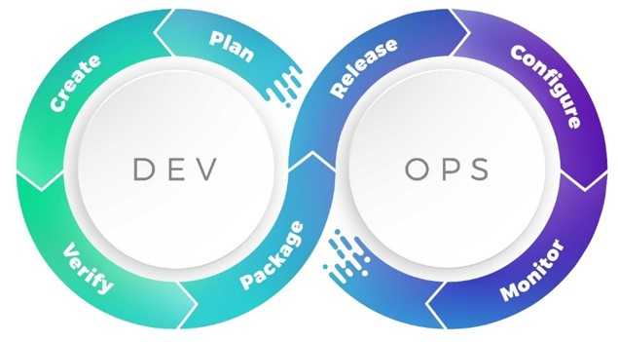

Change management and DevOps can coexist
Shift the responsibility and rigor to earlier in the process.
If you are implementing change management in a DevOps environment, ensure you have a strong DevOps lifecycle. You may wish to refer to Info-Tech’s research Implementing DevOps Practices That Work.
Consider starting in this blueprint by visiting Appendix II to frame your approach to change management. Follow the blueprint while paying attention to the DevOps Callouts.
DEVOPS CALLOUTS
Look for these DevOps callouts throughout this storyboard to guide you along the implementation.

Slide 12
Successful change management will provide benefits to both the business and IT
Respond to business requests faster while reducing the number of change-related disruptions.
IT Benefits | Business Benefits
Fewer change-related incidents and outages Faster change turnaround time Higher rate of change success Less change rework Fewer service desk calls related to poorly communicated changes | Fewer service disruptions Faster response to requests for new and enhanced functionalities Higher rate of benefits realization when changes are implemented Lower cost per change Fewer “surprise” changes disrupting productivity
IT satisfaction with change management will drive business satisfaction with IT. Once the process is working efficiently, staff will be more motivated to adhere to the process, reducing the number of unauthorized changes. As fewer changes bypass proper evaluation and testing, service disruptions will decrease and business satisfaction will increase.

Slide 13





Change management improves core benefits to the business: the four Cs
Most organizations have at least some form of change control in place, but formalizing change management leads to the four Cs of business benefits:
  Control
  Collaboration
  Consistency
  Confidence
Change management brings daily control over the IT environment, allowing you to review every relatively new change, eliminate changes that would have likely failed, and review all changes to improve the IT environment.
Change management planning brings increased communication and collaboration across groups by coordinating changes with business activities. The CAB brings a more formalized and centralized communication method for IT.
Request for change templates and a structured process result in implementation, test, and backout plans being more consistent. Implementing processes for pre-approved changes also ensures these frequent changes are executed consistently and efficiently.
Change management processes will give your organization more confidence through more accurate planning, improved execution of changes, less failure, and more control over the IT environment. This also leads to greater protection against audits.

Slide 14
You likely need to improve change management more than any other infrastructure & operations process
Of the eight infrastructure and operations processes measured in Info-Tech’s IT Management and Governance Diagnostic (MGD) program, change management consistently has the second largest gap between importance and effectiveness of these processes.
Source: Info-Tech 2020; n=5,108 IT Professionals from 620 organizations

Slide 15
Executives and directors recognize the importance of change management but feel theirs is currently ineffective
Info-Tech’s IT Management and Governance Diagnostic (MGD) program assesses the importance and effectiveness of core IT processes. Since its inception, the MGD has consistently identified change management as an area for immediate improvement.
Importance Scores
No importance: 1.0-6.9
Limited importance: 7.0-7.9
Significant importance: 8.0-8.9
Critical importance: 9.0-10.0
Effectiveness Scores
Not in place: n/a
Not effective: 0.0-4.9
Somewhat Ineffective: 5.0-5.9
Somewhat effective: 6.0-6.9
Very effective: 7.0-10.0
Source: Info-Tech 2020; n=5,108 IT Professionals from 620 organizations

Slide 16
There are several common misconceptions about change management
REALITY
Even a small change can cause a business outage. That small fix could impact a large system connected to the one being fixed.
REALITY
Ad hoc might be faster in some cases, but it carries far greater risk. Following defined processes keeps systems stable and risk-averse.
REALITY
Change management is about managing risk. It gives the illusion of speed by reducing downtime and unplanned work.
REALITY
Change management allows for a better alignment of process (release management) with governance (change management).
“It’s just a small change; this will only take five minutes to do.”
“Ad hoc is faster; too many processes slow things down.”
“Change management is all about speed.”
“Change management will limit our capacity to change.”
Which of these have you heard in your organization?

Slide 17
Overcome perceived challenges to implementing change management to reap measurable reward
Before: Informal Change Management
Change approval: Changes do not pass through a formal review process before implementation. 10% of released changes are approved. Implementation challenge: Staff will resist having to submit formal change requests and assessments, frustrated at the prospect of having to wait longer to have changes approved.
Change prioritization: Changes are not prioritized according to urgency, risk, and impact. 60% of changes are urgent. Implementation challenge: Influential stakeholders accustomed to having changes approved and deployed might resist having to submit changes to a standard cost-benefit analysis.
Change deployment: Changes often negatively impact user productivity. 25% of changes are realized as planned. Implementation challenge: Engaging the business so that formal change freeze periods and regular maintenance windows can be established.
 | After: Right-Sized Change Management
 | Change approval: All changes pass through a formal review process. Once a change is repeatable and well-tested, it can be pre-approved to save time. Almost no unauthorized changes are deployed. 95% of changes are approved. KPI: Decrease in change-related incidents.
 | Change prioritization: The CAB prioritizes changes so that the business is satisfied with the speed of change deployment. 35% of changes are urgent. KPI: Decrease in change turnaround time.
 | Change deployment: Users are always aware of impending changes and changes don’t interrupt critical business activities. Over 80% of changes are realized as planned KPI: Decrease in the number of failed deployments.

Slide 18
Info-Tech’s methodology for change management optimization focuses on building standardized processes
 | 1. Define Change Management | 2. Establish Roles and Workflows | 2. Establish Roles and Workflows | 3. Define the RFC and Post-Implementation Activities | 3. Define the RFC and Post-Implementation Activities | 4. Measure, Manage, and Maintain
Phase Steps | 1.1 Assess Maturity 1.2 Categorize Changes and Build Your Risk Assessment | 2.1 Determine Roles and Responsibilities 2.2 Build Core Workflows | 2.1 Determine Roles and Responsibilities 2.2 Design Change Workflows | 3.1 Design the RFC 3.2 Establish Post-Implementation Activities | 3.1 Create the Request for Change Form (RFC) 3.2 Establish Post-Implementation Activities | 4.1 Identify Metrics and Build the Change Calendar 4.2 Implement the Project
Phase Deliverables | Change Management Standard Operating Procedure (SOP) Change Management Project Summary Template
Phase Deliverables | Change Management Maturity Assessment Tool Change Management Risk Assessment Tool |  | Change Manager Job Description Change Management Process Library |  | Request for Change (RFC) Form Template Change Management Pre-Implementation Checklist Change Management Post-Implementation Checklist | Change Management Metrics Tool Change Management Communications Plan Chanage Management Roadmap Tool

Slide 19

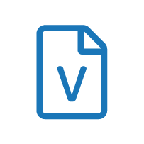

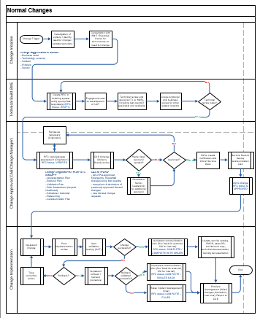
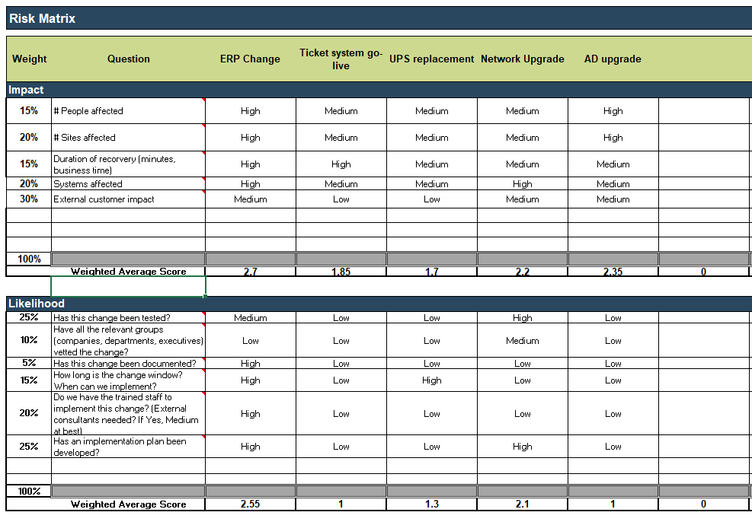
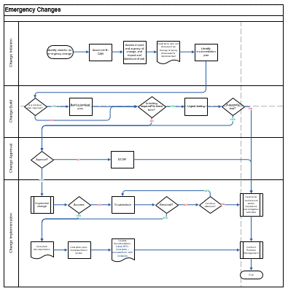
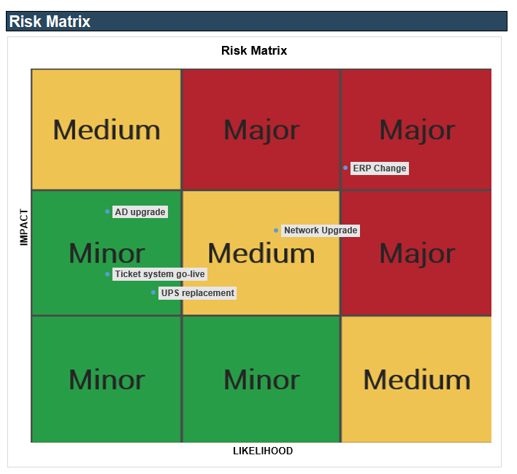
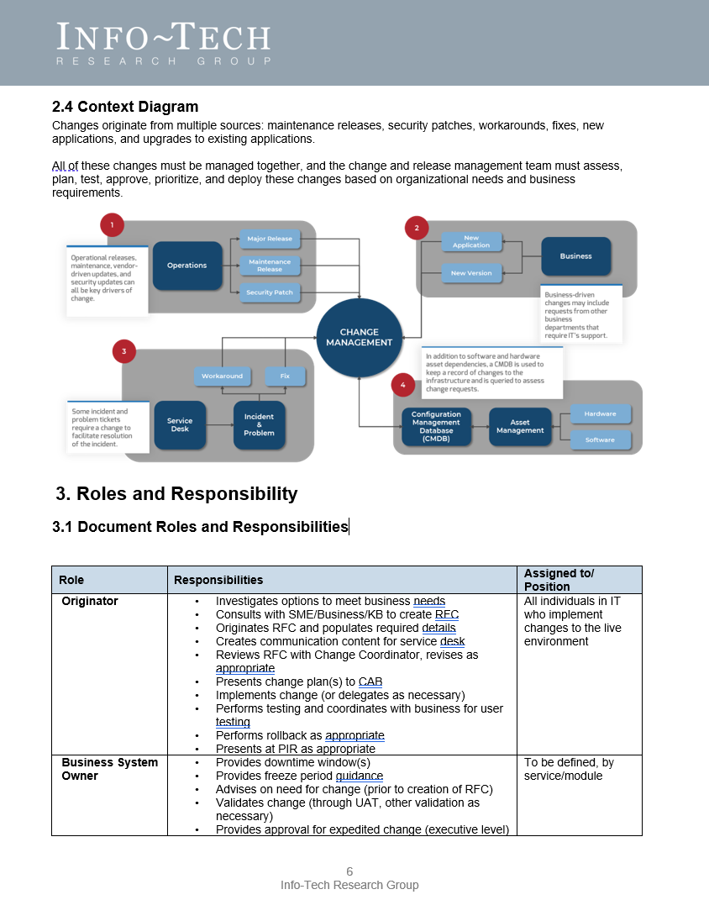
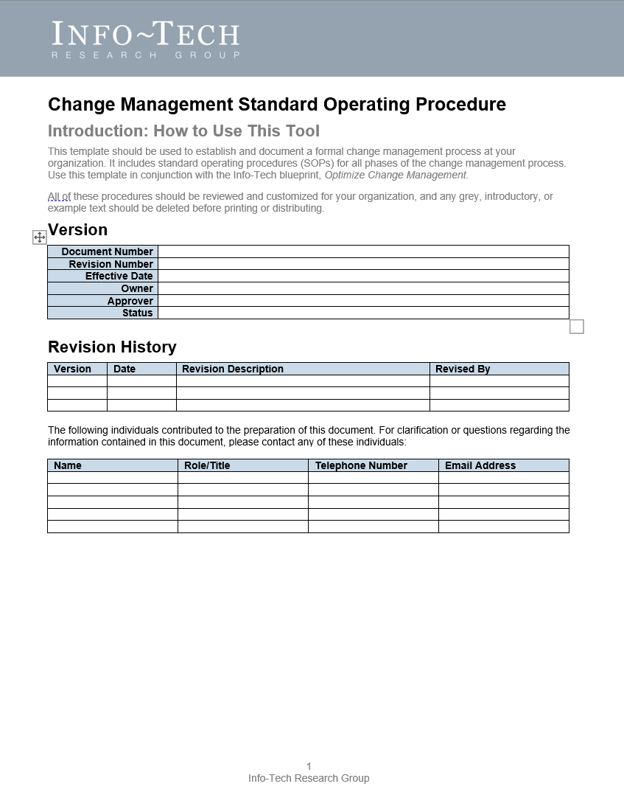

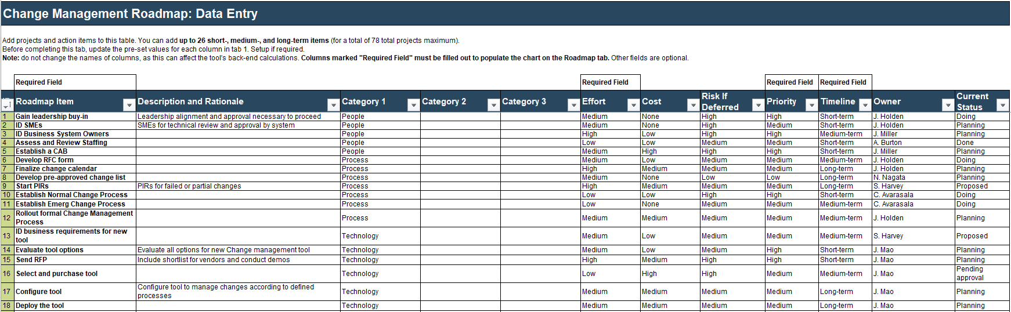
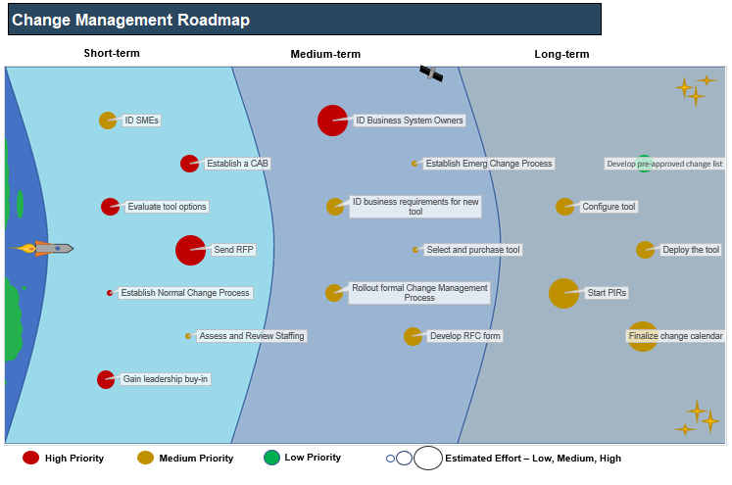
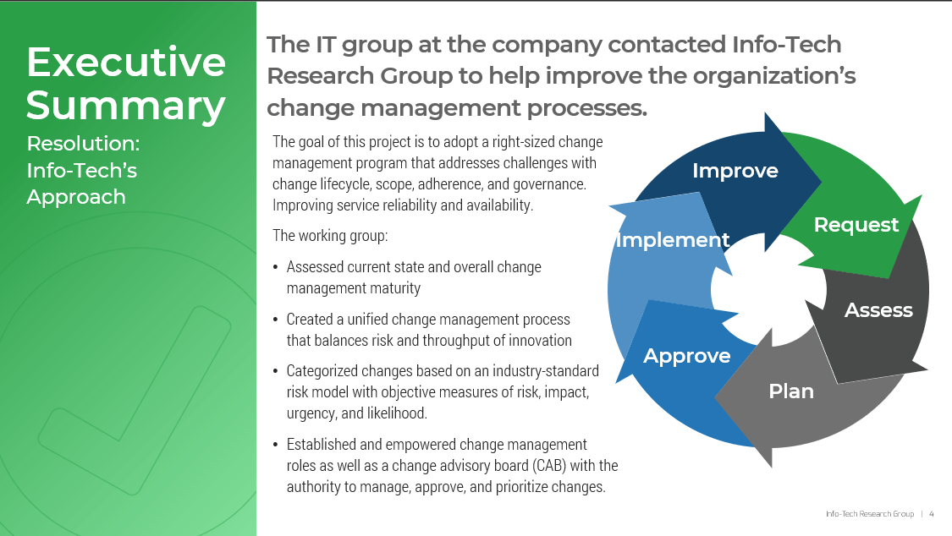
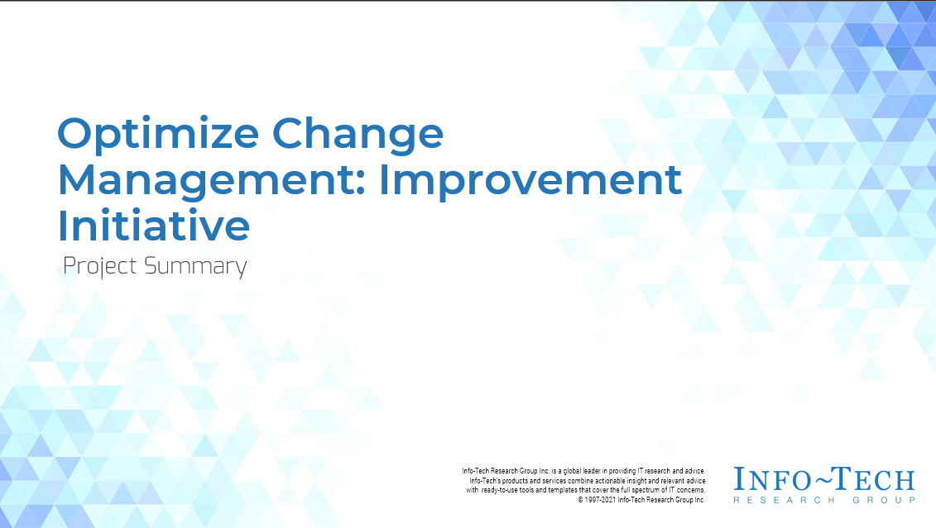
Blueprint deliverables
Key deliverable:
Each step of this blueprint is accompanied by supporting deliverables to help you accomplish your goals:
  Change Management SOP
Document and formalize your process starting with the change management standard operating procedure (SOP).
  Change Management Process Library
  Change Management Risk Assessment Tool
Document your normal, pre-approved, and emergency change lifecycles with the core process workflows .
Test Drive your impact and likelihood assessment questionnaires with the Change Management Risk Assessment Tool.
  Project Summary Template
  Change Management Roadmap Tool
Summarize your efforts in the Optimize IT Change Management Improvement Initiative: Project Summary Template.
Record your action items and roadmap your steps to a mature change management process.

Slide 20
These case studies illustrate the value of various phases of this project
A major technology company implemented change management to improve productivity by 40%. This case study illustrates the full scope of the project.
Define Change Management
Define RFC and Post-Implementation Activities
Measure, Manage, and Maintain
Establish Roles and Workflows
A large technology firm experienced a critical outage due to poor change management practices. This case study illustrates the scope of change management definition and strategy.
Ignorance of change management process led to a technology giant experiencing a critical cloud outage. This case study illustrates the scope of the process phase.
A manufacturing company created a makeshift CMDB in the absence of a CMDB to implement change management. This case study illustrates the scope of change intake.
A financial institution tracked and recorded metrics to aid in the success of their change management program. This case study illustrates the scope of the implementation phase.

Slide 21
Working through this project with Info-Tech can save you time and money
Engaging in a Guided Implementation doesn’t just offer valuable project advice, it also results in significant cost savings.
Guided Implementation | Measured Value
Phase 1: Define Change Management | We estimate Phase 1 activities will take 2 FTEs 10 days to complete on their own, but the time saved by using Info-Tech’s methodology will cut that time in half, thereby saving $3,100 (2 FTEs * 5 days * $80,000/year).
Phase 2: Establish Roles and Workflows | We estimate Phase 2 will take 2 FTEs 10 days to complete on their own, but the time saved by using Info-Tech’s methodology will cut that time in half, thereby saving $3,100 (2 FTEs * 5 days * $80,000/year).
Phase 3: Define the RFC and Post-Implementation Activities | We estimate Phase 3 will take 2 FTEs 10 days to complete on their own, but the time saved by using Info-Tech’s methodology will cut that time in half, thereby saving $3,100 (2 FTEs * 5 days * $80,000/year).
Phase 4: Measure, Manage, and Maintain | We estimate Phase 4 will take 2 FTEs 5 days to complete on their own, but the time saved by using Info-Tech’s methodology will cut that time in half, thereby saving $1,500 (2 FTEs * 2.5 days * $80,000/year).
Total savings | $10,800

Slide 22

Intel implemented a robust change management program and experienced a 40% improvement in change efficiency.
Case Study
INDUSTRY
SOURCE
Technology
Daniel Grove, Intel
Founded in 1968, the world’s largest microchip and semiconductor company employs over 100,000 people. Intel manufactures processors for major players in the PC market including Apple, Lenovo, HP, and Dell.
ITIL Change Management Implementation
With close to 4,000 changes occurring each week, managing Intel’s environment is a formidable task. Before implementing change management within the organization, over 35% of all unscheduled downtime was due to errors resulting from change and release management. Processes were ad hoc or scattered across the organization and no standards were in place.
Define Change Management
Define RFC and Post-Implementation Activities
Measure, Manage, and Maintain
Establish Roles and Workflows
Results
After a robust implementation of change management, Intel experienced a number of improvements including automated approvals, the implementation of a formal change calendar, and an automated RFC form. As a result, Intel improved change productivity by 40% within the first year of the program’s implementation.

Slide 24

Guided Implementation
A Guided Implementation (GI) is series of calls with an Info-Tech analyst to help implement our best practices in your organization.
A typical GI is between 8 to 12 calls over the course of 4 to 6 months.
What does a typical GI on this topic look like?
Define Change Management
Measure, Manage, and Maintain
Establish Roles and Workflows
Define RFC and Post- Implementation Activities
Call #1: Introduce change concepts.
Call #4: Review roles and responsibilities.
Call #6: Define change intake process.
Call #8: Review metrics.
Call #5: Review core change processes.
Call #2: Assess current maturity.
Call #7: Create pre-implementation and post-implementation checklists.
Call #9: Create roadmap.
Call #3: Identify target-state capabilities.
Info-Tech Research Group | 24

Slide 25
Workshop Overview
Contact your account representative for more information.
workshops@infotech.com 1-888-670-8889
 | Day 1 | Day 2 | Day 3 | Day 4 | Day 5
Activities | Define Change Management | Establish Roles and Workflows | Define the RFC and Post-Implementation Activities | Measure, Manage, and Maintain | Next Steps and Wrap-Up (offsite)
 | 1.1 Outline Strengths and Challenges 1.2 Conduct a Maturity Assessment 1.3 Build a Change Categorization Scheme 1.4 Build Your Risk Assessment | 2.1 Define the Change Manager Role 2.2 Outline CAB Protocol and membership 2.3 Build Normal Change Process 2.4 Build Emergency Change Process 2.5 Build Pre-Approved Change Process | 3.1 Create an RFC Template 3.2 Determine Post-Implementation Activities 3.3 Build a Change Calendar Protocol | 4.1 Identify Metrics and Reports 4.2 Create Communications Plan 4.3 Build an Implementation Roadmap | 5.1 Complete in-progress deliverables from previous four days 5.2 Set up review time for workshop deliverables and to discuss next steps
Deliverables | Maturity Assessment Risk Assessment | Change Manager Job Description Change Management Process Library | Request for Change (RFC) Form Template Pre-Implementation Checklist Post-Implementation Checklist | Metrics Tool Communications Plan Project Roadmap | Change Management Standard Operating Procedure (SOP) Workshop Summary Deck

