Slide 1
Optimize Applications Release Management
Build trust by right-sizing your process using appropriate governance.

Slide 2
Executive summary
Business demands high service and IT needs to respond. Rapid customer response through efficient release and deployment are critical in maintaining high business satisfaction.
The lack of process ownership leads to chaotic and uncoordinated releases, resulting in costly rework and poor hand-offs.
Release management is not solely driven by tools. It is about delivering high-quality releases on time through accountability and governance aided by the support of tools.
Release management is independent of your software development lifecycle (SDLC). A successful release management practice sits as an agnostic umbrella over your chosen development methodology.
Ownership of the entire process is vital. Release managers are the glue to ensure standards are upheld and the pipeline is operating efficiently.
IT emphasizes tools but release tools and technologies alone will not fix the problem. Tools are integrated into the processes they support – if the process challenges aren’t addressed first, then the tool won’t help.
Releases are traditionally executed in silos with limited communication across the entire release pipeline. Culturally, there is little motivation for cross-functional collaboration and holistic process optimization.
Acquire release management ownership. Ensure there is appropriate accountability for speed and quality of the releases passing through the entire pipeline. A release manager has oversight over the entire release process and facilitates the necessary communication between business stakeholders and various IT roles.
Instill holistic thinking. Release management includes all steps required to push release and change requests to production along with the hand-off to Operations and Support. Increase the transparency and visibility of the entire pipeline to ensure local optimizations do not generate bottlenecks in other areas.
Standardize and build a strong release management foundation. Optimize the key areas where you are experiencing the most pain and continually improve.

Slide 3
Our understanding of the problem
Release managers who are responsible for ensuring the efficiency and effectiveness of the entire release pipeline.
Applications directors who are accountable for delivering high-quality releases to business stakeholders in a timely manner while managing operational constraints.
Identify the business objectives and technical drivers for release management.
Conduct a current state assessment of your existing release practices and technologies.
Streamline and standardize your release processes, program framework, and release change management practices.
Software delivery teams looking for best practices and techniques to increase the success of releases.
Project and program managers who have difficulty managing release schedules involving multiple teams.
Standardize a core set of release processes that are repeatable across various projects and release types.
Complete, package, and deliver various types of releases in a coordinated and centralized manner with defined communication channels.

Slide 4
ANALYST PERSPECTIVE
Organizations often jump to automation and continuous delivery tools, thinking it will immediately improve the quality and speed of releases and deployment. However, they often forget that these tools and technologies can significantly widen existing gaps and issues if the right release management practices and governance foundation and ownership are not first established.
Downstream teams are often burdened with unrealistic upfront decisions and expectations that don’t account for release complexities and capacity constraints. Consequently, releases are defective and often delayed. A release manager owns and acts as a thread through the entire process to ensure the efficient delivery of features with cross-functional transparency and adherence to standards .
Andrew Kum-Seun
Research Manager, Applications
Info-Tech Research Group

Slide 5
Delivering valuable features and services in a timely manner is the goal of any software delivery team
Software delivery teams must enable the organization to react to market needs and competitive changes in order to improve the business’ bottom line. Otherwise, the business will question the team’s competencies.
The business is constantly looking for new and innovative ways to do their jobs better and they are expecting sufficient support from your technical teams. Since customer needs are rapidly changing and emerging technologies are constantly evolving business operations, the business is depending more on your teams to deliver high-quality services.
The increased stress from the business is widening the inefficiencies that already exist in release management, risking poor product quality and delayed releases.
Being detached from the release process, business stakeholders do not fully understand the complexities and challenges of completing a release, which complicates the team’s communication with them when issues occur.
IT Stakeholders Are Also Not Satisfied With
Their Own Throughput
Only 29% of IT employees find application development throughput highly effective.
Only 9% of organizations were classified as having highly effective application development throughput.
Application development throughput ranked 37th out of 45 core IT processes in terms of effectiveness.
Source: Info-Tech’s Management and Governance Diagnostic, N=3,930

Slide 6
Software delivery teams struggle on core release issues, resulting in delayed delivery and disappointed stakeholders
Implementing tools on top of an inefficient pipeline can significantly magnify the existing release issues. This can lead to missed deadlines, poor product quality, and business distrust with software delivery teams.
COMMON RELEASE ISSUES
1
Local Thinking: Release decisions and changes are made and approved without consideration of the holistic system, process, and organization.
2
No Release Cadence: Lack of process governance and oversight generates unpredictable bottlenecks and load, and ill-prepared downstream teams.
3
Mismanagement of Releases: Program management does not accommodate the various integrated releases completed by multiple delivery teams.
4
Poor Scope Management: Teams are struggling to effectively accommodate changes during the project.
The bottom line: The business’ ability to operate is dictated by the software delivery team’s ability to successfully complete releases. If the team performs poorly, then the business will do poorly as well. Release management is critical to ensure business expectations are within the team’s constraints.
As software becomes more embedded in the business, firms are discovering that the velocity of business change is now limited by how quickly they can deploy.
– Five Ways To Streamline Release Management, J.S. Hammond

Slide 7
Remove the ambiguity of release management
What Is Release Management?
Release management is a process that encompasses the planning, designing, building, configuration, and testing of hardware and software releases to create a defined set of release components (ITIL). Release activities can include the distribution of the release and supporting documentation directly to end users.
Clearly recognize the difference between release and deployment.
The scope of preparation, implementation, training, and support tasks for a given deployment will be significantly different compared to any other type of release. Having a solid foundation of how to manage and execute a release or deployment starts with clear definitions.
Release
Deployment
Release: Delivery of an executable package to a development, QA/testing, UAT, staging, or production environment. The customers of the deliverable may or may not be the end users.
Deployment: Delivery of an executable package to a production environment that will be consumed by the end user.

Slide 8
Obtain a holistic perspective of release management practices to effectively meet business release demands
As you begin to investigate initiatives to optimize your release management practices, consult the various roles in your release pipeline to ensure you are not introducing new bottlenecks and inefficiencies.
For example, if Development decides to implement automated build and packaging tools without consulting Operations, they may encounter the following consequences:
Non-functional requirements (e.g. system stability and security) are not implemented properly.
Testing and quality are sacrificed to push artifacts to production to increase release rates.
Existing holding costs are multiplied because Operations is incapable of handling additional load with existing resource capacity.
Traditionally, teams will optimize themselves in order to improve their own processes to meet their own objectives. In some cases, these initiatives to address these objectives may have negative effects on one another, causing issues up and down the delivery chain.
Holistic, release-level thinking will reveal all delivery impediments throughout the pipeline that may restrict you from releasing products in a timely manner. This level of thinking focuses on ensuring release packages are efficiently and effectively delivered to end users considering all complexities and challenges involved in software release.
Release management builds on and improves best practices successfully employed by your software delivery teams. The goal is to establish an efficient, best-fitting release process with an appropriate support and governance structure to maintain business alignment and satisfaction and ensure everyone knows what is involved with completing a release.
Discuss Trade-offs With All Roles in the Pipeline

Slide 9
eBay’s approach to optimize release management
CASE STUDY
Industry
Source
eCommerce
Serena Software
Company
eBay is a multinational e-commerce company providing consumer-to-consumer and business-to-consumer sales services through the internet.
Situation
GSI Commerce was acquired by eBay in 2011 and the two technology cultures met and set about creating a modern delivery lifecycle able to meet the challenges of one of the fastest moving and innovative companies in the market. GSI Commerce was driven to be responsive to every customer quickly, but eBay’s heritage spoke to cautious financial stability at the expense of some velocity in deploying innovations. eBay recognized that it needed to align practices, processes, and procedures with corporate policies and programs in a way that successfully combined these different cultures.
Solution
eBay began by optimizing the processes that were causing the most pain and improving the adoption rate and effectiveness of the tools already in place.
The change and release process was simplified: every decision point was made into a binary choice and ensured no system change went into production unless it ran through the process. No request, no deployment. No approval, no deployment.
Notifications were sent out to all stakeholders so that everyone knew what was coming.
QA sign-off was brought ahead of deployment approvals by the Change Control Board.
The entire release workflow included steps to deploy and validate in production.
Results:
10/11
process paths were exercised without a single error
<50
open change requests at any given time (decreased from 15,000)
Other Results:
Processes were easier to understand and execute.
Change approval time decreased.
Executives bought into optimization due to the early and quick results.

Slide 10
Release management practices are built independently from Agile and waterfall methodologies
Organizations can view release management as another bureaucratic process impeding release. However, a well-defined process brings a level of consistency and coordination to improve overall delivery quality and release time.
Your release process outlines the required tasks, artifacts, and metrics that must be completed for a release to be packaged, tested, and deployed (the “what”). Agile and waterfall methodologies simply define how these items should be completed. The activities and steps contained within your release process must be completed with the same amount of rigor in any methodology.
Release management ensures processes are consistently followed and transparent to increase the predictability of incoming releases and better prepare dependent teams. Notably, these core principles are inherent to both Agile and waterfall methodologies.
Take a step back and understand what is actually being done to complete a release.
Release Management
Agile
Waterfall
Kanban
Scrum
Iterative
Pure

Slide 11
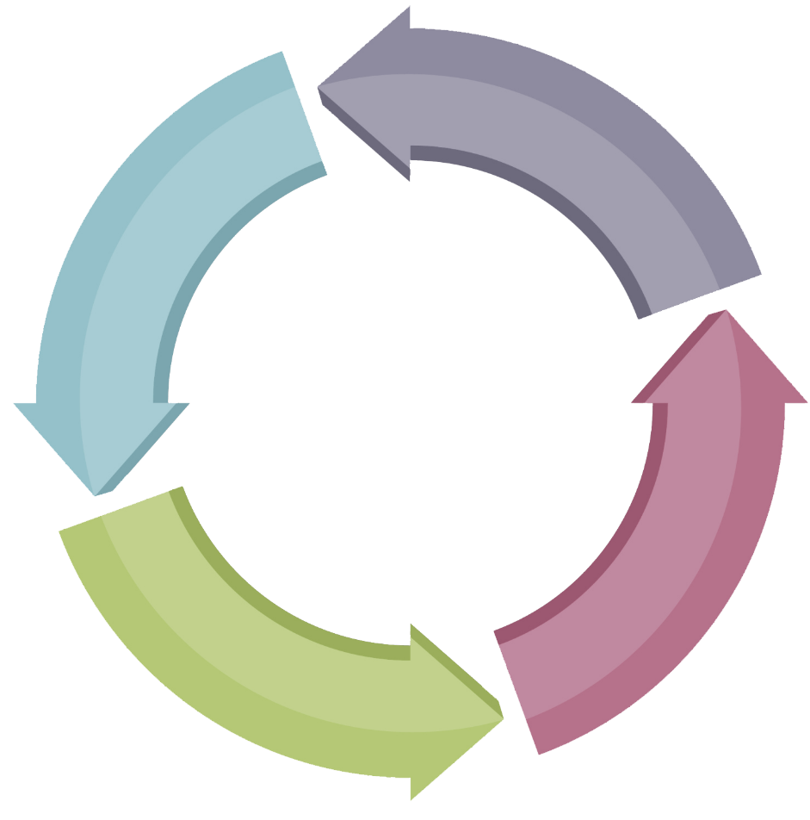
Use Info-Tech’s thought model for your release management optimization
Focus your initial release management optimization on your teams and processes.
Info-Tech recommends using an iterative approach to gauge the fit of your release management optimization initiatives and generate insightful metrics to further improve the acceptance of your releases.
DOCUMENT THE
ROADMAP
RELEASE MANAGEMENT OPTIMIZATION
Stick to your business and delivery team objectives in your release management optimization. Rationalize the fit and effectiveness of your proposed improvements.
Review your release process on a regular basis to create and modify an appropriate optimization roadmap.
2
RELEASE PROCESS
Define the release processes that your teams will follow to complete your various release types and approaches.
CURRENT STATE ANALYSIS
Info-Tech’s iterative process ensures your release management team, processes, and tools are continuously improved.
1
Assess the current state of your release objectives, teams, processes, and tools to gather a holistic view of release inefficiencies and quality issues.
3
PROGRAM FRAMEWORK
Create a release calendar to define the deployment windows that will coordinate the releases from multiple teams.
4
CHANGE MANAGEMENT
Manage, classify, and assess unplanned release change requests with change management practices.
OPTIMIZATION ROADMAP
6
Create and support your optimization roadmap so that it meets current business and release needs.
5
RELEASE MANAGEMENT TEAM
Define the responsibilities and accountabilities of the roles to support your release management target state.

Slide 12
Standardize your release process and roles & responsibilities before optimizing your release tools
The success of release management is ultimately dependent on the alignment of your release processes with defined roles & responsibilities and governance structures. Implementing tools on top of a shaky process with undefined roles can lead to widening of existing process gaps and execution of wasteful activities.
Leverage the appropriate tools, technologies, and environments to help expedite the building, testing, and deployment of solutions while maximizing the quality throughout the entire release pipeline. Automation and continuous integration are two popular enhancements organizations make to their release management toolchain.
Optimized Tools
Build and standardize a release process that accommodates the challenges, nuances, and constraints of the various teams involved. The release process extends the software development lifecycle into the program level to effectively manage the multiple releases coming from various delivery teams.
Standardized Release Process
Primary Focus of This Blueprint
Break down the responsibilities and accountabilities of each role involved in software delivery. This definition translates into a governance structure intended to identify the degree of oversight and reporting that is necessary to ensure alignment to standards.
Defined Roles & Responsibilities
and Governance Structure

Slide 13
Follow Info-Tech’s methodology to optimize release management
Phase 1: Review Your Release Management Objectives
Phase 2: Standardize Release Management
Phase 3: Roll Out Release Management Enhancements
Step 1.1: Identify the Objectives for Application Release
Step 2.1: Strengthen Your Release Process
Step 3.1: Define Your Release Management Metrics
Inputs
Business and technical objectives
List of stakeholders
Outputs
Business-technical objective alignment
Stakeholder map
Inputs
Current state release management
Outputs
Optimized release process
Workflows for release types
Inputs
Target state release management
Outputs
Metrics to measure success
Step 2.2: Coordinate Releases With a Program Framework
Step 3.2: Ensure Adherence to Standards
Inputs
Current state release management
Outputs
Program framework
Release calendar
Inputs
Target state release management
Outputs
Oversight and reporting structure of release management
Step 1.2: Conduct a Current State Assessment of Release Practices
Inputs
Understanding of current release teams, practices, and technologies
Outputs
Release management maturity assessment
Communication flow assessment
Current process and technology analysis
Release issue prioritization
Step 3.3: Create Your Optimization Roadmap
Step 2.3: Manage Releases Issues With Change Management Practices
Inputs
Current state release management
Outputs
Escalation process for release changes and issues
Inputs
Target state release management
Outputs
Optimization initiatives
Prioritized rollout plan
END DELIVERABLE:
Release Management Process Standard
Step 2.4: Define Your Release Management Team
Inputs
Current state release management
Outputs
Release manager and team responsibilities and accountabilities

Slide 14
Use Info-Tech’s Release Management Process Standard Template to ground expectations and ensure consistency
INFO-TECH DELIVERABLE
Leverage Info-Tech’s Release Management Process Standard Template to ensure all roles directly or indirectly involved in release management understand the objectives, steps, and acceptance criteria to successfully deliver features and fixes.
This standard should be regularly revisited and continuously improved based on lessons learned from past projects to increase success in future releases.
Goals:
Ensure your teams are consistently driving toward common business objectives and technical goals.
Establish the responsibilities of the various roles involved in release management.
Define a release process and program framework that will assist in the high and low level orchestration of releases.
Download Info-Tech’s Release Management Process Standard Template to document the key outcomes of this blueprint.

Slide 15
Use these icons to help direct you as you navigate this research
Use these icons to help guide you through each step of the blueprint and direct you to content related to the recommended activities.
This icon denotes a slide where a supporting Info-Tech tool or template will help you perform the activity or step associated with the slide. Refer to the supporting tool or template to get the best results and proceed to the next step of the project.
This icon denotes a slide with an associated activity. The activity can be performed either as part of your project or with the support of Info-Tech team members, who will come onsite to facilitate a workshop for your organization.

Slide 16
Info-Tech offers various levels of support to best suit your needs
Guided Implementation
DIY Toolkit
Workshop
Consulting
“Our team has already made this critical project a priority, and we have the time and capability, but some guidance along the way would be helpful.”
“Our team knows that we need to fix a process, but we need assistance to determine where to focus. Some check-ins along the way would help keep us on track.”
“We need to hit the ground running and get this project kicked off immediately. Our team has the ability to take this over once we get a framework and strategy in place.”
“Our team does not have the time or the knowledge to take this project on. We need assistance through the entirety of this project.”
Diagnostics and consistent frameworks used throughout all four options

Slide 17
Project overview
1. Review Your Release Management Objectives
2. Standardize Release Management
3. Roll Out Release Management Enhancements
Best-Practice Toolkit | 1.1 Identify the Objectives for Application Release 1.2 Conduct a Current State Assessment of Release Practices | 2.1 Strengthen Your Release Process 2.2 Coordinate Releases With a Program Framework 2.3 Manage Release Issues With Change Management Practices 2.4 Define Your Release Management Team | 3.1 Define Your Release Management Metrics 3.2 Ensure Adherence to Standards 3.3 Create Your Optimization Roadmap
Guided Implementations | Align business objectives with technical objectives using release management. Discuss root-cause issues of current state release management roles, communication, processes, and tools. | Discuss release management target state program framework, team, process, and tools. Validate the adaptability and flexibility of the target state. | Review your release management enhancement rollout plan and metrics to gauge success. Review your approach to govern and manage your release management practices.
Onsite Workshop | Module 1: Review Your Release Management Objectives | Module 2: Standardize Release Management | Module 3: Roll Out Release Management Enhancements
 | Phase 1 Outcome: Current state analysis of release management roles, communication, processes, and tools Release management business and technical objectives | Phase 2 Outcome: Future-state release management team, process, program framework, and tools | Phase 3 Outcome: Release management team oversight and reporting Release management enhancement rollout plan and standards

Slide 18
Workshop overview
Contact your account representative or email Workshops@InfoTech.com for more information.
 | Workshop Day 1 | Workshop Day 2 | Workshop Day 3 | Workshop Day 4 | Workshop Day 5
Activities | Review Your Release Management Objectives Identify your business objectives and software technical drivers for release management. Assess the current state of your communication flow, release process, and release management tools and technologies. | Strengthen Your Release Process Define release processes that address the various release types and approaches that your team completes. Identify the tools and technologies that will support your process. | Coordinate Releases With a Program Framework Design your release calendar and deployment windows. Create a program framework to coordinate your releases. | Support Your Release Processes and Program Framework Manage release issues with change management practices. Define your release management team. | Roll Out Release Management Enhancements Define your release management metrics. Ensure adherence to standards. Create your optimization roadmap.
Deliverables | Business objectives and technical drivers motivating release management optimization Root causes behind current state release process and tooling issues | Target state release processes accommodating all release types and approaches Tools and technologies to support your target process | Release calendar indicating deployment windows Program framework | Release change management processes Responsibilities and accountabilities of release management team and release manager | List of metrics to gauge release management success Degree of oversight of the release management team Release management optimization roadmap

