Slide 1
Build a Security Compliance Program
Cost-effective compliance is possible.
EXECUTIVE BRIEF

Slide 2
Analyst Perspective
The road to hell is paved with compliance obligations.
In my early years as a security practitioner, I remember welcoming new cybersecurity and data protection regulations. Why? Because I could use them to help justify purchasing new security controls. But as they say, be careful what you wish for because you just might get it.
These days, it is hard to find a security leader who welcomes new regulations. Almost 70% of organizations already manage five or more compliance obligations. Most are allocating at least 25% of their security budget to compliance activities.
Yet for all the good intentions behind these regulations, very few security professionals believe that government rules improve organizational cybersecurity. At this point compliance obligations are just inevitable, like death and taxes.
Fortunately, it is possible to manage your security compliance obligations without breaking the bank. Let’s discuss.
Kate Wood
Practice Lead
Security & Privacy Practice
Info-Tech Research Group

Slide 3
Your challenge
The cost of compliance is rising.
A recent report from Coalfire shows that most organizations spend between 25 and 40 percent of their security budget on compliance-related activities.
The same report tells us that almost all organizations have to manage at least two compliance obligations, and 70% of organizations need to manage at least five obligations.
Despite this growing investment in compliance, another recent report informs us that only 28% of organizations believe that government regulations are effective at helping them improve their cybersecurity.
Source: Coalfire “Compliance in the era of digital transformation” 2020
…but only 28% believe that government regulations are very effective at improving cybersecurity
So what exactly are we getting for our compliance investment?
28%
Source: Marsh / Microsoft “2019 Global Cyber Risk Perception Survey” 2019

Slide 4
Common obstacles
Costs of Non-Compliance
But the cost of non-compliance is rising even faster.
58% of companies view compliance costs as material barriers to entering new markets.
The cost of complying with cyber security and data-protection requirements has risen to the point where 58% of companies see compliance costs as barriers to entering new markets.
However, a recent Ponemon Institute report suggests that while the costs of complying are higher, the costs of non-compliance are almost three times greater.
58%
Source: Coalfire “Compliance in the era of digital transformation” 2020
USD $M
However, the cost of non-compliance can be almost triple the cost of compliance.
Mastering a cost-effective approach to security compliance can provide organizations with a clear strategic advantage.
Source: Ponemon “The True Cost of
Compliance with Data Protection Regulations” 2017

Slide 5
Blueprint benefits
IT Benefits | Business Benefits
Reduces complexity within the control environment by using a single framework to align multiple compliance regimes. Reduces costs and efforts related to managing IT audits through planning and preparation. Improves information security practices through self-assessments. | Provides senior management with a structured framework for making business decisions on allocating costs and efforts related to cybersecurity and data protection compliance obligations. Reduces compliance risk. Enables better visibility into compliance status.

Slide 7
Is this research right for you?
Should you use a GRC system instead?
This research offers Excel-based tools to help organizations manage their security compliance obligations.
Excel spreadsheets are an excellent way of managing compliance data, up to a point.
Organizations that have more complex structures and greater numbers of compliance requirements should consider the use of a special Governance, Risk, and Compliance (GRC) tool.
In these cases, this research product may still help you establish your security compliance program even if you opt to use a GRC system rather than the Excel tools provided.
Operational Environments
Compliance Obligations
Organizations with more than five separate operational environments should consider a GRC tool.
Organizations with more than ten security and privacy/data protection compliance obligations should consider a GRC tool.

Slide 8
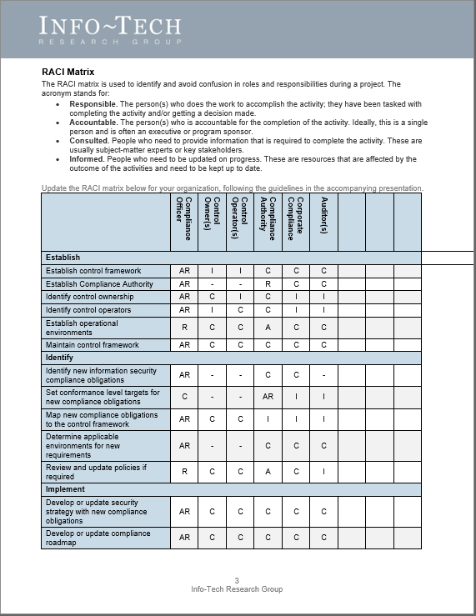
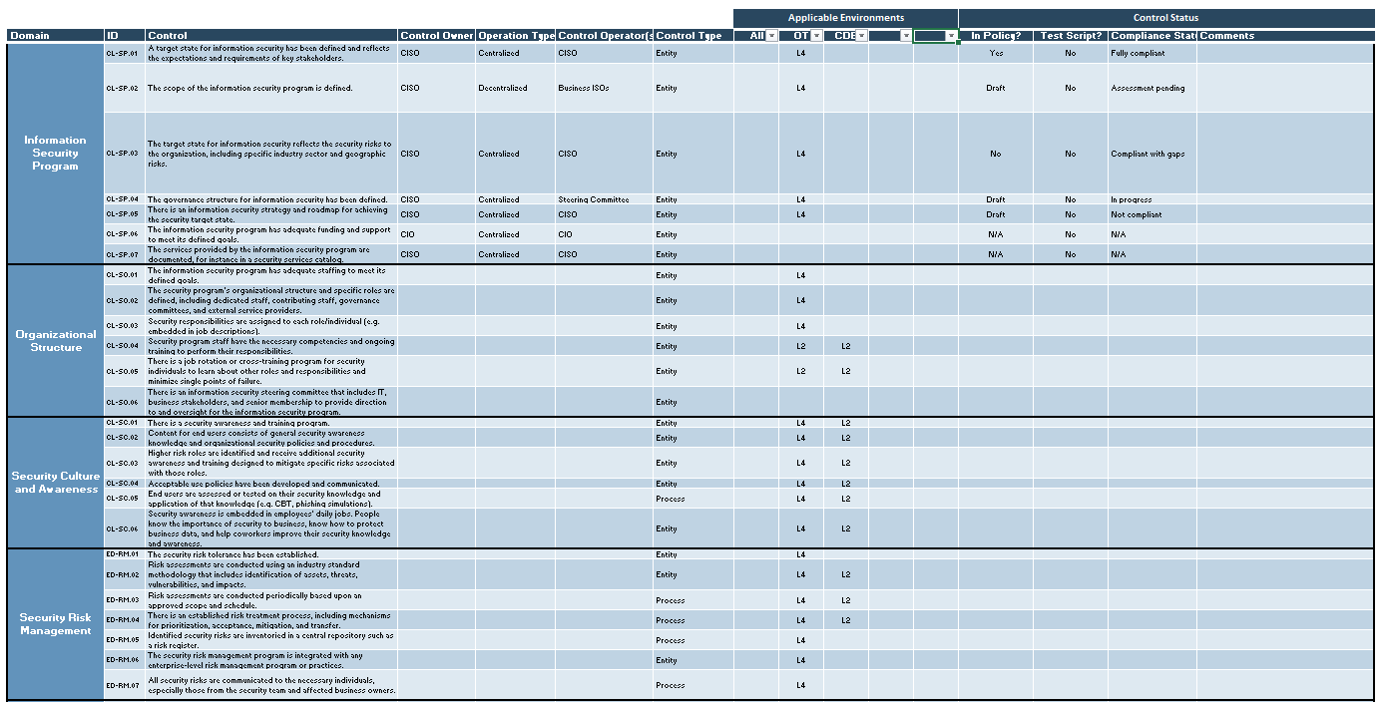
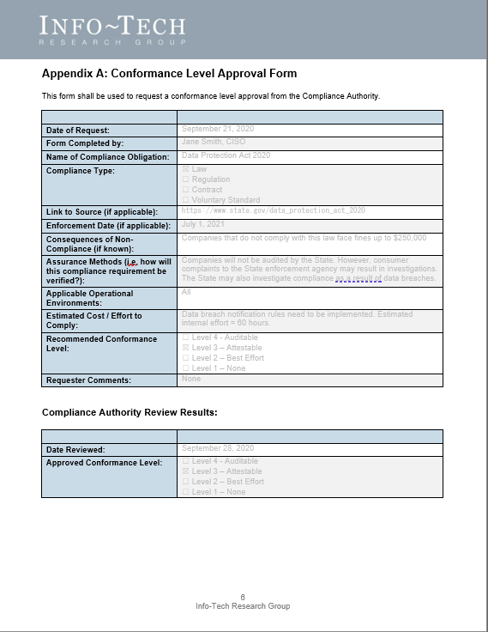
Blueprint deliverables
Key deliverable:
Each step of this blueprint is accompanied by supporting deliverables to help you accomplish your goals:
Security Compliance Management Tool
The Security Compliance Management Tool is a compact Governance, Risk, and Compliance (GRC) system in a convenient spreadsheet.
Security Compliance Process Template
A template that you can use to establish and document your security compliance management program.
Compliance Form Templates
Templates for forms that can be used as part of your compliance processes.

Slide 9
Measure the value of this blueprint
Cost-effective compliance is possible.
Consider tracking the following metrics to measure the value of your security compliance management program.
Metric | Expected Improvement
Number of security controls required for compliance obligations | Use of control framework may reduce # of controls by 25-50%
Control implementation costs | Use of conformance levels may reduce implementation costs by 25% per control on average
Control maintenance costs | Use of environments to scope control requirements may reduce maintenance costs by 25-50%
Audit costs | Test scripts and evidence preparation may reduce audit costs by up to 50%
Compliance management efforts | Effort required for overall compliance management may be reduced by 25% or more

Slide 11
Guided Implementation
A Guided Implementation (GI) is series of calls with an Info-Tech analyst to help implement our best practices in your organization.
A typical GI is between six to ten calls over the course of two to four months.
What does a typical GI on this topic look like?
Phase 1
Phase 4
Phase 2
Phase 3
Phase 5
Call #1: Scope requirements, objectives, and your specific challenges.
Call #2: Establish framework and roles.
Call #4: Identify compliance obligations and conformance levels.
Call #6: Review policies and strategy.
Call #8: Track status and exceptions.
Call #3: Identify operational environments.
Call #5: Map obligations into control framework.
Call #7: Develop test scripts.
Call #9: Report on program status.
Info-Tech Research Group | 11

Slide 12
Workshop Overview
Contact your account representative for more information. workshops@infotech.com 1-888-670-8889
 | Day 1 | Day 2 | Day 3 | Day 4 | Day 5
Activities | Establish program | Identify obligations | Implement compliance strategy | Track and report | Next steps and wrap-up (offsite)
 | 1.1 Review the business context. 1.2 Review the Info-Tech security control framework. 1.3 Establish roles and responsibilities. 1.4 Define operational environments. | 2.1 Identify relevant security and data protection compliance obligations. 2.2 Develop conformance level recommendations. 2.3 Map compliance obligations into control framework. 2.4 Develop process for operationalizing identification activities. | 3.1 Review state of information security policies. 3.2 Recommend updates to policies to address control requirements. 3.2 Review information security strategy. 3.3 Identify alignment points between compliance obligations and information security strategy. 3.4 Develop compliance exception process and forms. | 4.1 Define process and forms for self-attestation. 4.2 Develop audit test scripts for selected controls. 4.3 Review process and entity control types. 4.4 Develop self-assessment process. 4.5 Integrate compliance management with risk register. 4.6 Develop metrics and reporting process. | 5.1 Complete in-progress deliverables from previous four days. 5.2 Set up review time for workshop deliverables and to discuss next steps.
Deliverables | RACI matrix Environments list and definitions | List of compliance obligations Completed Conformance Level Approval forms (Optional) Mapped compliance obligation (Optional) Identification process diagram | Recommendations and plan for updates to information security polices Recommendations and plan for updates to information security strategy Compliance exception forms | Self-attestation forms Completed test scripts for selected controls Self-assessment process Reporting process Recommended metrics | Finalized deliverables

