Slide 1
Durable Goods Manufacturing IT/OT Convergence An Industry Key Trend

Slide 2
Executive Summary: Durable Goods Manufacturing IT/OT Convergence
Situation: New Connectivity and Integration
Complication: Security and Collaboration
Solution: Working Together
Industry 4.0 technology has changed the landscape by creating an all-encompassing connected ecosystem.
IoT and IIoT provide mobility and dashboard data in real time, which enables shop floor manufacturing with live warnings and an ability to implement proactive support and maintenance.
Factory automation including IoT, AI, AR, and VR, coupled with 5G wireless are providing the tools to synergize IT, engineering design, quality, and operations communications.
Remote work and being connected everywhere carry some unexpected costs:
The sophistication of cyberattacks and propagation of remote access was expected to some degree; however, OT operations have become a target due to weaknesses in supplier equipment.
IT and OT must form a united front in defending the company from cyberattacks.
Network bandwidth becomes choked by massive collaboration and encryption.
As a leader in Durable Goods Manufacturing IT, your approach must be simple, engaging, and collaborative:
Doing IT/OT convergence effectively is a competitive advantage.
Commissioning equipment into service for production requires deep analysis and planning with IT and OT.
IT/OT convergence demands a holistic approach which breaks services into layers of protection that can only be effective through IT/OT collaboration.
Digital twins enable replicated environments of known solutions.

Slide 3
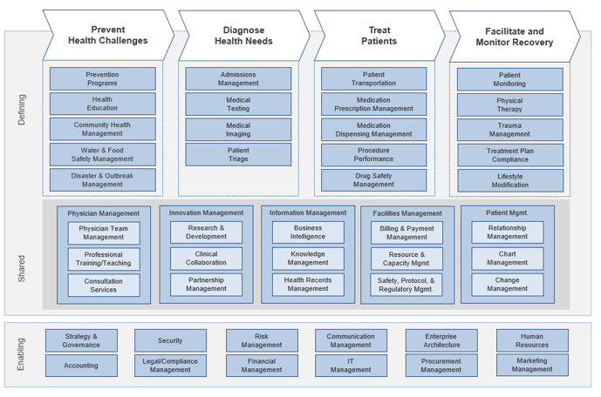
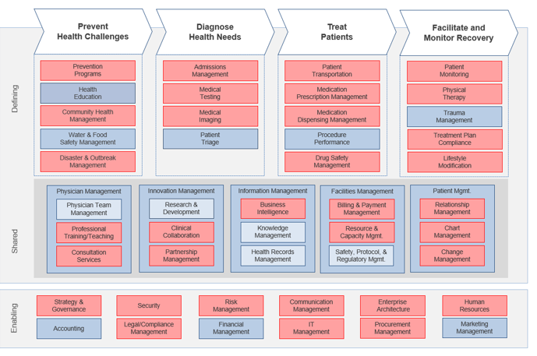
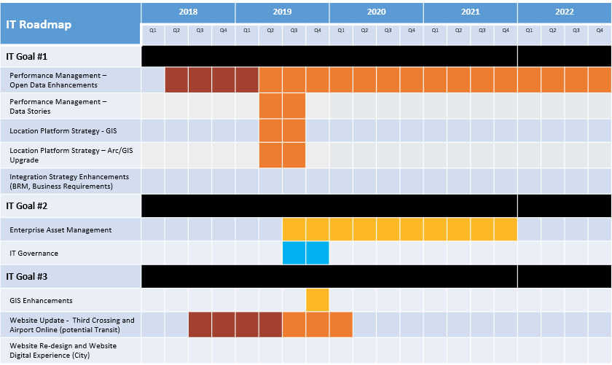
Assess the impact of key trends to refine your IT strategic priority initiatives
Trend
Business Capability Model
Heatmap
High-Level Impacts
IT Strategic Plan Initiatives
Info-Tech Research Group | 3

Slide 4
IT/OT convergence
Elimination of old barriers between IT and OT
If you only remember one thing…
The key characteristics of IT/OT convergence include:
A synergistic operating environment with IT/OT collaborating on tactical and strategic priorities.
Implementing Industry 4.0 solutions such as digital twins and augmented reality.
Putting security at the forefront of every initiative with penetration testing, and employee training being conducted daily.
Focus on innovation for competitive advantage.
Create a connected everything environment.
Deliver repetitive tasks through automation, self evolving AI and autonomous robotics.
As IT penetrates the OT space, the responsibility for manufacturing reliability, security and machine productivity will transfer to IT.
Many manufacturing operations are stuck in a silo culture where IT and OT don’t communicate unless there is a problem.
Cyber risk is rapidly changing the landscape.
Info-Tech Research Group | 4

Slide 5
Real impacts. Real dollars.
The impact of IT/OT convergence is tangible
IT/OT convergence drives true business outcomes. In a survey of manufacturing line-of-business executives and plant managers, they identified the following impacts in their operations:
17.5%
23.1%
Decrease in the defect rate
Decrease in unplanned downtime
Decrease in annual energy costs
Increase in inventory turns
Decrease in new product introduction cycle time
Increase in original equipment effectiveness
48.9%
47.8%
34.8%
16.2%
Source: Cisco, 2018
Info-Tech Research Group | 5

Slide 6
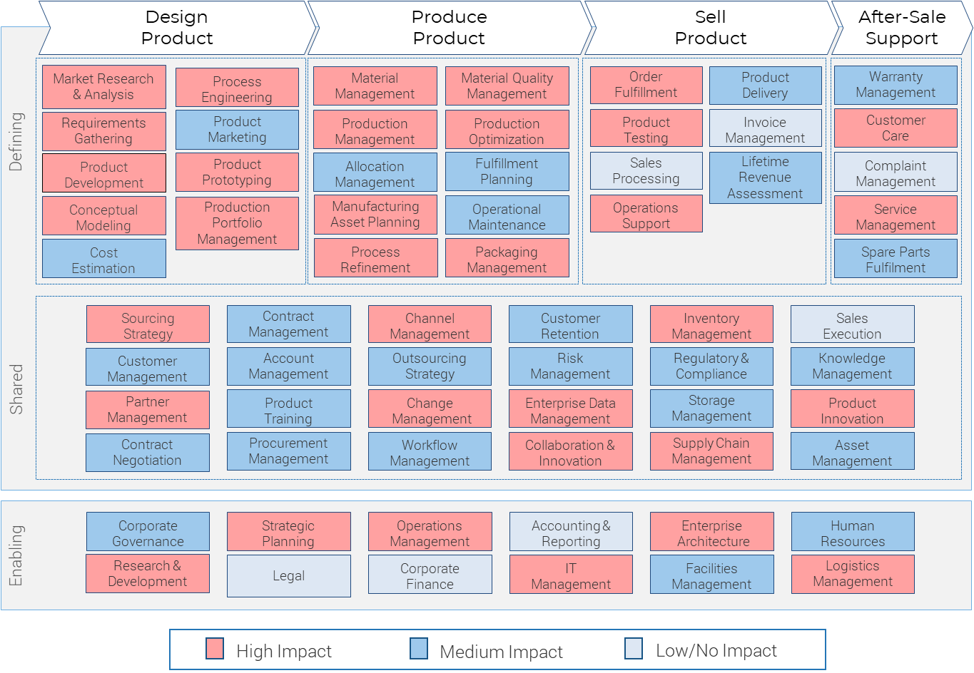
Business capabilities affected by the IT/OT convergence trend
Observations on IT/OT convergence
IT/OT convergence affects many capabilities within a Durable Goods Manufacturing organization’s value stream. However, some capabilities are more affected than others (see highlighting on the model).
Design and production processes are becoming linked as the convergence of IT and OT are impacting these processes.
Defining, shared, and enabling capabilities assist with understanding resource requirements for the transformation.
Info-Tech Research Group | 6

Slide 7
IT/OT convergence: People impact
Changing the way people work
Data management and analytics: Information management is the key to leveraging the data being generated by IoT capabilities. Data analytics can only be successful when IT and OT are working together to use the data for business improvement and further automation.
Communication gaps: IT and OT alignment is happening at the companies that realize it’s a competitive advantage. Success is a team game:
Roles and responsibilities need to break down silos.
Leaders must conduct transparent strategic planning that supports a shared vision, mission, goals and objectives.
Governance and risk management need to be integrated into the commissioning processes.
Project prioritization and use of internal and external expert resources across the Edge.
Info-Tech Research Group | 7

Slide 8
IT/OT convergence: Process impact
An operation-wide fit/gap is necessary for IoT to be effective and safe.
Getting on the same team: IT and OT need to work as an integrated team with visibility across all processes in the operation. Moving the business into Industry 4.0 and Edge AI requires operation-wide leadership, governance, project management, testing, and change management.
Better insight: Data analytics from IoT create the opportunity for data-driven decisions that can only occur through convergence of OT and IT.
Cost and profitability: Alignment of the departments will result of streamlined processes which expand profitability and reduce cost.
Business benefits:
Operations efficiency
Preventative service
Resource optimization
Compliance
Cost reductions
Increased profitability
Tight information security
Info-Tech Research Group | 8

Slide 9
IT/OT convergence: Technology impact
Asset Governance and Risk Management
Cybersecurity risks: Being connected at the Edge increases the amount of usable data and the amount of Risk to the business. Managing suppliers is of paramount importance. Ransomware has been steadily on the increase and some companies never recover. OT departments will need to work closely with IT departments as an overarching strategy for protecting the shop floor against cyberattacks.
Cloud mandate: A cloud first or hybrid cloud environment needs to be secure in order to protect the masses of data being collected by the business. Governance, Disaster Recovery, and Business Continuity plans are more important than ever before.
Shared change management: OT and IT require a technology commissioning process that is tightly aligned for all aspects of the quoting through contract process to ensure the technology can be smoothly implemented into the Ecosystem.
Living at the Edge: There is tremendous benefit associated with leveraging the Edge for Enterprise Data Management but contracts for data ownership and resiliency must be iron clad.
Info-Tech Research Group | 9

Slide 10
Activity: Gauge the impact of the IT/OT convergence trend
Duration: 1-2 Hours
Objective:
To determine how well positioned you are to address this trend in your organization.
Steps:
As a group, discuss the impact of the IT/OT convergence trend on the defining, shared, and enabling business capabilities, as highlighted in the heatmap version provided of the Durable Goods Manufacturing business capability model. Note any edits you want to make on the heatmap based on the impact of this trend on your organization.
Consider any further impacts of this trend on “people,” “process,” and “technology” as discussed on the previous slides. Note any further edits to the heatmap based on this discussion.
Using the editable version of the Durable Goods Manufacturing business capability map, apply the results of the above discussions to highlight the defining, shared, and enabling business capabilities impacted to create a unique heatmap for your organization.
Touch base with key stakeholders, using the heatmap you’ve created as a reference, and note any further edits from these meetings. Update your heatmap.
Use the heatmap as input to create a prioritized list of IT initiatives, listing each initiative as high, medium, or low priority on the template. Note impacts to IT capabilities in the Comments/Action column for each initiative.
Update these results into your Durable Goods Manufacturing IT Strategy Initiatives Workbook by copying and pasting the appropriate slides. Keep a copy of the heatmap in the appendix of the workbook.
Download the Durable Goods Manufacturing IT Strategy Initiatives Workbook
Info-Tech Research Group | 10

Slide 11
Activity: Gauge the impact of the IT/OT convergence trend
Key trends for industry Key stakeholder input from interviews Business capability model for each key trend Business strategy IT strategy initiatives long list | Updated business capability model with heatmap for IT/OT convergence for your organization Prioritized list of IT initiatives based on the impact of the IT/OT convergence trend
Durable Goods Manufacturing Business Capability Map | CIO Enterprise or business architect IT management team members Key business stakeholders in your organization
Input
Output
Materials
Participants
Info-Tech Research Group | 11

Slide 12
IT/OT convergence trend: Editable business capability map
Design
Product
Produce
Product
Sell
Product
After-Sale
Support
Market Research & Analysis
Process Engineering
Material Management
Material Quality
Management
Order
Fulfillment
Product
Delivery
Warranty Management
Requirements
Gathering
Product Marketing
Production
Management
Production
Optimization
Product
Testing
Invoice
Management
Customer
Care
Defining
Product Development
Product
Prototyping
Allocation
Management
Fulfillment
Planning
Sales
Processing
Lifetime Revenue Assessment
Complaint
Management
Conceptual
Modeling
Production Portfolio
Management
Manufacturing Asset Planning
Operational
Maintenance
Operations
Support
Service Management
Cost
Estimation
Process
Refinement
Packaging
Management
Spare Parts Fulfilment
Sourcing
Strategy
Contract
Management
Channel
Management
Customer Retention
Inventory
Management
Sales
Execution
Customer
Management
Account
Management
Outsourcing
Strategy
Risk
Management
Regulatory & Compliance
Knowledge
Management
Instructions: Adjust the color of each business capability for your organization. PowerPoint’s Eyedropper tool is useful here.
Shared
Partner
Management
Product
Training
Change
Management
Enterprise Data Management
Storage
Management
Product
Innovation
Contract Negotiation
Procurement
Management
Workflow Management
Collaboration & Innovation
Supply Chain
Management
Asset
Management
Corporate
Governance
Strategic
Planning
Operations
Management
Accounting & Reporting
Enterprise
Architecture
Human
Resources
Enabling
Research & Development
Legal
Corporate
Finance
IT
Management
Facilities
Management
Logistics
Management
High Impact
Medium Impact
Low/No Impact
Info-Tech Research Group | 12

Slide 13
Potential list of IT initiatives
Priority Rank | IT Initiative* | Value Stream Impacted | Funding Implications | Comments/Actions
1 | [Initiative] | [Value Stream]
2 | [Initiative] | [Value Stream]
3 | [Initiative] | [Value Stream]
4 | [Initiative] | [Value Stream]
5 | [Initiative] | [Value Stream]
6 | [Initiative] | [Value Stream]
7 | [Initiative] | [Value Stream]
8 | [Initiative] | [Value Stream]
9 | [Initiative] | [Value Stream]
10 | [Initiative] | [Value Stream]
* Consider adding these to your long list of initiatives or refining initiatives, if applicable, in your existing IT strategy.
Info-Tech Research Group | 13

Slide 14
Info-Tech’s position on IT/OT convergence
Bottom Line
IT/OT convergence is not a technology-specific problem. It creates teamwork and fills the communications gaps between IT, OT, and the business.
Convergence is a holistic approach that maintains clarity of roles but considers processes from end to end.
The time when some of the OT technologies could work in isolation is gone. Clarifying roles and responsibilities with the business, as well as communicating infrastructure impacts, and the risks of failure will provide OT a better understanding of the importance of convergence. Modernization requires that the business communicates with a common language.
Goal alignment opens the door to communication and for IT to demonstrate the value of convergence to the OT leadership.
IT/OT convergence is vital for Industry 4.0 success.
Info-Tech Research Group | 14

Slide 15
Tools & templates to finalize your list of strategic initiatives
The Durable Goods Manufacturing IT Strategy Initiatives Workbook is a place for you to collect all of the strategic initiative identification activity outcomes you’ve completed.
It also includes next-steps exercises to help you create a prioritized final list of initiatives and descriptions to consider for inclusion in your IT strategic plan.
Download the Durable Goods Manufacturing IT Strategy Initiatives Workbook
Once you’ve completed the IT Strategy Initiatives Workbook, it’s time to pull it all together and share with your organization’s leadership team.
Use the Durable Goods Manufacturing Industry Impacts on IT Strategy: Senior Management Presentation Template to highlight the key findings from the business-aligned analysis you’ve done.
Download the Durable Goods Manufacturing Industry Impacts on IT Strategy: Senior Management Presentation Template
Info-Tech Research Group | 15

Slide 16
Take best advantage of your industry benchmarking & roundtable experiences
THE FULL EXPERIENCE
DO-IT-YOURSELF
ANALYST GUIDANCE
With 36 planned experiences in each industry sector every year, how you participate is up to you.
PEER PARTICIPATION
INDUSTRY BENCHMARKING
INDUSTRY ESSENTIALS
Read all the research, talk to the analysts, do all the benchmarks, and attend all the roundtables.
Choose to read the published research and take action on your own using our step-by-step written guidance.
Work virtually with one of our industry analysts to understand the key insights in the published research and customize your experience.
Attend our monthly Executive Industry Roundtables to share insights and learn best practices from your peers on the hottest topics relevant to your industry.
Take the Industry Benchmarking Track for data-based insights on how you differ from others in your industry. Every three months, the Executive Industry Roundtables will focus on insights gleaned from the thousands of diagnostics we execute each year, from Stakeholder Satisfaction and Process Improvement to IT Staffing and Spending. Then we’ll create a custom benchmark report just for you.
Don’t have time to attend all 36 experiences? Let your executive advisor build a custom Key Initiative Plan that will guide you through the essential experiences customized to your environment.
Info-Tech Research Group | 16

Slide 17
Bibliography
“2018 Manufacturing Skills Gap Study.” Deloitte United States, 2018. Web.
“3D Printer Comparison Chart.” Product Chart, n.d. Accessed 13 Feb. 2020.
“Additive Manufacturing & Material Market by Technology, by Material (Plastics, Metals, and Ceramics), by Application, and by Geography – Analysis and Forecast to 2014 – 2020.” MarketsandMarkets, Oct. 2014. Accessed 13 Feb. 2020.
“Autonomous Mobile Robots Market Size Is Expected to Exhibit 600 Million USD by 2025.” MarketWatch, 8 April 2020. Accessed 13 Feb. 2020.
Badrick, Craig. “What CTOs Can Do to Get IT and OT on the Same Page.” Turn-Key Technologies, 6 Feb. 2019. Accessed 12 Feb. 2020.
Bosche, Ann, et al. “Unlocking Opportunities in the Internet of Things.” Bain & Company, 7 Aug. 2018. Web.
Columbus, Louis. “The State Of Digital Business Transformation, 2018.” Forbes, 22 April 2018. Accessed 13 Feb. 2020.
“Facts About Manufacturing.” National Association of Manufacturers, n.d. Accessed 12 Feb. 2020.
“Global 3D Printing Industry Market Size 2018.” Statista, July 2018. Accessed 13 Feb. 2020.
“The Internet of Things in Manufacturing: Benefits, Use Cases and Trends.” i-SCOOP, n.d. Accessed 12 Feb. 2020.
“IoT Market Size Worldwide 2017-2025.” Statista, Feb. 2019. Accessed 16 June 2020.
“IT/OT Convergence: Moving Digital Manufacturing Forward.” Cisco, 2018. Web.
Lueth, Knud Lasse. “IoT Platform Companies Landscape 2020.” IoT Analytics, 23 Dec. 2019. Accessed 13 Feb. 2020.
Nadel, Brian. “The Best Industrial 3D Printer Reviews of 2020.” business.com, n.d. Accessed 13 Feb. 2020.
Purvis, James. “8 Digital Transformation Statistics Every CIO Should Know in 2017.” LinkedIn, 17 Jan. 2017. Accessed 13 Feb. 2020.
Santagate, John. “Cloud Robotics: Enabling On-Demand Automation.” IDC, n.d. Web.
Shaffer, Jonathan. “How to Safely Implement Collaborative Robots.” AutomationWorld, 16 Dec. 2019. Web.
Shaw, Keith and John Santagate. “2019 RBR50: Top Robotics Companies Continue to Innovate, Grow Market.” Robotics Business Review, 2019. Accessed 13 Feb. 2020.
“Smart Manufacturing.” Fujitsu Ireland, n.d. Accessed 13 Feb. 2020.
Info-Tech Research Group | 17

Slide 18
Bibliography
“State of the 3D Printing Industry Survey 2019.” AMFG, 2019. Accessed 13 Feb. 2020.
“Talent Management for Manufacturing: The Need for a Fresh Approach.” PWC, n.d. Accessed 9 Mar. 2020.
“Top 4 Manufacturing Challenges of Implementing IoT” Wipfli, 12 June 2018. Accessed 13 Feb. 2020.
“Webinar Recap: Large-Scale 3D Printing – Realizing Value from Design to Production.” BigRep GmbH, 14 Sept. 2018. Web.
“What is 3D printing? The definitive guide.” 3D Hubs, n.d. Accessed 13 Feb. 2020.
M, A. (2020, Feb 11). Industry 4.0 Game changer in manufacturing Industry. Retrieved from Linkedin: https://www.linkedin.com/pulse/industry-40-game-changer-manufacturing-ashish-mohanpurkar
Supply Chain Game Changer. (2021, July 21). Industry 4.0 – Smart Manufacturing of the Future! Retrieved from Supply Chain Game Changer: https://supplychaingamechanger.com/industry-4-0-smart-manufacturing-of-the-future-infographic/
Tiempo Development. (2020, April 07). IT OT Convergence – Benefits and Challenges in Manufacturing. Retrieved from tiempo DEVELOPMENT - A 3PILLAR GLOBAL COMPANY: https://www.tiempodev.com/blog/it-ot-convergence-benefits-and-challenges-in-manufacturing/
Vincente, J. (2021, June 25). How Edge Technologies Pave The Way For IT-OT Convergence. Retrieved from Forbes: https://www.forbes.com/sites/tableau/2021/06/25/why-your-workforce-needs-data-literacy/?sh=2c799c1f4d0a
Info-Tech Research Group | 18

