Slide 1
Implement Business Relationship Management
Leverage knowledge of the business to become a strategic IT partner.

Slide 2
ANALYST PERSPECTIVE
Are your BRMs order takers or value creators?
Many organizations do not have a BRM program or have a program that does not focus on value creation and innovation.
BRMs often struggle to be recognized as a trusted advisor and business partner and this challenge stems from a lack of business knowledge and a lack of business focus.
BRMs must approach business leaders with an understanding of their business pain points and then propose solutions that help address those pain points.
Only then will IT be viewed as a strategic business partner.
Paul Brown
Senior Director, CIO Practice Info-Tech Research Group

Slide 3
Our understanding of the problem
CIO
Business relationship managers (BRMs)
Understand the benefits that an effective BRM program can bring to your organization and how to relay them to business stakeholders to obtain buy-in.
Design the BRM role depending on your organization’s level of maturity.
Implement the BRM role, measure success, and effectively communicate the value of the BRM program.
IT managers
Better understand the role of the BRM and improve their ability to support their objectives.

Slide 4
Executive summary
Business leaders believe that IT should be a partner with the business, but many IT organizations are not viewed as partners and trusted advisors.
The business does not view IT as a value creator.
BRM is not just a communication conduit between IT and the business. When implemented properly, a BRM is a value creator, advocate, innovator, and influencer.
The BRM role must be designed to match the maturity level of the IT organization and the business. Before you can create incremental business value, you must master the fundamentals of service and project delivery.
Third-party services have increased pressure on IT as they offer viable alternatives to the functions that an immature IT department performs.
IT organizations that do not create business value are at risk of being outsourced or replaced.
Info-Tech has developed an approach that will enable you to develop and implement a BRM program that is customized to the maturity level of your organization.
In the short run, BRM will help to demonstrate the value of the IT organization to the business and build credibility and trust.
In the long run, BRM will evolve with the IT organization as it transforms into a strategic partner, making IT an indispensable part of the business value chain.
The ideal state is achieved when the BRM comes to the business with innovative solutions to drive the business forward and achieve the organization’s goals and objectives.

Slide 5
Are your business leaders saying things like this?
1
IT does not create and deliver valuable services/solutions that resolve my business pain points.
2
IT does not come to me with innovative solutions to my business problems/challenges/issues.
3
IT blocks my efforts to drive the business forward using innovative technology solutions.
4
IT does not advocate for my needs with the decision makers in the organization.

Slide 6
IT is not meeting the demands of the business, and business stakeholders’ expectations are only increasing
Most IT organizations have an opportunity to prove their importance to the business as a strategic partner.
76%
of execs
27%
of IT orgs
49% gap
believe that IT should be a business partner.
are currently at the business partner level of maturity.
Source: Info-Tech’s CIO Business Vision diagnostic

Slide 7
Many organizations face business dissatisfaction because they do not understand what the role of a BRM should be
BRM is not just a go-between for the business and IT – BRM should deliver value and innovative solutions to the business.
A BRM is NOT:
A BRM is:
Order taker
Service desk
Project manager
Business analyst
Service delivery manager
Service owner
Change manager
Value creator
Innovator
Trusted advisor
Strategic partner
Influencer
Business subject matter expert
Advocate for the business
Champion for business process improvement

Slide 8
But it’s worse than that
IT organizations that do not create value are at risk of being treated as a commodity and therefore replaceable.
1 in 3
execs
believe that third-party services can significantly or completely substitute for the IT department.
Source: McKinsey Global Survey (on business technology)
Source: Harvey Nash / KPMG Report

Slide 9
When done right, BRM has a significant positive effect on business satisfaction
IMPACT OF RELATIONSHIP SATISFACTION ON BUSINESS SATISFACTION WITH IT
Relationships can make or break an IT department’s success.
In a study of 308 organizations, Info-Tech found that for every 10% increase in relationship satisfaction, business satisfaction with IT increased by 9.99%.
Can you afford to have 10% lower satisfaction?
Source: Info-Tech Diagnostic Programs, N=308 organizations

Slide 10
BRM improves business satisfaction in various ways
1
It drive business value into the organization via innovative technology solutions.
2
It improves IT’s ability to meet and exceed business goals and objectives, resulting in happier stakeholders (i.e. C-suite, board of directors).
3
It enhances IT’s ability to execute business activities to meet customer requirements and expectations, resulting in happier customers.
Taking an ad hoc approach does not work for most organizations.
You need a formal BRM strategy to get ahead.

Slide 11
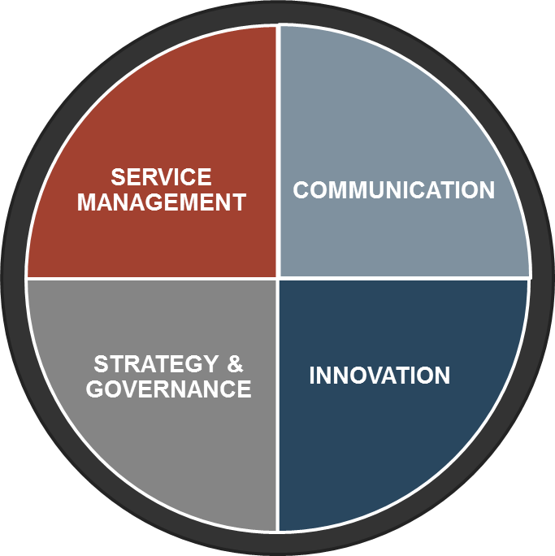
Deliver more than just table stakes to become an irreplaceable value creator
Info-Tech has developed an approach that can be used by any organization to improve or successfully implement BRM.
TRUSTED ADVISOR/ BUSINESS PARTNER
KNOWLEDGE OF THE MARKET
KNOWLEDGE OF THE BUSINESS
VALUE CREATOR
SERVICE MANAGEMENT
INNOVATOR
TABLE STAKES:
COMMUNICATION
SERVICE DELIVERY
PROJECT DELIVERY
ADVOCATE
INFLUENCER

Slide 12
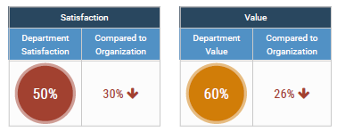
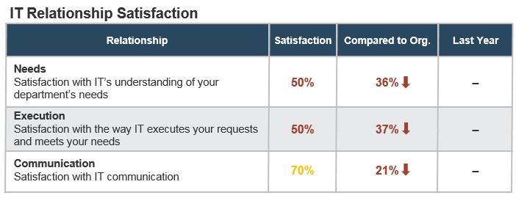
Measure the success of the BRM program
Most of the metrics you should track come from your business satisfaction survey (Info-Tech’s CIO Business Vision diagnostic)
Business satisfaction survey
Audience: Business leaders Frequency: Annual Metrics: Overall Satisfaction score Overall Value score Relationship Satisfaction: Understand needs Meet needs Communication

Slide 13
Our members have already had success after participating in an Info-Tech BRM workshop
CASE STUDY
Industry
Source
State Government Department
Info-Tech Workshop
Problem
IT struggled with low business satisfaction and low business engagement. The business saw IT as an order taker and not an advisor or partner. Some business leaders would not even meet with IT due to a perceived lack of credibility.
Solution
A new approach to business engagement was designed, where BRMs worked to understand the business pain points and validated this understanding with business leaders.
Knowledge of the business was developed by understanding business processes and the associated business activities.
Once trust was established, the BRMs proposed solutions to address the business pain points. Solutions could include existing IT services, new or enhanced IT services, or business process improvements.
Results
Business leaders began to recognize that IT could bring valuable solutions to their business problems to the table. With leadership from the BRMs, the business changed its perception of IT from an order taker to a business partner who could help the organization achieve its business goals and objectives.
Use this blueprint to create an effective and valuable BRM program:
1. Obtain executive buy-in
2. Design the BRM role
3. Implement the BRM role

Slide 14
Use these icons to help direct you as you navigate this research
Use these icons to help guide you through each step of the blueprint and direct you to content related to the recommended activities.
This icon denotes a slide where a supporting Info-Tech tool or template will help you perform the activity or step associated with the slide. Refer to the supporting tool or template to get the best results and proceed to the next step of the project.
This icon denotes a slide with an associated activity. The activity can be performed either as part of your project or with the support of Info-Tech team members, who will come onsite to facilitate a workshop for your organization.

Slide 15
Info-Tech offers various levels of support to best suit your needs
Guided Implementation
DIY Toolkit
Workshop
Consulting
“Our team has already made this critical project a priority, and we have the time and capability, but some guidance along the way would be helpful.”
“Our team knows that we need to fix a process, but we need assistance to determine where to focus. Some check-ins along the way would help keep us on track.”
“We need to hit the ground running and get this project kicked off immediately. Our team has the ability to take this over once we get a framework and strategy in place.”
“Our team does not have the time or the knowledge to take this project on. We need assistance through the entirety of this project.”
Diagnostics and consistent frameworks used throughout all four options

Slide 16
Transform IT Into a Value Creator With BRM – project overview
1. Obtain Buy-In
2. Define the BRM Role
3. Implement BRM
Best-Practice Toolkit | 1.1 Define objectives of the BRM program 1.2 Identify business pain points 1.3 Identify IT pain points 1.4 Understand business satisfaction with IT using the CIO Business Vision diagnostics | 2.1 Define components of the BRM role 2.2 Define BRM maturity levels 2.3 Define BRM candidate qualifications 2.4 Create a BRM role description | 3.1 Determine BRM reporting structure 3.2 Create BRM engagement plan 3.3 Gather feedback and measure value 3.4 Create BRM communication plan
Guided Implementations | Define the objectives of the BRM program and identify business and IT pain points Walk through the results from the CIO Business Vision diagnostic | Define components of the BRM role and the maturity levels Determine member’s BRM maturity level and walk through role descriptions | Walk through the different BRM reporting structures and create a BRM engagement and communication plan
Onsite Workshop | Module 1: Obtain Buy-In for the BRM Program | Module 2: Define the BRM Role | Module 3: Implement the BRM Role
 | Phase 1 Outcome: Mutually agreed upon objectives between IT and the business for how BRM can add value to the organization An understanding of both business and IT pain points by both parties | Phase 2 Outcome: An understanding of the various maturity levels for the BRM role and difference in focus for each level A job description for the hiring of a BRM role (if required) | Phase 3 Outcome: An engagement plan to ensure the BRM builds and maintains relationships with key stakeholders A communication plan to obtain buy-in from business and IT leaders

Slide 17
Workshop overview
Contact your account representative or email Workshops@InfoTech.com for more information
 | Workshop Day 1 | Workshop Day 2 | Workshop Day 3 | Workshop Day 4
Activities | Assess BRM Current State and Survey Results 1.1 Define objectives of the BRM program 1.2 Identify business pain points 1.3 Identify IT pain points 1.4 Understand business satisfaction with IT using CIO Business Vision diagnostics | Define Components of the BRM Role 2.1 Define components of the BRM role 2.2 Define BRM maturity levels 2.3 Define BRM candidate qualifications 2.4 Refine BRM role descriptions | Implement BRM – Engagement Plans 3.1 Determine BRM reporting structure 3.2 Create BRM engagement plans for each department | Implement BRM – Communication and Action Plans 4.1 Create BRM Communication Plan 4.2 Create Metrics Tracking Plan 4.3 Create Action Plan
Deliverables | List of objectives for the BRM program List of business pain points List of IT pain points Summary of CIO Business Vision results | BRM role descriptions | BRM reporting structure BRM engagement plans | BRM communication plan BRM metrics tracking plan Action plan and next steps

