Slide 1
Apply Design Thinking to Build Empathy With the Business
Use design thinking and journey mapping to make IT the business’s go-to problem solver.
Info-Tech's products and services combine actionable insight and relevant advice with ready-to-use tools and templates that cover the full spectrum of IT concerns.© 1997-2017 Info-Tech Research Group

Slide 2
ANALYST PERSPECTIVE
Empathy is the foundation of a true business partnership.
Stakeholder satisfaction with IT services is shockingly low at a time when the business and IT need to work together the most.
We are in the middle of a digital revolution. IT leaders must find ways to understand the needs of their business stakeholders and develop empathy on a much deeper level. This empathy is the foundation for a thriving business partnership.
MaryAnn Welke,
Research Director, CIO Practice Info-Tech Research Group

Slide 3
Our understanding of the problem
Enterprise Architects
Business Analysts
Business Relationship Managers
Empathize with the problems the business encounters.
Dynamically pivot IT projects according to the business’s changing expectations.
Design IT services and processes that exceed the business’ expectations.
Build the business’ trust and confidence in IT.
The CIO
IT Managers
IT Domain Experts
Position IT as the go-to solver of business problems.
Develop customer-centric IT strategy.
Enable IT staff to deliver on the business’ true needs and wants.
Learn a disciplined process for developing organizational empathy.

Slide 4
Executive summary
Business satisfaction with IT is low.
IT and the business have independently evolving strategy, initiatives, and objectives.
IT often exceeds their predicted project costs and has difficulty meeting the business’s expectations of project quality and time-to-market.
Product, service, and process design should always start with an intimate understanding of what the business is trying to accomplish and why it is important.
Business needs are unclear or ambiguous.
IT and the business do not know how to leverage each other’s talent and resources to meet their common goals.
Not enough steps are taken to fully understand and validate problems.
IT can’t pivot fast enough when the business’ needs change.
Empathize with business stakeholders.
Understand how the business’ needs, wants, and expectations fit into their bigger picture.
Formalize the business analysis process.
Use problem-centric thinking to ensure you use the right approach to solving a business problem.
Collaboratively create journey maps.
Understand how your business stakeholders behave outside of IT’s field of vision.
Predict business needs and pivot early.
Systematically develop and test design hypotheses to quickly and definitively pivot your approach to solving problems.

Slide 5
Introducing the experience design approach
IT often manages stakeholders who don’t know how to articulate what they want from IT. Requirements often say what the business needs, but rarely are IT and the business able to meaningfully discuss the underlying problems and motivations that drive their needs. As a result, IT has difficulty delivering on the business’ true expectations, and the business loses trust in IT.
Follow Info-Tech’s experience design methodology to discover hidden needs of the business and develop solutions that enable the business to solve its problems and achieve its long-term goals.
1
2
3
Research
Map
Iterate
Engage with business stakeholders early and discover their key issues and motivations.
Walk a mile in the shoes of your stakeholders by mapping their problem-solving journey and their use of IT in doing so.
Identify and test your assumptions about the business’ experience with IT and ideate ways to improve it.

Slide 6
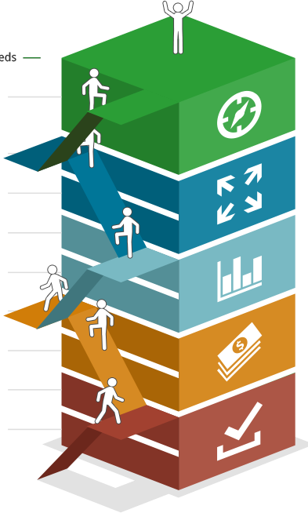
IT strives to contribute to business decision making, but IT is pigeonholed into the role of an order-taker or trusted operator
Innovator – Transforms the Business
Reliable Technology Innovation
Business Partner – Expands the Business
Effective Execution on Business Projects, Strategic Use of Analytics and Customer Technology
Trusted Operator – Optimizes the Business
Effective Fulfillment of Work Orders, Functional Business Applications, and Reliable Data Quality
Firefighter – Supports the Business
Reliable Infrastructure and IT Service Desk
Unstable – Struggles to Support
Inability to Provide Reliable Business Services

Slide 7
Business stakeholders regularly undervalue IT services that drive satisfaction
In a recent survey of over 20,000 IT and business executives, it was found that four of the core IT services with the largest impact on satisfaction were considered the four least important IT services by the business.
It is often the case that business stakeholders overvalue services that drive “business as usual” activities, but undervalue services that IT uses to understand and innovate around what the business actually wants from IT.
Importance as reported by business stakeholders
Statistical impact on business satisfaction
Network Infrastructure
Service Desk
Business Applications
Data Quality
Devices
1
1
Projects
Work Orders
Innovation Leadership
Business Applications
Requirements Gathering
2
2
3
3
4
4
5
5
11
* As determined by strength of correlation between Core Service scores and Overall Satisfaction
Info-Tech Business Vision Survey N=21,367

Slide 8
Past a certain point, IT needs to invest in innovation to drive high levels of satisfaction
10
Don’t overinvest in “business as usual.”
IT often overinvests in the core business-facing services.
Satisfaction is driven beyond the business’s field of vision.
The services that drive business satisfaction the most go on “behind the scenes” – projects, work orders, innovation, and business applications. Past about 75% overall IT satisfaction, improving these services yields the highest possible return.
9
8
Overall IT Satisfaction
7
6
5
4
4
5
6
7
8
9
10
Satisfaction in Core IT Services
*Created Based on
Correlation Coefficients
Projects
Work Orders
Innovation Leadership
Business Applications
Requirements Gathering
Service Desk
Client Facing Technology
Network Infrastructure
Analytical Capability
Data Quality
Devices
IT Policies

Slide 9
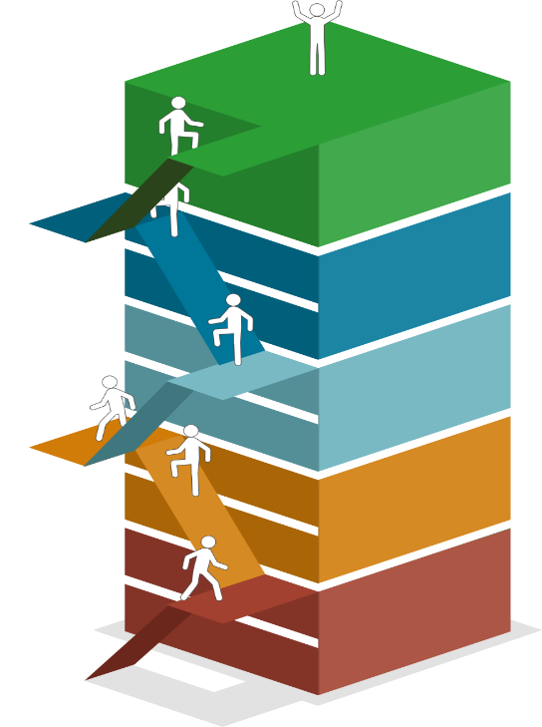
Run the CIO Business Vision program, then use Info-Tech’s systematic process of engagement and experience design
Understanding what drives your business stakeholders to action and mapping out how they solve problems will enable IT to predict their needs and adapt accordingly. Continued success in doing this will build satisfaction and trust in IT, enabling IT to start more ambitious projects as a strategic partner.
The CIO Business Vision Program provides a current-state evaluation of IT’s ability to provide services and solutions to the main business stakeholders’ most important business-technology areas of concern.
If you are here: Partner with the business to drive IT innovation and focus your experience design efforts on making business decisions that affect end customers.
Transforms
Expands
Optimizes
If you are here: Design the experience of internal stakeholders to discover the business’s hidden needs, build process maturity, and position IT optimally into their big picture.
Supports
Struggles

Slide 10
Apply experience design to your requirements gathering and innovation processes to optimize IT satisfaction
Requirements Gathering Asks:
Experience Design Asks:
What is the expected outcome of this process?
What are the required inputs and outputs?
Where do we interact with the customer?
How do we measure success?
How do we deliver maximum value for our investment?
What problem am I trying to solve?
What approach should I use to try to solve it?
What tools are available?
What do I expect to happen at the end?
Why does solving this matter?
What about the outcome I am looking for is valuable?
Think of your stakeholders as “DIY-ers.” They see IT as a set of tools and resources to help them get work done, not as a standalone solution to their problems. For IT to be viewed as the preferred solution, it must intimately understand and innovate around user pains and desired outcomes.

Slide 11
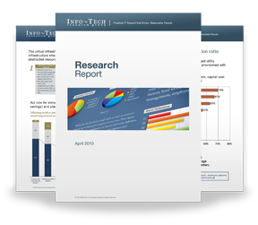
Info-Tech Research Group Helps IT Professionals To:
Quickly get up to speed with new technologies
Make the right technology purchasing decisions – fast
Deliver critical IT projects, on time and within budget
Manage business expectations
Justify IT spending and prove the value of IT
Train IT staff and effectively manage an IT department
Sign up for free trial membership to get practical
solutions for your IT challenges
“Info-Tech helps me to be proactive instead of reactive – a cardinal rule in a stable and leading edge IT environment.
- ARCS Commercial Mortgage Co., LP
Toll Free: 1-888-670-8889
www.infotech.com

