Slide 1
Modernize the Network
Merely replacing yesterday’s equipment will not prepare your network to meet the needs of tomorrow.

Slide 2
ANALYST PERSPECTIVE
Don’t just make the network faster, make the network smarter.
Modernizing a network is about more than increasing capacity in terms of ports and speed. It is about continuously delivering access to existing services or enabling new access to new ones. Today this has been complicated by innovation and disruption on many fronts.
In the enterprise, Wi-Fi is dominating the access layer and allowances for BYOD are the norm. In the WAN, private links are being challenged by the desire to consume applications in the public cloud. In the data center, the shift is toward software-driven, programmable networks and the disaggregation of software from hardware.
Opportunities to invest in network infrastructure are few and far between. Amid all the innovations and disruption, the investments that bring the most value are those that directly address pain points or opportunity gains. Make the most of your window of opportunity by rooting out these areas of focus as you build tomorrow’s network.
Fred Chagnon
Research Director, Infrastructure & Operations
Info-Tech Research Group

Slide 3
Make the most of your network investment
IT Managers
Network/Infrastructure Managers
Develop a comprehensive profile of the current state of your network infrastructure.
Understand your business and technical requirements and define a target state that aligns with needs and goals.
Pitch the modernization project to senior management.
Develop the requirements necessary to build an RFP.
CIOs
IT Infrastructure Directors
Ensure their organization’s IT capabilities support the evolving business needs.
Understand and articulate the need and benefit of modernizing network infrastructure.

Slide 4
Executive summary
Business units, functions, and processes are inextricably intertwined with less and less tolerance for downtime.
Wireless was once considered secondary access, a nice-to-have feature; now wireless network clients outnumber wired.
Network design historically focused on tiered, hierarchical, and centralized structures.
Build for your needs. Don’t fall into the trap of assuming what works for your neighbor, your peer, or your competitor will work for you.
Deliver on what your business knows it needs as well as what it doesn’t yet know it needs. Business leaders have business vision, but this vision won’t directly demand the required network capabilities to enable the business. This is where you come in.
Modern technologies are hampered by vintage processes. New technologies demand new ways of accomplishing old tasks.
Business demands change rapidly but the refresh horizon for infrastructure remains 5-7 years.
The number of endpoint devices the network is expected to support is growing geometrically but historic capacity planning grew linearly.
The business is unable to clearly define requirements, which paralyzes planning.
Use a systematic approach to document all stakeholder needs and rely on the network technical staff to translate those needs into design constraints, use cases, features, and management practices.
Spend only on those emerging technologies that deliver features offering direct benefits to specific business goals and IT needs.
Solidify the business case for your network modernization project by demonstrating and quantifying the hard dollar value it provides to the business.

Slide 5
The verdict is in. The network is your most critical IT service
Top IT Services for Business Stakeholders
Users, familiar with consumer apps, demand the same high level of performance and ease of use from business apps.
Increasingly interconnected IT systems over ever-wider geographies exacerbate design challenges.
Downtime remains anathema – lag tolerance is approaching zero. Network usage must now be micro-managed in order to meet business SLAs.
1. Network Infrastructure
2. Service Desk
3. Business Applications
4. Data Quality
5. Devices
6. Analytical Capability
7. Client-Facing Technology
8. Work Orders
9. Innovation Leadership
10. Projects
Source: Info-Tech Research Group; N = 21,367
Learn more about the CIO Business Vision program.
Since 2013, Info-Tech has surveyed over 20,000 business stakeholders as part of our CIO Business Vision program.
Business stakeholders rank 12 core IT services in terms of importance.

Slide 6
Having an effective network correlates with higher end-user satisfaction with all other IT services
Satisfaction with Network Resources
42.4%
On average, organizations that had end users who were satisfied with the network were 42.4% more satisfied with all other IT services when compared to those who were dissatisfied with the network resources.
“Satisfied” indicates average scores between 8 and 10.
“Dissatisfied" indicates average scores between 1 and 6.
Source: Info-Tech Research Group, 2016 (N=25,998)

Slide 7
Network behavior is changing. Are you keeping up?
Internet of Things: data collected from these non-traditional smart devices has to go somewhere, and it’s using the network to get there.
Software-as-a-Service: Increasing enterprise adoption of this model reduces internal network traffic, increasing pressure on the edge and out to the public cloud.
SD-WAN: MPLS is increasingly looking like Grandpa’s WAN, compared to widely available, cheap internet connections that can spin up in a matter of days.
Mobility: The modern worker expects the ability to work from anywhere, requiring ubiquitous Wi-Fi access and secure transmission from remote locations.
BYOD: Whether for business or personal use, employees are bringing their own devices, increasing demand on connectivity and bandwidth.
Don’t just build for what you need today; ask yourself what your network will need to support tomorrow. Opportunities to invest in network infrastructure are typically years apart – plan for that horizon.

Slide 8
Incremental upgrades aren’t enough to get you where you need to go
Traditional management, security, and deployment strategies will not scale to the explosive growth of connected devices.
Your job is to bridge the gap between evolution and transformation.
Source: Cisco IBSG, April 2011

Slide 9
Don’t just look at this as an opportunity to upgrade – instead, seize the opportunity to modernize your network
An IP fax machine is not the modern way to send a document. Challenge both what you used to do and how you used to do it.
Network modernization incorporates emerging technologies into a solution that solves particular problems resulting from the changing trends in network utilization.
Take a step backward to look ahead.
The consumption of your network is not going to get less complicated. Have the whole picture in mind to start your process. Regardless of what solution you settle on, it must last until the end of your refresh cycle.
A modern network is:
Resilient: Balancing agility and stability, guaranteeing the availability of core services.
Innovative: Exploiting emerging, possibly disruptive, technologies such as SDN or disaggregated switching.
Adaptive: Able to respond to trends such as BYOD, IoT, and the continued use of cloud computing.
How do we design it?
Be methodical. Gather, refine, and prioritize the needs of the users. Utilize real data where available but supplement that with extensive consultation with key players.
Confront problems. Don’t fall into the trap of assuming a new technology can solve an underlying problem. At best, it will mask the symptoms for a time – this is your chance to solve it right the first time.
If I had asked people what they wanted, they would have said faster horses.
– Henry Ford
When asked, people naturally respond with bigger, better, faster iterations of what they already have. Your strategy must move beyond what they want and incorporate what they don’t know they can have.

Slide 10
Modernizing your network has a ripple effect on overall satisfaction with IT
% Change in End-User Satisfaction Correlated to Network Improvement
End users who report high satisfaction with the network also feel:
TRUST that IT listens to them when they have a concern.
BELIEF that technology is a positive force toward better job performance.
CONFIDENCE they have the training required to use their technology.
SECURITY that IT is capable of responding to whatever comes their way.
Source: Info-Tech Research Group 2016 (N=25,998)
Improving the network improves end-user satisfaction across all of IT

Slide 11
Use Info-Tech’s methodology to build a modern network that is right for your organization
Align the network design to the business
If the network isn’t delivering what the enterprise wants, then the network is holding the enterprise back.
Understanding stakeholder needs is a critical step to ensure that what you build will make your job easier and facilitate business success in the future.
Rather than going by buzzwords, understand what you are trying to solve, then come up with the solution.
– Dhiman Deb Chowdhury
Director of System Engineering
Solution based on specifics
Your network might not be a unique snowflake, but it’s certainly not a clone. Assemble the right combination of network technologies by focusing on your specific needs. This way, you get a solution rather than wasting resources on an assortment of technologies that only benefits the vendors that sold them to you.
Examine what you have critically
Respect your past but don’t be shackled by it. Solutions implemented for yesterday’s problems may be just that – yesterday’s problems. Examine each element of your network and justify if it should be part of your modernization. This is your chance to discard elements that are no longer needed or are underutilized.
Anticipate the future
Technological obsolescence is the natural by-product of Moore’s Law. Analyzing specific trends can help predict future capacity requirements and workload demands. A modern network adapts to change and is designed for agility as much as for resiliency.

Slide 12
A Tale of Two Cities – Gotham Utilities and Central City College
CASE STUDY
Industry
Source
Municipal Government & Higher Education
Info-Tech Workshops
Situation
Two like-sized public sector organizations identified the need to modernize their patchwork legacy networks. Users at each organization had similar complaints about speed and access.
Complication
Complaints about speed are ambiguous at best. Proper analysis identified stakeholders in each organization that had vastly different expectations on what services the network was expected to support and how those services were to be delivered.
Results
Central City College used SD-WAN to more efficiently route internet traffic, decreasing the strain on its MPLS and increasing overall user performance. Gotham Utilities refreshed all its hardware from a single vendor whose solution included modern management software. Traffic was monitored, allowing for data-driven decisions to match network capacity with user demand.
Insight
There is no one-size-fits-all network modernization solution. Only through a methodical analysis of your current situation can you arrive at the solution that’s right for your organization.

Slide 13
Follow Info-Tech’s methodology to build and execute your network modernization strategy
Phases
1
2
3
Assess the Network
Envision the Future of Your Network
Communicate and Execute the Plan
Steps
1.1
Engage With Stakeholders
2.1
Evaluate Trends and Emerging Technologies
3.1
Prepare Your People and Process Tasks
1.2
Inventory Network Services
2.2
Match Features with Goals, Functions, and Challenges
3.2
Prepare Your Executive Presentation
1.3
Design Considerations
2.3
Develop Network Capacity Requirements
3.3
Prepare Your Request
1.4
Physical and Logical Topology
2.4
Group and Profile Sites
1.5
Care and Control
Executive Presentation Template
Tools
Network Modernization Workbook
Network Modernization Technology Assessment Tool
RFP / RFQ Templates

Slide 14
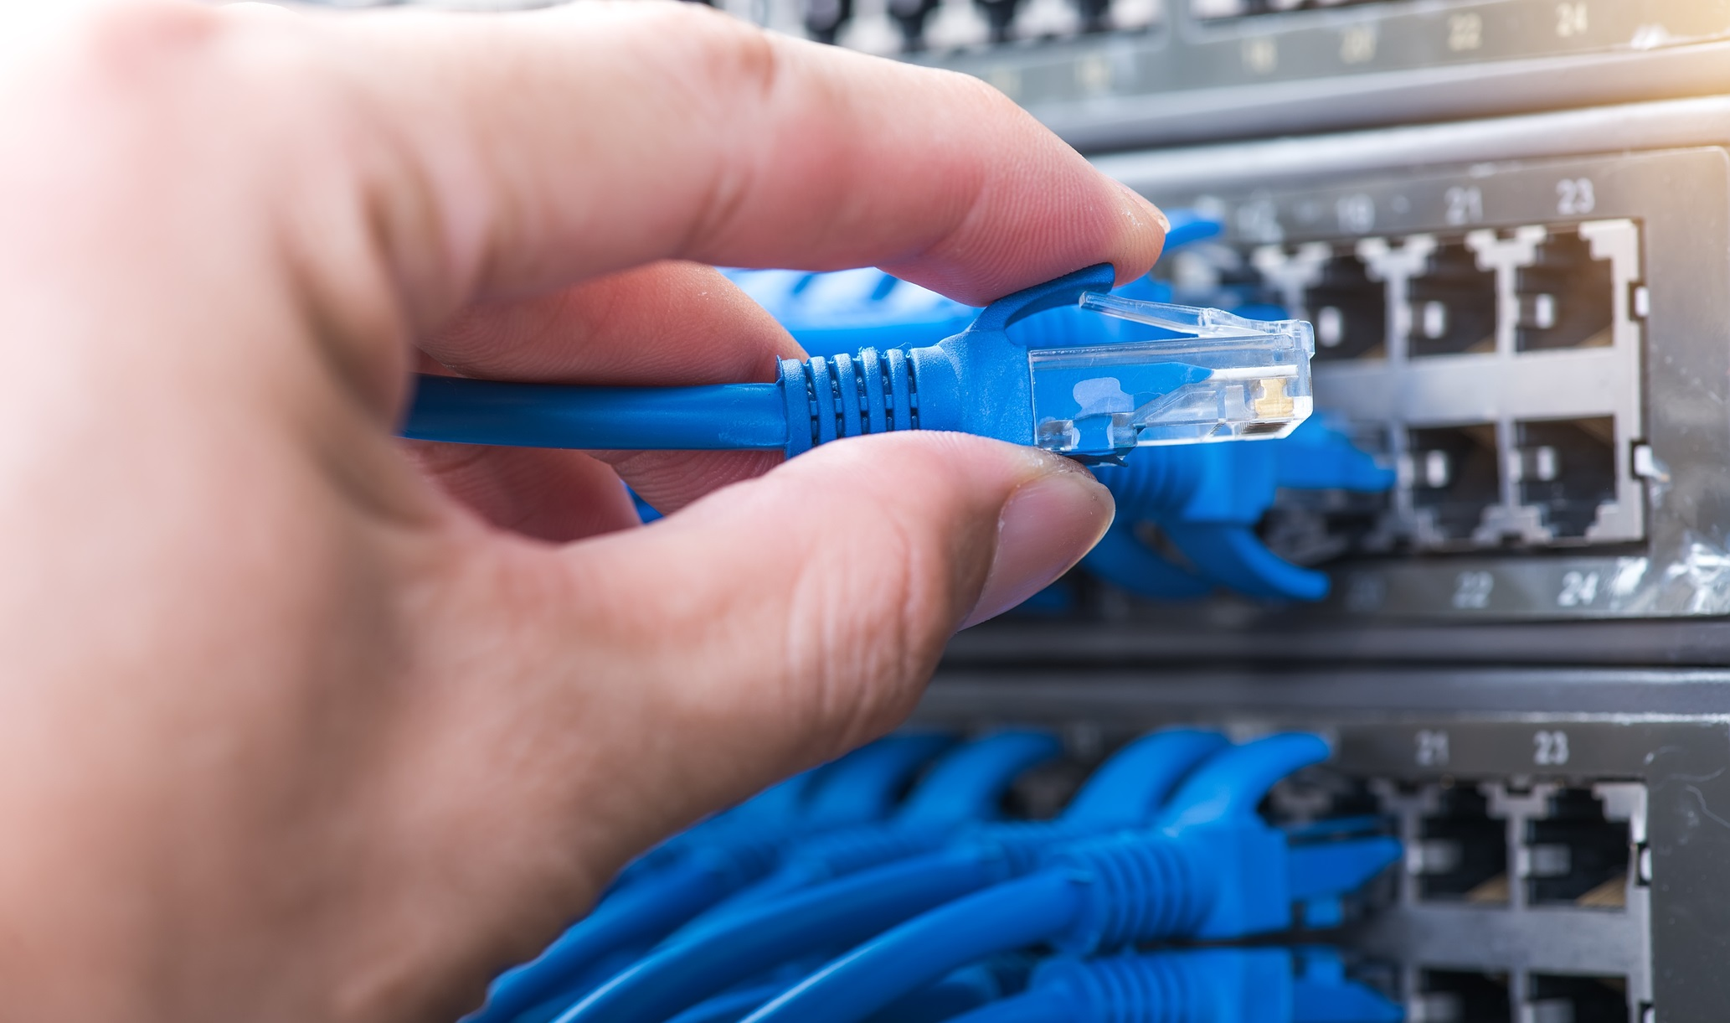
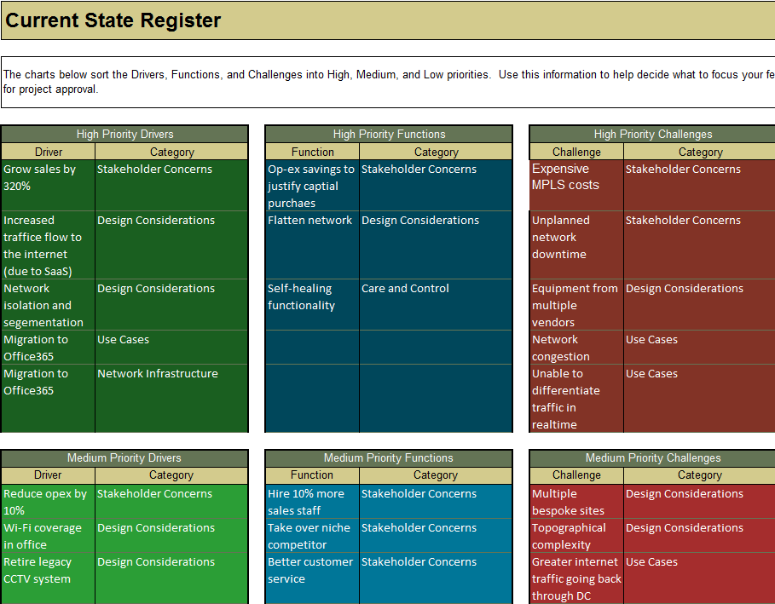
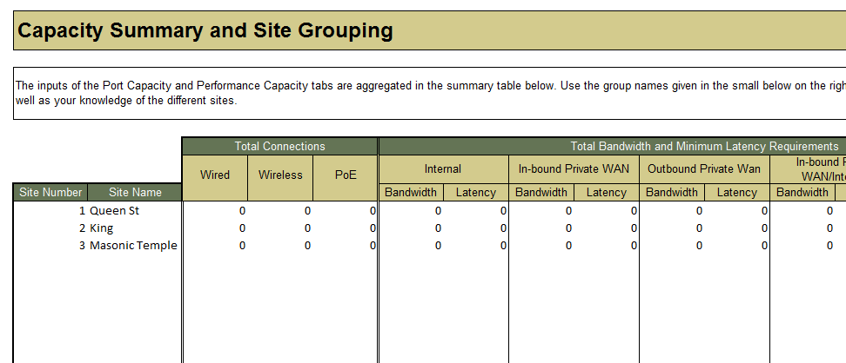
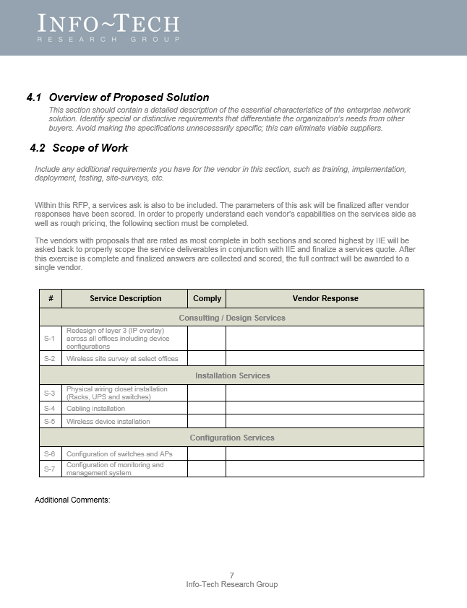
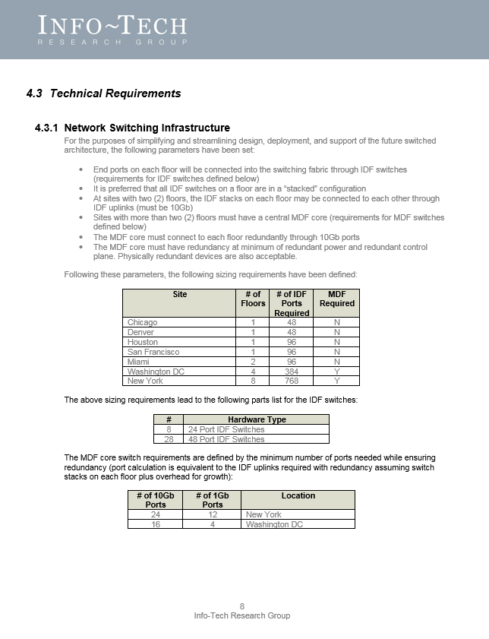
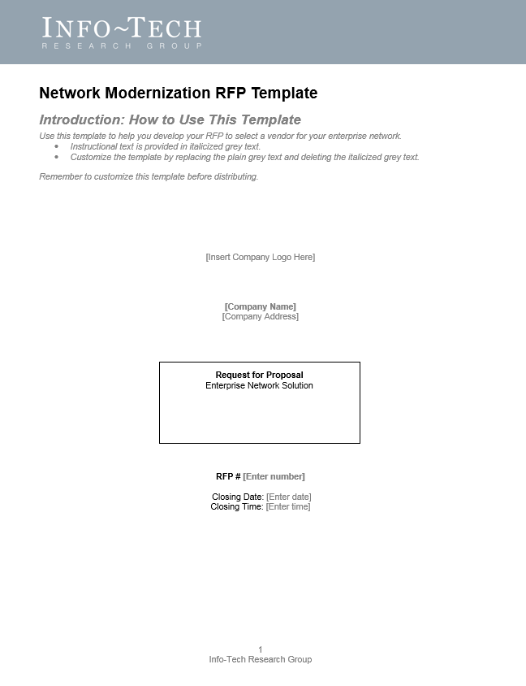
Info-Tech delivers: Use our tools and templates to accelerate your project to completion
Current State Register Comprehensively evaluate your current network by identifying and prioritizing goals, functions, and challenges using the Network Modernization Workbook.
Executive Pitch
Communicate value, high-level details, and timeline in a consulting quality presentation.
1
4
Technology Trends Assessment Assess emerging technology trends by value and readiness based on the current market and your specific needs.
Network Modernization Technology Assessment Tool
2
Request For Proposal
The details you develop through our process fit right into our RFP template so you can go to market immediately.
5
Network Modernization Requirements
Determine the features and capacity needed to support goals, functions, and challenges into the future.
3

Slide 15
Use these icons to help direct you as you navigate this research
Use these icons to help guide you through each step of the blueprint and direct you to content related to the recommended activities.
This icon denotes a slide where a supporting Info-Tech tool or template will help you perform the activity or step associated with the slide. Refer to the supporting tool or template to get the best results and proceed to the next step of the project.
This icon denotes a slide with an associated activity. The activity can be performed either as part of your project or with the support of Info-Tech team members, who will come onsite to facilitate a workshop for your organization.

Slide 16
Info-Tech offers various levels of support to best suit your needs
Guided Implementation
DIY Toolkit
Workshop
Consulting
“Our team has already made this critical project a priority, and we have the time and capability, but some guidance along the way would be helpful.”
“Our team knows that we need to fix a process, but we need assistance to determine where to focus. Some check-ins along the way would help keep us on track.”
“We need to hit the ground running and get this project kicked off immediately. Our team has the ability to take this over once we get a framework and strategy in place.”
“Our team does not have the time or the knowledge to take this project on. We need assistance through the entirety of this project.”
Diagnostics and consistent frameworks used throughout all four options

Slide 17
Measured value for Guided Implementations
GI | Measured Value
Phase 1: | Time, value, and resources saved by using Info-Tech’s methodology to engage stakeholders, assess the network, and document the layout. For example, 2 FTEs * 10 days * $80,000/year = $6,200
Phase 2: | Time, value, and resources saved by using Info-Tech’s tools and templates to evaluate new technologies, match functions to business goals, group and profile your network locations. For example, 2 FTEs * 5 days * $80,000/year = $3,100
Phase 3: | Time, value, and resources saved by following Info-Tech’s tools and methodology to build a project roadmap and communications plan. For example, 1 FTEs * 5 days * $80,000/year = $1,500
Total savings | $10,800
Engaging in Guided Implementations doesn’t just offer valuable project advice,
it also results in significant cost savings.

Slide 18
Modernize the Network – project overview
1. Assess the network
2. Envision your future network
3. Communicate and execute the plan
Best-Practice Toolkit | 1.1 Assess and prioritize stakeholder concerns 1.2 Assess and prioritize design considerations 1.3 Assess and prioritize use-case concerns 1.4 Assess and prioritize network infrastructure concerns 1.5 Assess and prioritize care and control concerns. | 2.1 Learn about emerging network technology and usage trends 2.2 Identify and shortlist features 2.3 Plan for future capacity requirements | 3.1 Build the executive presentation 3.2 Prepare the scope of work and technical requirements
Guided Implementations | Assess stakeholder and IT/network concerns Prioritize stakeholder and IT/network concerns | Learn about emerging network technology and usage trends Build your network modernization solution Plan for future capacity needs | Communicate to stakeholders Prepare the RFP
Onsite Workshop | Phase 1 Outcome: Prioritized lists of goals, functions, and challenges | Phase 2 Outcome: Technology readiness assessment Future capacity requirements Network modernization feature requirements | Phase 3 Outcome: Executive presentation RFP/RFQ

Slide 19
Modernize the Network – workshop overview
Contact your account representative or email Workshops@InfoTech.com for more information.
 | Workshop Day 1 | Workshop Day 2 | Workshop Day 3 | Workshop Day 4
Activities | Assess the network 1.1 Assess and prioritize stakeholder concerns 1.2 Assess and prioritize design considerations 1.3 Assess and prioritize use-case concerns 1.4 Assess and prioritize network infrastructure concerns 1.5 Assess and prioritize care and control concerns | Emerging technologies and feature identification 2.1 Analyze emerging technologies 2.2 Identify features that support goals, functions, and challenges | Plan for future capacity 3.1 Estimate port and bandwidth, and latency requirements 3.2 Group sites according to similar capacity requirements 3.3 Create standardized capacity plans for each group | Communicate and execute the plan 4.1 Build the executive presentation 4.2 Compose the scope of work 4.3 Compose the technical requirements
Deliverables | Prioritized lists of goals, functions, and challenges | Technology readiness assessment Network modernization feature requirements | Future capacity requirements | Executive presentation RFP/RFQ

