Slide 1
Select and Implement an ERP Solution
Selecting a best-fit solution requires balancing needs, cost, and vendor capability.
Info-Tech's products and services combine actionable insight and relevant advice with ready-to-use tools and templates that cover the full spectrum of IT concerns.© 1997-2019 Info-Tech Research Group

Slide 2
ANALYST PERSPECTIVE
Think beyond ERP functionality. Consider how vendors will satisfy your organizational support needs and culture.
ERP projects were never easy, but they are only getting more complex, with a consolidating market, blended on-premises and cloud environments, and diverse customer expectations for what an ERP solution should include.
Now that the market is mature, more and more ERP functionality is deemed to be table stakes. Vendors now choose to differentiate themselves with deployment models, unique licensing structures, and robust support offerings.
Much of the selection and implementation process comes down to having a comprehensive understanding of the range and depth of internal capability needs. Business needs can speak to the extensibility of a solution where depth is its ability to satisfy industry-specific or unique requirements.
It is crucial to make the right decision; missing the mark on an ERP initiative will have a direct impact on the business’ bottom line. It doesn’t have to be easy to be manageable. Info-Tech provides the necessary tools to prepare, select, and begin to deploy ERP.
Samuel Leese
Senior Consulting Analyst, Enterprise Applications Info-Tech Research Group
SAMPLE

Slide 3
Table of contents
1. Project Rationale
2. Execute the Project/DIY Guide
1. Phase 1: Launch the ERP Project and Collect Requirements 2. Phase 2: Select Your ERP Vendor 3. Phase 3: Plan Your ERP Implementation
3. Appendix: Vendor Landscape
4. Works Cited
SAMPLE

Slide 4
Use this blueprint to support your ERP selection and implementation
Launch the ERP Project and Collect Requirements
Phase 1
Understand where ERP fits within your organization.
Differentiate between deployment models.
Understand cloud ERP.
Determine if the organization is ready to undergo an ERP selection project.
Build the project team.
Create ERP metrics.
Elicit and prioritize requirements.
Select Your ERP Vendor
Phase 2
Develop ERP request for proposal.
Deploy ERP request for proposal.
Evaluate vendor responses and short-list ERP vendors based on organizational fit.
Develop vendor demonstration scripts.
Establish evaluation criteria.
Score vendor demonstrations.
Select the product and vendor.
Develop an ERP implementation roadmap and resourcing plan.
Re-engineer ERP processes and design system workflows, integration map, and user roles.
Create a comprehensive communication and change management plan.
Establish an ERP governance structure along with roles and responsibilities.
Determine project and performance metrics to measure and track success.
Plan Your ERP Implementation
Phase 3
SAMPLE

Slide 5
Stop! Are you ready for this project?
IT teams tasked with exploring the ERP vendor market and making solution recommendations.
Business units going into the selection or early implementation phases of an ERP project.
Organizations looking to deploy ERP for the first time, replace their entire ERP, or modify a component of their ERP.
Understand the ERP market of today, specific to product-centric and service-centric ERP use-case scenarios.
Follow best practices to prepare for and execute on selection, including requirements gathering and vendor evaluation.
Structure the implementation stage of your project with ERP-specific considerations in mind.
ERP project team or working group tasked with managing an RFP process for vendor selection.
ERP project team or working group tasked with implementing the ERP solution in the organization.
ERP architects, developers, and administrators tasked with configuring ERP solutions in accordance with business needs.
Assess organizational and project readiness for embarking on ERP selection and implementation.
Draft an RFP, manage the vendor and product review process, and select a vendor.
Prepare for implementation by following best-practice recommendations.
SAMPLE

Slide 6
Executive summary
Selecting and implementing an ERP is one of the most expensive and time-consuming technology transformations an organization can undertake. ERP projects are notorious for time and budget overruns, with only a margin of the anticipated benefits being realized. Making the wrong technology selection or failing to plan for an ERP implementation has significant – and possibly career-ending – implications.
ERP is a career killer. Upfront investment of time and resources into project planning will prevent post-implementation regret.
Vendor selection is just as important as product selection, if not more so. Ensure you understand what due diligence is required in partner selection. Select a partner whose strategy and support structure align with those of your own organization.
Deployment models are not binary. Think beyond cloud vs. on-premises ERP. Explore alternatives and hybrid models to find the best fit for your organization’s unique requirements.
The ERP technology market is so vast that it is nearly impossible to know where to start or how to differentiate between vendors and products.
Organizations rarely have sufficient internal resources to power an ERP implementation project, forcing them to turn to external partnerships.
ERP projects are multi-year commitments. Organizations need to do sufficient planning up-front to ensure milestones are met and end benefits are realized.
Leverage Info-Tech’s comprehensive three-phase approach to ERP selection and implementation projects: assess your organization’s preparedness for the project, move through technology selection, and prepare for ERP implementation.
Conduct an ERP project preparedness assessment as a means to ensure you maximize the value of your time, effort, and spend.
Using Info-Tech’s ERP vendor landscape and executive primer as a guide, the project team and their business stakeholders can be confident they are taking the right approach to selecting an ERP solution.
Leverage traceable and auditable tools to run an effective demonstration on evaluation and selection, with documentation of your selection and output processes. Be prepared to answer the retroactive question, “Why this ERP?”
By utilizing our methodology and vendor feature set–based approach, you will address the common and complex issues that arise during ERP initiatives, all the while gaining an understanding of the art of the possible.
SAMPLE

Slide 7
Understand ERP in the context of your organization
WHAT IS ERP?
Supply
Chain
ERP
Procure to Pay
Hire to Retire
Quote to Cash
Issue to Resolution
Record to Report
Acquire to Dispose
Forecast to Delivery
Idea to Offering
Market to Order
Plan to Perform
Enterprise resource planning (ERP) systems facilitate the flow of information across business units. An ERP allows for the seamless integration of systems and creates a holistic view of the enterprise to support decision making.
In many organizations, the ERP system is considered the lifeblood of the enterprise. Problems with this key operational system will have a dramatic impact on the ability of the enterprise to survive and grow.
An ERP system:
Automates processes, reducing the amount of routine manual work.
Integrates with core modules, eliminating the fragmentation of systems.
Centralizes reporting information from multiple parts of the value chain to a single point.
Production
Finance
Marketing
HR
R&D
Sales
Distribution
Customer
Service
Asset
Management
Product-Centric
Service-Centric
ERP USE CASES
Suitable for organizations that manufacture, assemble, distribute, or manage material goods.
Suitable for organizations that provide and manage field services and/or professional services.
SAMPLE

Slide 8
Remain competitive with a successful ERP implementation
81%
of organizations are either in the process of or have completed an ERP implementation, and for good reason.
Don’t get left behind.
Panorama Consulting Solutions, “Report,” 2018
Panorama Consulting Solutions, 2016
SAMPLE

Slide 9
Be aware of the ERP technology market trends when embarking on selection
7%
Expected market growth between 2017 and 2022 is
¹
²
The most drastic growth in the ERP market is coming from
Industry
Function
Geography
Aerospace & Defense
Finance
Asia-Pacific
³
85%
of organizations choose to deploy SaaS and cloud ERP solutions
³
On-premises adoption has decreased from 67% to
15%
IoT, big data, and rich vendor support continue to revolutionize the ERP market.
¹ MarketWatch, 2018; ² Business.com, 2017; ³ Panorama Consulting Solutions, “Report,” 2018
SAMPLE

Slide 10
A failed ERP selection and implementation has the potential to be a career killer
1 out of 4
IT projects underperform in the eyes of the business
64%
of ERP projects are over-budget
CIO, 2017
79%
of ERP initiatives finish behind schedule
Without taking the necessary steps to select the correct vendor and plan a comprehensive implementation, your project could suffer the same fate.
and nearly half deliver less than
50%
ERP projects are a business decision, so the sponsor should be a business owner. You should not move forward until you have a C-level business sponsor.
of the promised benefits.
– Jonathan Commanday, VP Application Development, Oldcastle Materials, Inc.
Panorama Consulting Solutions, “Report,” 2018
SAMPLE

Slide 11
Get ahead of the root causes of failed implementations and massive cost overruns
On average, organizations plan to spend
3.6%
¹
of annual revenue on their ERP project, and
64%
²
of projects exceed their budget.
Avoid the same fate by doing your due diligence in upfront planning to effectively anticipate scope, resourcing, and associated costs.
¹ Panorama, “Takeaways,” 2018
² Panorama, “Report,” 2018
Panorama Consulting Solutions, “Report,” 2018
SAMPLE

Slide 12
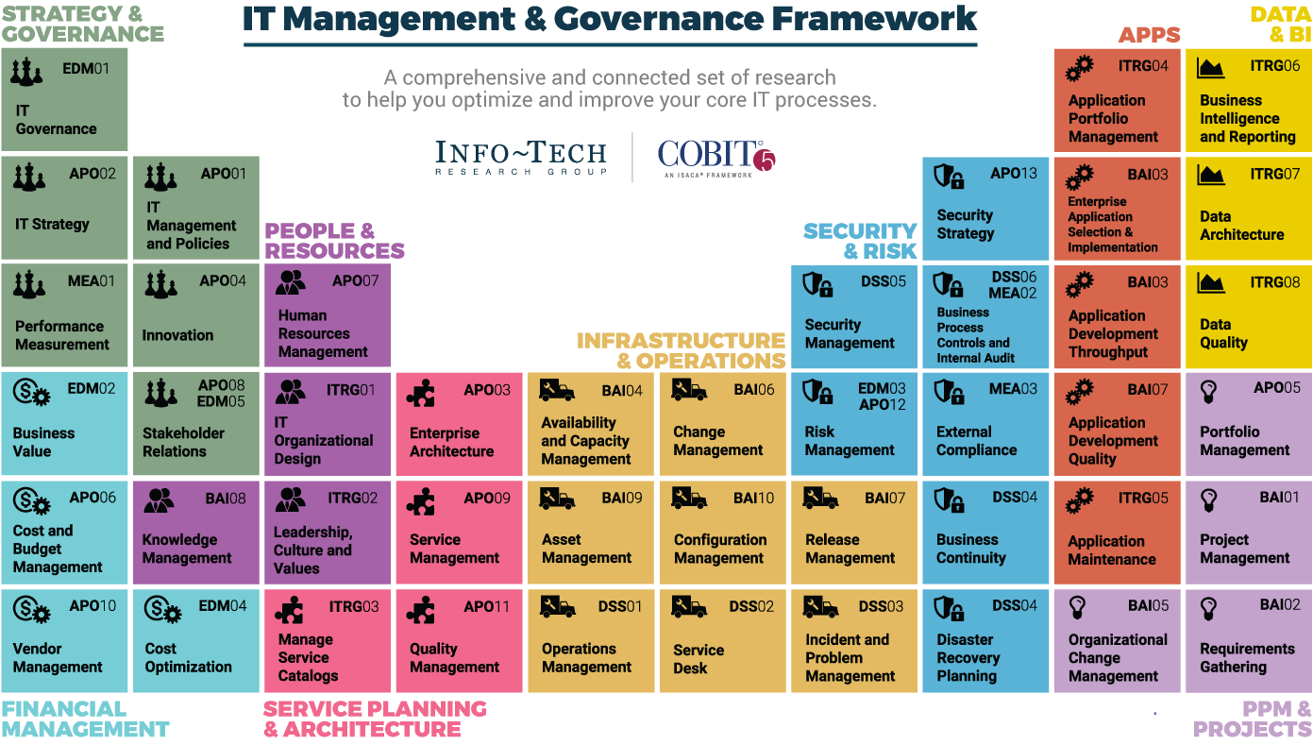
Dive Deeper Into Our Research
by Clicking One of the Elements Below
Find out how Info-Tech makes your job easier. Contact Us Today: Toll-Free (US & Canada): 1-888-670-8889
SAMPLE

