Slide 1
Make Prudent Decisions When Increasing Your Salesforce Footprint
The purchasing transparency that Salesforce once provided has diminished, making it critical to understand licensing methods, and foreshadows compliance audits.
Info-Tech's products and services combine actionable insight and relevant advice with ready-to-use tools and templates that cover the full spectrum of IT concerns.© 1997-2017 Info-Tech Research Group

Slide 2
ANALYST PERSPECTIVE
Keeping up with Salesforce’s ever-evolving offerings is crucial.
Salesforce (SFDC) employs a land-and-expand strategy. Organizations that fail to take an enterprise platform approach to Salesforce have a high risk of overspending.
Understanding licensing methods is crucial in order to make educated and informed purchasing decisions. The correct licensing will enable each IT service line to accurately predict costs over the full subscription lifecycle.
Salesforce’s partner network is expanding and the company has a growing number of acquisitions that impact its product offerings. These factors make understanding what to purchase increasingly complex and overwhelming.
Scott Bickley
Senior Director, Vendor Practice Info-Tech Research Group

Slide 3
Our understanding of the problem
CIOs, CTOs, CPOs, and IT directors negotiating licensing agreements, looking to match spend with “best fit” SFDC functionality.
IT managers scoping their Salesforce software requirements.
ITAM/software asset managers looking for a better way to track and manage Salesforce licensing.
IT and business leaders seeking to better understand Salesforce licensing that has already been purchased.
Understand and simplify product licensing options to help optimize spend.
Ensure the appropriate contract type is selected.
Navigate the purchase process to negotiate from a positon of strength.
Understand the future of the cloud in your Salesforce licensing roadmap.
Manage licenses more effectively to avoid non-compliance as Salesforce can require immediate true-up for exceeding system limits.
CFOs and the finance department
Vendor management departments
Enterprise architects
Organizations examining a move to the cloud
Understand the SFDC sales cycle and the best approach for their organization:
SFDC Business Model
SFDC Agreement – standards and language
Understand the SLA that comes with SFDC licenses

Slide 4
Executive summary
Salesforce has a vast, ever-growing portfolio of products, which can make it difficult to match with business requirements.
Salesforce uses a land-and-expand sales model coupled with its per-user licensing, creating the perfect set-up for shadow IT. Organizations that fail to take an enterprise platform approach to Salesforce risk overspending.
Buying power dissipates when you sign the contract. Get the right product for the right number of users for the right term and get it right the first time.
Getting the best price does not assure a great Total Cost of Ownership (TCO) or ROI. There are many components as part of the purchasing process that if not accounted for will lead to unbudgeted spend.
Avoid buyer’s remorse through due diligence before signing the deal. If you need to customize the software or extend it with a third-party add-on, identify your costs and timelines upfront. Plan for successful adoption.
Failure to achieve economy of scale. Too often, organizations neglect to negotiate price holds, do not negotiate deeper discounts as volume increases, or do not realize there are already existing contracts within the organization.
Understanding what to negotiate. Organizations do not know what can and cannot be negotiated, which means value gets left on the table.
Complex integrations. Integrations with other applications must be addressed from the outset. Many users buy the platform only to realize later on that the functionality they wanted does not exist and may be an extra expense with customization.
Centralize purchasing instead of enabling small deals to maximize discount levels by creating a process to derive a cost-effective methodology when subscribing to Sales Cloud, Service Cloud, and Force.com.
Educate your organization on Salesforce’s licensing methods and contract types, enabling informed purchasing decisions. Critical components of every agreement that need to be negotiated are a renewal escalation cap, term protection, and license metrics to document what comes with each. Re-bundling protection is also critical to ensure legacy product rights are protected upon end of life.
Proactively addressing integrations and business requirements will enable project success and the smooth acceptance of regular upgrades that come with a multi-tenant cloud services SaaS solution.

Slide 5
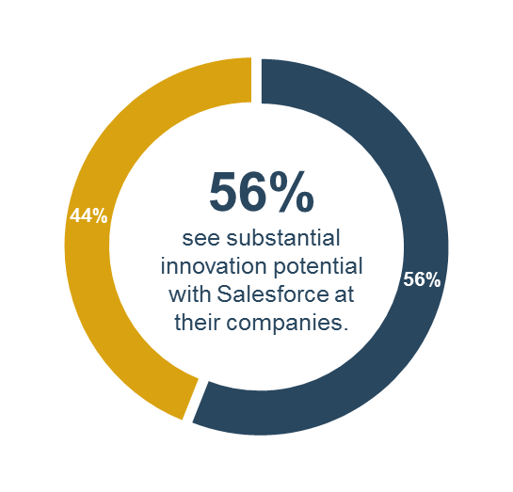
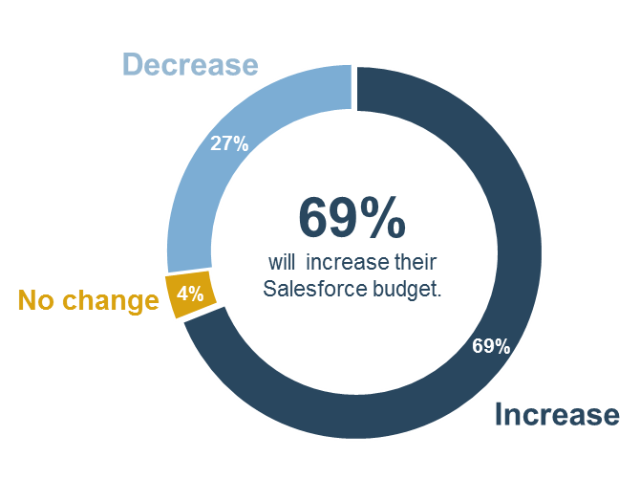
90% of organizations say Salesforce is more valuable to their company today than it was one year ago
Salesforce is only as powerful as the individuals who use it. When components of the process do not operate smoothly, the potential value associated with Salesforce can not be realized. As a result, the largest limitation of Salesforce is not necessarily the complexity of the platform itself but the willingness of an organization to learn and fully integrate it into their operations.
– Trevir Nath, ‎Director of Content at Estimize
Source: Apps Run the World

Slide 6
The aim of this blueprint is to provide a foundational understanding of Salesforce licensing and contracting
Why Salesforce
What to know
Salesforce is being used by many mid to large enterprises for their critical sales, service, and marketing applications.
Salesforce has a large, global client base and provides a broad spectrum of customer engagement products. It has recently made a compelling play into the SMB market with Salesforce IQ and Desk.com.
Salesforce’s platform provides a high degree of extensibility and customization for organizations that need maximum flexibility.
Salesforce has made its product easy to purchase for those outside of the IT function, enabling shadow IT.
Salesforce dominates the sales enablement category with a best-in-class set of tools for lead generation, pipeline management, and post-sales support.
Salesforce is hard to match in the range of CRM solutions it provides across sales, marketing, and customer service.
The Lightning interface provides an outstanding user experience.
The lack of on-premises deployment may be a detraction for organizations with regulatory requirements that prohibit certain data residing in the cloud.
While Salesforce’s enterprise-level CRM portfolio (Sales Cloud, Service Cloud, Marketing Cloud) maintains a premium price tag, its introduction of significantly more affordable solutions like Desk.com have significantly reduced cost barriers to its technology stack for smaller organizations.
Source: Apps Run the World

Slide 7
Salesforce is the 800-pound gorilla in the CRM space
Salesforce.com dominates the software-as-a-service (SaaS) customer relationship management (CRM) space and is a natural choice for many organizations.
Salesforce has taken 40% of CRM market share. More than three times that of Microsoft, IBM, Oracle, and SAP.
Salesforce controls 20% of the broader CRM market overall (sales, marketing, and customer engagement).
Salesforce marketing revenue is growing much faster than the number-two player IBM.
Salesforce is expecting to leverage its system integration partners for the bulk of its professional services responsibility, yielding a revenue mix of 94% subscription sales over the next ten years.
Building a strategic plan for your Salesforce negotiation will help you to:
1
Make sure IT is able to optimize spend with evolving business requirements.
2
Understand Salesforce’s product development and acquisition model.
3
Optimize the speed and quality of decision making by having accurate usage data.
4
Meet regulatory and compliance needs in the external environment.
Source: Bluewolf

Slide 8
Apply best practices when buying or renewing with Salesforce to ensure you are negotiating from a position of strength
Establish Software Requirements
Understand Salesforce’s product offerings.
Examine the competitive landscape.
Learn to look for red flags when beginning or continuing a relationship with Salesforce.
RASCI Chart
Salesforce Licensing Purchase Reference Guide
Evaluate Licensing Options
Understand optimal production licensing models.
Evaluate development licensing.
Assess storage and other system limits.
Salesforce TCO Calculator
Salesforce Discount Calculator
Salesforce Licensing Purchase Reference Guide
Evaluate Agreement Options
Determine terms and conditions to include that may not be standardized.
Review subscription options.
Confirm business situation or goals that may affect your choice of agreement.
Salesforce Terms and Conditions Evaluation Tool
Salesforce Licensing Purchase Reference Guide
Purchase and Manage Licenses
Learn negotiating tactics to enhance your current strategy.
Review Salesforce’s unique compliance approach.
Discover Salesforce partners and implementation options.
Controlled Vendor Communications Letter
Vendor Communication Management Plan
RASCI Chart
Core CRM Project Plan
Salesforce Licensing Purchase Reference Guide
Useful for first-time buyer or renewal customers.

Slide 9
Key success metrics for Salesforce licensing
Preventative practices can help find measured value ($).
Complex integrations
Decentralized purchasing
Time and resource disruption to find workarounds
Rebundling protection
Cost of extra licensing (i.e. Sandboxes)
Term protection
Lost discount percentage
Renewal escalation cap
Improved terms and conditions
Incorrectly licensed users

Slide 10
Due diligence is the best cost-saving practice
CASE STUDY
Industry
Source
Finance
Anonymous
Situation
ABC Corp, a global entity, was using multiple CRM systems. This made consistent reporting standards and relationship management difficult across business operations. Support costs were high due to the multitude of platforms being used and integrations were often very costly or impossible.
Complication
To reduce costs, minimize the complexity of integrations, and enable a more user-friendly platform, ABC launched an initiative to move to a single CRM system. Salesforce was one of the solutions under consideration, as some entities were already using the platform. Based on ABC’s requirements, scalability for the size of the organization was critical. The ability for collaboration across the global organization from a sales and service platform was necessary for lifecycle management purposes as was the ability for integration of customers’ data in one place and ease of use without the need for complex programming. Negotiating a large and highly complex deal with Salesforce posed another challenge and ABC wanted to maximize its negotiating position.
Resolution
After a lengthy due diligence process, ABC selected Salesforce as the option that best suited the organization’s needs. It conducted a user-needs analysis and broke down which editions, user licenses, and add-ons were needed. Negotiations occurred close to Salesforce’s end of year, when the organization was able to get an additional discount percentage, capped renewal increases, and negotiated for extra licensing rights and add-ons. Integrations were addressed early on to avoid cost increases and surprises later as Salesforce was rolled out to the global organization.

Slide 11
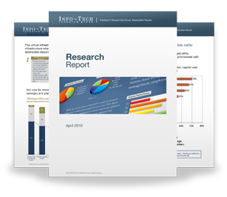
Info-Tech Research Group Helps IT Professionals To:
Quickly get up to speed with new technologies
Make the right technology purchasing decisions – fast
Deliver critical IT projects, on time and within budget
Manage business expectations
Justify IT spending and prove the value of IT
Train IT staff and effectively manage an IT department
Sign up for free trial membership to get practical
solutions for your IT challenges
“Info-Tech helps me to be proactive instead of reactive – a cardinal rule in a stable and leading edge IT environment.
- ARCS Commercial Mortgage Co., LP
Toll Free: 1-888-670-8889
www.infotech.com

