Slide 1
APT10 & Operation Cloud Hopper – Exposing a Global Cyberespionage Campaign
A brief research note for Info-Tech’s members.

Slide 2
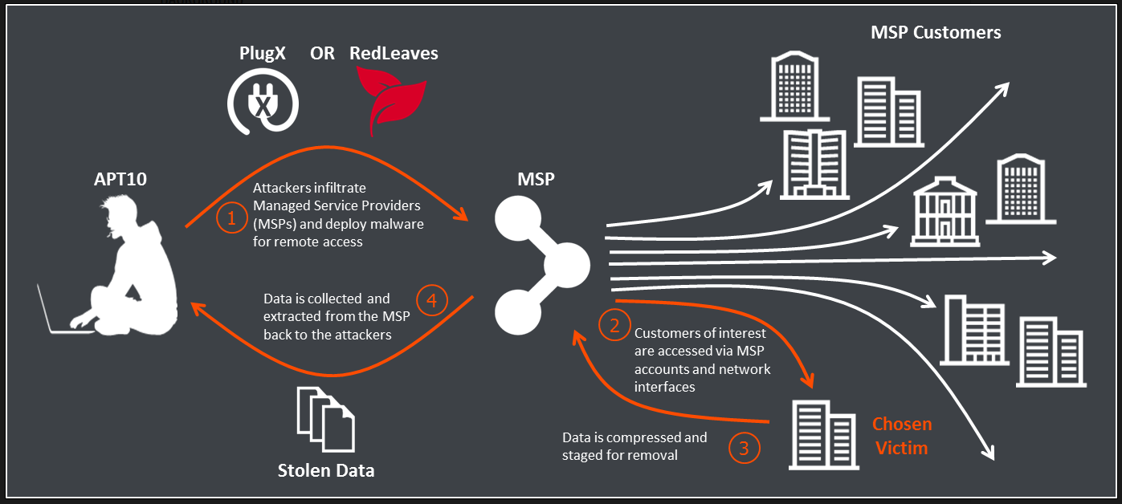
The facts about Operation Cloud Hopper
A China-based threat actor, otherwise known as APT10, has been targeting and exfiltrating sensitive data from managed IT service providers (MSP) and affiliated clientele.
1
APT10 has been operating since 2014, historically targeting construction, engineering, aerospace, telecom, and government industries in Canada, Brazil, France, Norway, Finland, Switzerland, South Africa, the United States, Australia, Japan, and India.
The compromise of MSP networks has provided broad access to MSP customer networks. APT10 leverages low-profile infrastructure from which it obtains legitimate credentials to access the client networks of MSPs and exfiltrate sensitive data.
2
3
APT10 has been documented leveraging custom malware. These threats can easily bypass traditional signature-based protection. The payload itself is delivered through traditional spearphishing email methods but has the potential to spread laterally to MSP clientele.
The command and control infrastructure used for Operation Cloud Hopper is predominantly dynamic-DNS domains, which are highly interconnected and link to the threat actor’s previous operations. (For a full list of domain IOCs, please refer to the appendix.)
4
Source: Bae Systems Threat Research Blog

Slide 3
Best practices moving forward
The compromise of a single MSP can provide access to multiple client-facing networks. Such exposure has dangerous implications. Key takeaways include:
Supply Chain Security
Security extends beyond your organization. Ensure your organization has a comprehensive view of your organizational threat landscape and a clear understanding of the security posture of any managed service providers in your supply chain.
Awareness and Training
Conduct security awareness and training. APT10 conducts reconnaissance and executes various spear-phishing campaigns. Teach end users how to recognize current cyberattacks before they fall victim – this is a mandatory first-line of defense.
Defense in Depth
Whether an MSP or not, lock down your organization. Amongst other tactics, control administrative privileges, leverage threat intelligence, utilize IP whitelisting, adopt endpoint protection, implement two-factor authentication, and formalize incident response measures.
Drive Adoption
Use this release as leverage to create organizational situational awareness around security initiatives and to drive adoption of foundational security measures: network hardening, threat intelligence, red-teaming exercises, and zero-day mitigation, policies, and procedures.
Block Indicators
Information alone is not actionable. A successful threat intelligence program contextualizes threat data, aligns intelligence with business objectives, and then builds processes to satisfy those objectives. Actively block indicators and act upon gathered intelligence.
See Info-Tech’s materials to address these issues

Slide 4
Immediate actions that you can take
Do not wait on vendors to update their security.
Action | Managed Service Provider | End User
Assess Your Exposure | Determine your exposure and the potential risk implications. Conduct internal scans for relevant IOCs. Complete the necessary due diligence to proactively mitigate security risks both in the short term and long term.
Block Indicators | Contact your network administrator to block all relevant indicators within applicable email/network gateways. Where specific vulnerabilities are identified, use risk assessment processes to determine the priority for remediation. Leverage network segmentation to restrict privileges and access to sensitive data. Adopt behavioral-based security controls that leverage next-gen capabilities such as machine learning to better detect and combat threats. | Search your organization’s infrastructure for APT10 indicators. Identify whether malware has transitioned laterally into your environment. Enterprises can demand proof of change from vendors by asking for evidence such as records of change, patches deployed, etc. Segregate all supplier connections into separate virtual local area networks. Force traffic through known monitored routes that have security controls such as firewalls, DLPs, and IDPSs.
Communicate | Send internal alerts to educate employees on APT10 and spear-phishing campaigns. Deliver internal security training sessions on Operation Cloud Hopper to foster organizational situational awareness. Send external alerts to clientele; proactively address any efforts undertaken to combat the threat. | Schedule regular cadence meetings with your managed service provider to discuss Operation Cloud Hopper and the corresponding security measures undertaken to combat it. Coordinate a meeting to discuss security-specific SLAs within your MSP contract. Share this intelligence and actively collaborate with your MSP to manage any potential risk.
Drive Security Strategy and IR | This is a good opportunity to review your security strategy and program and ensure that defense-in-depth practices are in place where possible, including formalized incident response procedures. Leaks that get mainstream media attention are always a good opportunity to demonstrate the importance of security to the board. “Don’t let a good crisis go to waste!”
Leverage Threat Intel | Review your threat intelligence program (or if there is none, refer to Info-Tech for guidance) and ensure that IOCs are being consumed and actioned. Timely intelligence can give you a crucial head start against threat actors.

Slide 5
Maintain a holistic security program
Operation Cloud Hopper is a good reminder that security threats are often unknown and unpredictable. The only way to maintain effective defense is through a comprehensive and flexible security program.
Prevent: Defense in depth is the best approach to protect against unknown and unpredictable attacks. Effective antimalware, diligent patching and vulnerability management, and strong human-centric security are essential.
Detect: There are two types of companies – those who have been breached and know it, and those who have been breached and don’t know it. Ensure that monitoring, logging, and event detection tools are in place and appropriate to your organizational needs.
Prevent
Detect
Analyze: Raw data without interpretation cannot improve security and is a waste of time, money, and effort. Establish a tiered operational process that not only enriches data but also provides visibility into your threat landscape.
Respond: Organizations can’t rely on ad hoc response anymore – don’t wait until a state of panic. Formalize your response processes in a detailed incident runbook to reduce incident remediation time and effort.
Analyze
Respond

Slide 6
Consult an Info-Tech analyst to discuss Operation Cloud Hopper
Each MSP provides direct access to a variety of client-facing networks and infrastructure. One breach can create widespread exposure and place your organization at risk.
Assess the risk posed by third-party relationships. Actively collaborate with your MSP to not only address their security infrastructure but also yours.
If you are not communicating, then you are not secure.
TJ Minichillo Senior Director – Security, Risk & Compliance Info-Tech Research Group
Edward Gray Consulting Analyst – Security, Risk & Compliance Info-Tech Research Group
When discussing with MSPs, address whether or not they provide adequate security measures:
What technical controls and processes do they have in place?
Is internal security awareness and training practiced?
Are there access control policies in place?
What is the process in the event of a data breach?
Call 1-888-670-8889 or email GuidedImplementations@InfoTech.com for more information.

Slide 7
Use this opportunity to conduct a security program evaluation
Leverage Info-Tech’s various security blueprints:
Effective information security management will help you:
Enhance your organizational security posture
Risk reduction
Enhanced compliance management
Improved organizational situational awareness
Build an Information Security Strategy
Create and clarify accountability and responsibility
Formalized role and process responsibility
Enhanced internal and external communication
Develop a Next-Gen Security Operations Program
Control security costs
Incident reduction
Streamlined security operations processes
Strategy alignment
Integrate Threat Intelligence Into Your Security Operations
Identify opportunities for improvement
Defined measurement programs
Defined opportunities for continuous improvement
Improve threat protection
Intelligence-driven security operations process
Optimized patch management program
Improved effectiveness of internal controls
Standardized operational use cases
Humanize the Security Awareness & Training Program

Slide 8
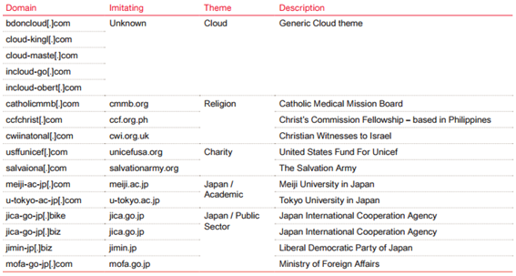
Appendix: Indicators of Compromise
Indicators of compromise (IOCs) represent the artifacts left by an intrusion. IOCs can enable the detection of additional activities conducted by threat actors.
Over 70 variants of backdoor were leveraged in Operation Cloud Hopper. Some of the more prominent threats include:
1
Haymaker: A backdoor that can download and execute additional payloads in the form of modules.
2
BUGJUICE: A backdoor that is executed by launching a benign file and then hijacking the search order to load a malicious dll (dynamic-link library) into it.
3
SNUGRIDE: A backdoor that communicates with its C2 server through HTTP requests.
Information alone is not actionable. Indicators of compromise can be useful as a tool, but they are not the standalone solution to your threat intelligence problems.
For a comprehensive list of indicators, please visit PwC’s Threat Alert

