Slide 1

Select and Implement an Enterprise Content Management Solution
Understand the ECM vendor market, make an informed decision, and take a bottom-up, process-based approach for an agile solution implementation.

Slide 2


ANALYST PERSPECTIVE
Understand the market, but don’t forget your organizational needs and culture.
Enterprise content management (ECM) platforms are a key component in the digital transformations taking hold in organizations everywhere. When deployed and managed properly, ECM provides a foundation on which to build out advanced information capabilities.
ECM projects often appear smaller than they turn out to be. The biggest mistake made during an ECM implementation is not designing and configuring to architectural and governance standards before rolling capabilities out to user communities. Without this planning, sins of the past are often repeated.
Following Info-Tech’s bottom-up, process-based approach to ECM avoids these costly pitfalls and ensures the right solution is adopted and configured in accordance with agreed upon standards, thus ensuring the quality of one of the most critical assets an organization has – its information.
Ryan Smith
Associate Director, Information Management Practice
Info-Tech Research Group

Slide 3
Stop! Are you ready for this project?
IT teams tasked with exploring the ECM vendor market and making recommendations.
Business units going into the selection or early implementation phases of an ECM technology project.
Organizations looking to review or change a specific component of their ECM platform.
Understand the ECM market of today, including functionality and vendor performance.
Follow best practices to gather requirements and assess your organizational needs through a use-case lens.
Structure the selection stage of your project, including vendor interactions.
Follow a bottom-up, process-based ECM implementation methodology.
ECM project team or working group tasked with managing an RFP process for vendor selection.
ECM project team or working group tasked with implementing the ECM solution in the organization.
ECM architects, developers, and administrators tasked with configuring ECM solutions in accordance with stakeholder needs.
Draft an RFP, manage the review process, and select a vendor.
Introduce ECM capabilities through an Agile methodology (i.e. minimum-viable solutions) with alignment to the organization’s greater ECM program vision.
Follow best practices when designing systems, sites, taxonomy, naming conventions, metadata, policies, etc.

Slide 4
Executive summary and problem definition
Organizations everywhere are transforming their information management practices, and look to introduce or update enterprise content management (ECM) solutions as a foundational piece.
The ECM market is confusing and there is a need to disambiguate the players, shortlist and evaluate solutions, and arrive at a vendor decision.
ECM is a key piece of digital transformation. Quality information provides a foundation for innovation.
Plan ahead or the sins of the past will be recreated. Without carefully planned architecture, governance, and management, users will resort to the way they’ve always done things.
ECM technology on its own is not enough. To truly realize the benefits of ECM on an on-going basis, a program is needed to manage it as a capability.
ECM technology is in a mature and saturated market, but not all solutions compare equally and understanding the nuances is a daunting task.
ECM ends up serving many different use cases across the organization; coordinating and satisfying all these needs requires a structured approach.
Organizations often underestimate the effort involved with content transformations and attempt to roll out to too many areas at once.
Understand where you want to go by setting an ECM program vision aligned to your organization’s greater enterprise information management (EIM) vision, and by structuring your ECM selection and implementation project accordingly.
Align your ECM solution selection to the organization’s broader ECM/EIM system architecture (including network drives, other content management products, data architectures, and enterprise or LOB applications).
Explore the ECM vendor market through a use-case lens and benchmark performance of key functions to make an informed decision about requirements and priorities.
Structure and conduct due diligence activities when evaluating solutions in order to validate vendors’ claims during the selection process and arrive at a confident vendor selection.
Implement the ECM program gradually and in a way that avoids common pitfalls, overcomes resistance to change, and minimizes the need for costly re-work by following Info-Tech’s bottom-up, process-based approach for ECM.

Slide 5






Understand how content management technology has evolved to continuously drive organizational efficiencies
Vendor consolidation and functional integration helps organizations transform work from ad hoc to managed, person to process, and paper to paperless.
 | The Age of Productivity Pockets |  | The Age of Enterprise Information Management
 | Content imaging, workflow, document management, and records management available as standalone products and deployed as point solution for individuals or teams. |  | End-to-end ECM solutions with process automation, integration capabilities, and cheaper scalability provide the technological foundation for enterprise-wide content management programs.
 | 1980s & 1990s |  | Today
 | 4 | 4 | 4 | 4
 |  | 2000s & 2010s |  | Tomorrow
 |  | Emergence of collaboration and process management functionality provides full information lifecycle management capabilities deployed at content domain, process, or departmental levels of organizations. |  | Enhanced options for integration and process management and automation will continue to see more processes digitized (made paperless) and managed within centralized ECM platforms across organizations.
 |  | The Age of Siloed Information Management |  | The Age of Digital Information Management

Slide 6
Today’s ECM technology market booms as organizations transform, unleashing the power of their information assets
ECM Technology Adoption (2016)
ECM Technology Market Growth
Of organizations with an ECM platform…
$66.27B
72%
use a general purpose, single-vendor solution, including 20% that rely on out-of-the-box functions, 29% that leverage supplemental add-ons, and 23% with additional customization.
$59.87B
$28.10B
13%
have an integrated set of ECM best-of-breed components.
$24.62B
13%
manage content through an in-house developed solution (10%) or a sector-specific supplier (3%).
Source: MarketsandMarkets (2016)
The ECM market will double by 2021.
The global ECM market has grown 14% in the past year and is forecasted to grow an additional 136% in the next five years at a compound annual growth rate (CAGR) of 18.7%.
Process functionality is top spending area.
AIIM identifies the top five ECM product spends as:
Getting beyond network drives…
At the same time, network drives remain a dominant piece of ECM system architectures for 53% of organizations in 2016 (down from 62% in 2015).
However, improving collaboration and mobile or remote access to information is a key focus area for 51% of organizations in 2016, and ECM platforms will be a major part of attaining these goals.
Workflow/BPM
Content Analytics/Big Data
Universal Search
Cloud Services
Email Management
Source: AIIM (2016)

Slide 7
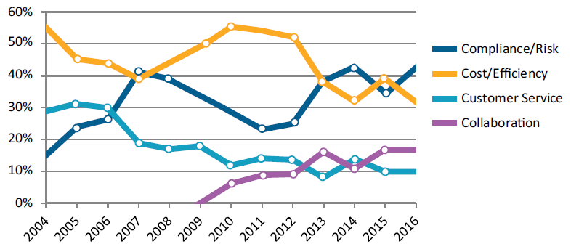
Organizations get the most out of their ECM technology investments by deploying them as part of a larger program
ECM Program Adoption (2016)
ECM Program Drivers
AIIM tracks the four primary drivers of ECM adoption to show how these change over time.
As of 2016…
Enterprise (5,000+ employees) and mid-size (500-5,000 employees) organizations have elevated compliance and risk to the number one ECM driver position.
Smaller organizations (<500 employees) keep cost and efficiency in the top two spot overall, with 40% stating it is the number one driver.
Improving ECM functionality is the number one project focus in 2016…
AIIM indicates the remaining top project focuses include:
85%
of organizations have either recently completed an enterprise-wide ECM capability or are actively engaged in ECM program development.
No capability, no plans
Looking to replace existing capability
Planning capability within next 18 months
Completed an enterprise-wide capability
Rolling out siloed capabilities
Rolling out enterprise-wide capability
Integrating capabilities across siloes
Putting the Enterprise in ECM…
79% of organizations claim that they still have room to grow when it comes to their ECM programs, either by enhancing existing capabilities or extending these capabilities to other areas of the organization.
Digitizing Paper Processes
Introducing or Enhancing Collaboration
Rolling Out to More Users
Integrating ILM Functionality
Source: AIIM (2016)

Slide 8

Organizations measure ECM project success across process efficiency, resource efficiency, and risk mitigation metrics
In its own right, ECM plays an important role in running an intelligent, efficient, and lean organization.
ECM Process Efficiency
ECM Resource Efficiency
ECM Risk Mitigation
73% of knowledge workers waste time looking for files. 47% of knowledge workers have worked on the wrong document. | 40% of organizations report lowering costs and improving IT efficiency as the number one driver for ECM. | 33% of organizations report compliance and risk as a critical driver for ECM.
Pains: Unable to find content; recreating content Manually indexing content Manually routing content through workflows Inaccurately stored content Print → Sign → Scan processes | Pains: IT time spent managing storage environments Redundant, outdated, and trivial content stored in repositories | Pains: Non-compliance fees Storing content beyond retention periods; litigation exposure Litigation discovery time and cost Off-brand content
Gains: Automated content indexing Faster content retrieval Digital workflows Just-in-time content delivery Faster collaboration and creation Improved employee experience | Gains: Reduced network demand Reduced storage consumption Optimal storage and archival media Resources reallocated to more innovative pursuits | Gains: Standard designs, naming conventions, and terminology Reduced litigation risk Automated and defensible content disposal eDiscovery
Harris Interactive, 2012
AIIM, 2015
AIIM, 2015
Leverage the benefits to sell information improvement initiatives to the organization. Whether you are embarking on ECM as a stand-alone initiative, as part of a broader transformational effort, or as some place in between, the positive impacts of ECM can be used to gain executive buy-in and organizational support. On its own, front-load digital transformation or knowledge management projects with ECM work to unlock quick wins.

Slide 9
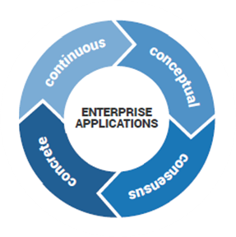
Follow Info-Tech’s methodology for selection and implementation
Prior to embarking on the vendor selection stage, ensure you have set the right building blocks and completed the necessary prerequisites.
Follow Info-Tech’s enterprise applications program that covers the application lifecycle from the strategy stage, through selection and implementation, and up to governance and optimization.
The implementation and execution stage entails the following steps:
Define the business case.
Gather and analyze requirements.
Build the RFP.
Conduct detailed vendor evaluations.
Finalize vendor selection.
Review implementation considerations.
1
2
3
4
5
6
A critical preceding task is developing a strategy that makes the case for the ECM procurement and creates alignment with corporate objectives. Use the ECM Readiness Assessment Checklist to ensure you have completed the necessary steps.

Slide 10
Use Info-Tech’s ECM technology framework to understand how ECM features apply across the information lifecycle
Table stakes represent the minimum standard all ECM platforms offer, while advanced features can vary widely by vendor in terms of availability, quality, and applicability to the information lifecycle.
Information Lifecycle Model for ECM Technology:
Table Stakes
Advanced Features
Generate
Capture
Deliver and Utilize
Manage and Retire
Metadata Mgmt.
Retention Mgmt.
Structured Collab.
Library Services
Basic Workflows
Document Imaging
Format Conversions
Version Controls
Version Controls
Access & Permissions
Format Conversions
Access & Permissions
OCR/ICR
Multimedia and Email Capture
Process & Workflow
Case Mgmt.
Defensible Disposal
Real-Time Collab.
eSignatures
Custom Views
eForms
Auto-Indexing
eDiscovery
Content Analytics
External Sharing
Advanced Search
Mobile Experience
Content Analytics
Mobile Experience
Content Analytics
Content Analytics
Please note: Different ECM features (such as document or records management and content capture) are displayed here in their component parts.

Slide 11






Understand how the ECM strategy fits into a greater information management practice aligned to your vision
Enterprise Information Management (EIM) Hierarchy of Organizational Information Capabilities:
Information Capabilities:
Organizational Impact:
Cognitive Operations
“automate optimal decisions”
Operational automation powered by artificial intelligence (predictive analytics, machine learning, neural networks, etc.). Advanced technologies build on top of derived templates, algorithms, heuristics, processes/workflows, and insights to discover, analyze, and take action.
Organizational planning, decisions, and processes informed by the best available information and supported by software-assisted automation. Business intelligence reports and dashboards are automatically compiled and displayed to the right people at the right time. System integration provides seamless experience across technologies, and act to automate processes and workflows.
Organizational planning, decisions, and processes supported by system and information architecture designs that drive just-in-time information findability and accessibility. Processes are evaluated for and re-engineered as necessary to fit with the ECM platform.
Organizational information assets (data and content) are managed to quality standards (accurate, complete, clean, consistent, current, etc.) at each stage of the information lifecycle (i.e. generate, capture, deliver and utilize, and manage and retire).
Transformational ECM
Intelligent
Operations
“make optimally informed decisions”
Information
Management
“provide quality information at the right time”
EIM Program Vision
EIM Engine:
Information Lifecycle
Management
Enterprise
Content Management
Foundational ECM
Enterprise
Data Management

Slide 12
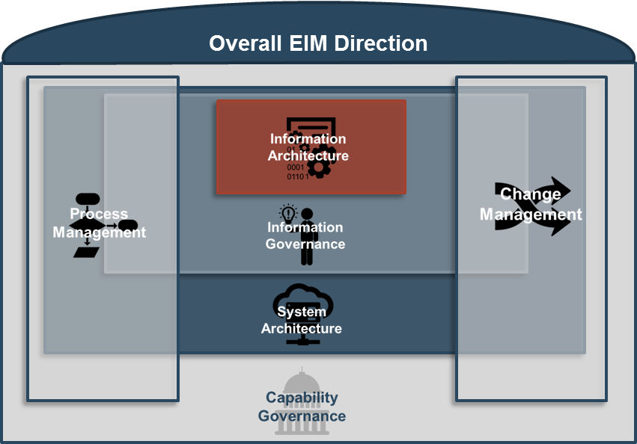
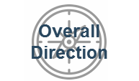

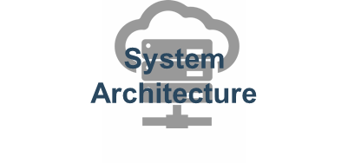
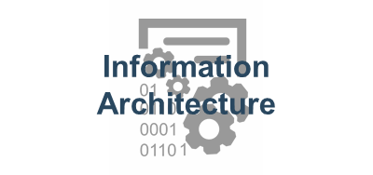

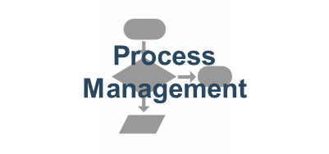
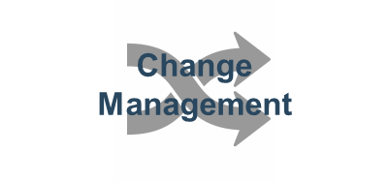
Enable an effective ECM program by mastering seven program planning areas – the seven sub-disciplines of ECM
ECM programs are built by addressing the seven sub-disciplines of ECM that organizations must consider, make decisions around, and manage on an on-going basis.
Info-Tech’s ECM Program Framework:
ECM Area | Description | Key Metric | Guiding Principles
 | Unifies ECM sub-projects to a common, executive-backed vision and mission. | Buy-In for Vision | Drive towards meaningful stakeholder benefits. Gaining the organizational buy-in for ECM is a function of aligning your vision and mission to stakeholder needs.
 | Establishes the bodies, roles, and responsibilities to sustain and improve the ECM program. | Organizational Structural Supports | Governance drives higher-order benefits. The degree to which you will realize your ECM vision is dependent on the degree of governance you’re willing to put in place.
 | Empowers users with optimal ECM functionality and seamless experiences. | Completeness & Seamlessness | Drive towards system simplicity. The complexity of an ECM system directly relates to the amount of planning, governance, and change management required – not to mention contracts to manage.
 | Enables intuitive and easy-to-use user experiences. | Information Findability | Design is only half the battle. Past a certain point, improving design alone will not realize the benefits expected; you must also be prepared to govern to the architectural standards.
 | Ensures quality standards across the information lifecycle. | Standards Compliance | IG is the necessary evil in ECM. If you don’t set up rules (and revise them over time), you aren’t able to set expectations for content users or managers; ad hoc or unmanaged ECM operations will prevail.
 | Optimizes delivery of information for processes, workflows, and decisions. | Process Efficiencies | Move towards transformational ECM by moving away from black-box solutions. Higher-order ECM benefits can’t be achieved by following the basic ECM solutioning approaches; you need to build process-up.
 | Onboards new users to ECM and facilitates program changes. | Program Extensibility | Change management is insurance for the ECM program. Even the most well-conceived architecture and governance plans will fail if users don’t understand them and if they aren’t periodically reviewed for improvements.
Info-Tech defines an organization’s ECM capability as a program comprised of seven inter-related sub-disciplines that work together to enable superior content access and delivery to an organization in support of processes and decision making.

Slide 13
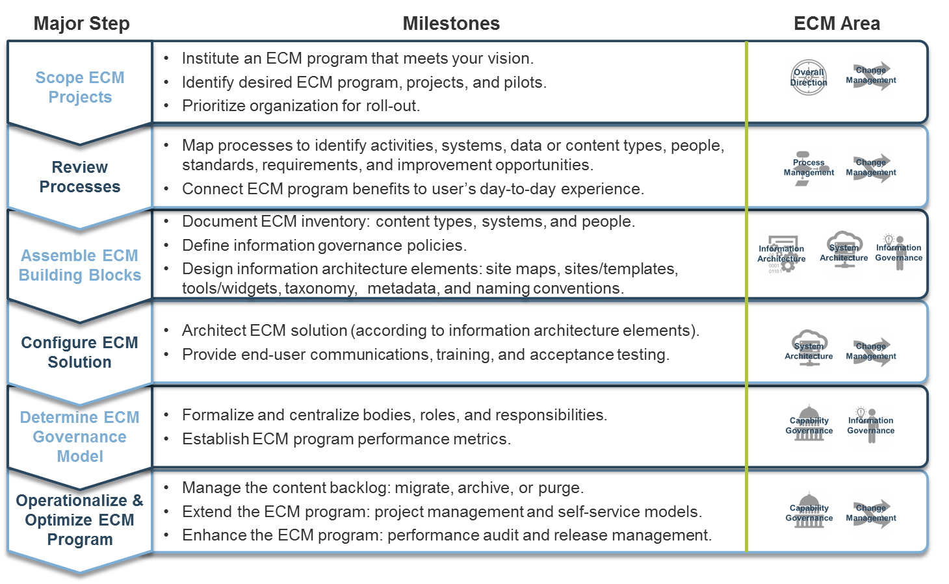
Successfully implement your ECM platform and program following Info-Tech’s bottom-up, process-based approach
Take an agile, systematic approach to working through each of the seven sub-disciplines of ECM by following these six pragmatic steps.

Slide 14


A US credit union takes the bottom-up, process-based approach to inform organization-wide ECM platform selection
CASE STUDY
Industry
Source
Banking
Info-Tech Research Group
Challenge
Solution
Results
State Department Federal Credit Union (SDFCU), a credit union located in the eastern United States, had a legacy check imaging system that needed to be replaced. Working together with IT, its deposit and check operations team brought in a new ECM system to help replace and improve the check imaging process. Given the gains experienced by users of the new system, SDFCU decided to embark on an initiative to migrate all content operations to a new system.
SDFCU needed expertise in the most current concepts of ECM. IT needed a systematic, yet user-friendly approach to determine requirements for an ECM system and the capability to support it.
SDFCU engaged Info-Tech Research Group to facilitate a week-long workshop with stakeholder groups with the goals of educating users on the concept of ECM, collecting their system requirements, and identifying process and capability governance improvements that would act to ensure future system investments.
Info-Tech met with each of SDFCU’s 17 departments to conduct the ECM footprint and information lifecycle assessments following Info-Tech’s bottom-up, process-based approach. Sessions were between 2 and 3 hours each and included representation from all staff levels.
Working with IT, Info-Tech consolidated and summarized current operations in graphic form and in an improvement opportunity register. ECM improvement opportunities were translated into recommendations for process and governance improvements, as well as an RFP to clearly articulate technology requirements to the vendor audience.
Empowered by a framework for understanding ECM and detailed requirements, SDFCU was able to enter into vendor negotiation confidently, while IT had clear next steps to work on from a process and governance standpoint.

Slide 15


Use this blueprint to support your ECM selection and implementation
Launch the ECM Project and Collect Requirements
Phase 1
Benefits
Use the project steps and activity instructions outlined in this blueprint to streamline your selection process and implementation planning. Save time and money, and improve the impact of your ECM solution by leveraging Info-Tech’s research and project steps.
Select an ECM Solution
Phase 2
Use Info-Tech’s ECM Vendor Landscape contained with Phase 2 of this project to support your vendor reviews and selection. Refer to the use-case performance results to identify vendors that align with the requirements and solution needs identified by your earlier project findings.
Plan Your ECM Implementation
Phase 3
Not everyone’s ECM needs are the same. Understand your organization’s various ECM operations, set a specific scope within this, and work with stakeholders to identify the architectural, governance, and management standards that will guide system selection and implementation in alignment to a greater ECM program.

Slide 16
Identify milestones for each of the three stages to track your progress
Launch the ECM Project and Collect Requirements
Phase 1
Align the ECM program and platform vision with corporate objectives.
Contextualize the ECM platform in the greater enterprise information system architecture.
Structure your ECM selection and implementation project.
Understand the ECM use cases in play across your organization.
Gather and document ECM requirements from different stakeholder groups.
Create the request for proposal (RFP).
Select an ECM Solution
Phase 2
Identify a shortlist of ECM vendors for further evaluation.
Submit RFP to shortlisted vendors.
Evaluate vendor responses.
Develop vendor demonstration scripts.
Score vendor demonstrations.
Select the final product.
Develop an ECM implementation plan.
Design ECM architectural, governance, and management standards.
Determine organizational structures to establish and govern ECM to standards.
Configure ECM solution in accordance with planned standards.
Determine project metrics to measure and track success.
Plan Your ECM Implementation
Phase 3

Slide 17
Info-Tech walks you through the following steps to help you to select your ECM solution
1.3 Gather requirements and document architecture
3.1 Create product specific architecture
1.1 Understand ECM technology
2.1 Analyze vendors in the ECM market
3.1 Plan configuration and deployment
1.1 Assess organizational readiness
3.1 Create governance plan
2.1 Shortlist vendors
2.2 Select your vendor
3.1 Develop ECM deliverables
2.1 Conduct a proof-of-concept and evaluate vendor solutions
1.2 Structure your project
3.2 Evaluate project metrics
Locate your starting point in the research based on the current stage of your project.
Milestones
Effort
Importance
Phase
Low
Average
Launch Your Project
Select Solution
Get Ready to Implement Solution
Greater
Major Milestone
High

Slide 18




Info-Tech offers various levels of support to best suit your needs
Guided Implementation
DIY Toolkit
Workshop
Consulting
“Our team has already made this critical project a priority, and we have the time and capability, but some guidance along the way would be helpful.”
“Our team knows that we need to fix a process, but we need assistance to determine where to focus. Some check-ins along the way would help keep us on track.”
“We need to hit the ground running and get this project kicked off immediately. Our team has the ability to take this over once we get a framework and strategy in place.”
“Our team does not have the time or the knowledge to take this project on. We need assistance through the entirety of this project.”
Diagnostics and consistent frameworks used throughout all four options

Slide 19



Select and Implement an ECM Solution – project overview
1. Launch the ECM Project and Collect Requirements
2. Select an ECM Solution
3. Plan Your ECM Implementation
Best-Practice Toolkit | 1.1 Market overview 1.2 Structure the ECM S&I project ECM Select and Implement Project Charter Template 1.3 Gather ECM requirements ECM Use-Case Fit Assessment Tool ECM Solution Requirements Template ECM RFP Template | 2.1 Analyze and shortlist ECM vendors ECM Vendor Shortlist & Detailed Feature Analysis Tool 2.2 Evaluate ECM vendor responses ECM Vendor Response Template ECM Vendor Demo Script Template ECM Vendor RFP Response Scoring Tool | 3.1 Develop and execute implementation plan ECM Work Breakdown Structure Template ECM Inventory and Audit Tool Information Governance Templates ECM Taxonomy Designer Tool ECM Metadata Schema Designer Tool 3.2 Evaluate your project metrics Project Metric Tracking Tool
Guided Implementations | Identify organizational fit for ECM. Create the project plan. Plan requirements gathering steps. | Discuss the use-case fit assessment results and the Vendor Landscape. Contract review. | Create an implementation plan. Discuss roll-out of processes and hand-over to operations.
Onsite Workshop | Module 1: Launch of Your ECM Selection Project | Module 2: Plan Your Procurement and Implementation Process
 | Phase 1 Outcome: Launch your ECM selection project Develop your organization’s ECM requirements | Phase 2 Outcome: Select an ECM solution | Phase 3 Outcome: Create a plan for implementing the selected ECM solution Build metrics tracking plan

Slide 20
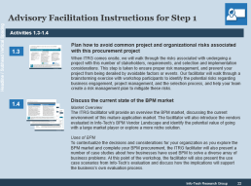
ECM selection workshop overview
Contact your account representative or email Workshops@InfoTech.com for more information.
 | Day 1 | Day 2 | Day 3 | Day 4
Preparation | Workshop Day | Workshop Day | Workshop Day | Working Session
Workshop Preparation Facilitator meets with project manager to review work already completed (goals, strategies, project plans, scope, IT architecture, etc.) Workshop participants from IT and the business are determined. Workshop is scheduled. Logistics and materials are planned. | Morning Session: Workshop introduction and overview of activities. Complete organizational context assessment to level-set understanding. | Morning Session: Gather ECM business requirements from stakeholders (as per scope of workshop) through interviews or focus groups. | Morning Session: Translate business requirements into functional and technical ECM solution requirements. Shortlist ECM vendors. | Morning Session: Meet with project manager to discuss workshop results, action items, and next steps. Present a workshop debrief to seniors and stakeholders.
 | Afternoon Session: Review and finalize project drivers, objectives, and timelines. Determine ECM solution vision and mission statements. | Afternoon Session: Perform ECM use-case assessment. Review use-case results with relevant stakeholders. Review vendor strengths and weaknesses relative to use-case assessment. | Afternoon Session: Determine vendor selection due diligence and timelines. Develop RFP in alignment with selection due diligence. | On-Going Support: RFP response review and scoring. Vendor demo script development, facilitation, and scoring. Client reference check planning, facilitation, and scoring. ECM implementation planning.
The light blue slides at the end of each section highlight the key activities and exercises that will be completed during the engagement with our analyst team.

Slide 21
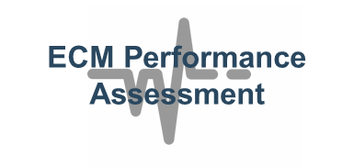
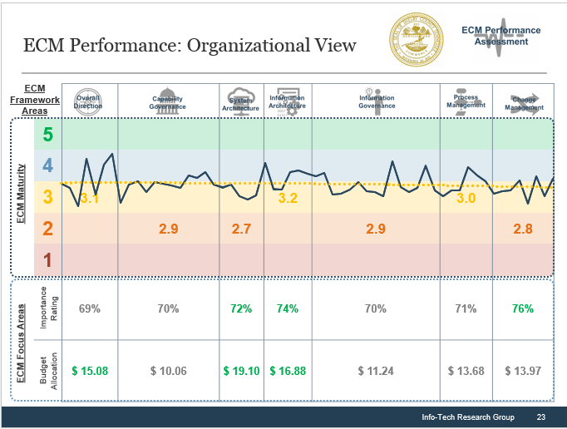
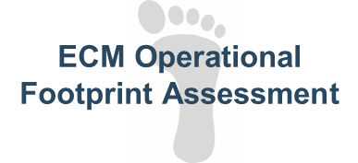
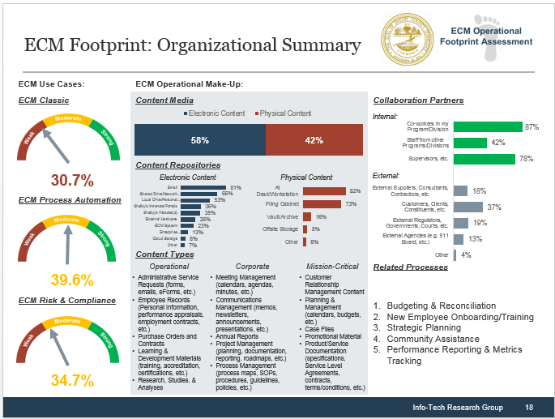

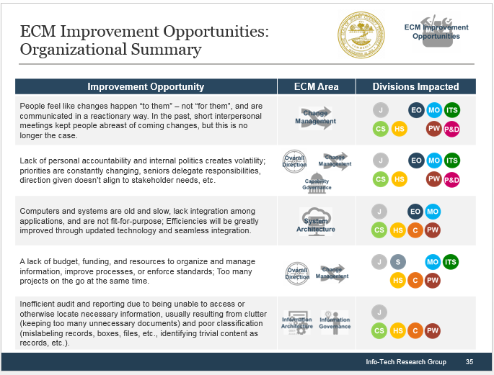
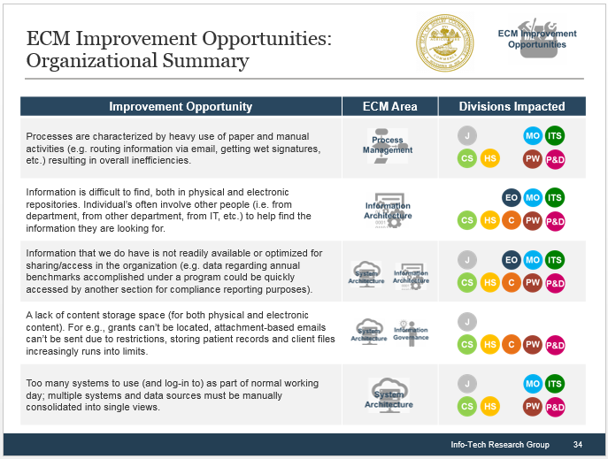
Enhance your ECM workshop experience and quality by completing Info-Tech’s ECM Strategy Diagnostic Survey
Double-down on the value of your ECM workshop with a 20-minute survey deployed to any and all end users within your organization.
View a demo survey
Gain detailed perspectives at organizational and divisional levels for the following:
Understand Your Maturity. Systematically determine a baseline for ECM program performance across 59 metrics.
Inside the workshop, the diagnostic helps to:
Inform richer dialogues with ECM experts.
Maximize data-driven decisions and minimize uninformed opinions.
Accelerate assessment activities and free up more time for executing ECM roadmap work initiatives.
Outside of the workshop, the diagnostic helps to:
Obtain feedback from maximum number of stakeholders.
Provide operational insight for project scoping, requirements gathering, and implementation considerations at organizational and divisional levels.
Calculate your current ECM program maturity.
Discover your ECM operational complexity.
Identify ECM issues and desires for the future.
Define Your Operations.
Identify the use cases, content types and formats, storage locations, processes supported, audiences, etc. present in your organization.
Reveal Improvement Opportunities. Collect end-user issues and desires for the future, and convert into executable action items.

Slide 22
Use these icons to help direct you as you navigate this research
Use these icons to help guide you through each step of the blueprint and direct you to content related to the recommended activities.
This icon denotes a slide where a supporting Info-Tech tool or template will help you perform the activity or step associated with the slide. Refer to the supporting tool or template to get the best results and proceed to the next step of the project.
This icon denotes a slide with an associated activity. The activity can be performed either as part of your project or with the support of Info-Tech team members, who will come onsite to facilitate a workshop for your organization.
This icon denotes a slide that pertains directly to the Info-Tech Vendor Landscape on ECM technology. Use these slides to support and guide your evaluation of the ECM vendors included in the research.

