Slide 1
Create a Winning BPI Playbook
Don’t waste your time focusing on the “as is.” Focus on the improvements and the “to be.”

Slide 2
ANALYST PERSPECTIVE
In today’s competitive environment, it is critical for organizations to have a program in place for continuous process improvement. With the complexity of business operations and increasingly high customer expectations, the need for businesses to reduce waste, find opportunities for improvement, and drive competitive advantage is higher than ever.
In structuring your approach, there are dozens of different improvement methodologies to choose from – a rigid and bureaucratic methodology is not necessarily appropriate. Alternatively, we recommend incorporating elements from several different proven methodologies, such as Lean, Six Sigma, and Organizational Change Management. To increase the success of your BPI program, focus on the right processes, specifically the processes that offer a competitive advantage and are your key differentiators.
Establish a program that is focused on tangible results and empowers your business analysts to successfully implement a business process improvement. This can be accomplished by creating root-cause formulas for your business process and consistently tracking, measuring, and analyzing the results.
Jenna Schroeder,
Senior Analyst, Enterprise Applications Info-Tech Research Group

Slide 3
Our understanding of the problem
Leaders of Business Analyst Teams
Application Managers
IT Managers
IT Directors
Business Analysts
CIOs
Standardize the BPI process and create a common framework for ongoing process improvement projects.
Develop the skills in-house to realize sustainable advantages and continuously improve.
Gain a holistic understanding of your core processes and how they are interrelated.
Business Stakeholders
BPI Decision Makers
Teach business analysts discovery, analysis, design, and implementation procedures that are necessary for any process improvement initiative.
Assess processes prior to any IT transformation and prepare IT and the business for an enterprise application implementation.

Slide 4
Executive summary
Customers are placing greater demands and expectations on organizations. In order for organizations to shift to a customer-centric model, leverage digital business, and remain compliant, they must continuously manage and improve their processes and ensure advantages are sustainable.
Adopt a Forward-Facing Outlook Don’t focus solely on the current state – set improvement targets upfront to drive the initiative.
Identify Root-Cause Variables Break problems down into root-cause variables. Don’t look at the symptom – dive deeper and alleviate the root cause.
Empower Business Analysts Create a practical process improvement methodology that your analysts can follow.
Companies understand the importance of process improvement and recognize the touted benefits: cost savings, waste elimination, and process efficiency. With this said, 70% of companies that embark on process improvement initiatives fail. The high probability of failure is attributed to a number of factors including a lack of continuous improvement and failing to define measurable outcomes.
Develop standard operating procedures for launching a process improvement initiative, discovering a process, analyzing the problem, designing process improvements, and implementing the improvements.
Launch: Kick-off process improvement by identifying the goals and defining the improvement targets.
Discover: Start by performing a stakeholder and document analysis in order to select the appropriate process. Once the team understands the relationship between processes they can begin to map the level-three process using a standard mapping notation.
Analyze: Use qualitative and quantitative techniques for analyzing the root cause rather than the symptoms.
Design: Ensure the design is aligned with the initial improvement targets. Focus on value-added activities.
Implement: Consistently monitor the process and assess the root-cause variables to gauge the success of the process improvements.

Slide 5
Glossary
Lean, Six Sigma, and Process Reengineering: Examples of process improvement methodologies that focus on adopting specific techniques for modeling, analyzing, and designing processes.
Business Process Management Suite (BPMS): Software that automates business processes.
Business Process Model and Notation Version 2.0 (BPMN 2.0): A modeling notation that uses graphical symbols to represent elements of a process.
Swimlane Diagrams: An expanded view of the process that shows the functional role that performs or is responsible for a specific activity.

Slide 6
Business Process Improvement 101
What is a Business Process?
Why do we need processes?
Ensure products and services are consistent and repeatable.
Conform to standards and regulations.
Provide organizational transparency.
Guide business optimization.
What is the benefit of managing and improving processes?
Organizational alignment
Operational controls
Risk management
Process transparency
Performance measurement
Process cost reduction
Process efficiency
A business process is the execution of a sequence of activities that are coordinated to produce a specific output for an internal or external outcome.
Input
Activities
Output
Something brought into the process to make it work.
A sequence of steps.
The result of a process to satisfy an internal or external customer.

Slide 7
Understand the meaning of business process improvement
Business process management (BPM)
is a term used to describe the discipline of process management, and encompasses process improvement, automation, and management.
BPM
Business Process Improvement
Process Automation
Management Discipline
Business Process Improvement (BPI)
Process Automation
Management Discipline
Applying BPI involves assessing an end-to-end process and applying a methodology to determine improvement opportunities. Common methodologies include Lean, Six Sigma, and Total Quality Management.
An approach to improve business processes by integrating disparate systems, automating workflows, and establishing business rules.
Applying BPM principles and methods to manage core business processes and govern the process portfolio. Managing overall business performance. Establishing an organizational commitment to measuring and monitoring processes.

Slide 8
Process improvement may be the answer to solving the top three CEO pain points identified in the CEO-CIO alignment program
Top Three CEO Pain Points
1
IT operating model complexity
2
IT constrains innovation and agility
How Can Process Improvement Help?
3
IT fails to deliver business value
Source: Info-Tech’s CEO-CIO Alignment Program
The Solution
As industries evolve and adopt more tools and technology, their IT operating models become more complex. Process improvement is needed to simplify complex operations and align processes with organizational goals.

Slide 9
Over half of process improvement projects fail! Follow Info-Tech’s four guiding principles to avoid being a statistic
Over
54%
Of Process Improvement Projects Fail
Source: BPM.com, 2015
Guiding Principles for Process Improvement
Establish a Common Language
Set Targets
Keep It Simple
Always Measure
Ensure stakeholders are on the same page.
Consistently communicate goals, expectations, metrics, and improvement targets.
Set goals and identify the improvement targets upfront.
Create quantitative goals that are measurable.
Strike a balance between standardization and flexibility.
Don’t overcomplicate the methodology.
Consistently measure and monitor a process to ensure the changes stick.
Source: The Wall Street Journal, 2010

Slide 10
More and more organizations are realizing the benefits of adopting a process improvement methodology
The Truth About Six Sigma
The opportunity to improve processes almost always exists.
The Good
With just a one-sigma shift, companies will experience a 20 percent margin improvement, a 12 to 18 percent increase in capacity, a 12 percent reduction in the number of employees, and a 10 to 30 percent capital reduction.
On average the inefficiencies in business processes are between 10% and 70%.
Continuous Improvement
5%
26%
30%
63%
2000%
The interest in continuous improvement is increasing.
The Bad
Sixty percent of all six-sigma programs fail to yield the desired results
Global
U.S.
U.K.
Asia
India
Increased Interest in Continuous Improvement
Source: Six Sigma: The Breakthrough Management Strategy, Mikal Harry, Richard Schroeder

Slide 11
Process improvement is proven to positively impact the bottom line through process efficiency and cost savings
A streamlined process means fewer errors and fewer delays.
Many companies are oblivious to the shortcomings that limit their performance and profits. Some of the largest and most powerful corporate names of the past few decades no longer exist or exist as a shadow of their former glory.
– Fred Fishman, Consultant, TechSolve
Why Business Process Improvement?
2
Return on Investment
Recoup the investment of establishing a continuous business process improvement program. McKesson reported that Lean Six Sigma had a 190% ROI in the first year.
1
Realize Billions in Savings
3
Increase Process Efficiency
Streamlining and consistently improving processes generates savings from reducing rework, eliminating errors, increasing customer satisfaction, and removing process delays.
Motorola reported savings of over 20 billion from Six Sigma.
Through reducing waste, minimizing process variation, and eliminating the non-value added activities, your organization can optimize process efficiency. Implementing Lean saved 1.5 million labor hours for Boeing.
Source: Kepner Tregoe

Slide 12
Follow Info-Tech’s approach and incorporate best practices from various process improvement methodologies
Six Sigma
Consistently measure and monitor your process to discover process variation and identify techniques to reduces variation.
Change Management
Incorporate elements from change management to ensure the new process design is adopted.
Change Management
Process improvement needs to be simple and straightforward.
Six Sigma
Project Management
Incorporate elements from project management to manage the scope, scheduling, and cost of the improvement initiative.
Lean
Project Management
Lean
Analyze processes to identify waste and opportunities to streamline a process.

Slide 13
Look beyond the symptoms; dive deeper and alleviate the root cause
Break down your process into the appropriate steps and determine the relevant metrics. These metrics are the variables that directly impact your process improvement target and define the root-cause formula.
A root-cause formula consists of defining your root-cause variables.
ROOT-CAUSE FORMULA
Improvement Target
=
Variable 1 + Variable 2 + Variable 3
Directly impact your improvement target using root-cause variables
Gauge the success of the process improvement initiative
The root-cause variable is a component that if it is subject to change can directly impact your improvement target. For example, if your improvement goal is to decrease recruitment time by 20%, then your metric would be time to fill a new position, and the variables could be number of resumes, time to interview, interview time itself, etc.
Establishing a root-cause formula allows the business to assess which variables are most likely to impact the improvement targets. Having defined root-cause variables enables continuous monitoring of the process on a granular level, ensuring accurate gauging of the success of the improvement initiative.

Slide 14
Before jumping into business process improvement understand how your business operates
Flexibility Versus Standardization
Find a Balance
All organizations are different and will benefit from a different balance of standardization and flexibility.
Having both a degree of flexibility and standardization will prove beneficial
Flexibility
Not all organizations are conducive to a rigorous and bureaucratic process improvement methodology. Create a methodology that will work for your organization.
– Lisa Jenkins, Independent Consultant
Standardization
Understand your organization to know how to strike a balance between flexibility and standardization.
Source: The BPI Blueprint, Shelly Sweet

Slide 15
Follow Info-Tech’s five-phase approach to process improvement
1
2
3
4
5
LAUNCH
DISCOVER
ANALYZE
DESIGN
IMPLEMENT
Set the direction of the project by defining the improvement target and your root-cause formula from the outset.
Gather the information to accurately define the current-state process.
Identify pains, gains, and opportunities associated with the current state.
Apply qualitative and quantitative analytical techniques to uncover the root causes.
Use solution techniques to eliminate, minimize, and reduce process pains in the future-state process design.
Create the detailed future-state diagram and get buy-in to move forward.
Continuously monitor the root-cause variables to gauge the success of the improvement initiative.

Slide 16
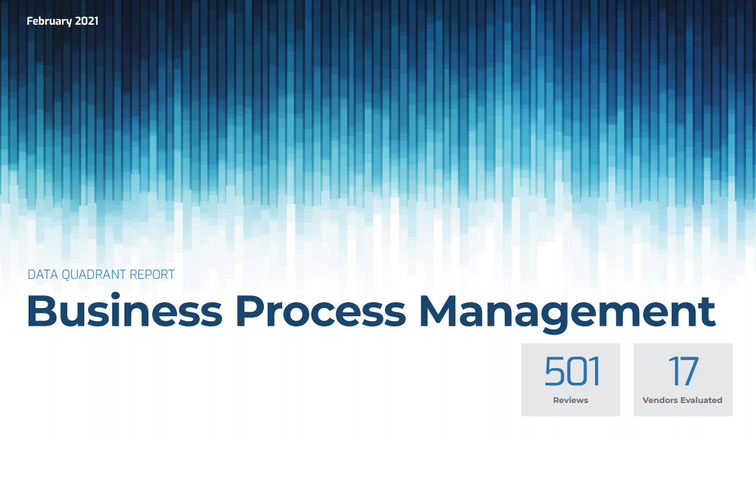
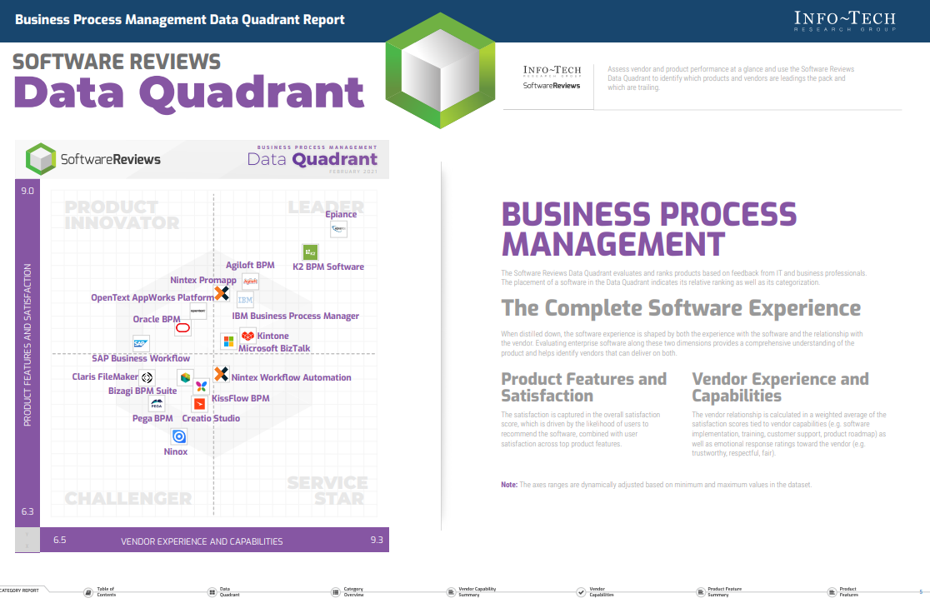
BPM should start with a methodology for process improvement
Let Info-Tech guide you through your BPM journey
1
2
3
Create a Business Process Management Strategy
Create a Winning BPI Playbook
SoftwareReviews: Business Process Management Solutions
Learn how to create a BPM strategy for automation.
Understand the costs, benefits, and time investment required for a successful BPM strategy.
Recognize the challenges commonly faced during BPM strategy setting and how to avoid them.
Start with adopting a standard approach to process improvement and creating standard operating procedures to launch, discover, analyze, design, and implement process improvement.
Accelerate your selection of a BPM solution that fits your organization’s specific requirements with Info-Tech’s Rapid Application Selection Framework and verify this decision with SoftwareReviews’ product landscape reports.

Slide 17
Reduce the unnecessary waste in your organization
Up to 90% of all process steps have room for improvement.
Waiting
Decrease the amount of idle time where employees are waiting for approvals or handoffs.
Over-Production
Reduce unnecessary production that isn’t needed.
Extra Processing
Create outputs that meet the expectations of the customer.
Defects
Eliminate the output errors and rework caused as a result.
Motion
Eliminate unnecessary travel between activities.
Inventory
Optimize inventory by keeping the right amount on hand.
Transportation
Reduce the unnecessary movement of materials and goods.
Non-Utilized Talent
Allocate resources properly to ensure proper talent utilization.

Slide 18
Choose processes that are strategically aligned with your organizational goals
Process selection is critical
Make sure the processes you choose are:
1. Strategically Aligned
Determine if process improvement is going to support the organization’s strategic goals and is aligned with the organizational goals.
The process must transform an input into a valuable output for the internal or external customer.
The process should directly or indirectly add value.
2. Well Defined
Ensure the process has a distinct start and end.
Choose a process that is repeated frequently.
The 80:20 Rule
Organizations compete with 5% of their processes. Roughly 15% of processes focus on supporting a business’s competitive advantage and 80% of processes are industry standards. The biggest benefits are going to come from improving the processes that deliver on the business’s competitive advantage.
Source: The Complete Business Process Handbook

Slide 19
Info-Tech walked a consulting company through process analysis, design, and implementation
CASE STUDY
Industry
Source
Consulting
Info-Tech Research Group
Process Analysis
Process Design
Process Implementation
Team members and Info-Tech experts analyzed current-state process maps and conducted high-level requirements gathering.
Through analysis it was concluded that there were several inputs, outputs, and handoffs that could be automated.
Analysis discovered inefficiencies from manual processes and lack of standardization and ownership.
Stakeholders and Info-Tech experts worked together to identify improvement opportunities.
Several of the improvement opportunities consisted of automating tedious and error-prone manual processes. It was concluded that automation would reduce the number of manual entries and the risk of potential data errors.
Analysis also discovered that the HRIS was not being fully leveraged and functionality was not being used.
Opportunities were prioritized according to strategic importance, urgency, and effort.
Once prioritized, opportunities were segregated into quick wins, big bets, and long-term considerations. This helped to create a roadmap of initiatives and allocate responsibilities appropriately.
The consulting company and Info-Tech worked together to create a RACI chart and realign the onboarding process roles to support the new process.
Analyze
Design
Implement

Slide 20
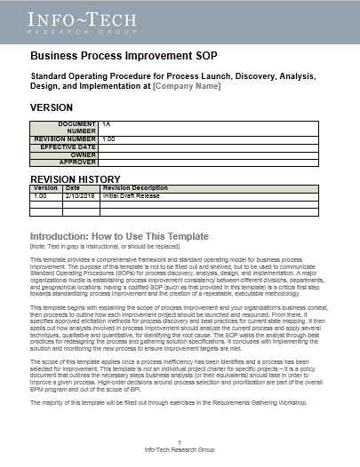
Build a comprehensive set of standard operating procedures using Info-Tech’s tools and templates
Elements of a business process improvement playbook should contain instructions on how to:
Launch an improvement initiative.
Create an operating model and take inventory of level 1, 2, and 3 processes.
Gather current-state process information.
Analyze the current-state process using the right techniques.
Identify improvement opportunities and design the new process.
Implement the new process and align roles to support it.
BENEFITS
A holistic view of the current processes, future direction, and the initiatives required to achieve the desired future-state process.
A consistent and repeatable approach for process improvement that will be adopted organization wide.
A methodology that will assist you in discovering improvement opportunities to eliminate inefficiencies and improve process time, cost, and quality.
BLUEPRINT TOOLS AND TEMPLATES
Process Mapping Guide
Business Process Improvement Playbook
Business Process Improvement Workbook
*This blueprint contains additional resources that support the creation of interim deliverables and the execution of project steps.

Slide 21
Use these icons to help direct you as you navigate this research
Use these icons to help guide you through each step of the blueprint and direct you to content related to the recommended activities.
This icon denotes a slide where a supporting Info-Tech tool or template will help you perform the activity or step associated with the slide. Refer to the supporting tool or template to get the best results and proceed to the next step of the project.
This icon denotes a slide with an associated activity. The activity can be performed either as part of your project or with the support of Info-Tech team members, who will come onsite to facilitate a workshop for your organization.

Slide 22
Info-Tech offers various levels of support to best suit your needs
Guided Implementation
DIY Toolkit
Workshop
Consulting
“Our team has already made this critical project a priority, and we have the time and capability, but some guidance along the way would be helpful.”
“Our team knows that we need to fix a process, but we need assistance to determine where to focus. Some check-ins along the way would help keep us on track.”
“We need to hit the ground running and get this project kicked off immediately. Our team has the ability to take this over once we get a framework and strategy in place.”
“Our team does not have the time or the knowledge to take this project on. We need assistance through the entirety of this project.”
Diagnostics and consistent frameworks used throughout all four options

Slide 23
Create a Winning BPI Playbook – project overview
Launch the BPI Project
Discover the Process
Analyze
Root-Cause Variables
Design Solutions
Implement the Process
Best-Practice Toolkit | 1.1 Create the project charter | 2.1 Gather process documentation 2.2 Assess the current state 2.3 Create and review current-state process diagram | 3.1 Assess the root-cause formula 3.2 Conduct a qualitative analysis 3.3 Conduct a quantitative analysis | 4.1 Choose solution techniques 4.2 Determine future state | 5.1 Create an implementation plan 5.2 Monitor the process and continuously improve
Guided Implementations | Identify the problem, vision, and improvement targets. Assemble the project team. | Gather and analyze process documentation. Create a high-level process map and discuss pains, gains, and opportunities. Convert the high-level process map into a process diagram. | Conduct and discuss qualitative analysis. Conduct and discuss quantitative analysis. | Explore solution techniques. Create the ideal future state. | Create an implementation plan. Monitor and continuously improve the process.
Onsite Workshop | Phase 1 Results: Project charter | Phase 2 Results: Current-state process identified and documented | Phase 3 Results: Process inefficiencies identified | Phase 4 Results: Ideal future-state documentation | Phase 5 Results: Implementation plan

Slide 24
Workshop overview
Contact your account representative or email Workshops@InfoTech.com for more information.
 | Workshop Day 1 | Workshop Day 2 | Workshop Day 3 | Workshop Day 4 | Workshop Day 5
Activities | Launch BPI Process improvement challenges and pitfalls. Benefits of standardizing business process improvement. Identify objectives for BPI. Identify current capabilities and future state. Choose pilot project. Craft a problem statement. Identify the improvement target and define root-cause variables. | Discover Identify stakeholders and elicit requirements and pain points. Gather process requirements. Map the current state using BPMN and swim lanes. Identify the process pains, gains, and sustains. | Analyze Create a root-cause formula. Analyze the current-state process diagram. Perform a qualitative analysis. Create a data collection plan for a quantitative analysis. Learn techniques for quantitative analysis. | Design Identify potential solution ideas. Cluster and refine ideas to generate solution options. Identify the value-added steps in the process. | Implement Create a future-state process diagram. Create a plan for implementing process changes. Define the roles and responsibilities for the new process. Create a plan to continuously monitor the new plan.
Deliverables | Standard operating procedures for a BPI program | Organization operating model Current-state process map | Root-cause formula Process inefficiencies identified | Solution options for future-state process | Future-state process diagram

