Slide 1
Recalibrate Your End-User Computing Strategy and Roadmap
The days of banning Macs and smartphones from the enterprise is over—make sure that IT is ready to support the workplace of the future.

Slide 2
Table of contents
1. Title
2. Introduction
3. Project Rationale
4. Execute the Project/DIY Guide
4.1. Assess Your Current State 4.1.1. Set a vision for your new end-user computing roadmap 4.1.2. Analyze user groups with a persona analysis 4.2. Select Initiatives and Draft a Strategy 4.2.1. Select initiatives to include in your end-user computing roadmap 4.2.2. Create a high-level implementation and migration strategy 4.3. Finalize the End-User Computing Roadmap 4.3.1. Refine the roadmap 4.3.2. Define the costs and benefits of your implementation
5. Summary/Conclusion
6. Next Steps
7. Appendices

Slide 3
ANALYST PERSPECTIVE
The post-PC era is now! Recalibrate your strategy for any device running any platform from any location.
Post-PC is not “no PC” but an environment where workers use a range of devices to access a range of services and applications. This is a reality today that your end-user computing (EUC) strategy must address.
In the PC-centric world, Microsoft Windows – and Windows PC management – held sway over the bulk of EUC. The Windows hegemony is over. In today’s workplace, there is a near equal mix of devices running Windows, Mac OS and iOS, and Android. Microsoft, Apple, and Google have changed their service offerings to be accessible to devices running any of these platforms whether the device is a desktop, smartphone, or tablet.
Management tools and philosophies have also been adapting. Traditional endpoint management and enterprise mobility management tools are converging into unified endpoint management.
Ken Weston,
Senior Consulting Analyst, Infrastructure Info-Tech Research Group

Slide 4
Executive summary
End users are living in a post-PC world in their personal lives. For instance, 62% of US post-secondary graduates own a tablet, followed by 45% of American adults more generally (M. Anderson 2015).
Service desk teams are already stretched thin; IT needs to focus efforts on initiatives that will reduce the cost of supporting users.
Take the step toward device, platform, and location independence. Avoid projects that will not bring you closer to market trends.
Frame your roadmap in terms of user needs. Let us help you perform a user group and persona analysis.
What works for others might not be best for you. Avoid investing in products that are not a good fit for your organization.
Vendors have begun approaching line of business units, and even individual teams, directly.
Tools chosen by the end user normally have a higher adoption rate (and longer staying power) than tools supplied by IT. Withholding support can negatively impact stakeholder satisfaction with IT.
A well-planned end-user computing strategy can:
Improve the lives of users by enabling access to company resources in a way that fits their use cases.
Improve the lives of IT by implementing the most efficient tools for deploying, managing, and supporting end-user computing resources.
Improve the business by reducing wasted spending and identifying new revenue opportunities enabled by new end-user computing trends.
Develop an end-user computing strategy and roadmap that fits all the pieces together. Then communicate the plan with a set of simple documents.

Slide 5
Harness the nuclear power of device, platform, and location independence while avoiding apocalyptic fallout
You can survive the transition to the post-PC world. Let us show you how.
EMM
Mac OS X
Definition: Device Independence
The ability for IT to provide the same services to traditional computers, smartphones, and tablets.
Device Independence
AppConfig
Platform Independence
Office
365
Definition: Platform Independence
End-User
Computing
The capability to provide services to a diverse environment of operating systems—Windows, Mac OS X, iOS, Android, etc.
iOS
BYOD
COBO
Location Independence
Windows
10
Definition: Location Independence
Enabling end users to access IT services and resources from both inside and outside of the office.
Cloud
Android

Slide 6
Without an end-user computing (EUC) strategy, your end users will be stuck a decade in the past
People have become much more tech savvy over the past decade. Give them familiar tools, and watch productivity and satisfaction increase.
10 Years Ago
Present
Browser Distribution¹
IE: 63.0%
Firefox: 25.7%
Chrome: 70.4%
IE: 5.8%
Firefox: 17.5%
Dominant Operating Systems²
Windows (~65%)
Symbian
BlackBerry
OS X
Google Android and AOSP (~50%)
iOS
Windows
47% have high speed internet
71% are internet users
67% are online at home
74% have cellphones³
92% own a cellphone or smartphone
68% own a smartphone
73% own a computer
45% own a tablet⁴
American Adults
¹ May 2006 and April 2016 statistics from W3Schools
² Based on platform sales for 2006 and 2015. Bajarin, B. “The End of Standardized Platforms”
³ Horrigan, J. “Broadband Adoption: Trends & Consequences”
⁴ Anderson, M. “Technology Device Ownership: 2015”

Slide 7
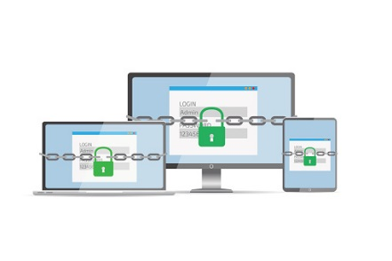
Prioritize initiatives that are aligned with industry trends and people’s day-to-day realities
Mobility is a given in day-to-day life, and it can be a given within your organization too.
Cisco is forecasting monthly mobile traffic to grow from 3.7 EB in 2015 to 30.6 EB in 2020 (Cisco 2016).
Your company’s talent pool is already using mobile devices; 62% of American post-secondary graduates own a tablet and 81% own a smartphone (M. Anderson 2015).
Traditional endpoint management and enterprise mobility management tools are converging into one: unified endpoint management.
Become an innovative IT department, and your stakeholders will notice. Innovative initiatives such as offering iPads, Surfaces, or Android tablets to end users as primary computing devices will impress your stakeholders. See the next slide to learn just how important innovation is to stakeholders.

Slide 8
Adapt innovative end-user computing initiatives and impress your stakeholders
There is a clear relationship between satisfaction with IT and the IT department’s innovation leadership.
Organizations without high satisfaction with IT innovation leadership are only 20% likely to be highly satisfied with IT
IT innovation leadership explains 75% of variation in satisfaction with IT
You rarely see a real-world correlation of .86!
- Mike Battista, Staff Scientist
When an organization’s members were asked “Overall, how satisfied are you with your IT department?”, their response was strongly correlated with the IT department’s innovation leadership. Use our process to achieve innovation leadership.

Slide 9
Adopt device independence, platform independence, and location independence with Info-Tech’s help
Info-Tech can help you decide which initiatives your IT department should prioritize in order to avoid investing in laggard approaches to IT.
Adopt these trends …
Definition: Device Independence
The ability for IT to provide the same services to traditional computers, smartphones, and tablets.
Definition: Platform Independence
The capability to provide services to a diverse environment of operating systems—Windows, Mac OS X, iOS, Android, etc.
Definition: Location Independence
Enabling end users to access IT services and resources from both inside and outside of the office.
… with these initiatives.

Slide 10
Follow Info-Tech’s methodology to develop an end-user computing strategy aligned with post-PC realities
Phase 1: Assess Your Current State
Phase 2: Select Initiatives and Draft a Strategy
Phase 3: Finalize the End-User Computing Roadmap
Phases
Steps
1.1
Set a vision for your new end-user computing roadmap
2.1
Select initiatives to include in your end-user computing roadmap
3.1
Refine the roadmap
1.2
Analyze user groups with a persona analysis
2.2
Create a high-level implementation and migration strategy
3.2
Define the costs and benefits of your implementation
Tools and Templates
Roadmap and Monitoring Tool
Communication Template
Welcome to the Post-PC Era
Roadmap Template
Roadmap and Monitoring Tool
Communication Template
User Group and Persona Analysis Template
Communication Template
Roadmap Template
Roadmap Template

Slide 11
Gain immediate, measurable benefits from our advice, while executing plans that yield long-term savings
Use our templates
Follow our processes
Download our Service Desk Technician Level II job description
Customize it for your organization
Analyze your user groups and use cases
Procure features and implement initiatives you need
Measured Value
Measured Value
Save 2 business days:
$800-1,200¹
Procuring the right Office 365 licence:
$72,000-$90,000²
Selecting the right EMM product tier:
$28,620-$180,000³
¹ Based on two days of an IT manager’s salary. Robert Half Technology Salary Guide for Technology Professionals 2016, pg. 8.
² Based on publicly available pricing information for 500 users for one year from Microsoft. Amount calculated by subtracting difference between Enterprise E3 and E1 licenses, as well as between E5 and E3 licenses, respectively.
³ Based on publicly available pricing information for 1,500 users from AirWatch. Amount calculated by subtracting difference in per-device-per-month tier pricing, for one year.

Slide 12
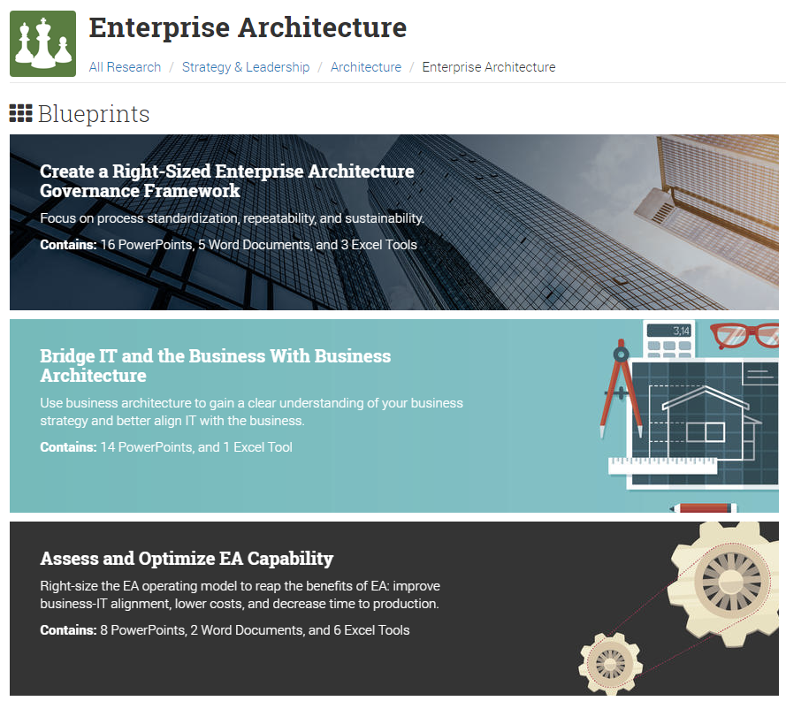
Develop your end-user computing roadmap in alignment with COBIT
Our best practices for architecting your end-user roadmap align with APO03 Enterprise Architecture.
Info-Tech’s Advice | COBIT
Phase 1: Analyze your stakeholder and end-user needs. | APO03.01 Develop the enterprise architecture vision
Phase 2: Select initiatives to include on your roadmap. Create target and transition state diagrams as necessary. | APO03.02 Define reference architecture
 | APO03.03 Select opportunities and solutions
Phase 3: Finalize your roadmap. Define costs, benefits, and key performance indicators. | APO03.04 Define architecture implementation
 | APO03.05 Provide enterprise architecture services
Interested in enterprise architecture? Check out our blueprints specifically on this topic.

Slide 13
Preparing for these trends will increase end-user morale and help your company in the war for talent
CASE STUDY
Industry
Source
Information Technology
Interview
SAP SE
Info-Tech analysts spoke with SAP SE’s CIO Thomas Saueressig. He is one of the youngest CIOs of a multinational corporation, and has brought innovative goals with him to SAP. One of Saueressig’s more impressive initiatives is to support Macs throughout SAP .
Supporting Macs: SAP SE’s Approach
Saueressig recognized that managing Macs required a paradigm shift within IT; trying to manage Macs the same way they manage Windows PCs would have killed the initiative.
As such, SAP SE hired Apple-certified technicians as well as Apple experts who embrace Apple’s philosophy to manage their fleet of Apple computers. They also empower their Mac end users through self-service.
Results
Directly measuring the benefits of supporting Macs is difficult. However, it fits into SAP’s overall strategy of increasing employee morale. SAP SE also uses its support of Macs to help in the war for talent—many post-secondary graduates want to use Macs at work.
The self-service functionality is also helping to reducing the call load on their service desk over the long run.
What we saw was a lot of young people from university are using Mac books. We need to be attractive to those graduates.
– Thomas Saueressig, CIO, SAP SE

Slide 14
Info-Tech delivers: The EUC Strategy and Roadmap Template and EUC Strategy Communications Template
These are the main outputs of Info-Tech’s Recalibrate Your End-User Computing Strategy and Roadmap.
INFO-TECH TEMPLATE
INFO-TECH TEMPLATE
The EUC Strategy and Roadmap Template is the default communication tool for IT.
The roadmap will go into depth about each initiative.
The EUC Strategy Communications Template is the default communication tool for stakeholders, including end users.
This artefact will quickly relay information to users at a high level.
All of the activities in this blueprint feed into these templates

Slide 15
Leverage Info-Tech’s EUC Strategy and Roadmap Template to collect information about your roadmap
EUC Strategy and Roadmap Template
Maintaining continuity through the roadmapping process is as important as the roadmap itself. Compile a report and ensure that it meets all of the business goals identified in Phase 1.
Use Info-Tech’s EUC Strategy and Roadmap Template.
The roadmap should contain:
Project Rationale
Team List
Satisfaction Survey Results
Business Goals Prioritization
User Group Analysis Overview
End-User Computing Initiatives List
Risks and Dependencies List
Future IT Infrastructure Skills Requirements
End-User Computing Roadmap
Total Cost of Ownership
Phase 1
The end-user computing roadmap will contain all of the information about this project.
Use it as a project tool and as a communication tool internally within IT.
Phase 2
Phase 3

Slide 16
Create an abridged strategy document to communicate with end users
EUC Strategy Communications Template
Compile a summary document that tells end users how they will be impacted.
Use Info-Tech’s EUC Strategy Communications Template.
Best practices for creating an end-user strategy document:
Share only individual slides with end users
At the beginning of the project, share the overview slide
Before and after each initiative, share the respective slide
Follow the communication document’s instructions
This communication document is the default communication document.
While you may rarely present the report as a whole, compile the key elements of any potential presentation here.
Keep communications short and simple. You have end users’ attention for only a brief moment—create and send single slides via email, without technical detail, to let users know which initiatives IT is working on.

Slide 17
Use these icons to help direct you as you navigate this research
Use these icons to help guide you through each step of the blueprint and direct you to content related to the recommended activities.
This icon denotes a slide where a supporting Info-Tech tool or template will help you perform the activity or step associated with the slide. Refer to the supporting tool or template to get the best results and proceed to the next step of the project.
This icon denotes a slide with an associated activity. The activity can be performed either as part of your project or with the support of Info-Tech team members, who will come onsite to facilitate a workshop for your organization.

Slide 18
Info-Tech offers various levels of support to best suit your needs
Guided Implementation
DIY Toolkit
Workshop
Consulting
“Our team has already made this critical project a priority, and we have the time and capability, but some guidance along the way would be helpful.”
“Our team knows that we need to fix a process, but we need assistance to determine where to focus. Some check-ins along the way would help keep us on track.”
“We need to hit the ground running and get this project kicked off immediately. Our team has the ability to take this over once we get a framework and strategy in place.”
“Our team does not have the time or the knowledge to take this project on. We need assistance through the entirety of this project.”
Diagnostics and consistent frameworks used throughout all four options

Slide 19
Our understanding of the problem
IT Infrastructure Managers
IT Mobility Managers
Create a plan for improving the experience and productivity of end users
CIOs and CTOs
Enterprise Architects
Understand trends in end-user computing
Understand how the needs of end users are changing

Slide 20
Recalibrate Your End-User Computing Strategy and Roadmap – project overview
Assess Your Current State
Select Initiatives & Draft a Strategy
Finalize Your Roadmap
Supplementary Initiatives
Best-Practice Toolkit | 1.1 Set a vision for your new end-user computing roadmap. 1.2 Perform a user group analysis. | 2.1 Select initiatives to include in the roadmap. 2.2 Create a high-level implementation and migration strategy. | 3.1 Refine the roadmap. 3.2 Define the costs and benefits of implementation. | Choose from: Forge a Standard for End User Devices Steer Your Environment Toward Bring Your Own Everything Migrate to Windows 10 One of our other end-user computing sets
Guided Implementations | Review end-user computing trends Plan kick-off meeting Perform guided user group analysis | Review Welcome to the Post-PC Era and select items for roadmap Consolidate initiatives, and identify risks and initiatives Define target and transition states | Review your finalized roadmap Establish KPIs for end-user computing
Onsite Workshop | Module 1: Assess Your Current State | Module 2: Select Initiatives and Create a Roadmap
 | Phase 1 Results: Established vision for end-user computing Completed user group and persona analysis | Phase 2 Results: Initialized end-user computing strategy Defined target state for each user group | Phase 3 Results: Finalized roadmap Established success metrics | Supplementary Initiative Results: An action plan for your next initiative

Slide 21
Workshop overview
Contact your account representative or email Workshops@InfoTech.com for more information.
 | Workshop Day 1 | Workshop Day 2 | Workshop Day 3 | Workshop Day 4 | Workshop Day 5
Activities | Assess Current State 1.1 Set a vision for your new end-user computing roadmap. 1.2 Perform a user group analysis. | Create Your End-User Computing Roadmap 2.1 Select initiatives to include in the roadmap. 2.2 Create a high-level implementation and migration strategy. 3.1 Refine the roadmap. 3.2 Define the costs and benefits of implementation. | Sample – Migrate to Windows 10 Prepare for Deployment 3.1 Map user groups to rings. 4.1 Set up your Windows 10 test ring. 4.2 Generate tasks associated with testing. 4.3 Set up and define tasks associated with piloting. 5.1 Determine the deployment type that best suits each user group. | Sample – Migrate to Windows 10 Address People Issues 5.2 Outline your images and/or provisioning packages. 5.3 Plan deployment to standard, stable, and mobile rings. 6.1 Develop an IT and pilot ring training plan. 6.2 Expand your knowledgebase. 6.3 Develop an end-user transition support plan. 6.4 Finalize your migration roadmap. | Day spent finalizing deliverables
Deliverables | Interviewed two stakeholders Created a vision for end-user computing Completed a user group and persona analysis | Identified high-priority end-user computing projects Set target states for all user groups Created a roadmap for end-user computing Established KPIs Established a responsibility matrix | Windows 10 Migration Plan Section 3: Windows-as-a-Service Plan Windows 10 Migration Plan Section 4: Test and Pilot Deployment Plan Windows 10 Migration Plan Section 5: Deployment Considerations | Knowledgebase articles Windows 10 Migration Roadmap Windows 10 Migration Plan Section 6: Training Plan

