Slide 1
Establish a Program to Enable Effective Performance Monitoring
Maximize the benefits of infrastructure monitoring investments by diagnosing and assessing transaction performance, from network to server to end-user interface.
Info-Tech's products and services combine actionable insight and relevant advice with ready-to-use tools and templates that cover the full spectrum of IT concerns.© 1997 - 2016 Info-Tech Research Group

Slide 2
ANALYST PERSPECTIVE
Effective performance management is more than buying a “big red easy button.”
Application issues caused by performance slowdowns or downtime will directly translate into negative experiences for end users and customers. However, despite the immediate impact of inadequate application performance, the majority of organizations do not have any effective performance management processes in place.
Many IT organizations invest considerable resources for application performance management (APM), yet the business value that these investments generate is limited at best. These tools on their own do not give you clarity on end-to-end application performance and, more specifically, the performance measurements for critical transactions that may touch multiple components are often unclear.
Before buying a new performance management tool, understand your applications first – this will allow you to tailor the solution to your needs.
David (Da) Xu,
Senior Consulting Analyst, Infrastructure Info-Tech Research Group

Slide 3
Performance management needs to become top of mind as it significantly impacts workforce productivity
The inability to determine the source of performance issues is a primary inhibitor to workforce productivity. While most organizations recognize the importance of performance, they often do not know where to start.
The inability to act stems from today’s highly complex IT environments. Today’s data centers often involve a mix of platforms as well as on-premises and a variety of off-premises solutions (e.g. public clouds). Measuring and diagnosing application performance issues are increasingly challenging.
Growing challenges combined with the potential impact of APM dictates the need for a tailored solution that can address the specific application performance challenges of your firm.
Source: Aternity Inc., 2016 Business Transformation and User Experience Trend Survey

Slide 4
Do not let user perception become your performance reality
When addressing end-user complaints, between 80% and 90% of the engagement is troubleshooting. Essentially, IT spends the majority of support cycles reacting to issues instead of preventing them. The reactive nature of the engagement means that end users, and potentially customers, have already been impacted and friction is created. This phenomenon widens the visibility gap between end-user perception of received performance and IT’s measurement of delivered performance.
Current estimates further validate the visibility gap: 70-80% of problems impacting end users are not detected by IT. Essentially, when IT hears about issues it is the exception rather than the norm. The visibility gap will continue to worsen as end users suffer in silence and do not escalate issues to IT. There needs to be a conscious effort to create visibility and eliminate the visibility gap through effective application performance management.
Source: Aternity Inc., 2016 Business Transformation and User Experience Trend Survey

Slide 5
Reducing ticket volume leads to increased employee productivity and total savings of $27,270
CASE STUDY
Industry
Source
Large Enterprise
XO Communications
Situation
Action
Results
Identifying, isolating, and resolving issues more quickly is one of the most direct benefits of application performance management.
A large enterprise was experiencing significant issues meeting its internal SLAs due to being overloaded with support/trouble tickets.
The primary challenge the team had was their inability to drill down on issues and identify where specifically the error was occurring. This challenge was exasperated by the fact that the enterprise was leveraging a hybrid environment consisting of legacy hardware, a co-lo environment, and several cloud services.
“With an APM approach centered around actual end-user experience instead of just individual network and application measurements, IT can increase business efficiency by decreasing the number of IT staff members needed to triage a problem and lower operational costs by reducing trouble ticket escalations by 40-50%.”
– Doug Roberts, Managing Director of Product Strategy, Fluke Networks Visual
The enterprise implemented performance management with the focus on reducing the number of tickets as well as increasing resolution speed.
Prior to APM implementation:
Time to resolve: 30 minutes
Average tickets per mo.: 200
Staff salary: $45/hour
Total Annual Cost: $ 54,000
After APM implementation:
Time to resolve: 20 minutes
Average tickets per mo.: 150
Staff salary: $45/hour
Total Annual Cost: $26,730
Total Savings: $27,270
Source: The ROI of Application Performance Management, XO Communications

Slide 6
Using a stock APM tool without understanding business impact and requirements will limit APM investment success
APM tools are often implemented for two reasons:
Reactionary
Performance management is implemented because the pain threshold gets too high. The organization experiences frequent and worsening occurrences of application performance degradation and purchases an out-of-the-box APM tool. Without first understanding business requirements, the APM tool is often relegated to monitoring and reporting low-level technical metrics.
Strategic
A performance management tool is implemented during the development or implementation of a project. The APM tool is focused on managing business impact so that IT teams can prioritize on what to troubleshoot rather than over-rotating on infrastructure resource, health, or capacity metrics.
Avoid reactionary performance management implementation by focusing on the fundamentals of tailoring infrastructure flow maps and transaction profiles to business impact.
Too often, APM is focused on monitoring and correlating information about web-application components or server performance. This does not consider the full implications of what it takes to deliver a service to the user. Nor does it identify all issues that can impact the performance of an application or service. The bigger question IT needs to focus on is ‘What am I trying to achieve to support the business?’ IT must consider service delivery as a strategy and holistic responsibility. APM technologies should be evaluated based on the desired end goal of assuring service delivery, and must consider all elements that impact a user’s experience.
– Steven Shalita, Vice President of Marketing, NetScout
Source: 15 top reasons why APM deployments fail, APM Digest

Slide 7
Follow Info-Tech’s methodology to establish a program to enable effective performance monitoring
1. Kick-start the performance management pilot
2. Establish and evaluate current performance baseline
3. Build the case for additional performance management investments
1.1 Outline a project charter to define the scope of the pilot
2.1 Visualize application interactions through infrastructure flow mapping
3.1 Define and quantify the benefits of performance management
1.2 Document transaction dependencies
2.2 Track baseline metrics to monitor normal operation characteristics
3.2 Build a business case for additional application performance investments
1.3 Establish transaction priorities based on business impact
2.3 Establish a methodology to analyze and interpret baseline metrics
3.3 Create and present an executive presentation
Project Charter
Insight Handbook
Business Case
Transaction Impact Analysis Tool
Executive Presentation
Infrastructure Flow Maps and Transaction Profiles

Slide 8
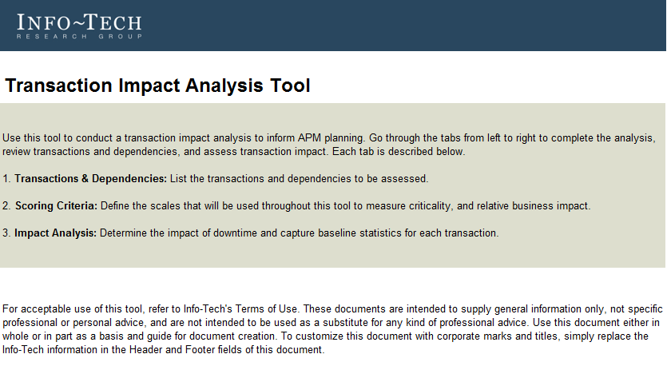
Kick-start the performance management program pilot
1
PHASE
IT environments have become so big and complex that implementing enterprise-wide rollouts will be destined for bottlenecks and failures.
In today’s IT environment, it is common to find enterprises with thousands of servers and hundreds of applications. Due to such complexity, it is unrealistic to expect that every team will be standardized on the same performance management tool immediately after deployment. Optimize the performance management rollout by:
Focusing the initial implementation on a few servers and 10-15 truly mission-critical transactions. A pilot approach will help expedite the rollout, build expertise with the system, and then scale the deployment up.
Obtaining proper executive sign-off and project ownership for the pilot via a project charter.
Capturing transaction dependencies and clarifying the current environment.
Creating an impact scale that standardizes each transaction and accurately gauges the transaction’s business impact.

Slide 9
Establish and evaluate current performance baseline
2
PHASE
Leverage the results of infrastructure flow mapping and transaction profiling to build a foundation to capture current-state transaction statistics.
Today’s APM tools have the potential to provide deep end-to-end insight into your IT environment. However, these tools are not tailored for your environment right out of the box. Only by understanding which transaction statistics are the most relevant, what your current baseline looks like, and the performance demands from end users will you be able to maximize the value from the APM implementation.
Leverage Info-Tech’s Transaction Impact Analysis Tool to document the current performance baseline.

Slide 10
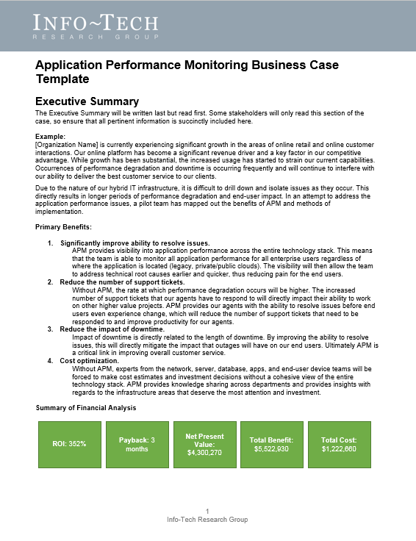
Build the case for additional performance management investments
3
PHASE
Review pilot project benefits. Assess the go/no-go decision criteria and engage executives regarding next steps for additional project investments.
Assess the gap between the current and the desired state of transaction statistics.
If current performance is at or above desired metrics, then potentially defer additional investments until a stronger business case can be built.
If current performance is below desired metrics, then consider building a business case for additional performance management capabilities.
Leverage Info-Tech’s Business Case Template and engage the business.

Slide 11
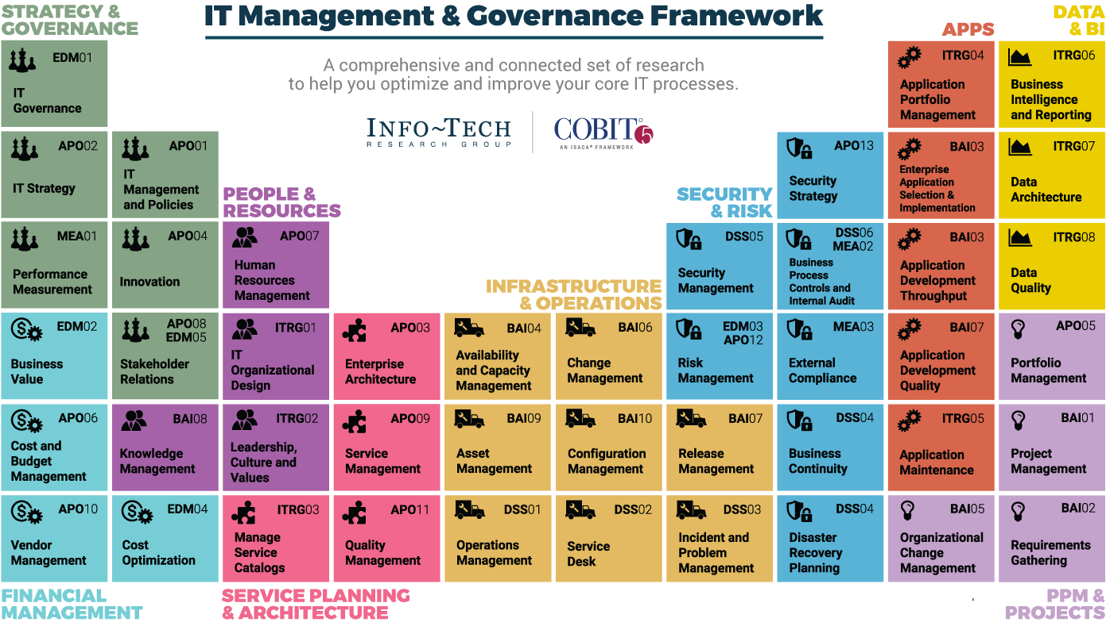
Dive Deeper Into Our Research
by Clicking One of the Elements Below
Find out how Info-Tech makes your job easier. Contact Us Today: Toll-Free (US & Canada): 1-888-670-8889

