Slide 1
Consolidate IT Asset Management
Enterprise-wide decisions require a centralized view into enterprise-wide assets.

Slide 2
ANALYST PERSPECTIVE
Asset management requires effort. Consolidate IT asset management (ITAM) to ensure that effort does not go to waste.
Most organizations struggle with asset management already, but the challenge is amplified for those that have grown – be it through mergers, acquisitions, or organic growth. They find themselves with multiple locations and multiple processes and tools for asset management, some more effective than others.
Decentralization prevents visibility across the enterprise, leading to operational inefficiencies, poor optimization of hardware and software assets, and often overspending on software licenses. In addition, the data necessary for lifecycle management and impending audits is lacking.
Centralizing and standardizing IT asset management will benefit organizations in this position immensely. Consolidation provides total visibility of the hardware and software licensing landscape across the enterprise, data to guide strategic decisions and ensure compliance, and cost savings through asset optimization.
Sandi Conrad,
Senior Director, Infrastructure Practice Info-Tech Research Group

Slide 3
Who benefits from this research and how?
IT Directors
Asset Managers
Asset Coordinators
Project Managers
Organizations that have multiple asset management processes and tools in place as a result of natural growth or mergers and acquisitions
Centralize asset management processes and tools.
Inventory contracts to determine how to consolidate them into one agreement (and whether it makes sense to consolidate them).
Inventory licenses under each contract and determine how many installs remain.
Develop a strategy for rightsizing the licensing agreements and sharing resources across the organization.
Gain centralized oversight into assets across the enterprise.
Gain a better understanding of where dollars are spent overall on assets and where they should be spent.

Slide 4
Executive summary
Whether through growth, mergers, or acquisitions, many organizations have come to rely on a decentralized IT asset management approach, using separate tools and processes to manage and track assets in various locations or departments.
As a result, they lack a centralized view into assets and a comprehensive flow of data across the organization.
The full benefits of asset management can not be realized through a decentralized model. You will fail to realize the benefits of effort put into managing equipment lifecycles without a centralized oversight into those processes, even with good asset management practices in place.
Consolidating asset management doesn’t simply mean moving your data into one ITAM tool. There must be a focus on standardizing and consolidating processes at the same time. If not, the data in the centralized tool will be meaningless.
Without a centralized view organizations can’t track assets and their movement across locations.
Audits are conducted globally, but if asset management is done locally there is no way to provide the data and information needed to complete the audit successfully.
Multiple contracts and licenses in different locations lead to duplication and wasted resources.
Moving to a single system of record and standardized processes will provide a clear view of hardware and software assets, contracts, and lifecycles across the organization to make more informed decisions.
Improved visibility can inform software and hardware rationalization and uncover opportunities for redeployment, leading to cost savings and reduced total cost of ownership.
A single ITAM tool or database ensures accurate and up-to-date inventory and improved capabilities for data integration.

Slide 5
Consolidate ITAM to optimize the cost savings of asset management
Poor asset management results in wasted money.
A centralized and standardized ITAM program results in cost savings
Software licenses account for about 20% of IT costs, and will continue to rise (Ernst & Young, 2010).
Putting in place a software and hardware asset management program can help most organizations achieve between 8-15% cost savings annually on a managed asset, even those that already have asset management in place.
A centralized view into hardware assets across the organization and throughout their lifecycles reduces the amount spent on hardware through reduced maintenance costs and hardware budgets.
A centralized view into software licensing across the organization allows for cost savings through license optimization and application rationalization.
20%
A 2015 study by 1E of 129 companies across 14 industries found:
37% of all software found in enterprises is not used (software that is deployed and then unused).
This amounts to $30 billion in software waste.
Not having a centralized view into software use and licensing across the entire organization can put you at risk of overbuying, overspending, wasting resources, and possible vendor fines for being out of compliance.

Slide 6
All organizations can benefit from consolidation, but especially those going through an M&A or preparing for audits
Any company that has grown to have multiple IT departments or locations that each track or manage assets separately will benefit from consolidating ITAM.
Companies preparing for or going through mergers and acquisitions (M&As) will have a particularly strong need for an ITAM consolidation strategy.
M&As are one of the top triggers for software audits.
It’s important to maintain a robust asset management system throughout the M&A process and include all assets in one centralized asset management system.
Beyond M&As, all organizations need to be prepared for audits.
Industry studies suggest that about 60% of firms undergo at least one software audit each year (BizTech, 2013).
When audits occur, it is not the local or individual departments that are at risk of being found non-compliant by auditors, but the legal entity: the organization.
It is challenging, if not impossible to obtain the necessary data from three or more disparate systems in a manner that’s accurate and consistent. That’s why it’s essential that all of the company’s data on software and hardware assets be stored and managed in one central location, where licensing or SAM experts can analyze the information to identify areas of risk and prepare for audits.

Slide 7
Unlock these benefits of centralized ITAM with a consolidation strategy
Improve efficiency
Improve service
Comprehensive and standardized IT asset management processes will improve asset tracking to more quickly and easily locate assets but also prevent duplication of efforts across locations/departments.
Improved monitoring and control of assets will result in more timely resolution of outages and system issues, and improve SLAs for software and hardware requests.
Reduce risk
Make more informed decisions
A centralized view and management of software and licenses makes it easy to identify where the biggest areas of compliance risk lie, as well as security risk from missing patches and updates.
Reliable data on assets across the organization allows for more informed strategic decisions on hardware lifecycle management and refreshment, application rationalization, and software license optimization.
Optimize licensing
Increase purchasing power
Centralizing software license management provides administrators with a single view to manage and optimize licenses across the enterprise and re-deploy under-utilized licenses.
By negotiating software licenses and contracts for the entire organization rather than for individual departments or locations, the company gains more purchasing power to obtain better contracts or support services.
Improve data visibility and flow
Reduce costs
Centralized ITAM breaks down information silos by allowing data to flow across departments, enabling knowledge sharing and flow of information across the enterprise.
A consolidated view of assets provides the data and visibility needed to identify areas of cost savings and license optimization, and capture total cost of ownership.

Slide 8
Organizations with decentralized ITAM can all benefit from at least some degree of centralization
Decentralized ITAM
Centralized ITAM
Each location manages (or fails to manage) its assets separately.
Disjointed approach with varying methods and tools.
No centralized view into assets across the organization.
Separate locations can still maintain control over assets, but they are formally tracked and managed through one centralized ITAM office.
Broad, enterprise-wide view into assets; consistent data and application of policies.
ITAM in Location 1
Centralized ITAM/SAM managing HW & SW assets
Assets in Location 1
Assets in Location 3
Assets in Location 2
No centralized ITAM or view of assets
ITAM in Location 2
No ITAM in Location 3
Completely “centralized” and “decentralized” ITAM organizational structures are two ends of a spectrum; many organizations may fall somewhere in the middle. While some degree of decentralization may benefit certain organizations, a centralized view into assets will benefit all.

Slide 9
Decentralized ITAM inhibits decision making, data flow, and visibility, and results in overspending and compliance issues
Decentralization is common among large companies, particularly those that have gone through times of change such as M&As, strategic re-alignment, or natural growth.
Each location, department, or IT group ends up with its own methods and technology to track their assets. They lack a central system to track all assets across the organization and have no standard ITAM processes.
Challenges arising from decentralized ITAM:
Silos delay or inhibit business flow.
No transparent, centralized view into assets across the organization to inform decision making.
Resources are not distributed in a way that maximizes potential and provides greatest benefit to the organization.
Duplication of efforts across business units.
Storing data in multiple ITAM tools results in multiple incompatible data repositories stored across different servers, preventing data flow and integration.
Lack of visibility into how, when, and where software licenses are being used across the enterprise, resulting in:
Too many or too few licenses purchased.
Lack of licensing strategy and optimization.
Multiple administrators are forced to become licensing “experts,” reducing efficiency.
Lack of risk identification or understanding of where key areas of risks lie from a compliance perspective.
Bad or missing software contracts.
Decentralized license management makes it difficult to prepare for audits and can result in auditors finding large amounts of unlicensed software, resulting in penalties.
“Recently, I was working with a large financial institution and there was nearly 70% duplication of processes, standards and efforts across all the business units. In one case, two major business units had purchased the same asset center product and were both implementing it simultaneously with little success. The decentralization of organizations is a consistent and recurring challenge that costs companies both financial and human resources. ”
– Phara McLachlan of Animus Solutions, (“Why SAM Projects Fail,” The ITAM Review)

Slide 10
Centralized ITAM is a necessary component of quality asset management
Why do you need a consolidation strategy?
Companies are always changing through mergers, acquisitions, divestures, joint ventures, or growth, and it’s important to maintain a strategy to centrally manage hardware and software to stay compliant, optimize spending, and manage risk.
A centralized, standardized ITAM process will save time, money, and resources by allowing more effective management of assets and reducing SLAs for hardware and software requests.
It also provides the visibility needed to improve business processes and guide strategic decisions.
Consolidating ITAM makes it easier to do asset management well.
The 2016 IAITAM Practitioner Survey found that the top five responsibilities of over 500 ITAM professionals surveyed were:
Inventory tracking and management
Policies
Audit response
ITAM repository as a source of truth for decision making
Asset standards
Managing these responsibilities is difficult if not impossible without a centralized view of assets across the enterprise.
Source: The IAITAM Practitioner Survey for 2016

Slide 11
Organizations with decentralized ITAM programs at all maturity levels can achieve benefits from consolidation
Mature ITAM in each location, but still decentralized
Consolidated ITAM
4
5
6
No or Decentralized ITAM
3
One centralized ITAM program and system
Mature, centralized ITAM with continual improvement
Mixture of both mature and poor ITAM processes across locations
2
Whether you’re at stage 1 or 4, this project is designed to help you reach stage 5 – a consolidated ITAM program, with guidance to improve to stage 6 after this project.
Some ITAM in each location but at low maturity
1
No ITAM in place at any location

Slide 12
Follow Info-Tech’s methodology to develop a successful ITAM consolidation strategy
Phase 1:
Assess Current ITAM Programs and Data
Phase 2:
Plan Consolidated ITAM
Phase 3:
Develop Transition Plan
Phases
Steps
1.1
Initiate the project
2.1
Compare data and assess requirements
3.1
Develop a consolidation plan
1.2
Assess current ITAM processes and data
2.2
Design ITAM processes and tool
3.2
Communicate the change
Tools and Templates
Project Charter
ITAM Assessment Scorecard Tool
ITAM Consolidation Plan Template
ITAM Assessment Tool
ITAM Policies
RFP for Professional Services
ITAM SOP
ITAM Consolidation Communication Plan
Job Description Templates

Slide 13
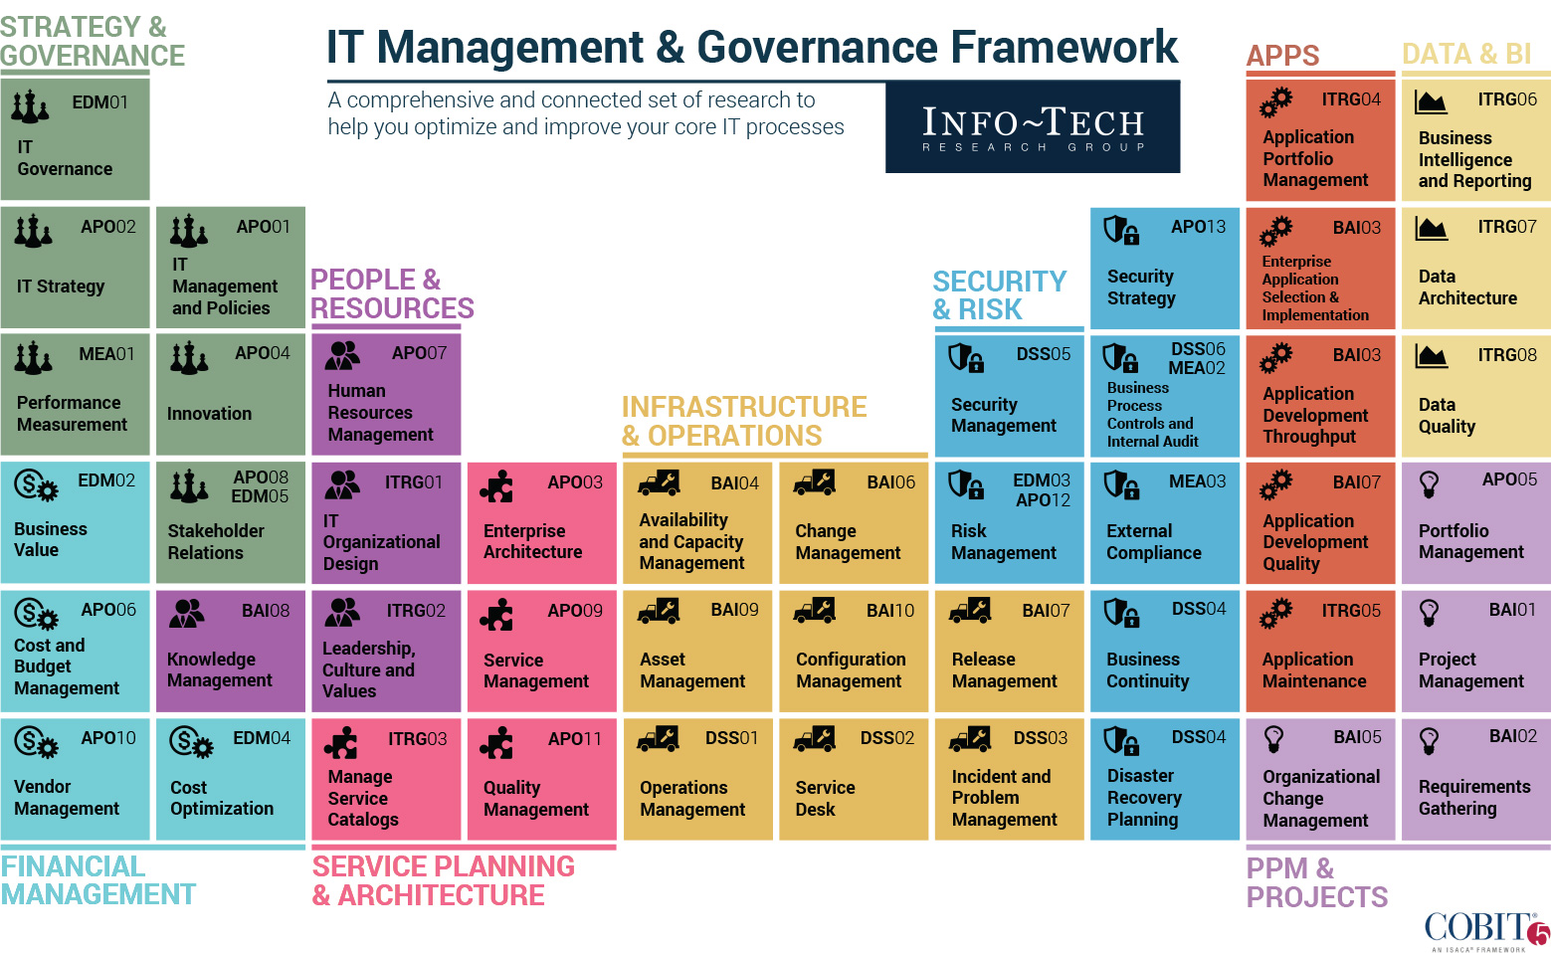
Info-Tech draws on the COBIT framework, which focuses on consistent delivery of IT services across the organization

Slide 14
Info-Tech Research Group’s approach to asset management optimization focuses on building essential best practices
Create an Effective Plan to Implement IT Asset Management
Before moving forward with an ITAM practice, ensure success by engaging executives for financial and resource support by creating a business case and project charter.
Optimize Software Asset Management
Now that you have the base processes in place, expand your ITAM practice to improve and optimize your software asset management practice.
Info-Tech’s
Asset Management
Methodology
You are here
Consolidate IT Asset Management
Build a strategic roadmap to consolidate and centralize asset management functions to reduce support costs and improve data quality.
Implement IT Asset Management
Build essential hardware and software asset management processes, policies, and procedures, develop an asset management implementation plan, and communicate processes to key stakeholders.
Our Approach to Asset Management
Asset management goes beyond just discovering CIs in a CMDB.
Info-Tech’s ITAM approach focuses on adding value to the data, building workflows, policies, and procedures that support a proactive asset management practice, putting in place an improvement plan, and choosing the right technology to support the functionality needed.
Select and Implement IT Asset Management
Review IT asset management tools, select an ITAM solution, and build an implementation plan to ensure your investment meets your needs.

Slide 15
The project blueprint illustrates the scope of each phase of the project with relevant case studies
A large county in North Carolina consolidated its ITAM divisions and increased end-user satisfaction to 95%.
This case study illustrates the full scope of the project.
A petroleum company in Pakistan established a central repository for ITAM data and increased data accuracy from 30% to 100% while saving $100,000 from reduced IT support contracts.
This case study illustrates the scope of Phase 1 of the project.
Gather information
Plan consolidated ITAM
A global information services company implemented an ITAM tool to consolidate data, providing greater insights into its assets.
This case study illustrates the scope of Phase 2 of the project.
Develop transition plan
A leading online automotive sale platform consolidated nine tools into a single ITAM tool and reduced ITAM spend by 25%.
This case study illustrates the scope of Phase 3 of the project.

Slide 16
Mecklenburg County consolidated its asset management practice to increase end-user satisfaction to 95%
CASE STUDY
Industry
Source
Government
IAITAM
Mecklenburg County
Mecklenburg County is the largest county in North Carolina, comprising the city of Charlotte and surrounding communities, serving a population of over one million people.
ITAM Consolidation Project
The county’s IT Asset & Procurement Division (APM) was fragmented across the entire county, with each department having their own IT personnel. As a result, IT’s overall effectiveness was experiencing many negative issues. A consolidation of the county’s various ITAM practices was determined as the solution. The process began with the hiring of a designated Asset Coordinator who brought the necessary experience to complete the project effectively.
Results
End-user satisfaction ratings soared to 95% in just under four years after the consolidation. Ultimately, teamwork helped drive project success. The team at Mecklenburg County reported greatly increased visibility into IT asset lifecycle management as a result of streamlined, centralized processes.
APM
Finance
IST
ITAM
Consolidation
This case study extends throughout the blueprint at the start of each project phase.

Slide 17
Info-Tech offers various levels of support to best suit your needs
Guided Implementation
DIY Toolkit
Workshop
Consulting
“Our team has already made this critical project a priority, and we have the time and capability, but some guidance along the way would be helpful.”
“Our team knows that we need to fix a process, but we need assistance to determine where to focus. Some check-ins along the way would help keep us on track.”
“We need to hit the ground running and get this project kicked off immediately. Our team has the ability to take this over once we get a framework and strategy in place.”
“Our team does not have the time or the knowledge to take this project on. We need assistance through the entirety of this project.”
Diagnostics and consistent frameworks used throughout all four options

Slide 18
Consolidate IT Asset Management – project overview
1. Assess Current ITAM Programs and Data
2. Plan Consolidated ITAM
3. Develop Transition Plan
Best-Practice Toolkit | 1.1 Initiate the project 1.2 Assess current ITAM processes and data | 2.1 Compare data and assess requirements 2.2 Design ITAM processes and tool | 3.1 Develop a consolidation plan 3.2 Communicate the change
Guided Implementations | Identify key stakeholders to engage, then assemble project team to complete the consolidation. Define drivers, objectives, and metrics for the project and develop a project charter to guide the consolidation. Conduct a comprehensive assessment of current ITAM processes and policies as well as major software and hardware assets in each location that will be involved in the consolidation. | Evaluate needs of stakeholders in each location and build a requirements list for a new ITAM tool. Compare ITAM processes, policies, software, and hardware across locations. Design ITAM program: define and document ITAM processes and policies in an SOP, develop an ITAM tool shortlist and RFP, and define staffing roles and responsibilities. | Build a plan to achieve the consolidation including prioritized initiatives with assigned responsibility. Develop an RFP to hire a consultant to assist during and after the consolidation, if needed. Develop a plan for targeted and timely communications to all stakeholders involved in the consolidation.
Onsite Workshop | Module 0: Gather relevant data Module 1: Initiate the project | Module 2: Assess data and requirements Module 3: Design consolidated ITAM program | Module 4: Plan the transition and communications
 | Phase 1 Outcomes: A project team and project charter to lead the project with buy-in from stakeholders. A comprehensive assessment of ITAM processes, policies, hardware, and software in each location. | Phase 2 Outcomes: Evaluation and comparison of ITAM processes, policies, hardware, and software across sites to identify best practices and gaps. Design consolidated ITAM program using this information and document processes and staffing in an SOP. | Phase 3 Outcomes: A plan to achieve the consolidation including prioritized initiatives with assigned responsibility and timeline. A plan for targeted and timely communications to all stakeholders involved in the consolidation.

Slide 19
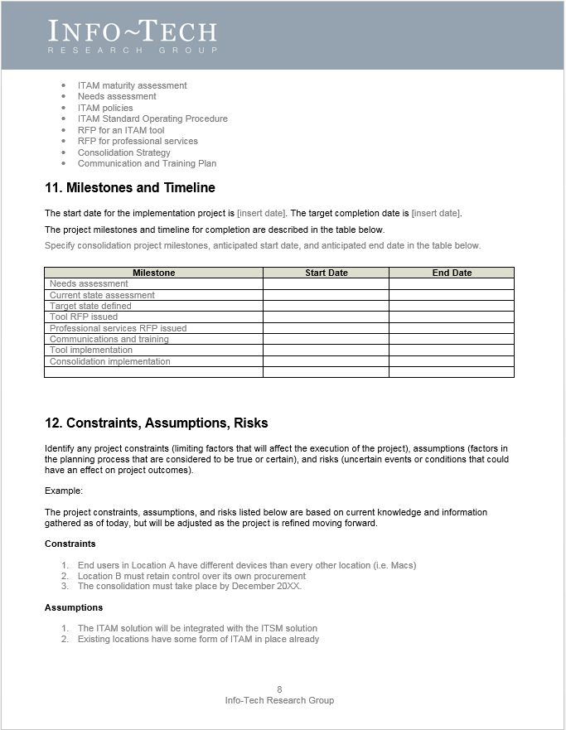
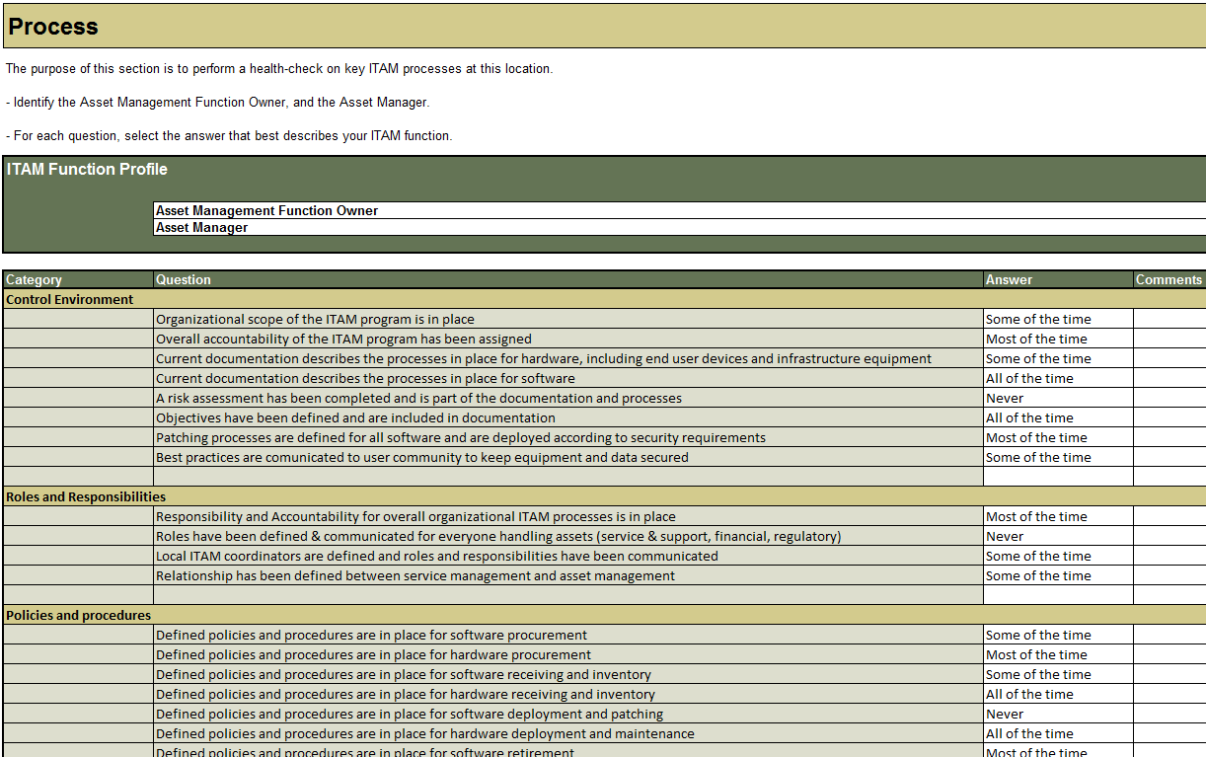
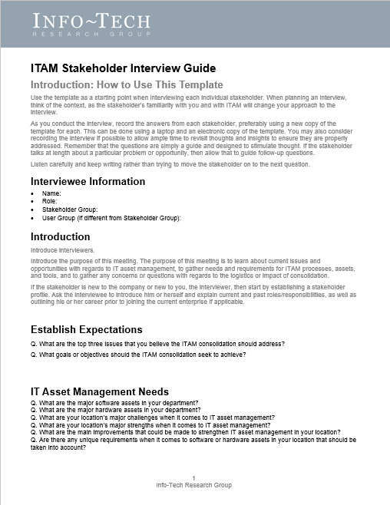
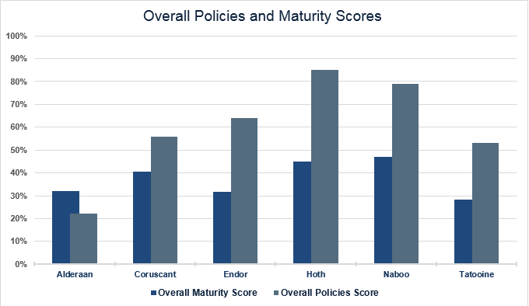
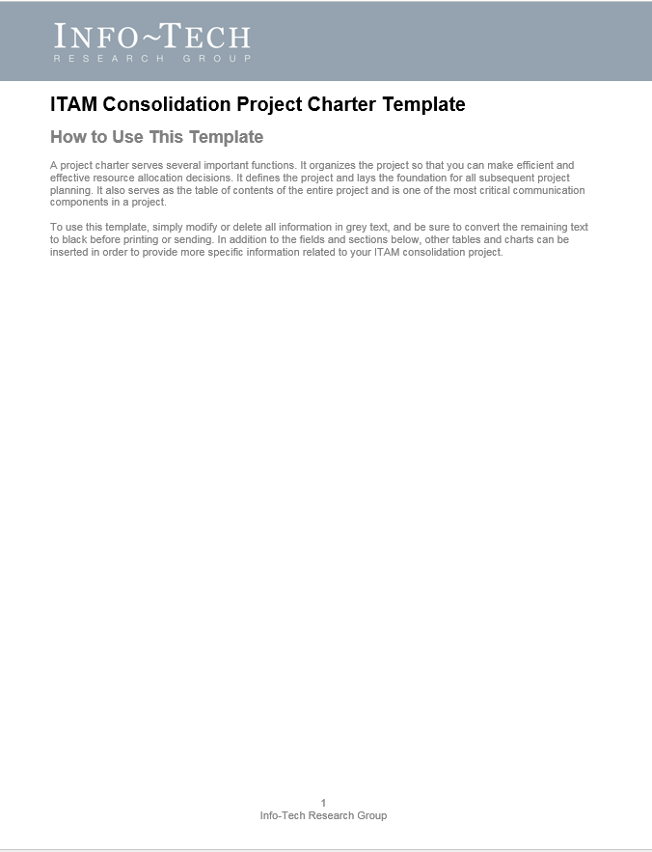
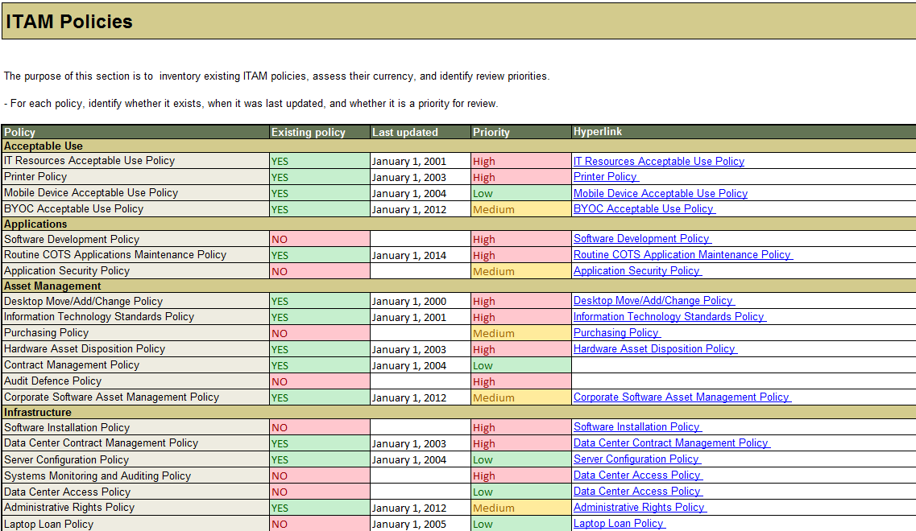
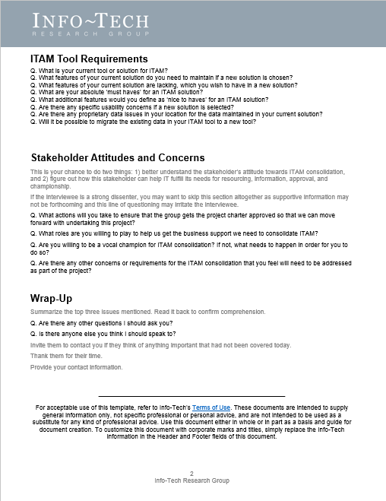
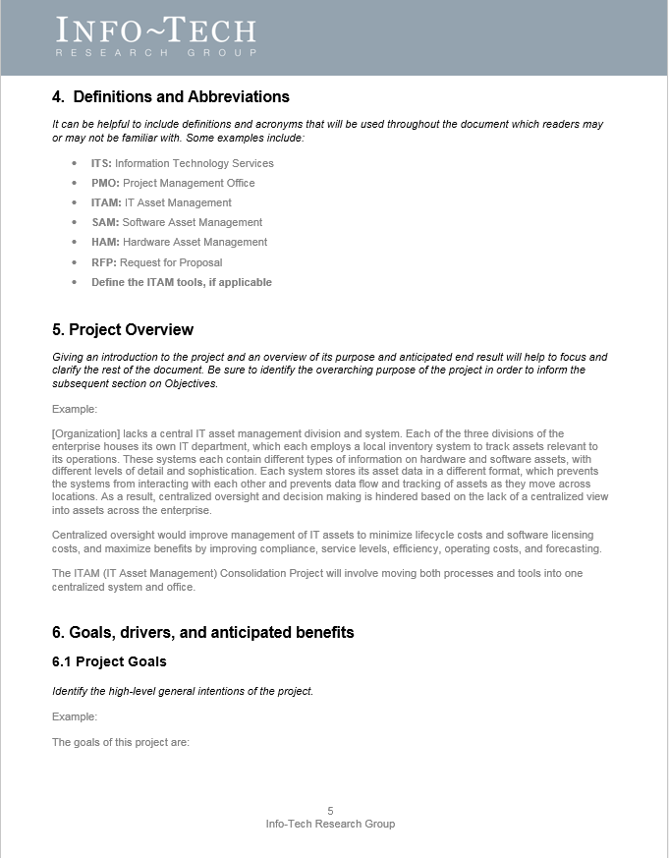
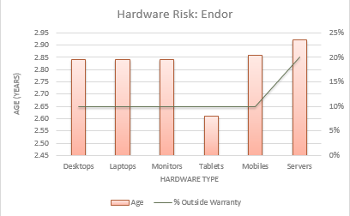
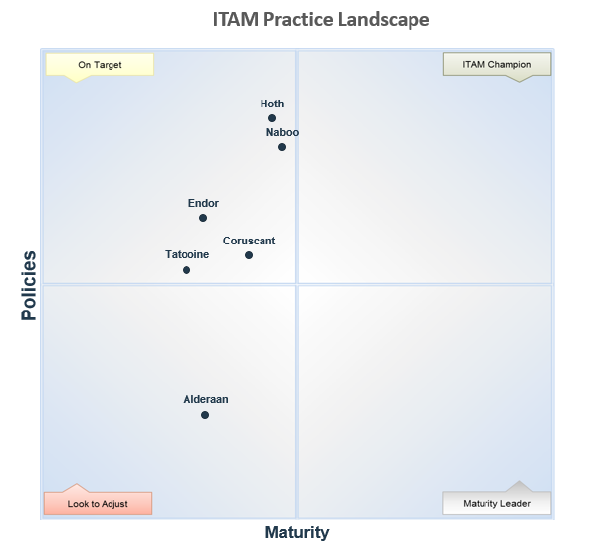
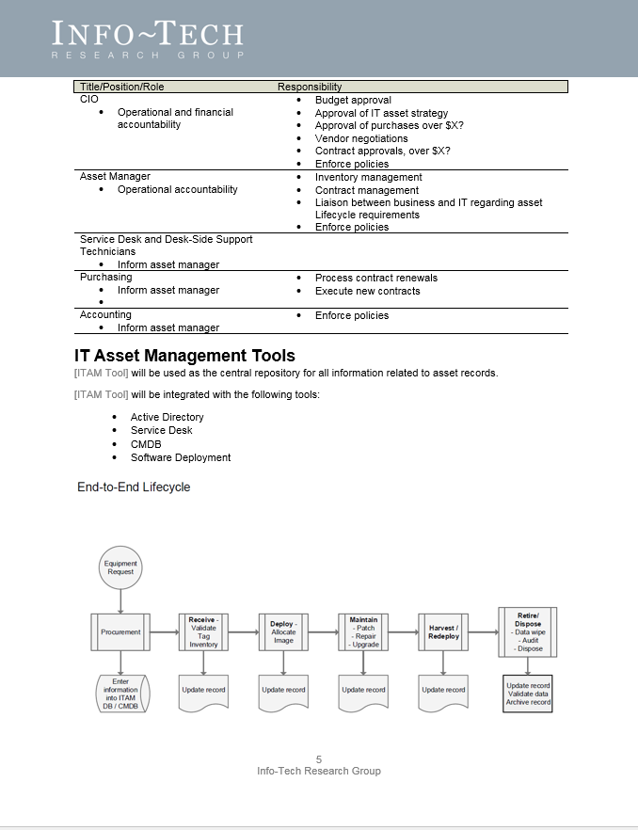
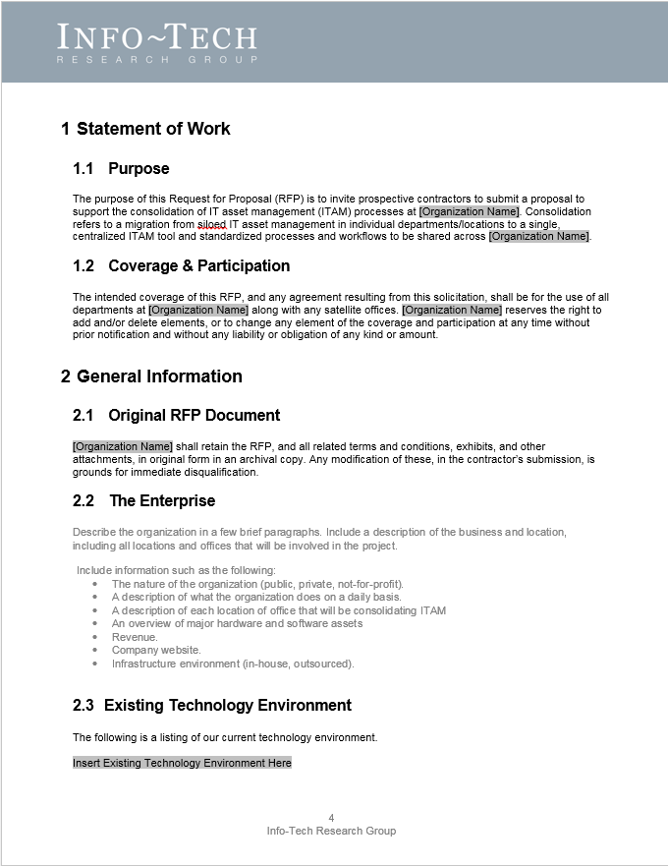
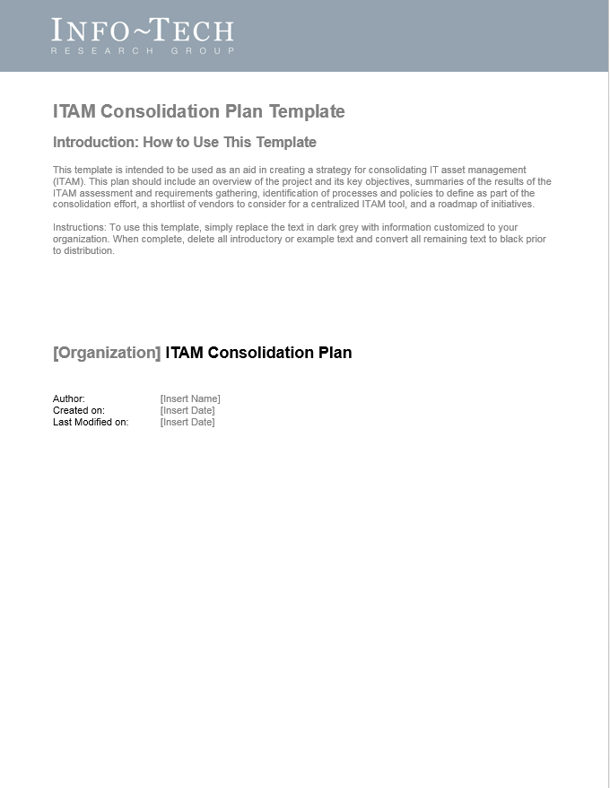
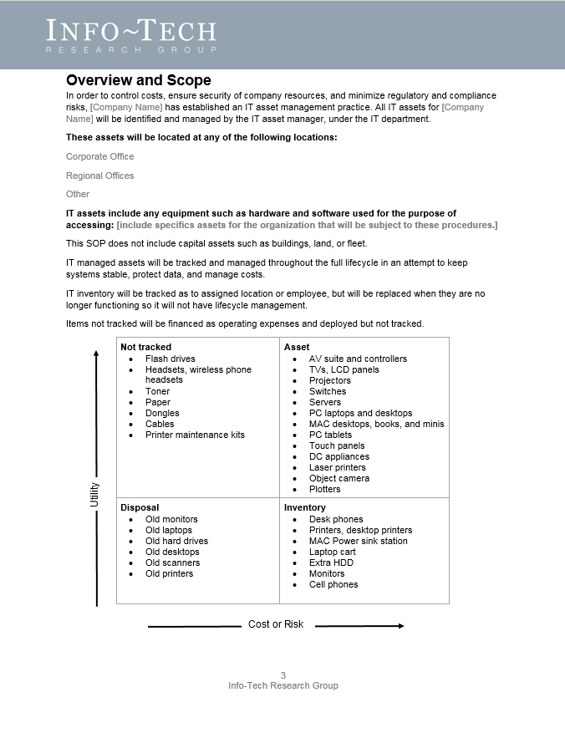
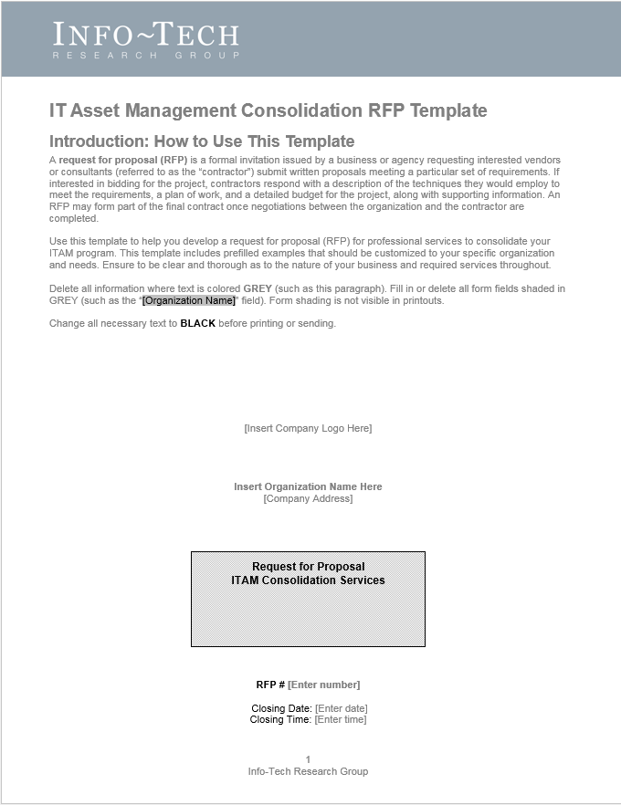
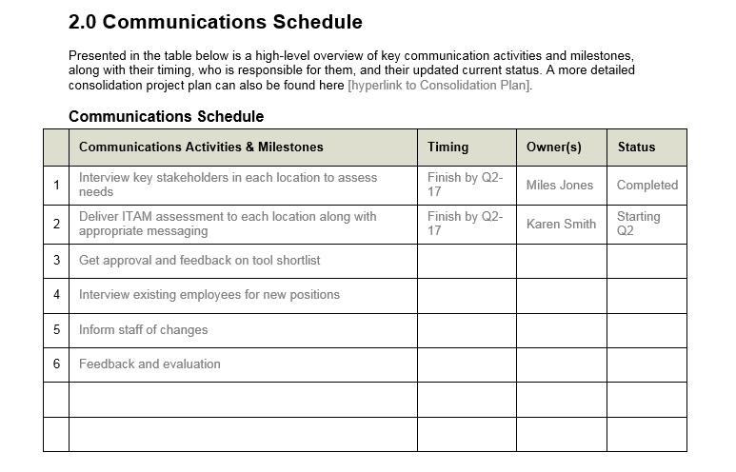
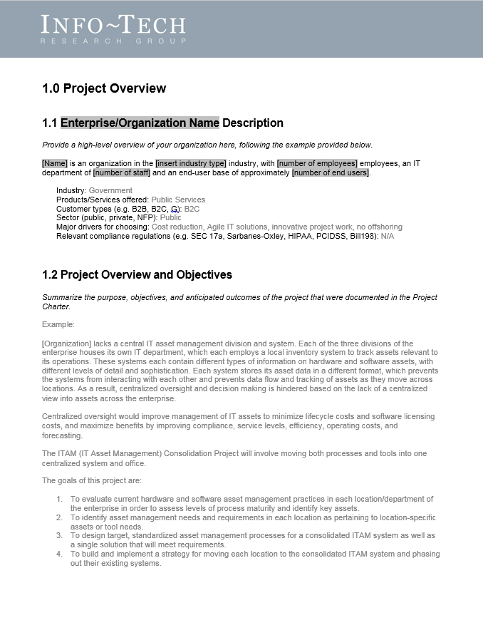
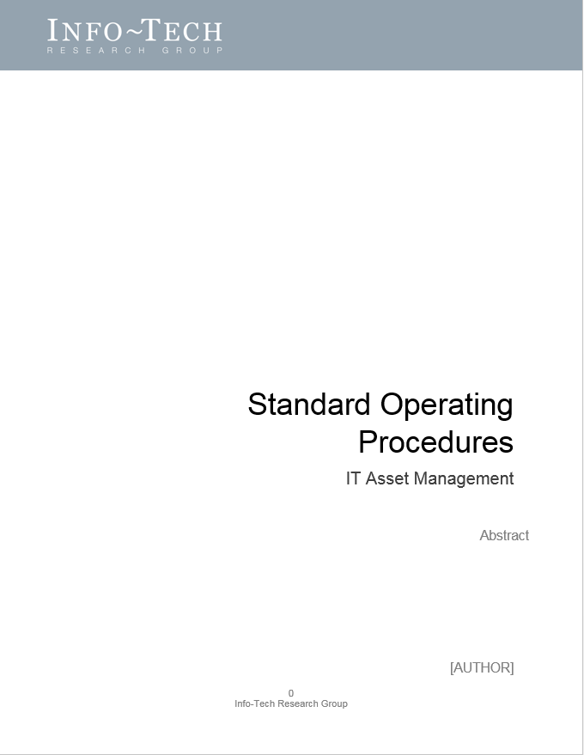
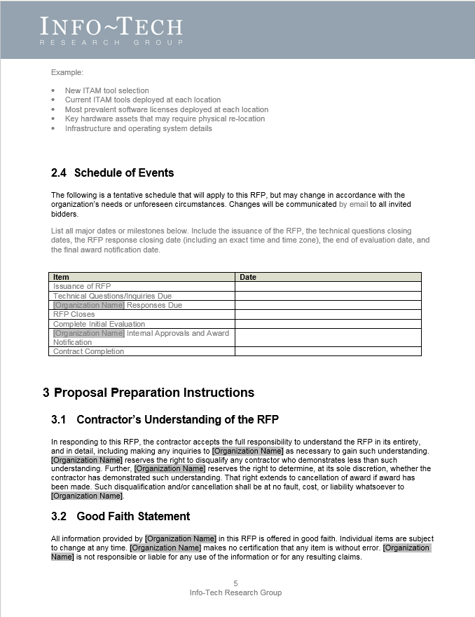
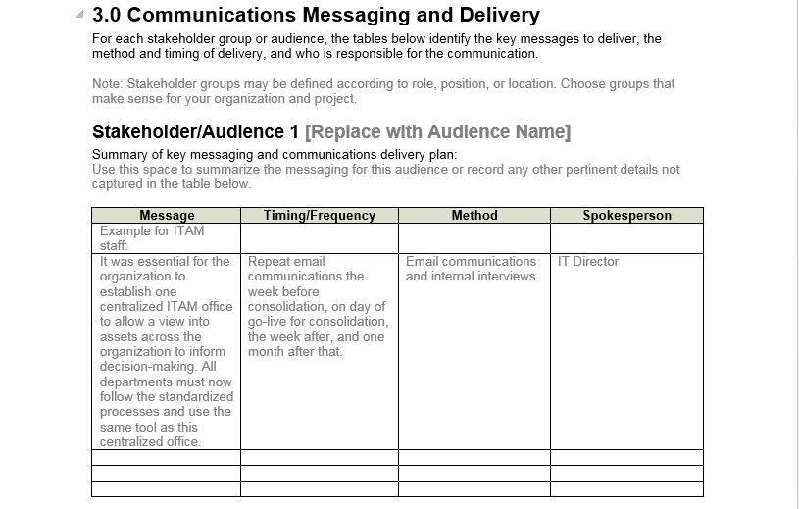
Info-Tech delivers: Use our tools and templates to accelerate your project to completion
ITAM Consolidation Project Charter
ITAM Assessment Tool
ITAM Stakeholder Interview Guide
ITAM Assessment Scorecard Tool
IT Asset Management SOP and ITAM Job Descriptions
ITAM Consolidation RFP (for professional services)
ITAM Consolidation Plan
ITAM Consolidation Communications and Training Plan

Slide 20
Measured value for Guided Implementations (GIs)
Engaging in GIs doesn’t just offer valuable project advice, it also results in significant cost savings.
GI | Measured Value
Phase 1: Assess Current ITAM Programs and Data | Time, value, and resources saved by using Info-Tech’s methodology to initiate the project and assess current ITAM processes and data. For example, 2 FTEs * 10 days * $80,000/year = $6,200
Phase 2: Plan Consolidated ITAM | Time, value, and resources saved by using Info-Tech’s tools and templates to compare data, assess requirements, and design the consolidated ITAM program. For example, 2 FTEs * 5 days * $80,000/year = $3,100
Phase 3: Develop Transition Plan | Time, value, and resources saved by following Info-Tech’s tools and methodology to develop a consolidation plan and communicate the change. For example, 1 FTE * 5 days * $80,000/year = $1,500
Total savings | $10,800

Slide 21
Workshop overview
Contact your account representative or email Workshops@InfoTech.com for more information.
 | Pre-Workshop | Workshop Day 1 | Workshop Day 2 | Workshop Day 3 | Workshop Day 4
Activities | Module 0: Gather relevant data 0.1 Send ITAM Assessment Tool to each location to have them assess their ITAM process, policies, software, and hardware. 0.2 Interview stakeholders in each location to assess needs and requirements (if members of each location will be in attendance, this could be done in the workshop). | Module 1: Initiate the project 1.1 Identify key stakeholders and develop an engagement plan. 1.2 Assemble project team and assign roles and responsibilities. 1.3 Define drivers, objectives, anticipated benefits, objectives, and metrics for project. 1.4 Complete a project charter to guide the consolidation. 1.5 Review data collected from the Assessment Tool to ensure completeness and add to Scorecard Tool. | Module 2: Assess data and requirements 2.1 Review stakeholder interview results to evaluate needs in each location. 2.2 Build a requirements list for an ITAM tool. 2.3 Use the Scorecard Tool to compare ITAM processes, policies, software, and hardware across locations. 2.4 Identify best practices and areas of weakness. | Module 3: Design consolidated ITAM program 3.1 Identify ITAM processes and policies to extend, review, and revise, or create and assign responsibility. 3.2 Define and document ITAM policies and procedures in SOP. 3.3 Develop ITAM staffing roles and responsibilities. 3.4 Develop an ITAM tool shortlist and RFP. | Module 4: Plan the transition and communications 4.1 Build a plan to achieve the consolidation. 4.2 Identify initiatives needed to reach target state and prioritize them in a roadmap. 4.3 Decide whether to hire professional services to assist with the consolidation. 4.4 Develop a communications plan. 4.5 Develop a plan for project evaluation, next steps, and continual improvement.
Deliverables | ITAM Assessment Tool ITAM Stakeholder Interview Guide | Project Charter ITAM Assessment Tool | ITAM Stakeholder Interview Guide ITAM Assessment Scorecard Tool | IT Asset Management SOP ITAM Policies ITAM Job Descriptions ITAM Vendor Shortlist Tool and RFP Template | RFP for Professional Services (if applicable) ITAM Consolidation Plan Communications Plan

Slide 22
Use these icons to help direct you as you navigate this research
Use these icons to help guide you through each step of the blueprint and direct you to content related to the recommended activities.
This icon denotes a slide where a supporting Info-Tech tool or template will help you perform the activity or step associated with the slide. Refer to the supporting tool or template to get the best results and proceed to the next step of the project.
This icon denotes a slide with an associated activity. The activity can be performed either as part of your project or with the support of Info-Tech team members, who will come onsite to facilitate a workshop for your organization.

