Slide 1
Transition Licensing to the Microsoft Cloud
The cloud is coming – be prepared with a proactive strategy.
Info-Tech's products and services combine actionable insight and relevant advice with ready-to-use tools and templates that cover the full spectrum of IT concerns.© 1997 – 2016 Info-Tech Research Group

Slide 2
ANALYST PERSPECTIVE
Like it or not, Microsoft’s cloud is on its way.
Hyped up and hailed as a revolutionary technology, the cloud is changing the way businesses work. Microsoft has made a strong push to move customers to the cloud. If your reseller or your executive team hasn’t already suggested a cloud transition, they will soon.
But that doesn’t mean it’s a good fit. Moving to the cloud might not make sense functionally or financially for your organization. Before your leadership starts asking about the cloud, understand whether it’s a viable option. Examine your IT strategy and document whether or not the cloud works for your business goals and is financially feasible.
It’s time to take a careful look at your current licensing position and your organization’s needs – does the cloud make sense? Get ready to justify and defend your position either way.
Scott Bickley
Senior Director, Vendor Practice
Vendor and Custom Research Info-Tech Research Group

Slide 3
Our understanding of the problem
Organizations examining a move to the cloud.
IT managers scoping their Microsoft licensing requirements.
CIOs and IT directors negotiating licensing agreements and looking to save money.
IT and business leaders seeking to better understand Microsoft licensing and evaluate cloud options.
Understand Microsoft’s cloud offerings.
Evaluate if transitioning to a Microsoft cloud product is viable and beneficial.
CFOs and the finance department
Vendor management
Software asset managers
Align Microsoft licensing to business goals
Optimize spend
Maintain licensing compliance

Slide 4
Executive summary
Microsoft is making a big push to move the customer base to the cloud. Resellers are being heavily incentivized to sell cloud products.
This guarantees Microsoft annual revenue where historically organizations may not have purchased products for years at a time.
A move to the cloud may be coming, but you need to evaluate what makes sense for you.
Discuss and document your position. Document your position on the cloud – whether that means transitioning or not, make sure you can justify your position to your organization.
There’s no turning back. Once you’ve committed to the cloud, it’s difficult to go back to on-premise licensing. Be certain the cloud is a good fit before executing.
If the cloud doesn’t fit, it’s time to start making room. Most organizations are still at a stage where they can keep their on-premise licensing. But this will likely change over the next couple of years – the cloud is imminent, if not inevitable. If the cloud doesn’t make sense now, start thinking about how you might make it work in the future.
While there are benefits, there are critical reasons organizations are delaying or refusing to move to the cloud in the near future.
For those looking to make the move, there are many different ways to license, purchase, and deploy the cloud products, making it challenging to know how to maximize your organization’s benefits.
Understand what your organization needs and why before you commit to moving to the cloud. It’s always easier to purchase more later than to try to reduce your spend.
Complete cost calculations carefully as the cloud might end up costing significantly more for the desired feature set. In some scenarios, it may be more cost efficient for organizations to license in the cloud.
If there are significant barriers to cloud adoption, discuss and document them. You’ll need this documentation in three years when it’s time to renew your agreement.

Slide 5
When the cloud makes sense
CASE STUDY
Industry
Source
Airline
Microsoft
British Airways
British Airways employs a large workforce that works primarily outside the office. They comprise over 41,000 employees, in more than 75 countries, serving 37.5 million customers annually.
O365 and Yammer Adoption
Staff who did not work in front of PCs needed a way to communicate, collaborate, and access data on the go. Top down communications were an issue: since many staff do not work in front of PCs with their own email, corporate announcements were sent through several different communication channels, including the postal service. They also used four different email clients that made sharing calendars very difficult. The airline started with a small group of early adopters and then expanded to the rest of the company.
Results
The adoption provided a whole new set of tools to deskless workers. Yammer allowed employees to communicate quickly, an especially important need when faced with customer service issues. O365 has synchronized their communication, helping them better achieve their business goals.
“We heard repeatedly that they were more productive at home with their own devices than they were at work. Mobility and flexibility; anywhere, anytime access to data; real-time communications; sharing and storing files in a secure manner online – all these capabilities pointed us to Microsoft Office 365.”

Slide 6
Transition Microsoft Cloud Licensing – project overview
1. Review and Document Current License Usage
2. Map Microsoft’s Cloud Offerings to Needs
3. Negotiate the Cloud Transition
Best-Practice Toolkit | 1.1 Gather licensing documentation. 1.2 Build an effective license position (ELP). 1.3 Incorporate licensing shortfalls into cloud transition plan. | 2.1 Determine functionality requirements. 2.2 Evaluate licensing options. 2.3 Choose your licenses. | 3.1 Licensing negotiation due diligence. 3.2 Choose your licensing negotiation strategy.
Guided Implementations | Gather documentation. Build an ELP. Incorporate licensing shortfalls into the cloud transition plan. | Sort licensing groups by functional need. Model your licensing costs. Assess and plan your transition. | Negotiation due diligence. Leverage your unique position.
Onsite Workshop | Module 1: Document your ELP. | Module 2: Match offerings to needs. | Module 3: Negotiate effectively.
 | Phase 1 Outcome: ELP Purchasing reference guide | Phase 2 Outcome: Licensing needs documented Licensing options assessed | Phase 3 Outcome: Negotiation strategy

Slide 7
Workshop overview
Contact your account representative or email Workshops@InfoTech.com for more information.
 | Workshop Day 1 | Workshop Day 2 | Workshop Day 3 | Workshop Day 4 | Workshop Day 5
 | Assemble and Review Documentation 1.1 Send workshop agenda to all workshop participants. 1.2 Obtain and review Microsoft ELP. 1.3 Identify Microsoft cloud options that align with ELP and desired future state goals. | Identify and Review Current State vs. Future State 2.1 Cloud transition framework overview. 2.2 Align technology and business goals to workshop; review business feedback. 2.3 Map future state license options for cloud products. | Analyze Gaps and Plan Cloud Licenses 3.1 Identify gaps between on-premise current state with cloud/hybrid future state. 3.2 Identify product license changes, requirements, and license rules. 3.3 Model high-level cost impact. | Develop Cloud Transition Strategy Options 4.1 Document licensing migration paths for cloud/hybrid future state. 4.2 Discuss migration options, costs, and overall license strategy. 4.3 Develop cloud migration product list and action items. | Present Cloud Transition Options and Costs 5.1 Prepare final deliverables. 5.2 Finalize viable migration options and costs.
 | Effective Licensing Position (ELP) Microsoft Cloud Products Cost Modeler | Cloud Decision Flowchart | Pricing Estimator Gap Analysis Assessment | Negotiation Decision Flowchart | Final Report & Strategy Document
Activities
Deliverables

Slide 8
Microsoft’s cloud-first, mobile-first strategy is paying off
By 2018, Microsoft expects commercial cloud revenues to exceed
$20B
driven by Office 365, Azure, and Dynamic CRM Online
and is now on an annualized revenue run rate of
$12.1 billion
Commercial cloud growth of 80%
Azure cloud growth of 102%
Cloud customer base has doubled over the
past 12 months
Source: Todd, Deborah M. “Cloud business boosts Microsoft’s quarterly revenue, shares rise.” Reuters.
Source: Taft, Darryl K. “Microsoft Continues to See Impact of Transition to Cloud.” eWeek.

Slide 9
Transition to the cloud is inevitable, if not imminent
Info-Tech Insight
Your investment in Microsoft cloud licensing will increase in the next three years. Microsoft is in the process of making cloud products your default option. New products with additional features are being developed only in the cloud leading to on-premise versions that will eventually lag in functionality.
The world has become more interconnected, more mobile, more innovative, and more complex.
[We want to empower] employees to contribute and collaborate whether they’re behind their desks, in a conference room, on a plane, at a hotel, or home. That flexibility allows people to do their best, achieve their highest potential, and be part of a team.
– Blair Christie, former Senior Vice President and Chief Marketing Officer at Cisco
Users work anywhere, anytime, on any device.
We work with more people on a day-to-day basis today than ever before.
– Richard Harbridge, SharePoint specialist
The number of very small companies using a paid cloud solution will potentially triple in the next 3 years.
– Microsoft

Slide 10
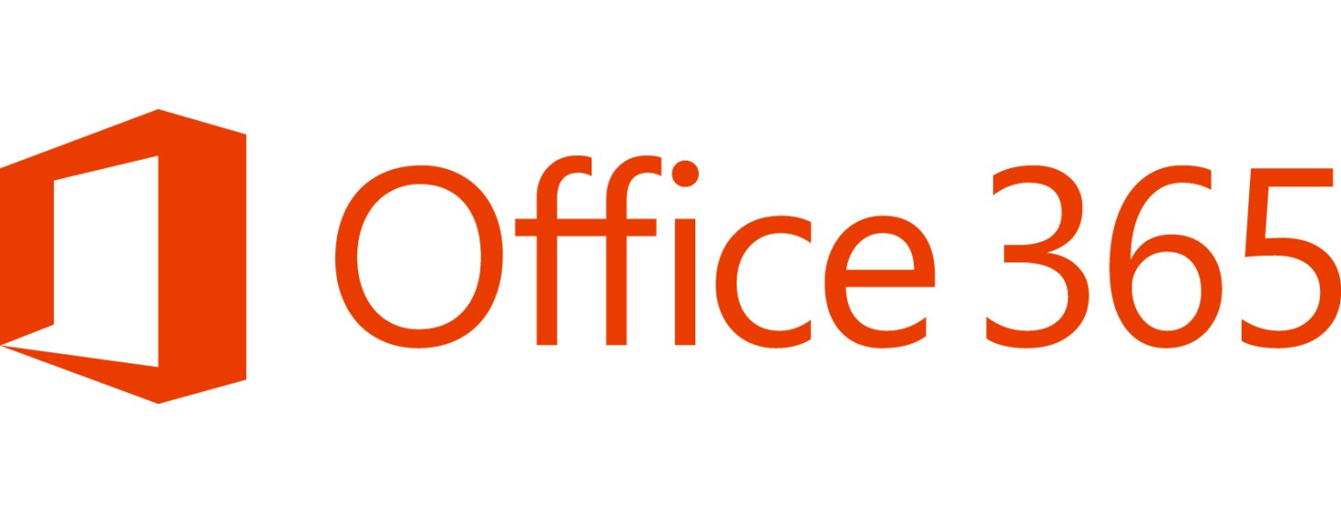
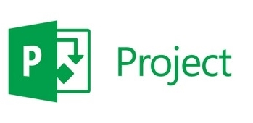
Consider more than just Office 365 – Microsoft offers six different products that can be deployed in the cloud
Microsoft Office, as well as Yammer, Lync/Skype for Business, OneNote, Publisher, and Access
Enables employees to work from virtually anywhere on almost any device
Provides mobile device management, mobile application management, and PC management capabilities
Intune is a per user subscription and a component of the EMS
Platform and infrastructure for building, deploying, and managing applications
Empowers organizations with the creation of innovative applications
Enterprise resource planning (ERP) and customer relationship management (CRM) software applications
Project management software
Provides the same functionality as on-premise product
Diagramming and vector graphics application
Provides the same functionality as on-premise product

Slide 11
There are benefits to the cloud; examine common criteria when evaluating a move
True Up or Down
15 Devices
Excellent Cloud Security
Enabled Collaboration
Once a year you will have the ability to true up or true down your licenses. Historically, only an annual true-up was possible, adding to cumulative SA costs.
Microsoft has increased the number of devices that can be used with O365 licenses enabling shared devices.
Microsoft has invested hundreds of millions of dollars into security for its cloud. It knows that with a single breach, many organizations will be searching for an alternative.
Microsoft is continuously increasing integration and collaboration capabilities within its products. Exchange, SharePoint, Skype, and Office have all seen changes in recent years.
99.9% Uptime
User-Based Licensing
Automatic Updates
Reduce Infra Costs
Corporations can lose millions or hundreds of millions of dollars in the event of downtime.
Microsoft has a 99.9% uptime guarantee.
Historically, licensing has been device based, as BYOD and multiple devices weren’t prominent.
User licensing allows for multiple devices and is approximately 30% more expensive than licensing one device.
If you want to reduce time spent on providing patches and updates, Microsoft wants to automate tasks leaving you more time to work on other areas of your business.
Instead of having to replace hardware every 3-4 years, moving to Microsoft’s cloud can move you out of the hardware management space and help you focus on performance.
Fifty-six percent of enterprises consider cloud to be a strategic differentiator, and approximately fifty-eight percent of enterprises spend more than 10 percent of their annual budgets on cloud services. – ICD

Slide 12
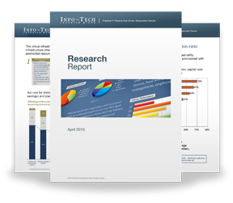
Info-Tech Research Group Helps IT Professionals To:
Quickly get up to speed with new technologies
Make the right technology purchasing decisions – fast
Deliver critical IT projects, on time and within budget
Manage business expectations
Justify IT spending and prove the value of IT
Train IT staff and effectively manage an IT department
Sign up for free trial membership to get practical
solutions for your IT challenges
“Info-Tech helps me to be proactive instead of reactive – a cardinal rule in a stable and leading edge IT environment.
- ARCS Commercial Mortgage Co., LP
Toll Free: 1-888-670-8889
www.infotech.com

