Slide 1
Build a Strong Technology Foundation for
Customer Experience Management
Design an end-to-end technology strategy to enhance marketing effectiveness, drive sales, and create compelling customer service experiences.
Info-Tech's products and services combine actionable insight and relevant advice with ready-to-use tools and templates that cover the full spectrum of IT concerns.© 1997-2019 Info-Tech Research Group

Slide 2
ANALYST PERSPECTIVE
Technology is the catalyst to create – and keep! – your customers.
Customers want to interact with your organization on their own terms, and in the channels of their choice (including social media, mobile applications, and connected devices). Regardless of your industry, your customers expect a frictionless experience across the customer lifecycle. They desire personalized and well-targeted marketing messages, straightforward transactions, and effortless service. Research shows that customers value – and will pay more for! – well-designed experiences.
Strong technology enablement is critical for creating customer experiences that drive revenue. However, most organizations struggle with creating a cohesive technology strategy for customer experience management (CXM). IT leaders need to take a proactive approach to developing a strong portfolio of customer interaction applications that are in lockstep with the needs of their marketing, sales, and customer service teams. It is critical to incorporate the voice of the customer into this strategy.
When developing a technology strategy for CXM, don’t just “pave the cow path,” but instead move the needle forward by providing capabilities for customer intelligence, omnichannel interactions, and predictive analytics. This blueprint will help you build an integrated CXM technology roadmap that drives top-line revenue while rationalizing application spend.
Ben Dickie
Research Director, Customer Experience Strategy
Info-Tech Research Group
Info-Tech Research Group
SAMPLE

Slide 3
Framing the CXM project
IT leaders who are responsible for crafting a technology strategy for customer experience management (CXM).
Applications managers who are involved with the selection and implementation of critical customer-centric applications, such as CRM platforms, marketing automation tools, customer intelligence suites, and customer service solutions.
Clearly link your technology-enablement strategy for CXM to strategic business requirements and customer personas.
Build a rationalized portfolio of enterprise applications that will support customer interaction objectives.
Adopt standard operating procedures for CXM application deployment that address issues such as end-user adoption and data quality.
Business leaders in marketing, sales, and customer service who want to deepen their understanding of CXM technologies, and apply best practices for using these technologies to drive competitive advantage.
Marketing, sales, and customer service managers involved with defining requirements and rolling out CXM applications.
Work hand-in-hand with counterparts in IT to deploy high-value business applications that will improve core customer-facing metrics.
Understand the changing CXM landscape and use the art of the possible to transform the internal technology ecosystem and drive meaningful customer experiences.
Info-Tech Research Group
SAMPLE

Slide 4
Executive summary
Customer expectations for personalization, channel preferences, and speed-to-resolution are at an all-time high.
Your customers are willing to pay more for high-value experiences, and having a strong customer CXM strategy is a proven path to creating sustainable value for the organization.
IT can’t hide behind the firewall. IT must understand the organization’s customers to properly support marketing, sales, and service efforts.
IT – or Marketing – must not build the CXM strategy in a vacuum if they want to achieve a holistic, consistent, and seamless customer experience.
IT must get ahead of shadow IT. To be seen as an innovator within the business, IT must be a leading enabler in building a rationalized and integrated CXM application portfolio.
Technology is a fundamental enabler of an organization’s CXM strategy. However, many IT departments fail to take a systematic approach to building a portfolio of applications to support Marketing, Sales, and Customer Service.
The result is a costly, ineffective, and piecemeal approach to CXM application deployment (including high profile applications like CRM).
IT must work in lockstep with their counterparts in marketing, sales, and customer service to define a unified vision, strategic requirements and roadmap for enabling strong customer experience capabilities.
In order to deploy applications that don’t simply follow previously established patterns but are aligned with the specific needs of the organization’s customers, IT leaders must work with the business to define and understand customer personas and common interaction scenarios. CXM applications are mission critical and failing to link them to customer needs can have a detrimental effect on customer satisfaction – and ultimately revenue.
IT must act as a valued partner to the business in creating a portfolio of CXM applications that are cost effective.
Organizations should create a repeatable framework for CXM application deployment that addresses critical issues, including the integration ecosystem, customer data quality, dashboards and analytics, and end-user adoption.
Info-Tech Research Group
SAMPLE

Slide 5
Guide to frequently used acronyms
Customer Experience Management
Request for Proposal
CXM
RFP
Software as a Service
CX
SaaS
Customer Experience
Customer Relationship Management
CRM
Customer Service Management
CSM
Marketing Management System
MMS
Social Media Management Platform
SMMP
Info-Tech Research Group
SAMPLE

Slide 6
Customers’ expectations are on the rise: meet them!
Today’s consumers expect speed, convenience, and tailored experiences at every stage of the customer lifecycle. Successful organizations strive to support these expectations.
5 CORE CUSTOMER EXPECTATIONS
1 More personalization
2 More product options
3 Constant contact
4 Listen closely, respond quickly
5 Give front-liners more control
Source: Customer Experience Insight, 2016
67%
of end consumers will pay more for a world-class customer experience. 74% of business buyers will pay more for strong B2B experiences.
Source: Salesforce, 2018
Customers expect to interact with organizations through the channels of their choice. Now more than ever, you must enable your organization to provide tailored customer experiences.
Info-Tech Research Group
SAMPLE

Slide 7
Realize measurable value by enabling CXM
Providing a seamless customer experience increases the likelihood of cross-sell and up-sell opportunities and boosts customer loyalty and retention. IT can contribute to driving revenue and decreasing costs by providing the business with the right set of tools, applications, and technical support.
Contribute to the bottom line
Enable cost savings
Cross-sell, up-sell, and drive customer acquisition.
Focus on customer retention as well as acquisition.
67%
of consumers are willing to pay more for an upgraded experience.
6-7x
It is more costly to attract a new customer than it is to retain an existing customer.
Source: Salesforce, 2018
80%:
The margin by which CX leaders outperformer laggards in the S&P 500.
Source: Salesforce Blog, 2019
5%
A increase in customer retention has been found to increase profits by
Source: Qualtrics, 2017
25% to 95%.
59%
of customers say tailored engagement based on past interactions is very important to winning their business.
Source: Bain & Company, n.d.
Source: Salesforce, 2018
Info-Tech Research Group
SAMPLE

Slide 8
Strategic CXM is gaining traction with your competition
Organizations are prioritizing CXM capabilities (and associated technologies) as a strategic investment. Keep pace with the competition and gain a competitive advantage by creating a cohesive strategy that uses best practices to integrate marketing, sales, and customer support functions.
87%
Top Investment Priorities for Customer Experience
of customers share great experiences they’ve had with a company.
Voice of the Customer
Customer Insight Generation
Customer Experience Governance
Customer Journey Mapping
Online Customer Experience
Experience Personalization
Emotional Engagement
Multi-Channel Integration/Omnichannel
Quality & Customer Satisfaction Management
Customer/Channel Loyalty & Rewards Programs
1
2
Source: Zendesk, n.d.
3
61%
4
of organizations are investing in CXM.
5
Source: CX Network, 2015
6
53%
7
of organizations believe CXM provides a competitive advantage.
8
9
Source: Harvard Business Review, 2014
10
Source: CX Network, 2015
Info-Tech Research Group
SAMPLE

Slide 9
Omnichannel is the way of the future: don’t be left behind
Get ahead of the competition by doing omnichannel right. Devise a CXM strategy that allows you to create and maintain a consistent, seamless customer experience by optimizing operations within an omnichannel framework. Customers want to interact with you on their own terms, and it falls to IT to ensure that applications are in place to support and manage a wide range of interaction channels.
Omnichannel is a “multi-channel approach to sales that seeks to provide the customer with a seamless transactional experience whether the customer is shopping online from a desktop or mobile device, by telephone, or in a bricks and mortar store.”
Source: TechTarget, 2014
97%
23%
BUT, ONLY…
of companies say that they are investing in omnichannel.
of companies are doing omnichannel well.
Source: Huffington Post, 2015
Info-Tech Research Group
SAMPLE

Slide 10
CXM applications drive effective multi-channel customer interactions across marketing, sales, and customer service
The success of your CXM strategy depends on the effective interaction of various marketing, sales, and customer support functions. To deliver on customer experience, organizations need to take a customer-centric approach to operations.
From an application perspective, a CRM platform generally serves as the unifying repository of customer information, supported by adjacent solutions as warranted by your CXM objectives.
CXM ECOSYSTEM
Web Experience Management
Platform
Marketing Management
Suite
E-Commerce & Point of Sale Solutions
Customer Relationship Management
Platform
Customer Service Management Tools
Social Media Management
Platform
Customer Intelligence
Platform
Info-Tech Research Group
SAMPLE

Slide 11
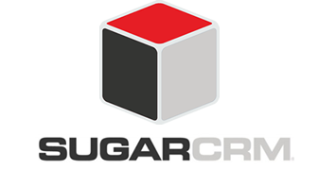
Application spotlight: Customer experience platforms
Description
CXM solutions are a broad range of tools that provide comprehensive feature sets for supporting customer interaction processes. These suites supplant more basic applications for customer interaction management. Popular solutions that fall under the umbrella of CXM include CRM suites, marketing automation tools, and customer service applications.
Features and Capabilities
Highlighted Vendors
Manage sales pipelines, provide quotes, and track client deliverables.
View all opportunities organized by their current stage in the sales process.
View all interactions that have occurred between employees and the customer, including purchase order history.
Manage outbound marketing campaigns via multiple channels (email, phone, social, mobile).
Build visual workflows with automated trigger points and business rules engine.
Generate in-depth customer insights, audience segmentation, predictive analytics, and contextual analytics.
Provide case management, ticketing, and escalation capabilities for customer service.
Info-Tech Research Group
SAMPLE

Slide 12
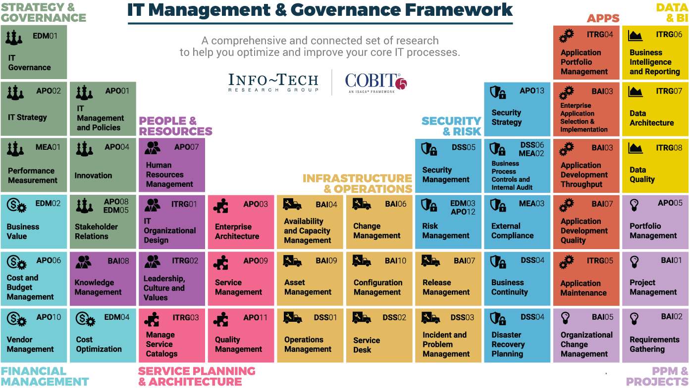
Dive Deeper Into Our Research
by Clicking One of the Elements Below
Find out how Info-Tech makes your job easier. Contact Us Today: Toll-Free (US & Canada): 1-888-670-8889
Info-Tech Research Group
SAMPLE

