Slide 1

Outsource the Service Desk
If your outsourcing project is driven by cost alone, you will fail.

Slide 2


ANALYST PERSPECTIVE
Outsourcing is no longer just a cost-saving move. Make sure you prepare accordingly.
Service desk outsourcing has traditionally been a cost-cutting measure. The rise of the middle class in many offshore outsourcing hubs combined with the evolved role of the service desk to deliver more value to the business has changed the approach of outsourcing.
Many organizations fail to understand that outsourcing excels when your processes have a certain degree of maturity. An outsourcing vendor is not always in the business of fixing problems; they provide managed services. Before you make the decision to outsource, you need to assess where your service desk is now, where you want it to go, and the cost and effort involved. Outsourcing without defining your requirements, processes, and escalations will result in services provided to match the outsourcer’s needs rather than your company needs.
Outsourcing will create value for your organization. Just make sure the necessary work is completed beforehand.
Sandi Conrad,
Senior Director, Infrastructure Practice
Info-Tech Research Group

Slide 3
Our understanding of the problem
IT leaders and service desk managers interested in outsourcing the service desk or portions of service management.
Business leaders involved in the IT department’s decision making.
Understand the rationale behind outsourcing the service desk and decide whether it’s the right move for you.
Organize and standardize the service desk to allow for a future move.
Determine the right approach to moving the service desk to a different organization.
Ensure that the service desk can be rebuilt if outsourcing is unsuccessful.
Service desk staff affected by the moving of support services.
Business executives who will need to be informed of the transition.
Understand the impact that outsourcing would have on the service desk.
Understand the potential benefits that outsourcing can bring to the organization.

Slide 4
Executive summary
In organizations where technical support is viewed as non-strategic, many see outsourcing as a cost-effective solution. However, outsourcing projects often fall short of their goals in terms of cost savings and support quality.
If you are outsourcing only to save money, you will fail. The goal of outsourcing should be to improve key service metrics, not reduce costs.
Poor processes won’t disappear by outsourcing; they’ll merely be relocated. Take time to define processes and standardize workflows before outsourcing.
Don’t let the outsource service provider dictate your services and service levels. Set clear expectations for service up-front, and have an exit strategy in case service levels are not met.
Significant administrative work and up-front costs are required to outsource the service desk, and poor planning often results in project failure and decreases in end-user satisfaction
A complete turnover of the service desk can result in lost knowledge and control over processes, and organizations without an exit strategy can struggle to bring their service desk back in house and return the confidence of end users.
First decide if outsourcing is the correct step; there may be more preliminary work to do beforehand.
Assess current processes and make necessary adjustments before developing an outsource/repatriate RFP.
Clearly define the project and produce an RFP to provide to vendors.
Plan for long-term success, not short-term gains.
Prepare to retain some of the higher level service desk work.
Develop a plan to execute and manage the transition.

Slide 5




The role of the service desk has evolved and so has the role outsourcing plays
Current Situation
  In the past decade, the role that an outsourced service desk plays in the success of the organization has shifted. The primary motivator for outsourcing has always been cost, but the role of the service desk for many organizations has transcended that of a ticket triage center.
  Today, successful outsourcing transitions are predicated on the improvement of service metrics and delivering value to the business. Cost savings are still present, but these emerge as a by-product of the improvement in service metrics and execution of strategic projects from the service desk.
Where This Project Fits
  Before a service desk can be outsourced, its processes and structure need to reach a certain degree of maturity. Perform a feasibility assessment to achieve an accurate understanding of the outsourcing project.
  A detailed outsourcing strategy ensures a clear vision of the project. This feeds into the development of a comprehensive RFP; the more detailed the RFP, the better your respondents’ proposals will match your needs. A thorough evaluation of these replies must be done before an outsourcing partner is selected.

Slide 6





Outsourcing can create substantial value for your organization
A survey of 100 S&P 500 companies valued at $37.3 billion revealed that their IT outsourcing contracts averaged $1.1 billion, with an annual value of $47 million. The survey encompassed the outsourcing of all IT functions including the service desk.
Firms that developed procedural learning (like standardizing processes) and relational learning (developing a relationship with a vendor prior to signing a contract) experienced significant returns on value creation. The average impact was $142 million per contract.
Firms that failed to perform their due diligence actually incurred losses in value creation, but still maintained slight growth on their overall organizational value. The three-year difference in stock price of proactive firms outperformed reactive firms by over 36 percent.
Outsource to create value for your organization, but perform the necessary legwork beforehand to realize the best value for dollar impact. Coordinating with your vendor in terms of continual learning and consistent documentation has long-term implications for value creation and financial performance.

Slide 7

Follow this model to avoid outsourcing pitfalls
Many organizations make the decision to outsource without giving serious thought to their current situation, which only harms them in the long run. Our project model gives heavy emphasis to two of the six project steps to ensure key checkpoints are completed before the project moves forward.
Look for this thought model at the beginning of each step to keep on track with the goals, outcomes, and overarching insights present throughout the step of the project.
1.1 Assess maturity
2.2 Develop RFP
1.2 Assess cost
2.1 Build strategy
3.1 Evaluate responses
3.2 Manage the transition
Phase 1
Phase 2
Phase 3
Service Desk Process Maturity Assessment Tool
Service Desk Efficiency Calculator
Service Desk Outsourcing Strategy Template
Service Desk Outsourcing RFP Template
Service Desk Outsourcing RFP Scoring Tool
Service Desk MSP Interview Template
Step involves greater effort and importance
Step involves average effort and importance

Slide 8
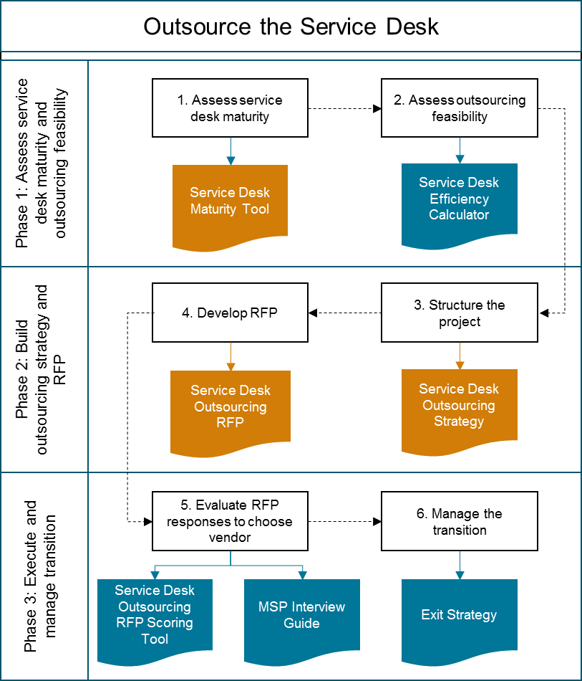

Tools and templates support each step of the project
Project Structure
Key Project Deliverables
A service desk maturity assessment tool (Excel) to assess the maturity of your service desk functions and processes to determine whether outsourcing would be appropriate for your organization.
A service desk outsourcing strategy (Word) to document your project goals, requirements, responsibilities, and metrics.
A service desk outsourcing request for proposal (RFP) template (Word) to structure and document your current and future requirements from an outsourcing vendor.

Slide 9
Map your project goals to the overarching insight for each step
  Treat outsourcing like a relay race. In order to hand off your service desk to an outsourcer effectively, you need to have it operating at a certain level of maturity. Otherwise your organization won’t be up to speed, the transition won’t be smooth, and it will cost you the race.
1.1
  Get the whole team involved to avoid a pure business decision. One of the biggest issues with outsourcing is using cost as the ultimate determinant. Outsourcing affects the entire organization, not just the bottom line. Gain stakeholder buy-in from the beginning and present a compelling case motivated by a variety of factors, not just cost.
1.2
  Make a list before you go shopping. Each organization is different and those that dictate the terms of the engagement with their vendor experience higher gains in value and a better relationship throughout the contract, reducing the (very expensive) risk of terminating the agreement. A clear strategy will allow your organization to proceed with confidence.
2.1
  The vendor wants your business; make them work for it. A quality RFP covers all of the bases and ensures that the DNA of your strategy is embedded in the document. Avoid the “one-size-fits-all” solution provided by vendors; a customized solution yields better returns.
2.2
  Don’t bite on the least expensive proposal. It’s a common sales tactic to use a low price as an easy solution. Carefully evaluate the vendors on your short-list and ensure that SLAs, culture, and price all match to your organization.
3.1
  All outsourcing contracts are finite. Plan for the inevitable expiry date. Exit strategies are often avoided due to the sensitive nature of contract termination. By defining a clear exit strategy at the beginning of the contract process, you hold your vendor accountable and make them work to retain your business through a re-negotiated contract.
3.2

Slide 10
Info-Tech draws on the COBIT framework, which focuses on consistent delivery of IT services across the organization
 | Evaluate, Direct, and Monitor
 | EDM01 Ensure Governance Framework Setting and Maintenance | EDM02 Ensure Benefits Delivery | EDM03 Ensure Risk Optimization | EDM04 Ensure Resource Optimization | EDM05 Ensure Stakeholder Transparency |  |  |  | Monitor, Evaluate, and Assess
 | Align, Plan, and Organize
 | APO01 Manage the IT Framework | APO02 Manage Strategy | APO03 Manage Enterprise Architecture | APO04 Manage Innovation | APO05 Manage Portfolio | APO06 Manage Budget and Costs | APO07 Manage Human Resources |  | MEA01 Monitor, Evaluate, and Assess Performance and Conformance
 | APO08 Manage Relationships | APO09 Manage Service Agreements | APO10 Manage Suppliers | APO11 Manage Quality | APO12 Manage Risks | APO13 Manage Security
 | Build, Acquire, and Implement
 | BAI01 Manage Programs and Projects | BAI02 Manage Requirements Definition | BAI03 Manage Solutions Identification and Build | BAI04 Manage Availability and Capacity | BAI05 Manage Organizational Change Enablement | BAI06 Manage Changes | BAI07 Manage Change Acceptance and Transitioning |  | MEA02 Monitor, Evaluate, and Assess the System of Internal Control
 | BAI08 Manage Knowledge | BAI09 Manage Assets | BAI10 Manage Configuration
 | Deliver, Service, and Support
 | DSS01 Manage Operations | DSS02 Manage Service Requests and Incidents | DSS03 Manage Problems | DSS04 Manage Continuity | DSS05 Manage Security Services | DSS06 Manage Business Process Controls |  |  | MEA03 Monitor, Evaluate, and Assess Compliance with External Requirements

Slide 11



This blueprint illustrates the scope of each phase of the project with relevant case studies
0
Australia’s largest household products company needed to streamline its service desk operations to focus on strategic projects. This in-depth case study focuses on how it developed an innovative solution with an outsourcing partner.
1
Before it was acquired by Dell, Everdream was a rapidly growing software company that needed to outsource its service desk to cut costs. This case study focuses on the importance of matching the needs of your end users with the vendor.
2
Lone Star College had a standardization issue across its six campuses and over 100,000 end users. This case study investigates the importance of matching your needs and tool(s) to your vendor’s.
3
A private medical college outsourced its after-hours support. Diligent monitoring revealed that SLAs were not being met. An ultimatum and exit strategy were instigated in an effort to solve the issue.

Slide 12

How Reckitt Benckiser turned its IT help desk outside-in
CASE STUDY
Industry
Source
Cleaning Products
PicNet
Reckitt Benckiser
The world’s leader in household cleaning products, Reckitt Benckiser, has operations in 60 countries and its products are sold in 180 countries.
Enterprise Information Management Initiative
The Australian division of Reckitt Benckiser performed a maturity assessment of their service desk. Based on multiple factors revealed during the assessment, it was determined that outsourcing the service desk to an external vendor was the best solution.
Results
Reckitt Benckiser Australia saw numerous benefits as a result of the outsourcing including:
Faster response times
Significant savings
Onsite staff can focus on strategic projects.
Hybrid Outsourced
Service Desk Structure:
External Vendor
Tier 3 – In-house
Tier 2 –
In-house
Tier 1 – Outsourced
This case study continues.

Slide 13


Use these icons to help direct you as you navigate this research
Use these icons to help guide you through each step of the blueprint and direct you to content related to the recommended activities.
This icon denotes a slide where a supporting Info-Tech tool or template will help you perform the activity or step associated with the slide. Refer to the supporting tool or template to get the best results and proceed to the next step of the project.
This icon denotes a slide with an associated activity. The activity can be performed either as part of your project or with the support of Info-Tech team members, who will come onsite to facilitate a workshop for your organization.

Slide 14




Info-Tech offers various levels of support to best suit your needs
Guided Implementation
DIY Toolkit
Workshop
Consulting
“Our team has already made this critical project a priority, and we have the time and capability, but some guidance along the way would be helpful.”
“Our team knows that we need to fix a process, but we need assistance to determine where to focus. Some check-ins along the way would help keep us on track.”
“We need to hit the ground running and get this project kicked off immediately. Our team has the ability to take this over once we get a framework and strategy in place.”
“Our team does not have the time or the knowledge to take this project on. We need assistance through the entirety of this project.”
Diagnostics and consistent frameworks used throughout all four options

Slide 15

Outsource the Service Desk – project overview
1. Assess maturity and feasibility
2. Build strategy and RFP
3. Execute and manage transition
Best-Practice Toolkit | 1.1 Assess maturity 1.2 Assess cost and feasibility | 2.1 Build outsourcing strategy 2.2 Develop RFP | 3.1 Evaluate RFP responses 3.2 Manage the transition
Guided Implementations | Define the structure of your service desk and identify service desk agent skills and gaps. Complete service desk maturity assessment and analyze results. Complete service desk efficiency assessment and analyze results; use results of both assessments to determine whether outsourcing is appropriate. | Identify goals and objectives of outsourcing and define roles and responsibilities for the project. Identify key success metrics; outline strategy for the outsourcing project. Identify current and future requirements from MSP; use requirements to complete a detailed RFP to issue to MSPs. | Evaluate RFP responses using the scoring tool. Complete script of questions to ask MSPs and references in interviews. Choose MSP and discuss plan for managing the transition and defining an exit strategy before signing contract.
Onsite Workshop | Module 1: Assess maturity and feasibility of outsourcing | Module 2: Build outsourcing strategy and RFP | Module 3: Evaluate RFP responses to select MSP and manage transition
 | Phase 1 Outcome: Evaluation of service desk maturity to determine whether to proceed with outsourcing. Efficiency metrics to determine whether the cost of outsourcing is worth potential efficiency gains. | Phase 2 Outcome: Outsourcing strategy outlining project objectives, tasks, roles, and metrics. Service desk outsourcing RFP clearly defining requirements from MSP. | Phase 3 Outcome: RFP responses scored and interviews completed to fully understand MSP options. MSP selected and strategy in place to manage transition to and from MSP.

Slide 16
Measured value for Guided Implementations (GIs) of this project
Engaging in GIs doesn’t just offer valuable project advice, it also results in significant cost savings.
GI | Measured Value
Phase 1: Assess service desk maturity and outsourcing feasibility | Time, value, and resources saved by using Info-Tech’s tools to assess service desk maturity and whether outsourcing is appropriate and feasible. For example, 2 FTEs * 10 days * $80,000/year = $6,400
Phase 2: Build outsourcing strategy and RFP | Time, value, and resources saved by using Info-Tech’s methodology and templates to build an outsourcing strategy and develop an RFP for outsourcing services. For example, 2 FTEs * 5 days * $80,000/year = $3,200
Phase 3: Execute and manage the transition | Time, value, and resources saved by following Info-Tech’s tools and templates to evaluate RFP responses, build an exit strategy, and manage the transition. For example, 2 FTEs * 5 days * $80,000/year = $3,200
Total savings | Example: $12,800

Slide 17
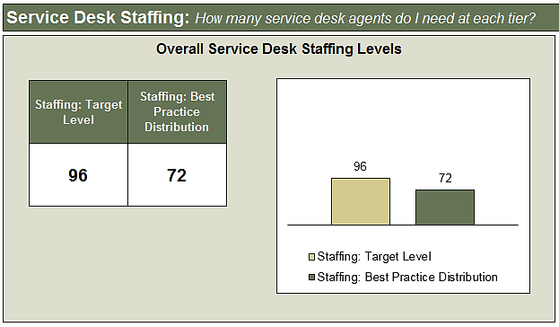
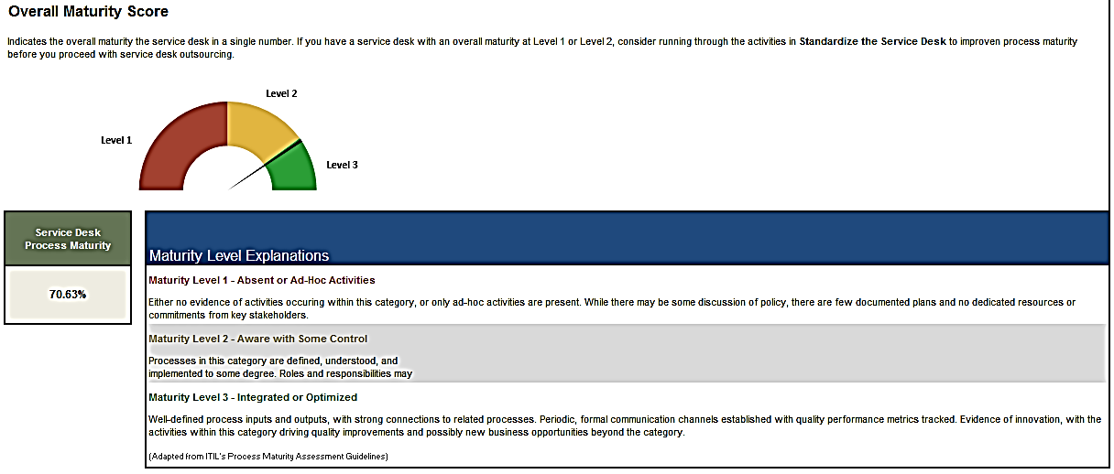
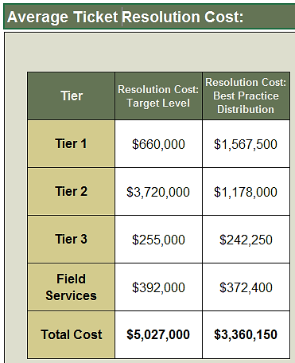
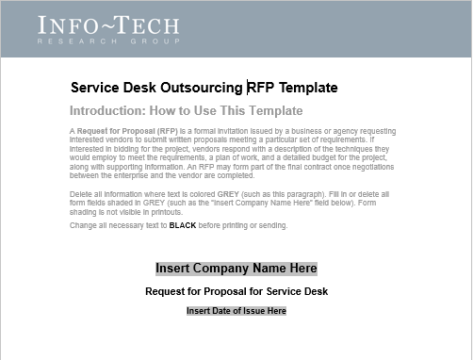
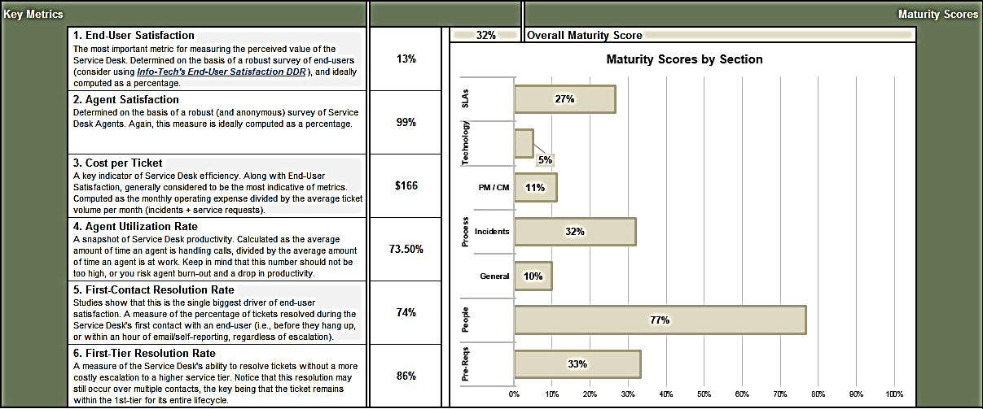
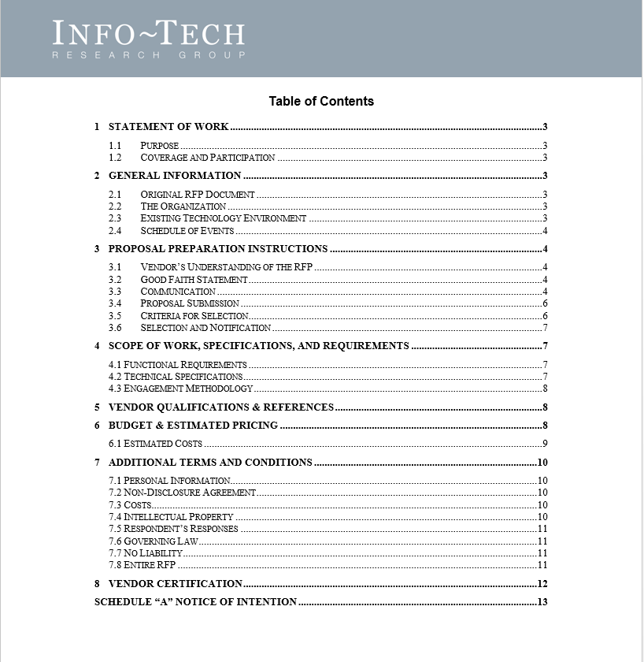
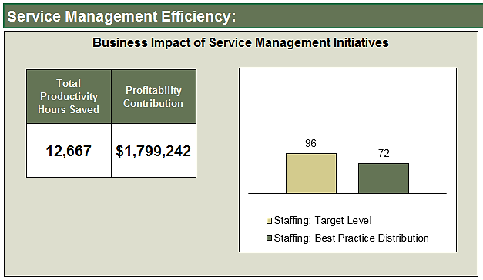
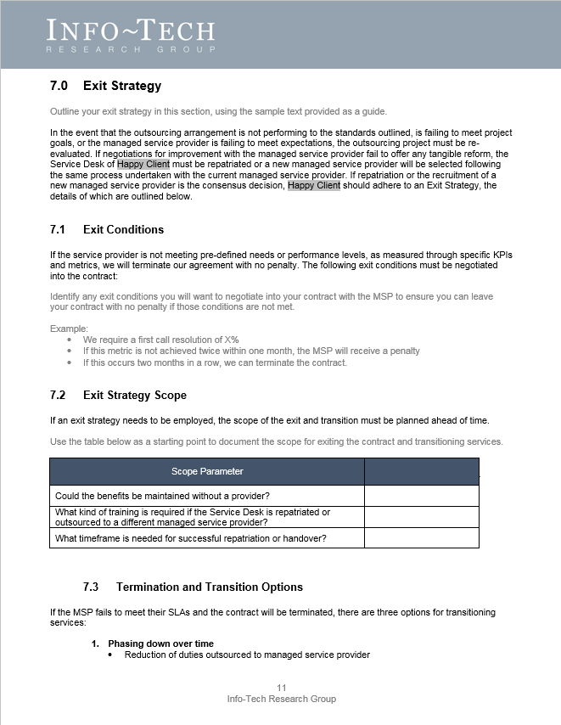
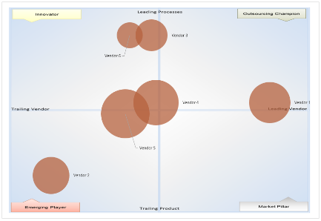
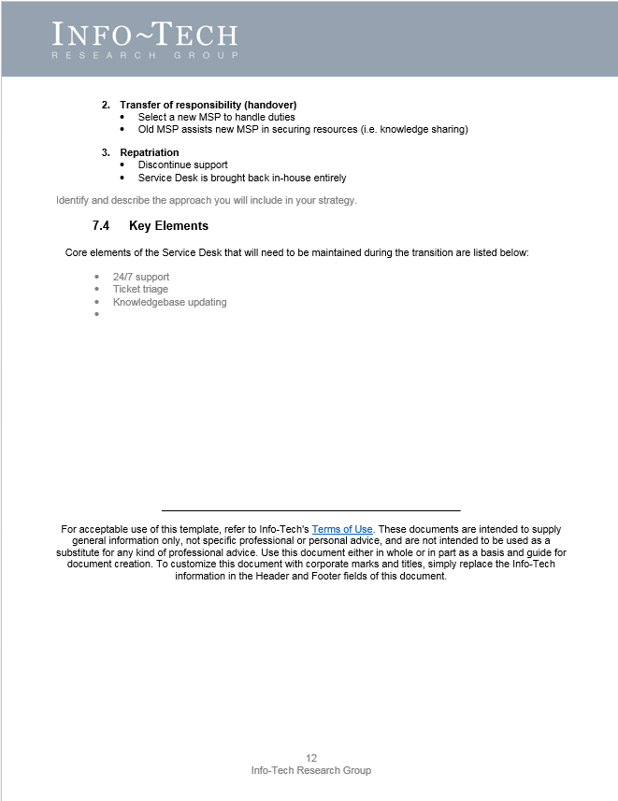
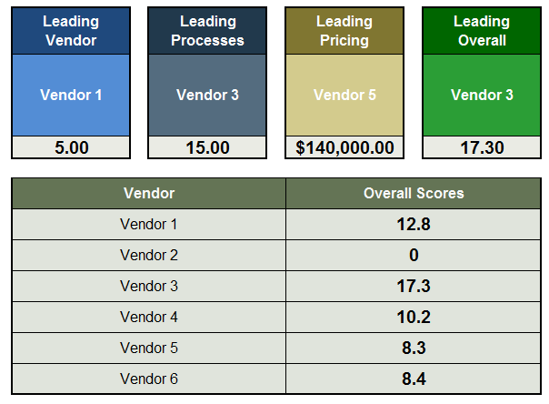
The project blueprint will provide guidance on how to produce the final project with the following tools
Service Desk Process
Maturity Assessment (Excel)
Service Desk
Efficiency Calculator (Excel)
Service Desk
Outsourcing RFP (Word)
Service Desk
Outsourcing Strategy (Word)
Service Desk
Outsourcing RFP Scoring Tool (Excel)

Slide 18
Workshop overview
Contact your account representative or email Workshops@InfoTech.com for more information.
 | Workshop Day 1 | Workshop Day 2 | Workshop Day 3 | Workshop Day 4
Activities | Task – Prepare Your Service Desk for Outsourcing 1.1 Assess service desk maturity. 1.2 Design your tiered service desk. 1.3 Outsourcing decision matrix. 1.4 Service desk feasibility assessment. | Task – Develop Your Outsourcing Strategy 2.1 Identify roles & responsibilities. 2.2 Identify goals & objectives. 2.3 Outline potential risks & constraints. 2.4 Define tension metrics to balance reporting. | Task – Develop Your Outsourcing RFP 3.1 Identify current and future requirements. 3.2 Outline ITSM solution requirements. 3.3 Define in-house and retained service desk functions. 3.4 Complete RFP. | Task – Select a Managed Service Provider and Manage the Transition 4.1 Develop interview questions for candidate managed service providers and client references. 4.2 Score RFP responses. 4.3 Identify roles & responsibilities. 4.4 Develop exit strategy.
Deliverables | Service Desk Process Maturity Assessment Service desk cost estimate | Service Desk Outsourcing Strategy | Service Desk Outsourcing RFP | MSP interview script Client reference interview script RFP scoring summary Exit strategy

