Slide 1

Build an IT Risk Management Program
Mitigate threats with a cost-focused approach to IT risk management.

Slide 2


ANALYST PERSPECTIVE
A good security practice is not enough to manage IT risk.
When most CIOs and IT leaders think of risk, their minds immediately jump to the latest security threat making headlines.
While security is an important part of IT risk, it is only one component. Risk across IT requires a holistic perspective, driven by the needs and priorities of the business. Failing to understand the true business ramifications of IT risk exposes the business to IT-related threats, or leads to overspending on low-priority initiatives. Like good leadership, risk management must be proactive, dynamic, and constantly improving. In the modern IT risk environment, hoping for the best is not an acceptable strategy for managing risk – and the line between optimism and negligence is razor thin.
Use this blueprint to build a right-sized, business-driven risk management program with minimal effort.
Scott Janz,
Consulting Analyst, CIO Advisory
Info-Tech Research Group

Slide 3
Our understanding of the problem
Any IT Leader responsible for IT risk management in their organization.
Any CIO mandated to integrate IT risk management with their organization’s central risk management function or Enterprise Risk Management (ERM).
Any IT Director or Manager undertaking a risk assessment.
Any IT Director or Manager responding to or preparing for an IT audit.
Establish a comprehensive IT risk management program that exposes your IT risks.
Create a strategy for managing and mitigating risks to meet your organization’s risk appetite.
Quantify risk exposure in meaningful financial terms.
Build business buy-in and shared accountability for business-impacting IT risks.
Enterprise Risk Management
Senior Leadership
Develop consensus on organizational risk appetite.
Establish a framework and metrics for acceptable risk tolerance.
Align business and IT risk management objectives.
Enable the business to make informed investments when managing IT risks.

Slide 4
Executive Summary
Risk is unavoidable. Without a formal program to manage IT risk, you may be unaware of your severest IT risks.
66% of organizations do not formally manage IT risk.¹
IT risk is business risk – however, IT is often left to manage risk independently.
IT risk is business risk.
Every IT risk has business implications. Create an IT risk management program that shares accountability with the business.
Risk is money.
It’s impossible to make intelligent decisions about risks without knowing what their financial impact will be.
You don’t know what you don’t know.
And what you don’t know can hurt you. To find hidden risks, you must utilize a structured risk identification method.
Reacting to risks AFTER they occur can be costly and crippling, yet is one of the most common tactics used by IT departments.
Security risk receives such a high profile that it often eclipses other important IT risks, leaving the organization vulnerable.
Failing to include the business in IT risk management leaves IT leaders too accountable; the business must have accountability as well.
Stop leaving IT risk to chance. Transform your ad hoc IT risk management processes into a formalized, ongoing program and increase risk management success by 53%.²
Take a proactive stance against IT threats and vulnerabilities by identifying and assessing IT’s greatest risks before they occur and have serious implications.
Involve key stakeholders including the business senior management team to gain buy-in and to focus on IT risks that matter most to the organization.
Share accountability for IT risk with business stakeholders and have them weigh-in on prioritizing investments in risk response activities.
1: ESI International
2: Info-Tech Research Group, 2013, N=76

Slide 5


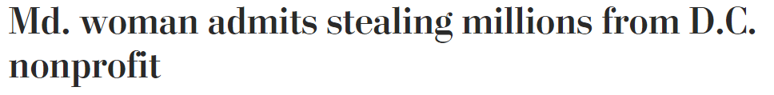

Poor IT risk management is expensive
IT Risk Is Headline News
BBC
The Guardian
The Wall Street Journal
The Wall Street Journal
The Washington Post
The Australian
Computer Business Review
The Wall Street Journal

Slide 6
Risk management is a top IT priority
Info-Tech’s Top 10
IT Improvement Priorities
Info-Tech asked over 2,500 IT professionals to rate, on a scale of 1 to 10, the importance of risk management and how effective they were at managing IT risks.
Data Quality
IT Governance
Risk Management
Knowledge Management
Requirements Gathering
Manage Service Catalog
Organizational Change Management
Quality Management
Performance Measurement
Application Portfolio Management
8.3
Importance of
risk management:
Effectiveness of
risk management:
Above average importance
5.9
Significantly below average effectiveness
For more information, see Info-Tech’s IT Management & Governance Diagnostic.

Slide 7


66% of organizations lack a formal risk management program
1
If you are like the majority of IT departments, you do not have a consistent and comprehensive strategy for managing IT risk.
Ad hoc approaches to managing risk fail because…
The results:
1
Ad hoc risk management is often reactionary.
Increased business risk exposure caused by a lack of understanding of the impact of IT risks on the business.
Increased IT non-compliance, resulting in costly settlements and fines.
IT audit failure.
Ineffective management of risk caused by poor risk information and wrong risk response decisions.
Increased unnecessary and avoidable IT failures and fixes.
Without formalized procedures for managing IT risk, risk events are often “managed” after they have occurred.
IT departments that spend most of their time putting out fires receive the lowest ratings for satisfaction and perceived value by business stakeholders.
2
Ad hoc risk management is often focused only on IT security.
Organizations must respond to the entire spectrum of IT risk.
A client who recently completed Info-Tech’s methodology for risk identification and assessment found that only 15 of the 135 IT risks identified were related to security and compliance.
3
Ad hoc risk management lacks alignment with business objectives.
Most IT departments aren’t thinking about formal risk management, and if they are, it’s back-of-the-napkin planning.
Ken Piddington, CIO & Executive Advisor, MRE Consulting
Many IT risk assessments fail to communicate IT risks in a way that compels the business to take action.
63% of CEOs indicate they want IT to provide better risk metrics (CIO-CEO Alignment survey data, Info-Tech Research Group).
1: ESI International

Slide 8
Unmanaged IT risk isn’t just bad for the organization, it’s also bad for your career
Take luck out of the equation – “Hoping for the best” is not a risk management strategy.
Take control of IT risk and avoid leaving your job security
to chance.
The top four reasons why CIOs lose their jobs:
Project Failures
X
IT Risk Management
If I wait until a risk event occurs, I might be out of a job before the business recovers.
– VP of Security and Risk, Energy Logistics Company
Security Breaches
X
IT Risk Management
Disaster Recovery Failures
X
IT Risk Management
System Failures
X
IT Risk Management
Source: Silverton Consulting
When business stakeholders are unaware of top IT threats, blame for project, security, disaster recovery, and system failures is usually assigned to the CIO and other senior IT managers.
When effectively integrated with business risk management,
IT risk management is your best job security policy.

Slide 9




Ensure that your greatest IT risks are on your radar
CASE STUDY
IT vendor risks may be your greatest business risks.
Focusing on internal IT security risks may not be enough to protect your organization from a breach. Learn from these organizations whose security breaches all originated from third-party vendors.
“AT&T data breaches revealed: 280K US customers exposed”¹
“Home Depot faces dozens of data breach lawsuits”²
“868,000 Payment Cards, 330 Stores Hit in Goodwill Credit Card Breach”³
Employees at an IT service provider stole customer names and SSNs to request unlock codes for stolen phones. In 2015, AT&T agreed to settle with the FCC and pay a $25 M fine.
Hackers stole credentials from a third-party vendor to gain access to Home Depot’s network, stealing data from 56 million credit cards, as well as 53 million email addresses.
Hackers breached the system of a cloud-based card processing service vendor, with the intrusion lasting more than 18 months.⁴
1: CNBC 2: Fortune 3: Forbes 4: KrebsOnSecurity

Slide 10
Formalize risk management to increase your likelihood of success by 53%
Organizations that adopted formal risk programs increased their risk management success by 53%.
Risk management is a business enabler.
Line managers often see risk management as an impediment to their day-to-day function. But, in fact, the opposite is true. By identifying areas of risk exposure and creating solutions proactively, obstacles can be removed or circumvented before they become a real problem.
Risk Management Success:
Formal Strategy vs. Ad Hoc Approach
53% Increase
A certain amount of risk is healthy and can stimulate innovation.
A formal risk management strategy doesn’t mean trying to mitigate every possible risk; it means exposing the organization to the right amount of risk. Taking a formal risk management approach allows an organization to thoughtfully choose which risks it is willing to accept. Organizations with high risk management maturity will vault themselves ahead of competition because they will be aware of which risks to prepare for, which risks to ignore, and which risks to take.
Taking the initiative pays off. A security manager in the energy industry saved over $80,000 by developing an IT risk management program in-house instead of bringing in external consultants.
Survey: Info-Tech Research Group, N = 76

Slide 11
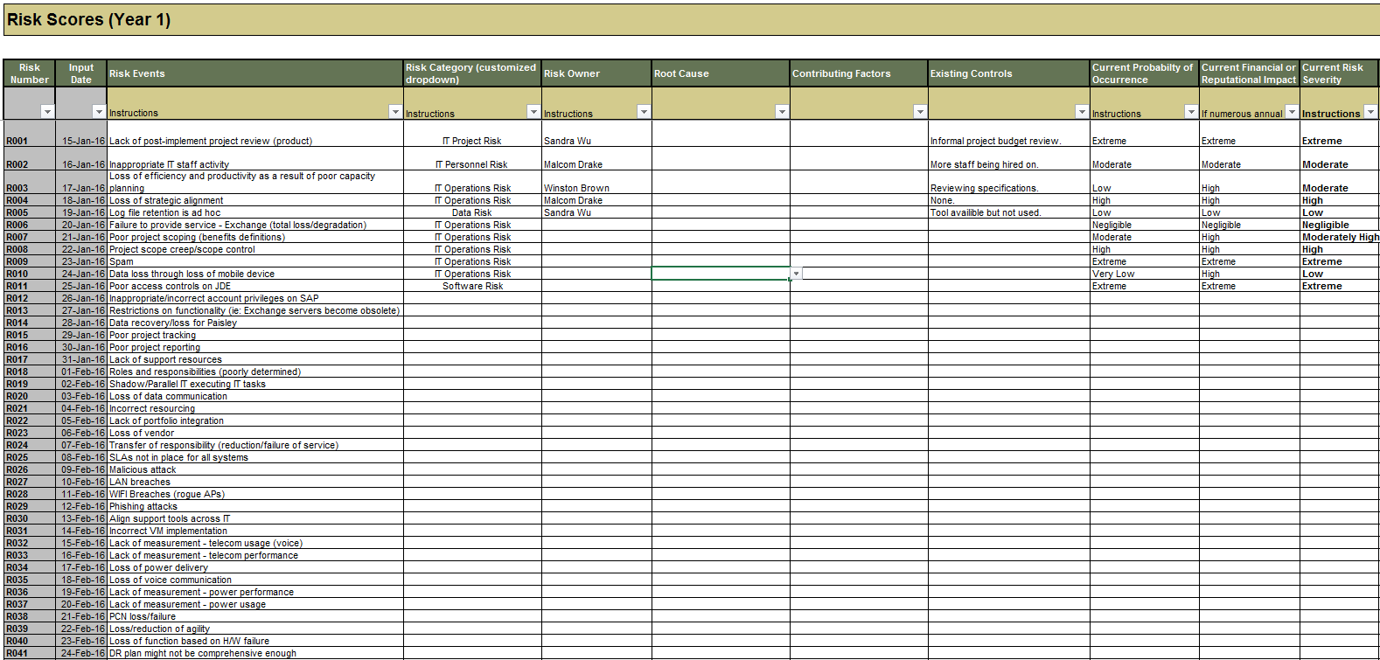
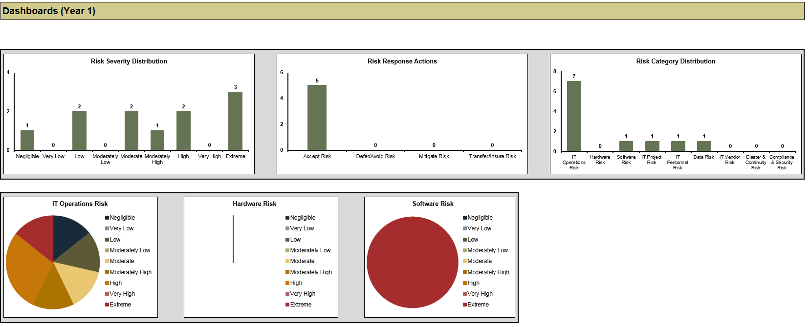
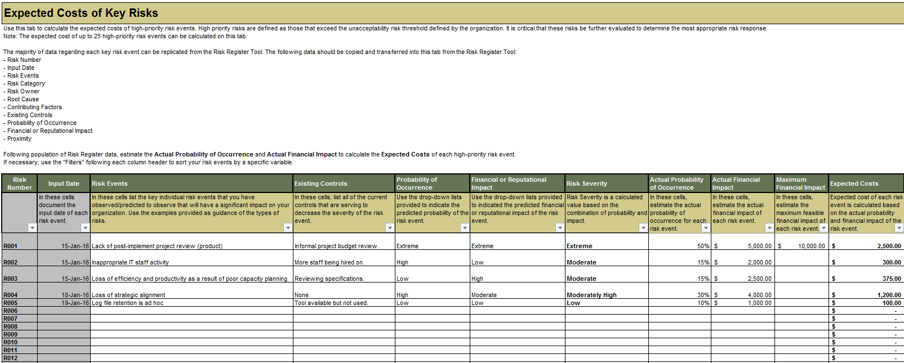
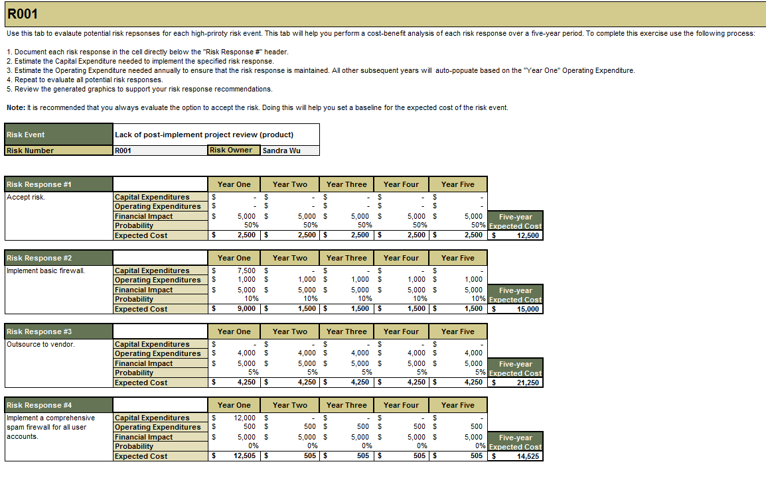

You don’t know what you don’t know…
…and what you don’t know can hurt you!
So find out using Info-Tech’s risk identification and risk assessment methodology.
Developed and tested directly with our clients, Info-Tech’s Risk Register Tool allows you to document and track a comprehensive list of IT risk events that may affect your organization.
Assess risk severity using acceptability thresholds developed in collaboration with senior leadership.
Identify and manage the top IT risks impacting the organization.
Use Info-Tech’s Risk Costing Tool to put a price on your top risks.
Calculate the expected cost of anticipated risk events.
Calculate the expected cost of alternative risk response actions.
Project the costs of risk response actions over multiple years to inform risk response decisions.
Conduct cost-benefit analyses for your top risks and select a risk response that offers the greatest value to the organization.
Risk is money. It’s impossible to make intelligent decisions about risks without knowing how much they cost. Use Info-Tech’s Risk Costing Tool to calculate and present the expected costs associated with accepting and responding to high-priority risk events.

Slide 12
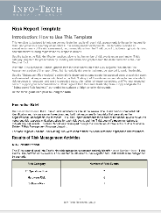
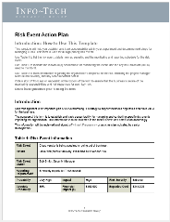
IT risk is business risk – engage with the business to manage risk effectively
IT Risk is Business Risk
Integrate IT risk management with ERM using:
Business Risk Management
Therefore:
Accountability for IT risks and the decisions made to address them should be shared between IT and the business.
Risk Report
A robust risk management program accomplishes this by
building permanent channels
between IT and the senior leadership team that enable risk information and recommendations to be easily communicated and acted upon.
Risk Event Action Plan
Info-Tech Insight
The central goal of IT risk management is to provide clear and accurate interpretations of IT risk to the business regarding risk implications and response options. Ultimately, senior leadership is responsible for making decisions regarding all business risk.
Organizations that were successful in gaining business involvement had approximately 59% more risk management success than organizations that did not.
IT Risk Management
59%

Slide 13
Follow the steps of this blueprint to build or optimize your IT risk management program
PHASE 3
Monitor, Communicate, and Respond to IT Risk
Risk
Governance
Risk
Identification
3.1
3.2
Risk
Response
Risk
Assessment
Monitor IT Risks and Develop Risk Responses
Communicate IT Risk Priorities
Start Here
PHASE 2
Identify and Assess IT Risk
PHASE 1
Review IT Risk Fundamentals and Governance
2.1
2.2
Identify IT Risks
Assess and Prioritize IT Risks
1.1
1.2
Review IT Risk Management Fundamentals
Establish a Risk Governance Framework

Slide 14
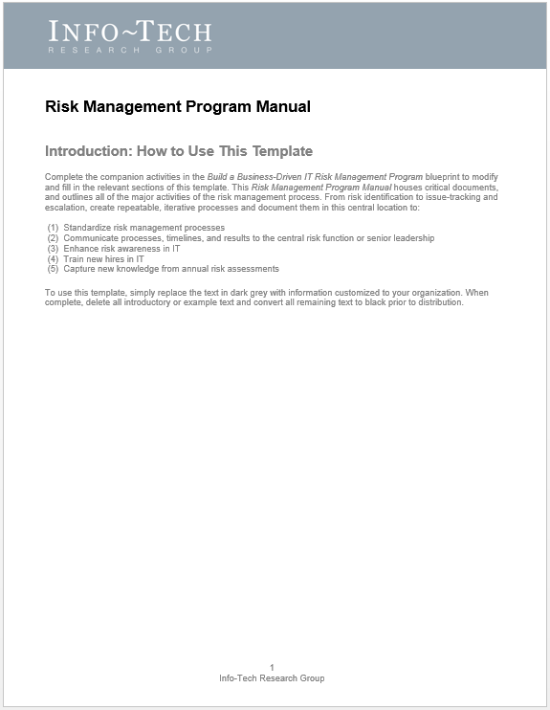
Use Info-Tech’s Risk Management Program Manual to build your customized risk management program
PHASE 3
Phase-By-Phase Deliverables:
3.1
3.2
Monitor, Communicate, and Respond to IT Risk:
Risk Event Action Plan
Risk Reports*
IT Risk Recommendations
Primary
Deliverable:
PHASE 2
2.1
2.2
PHASE 1
Identify and Assess IT Risk:
Acceptable Risk Thresholds
Risk Register*
Prioritized List of IT Risks
1.1
1.2
Review IT Risk Fundamentals and Governance:
Maturity Assessment
Stakeholder Map
IT Risk Council Charter
Use the tools and activities in each phase of the blueprint to create a comprehensive, customized program manual for the ongoing management of IT risk.
Risk Management Program Manual
*Standalone Deliverables

Slide 15


Seize the potential of risk management to better align IT with the business
IT creates value for the
business
CIOs
CEOs
IT keeps the lights on
63%
of CIOs and CEOs disagree about the objectives of IT.
1
IT risk management is an opportunity to enhance IT’s profile in the eyes of the CEO, and to align IT with the organization’s strategic direction.
Risk is money, and minimizing risk is money saved. Use your risk management program to illustrate how
IT creates value for the business.
Proactive risk management that translates IT risk into business language illustrates that IT decision-making is focused on how IT can add to and avoid detracting from business value.
1: Info-Tech Research Group, 2015.

Slide 16
Executive Brief case study – The board of a mid-sized, regional retailer asks IT to increase its risk management activities
CASE STUDY
Industry
Retail
Formalizing Risk Management
Completing Risk Management Activities
Sustaining IT Risk Management
During a disaster recovery planning session, the CIO received a mandate to improve IT’s risk management activities.
Learning from past risk exposures, the CIO understood that risk management processes had to be formalized to ensure that activities were sustainable and that key risks were mitigated and reported on.
To kick-start risk management, the CIO hired two Info-Tech Research Group analysts to accelerate the risk identification and assessment process.
The CIO was committed to identifying IT risks, presenting them proactively to the board, and getting their buy-in on risk responses. This ensured that when things went south, accountabilities are not directly relayed upon IT. – PMO Director
A total of 96 critical risk events were identified and assigned appropriate risk owners to track and monitor risk events between annual assessments.
The IT risk council assessed the severity of all 96 risk events cataloged in the risk portfolio. The exercise revealed:
  26 Extreme Risk Events
  22 Very-High Risk Events
This analysis also revealed the highest risk area of IT:
  Security and Compliance Risks (26)
It was determined that 28 projects were already underway and 24 new project requests needed to be created to tackle the top 31 IT risk events identified by the IT risk council.
To adequately mitigate key risks, the IT risk council determined that approximately $850,000 was needed to fund both new projects and projects already underway.
The IT risk council presented their recommendations to the board of directors and successfully received needed funding.
The IT risk council now meets on a quarterly basis to assess the risk portfolio and manage response projects.
One of the best outcomes of our Info-Tech engagement was the action plans that we received. This has helped keep the IT risk council on track and enables us to manage key IT risks that are being mitigated.
– PMO Director

Slide 17


Appoint an owner of the IT risk management program and get started right now
Ideal Roles:
CIO
CRO
Director of IT
IT Risk Manager
IT Security Manager
IT Auditor
Who should carry out this project?
The Ideal Risk Management Owner:
Will have a comprehensive understanding of all IT functions, activities, and services.
Will be able to lead a team of senior stakeholders.
Will be an effective communicator and problem-solver with demonstrated ability to resolve conflicts and build relationships.
Will have strong relationships with most areas and key executive stakeholders in the organization.
Will have familiarity with risk management frameworks and methodologies.
Primary Responsibilities:
1
Obtain approval for a permanent IT risk council, build the team, and lead regular meetings.
2
Communicate what IT is doing to proactively manage risk through its risk management program and serve as the primary point of contact for IT risk management.
3
Maintain ownership over all risk management processes, as well as the Risk Management Program Manual.

Slide 18
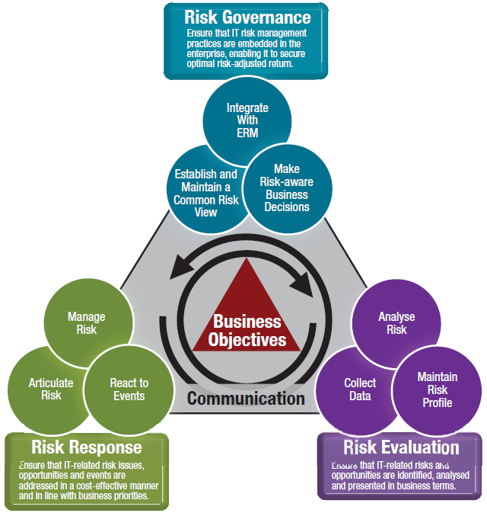


Benefit from industry-leading best practices
As a part of our research process, we utilized the M_o_R, RiskIT, and COBIT5 frameworks. Contextualizing IT risk management within these frameworks ensured that our project-focused approach is grounded in industry-leading best practices for managing IT risk.
The Government of the United Kingdom’s M_o_R framework provided best practices for IT risk governance, identification, and assessment.
COBIT5’s IT functions were used to develop and refine our Nine IT Risk Scenarios used in our top-down risk identification methodology.
RiskIT’s IT Risk Framework was modified to create Info-Tech’s IT Risk Management Framework.
M_o_R
RiskIT
COBIT5

Slide 19


Use these icons to help direct you as you navigate this research
Use these icons to help guide you through each step of the blueprint and direct you to content related to the recommended activities.
This icon denotes a slide where a supporting Info-Tech tool or template will help you perform the activity or step associated with the slide. Refer to the supporting tool or template to get the best results and proceed to the next step of the project.
This icon denotes a slide with an associated activity. The activity can be performed either as part of your project or with the support of Info-Tech team members, who will come onsite to facilitate a workshop for your organization.

Slide 20




Info-Tech offers various levels of support to best suit your needs
Guided Implementation
DIY Toolkit
Workshop
Consulting
“Our team has already made this critical project a priority, and we have the time and capability, but some guidance along the way would be helpful.”
“Our team knows that we need to fix a process, but we need assistance to determine where to focus. Some check-ins along the way would help keep us on track.”
“We need to hit the ground running and get this project kicked off immediately. Our team has the ability to take this over once we get a framework and strategy in place.”
“Our team does not have the time or the knowledge to take this project on. We need assistance through the entirety of this project.”
Diagnostics and consistent frameworks used throughout all four options

Slide 21

Build a business-driven IT risk management program – project overview
1. Review IT Risk Fundamentals and Governance
2. Identify and Assess IT Risk
3. Monitor, Communicate, and Respond to IT Risk
Best-Practice Toolkit | 1.1 Review IT Risk Management Fundamentals 1.2 Establish a Risk Governance Framework | 2.1 Identify IT Risks 2.2 Assess and Prioritize IT Risks | 3.1 Monitor IT Risks and Develop Risk Responses 3.2 Communicate IT Risk Priorities
Guided Implementations | Assess current maturity and set risk management program goals. Engage stakeholders and establish an IT risk council. | Understand risk categories, scenarios, and identification methodologies. Review identified risks and establish assessment thresholds and scales. Prepare for risk assessment by selecting tools and methodologies. | Prioritize assessed risks and set up monitoring responsibilities. Identify and assess risk response actions. Communicate risk priorities to the business.
Onsite Workshop | Establish a Risk Governance Framework | Identify and Assess IT Risk | Monitor, Communicate, and Respond to IT Risk
 | Phase 1 Outcome: Maturity Assessment Stakeholder Map IT Risk Council Risk Management Program Manual | Phase 2 Outcome: Risk Register Risk Management Program Manual | Phase 3 Outcome: Risk Register Risk Event Action Plan Risk Report Risk Management Program Manual

Slide 22
Workshop overview
Contact your account representative or email Workshops@InfoTech.com for more information.
 | Workshop Day 1 | Workshop Day 2 | Workshop Day 3 | Workshop Day 4
Activities | AM: Establish a Risk Governance Framework 1.1 Assess current program maturity 1.2 Create a stakeholder map 1.3 Complete RACI chart 1.4 Create the IT risk council PM: Identify IT Risks 1.5 Identify and engage key stakeholders 1.6 Add organization-specific risk scenarios 1.7 Identify risk events | AM: Identify IT Risks (continued) 2.1 Identify risk events (continued) 2.2 Augment risk event list using COBIT5 processes PM: Assess and Prioritize IT Risks 2.3 Determine the threshold for (un)acceptable risk 2.4 Create impact and probability scales 2.5 Select a technique to measure reputational cost 2.6 Conduct risk severity level assessment | AM: Assess and Prioritize IT Risks (continued) 3.1 Conduct risk severity level assessment 3.2 Document the proximity of the risk event 3.3 Conduct expected cost assessment PM: Monitor IT Risks and Develop Risk Responses 3.4 Develop key risk indicators (KRIs) and escalation protocols 3.5 Root cause analysis 3.6 Identify and assess risk responses | AM: Monitor IT Risks and Develop Risk Responses (continued) 4.1 Identify and assess risk responses 4.2 Risk response cost-benefit analysis 4.3 Create multi-year cost projections PM: Communicate IT Risk Priorities 4.4 Review techniques for embedding risk management in IT 4.5 Finalize the Risk Report and Risk Management Program Manual 4.6 Transfer ownership of risk responses to project managers
Deliverables | Maturity Assessment Stakeholder Map Risk Management Program Manual | Finalized List of IT Risk Events Risk Register Risk Management Program Manual | Risk Register Risk Event Action Plans Risk Management Program Manual | Risk Report Risk Management Program Manual

