Slide 1
Strategy | Infrastructure | Applications | Security
Improve Information Security Practices in the Small Enterprise
Create a realistic security plan that manages the threats of today and tomorrow.
Info-Tech Research Group, Inc. is a global leader in providing IT research and advice. Info-Tech’s products and services combine actionable insight and relevant advice with ready-to-use tools and templates that cover the full spectrum of IT concerns. © 1997-2016 Info-Tech Research Group Inc.
Info-Tech's products and services combine actionable insight and relevant advice with ready-to-use tools and templates that cover the full spectrum of IT concerns.© 1997 - 2016 Info-Tech Research Group

Slide 2
All data is valuable.
The days of purely high-profile hacking are over. Smaller enterprises are now at the forefront of targeted attacks. Smaller organizations still have valuable data that threat actors want and that can be more easily compromised due to less resources dedicated towards security. Often, small enterprises are compromised for the purpose of being a hopping point to a larger target, generating complex levels of security considerations and legal liabilities.
Just because you don’t see headline news about small organizations being breached doesn’t mean it isn’t happening. The reality is that small enterprises are now faced with the same security concerns and requirements as large organizations, but with limited resources. Small enterprises need to know what matters to them even more than large organizations so that they can build a right-sized security program.
Wesley McPherson
Info-Tech’s Security, Risk, and Compliance Practice
The VIP Boardroom at Info-Tech Research Group’s Toronto Office

Slide 3
MYTH
Cyber-attacks aren’t an issue for small enterprises.
THE UNFORTUNATE REALITY
60%
of all targeted attacks are towards small to medium-sized organizations.
Source: Symantec, 2015.
Cyber-attackers prefer targeting smaller enterprises because they often have weak security systems.
AND YET
82%
of small to medium-sized businesses consider themselves non-targets for cyber-attacks because they have nothing worth stealing.
Source: London Chamber of Commerce and Industry, 2014.
In a transaction- and data-heavy society, nearly all organizations have highly valuable and sensitive data (contract information, customer data, payment information, etc.).

Slide 4
Data breaches pose a serious risk to organizations of all sizes
90%
Security incidents of large organizations have ruled the media since late-2013.
High-Profile Examples
Target
Home Depot
iCloud
eBay
SONY
JP Morgan Chase
And unfortunately, more are expected to come.
of data breaches impact small businesses.
(First Data, 2014)
Despite the media focus on large enterprises, small businesses are the most vulnerable and attacked business segment.
Small enterprise security incidents are often included in large and high-profile attacks, either as:
Victims
Points of entry for large multi-organization hacks
EXAMPLE
Target’s HVAC contractor was the point of entry for its high-profile 2013 data breach resulting in the theft of over 40 million debit and credit card numbers.

Slide 5
Security programs are a MUST-HAVE, not a nice-to-have
23%
WHY?
The volume, intelligence, and complexity of threats has been and will be increasing.
of CIOs polled stated increasing cybersecurity was the most significant driver behind IT investments in 2015 (CIO, 2015).
Security is a must-have – but to what degree?
New Attack Types
Targeted malware
Zero-day vulnerability exploits
Advanced persistent threats (APTs)
In this day and age, where security is on the tip of everyone’s tongues, it is sometimes difficult to prioritize what must be done to best address organizational vulnerabilities.
For small organizations it is important to focus on foundational technical capabilities. From this foundation, over time, capabilities can grow with the setting of clear policies and by addressing critical business and IT processes.
Increasing Threat Actors
Commodification of hacking techniques
Conventional threats adopting hacking
Increasing in number and complexity
Changing Environments
Mobile
Cloud
Big Data
Internet of Things
Rachel D’Hollander
Manager of Small Enterprise Research
Info-Tech Research Group

Slide 6
Is this research right for you?
Research Navigation
Info-Tech Research Group has two research reports related to building an information security strategy. Use the questions below to help steer you to the research project that best suits your organization.
1 | Does your IT department consist of fewer than 15 full-time employees?
2 | Does your organization have limited resources for its security program?
3 | Is your organization looking to build a lean information security strategy?
4 | Is your organization in a loosely/un-regulated industry?
If you answered YES to most of these questions, keep reading this blueprint for small enterprises (SE).
If you answered NO to question 4 or have significant concerns with your current security capabilities, go to the Build an Information Security Strategy research.

Slide 7
Use this research to build a security strategy
Use the following tools and templates:
Information Security Strategy and Workbook Template
Security Pressure Posture and Analysis Tool
Security Component Maturity Level Descriptions
Information Security Program Gap Analysis and Roadmap Tool
Project Charter and Status Update Template
Information Security Strategy and Roadmap Communication Deck
Intended Audience
IT departments with 15 or fewer full-time employees.
Organizations that want to quickly assess and build a security strategy focused on foundational capabilities.
This Research Includes
Guidance for analyzing and building security capabilities.
Directions that help to accelerate brainstorming, analysis, and execution of security plans.
WALK AWAY FROM THIS BLUEPRINT WITH:
Expected Benefits
Completed security strategy documentation using best-practice templates.
Strong understanding of security issues and requirements.
Improved business awareness and understanding of the importance of information security.
Improved performance of critical security functions.
Plans for improving the performance of foundational security functions.
A vision for how to mature the organization’s security program (estimated one- to three-year trajectory).

Slide 8
Assess Security Requirements
Determine Current and Target States
Develop Improvement Plans
Create and Communicate Your Roadmap
Improve your ability to prevent security incidents and improve protective practices by leveraging Info-Tech’s four-step approach.
You will need to have a deep understanding of the business, even and especially if your organization does not have an awareness or understanding of information security.
Use the information and insight that you gather at the outset to drive your project’s activities and enable you to build and implement a roadmap that best maps to your business’s priorities and vulnerabilities.
Info-Tech
Recommends
Leverage your Info-Tech Advisory Services by scheduling a call with an experienced security analyst to discuss the plans and progress of your information security project.
Contact Info-Tech to book a call at
Phone: 1-888-670-8889
Email: GuidedImplementations@InfoTech.com

Slide 9
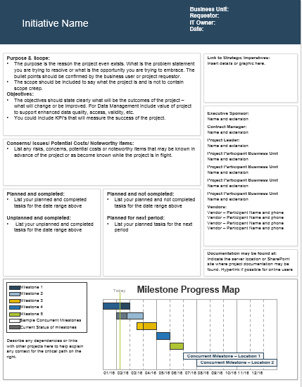
Don’t just read it – do it!
Use this research to create the following key deliverables.
Scoped Initiatives
Program Roadmap
Security strategy
Consume this research in a variety of different ways.
DIY Blueprint
Download this PowerPoint deck and the linked tools and templates.
Guided Implementation
Speak with an analyst in a series of guided calls as you use the research materials.
Workshop
Have Info-Tech come on site and facilitate a four-day workshop on the topic.
Service Spotlight – Workshops
Onsite Workshops offer an easy way to accelerate your project. If you are unable to do the project yourself, and a Guided Implementation isn’t enough, we offer low-cost, onsite delivery of our projects. We take you through every phase of your project and ensure that you have a roadmap that will guide your creation of a successful security program.
Book Now

Slide 10
Information Security Strategy
Project Overview
Recommended Project Manager
Manager responsible for security at the organization (likely from Infrastructure).
Recommended Oversight
Depending on size and structure could be: Head of IT (CIO or IT Manager) Head of Shared Services (CFO, COO, etc.) Company Owner or CEO
Estimated Timeline
Roughly 2-4 weeks
Project Scope
Organization’s IT security practices

Slide 11
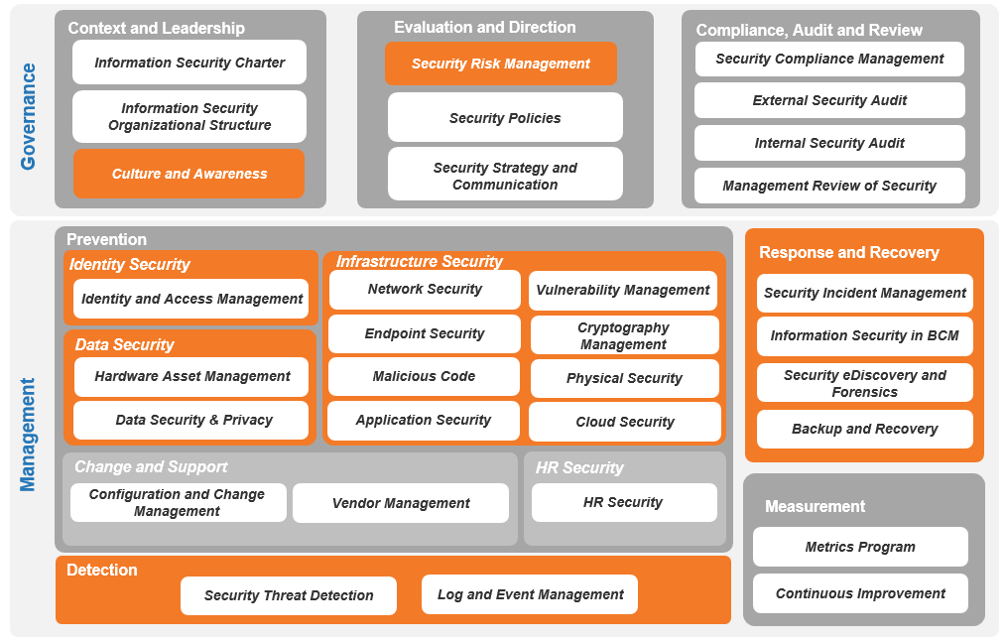
Address foundational and baseline functions of security
Info-Tech’s Information Security Framework
Info-Tech SE Perspective
Focus on components* and capabilities that will be the most feasible and critical for your organization.
Focus on foundational components:
Response and recovery capabilities
Prevention
Detection performance
Expand into governance to address business awareness of security and to incorporate a security mindset into the organizational culture.
(see Appendix for a full overview of the framework)
= Foundational Security Components
*Investments in additional components may be necessary (in addition to the highlighted components), depending on organizational maturity and specific requirements.

Slide 12
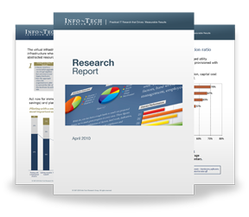
Info-Tech Research Group Helps IT Professionals To:
Quickly get up to speed with new technologies
Make the right technology purchasing decisions – fast
Deliver critical IT projects, on time and within budget
Manage business expectations
Justify IT spending and prove the value of IT
Train IT staff and effectively manage an IT department
Sign up for free trial membership to get practical
solutions for your IT challenges
“Info-Tech helps me to be proactive instead of reactive – a cardinal rule in a stable and leading edge IT environment.
- ARCS Commercial Mortgage Co., LP
Toll Free: 1-888-670-8889
www.infotech.com

