Slide 1
Strategy | Infrastructure | Applications | Security
For small and medium enterprises
Rebalance Project Intake for Small Enterprise
Tip the scale of supply and demand in IT’s favor.

Slide 2
Too many IT leaders have convinced themselves that they succeed by getting the best projects approved. That perspective needs to be tuned a bit, to focus on approving the right number of the best projects.
The actual capacity of the organization needs to be considered when you’re approving projects… You want to avoid having a big stack of broken promises and a damaged reputation. There’s an easy way to gauge it: measure your success on projects that get done instead of the number you approve.
Matt Burton,
Research Director, Project Portfolio Management
Info-Tech Research Group

Slide 3
Standardize project intake as a first step in building PPM capabilities
Intake
PPM = Project Portfolio Management
What does it mean for project intake to be standardized?
Execution
The following elements are clearly identified.
Request Submissions
The individuals who can request a project are identified.
There are intake forms and an explicit forum for completing and submitting a project request.
A workflow for processing the request is clearly documented and consistently used. This process addresses communication, additional scoping, and review of the project request.
Review Process
Closure
Approval Criteria and Process
The criteria and process for approving or denying a project is clearly identified and adhered to during reviews.
The steps required to place an approved request into the project backlog and portfolio are documented and followed.

Slide 4
Use effective project intake to improve PPM and project management practices
Project management is about doing things right. Portfolio management is about doing the right things.
Info-Tech’s
Portfolio Management Operating Plan
PMBOK’s
Five-Phase Project Lifecycle
Intake
Project Intake and PPM
Intake processes not only determine the manageability of your portfolio, but also ensure IT is working on the projects that are the most important and valuable to the business.
Effective Project Intake
Project intake supports the portfolio and shapes the conditions for project success by ensuring: Clarity: Projects have clear expectations and a vision for the solution. Control: Scope is clearly defined. Feasibility: Project resourcing and timelines align to the expectations and scope of the project. Engagement: Relevant stakeholders are identified early in the process to support requirements gathering or organizational change management initiatives.
Initiate
Execution
Plan
Closure
Execute
Controls and oversight during project intake ensures:
Manageability: IT is not overwhelmed with the number of projects and their corresponding resourcing demands.
Prioritization: Projects with cases for business value are prioritized and resourced.
Efficiencies: Requests with similar objectives and solutions can be consolidated into one project.
Control
Close

Slide 5
Develop discipline for your project intake cycle to save IT budget and improve project success
With proper intake discipline, you can reduce project waste from
10% to 5%.
With a significant and unmanaged backlog, you may be forced to hire a project manager.
POTENTIAL EFFICIENCY SAVINGS
POTENTIAL LABOR COST
$
$
29,000 - $44,000¹
$95,250 - $146,500²
Assumptions |
10-15 people in IT
Annual IT spend < $5-million
¹ Info-Tech MeasureIT Staffing Benchmarking Service (2013-2016, N=58)
² Robert Half Technology 2016 Salary Guide for IT Professionals
Sources |

Slide 6
Small IT shops often face a supply-demand imbalance
76%
Avoid setting unrealistic expectations as exciting and new requests come in the door.
of organizations say they have too many projects on the go and an unmanageable and ever-growing backlog of things to get to.
Source: Cooper, 2015, Product Development Institute
Barry Cousins, Senior Director
Info-Tech Research Group
Small enterprises are often burdened with specific issues:
Strike a balance between supporting the business and creating a project workload that is feasible and does not undermine general operations.
1. Operational demand frequently trumps project work
2. Limited visibility
3. Staff don’t have the luxury to focus on one thing at a time
4. Project management time has not been allocated

Slide 7
Is this research right for you?
Research Navigation
Managing project intake can make or break a small IT shop, but it may not be the most critical improvement area related to IT projects. Use the questions below to help direct you to Info-Tech resources and guidance that best aligns with the outcomes you want to achieve.
Question | If you answered no | If you answered yes
Do you have more than 15 in IT? | Follow the guidance in this blueprint | Review Info-Tech’s blueprint, Optimize Project Intake, Approval, and Prioritization
Are you trying to improve the project intake policies and practices in your small enterprise (SE)? | Review Info-Tech’s other project management offerings | Follow the activities in this blueprint
Do you need to create a more systematic approach for managing all project requests? | Focus on project intake and follow the activities in this blueprint | Review Info-Tech’s blueprint, Formalize Project Portfolio Management for Small Enterprise
Are you looking to improve project execution? | Review Info-Tech’s other project management offerings | Review Info-Tech’s blueprint, Create Project Management Success

Slide 8
Use this research to manage project intake
Intended Audience
IT staff responsible for managing project requests
This Research Includes
Guidance on developing a detailed project intake workflow Recommendations and activities to enhance project intake capabilities Techniques to develop more transparent communication with the business
Expected Benefits
Increased intake discipline A rigid workflow that can be applied to any project, regardless of size or scope Refined intake process that will ensure higher quality throughput An understanding of core intake capabilities and proper communication skills
WALK AWAY FROM THIS BLUEPRINT WITH:
A defined intake process that is manageable for your department Enhanced intake capabilities

Slide 9
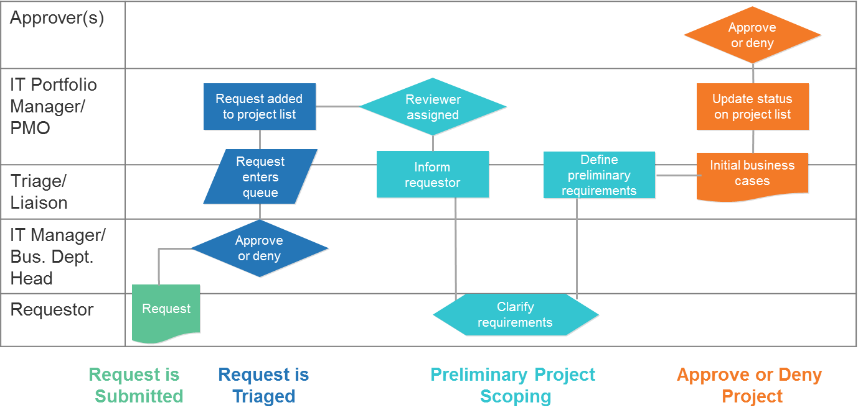
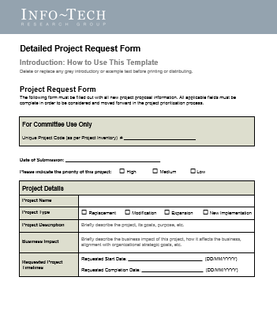
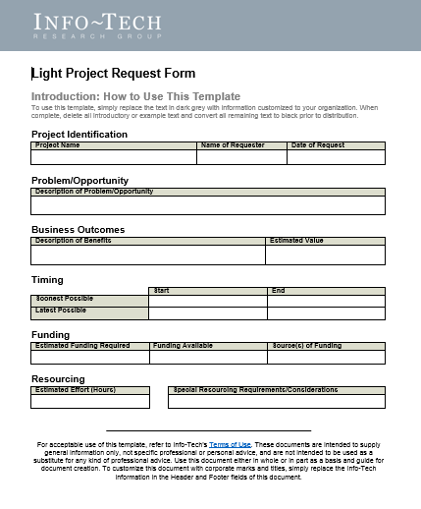
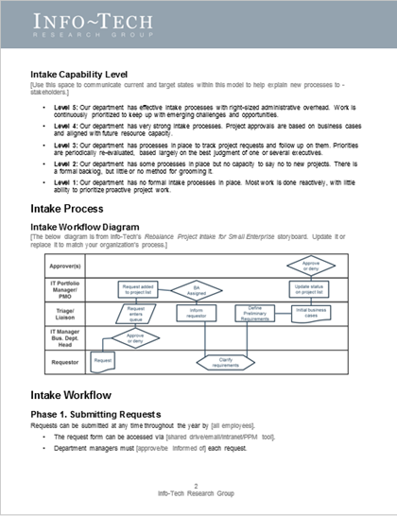
Don’t just read it – do it! Use this research to create the following key deliverables:
Consume this research in a variety of different ways.
1. A complete project intake workflow
DIY Blueprint
Download this PowerPoint deck and the linked tools and templates.
2. Light and detailed project intake workflow
Guided Implementation
Speak with an analyst in a series of guided calls as you use the research materials.
Guided Implementation Outline
3. Project intake standard operating procedures
Workshop
Have Info-Tech come onsite and facilitate a four-day workshop on the topic.
Workshop Overview

Slide 10
Info-Tech’s research is built upon essential frameworks
Info-Tech leverages COBIT, ITIL, PMBOK and Prince2 to provide high quality research backed by industry standards.
Our approach takes into account the realities that small IT departments face and offers a simplified and more realistic pathway toward portfolio visibility.

