Slide 1
Develop a Master Data Management Strategy and Roadmap
Make sure your most important data is accurate and accessible across your business units to ensure optimal decision support and to monetize your data assets.

Slide 2
ANALYST PERSPECTIVE
Organizations shy away from MDM because they don’t know where to start, fear the expense and disruption, and don’t truly know the benefits for the effort involved.
MDM is valuable for all sizes of organizations; bigger ones will use the expensive tools but smaller ones can still benefit from MDM using simple tools and processes.
Use an approach to drive real and practical MDM into your organization by starting with reference data; doing this right and first makes the rest of MDM go so much smoother because it is easy, non-contentious, and fast and builds momentum based on success. A strong MDM foundation enables better use of key data assets to drive greater business results and data monetization.
Steven Wilson,
Senior Director, Research & Advisory Services Info-Tech Research Group

Slide 3
Our understanding of the problem
CIO, CDO, or IT Executive
Business Domain Representatives
Head of the Information Management Practice
Enterprise Architecture Domain Architects
Information Management MDM Experts
Manage your organization’s most valuable data assets more effectively.
Improve your organization’s confidence in master data.
Improve organizational understanding of Master Data Management (MDM) concepts.
Create realizable initiatives that improve the organization’s ability to deliver on its short-term and long-term plans for MDM.
Data Stewards / Data Custodians
Solution Architects
Data Quality Specialists
Target and eliminate common frustrations due to unorganized data.
Improve the organization’s ability to trust the organization’s most valuable data assets.
Have increased confidence in and better access to the data, enabling strong analytics, cost savings, and greater productivity.

Slide 4
Executive summary
Master data domains include the most important data assets of an organization. For this data to be used across an enterprise in consistent and value-added ways, the data must be properly managed.
For a consistent view of master data domains the data should be controlled by Master Data Management (MDM).
MDM is only for the “big guys.” Not so! Big MDM systems are complex and require deep commitment to deploy and run, but MDM for SMEs to monetize data is still a critical requirement to achieve success.
MDM can be difficult and expensive. It can be, so start small. Use the Info-Tech tools to help identify quick-win opportunities for establishing MDM in your organization then grow it organically and as value is realized.
Good MDM requires good reference data. Get your reference data in order with MDM processes and ensure the MDM data is usable in your BI and analytics platforms.
Simple in concept, MDM is complex in practice and requires investments in governance, technology, and planning.
Master data is pervasive throughout the business and is often created and captured in highly disparate sources that often are not easily shared across business units and applications.
Ready? Make sure that your practice has the necessary pre-requisites for MDM. Don’t waste time and resources before you have identified your first group of data to begin your MDM solution, and the necessary architecture, governance, and support from very senior champions to ensure the ongoing success of your MDM initiative.
Aim. Figuring out what the organization needs out of its master data is essential before you pull the trigger on a MDM strategy; alignment to strategic business needs will ensure buy-in and support through project disruptions to the business.
Fire! Approaching MDM with a clear-cut blueprint that provides you with a solid plan and organized direction will help you stay adaptable when unexpected nuances of organization requirements or road blocks crop up.

Slide 5
To differentiate and remain competitive in today’s marketplace organizations are becoming more data-driven
Analytic Competitor
Leveraging data as a competitive advantage makes data a central enabler to an organization’s operations and strategy.
Master data is the lifeblood data of the organization – those who manage their master data effectively become industry leaders through better strategic planning.
Analytical Companies
Analytical Aspirations
Localized Analytics
Analytically Impaired
Source: Davenport and Harris,
Competing on Analytics, 2007
Data and the use of data analytics has become a centerpiece to effective modern business. Top-performing organizations across a variety of industries have been cited to use analytics five times more than lower performers.
Source: MIT Sloan Management Review

Slide 6
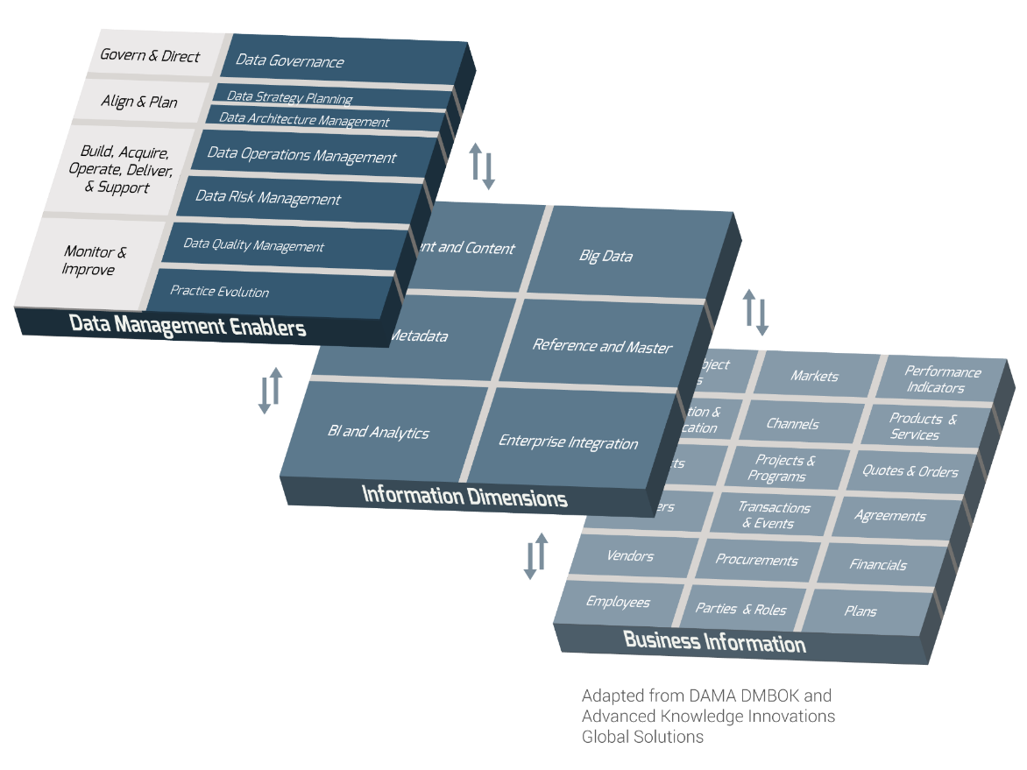
Master data management is a critical dimension of data management
Master Data Management (MDM) is the control over master data values to enable consistent, shared, contextual use across systems, of the most accurate, timely, and relevant version of truth about essential business entities (DAMA DMBOK).
Fundamental Objective of
Master Data Management
Enable the business to see one view of critical data elements across the organization.
What Is Included in the
Scope of MDM?
Party Data (Employees, Customers, etc.)
Product/Service Data
Financial Data
Location Data
Successful MDM Requires a Comprehensive Approach
For master data management to be successfully planned, implemented, and maintained it must include effective capabilities in the critical processes and sub-practices of data management (see Layer 1: Data Management Enablers).
For more information on Info-Tech’s Data Management, see the description of its approach and layers in the appendix.
Reference
and Master

Slide 7
Master data management provides opportunities to use data for analytical and operational purposes with greater accuracy
MDM provides a single consolidated and accurate view of an organization’s most valuable data assets.
Sales data for customer A
Marketing data of customer A
Analytical data including customer A
An investment in MDM will improve the opportunities for using the organization’s most valuable data assets.
It is important to keep customer information up to date …
Data is more easily shared across the organization’s environment with greater accuracy and trust.
Multiple instances of the same data are consistent.
MDM enables the ability to find the right data more quickly.
30%
Think of it in the context of your own organization.
of customers will never buy from a company again if they encounter even one shipping error.
(Material Handling and Logistics Magazine)
How will MDM improve the ability for accurate data to be shared across business processes (Operational MDM)?
How will MDM improve the quality of reports for management reporting and executive decision making (Analytical MDM)?

Slide 8
Master data drives practical insights that arise from key aspects of the business
A Single Source of Truth
Well-managed master data, the key dimension around which analytics are done, can provide a single, reliable, and precise view of the organization.
Why Manage Master Data?
1
2
Customer Intimacy
Innovation Leadership
Improve marketing and the customer experience by using the right data from the system of record to analyze complete customer views of transactions, sentiments, and interactions.
Gain insights on your products, services, usage trends, industry directions, and competitor results, and use these data artifacts to support decisions on innovations, new products, services, and pricing.
3
Risk Management
4
Operational Excellence
Maintain more transparent and accurate records and ensure that appropriate rules are followed to support audit, compliance, regulatory, and legal requirements. Monitor data usage to avoid fraud.
Make sure the right solution is delivered rapidly and consistently to the right parties for the right price and cost structure. Automate processes by using the right data to drive process improvements.

Slide 9
Improved master data management can drive better customer relations
What is a business without the customer? Customer retention, satisfaction, and how much value an organization creates from each customer drives revenue growth and ultimately determines the success of the organization. Effective MDM can improve customer relations, stickiness, wallet/mind share, and customer retention. Consider the following:
In a survey of 428 enterprises, the best-in-class (BIC) performers in their ability to have a complete customer data view, performed significantly better in customer value, satisfaction, and retention than those who did not – the industry laggards.
86%
91%
67%
+6%
62%
32%
-9%
Of consumers will pay for a better customer experience.
Oracle Customer Experience Impact Report, 2011
Aberdeen Group, 2010

Slide 10
Modern organizations have unprecedented data challenges
Why is there an increasing need for dedicated investments in MDM within an organization’s data management practice?
1
Too much data volume, variety, and velocity, from more and more sources.
25% of organizations have 15 or more data repositories.
2
Disorganized and disparate data across multiple systems and applications.
3
Conflicting viewpoints and definitions of data assets that should reside in MDM.
The Information Difference MDM Landscape, 2014
The Solution
The critical, underlying master data that feeds the applications and processes driving an organization, as well as the reference data that regulates how different data silos relate to each other, must be managed effectively to gain clear and business-relevant insights.

Slide 11
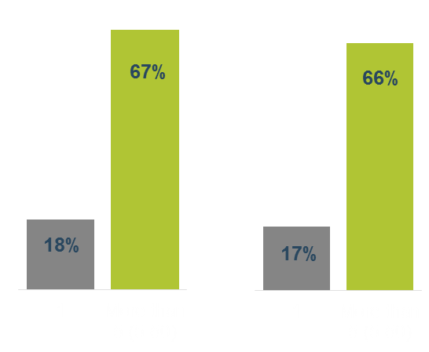
Finding a single source of truth throughout the organization can be difficult
The Challenge
Simple concept, complicated outcome
Data is created by many different sources, in many different locations, and changed often. Having a unified view of the definitions and systems of record for the most critical data in your organization can be difficult to achieve.
Companies have indicated their number of definitions of the following terms:
“Customer”
“Product”
15
Median number of systems per organization generating master data in 2008 – this number did not improve through 2014 (The Information Difference, 2014).
80%
Number of organizations that have two or more data repositories (IBM, 2006).
Fast Fact
There are 128,000 change of address requests made every day in the US, according to the US Postal Service.
The Data Warehousing Institute, 2012

Slide 12
You can’t make sense of big data without master data
Although MDM is used for managing structured data from more traditional sources, it also plays an
essential role in ensuring new data sources (semi-structured & unstructured big data) are also managed.
Since 2013, Info-Tech has surveyed over 20,000 business stakeholders as part of our CIO Business Vision program.
We asked them to rank the importance of the following 12 core IT services…
1
Mobile for Employees
Big Data - Analytics
Internal Collaboration Tools
Mobile for Customers
Social Media for Engagement
Big Data - Collection
Cloud for Application Functionality
Cloud for Agile Infrastructure
Social Media for Acquisition
Internet of Things for Product Innovation
Big data is a top priority for modern organizations…
2
3
4
But with its enormous volume of unstructured data, big data can’t be leveraged without having a dependable reference.
Top Upcoming Technology Innovations for CEOs
5
6
7
8
Master data is that reference.
9
10
July 2015; N= 215

Slide 13
Master Data Focus: Party master data in the Energy Industry
Energy utility companies have unprecedented challenges in the modern world. Customers have increasingly high expectations of power reliability while also becoming more concerned about carbon emissions. In addition, government regulations are increasing the need for transparency in the industry. To meet these challenges, energy companies need a holistic understanding of customer master data in real time. The result is a Smart Grid system that improves service and reduces costs using the singular, clear, and actionable view of energy customers provided by customer master data management.
$3.4B
Customer
Master Data
Funding from the U.S. government for Smart Grid projects
Benefits of better customer master data analytics and the Smart Grid:
1
Optimal customer relations
3
Strategic energy usage advice
2
Timely outage notifications
Reduce costs and waste from excess production
4
Pitney Bowes, 2015

Slide 14
Master Data Focus: Product master data in the Automotive Industry
Suppliers and Materials
Master Data
During the auto industry crisis of 2008-2010, the industry experienced major overhauls due to poor product planning and a lack of understanding of what products its customers wanted. To improve efficiency and gain customer trust, it needed to drastically improve the management of its product data. Successful MDM was implemented by a large automobile company by effectively communicating with its data stewards, having a comprehensive change management program, and establishing clear internal data rules that complied with increasingly stringent external guidelines.
PWC, 2011
Benefits of better supplier and material master data:
Reduce product delays to customer
Synchronize processes
Improved product development
1
2
3

Slide 15
Master Data Focus: Financial master data in the Banking Industry
An investment bank implemented MDM to improve its transactional master data and the efficiency of its operations.
Transactional Master Data
50%
Reduction in straight-through-processing failure rate.
$2M
Annual savings from decreased need for manual error fixing of failed stock trades.
By keeping the business benefits of MDM front and center and starting with realistic master data domain goals, implementing a MDM solution succeeded in providing a unified and dependable view of stock transactions and the ability to clearly see interactions within the context of other data domains.
$50M
How?
Reduction in yearly costs due to increased liquidity from fewer “stuck” trades.
Informatica, 2010

Slide 16
Master data management is not just another technology project
Too often there is a disconnect between what the IT team considers "required" or "sufficient" in an MDM project vs. the rapid value business groups want to and can achieve from integrated customer information.
– Mehmet Orun, Data Strategy Leader, Salesforce
Master data management needs to be driven by business goals and objectives.
For master data to be a strategic asset of the business, the business and IT processes that support its use, access, delivery, and management must work together in alignment.
Business Goals
Master Data Management Cycle
Technical Solutions
Collaborative Processes
The Data Warehousing Institute, 2012

Slide 17
Master data management is possible
Info-Tech Research Group’s approach to implementing master data management will align your goals with the drivers of the organization, taking off the veil of MDM and ensuring success.
The first MDM hub solutions entered the market in 2004. Over time, the maturity of the solutions and the ability to complete a successful implementation has grown. MDM implementation success is rapidly improving with maturity. There is more cross-talk between processes and technology than ever before.
In 2011, 82% of MDM initiatives were rated as successful, compared with 25% in 2008.
– The Information Difference
For a long time, master data management had a bad reputation because it took a long time to implement. I think we have now gone beyond that with new approaches.
82%
25%
– Julie Hunt, Software Industry Analyst, Hub Designs Magazine

Slide 18
This blueprint’s two-phase structure helps clients build a MDM practice for a business-aligned single version of truth
Phase 1
Phase 2
Build a Vision for MDM
Create a Plan and Roadmap for the Organization’s MDM Program
Identify the Master Data Needs of the Business
Inputs
Business requirements of master data
Outputs
Data domain priorities
Project scope
Readiness Assessment
Inputs
Business willingness to change
Data culture
Business strategies and plans
Outputs
Defined data needs of the business and the current state of organization’s culture
Assess Current MDM Capabilities
Inputs
Assessment framework
Current practices
Outputs
Current capability results
Initiative Planning
Inputs
Data requirements
“To be” environment vision
Current capability results
Outputs
Gap and priority analysis
Strategic Roadmap
Inputs
Feasibility and priority analysis
Improvement plans
Outputs
Practice roadmap
Transition map
Action plan
Business Needs Assessment Tool
Create a Strategic Vision
Inputs
Business requirements
Goals of MDM
Funding plans
Outputs
Target data domains
Project scope
Capabilities Assessment and Initiative Planning Tool
Capabilities Assessment and Initiative Planning Tool
MDM Roadmap
Readiness Assessment Tool
Business Case Presentation,
Project Charter
Ongoing Project Management
Complete project steps
Maintain stakeholder involvement and project momentum
Manage timelines
Align outcomes with initial expectations and success criteria
Project Positioning
Project scoping
Resource and project planning
Project Completion

Slide 19
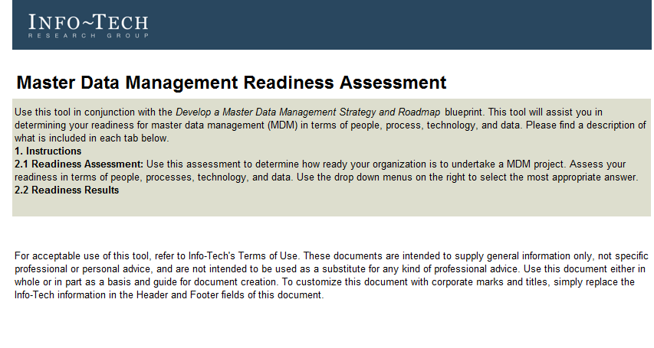
Info-Tech delivers
Use the step-by-step advice within this blueprint to adopt an iterative approach to creating information strategies for the organization and building a plan for creating a well-aligned master data management practice. Following the phases outlined in the blueprint will support your organization in developing master data strategies and building a roadmap that will enable end users to:
Have access to quality master data.
Have master data to support the analytical and operational use for each relevant business area.
Use master data that is properly secured.
BLUEPRINT RESOURCES
MDM Readiness Assessment
Business Needs Assessment
MDM Capabilities Assessment and Initiative Planning Tool
Strategic MDM Roadmap
*This blueprint contains additional resources that support the creation of interim deliverables and the execution of project steps.

Slide 20
Workshop overview
Contact your account representative or email Workshops@InfoTech.com for more information.
 | Preparation | Workshop Day 1 | Workshop Day 2 | Workshop Day 3 | Workshop Day 4
Activities | Organize and Plan Workshop Finalize workshop itinerary and scope. Identify workshop participants. Gather strategic documentation. Engage necessary stakeholders. Book interviews. | Develop a Vision for the MDM Project Establish business context for master data management. Assess the value, benefits, challenges, and opportunities associated with MDM. Develop the vision, purpose, and scope of master data management for the business. Identify master data management enablers. Interview business stakeholders. | Assess MDM Capabilities Understand data flow: Evaluate the risks and value of critical data. Map and understand the flow of data within the business. Identify master data sources and users. Assess current master data management capabilities. Set target master data management capabilities. Identify performance gaps. | Analyze Gaps and Develop Improvement Initiatives Evaluate performance gaps for remediation. Develop alignment of initiatives to strategies. Consolidate master data management initiatives and strategies. Develop a project timeline, and define key success measures. | Design Roadmap and Plan Implementation Identify dependencies of initiatives. Prioritize actions. Build a master data management roadmap (short and long term). Consolidate into master data management strategy.
Deliverables | Workshop Itinerary Workshop Participant List | High-level data requirements Identification of business priorities | Data flow diagram with identified master data sources and users Master Data Dictionary Master Data Management Capability Assessment | Data and master data management alignment and strategies | Master Data Management Roadmap Master Data Management Strategy for continued success

Slide 21
Navigate the two phases of the blueprint using this table of contents
Phase 1
Step 1: Assess Your Organizational Readiness for MDM Tool: MDM Readiness Assessment
Step 2: Determine Business Requirements for MDM Tool: MDM Business Needs Assessment
Step 3: Make Key Decisions for Your MDM Program Template: MDM Business Case Presentation Template Template: Project Charter Template
Phase 2
Step 1: Perform a MDM Capabilities Assessment Tool: MDM Capabilities Assessment and Initiative Planning Tool
Step 2: Develop MDM Initiatives Tool: MDM Capabilities Assessment and Initiative Planning Tool
Step 3: Create a Roadmap and Plan of Action for Master Data Management Template: MDM Roadmap Template
Appendix Info-Tech Research Group’s Information Management Framework Additional Research Bibliography

Slide 22
Use these icons to help direct you as you navigate this research
Use these icons to help guide you through each step of the blueprint and direct you to content related to the recommended activities.
This icon denotes a slide where a supporting Info-Tech tool or template will help you perform the activity or step associated with the slide. Refer to the supporting tool or template to get the best results and proceed to the next step of the project.
This icon denotes a slide with an associated activity. The activity can be performed either as part of your project or with the support of Info-Tech team members, who will come onsite to facilitate a workshop for your organization.

Slide 23
Develop a Master Data Management Strategy and Roadmap – Project Overview
PHASE 1
PHASE 2
Build a Vision for MDM
Create a Plan and Roadmap for the Organization’s MDM Program
Best-Practice Toolkit | Executive Brief 1.1 Assess Your Organizational Readiness for MDM MDM Readiness Assessment 1.2 Determine Business Needs for MDM MDM Business Needs Assessment 1.3 Make Key Decisions for Your MDM Program Business Case Presentation Template Project Charter Template | 2.1 Perform a MDM Capabilities Assessment MDM Capabilities Assessment and Initiative Planning Tool 2.2 Develop MDM Initiatives MDM Capabilities Assessment and Initiative Planning Tool 2.3 Create a Roadmap and Plan of Action for Master Data Management MDM Roadmap Template Appendix
Guided Implementations | Identify what master data management means to the organization. Discuss the strategic plans of the business and establish a business context for master data management. Determine master data management strategies. | Discuss the results of the master data management capabilities evaluation. Plan initiatives for master data management. Create a roadmap and discuss next steps.

Slide 24
Info-Tech offers various levels of support to best suit your needs
Guided Implementation
DIY Toolkit
Workshop
Consulting
“Our team has already made this critical project a priority, and we have the time and capability, but some guidance along the way would be helpful.”
“Our team knows that we need to fix a process, but we need assistance to determine where to focus. Some check-ins along the way would help keep us on track.”
“We need to hit the ground running and get this project kicked off immediately. Our team has the ability to take this over once we get a framework and strategy in place.”
“Our team does not have the time or the knowledge to take this project on. We need assistance through the entirety of this project.”
Diagnostics and consistent frameworks used throughout all four options

