Slide 1

Build a Reporting and Analytics Strategy
Deliver actionable business insights by creating a business-aligned reporting and analytics strategy.

Slide 2
Terminology
As the reporting and analytics space matured over the last decade, software suppliers used different terminology to differentiate their products from others’. This caused a great deal of confusion within the business communities.
Following are two definitions of the term Business Intelligence:
Business intelligence (BI) leverages software and services to transform data into actionable insights that inform an organization’s strategic and tactical business decisions. BI tools access and analyze data sets and present analytical findings in reports, summaries, dashboards, graphs, charts, and maps to provide users with detailed intelligence about the state of the business.
The term business intelligence often also refers to a range of tools that provide quick, easy-to-digest access to insights about an organization's current state, based on available data.
CIO Magazine
Business intelligence (BI) comprises the strategies and technologies used by enterprises for the data analysis of business information. BI technologies provide historical, current, and predictive views of business operations.
Common functions of business intelligence technologies include reporting, online analytical processing, analytics, data mining, process mining, complex event processing, business performance management, benchmarking, text mining, predictive analytics, and prescriptive analytics.
Wikipedia
This blueprint will use the terms “BI,” “BI and Analytics,” and “Reporting and Analytics” interchangeably in different contexts, but always in compliance to the above definitions.

Slide 3


ANALYST PERSPECTIVE
A fresh analytics & reporting strategy enables new BI opportunities.
We need data to inform the business of past and current performance and to support strategic decisions. But we can also drown in a flood of data. Without a clear strategy for business intelligence, a promising new solution will produce only noise.
BI and Analytics teams must provide the right quantitative and qualitative insights for the business to base their decisions on.
Your Business Intelligence and Analytics strategy must support the organization’s strategy. Your strategy for BI & Analytics provides direction and requirements for data warehousing and data integration, and further paves the way for predictive analytics, big data analytics, market/industry intelligence, and social network analytics.
Dirk Coetsee,
Director, Data and Analytics
Info-Tech Research Group

Slide 4
Our understanding of the problem
A CIO or Business Unit (BU) Leader looking to improve reporting and analytics, reduce time to information, and embrace fact-based decision making with analytics, reporting, and business intelligence (BI).
Application Directors experiencing poor results from an initial BI tool deployment who are looking to improve the outcome.
Align your reporting and analytics strategy with the business’ strategic objectives before you rebuild or buy your Business Intelligence platform.
Identify reporting and analytics objectives to inform the data warehouse and integration requirements gathering process.
Avoid common pitfalls that derail BI and analytic deployments and lower their adoption.
Identify Business Intelligence gaps prior to deployment and incorporate remedies within your plans.
Project Managers and Business Analysts assigned to a BI project team to collect and analyze requirements.
Business units that have their own BI platforms and would like to partner with IT to take their BI to an enterprise level.
Recruit the right resources for the program.
Align BI with corporate vision, mission, goals, and strategic direction.
Understand the needs of business partners.
Assess BI maturity and plan for target state.
Develop a BI strategy and roadmap.
Track the success of the BI initiative.

Slide 5
Executive summary
BI drives a new reality. Uber is the world’s largest taxi company and they own no vehicles; Alibaba is the world’s most valuable retailer and they have no inventory; Airbnb is the world’s largest accommodation provider and they own no real estate. How did they disrupt their markets and get past business entry barriers? A deep understanding of their market through impeccable business intelligence!
Put the “B” back in BI. Don’t have IT doing BI for IT’s sake; ensure the voice and needs of the business are the primary drivers of your strategy.
The BI strategy drives data warehouse and integration strategies and the data needs to support business decisions.
Go beyond the platform. The solution to better BI often lies in improving the BI practice, not acquiring the latest and greatest tool.
In respect to BI matureness, you can’t expect the whole organization to be at the same place at the same time. Your BI strategy needs to recognize this and should strive to align rather than dictate.
Technology is just one aspect of your BI and Analytics strategy and is not a quick solution or a guarantee for long term success.
Drive strategy development by establishing the business context upfront in order to align business intelligence providers with the most important needs of their BI consumers and the strategic priorities of the organization.
Revamp or create a BI strategy to update your BI program to make it fit for purpose.
Understand your existing BI baggage – e.g. your existing BI program, the artifacts generated from the program, and the users it supports. Those will inform the creation of the strategy and roadmap.
Assess current BI maturity and determine your future state BI maturity.
BI needs governance to ensure consistent planning, communication, and execution of the BI strategy.
Create a network of BI ambassadors across the organization to promote BI.
Plan for the future to ensure that required data will be available when the organization needs it.

Slide 6

Metrics to track BI & Analytical program progress
Info-Tech’s Suggested Metrics for Tracking the BI Program
Goals for BI:
Understand business context and needs. Identify business processes that can leverage BI.
Define the Reporting & Analytics Roadmap. Develop data initiatives, and create a strategy and roadmap for Business Intelligence.
Continuous improvements. Your BI program is evolving and improving over time. The program should allow you to have faster, better, and more comprehensive information.
Practice Improvement Metrics |  | Data Collection and Calculation | Expected Improvement
Program Level Metrics | Efficiency Time to information Self-service penetration | Derive from the ticket management system Derive from the BI platform | 10% reduction in time to information Achieve 10-15% self-service penetration
 | Effectiveness BI Usage Data quality | Derive from the BI platform Data quality perception | Majority of the users use BI on a daily basis 15% increase in data quality perception
 | Comprehensiveness # of integrated datasets # of strategic decisions made | Derive from the data integration platform Decision-making perception | Onboard 2-3 new data domains per year 20% increase in decision-making perception
Intangible Metrics: Tap into the results of Info-Tech’s CIO Business Vision diagnostic to monitor the changes in business-user satisfaction as you implement the initiatives in your BI improvement roadmap.
Learn more about the CIO Business Vision program.

Slide 7
Your Enterprise BI and Analytics Strategy is driven by your organization’s Vision and Corporate Strategy
Formulating an Enterprise Reporting and Analytics Strategy requires the business vision and strategies to first be substantiated. Any optimization to the Data Warehouse, Integration and Source layer is in turn driven by the Enterprise Reporting and Analytics Strategy
Business vision /strategies
Sources
Integration and Translation
Data Warehouse
Business Intelligence
Source Strategy (Content/Quality)
Informs
Data Integration Strategy
Drives
Data Warehouse/ Data Lake Strategy
Informs
Reporting & Analytics Strategy
Plan
Analytical Data requirements
Deploy
Current state determine: Data delivered
The current state of your Integration and Warehouse platforms determine what data can be utilized for BI and Analytics

Slide 8
Where we are, and how we got here
How we got here
Where we are now
In the beginning was BI 1.0. Business intelligence began as an IT-driven centralized solution that was highly governed. Business users were typically the consumers of reports and dashboards created by IT, an analytics-trained minority, upon request.
In the last five to ten years, we have seen a fundamental shift in the business intelligence and analytics market, moving away from such large-scale, centralized IT-driven solutions focused on basic reporting and administration, towards more advanced user-friendly data discovery and visualization platforms. This has come to be known as BI 2.0.
Many incumbent market leaders were disrupted by the demand for more user-friendly business intelligence solutions, allowing “pure-play” BI software vendors to carve out a niche and rapidly expand into more enterprise environments.
BI-on-the-cloud has established itself as a solid alternative to in-house implementation and operation.
BI 3.0 has arrived. This involves the democratization of data and analytics and a predominantly app-centric approach to BI, identifiable by an anywhere, anytime, and device-or-platform-independent collaborative methodology. Social workgroups and self-guided content creation, delivery, analysis, and management is prominent.
Where the need for reporting and dashboards remains, we’re seeing data discovery platforms fulfilling the needs of non-technical business users by providing easy-to-use interactive solutions to increase adoption across enterprises.
With more end users demanding access to data and the tools to extract business insights, IT is looking to meet these needs while continuing to maintain governance and administration over a much larger base of users. The race for governed data discovery is heated and will be a market differentiator.
The next kid on the block is Artificial Intelligence that put further demands on data quality and availability.

Slide 9

RICOH Canada used this methodology to develop their BI strategy in consultation with their business stakeholders
CASE STUDY
Industry Source
Manufacturing and Retail
RICOH
Ricoh Canada transforms the way people work with breakthrough technologies that help businesses innovate and grow. Its focus has always been to envision what the future will look like so that it can help its customers prepare for success. Ricoh empowers digital workplaces with a broad portfolio of services, solutions, and technologies – helping customers remove obstacles to sustained growth by optimizing the flow of information and automating antiquated processes to increase workplace productivity. In their commitment towards a customer-centric approach, Ricoh Canada recognized that BI and analytics can be used to inform business leaders in making strategic decisions.
Enterprise BI and analytics Initiative
Ricoh Canada enrolled in the ITRG Reporting & Analytics strategy workshop with the aim to create a BI strategy that will allow the business to harvest it strengths and build for the future. The workshop acted as a forum for the different business units to communicate, share ideas, and hear from each other what their pains are and what should be done to provide a full customer 360 view.
Results
“This workshop allowed us to collectively identify the various stakeholders and their unique requirements. This is a key factor in the development of an effective BI Analytics tool.” David Farrar
The Customer 360 Initiative included the following components
Organization and contact person data
Data Governance
Enterprise Data Modeling
Enterprise Vocabulary
Enterprise Managed Metadata Management
Legend
Component falls into the scope of Data Architecture

Slide 10
Improve BI Adoption Rates
Reasons for low BI adoption
Employees that never used BI tools are slow to adopt new technology.
Lack of trust in data leads to lack of trust in the insights.
Complex data structures deter usage due to long learning curves and contained nuances.
Difficult to translate business requirements into tool linguistics due to lack of training or technical ineptness.
Business has not taken ownership of data, which affects access to data.
Sisense
How to foster BI adoption
Senior management proclaim data as a strategic asset and involved in the promotion of BI
Role Requirement that any business decision should be backed up by analytics
Communication of internal BI use case studies and successes
Exceptional data lineage to act as proof for the numbers
A Business Data glossary with clearly defined business terms. Use the Business Data Glossary in conjunction with data lineage and semantic layers to ensure that businesses are clearly defined and traced to sources.
Training in business to take ownership of data from inception to analytics.

Slide 11
Why bother with analytics?
In today’s ever-changing and global environment, organizations of every size need to effectively leverage their data assets to facilitate three key business drivers: customer intimacy, product/service innovation, and operational excellence. Plus, they need to manage their operational risk efficiently.
Investing in a comprehensive business intelligence strategy allows for a multidimensional view of your organization’s data assets that can be operationalized to create a competitive edge:
Historical Data
Data Democracy
Predictive and
Big Data Analytics
Without a BI strategy, creating meaningful reports for business users that highlight trends in past performance and draw relationships between different data sources becomes a more complex task. Also, the ever growing need to identify and assess risks in new ways is driving many companies to BI.
The core purpose of BI is to provide the right data, to the right users, at the right time, and in a format that is easily consumable and actionable. In developing a BI strategy, remember the driver for managed cross-functional access to data assets and features such as interactive dashboards, mobile BI, and self-service BI.
As the volume, variety, and velocity of data increases rapidly, businesses will need a strategy to outline how they plan to consume the new data in a manner that does not overwhelm their current capabilities and aligns with their desired future state. This same strategy further provides a foundation upon which organizations can transition from ad hoc reporting to using data assets in a codified BI platform for decision support.

Slide 12
Business intelligence serves as the layer that translates data, information, and organizational knowledge into insights
As executive decision making shifts to more fact-based, data-driven thinking, there is an urgent need for data assets to be organized and presented in a manner that enables immediate action.
Typically, business decisions are based on a mix of intuition, opinion, emotion, organizational culture, and data. Though business users may be aware of its potential value in driving operational change, data is often viewed as inaccessible.
Actions
Business intelligence bridges the gap between an organization’s data assets and consumable information that facilitates insight generation and informed decision making.
Business Intelligence
Knowledge
Business Intelligence
Information
Most organizations realize that they need a BI strategy; it’s no longer a nice-to-have, it’s a must-have.
– Albert Hui, Principal, Data Economist
Data Assets

Slide 13



Business intelligence and business analytics: what is the difference and should you care?
Ask 100 people and you will get 100 answers. We like the prevailing view that BI looks at today and backward for improving who we are, while BA is forward-looking to support change decisions.
Business Intelligence
Business Analytics
Both
Time
Past
Present
Future
Business intelligence is concerned with looking at present and historical data.
Use this data to create reports/dashboards to inform a wide variety of information consumers of the past and current state of affairs.
Almost all organizations, regardless of size and maturity, use some level of BI even if it’s just very basic reporting.
Business analytics, on the other hand, is a forward-facing use of data, concerned with the present to the future.
Analytics uses data to both describe the present, and more importantly, predict the future, enabling strategic business decisions.
Although adoption is rapidly increasing, many organizations still do not utilize any advanced analytics in their environment.
However, establishing a strong business intelligence program is a necessary precursor to an organization’s development of its business analytics capabilities.

Slide 14
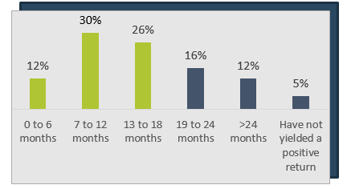
Organizations that successfully grow their BI capabilities are reaping the rewards
Evidence is piling up: if planned well, BI contributes to the organization’s bottom line.
45 bn
The global business intelligence market size to grow from US$23.1 billion in 2020 to US$33.3 billion by 2025, at a compound annual growth rate (CAGR) of 7.6%
(Global News Wire, 2020)
42%
7.6%
Connected Devices
Increase in data Volume
It’s expected that there will be nearly 45 billion connected devices and a 42% increase in data volume each year posing a high business opportunity for the BI market (BERoE, 2020).
69%
In the coming years, 69% of companies plan on increasing their cloud business intelligence usage (BARC Research and Eckerson Group Study, 2017).
Small organizations of up to 100 employees had the highest rate of business intelligence penetration last year (Forbes, 2018).
Call to Action
Source: IBM Business Value, 2015

Slide 15

For the New England Patriots, establishing a greater level of customer intimacy was driven by a tactical analytics initiative
CASE STUDY
Industry
Source
Professional Sports
Target Marketing
Problem
Despite continued success as a franchise with a loyal fan base, the New England Patriots experienced one of their lowest season ticket renewal rates in over a decade for the 2009 season. Given the numerous email addresses that potential and current season-ticket holders used to engage with the organization, it was difficult for Kraft Sports Group to define how to effectively reach customers.
Turning to a Tactical Analytics Approach
Kraft Sports Group turned to the customer data that it had been collecting since 2007 and chose to leverage analytics in order to glean insight into season ticket holder behavior. By monitoring and reporting on customer activity online and in attendance at games, Kraft Sports Group was able to establish that customer engagement improved when communication from the organization was specifically tailored to customer preferences and historical behavior.
Results
By operationalizing their data assets with the help of analytics, the Patriots were able to achieve a record 97% renewal rate for the 2010 season. KSG was able to take their customer engagement to the next level and proactively look for signs of attrition in season-ticket renewals.
We're very analytically focused and I consider us to be the voice of the customer within the organization… Ultimately, we should know when renewal might not happen and be able to market and communicate to change that behavior.
– Jessica Gelman,
VP Customer Marketing and Strategy, Kraft Sports Group

Slide 16
A large percentage of all BI projects fail to meet the organization’s needs; avoid falling victim to common pitfalls
Tool Usage Pitfalls
Selection Pitfalls
Business units are overwhelmed with the amount and type of data presented.
Poor data quality erodes trust, resulting in a decline in usage.
Analysis performed for the sake of analysis and doesn’t focus on obtaining relevant business-driven insights.
Inadequate requirements gathering.
No business involvement in the selection process.
User experience is not considered.
Focus is on license fees and not total cost.
62%
Only 62% of Big Data and AI projects in 2019 provided measurable results.
Implementation Pitfalls
Strategic Pitfalls
Absence of upfront planning
Lack of change management to facilitate adoption of the new platform
No quick wins that establish the value of the project early on
Inadequate initial or ongoing training
Poor alignment of BI goals with organization goals
Absence of CSFs/KPIs that can measure the qualitative and quantitative success of the project
No executive support during or after the project
Source: NewVantage Partners LLC
BI pitfalls are lurking around every corner, but a comprehensive strategy drafted upfront can help your organization overcome these obstacles. Info-Tech’s approach to BI has involvement from the business units built right into the process from the start and it equips IT to interact with key stakeholders early and often.

Slide 17
Business and IT have different priorities for a BI tool
Business executives look for:
Ease of use
Speed and agility
Clear and concise information
Sustainability
IT professionals are concerned about:
Solid security
Access controls on data
Compliance with regulations
Ease of integration
Elizabeth Mazenko
Info-Tech Insight
Combining these priorities will lead to better tool selection and more synergy.

Slide 18
The top-down BI Opportunity Analysis is a tool for senior executives to discover where Business Intelligence can provide value
Industry Drivers
Company strategy, goals, and objectives
Business context for BI Opportunities
How the company competes
Value disciplines:
Low cost/prices, differentiated products, customer intimacy, niche domination, superior service, etc.
Core business processes & management/analytical frameworks that will operationalize the value discipline(s)
Business processes where BI might be leveraged
Business-driven BI value creation opportunities
Management processes:
planning, budgeting, performance monitoring/assessment, process
improvement, cost analysis, optimization etc.
Revenue generating processes:
Customer segmentation, campaign/ channel/sales management, etc.
Resource consumption processes:
product/service development, manufacturing/operations, supply
chain, order management, purchasing, etc.
Williams 2016

Slide 19
Example: Uncover BI opportunities with an opportunity analysis
Industry Drivers
Private label
Rising input prices
Retail consolidation
Company strategies
Win at supply chain execution
Win at customer service
Expand gross margins
Value disciplines
Strategic cost management
Operational excellence
Customer service
Purchasing
Inbound logistics
Sales, service & distribution
Core processes
Enterprise management: Planning, budgeting, control, process improvement, HR
BI Opportunities
Customer service analysis
Cost and financial analysis
Demand management
Williams (2016)

Slide 20
Bridge the gap between business drivers and business intelligence features with a three-tiered framework
Info-Tech’s approach to formulating a fit-for-purpose BI strategy is focused on making the link between factors that are the most important to the business users and the ways that BI providers can enable those consumers.
Drivers to Establish Competitive Advantage
Operational Excellence
Client Intimacy
Innovation
BI and Analytics Spectrum
Strategic Analytics
Tactical Analytics
Operational Analytics
Info-Tech’s BI Patterns
Delivery
User Experience
Deep Analytics
Supporting

Slide 21
Widen the range of your BI to include strategic, tactical, and operational benefits
Though business intelligence is primarily thought of as enabling executives, a comprehensive BI strategy involves a spectrum of analytics that can provide data-driven insight to all levels of an organization.
Tactical Analytics
Often considered Response Analytics and used to react to situations that arise, or opportunities at a department level.
Sample objectives:
  Staff productivity or cost analysis
  Heuristics/algorithms for better risk management
  Product bundling and packaging
  Customer satisfaction response techniques
Recommended
Strategic Analytics
Typically focused on predictive modeling
Leverages data integrated from multiple sources (structured through unstructured)
Assists in identifying trends that may shift organizational focus and direction
Sample objectives:
  Drive market share growth
  Identify new markets, products, services, locations, and acquisitions
  Build wider and deeper customer relationships earning more wallet share and keeping more customers
Operational Analytics
Analytics that drive business process improvement whether internal, with external partners, or customers.
Sample objectives:
  Process step elimination
  Best opportunities for automation

Slide 22
Business Intelligence Terminology
Styles of BI
New age BI
New age data
Functional Analytics
Tools
Reporting
Agile BI
Social Media data
Performance management analytics
Scorecarding dashboarding
Ad hoc query
SaaS BI
Unstructured data
Financial analytics
Query & reporting
Parameter-ized queries
Mobile data
Pervasive BI
Supply chain analytics
Statistics & data mining
Big data
OLAP
Cognitive Business
Customer analytics
OLAP cubes
Sensor data
Advanced analytics
Self service analytics
Operations analytics
ETL
Machine data
Cognitive business techniques
Real-time Analytics
HR Analytics
Master data management
BI can be confusing and overwhelming…
– Dirk Coetsee,
Research Director,
Info-Tech Research Group
Scorecards & dashboards
Mobile Reporting & Analytics
“fill in the blanks” analytics
Data Governance
Williams (2016)

Slide 23
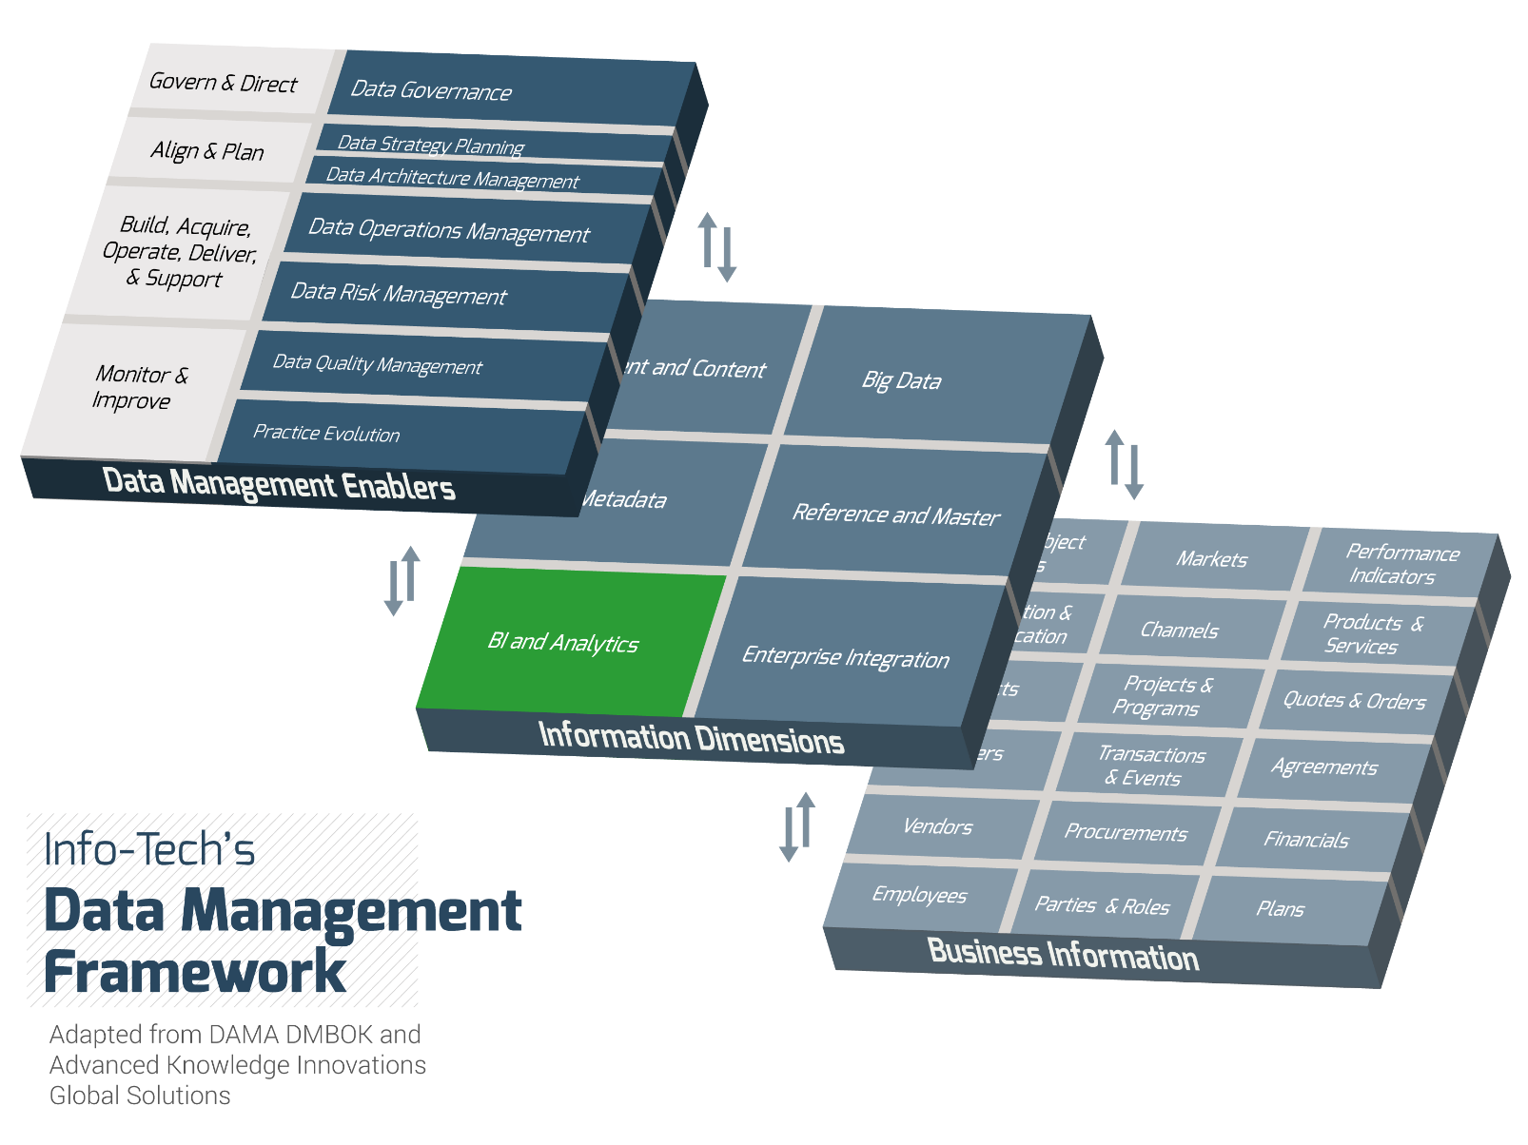
Business intelligence lies in the Information Dimensions layer of Info-Tech’s Data Management Framework
The interactions between the information dimensions and overlying data management enablers such as data governance, data architecture, and data quality underscore the importance of building a robust process surrounding the other data practices in order to fully leverage your BI platform.
Within this framework BI and analytics are grouped as one lens through which data assets at the business information level can be viewed.

Slide 24


Use Info-Tech’s three-phase approach to a Reporting & Analytics strategy and roadmap development
Project Insight
A BI program is not a static project that is created once and remains unchanged. Your strategy must be treated as a living platform to be revisited and revitalized in order to effectively enable business decision making. Develop a reporting and analytics strategy that propels your organization by building it on business goals and objectives, as well as comprehensive assessments that quantitatively and qualitatively evaluate your current reporting and analytical capabilities.
Phase 1: Understand the Business Context
and BI Landscape
Phase 2: Evaluate Your Current
BI Practice
Phase 3: Create a BI Roadmap for
Continuous Improvement
1.1 Establish the Business Context
2.1 Assess Your Current BI Maturity
3.1 Construct a BI Initiative Roadmap
Business Vision, Goals, Key Drivers
BI Practice Assessment
BI Improvement Initiatives
Business Case Presentation
Summary of Current State
RACI
1.2 Assess Existing BI Environment
High-Level ROI
BI Strategy and Roadmap
BI Perception Survey Framework
Usage Analyses
BI Report Inventory
2.2 Envision BI Future State
3.2 Plan for Continuous Improvement
1.3 Develop BI Solution Requirements
Requirements Gathering Principles
BI Style Requirements
Excel/Access Governance Policy
BI Practice Assessment
BI Ambassador Network Draft
Overall BI Requirements

Slide 25
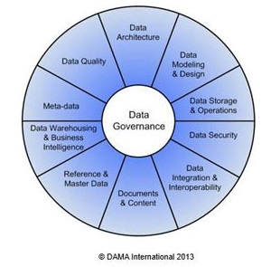
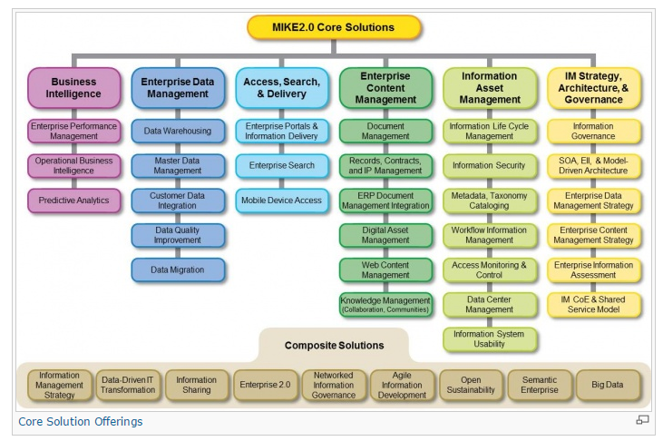

Stand on the shoulders of Information Management giants
As part of our research process, we leveraged the frameworks of COBIT5, Mike 2.0, and DAMA DMBOK2. Contextualizing business intelligence within these frameworks clarifies its importance and role and ensures that our assessment tool is focused on key priority areas.
The DMBOK2 Data Management framework by the Data Asset Management Association (DAMA) provided a starting point for our classification of the components in our IM framework.
Mike 2.0 is a data management framework that helped guide the development of our framework through its core solutions and composite solutions.
The Cobit 5 framework and its business enablers were used as a starting point for assessing the performance capabilities of the different components of information management, including business intelligence.

Slide 26
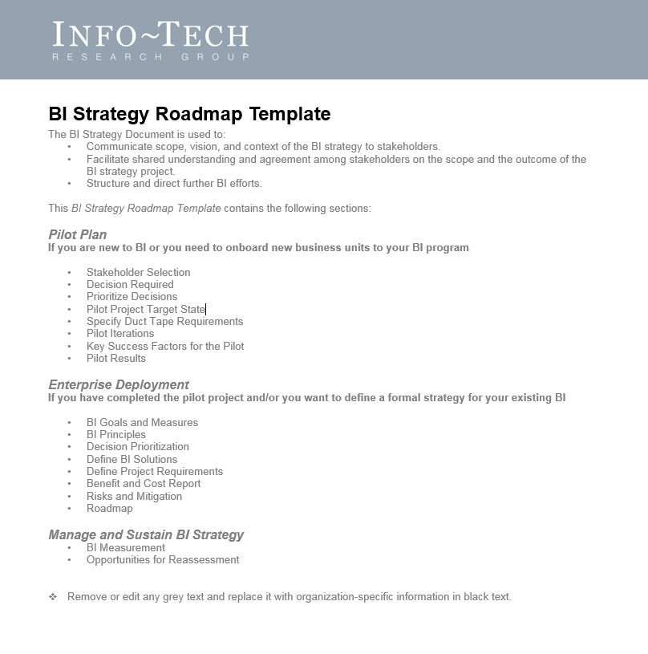
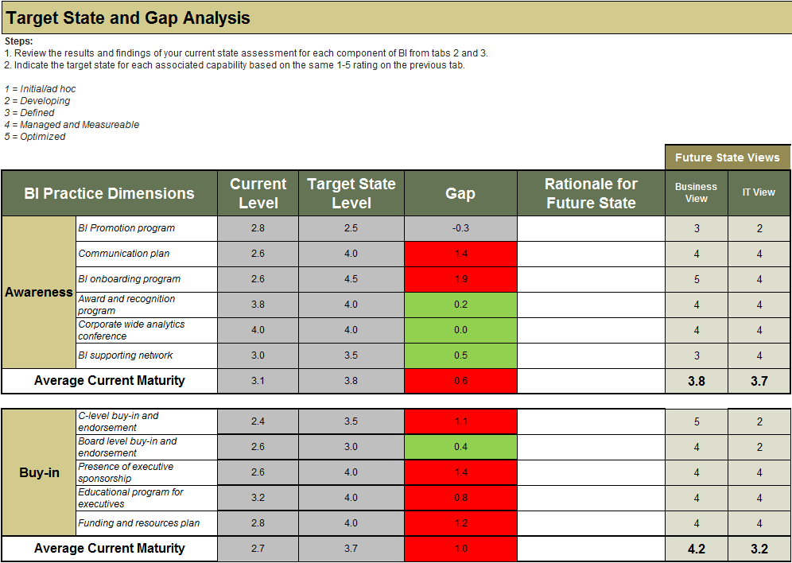
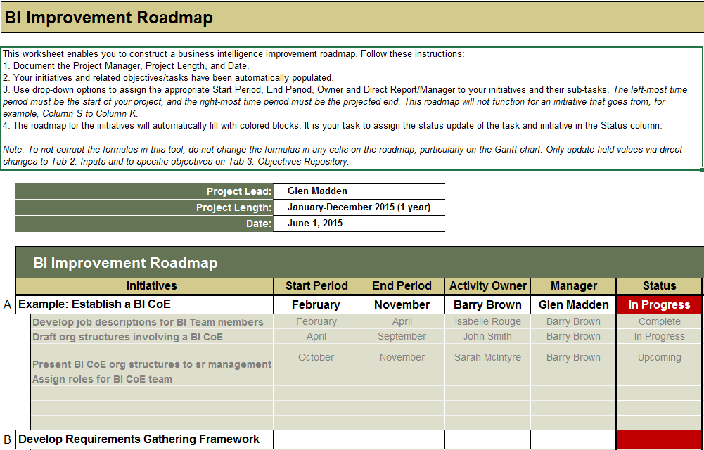
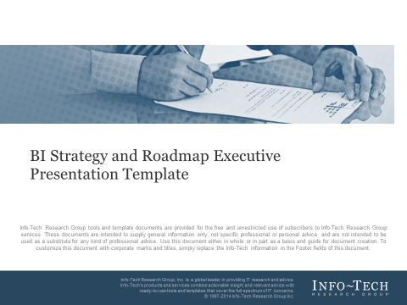
Info-Tech has a series of deliverables to facilitate the evolution of your BI strategy
BI Strategy Roadmap Template
BI Practice Assessment Tool
BI Strategy and Roadmap Executive Presentation Template
BI Initiatives and Roadmap Tool

Slide 27


Use these icons to help direct you as you navigate this research
Use these icons to help guide you through each step of the blueprint and direct you to content related to the recommended activities.
This icon denotes a slide where a supporting Info-Tech tool or template will help you perform the activity or step associated with the slide. Refer to the supporting tool or template to get the best results and proceed to the next step of the project.
This icon denotes a slide with an associated activity. The activity can be performed either as part of your project or with the support of Info-Tech team members, who will come onsite to facilitate a workshop for your organization.

Slide 28




Info-Tech offers various levels of support to best suit your needs
Guided Implementation
DIY Toolkit
Workshop
Consulting
“Our team has already made this critical project a priority, and we have the time and capability, but some guidance along the way would be helpful.”
“Our team knows that we need to fix a process, but we need assistance to determine where to focus. Some check-ins along the way would help keep us on track.”
“We need to hit the ground running and get this project kicked off immediately. Our team has the ability to take this over once we get a framework and strategy in place.”
“Our team does not have the time or the knowledge to take this project on. We need assistance through the entirety of this project.”
Diagnostics and consistent frameworks used throughout all four options

Slide 29

Build a Reporting and Analytics Strategy
– Project Overview
1. Understand the Business Context and BI Landscape
2. Evaluate the Current
BI Practice
3. Create a BI Roadmap for Continuous Improvement
Best-Practice Toolkit | 1.1 Document overall business vision, mission, industry drivers, and key objectives; assemble a project team 1.2 Collect in-depth information around current BI usage and BI user perception 1.3 Create requirements gathering principles and gather requirements for a BI platform | 2.1 Define current maturity level of BI practice 2.2 Envision the future state of your BI practice and identify desired BI patterns | 3.1 Build overall BI improvement initiatives and create a BI improvement roadmap 3.2 Identify supplementary initiatives for enhancing your BI program
Guided Implementations | Discuss Info-Tech’s approach for using business information to drive BI strategy formation Review business context and discuss approaches for conducting BI usage and user analyses Discuss strategies for BI requirements gathering | Discuss BI maturity model Review practice capability gaps and discuss potential BI patterns for future state | Discuss initiative building Review completed roadmap and next steps
Onsite Workshop | Module 1: Establish Business Vision and Understand the Current BI Landscape | Module 2: Evaluate Current BI Maturity Identify the BI Patterns for the Future State | Module 3: Build Improvement Initiatives and Create a BI Development Roadmap
 | Phase 1 Outcome: Business context Project team BI usage information, user perception, and new BI requirements | Phase 2 Outcome: Current and future state assessment Identified BI patterns | Phase 3 Outcome: BI improvement strategy and initiative roadmap

Slide 30
Workshop overview
Contact your account representative or email Workshops@InfoTech.com for more information.
 | Workshop Day 1 | Workshop Day 2 | Workshop Day 3 | Workshop Day 4
Activities | Understand Business Context and Structure the Project 1.1 Make the case for a BI strategy refresh. 1.2 Understand business context. 1.3 Determine high-level ROI. 1.4 Structure the BI strategy refresh project. | Understand Existing BI and Revisit Requirements 2.1 Understand the usage of your existing BI. 2.2 Gather perception of the current BI users. 2.3 Document existing information artifacts. 2.4 Develop a requirements gathering framework. 2.5 Gather requirements. | Revisit Requirements and Current Practice Assessment 3.1 Gather requirements. 3.2 Determine BI Maturity Level. 3.3 Perform a SWOT for your existing BI program. 3.4 Develop a current state summary. | Roadmap Develop and Plan for Continuous Improvements 5.1 Develop BI strategy. 5.2 Develop a roadmap for the strategy. 5.3 Plan for continuous improvement opportunities. 5.4 Develop a re-strategy plan.
Deliverables | Business and BI Vision, Goals, Key Drivers Business Case Presentation High-Level ROI Project RACI | BI Perception Survey BI Requirements Gathering Framework BI User Stories and Requirements | BI User Stories and Requirements BI SWOT for your Current BI Program BI Maturity Level Current State Summary | BI Strategy Roadmap accompanying the strategy with timeline A plan for improving BI Strategy plan

