Slide 1

Conquer Data Quality Challenges in 4 Steps
A manifesto for strategic data quality improvement.

Slide 2


ANALYST PERSPECTIVE
Data confidence addressing business needs…..the new data paradigm!
The data quality journey begins with data strategy formulation and does not end until data disposition.
In addition to integrating data quality provisions in every stage of the data life cycle, data quality improvement must focus on making data fit-for-purpose for business users, increasing data trust and relevance, improving data usability and usefulness, and containing risks surrounding data security and compliance.
Take a strategic approach that is rooted in business context, use cases to get the data right, and implement best practices to ensure it stays this way.
Nurith Rochon,
Senior Director, Information Management Practice Info-Tech Research Group

Slide 3
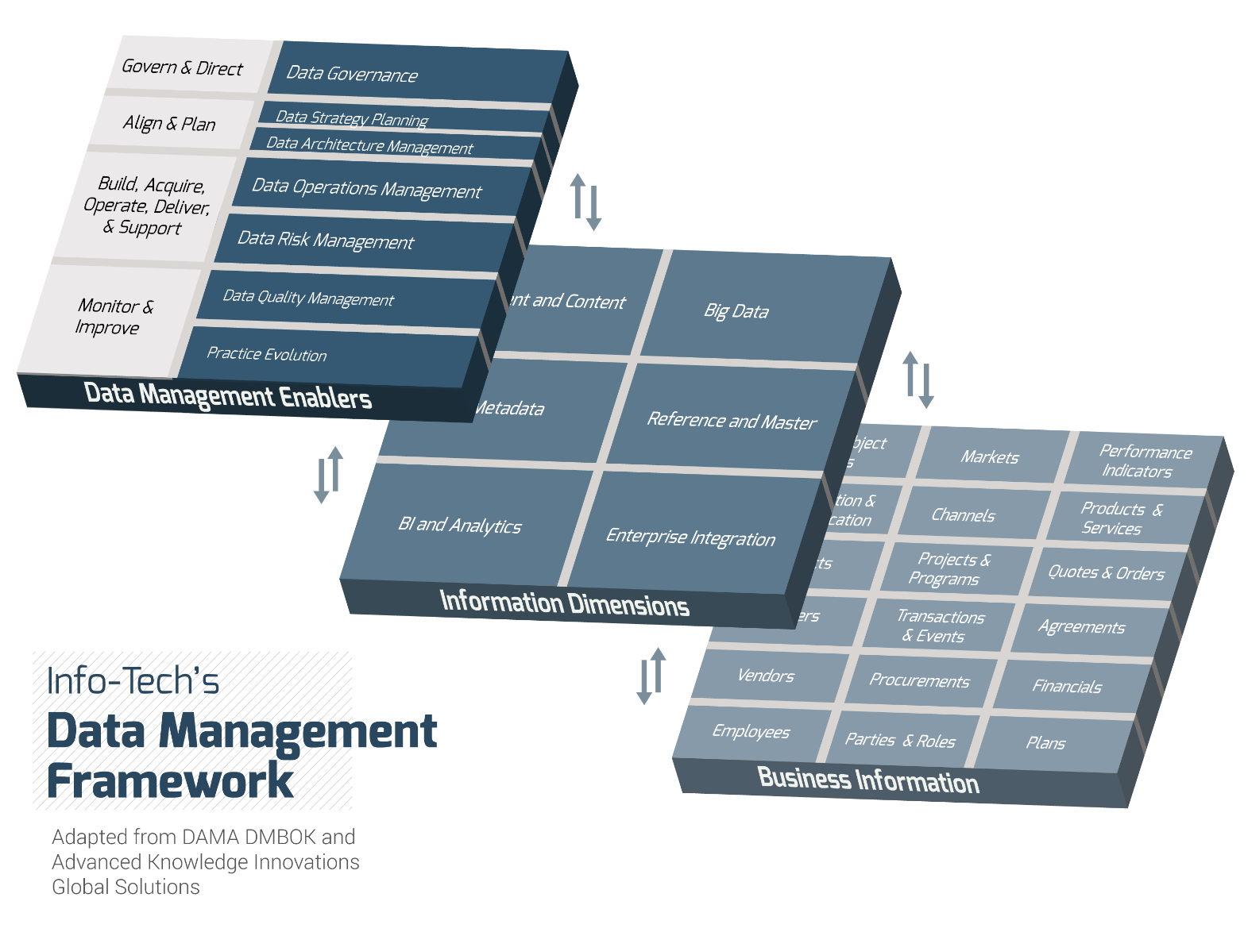
Data Quality in Info-Tech’s Data Management Framework
Although definitions vary across management frameworks, there is agreement on the fact that data quality management encompasses “planning, implementation, and control activities that apply quality management techniques to measure, assess, improve, and ensure the fitness of data for use” (DAMA DMBOK, 2009).
Info-Tech Insight
Data Quality Management exists within a data management ecosystem. It cannot succeed without proper alignment and collaboration with other data management practices.

Slide 4
Our understanding of the problem
A CIO or data management executive looking to improve data quality, reduce data complexity, and build a data quality practice.
Data owners and stewards that are tasked with the duty of improving data quality and/or currently managing data initiatives.
Align your data quality initiative with the business, making it fit-for-purpose.
Avoid common pitfalls and challenges that derail data quality initiatives.
Recognize any organizational data quality gaps and deficiencies.
Establish or improve the data quality practice and define data improvement initiatives.
Project Managers and Business Analysts assigned to the data quality projects.
Recruit the right resources for the project.
Conduct data assessment and user interviews to understand your current data.
Analyze data quality root cause and impact.
Assess your current data quality practice and envision a fit-for-purpose future state.
Develop a data quality strategy and roadmap.

Slide 5
Executive summary
Data is a valuable asset in many organizations. As organizations grow, they can accumulate a lot of data and data quality issues. Those data quality issues will in turn become barriers to business operations.
Strategic data initiatives such as analytics, master data management, and big data may be delayed due to suboptimal data quality. Ultimately, the business is complaining and demanding that IT fix these data issues.
Collaborate with the business to define what to tackle. Your business units use and own data. They know the most burning data issues, and they can help you to define a manageable scope to start with.
Know the symptoms and understand the root causes. Knowing the symptoms is only the first step. Understanding the root causes allows you to find the ultimate cure for your data issues.
Build data confidence by establishing data trust, usability, security, and compliance.
Bad data prevents enterprises from establishing data trust, data usability, data security, and data compliance. Without confidence in the data, enterprises find it difficult to transform into data-driven organizations.
Organizations still rely on intuition for decision making. Without data to support their decisions, they are unable to identify business opportunities, and are subject to lost revenue, mismanaged risk, and security issues.
Info-Tech will guide you through the process of understanding your data quality issues, identifying data quality initiatives, and prioritizing those initiatives to develop a business-oriented data quality strategy and roadmap.
Info-Tech will help you perform root cause analysis on your data issues. Understanding the root causes helps you to identify data quality gaps and opportunities.
Info-Tech will help you assess your current data quality practice to identify capability gaps and inefficiencies. We will also help you develop a future state that is equipped with the necessary capabilities so that you can tackle data issues.

Slide 6
Conquer Data Quality Challenges Insight Breakdown
Overarching Insight
Your manifesto for data quality improvement must focus on making data fit-for-use by the business, by increasing data trust and relevance, improving data usability and usefulness, and containing risks emanating from data security and compliance.
Begin your data quality improvement journey with the right strategy and the goal of integrating quality provisions in every stage of the data life cycle. First, achieve quality in your key data subject area and implement best practices to ensure a modern framework is in place to keep it that way. Then, use this experience and framework to extend your data quality improvements to additional data and to facilitate related data initiatives.

Slide 7

Executives see data quality as a core IT function, yet they are unsatisfied with how it services their businesses
Business stakeholders rank the importance of data quality in the top 5 out of 12 core IT services according to Info-Tech’s CIO Business Vision program. However, there is a significant gap between executives’ importance ranking of data quality and their satisfaction with performance in that area.
Learn more about the CIO Business Vision program.
Top IT Services for Business Stakeholders
Importance minus Satisfaction Ranking for Business Stakeholders
1
Network Infrastructure
Service Desk
Business Applications
Data Quality
Devices
2
3
4
5
n = 21,367
Data quality has a significant influence on business capabilities.
Using analytics to drive informed business decision-making depends on data quality. Yet executives report an even greater disconnect between the importance of analytical capabilities and the satisfaction with current capabilities. Furthermore, our research shows that satisfaction with how quality data serves business analytics decreases as company size increases.

Slide 8

Data is a business asset and needs to be treated as such
Data quality management is paramount to managing and protecting data assets. Data supports every facet of your business operations and informs your strategic, tactical, and operational decision-making processes. Data quality is key to your business’s ability to realize its vision and achieve key goals and objectives.
Business Drivers
Supporting Data Quality Strategies
1
Customer Intimacy / Service Excellence
Increase Data Trust and Relevance
Contain Data Risks
Ensure Data Usefulness and Usability
2
Product / Service Innovations
3
Operational Excellence
4
Privacy, Risk, and Compliance Management

Slide 9
Organizations need reliable data to differentiate and remain competitive in today’s marketplace
Insights
Knowledge
Information
Data
Reliable data is needed to facilitate data consumers at all levels of the enterprise.
Insights, knowledge, and information are needed to inform operational, tactical, and strategic decision-making processes. Data and information are needed to manage the business and empower business processes such as billing, customer touchpoints, and fulfillment.
“It [data quality] should be considered a constantly evolving strategy, vision and architecture that continuously seeks to align an organization’s operations and direction with its strategic business goals and tactical and operational decisions…”
Source: Haluk Demirkan and Bulent Dal, The Data Economy, 2014
Data should be at the foundation of your organization’s evolution; the transformational insights that executives are constantly seeking to leverage can be uncovered with a data quality practice that makes high quality, trustworthy information readily available to the business users who need it.

Slide 10
The quest for improved data quality is driven by challenges in strategic business value disciplines
The inability to innovate due to poor data quality.
51% cited enabling more informed decisions as the reason for maintaining high data quality
Customers, clients, and partners are complaining about poor experiences.
67%
indicated customer dissatisfaction as a result of poor data
Employees are spending a tremendous amount of time fixing data, impacting operational efficiencies.
UK CIOs believed that they could increase profits by 15% with better quality data
The inability to predict, forecast, and report adequately due to poor data.
58% of companies identify increased operational efficiency as a key benefit of data quality
Slow response or non-response in meeting government, regulatory, or audit requirements.
The inability to leverage data for strategic, tactical, and operational purposes due to data trust issues.
87% of companies wasted time reconciling data because data was not integrated
Poor data delaying strategic investments in enterprise data warehouse, BI, predictive analytics, and more.
Sources: Experian Data Quality, The Data Quality Benchmark Report, 2015 | Experian Data Quality, Dawn of the CDO Research, 2014 |
TDWI, Achieving Business Success through a Commitment to High Quality Data , 2011

Slide 11
Adopt a business perspective to transform your organization’s data quality from a pain into a gain
$600B
  Total estimated cost of poor data quality to U.S business.
Committing to an enterprise-wide data quality improvement plan requires significant but necessary investment, as the variety, volume, and velocity of data generated exponentially increases.
Speaking in IT terms will not garner the necessary support for a project; the ROI for data quality improvement will be more impactful when expressed in relation to business objectives.
Source: TDWI, 2002
40%
  Percentage of businesses with unsolidified data quality practices that feel revenue is wasted (compared to 14% of organizations with optimized data quality strategies).
Source: Experian Data Quality, 2015
$1.5B
  Spent by United States Postal Service sending mail to out-of-date and incorrect addresses in 2014.
Source: USPS, 2015
10 – 20%
  The implementation of data quality initiatives can lead to reductions in corporate budget.
Source: HaloBI, 2015

Slide 12
Enable your organization to use data, trust data quality, and abide by regulatory requirements
Data Quality Attributes
Trust & Relevance
Data consumers’ confidence in data will promote data usage and will improve effectiveness in corporate decision making.
Security
Risks can be identified, quantified, and contained with data. Data-driven risk management helps your organization avoid or manage risks strategically.
Compliance
Building a comprehensive strategy around data assets prepares your organization for adherence to increasingly stringent regulatory policies.
Usefulness & Usability
Having the right information at the right time, place, and format will increase data value and utility throughout your organization.
Related Quality Dimensions
Accuracy
Objectivity
Relevancy
Believability
Completeness
Currency
Interpretability
Understandability
Ease of Manipulation
Availability/Timeliness
Appropriate Amount of Information
Consistent Representation
Reputation
Restricted Access

Slide 13

Empower IT and eliminate costs by initiating a data quality improvement program
1
Eliminate costly data practices
A data quality management program works on three levels:
data quality can become compromised at entry, transformation, or storage. The absence of data quality measurements and an ineffective data quality practice leads to wasted resources, inefficient operations, and increased risk for your organization.
2
Empower business decision making with evidence-based data, information, knowledge, and insight
A data quality management program works on three levels:
(1) strategic data improvement, (2) continuous data improvement, and (3) sustainability of data quality. This ensures that best practices are put in place and that data improvement initiatives are aligned to business objectives and business priorities.
3
Elevate IT to a strategic partner through a self-governed data quality program
Data is one of your business’s most valuable assets…
Treat it as such!
A thoroughly constructed data quality program will have elements that are automated to minimize human error. The consistent production of quality data will continually yield dividends for business users, ultimately leading to increased data confidence, and the ability of the business to leverage data as one of the most valuable business assets.

Slide 14
Define guiding principles for your data quality program
GUIDING PRINCIPLES FOR
IMPROVING DATA QUALITY
Planning, strategy, and business context are essential to effective data quality improvement.
Everyone is responsible for data quality, not just IT. Collaboration yields the best data quality results.
Focus on the most critical data first. Ignore data where acceptable data quality cannot be guaranteed.
Consider data that is of the greatest benefit to the majority of users and to the most diverse uses.
Work on benefit areas where data can be cleaned at the best effort-cost relationship.
Promote self-governed data quality, with a balance between issue prevention and remedy after the fact.
Automate data manipulation processes to avoid human errors.

Slide 15

Make sure critical success factors are found in your data quality initiatives
You want to….
Engage senior executives so that they can provide support to data quality initiatives.
Promote data usability, data trust, and data-driven risk management.
Align business and IT by creating a joint team to conquer data quality issues.
Perform comprehensive root cause analyses to understand the origins of data quality issues.
Quantify the business impact of data quality issues.
Integrate data quality with key business processes and analytics through a data quality practice.
Measure key performance indicators (KPIs) at the data quality and practice levels.
Outcomes ($)
#1 Improve Customer Intimacy | #2 Enable Upsell and Cross-sell
#3 Accurate, Trustworthy Analytics | #4 Minimize Lost Revenue due to Bad Data
Drives

Slide 16
Strike a balance between centrally-governed and self-governed data quality
Achieve a fit-for-use data quality practice in which data quality is driven by the business. This kind of practice will include a component that is centrally-governed and another component that is self-governed.
Over the long term, the goal is to ingrain data quality practices in the operations of the organization so that maintaining data quality is the responsibility of all employees.
Examples of
Centrally-Governed Data Quality
The central governance body ensures that…
Data quality is strategically planned and managed within the business context.
The centralized governance body is committed to making final decisions.
Directive guiding principles and guidelines are developed around data quality.
Best practices and lessons learned are centralized and communicated.
Examples of
Self-Governed Data Quality
  Everyone is accountable for…
  Being responsive to the data quality in their business domain.
  Promoting accountability and ownership of data, and engagement in maintaining quality.
  Allowing ongoing collaboration and alignment to improve data quality.
  Allowing transparency via self reporting and audit of their data.

Slide 17



Support your business in its data quality quest by developing a strong data quality practice
Improve data usability, grow data quality confidence, and contain data quality risk by engaging the necessary people, processes, technology, and services.
Essential Elements in a Successful Practice
Key Services in an Effective Practice
People
The business value derived from quality data depends on how the business uses the data. These are the two services your practice must deliver to realize the benefits of better data quality:
Data Quality Improvement
Data Quality Practice Improvement
Support the business’s evolving data quality requirements by regularly identifying current and target capabilities. Create and routinely recalibrate your practice improvement roadmap, and always measure and report on capability performance.
Data quality stakeholders have the communication and capacity to achieve targets with business-IT alignment.
The people responsible for data assets have the direction and endorsement to advance data quality initiatives.
Processes and Procedures
Following root cause analysis, the necessary policies and processes are in place to ensure ongoing completion of data quality initiatives, and this results in long-term solutions rather than repetitive temporary fixes.
Target
Baseline
Technology
Data quality requirements are expressed transparently so that appropriate and right-sized technology is in place, and the practice is automated wherever possible to streamline operational data quality.

Slide 18

Establish baseline metrics and set achievable targets and realistic timelines
Users’ Perception of Data Quality:
Data Trust
Do users trust the data?
Data Usability
Are business users leveraging data?
Data Security
Do users feel the data is secure?
Data Compliance
Are data regulations complied with?
Business
Oriented
Metrics
User Satisfaction on Data (rec’d)
Datasets Recommended by Existing Users
# of Reports Run Daily (rec’d)
# of Data-Driven Decisions Made
# of Security Breaches (rec’d)
Time to Identify Security Issues
# of Audits Conducted (rec’d)
# of Compliance Issues
Technical
Oriented
Metrics
# of Datasets Fixed by Data Stewards
# of Data Standards Fulfilled
Usage Data from Data Systems
# of Self-Service Datasets
# of Data Security Issues Fixed
Time to Fix Data Security Issues
# of Data Compliance Issues Fixed
# of Compliance Certificates

Slide 19
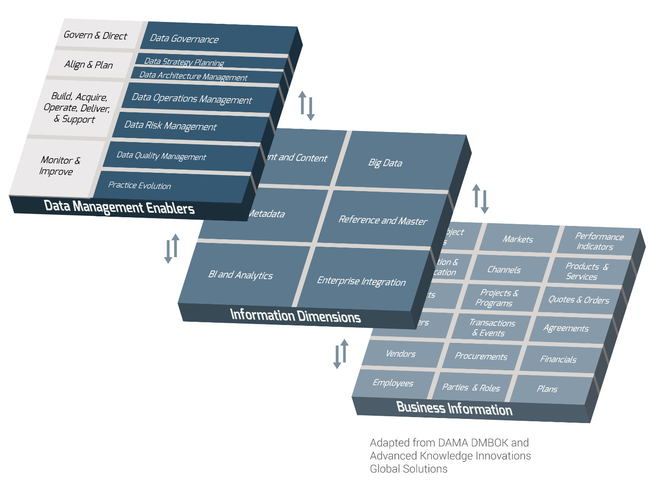
Consider how your data quality practice will fit within your organization’s data management practice
Data Quality Management is integral to Data Management (DM)
Data quality management is an essential component in the overall data management framework. The investment in production and maintenance of high quality data serves as an enabler for other data activities such as analytics and BI.
The activities conducted in areas such as data strategy planning, data architecture, and data modelling are heavily influenced by how committed an organization is to its data quality practice.

Slide 20

Industry Spotlight: operational and client service excellence in the automotive sector
Data Trust and Relevance
Benefits
1
Holistic view of client information
2
Data unification
Daimler-Chrysler had parts of customer data sequestered in different departments, leading to inconsistencies in customer information, wasted time reconciling data differences, and overcomplicated evaluations of data quality and usefulness. Through creation of COIN (Customer Operation Information Network), Chrysler established a single point-of-truth for customer information that consolidated data from all departments. They were able to achieve 98% data quality across a 50-million-record database.
Source: “Chrysler’s Data Quality Management Case Study.” Todd Schwartzrock, 2011
3
Operational efficiency
4
Informed decision making
5
Marketing optimization
6
Customer loyalty analytics
Industry leaders cite data and the insights they glean from data as the means to stand apart from their competitors. Data trust is a prerequisite for BI and Analytics.

Slide 21

Industry Spotlight: data quality risk management in the financial services sector
Regulatory
Compliance
$11M USD FINE
Compliance with regulations is the #1 driver for data risk management.
This fine was levied on a well known Wall Street firm after it used inaccurate data to execute short sales orders.
The financial crisis of 2007-08 is considered to have been the worst financial crisis since the Great Depression. In the U.S. Senate's Levin–Coburn Report, it concluded that the crisis was the result of “high risk, complex financial products; undisclosed conflicts of interest; and the failure of regulators, the credit rating agencies, and the market itself to rein in the excesses of Wall Street.” In July 2010, the Dodd-Frank regulatory reforms were enacted in the U.S., heightening the importance and role of data quality and data transparency in managing systemic risk in increasingly complex and interdependent global markets.
Sources: “Wall Street and the Financial Crisis: Anatomy of a Financial Collapse.” United States Senate, 2011
Analytics Stories: A Case Study from Fannie Mae.” Informatica, 2014

Slide 22

Industry Spotlight: data source integration in the life sciences sector
Data Usability and Usefulness
1
Usable Quality
Developing usable data systems is only worthwhile with quality data.
A large pharmaceuticals company with multiple data systems implemented a project to enhance data usability and relevance. But because the organization involved diverse end users and a wide variety of products, increasing data usability involved multiple moving parts. From integrating five data sources into one, to defining product naming conventions, developing new business processes, molding data around the consumption needs of different user groups, and enhancing compliance, the core requirement of every project step was ensuring the existence of data quality. With the evolution of ways that data can drive business value, organizations must adopt a comprehensive data quality improvement strategy to ensure they remain accountable to their stakeholders and strategic for the future.
Source: “Merck Serono Achieves Single Source of Truth with Comprehensive RIM Solutions.” Product Life Group, 2013
2
End-User Relevance
Increase data relevance by molding it around user consumption and wrapping data quality around it.
3
Product Innovation
Valuable business innovation requires clear strategy, and is best enabled by quality and usable data.
4
Project Scope
Data projects are often large and difficult, so an initial analysis of data quality will help refine project scope and shape data usability.

Slide 23




Info-Tech offers various levels of support to best suit your needs
Guided Implementation
DIY Toolkit
Workshop
Consulting
“Our team has already made this critical project a priority, and we have the time and capability, but some guidance along the way would be helpful.”
“Our team knows that we need to fix a process, but we need assistance to determine where to focus. Some check-ins along the way would help keep us on track.”
“We need to hit the ground running and get this project kicked off immediately. Our team has the ability to take this over once we get a framework and strategy in place.”
“Our team does not have the time or the knowledge to take this project on. We need assistance through the entirety of this project.”
Diagnostics and consistent frameworks used throughout all four options

Slide 24



Conquer Data Quality Challenges in 4 Steps: Project Overview
1. Develop a Data Quality Improvement Plan
2. Assess Data Assets
3. Assess Data Quality Practice
4. Create a Data Quality Improvement Roadmap
Best-Practice Toolkit | 1.1 Make sense of your business context and data subject areas 1.2 Discuss data quality barriers, needs, and principles 1.3 Develop data quality project team, scope, and strategy | 2.1 Prioritize data areas and build data asset inventory 2.2 Assess current data quality of priority data 2.3 Perform root cause and business impact analyses to quantify data quality issues 2.4 Quantify the impact of data quality issues | 3.1 Assess existing practice 3.2 Map practice gaps to critical data quality issues 3.3 Review and prioritize practice gaps 3.4 Identify future practice needs | 4.1 Generate improvement initiatives 4.1 Formulate strategies and a prioritized roadmap 4.2 Improve data quality continuously
Guided Implementations | Create your business and data quality vision Plan your data quality project | Review results of the data inventory and assessment Review results of the root-cause analysis and impact assessment | Review results of the data quality practice assessment Define the future state for the data quality practice | Review planned initiatives Discuss roadmap findings and next steps
Onsite Workshop | Module 1: Create Business Vision Launch Your Data Quality Project | Module 2: Assess Your Data Assets Determine Business Impact | Module 3: Assess Your Data Quality Practice Formulate Improvement Actions | Module 4: Create Data Quality Initiatives and Improvement Roadmap
 | Phase 1 Outcomes: Business Case Project Charter Data Quality Project Team | Phase 2 Outcomes: Data Inventory and Assessment Quantitative Business Impacts | Phase 3 Outcomes: Assessment of Practice Future State of the Data Quality Practice | Phase 4 Outcomes: Data Quality Improvement Roadmap Executed Data Quality Initiatives

Slide 25



Time constrained? Book an onsite engagement to expedite your project and get to the results faster
Offsite
Onsite
Contact your account representative or email Workshops@InfoTech.com for more information.
Info-Tech Research’s Group’s Data Quality (DQ) Diagnostic Workshop
Day 1 | Day 2 | Day 3 | Day 4 | Day 5
Workshop Day | Workshop Day | Workshop Day | Workshop Day | Working Day
Develop High-Level DQ Improvement Strategy 1.1 Explain approach and value proposition 1.2 Detail business vision, objectives, drivers, and data functional and subject areas 1.3 Discuss DQ barriers, needs, and principles 1.4 Develop project scope and team structure 1.5 Develop DQ strategy | Assess Data Quality (Part 1) 2.1 Select priority data areas and key dimensions 2.2 Build detailed data asset inventory 2.3 Assess current data quality of priority assets 2.4 Discuss results and map identified gaps to business vision, objectives, and drivers | Assess Data Quality (Part 2) 3.1 Perform root cause analysis of DQ issues 3.2 Perform business impact of DQ issues 3.3 Quantify DQ issues 3.4 Set specific target DQ requirements based on business objectives 3.5 Present overarching view of DQ current and target states | Assess Data Quality Practice 4.1 Assess high-level current DQ practice 4.2 Assess DQ practice in information dimensions 4.3 Map practice gaps to critical DQ issues 4.4 Rationalize and rank practice gaps 4.5 Formulate strategies and actions to achieve DQ practice future state | Create DQ Initiatives and Improvement Roadmap 5.1 Transform strategies into improvement initiatives 5.2 Plot initiatives into a prioritized roadmap 5.3 Identify and discuss next milestone plan 5.4 Compile an executive report
Deliverables | Deliverables | Deliverables | Deliverables | Deliverables
Data Quality Improvement Strategy Business Context DQ Barriers/Principles DQ Project Team, Scope, and Charter | Data Asset Inventory Quality Assessment of priority data Dimensions Framework Mind-map of DQ issues in business context | Root Cause/Business Impact Analyses DQ Current State Quantitative Target DQ Requirements mapped to business objectives | DQ Current State Prioritized Gaps DQ Practice Strategies | DQ Improvement Roadmap DQ Assessment and Roadmap Report (from analyst team)

Slide 26


Follow Info-Tech’s blueprint to conquer data quality challenges
Develop a High-Level Data Quality Improvement Strategy
Discover Data Quality Issues and
Create Data Quality Improvement Initiatives
Build Data Quality Roadmap for Continuous Improvement
Rationalize the Business Context
Create a Prioritized List of Data Quality Improvement Objectives
Develop Comprehensive Data Quality Initiatives
Set the stage for data quality improvement by establishing the business perspective
Transform data quality objectives into thorough initiatives and assign responsibility
Data Quality Improvement Actions
Business Vision, Objectives, and Key Drivers
Prioritized Data Quality Improvement Initiatives
Assess Data Quality
Leverage Info-Tech’s two-pronged data assessment
Identify the root causes of key data issues
Formulate data-focused improvement actions
Leverage Info-Tech’s two-pronged Data Assessment
Identify the root causes of poor data quality
Assess Data Quality Practice
Develop a Data Quality Improvement Roadmap
Leverage Subject Areas to Scope the Project
Perform current and target state assessments for your data quality practice
Identify the root causes of key data issues
Formulate data-focused improvement actions
Use the business context to pinpoint the data assets to include in your project
Convert your list of prioritized initiatives into an actionable timeline that can be presented for approval
Prioritized Data Assets and Subject Area
Data User Profiling
Data Quality Practice Assessment
Data Quality Improvement Roadmap
Data Asset Inventory of Key Subject Area
Structure and Launch the Project
Data Quality Practice Improvement Initiatives
Data Profiling
Continual Improvement of Data Quality
Set the stage for data quality improvement by establishing the business perspective
Root Cause and Business Impact Analyses
Areas of data management can elevate or be elevated by your improved data quality and practice
Data Quality Project Team
and Charter
Data Quality Improvement Strategy and Roadmap

